Slide 1
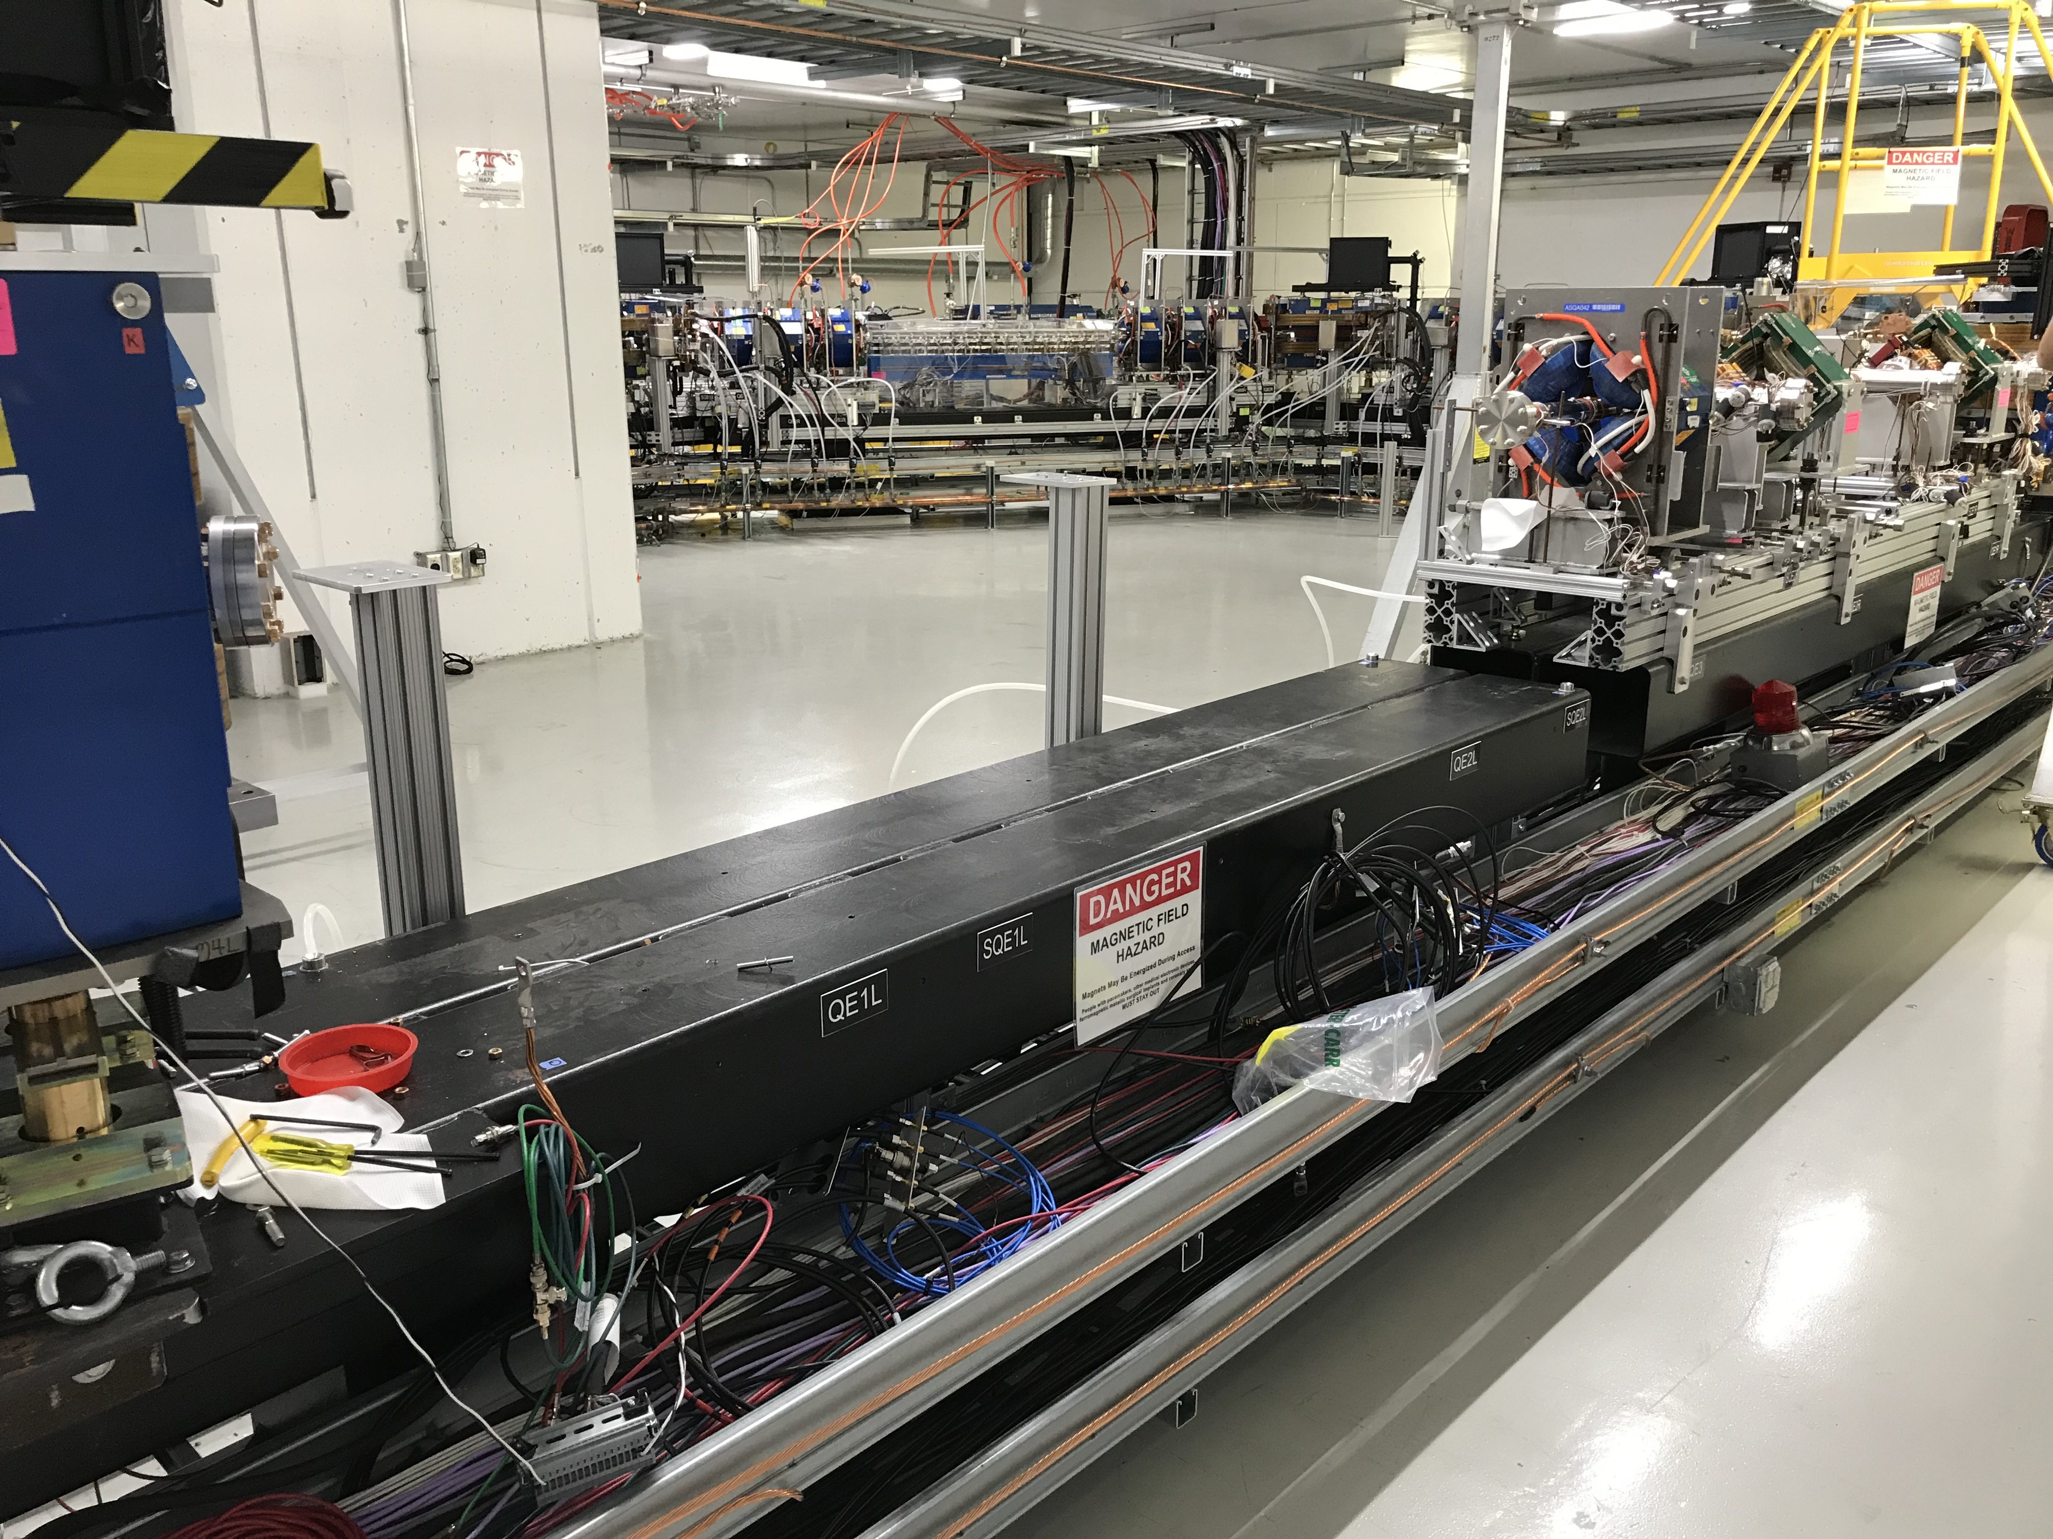

Slide 2
RunCo Report for IOTA/FAST Meeting 09/25
FAST Startup has started. (will run off-hours)
Tasks before beam (started): Laser shields • HLRF • Cooldown • System check-outs • SRF conditioning
ES&H: Still trying to get signatures to run
Cryo: Cool-down continues
Many delays due to fridge issues • Pumpdown delayed • CM @~5K (again) • CC1 & CC2 isolated till CM filled
IOTA: back under vacuum till Monday
B-Right: BPM buttons being put in spool
E-Straight: E-L disintegrated • E-R on Monday
FESS: NML Gas work done • Hot water • ESB A/C still out • 25t portable @ESB • ICW-AS fixed (again) • ICW hydrant flushing Monday (Cryo watching)
Reminders:
Cave will remain Controlled Access (unless cleared with RunCo)
Currently in RunCo-approved Supervised Access for current IOTA work
Document everything in the eLog!!!
Notes:
Why are you looking down here? Look back at the slide.

