Slide 1
A2D2 Operational Meeting
Michael Geelhoed

Slide 2
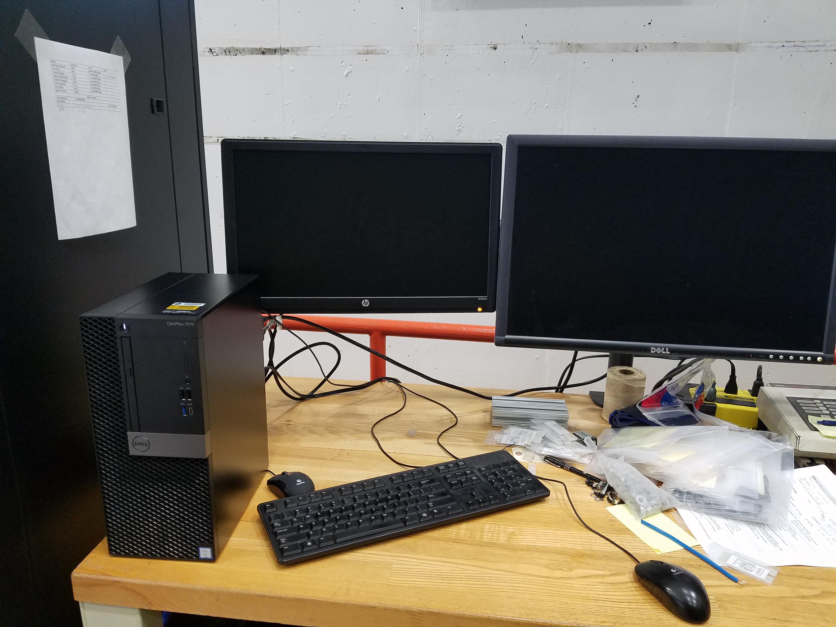
Upgrade and Status
Computer Replacement
New computer downstairs
Reloaded LabView and other pgms
Finally got this to work
DCO are back on
Procurements
Low Dose Films Pur Req #311174 (NIST)
J. Graves and I talked last week
Looks to be proceeding well now

Slide 3
Work and Samples on the horizon
APS-TD Nb Cavity (Internal)
GWRC Ballast Water (CRADA)
Stonybrook (SUNY CRADA)
Regher Solar (SPP)
PPD CMS Detector Boards (Internal)
FDA (CRADA/RCA)
NIU/DuPage (NPUA)
APTIM Leachrate (CRADA/SOW pending)
MWRD (~ months)
EERE 3M
SRNL

Slide 4
Accelerator Test Cave

