Slide 1
Magnet Fabrication Travelers, Non-Conformities and Resolution
Katherine Ray – LBNL (QA)
Mike Solis – LBNL (Procurement Technical Contact)
October 20, 2020 – MQXFA06 Structure and Loading Review

Slide 2
Overview
State of the Magnet Fabrication Travelers
Non-Conformances on MQXFA06
Pion Non-Conformance Discussion

Slide 3
Magnet Fabrication Travelers Overview
# | Title | Revision | ID
1 | Coil Acceptance WI | A | SU-1011-5294
2 | Coil CMM WI (new) | A | SU-1012-3958
3 | Yoke Pre-Stack WI | C | SU-1008-8072
4 | Yoke Half Stack WI | E | SU-1009-7829
5 | Shell Instrumentation WI | E | SU-1009-3745
6 | Shell-Yoke Assy WI | C | SU-1008-2169
7 | Loadpad Pre-Stack WI | B | SU-1008-8075
8 | Dressed Coil WI | G | SU-1008-8073
9 | Pad-Collar Assy WI | B | SU-1010-1610
10 | Coil Pack Subassy WI | C | SU-1008-8074
11 | Magnet Electrical QA at LBNL | D | SU-1010-1903
12 | Magnetic Measurements | A | SU-1010-2018
13 | Integration and Loading WI | C | SU-1011-5637
14 | Axial Rods Instrumented WI | D | SU-1008-8069
15 | Connectors and Finishing WI (new) | A | SU-1012-5517
16 | Splice Box WI | C | SU-1008-8067
17 | Magnet Shipping WI | B | SU-1011-3284

Slide 4
Magnet Fabrication Travelers Overview
# | Title | Revision | ID
1 | Coil Acceptance WI | A | SU-1011-5294
2 | Coil CMM WI (new) | A | SU-1012-3958
3 | Yoke Pre-Stack WI | C | SU-1008-8072
4 | Yoke Half Stack WI | E | SU-1009-7829
5 | Shell Instrumentation WI | E | SU-1009-3745
6 | Shell-Yoke Assy WI | C | SU-1008-2169
7 | Loadpad Pre-Stack WI | B | SU-1008-8075
8 | Dressed Coil WI | G | SU-1008-8073
9 | Pad-Collar Assy WI | B | SU-1010-1610
10 | Coil Pack Subassy WI | C | SU-1008-8074
11 | Magnet Electrical QA at LBNL | D | SU-1010-1903
12 | Magnetic Measurements | A | SU-1010-2018
13 | Integration and Loading WI | C | SU-1011-5637
14 | Axial Rods Instrumented WI | D | SU-1008-8069
15 | Connectors and Finishing WI (new) | A | SU-1012-5517
16 | Splice Box WI | C | SU-1008-8067
17 | Magnet Shipping WI | B | SU-1011-3284
We continue to update the travelers based on lessons learned. We have 2 new travelers since last time, one for using the Leica, one for describing the wiring
All travelers were used and signed off for MQXFA05

Slide 5
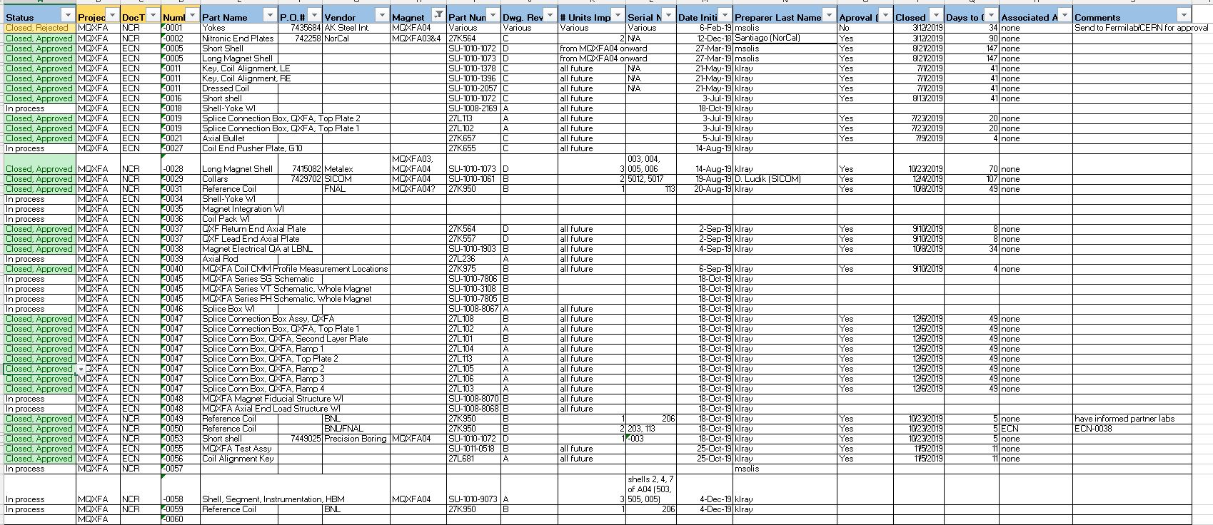
Change Records
We are tracking Non-Conformances, Deviations and Engineering Changes in one spreadsheet
These are currently communicated to Fermilab L2 on a monthly basis

Slide 6
MQXFA06 Change Records
The NCRs on A06 thus far include:
(#29) wrong s/n on collars (reworked)
(#80) Dents in master keys (discussed during A05 review) (accept as is)
(#99) Loadpad minor non-conformances (accept as is)
(#129) Overtorqued yoke half stacks, wrong bushing ordering (reworked)
(#138) Scratched yokes (reworked – stoned/polished)
(#140) rust on loadpads (reworked – cleaned)
(#142) Coil 122 sequential R (CRITICAL) (accept as is, create as-built schematic)
(#145) Coil 122 hole in GPI (reworked)
(#147) Coil 122 flashing not filed down, damaged GPI on coil 117 (CRITICAL) (reworking/reworked)
(#148) Coil 119 PHB03a and PHB02a wires protruding (CRITICAL) (reworked)
(#149) All 4 coils have pion location out of spec (CRITICAL) (to be discussed)

Slide 7
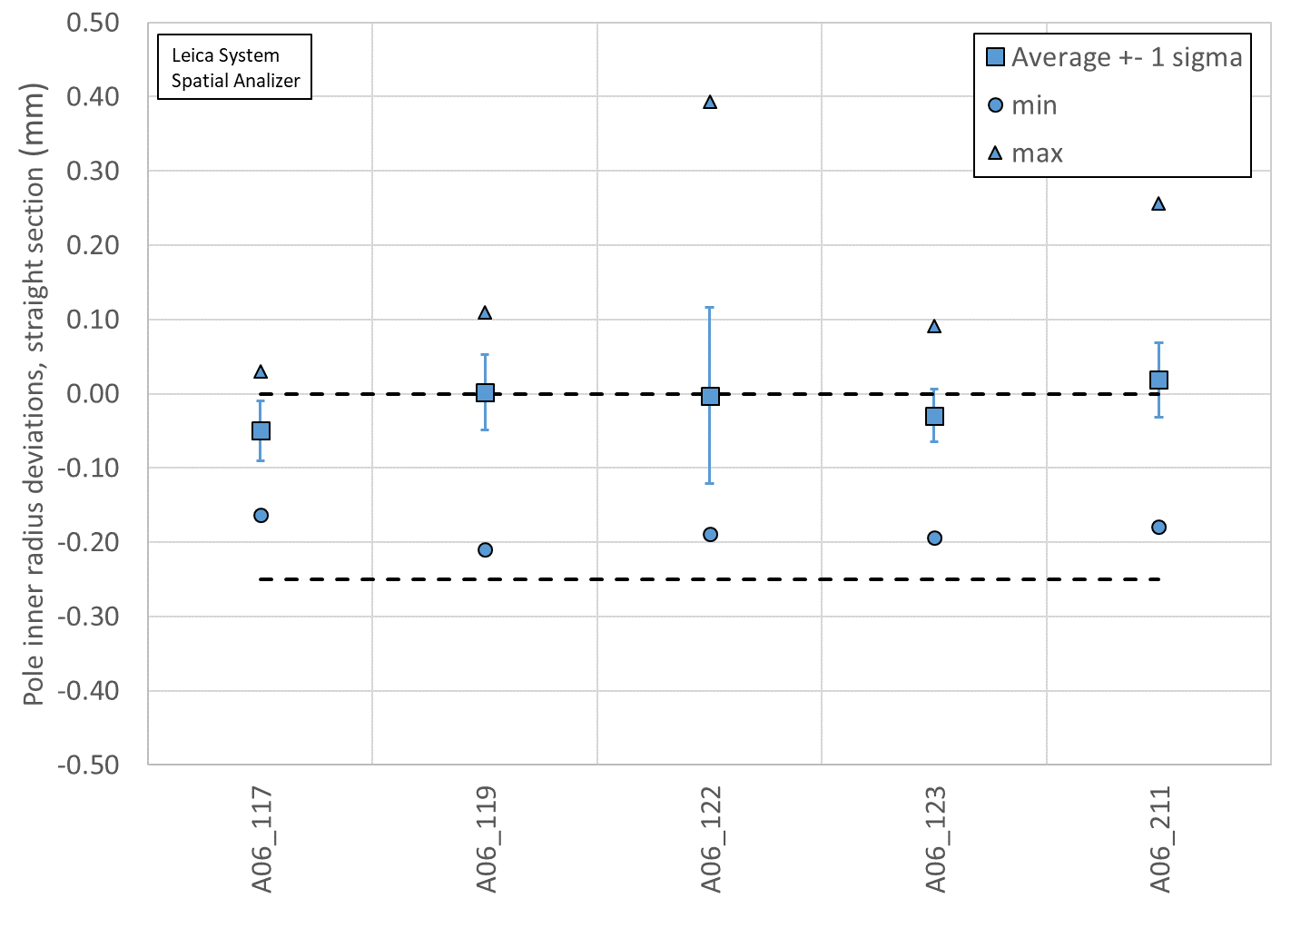
Pion Location Data for MQXFA06

Slide 8
Investigation
Question: Is the pion location out of spec due to delamination?
Question: If we clamp down on delaminated areas, will it come in spec?
Question: Should we clear the fiberglass and glue pion directly to the titanium pole?
FNAL sent us a section of coil 108 that had 6 pin holes, 3 looked delaminated, 2 looked still laminated, one uncertain
Measured all 6 locations
Clamped one to see if we could press the area down
Cleared fiberglass in two locations
Installed pions in 4 locations (two with fiberglass, two cleared)

Slide 9
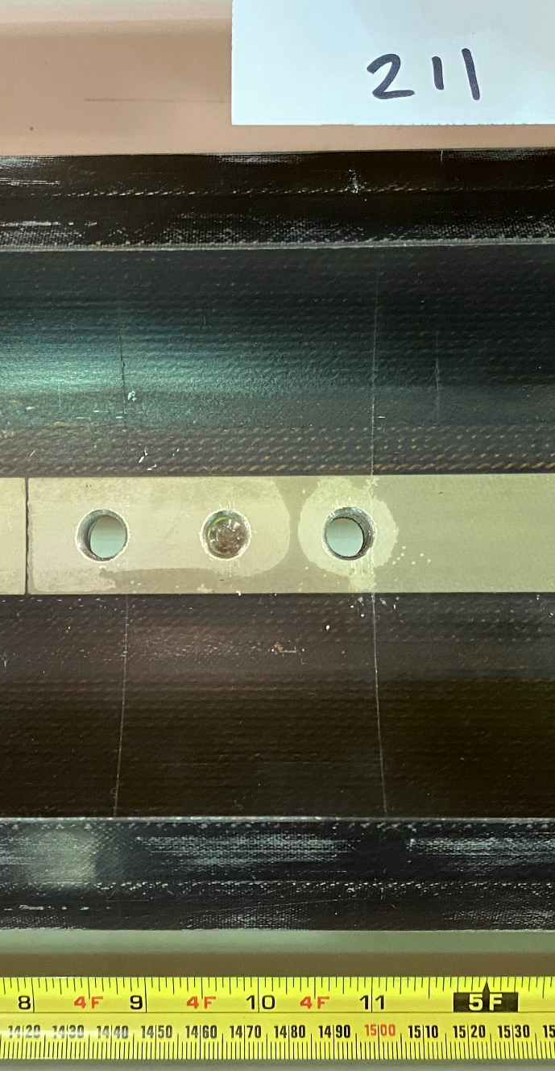
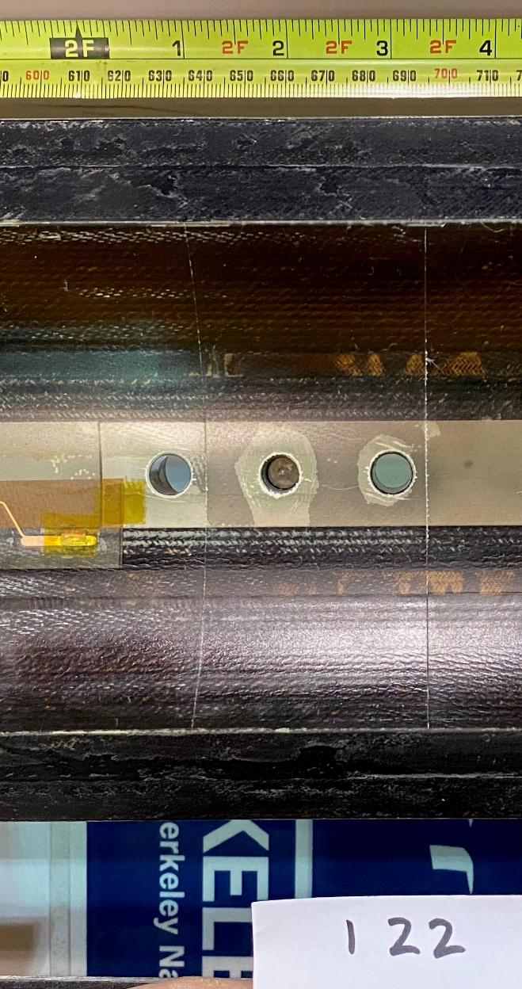
Some examples of out of spec pion locations

Slide 10
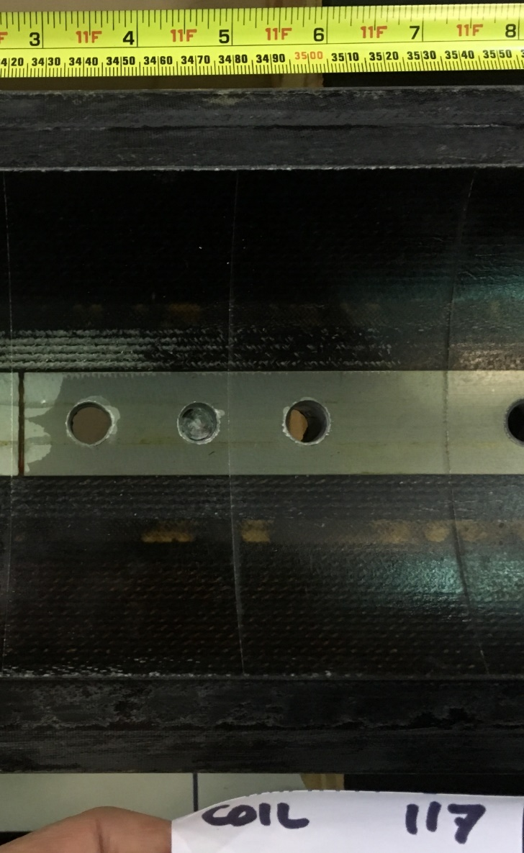
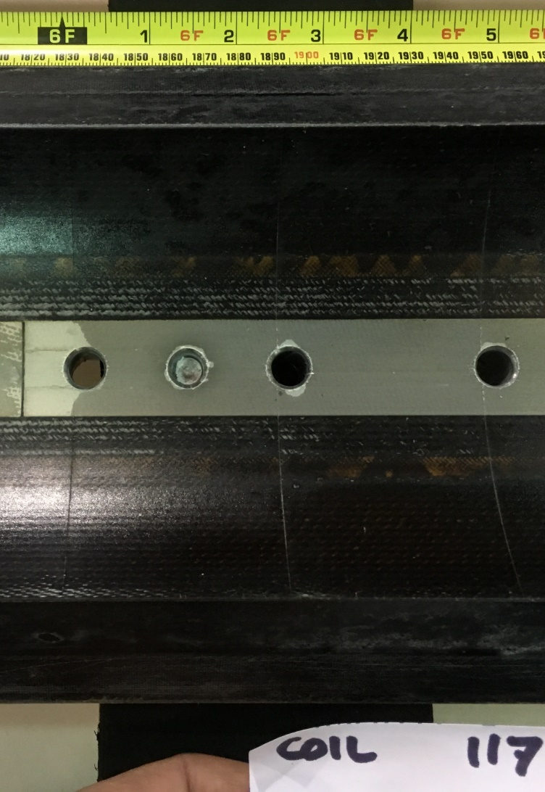
Pion locations on Coil 117
In Spec
In Spec
Out of Spec

Slide 11
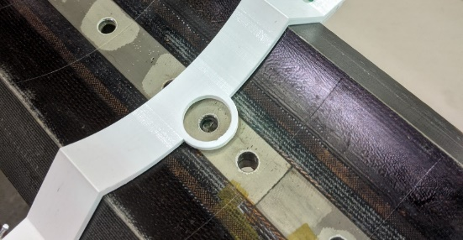
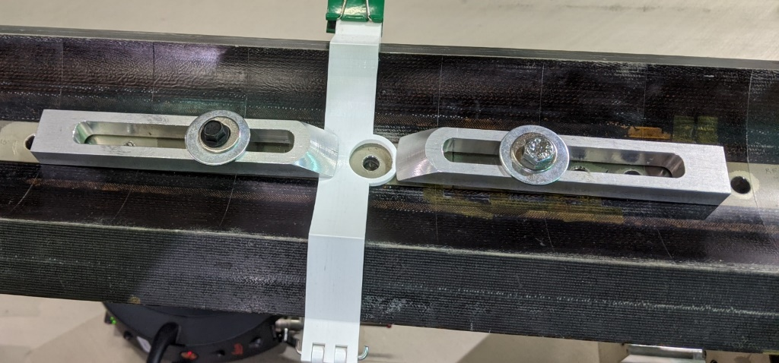
Clamping
Difference between clamped and not is 8-12 microns

Slide 12
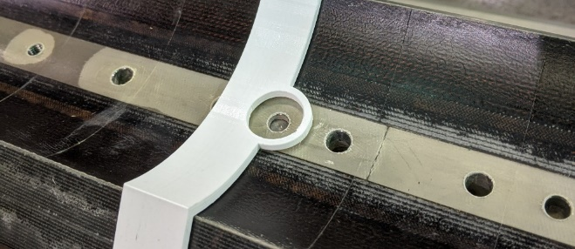
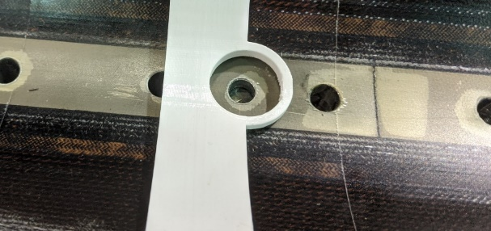
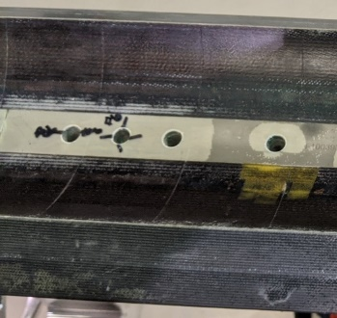
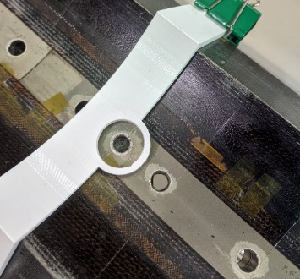
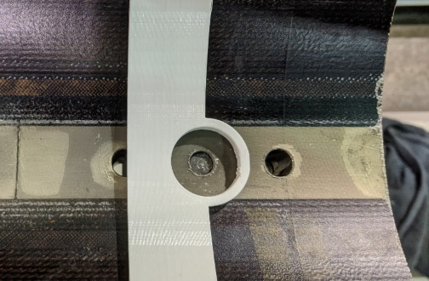
Pions vs. Delamination on small section of 108

Slide 13
Further Steps, and Proposal for MQXFA06
We took measurements with the pions installed on the Coil 108 section on 10/19/20, but the data is not processed yet, to be presented after this review
Two possible approaches:
File the pions to proper thickness to accommodate out-of-spec pion locations (Preferred and proposed for MQXFA06)
Clear the fiberglass
After data processing of glued pions above is completed.
Will require a redesigned (thicker) pion (this is similar to MQXFA03 pion installation)

