Slide 1
MICE Coupling Coil Test Proposal
Ruben Carcagno
Fermilab
July 9, 2011

Slide 2
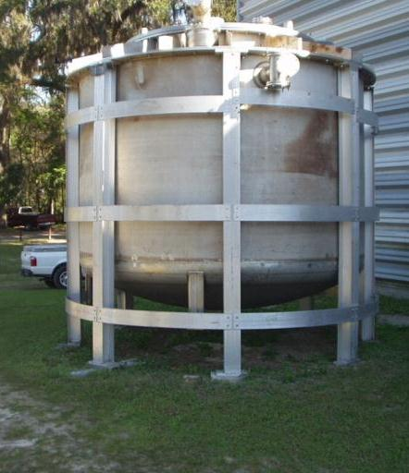
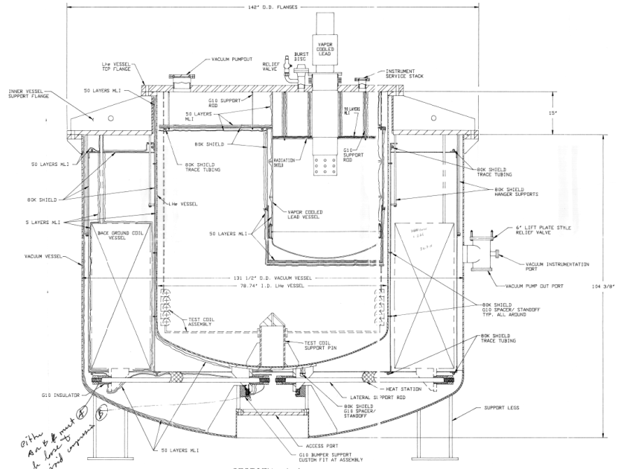
The Cryostat
Built by Meyer Tool in 1997 for SMES, apparently never used, now residing outdoors at the NHMFL/FSU
11.8 ft.
10 ft.
Test diameter: 78.74” (2 m)
Test height ~ 13” (33 cm)

Slide 3
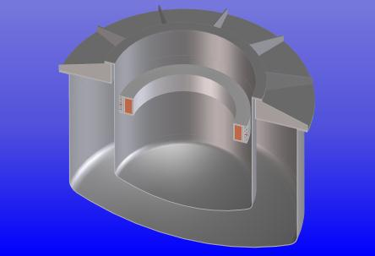
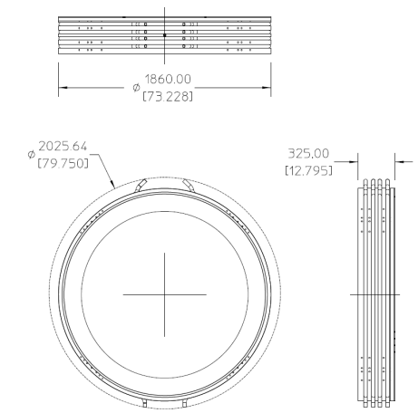
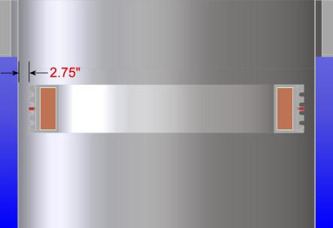
MICE Coupling Coil Fit
Fits Cryostat Test Volume without protruding cooling tubes
Coil to be tested in “Bath Mode”; cooling tubes not needed

Slide 4
Cryostat Cryogenic Requirements
Reference: R. Luther, “Design and Fabrication of a Large Cryostat for Testing SMES Apparatus”, Advances in Cryogenics Engineering, Volume 45, Plenum Publishers, 2000
Published Heat Leaks Estimate for “Bath Mode”
  193.4 W to 4.5K
    IB1 refrigerator provides 1,500 W at 4.5K
  42.6 W to 80K
Test Vessel MAWP: 25 psi
  Preliminary Relief Area estimate for MICE Coupling Coil test: 9.5 in²

Slide 5
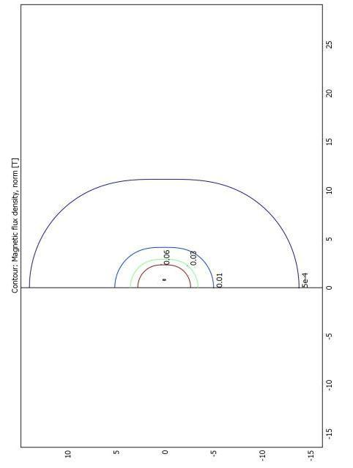
Mice CC Fringe Magnetic Field
FESHM 5063.2 Limits
  Magnetic Field Hazard (>5 G): 15 m from center
  High Magnetic Field Hazard (>600 G): 3 m from center
Operational Caution
  > ~ 100 G: 5 m from center
MICE Field Contours from Holger Witte, Oxford University, provided by Alan Bross

Slide 6
IB1 Test Facility Location
Advantages
  All services readily available (cryogenics, instrument air, crane, power and instrumentation, experienced staff, etc.)
  Relatively fast installation and commissioning if ongoing staff efforts are redirected
Disadvantages
  Crowded test area supporting multiple active test programs (SRF cavities, LARP/HFM magnets, 11T LHC upgrade, NOvA, etc)
  Large fringe magnetic field highly disruptive to these other programs

Slide 7
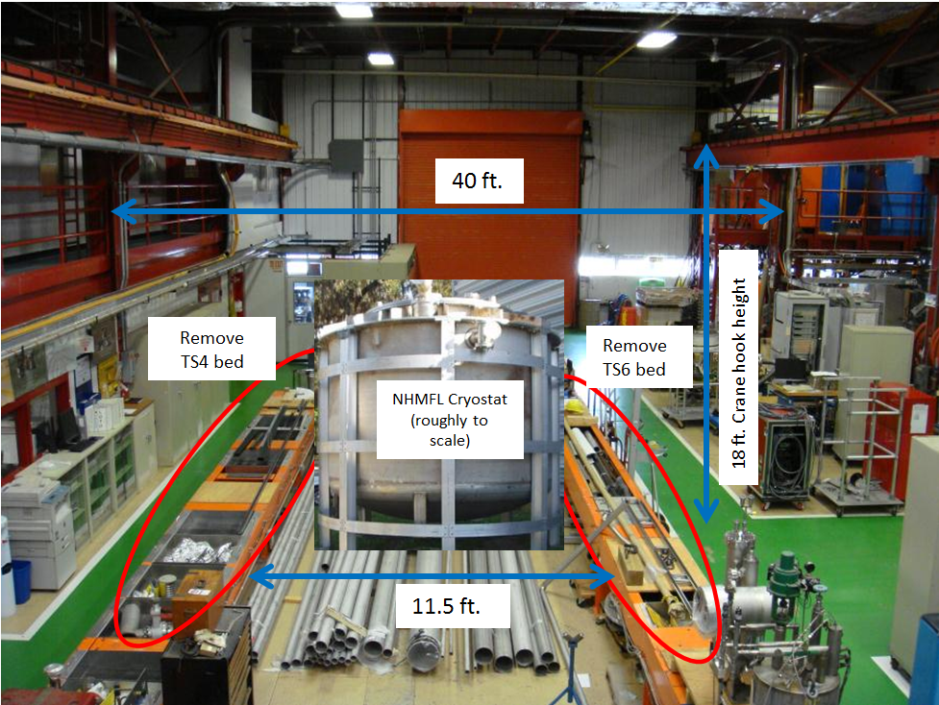
Proposed IB1 Location

Slide 8
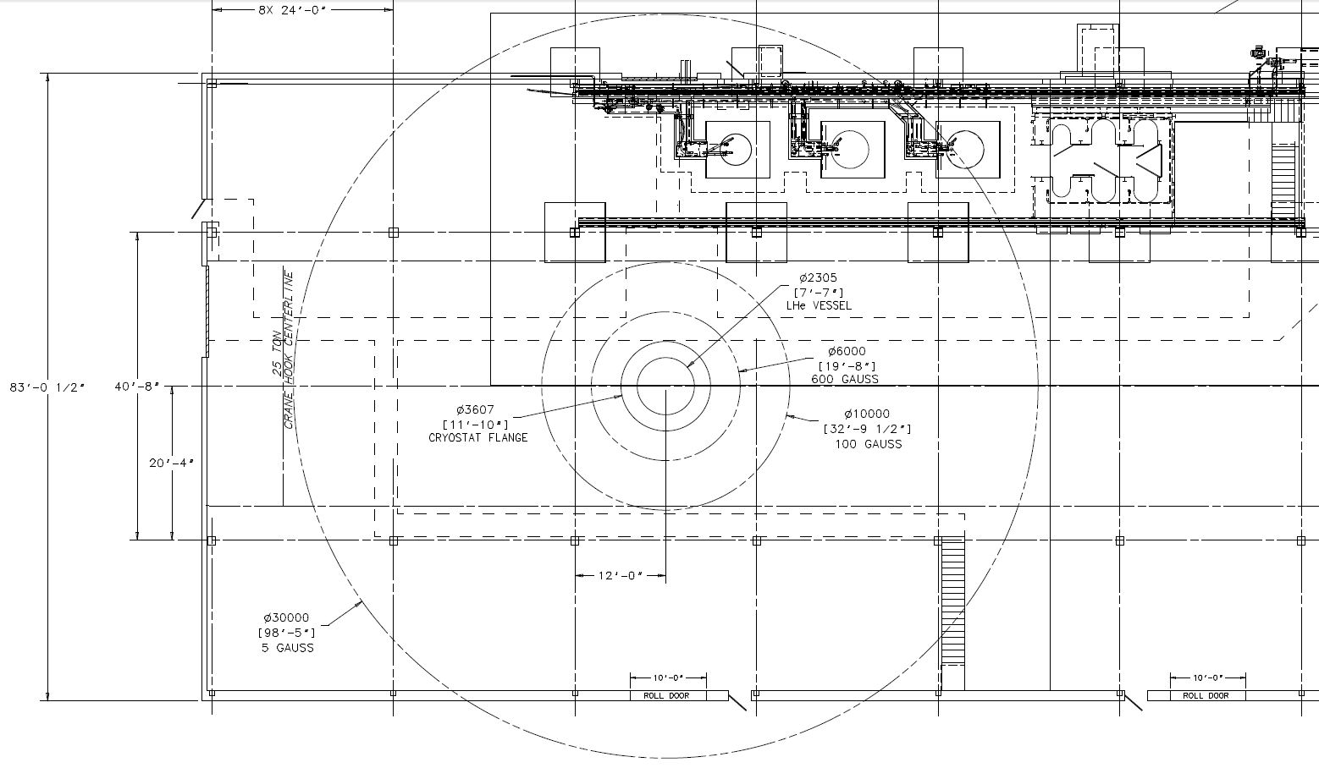
Fringe Magnetic Field in IB1
SRF Cavity Test Stands
600 G
100 G
Technician Offices
Control Room, Servers
5 G

Slide 9
Magnetic Shielding
Passive
  Very preliminary: ~ 10 cm thick iron walls to bring 5 G line from 15 m to 5 m. More detailed studies needed.
Active
  Use background coil for active shielding? Needs more study, background magnetic field may skew test results, synchronized field operation, etc.
A magnetic shield solution does not appear feasible in the short term for IB1

Slide 10
Testing at IB1
Without magnetic shielding, IB1 does not appear to be a viable long-term solution for testing large fringe field coils because of the highly disruptive effect on other test programs (SRF cavities, LARP/HFM magnets, 11T LHC upgrade, etc)
Short term testing (a few coils) may be accommodated in IB1 with adequate personnel safety precautions and coordination with other test programs, but the risk of permanently magnetizing IB1 structures such as ferrous re-bars must be clearly understood and evaluated
  SRF Cavity Testing requires < 10 mG on cavity surface during cooldown!
For long term testing programs (several coils), we recommend that the cryostat be moved to a more suitable location after commissioning in IB1

Slide 11
Preliminary M&S and Labor Estimate
$300K and 2.5 FTEs to install, instrument, and commission the cryostat in IB1.

Slide 12
Schedule Estimate
Assuming redirection of TD/T&I Department staff, a minimum of six months after cryostat delivery
Competing projects activities:
  VTS 2&3 installation and commissioning
  IB1 Cryo Upgrades
  Cryomodule 2 Instrumentation
  SELVA winding machine controls upgrade for 11T Nb3Sn LHC upgrade coil prototypes
  IB1 Magnetic Measurement System Upgrade

Slide 13
Next Steps
Determine long-term cryostat availability
  Will the cryostat need to go back to FSU, if so how soon?
Inspect cryostat condition and improve cost estimate
Improve understanding of fringe magnetic field effects on IB1 and possible shielding solutions
Continue evaluating long term locations at Fermilab for testing large coils with large fringe magnetic field (needed for MICE, mu2e)
  Combine with possible ITER CS Modules Test Facility?
  Reuse other buildings after Tevatron Shutdown (e.g., CDF, D0)?
  Build an IB1 satellite test area and run cryo transfer lines?
Thanks to Alan Bross, John Tompkins for MICE CC and test requirements information and several discussions related to this proposal

