Slide 1
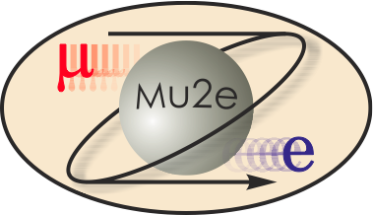
-II
Mu2e-II Workshop (v) - Introduction
Frank Porter
October 28, 2020
DocDB-nnnnn
This meeting will be recorded

Slide 2
Thanks to Becky Chislett, Eric Prebys, and Leo Borrell, Mu2e-II was well-represented at the rare frontier town hall on October 2; as well as Sophie Middleton for Mu2e

Slide 3
Mu2e-II workshops
Nearby workshop dates | Links to recordings
Thursday, June 18 https://mu2e-docdb.fnal.gov/cgi-bin/sso/DisplayMeeting?conferenceid=9755 | AM: https://caltech.box.com/s/b67edbgtxofaujuooorafm4kfq9owhjd PM: https://caltech.box.com/s/vnsm9nh7qroznt3n6q5n3sn4ut1bswo5
Wednesday, July 29 https://indico.fnal.gov/event/44541/ | https://caltech.box.com/s/k45jik5i7uztq2letmaxb93fq3arl0kf
Wednesday, August 26 https://indico.fnal.gov/event/44997/ | https://caltech.box.com/s/ws8hkzmjo96xlnile8q27yphb87nlpjp
Wednesday, September 23 https://indico.fnal.gov/event/45632/ | https://caltech.zoom.us/rec/play/_xbOzK448M0VhhDArf9UE8AjiOKdshh4et0tYOOhtViPn3qveG95CkQUOHQ0_SzeJ8pxVzw5M0PoIvjD.I-zdhaNXvu3i5Sll?autoplay=true&startTime=1600873315000
Wednesday, October 28 https://indico.fnal.gov/event/45937/
Wednesday, December 9

Slide 4
Working Groups
Mu2e-II working groups | Convenors
Theory mu2eii-theory@fnal.gov | Julian Heeck Lorenzo Calibbi
Accelerator (including PS, production target, extinction) mu2e-ii-accelerator@fnal.gov | David Neuffer Eric Prebys
Radiation mitigation (includes radiation simulation) mu2eii-radiation@fnal.gov | Vitaly Pronskikh Michael MacKenzie Stefan Mueller
Tracker mu2eii-tracker@fnal.gov | Daniel Ambrose Giovanni Tassielli
Calorimeter (and STM?) mu2eii-calorimeter@listserv.fnal.gov | Ivano Sarra Luca Morescalchi David Hitlin
CRV mu2eii-crv@listserv.fnal.gov | Yuri Oksuzian Craig Dukes
Sensitivity estimate (includes simulation, stopping target) mu2e-ii-sensitivity@listserv.fnal.gov | Lisa Goodenough Sophie Middleton Yuri Oksuzian
Trigger and DAQ mu2e-ii-tdaq@listserv.fnal.gov | Giani Pezzullo Antonio Gioiosa

Slide 5
Accelerator
David Neuffer, Convenor, FNAL
Eric Prebys, Convenor, UCD
Mary Anne Cummings, Muons, Inc.
Keegan Harrig, UCD
Andrei Gaponenko, FNAL
Kevin Lynch, CUNY
James Popp, CUNY
Diktys Stratakis, FNAL

Slide 6
Radiation simulation and mitigation
Michael MacKenzie, Convenor, Northwestern
Vitaly Pronskikh, Convenor, FNAL
Stefan Mueller, Convenor, HZDR
James Popp, CUNY
Anna Ferrari, Reuven Rachamin, HZDR
Sophie Middleton – Sensitivity liaison
Yuri Oksuzian – CRV liaison
David Neuffer – Accelerator liaison
Gianantonio Pezzullo – TDAQ liaison
Ivano Sarra – Calorimeter liaison
Mete Yucel – Tracker liaison

Slide 7
Theory
Julian Heeck, Convenor, Uva
Lorenzo Calibbi, Convenor, Nankai U
Robert Szafron, CERN

Slide 8
Tracker
Daniel Ambrose, Convenor, UMinn
Giovanni Tassielli, Convenor, INFN Lecce
David Brown, LBNL
Brendan Casey, FNAL
Manolis Kargiantoulakis, FNAL
Mete Yucel, FNAL

Slide 9
Calorimeter
David Hitlin, Convenor, Caltech
Luca Morescalchi, Convenor, INFN Pisa
Ivano Sarra, Convenor, LNF
Leo Borrell, Bertrand Echenard, Dexu Lin, Sophie Middleton, James Oyang, Frank Porter, Liyuan Zhang, Renyuan Zhu, Caltech
Eleonara Diociaiuti, Raffaella Donghia, Simona Giovannella, Fabio Happacher, Stefano Miscetti, LNF
Stefano Di Falco, Simone Donati, Antonio Gioiosa, Elena Pedreschi, Franco Spinella, INFN Pisa

Slide 10
Cosmic Ray Veto
Craig Dukes, Convenor, Uva
Yuri Oksuzian, Convenor, ANL
Karen Byrum, Simon Corrodi, Peter Winter, Lei Xia, ANL
Raymond Culbertson, Gary Drake, Anna Pla-Dalmau, Greg Rakness, FNAL
Akram Artikov, Yuri Davydov, JINR, Dubna
Timothy Bolton, Glenn Horton-Smith, Yurii Maravin, Kres Neely, KSU
Gerald Blazey, Kurt Francis, Sergey Uzunyan, Vishnu Zutshi, NIU
Merrill Jenkins, U South Alabama
Steven Boi, Ralf Ehrlich, Stephen Goadhouse, Craig Group, UVa

Slide 11
Trigger/DAQ
Gianantonio Pezzullo, Convenor, Yale
Antonio Gioiosa, Convenor, INFN Pisa
Richard Bonventre, LBNL
Rebecca Chislett, UCL, Tracker liaison
Raffaella Donghia, LNF
Bertrand Echenard, Caltech
Ryan Rivera, FNAL
Franco Spinella, INFN Pisa – Calorimeter liaison
Craig Dukes, UVa – CRV liaison

Slide 12
Sensitivity estimates group members
Lisa Goodenough, Convenor, FNAL
Sophie Middleton, Convenor, Caltech
Yuri Oksuzian, Convenor, ANL
Rebecca Chislett, UCL
Michael Hedges, Purdue
Cole Kampa, Northwestern
Manolis Kargiantoulakis, FNAL
Michael MacKenzie, Northwestern

Slide 13
Production solenoid
We are pursuing the idea of another working group addressing the solenoids (mainly the production solenoid and associated HRS)
Vadim Kashikhin will make a presentation at our December 9 workshop on the production solenoid

Slide 14
Snowmass21 Contributed Paper
Next (and final) product for Snowmass21 is a Contributed Paper, deadline July 31, 2021
Desirable to have something ready as input to Rare Frontier meeting in June 2021
Planning to produce a decent draft by May 1, 2021
Top level outline and framework on Overleaf (read link):
https://www.overleaf.com/read/mrbgttkmfgvq

Slide 15
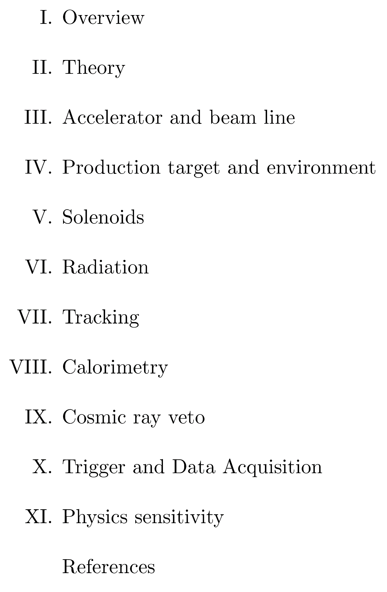
Contributed Paper – Proposed Top Level Outline

Slide 16
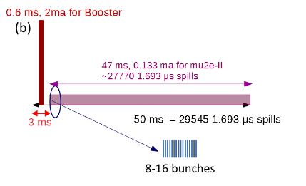
Mu2e-II workshop, Wednesday, Oct. 28
Includes continued discussion of capability, issues, R&D to accept higher rate/more power
Suggested assumptions (“straw man”):
Use the spill period of 1.7 microsecond assumed for an aluminum stopping target
Factor of four increase in protons in a spill (over nominal), one factor of two from taking bunches at 162.5 MHz, and another factor of two from increasing the spill duration to 200 ns.
Issues to be concerned about include:
power
radiation
rate
backgrounds
can we gain linearly in sensitivity
Eric Prebys https://indico.fnal.gov/event/44997/

Slide 17
Mu2e-II Communication
Public wiki page: https://mu2eiiwiki.fnal.gov
Have also a private Wiki, working out some details
Mu2e-II Slack channel invite link:
https://join.slack.com/t/caltech-tka1525/shared_invite/zt-glsr3405-OondWg0KCpBoUJwIr2uyJw
Mu2e-II mailing list: mu2eii@listserv.fnal.gov

Slide 18
Future Mu2e-II/Snowmass21 Events of interest
Date TBA (maybe November): CLFV – CLFV with high intensity muon factory
Wednesday, December 9, 2020 (10AM-2PM CT): Mu2e-II workshop
June 2021: Rare/precision frontier meeting
2021 Snowmass Summer Study (July 11 - 20, 2021 at UW Seattle)
Tracker workshop being scheduled for first week of December (contact: Dan Ambrose)
CRV workshop being scheduled around second week of December (contact: Yuri Oksuzian)

Slide 19
October 28 Mu2e-II workshop agenda
When (CT) | Who | What
10:00-10:20 | Frank Porter | Introduction
10:20-10:50 | Ryan Plestid | Radiative muon capture
10:50-11:05 | Sophie Middleton | sensitivity
11:05-11:30 | Daniel Ambrose | Tracker
11:30-11:50 | David Hitlin | Calorimeter
11:50-12:30 | All | Break
12:30-12:55 | Yuri Oksuzian | CRV
12:55-13:10 | Giani Pezzullo Antonio Gioiosa | TDAQ
13:10-13:35 | Vitaly Pronskikh | MARS simulations
13:35-14:00 | Stefan Mueller | Fluka simulations
14:00 | All | End
Indico timetable at: https://indico.fnal.gov/event/45937/

Slide 20
Additional Material

Slide 21
Mu2e-II Snowmass21 Committee
Name | Institution | Email
Dan Ambrose | U Minn | ambrose0028@gmail.com
Rebecca Chislett | UC London | rebecca.chislett@ucl.ac.uk
Lisa Goodenough | FNAL | goodenou@fnal.gov
Julian Heeck | U Virginia | julian.heeck@gmail.com
David Neuffer | FNAL | neuffer@fnal.gov
Yuri Oksuzian | ANL | yoksuzian@anl.gov
Frank Porter (chair) | Caltech | fcp@caltech.edu
Giovanni Tassielli | INFN-Lecce | giovani.tassielli@le.infn.it
Robert Bernstein (ex officio) | FNAL | rhbob@fnal.gov
Jim Miller (ex officio) | Boston U | miller@bu.edu

Slide 22
Calendar
Wiki already has a calendar of Mu2e-II workshops:
https://mu2eiiwiki.fnal.gov/wiki/Calendar_of_Workshops
Also, Rare frontier has a calendar:
https://snowmass21.org/rare/start#calendar_of_meetings
Proposing to provide an editable Mu2e-II calendar on the private Wiki page
Working group meetings and workshops
Ad hoc working meetings
Convenor meetings
Committee meetings
Related Snowmass21 events
Include links to Zoom, agendas

