Slide 1
Pyramid Simulation
Ralf Ehrlich
University of Virginia
January 25, 2021

Slide 2
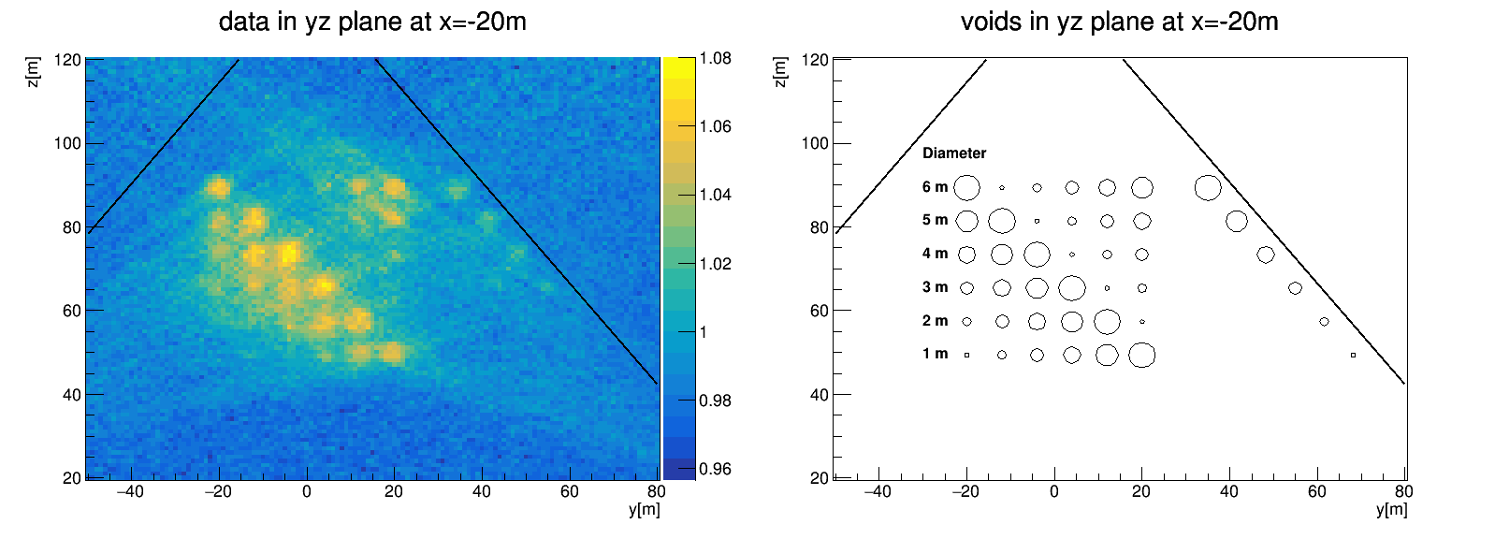
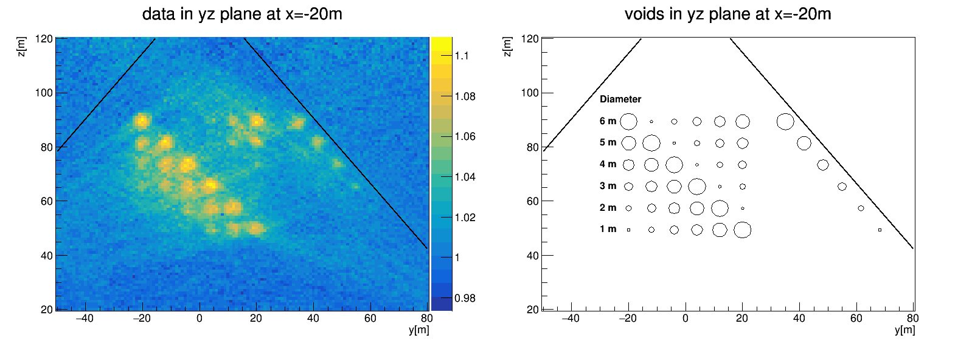
FAQ
No cut
10 GeV cut

Slide 3
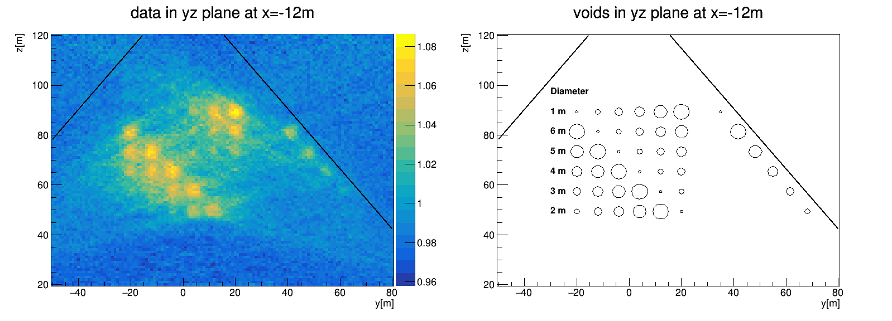
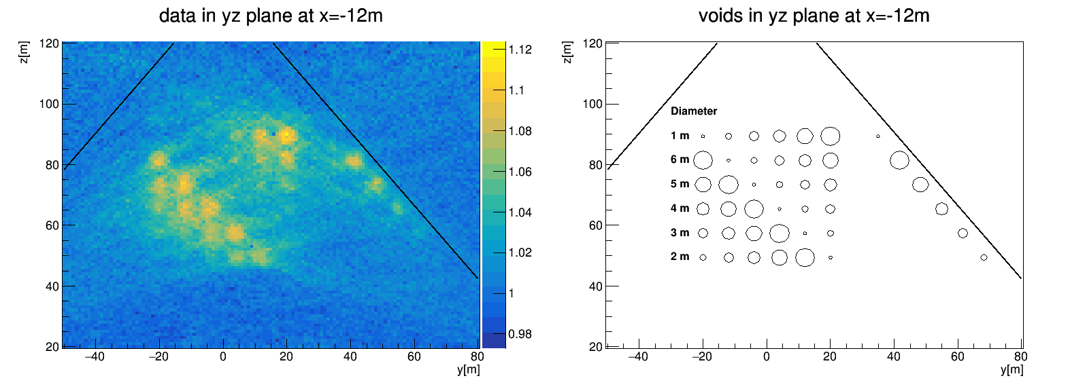
FAQ
No cut
10 GeV cut

Slide 4
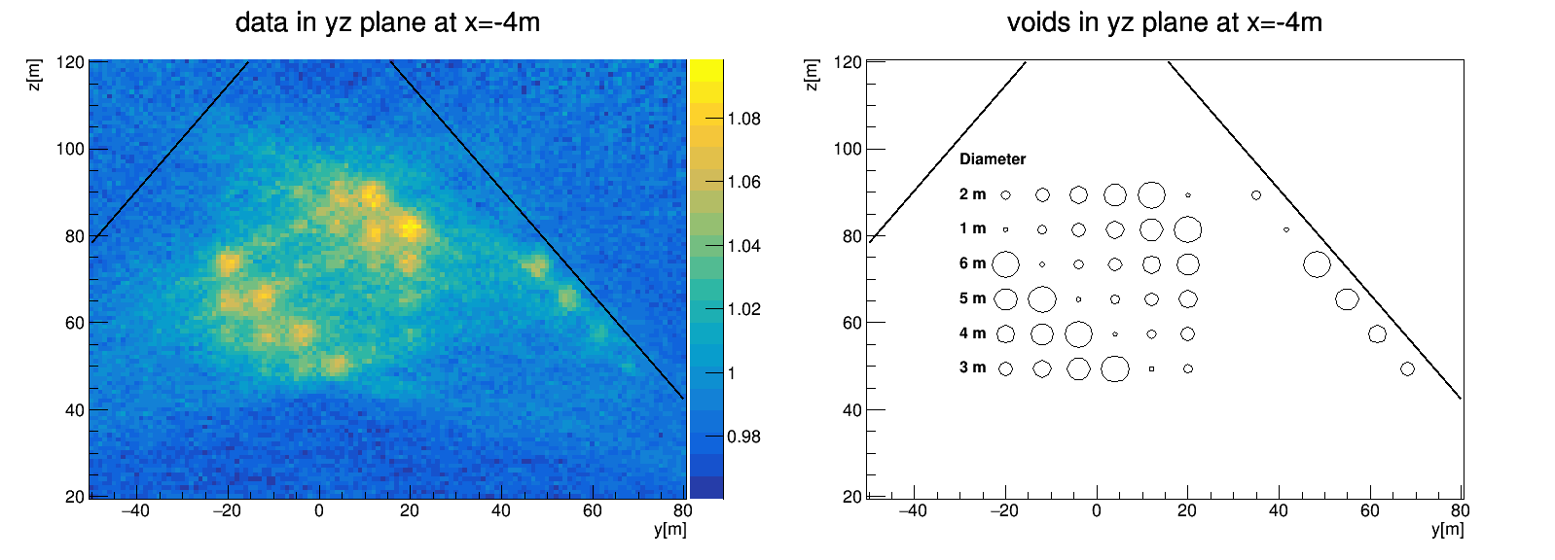
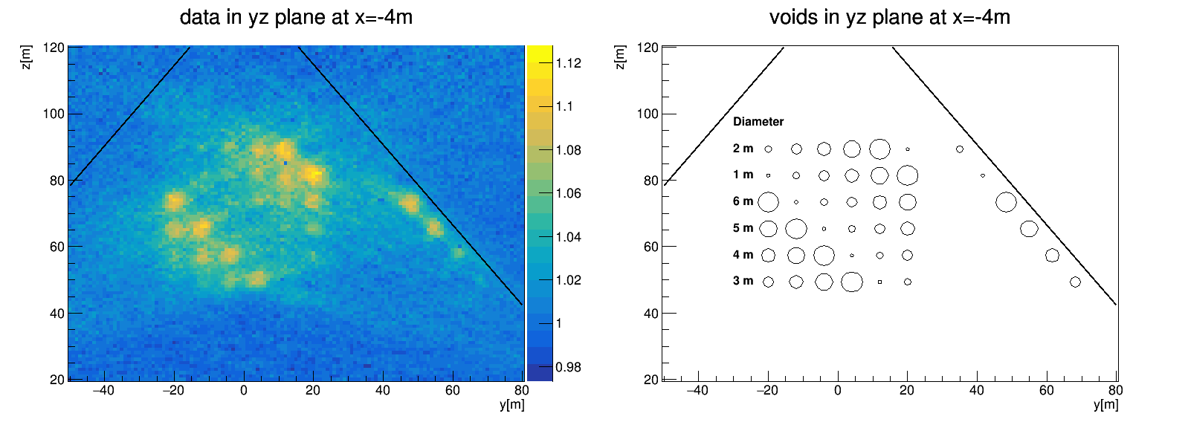
FAQ
No cut
10 GeV cut

Slide 5
FAQ
No cut
10 GeV cut

Slide 6
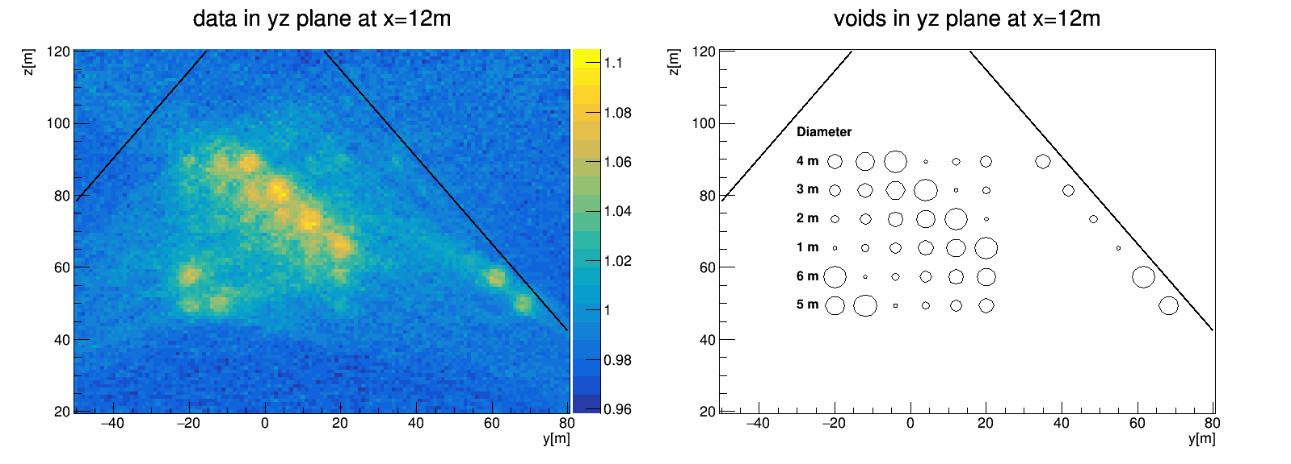
FAQ
No cut
10 GeV cut

Slide 7
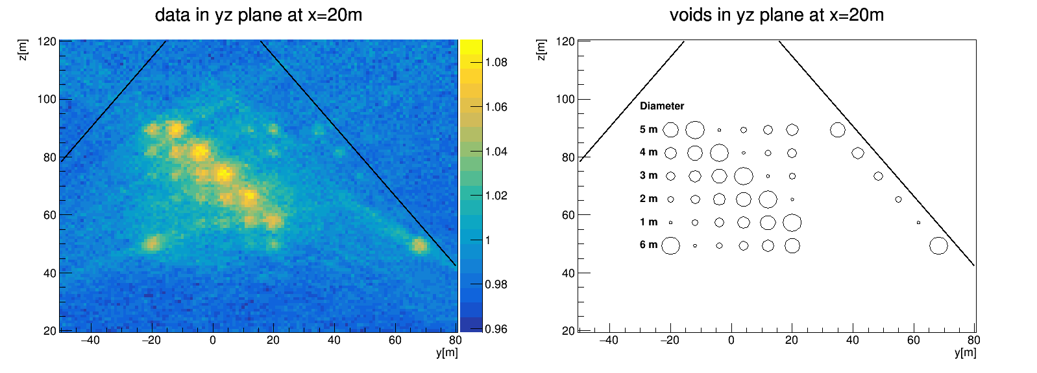
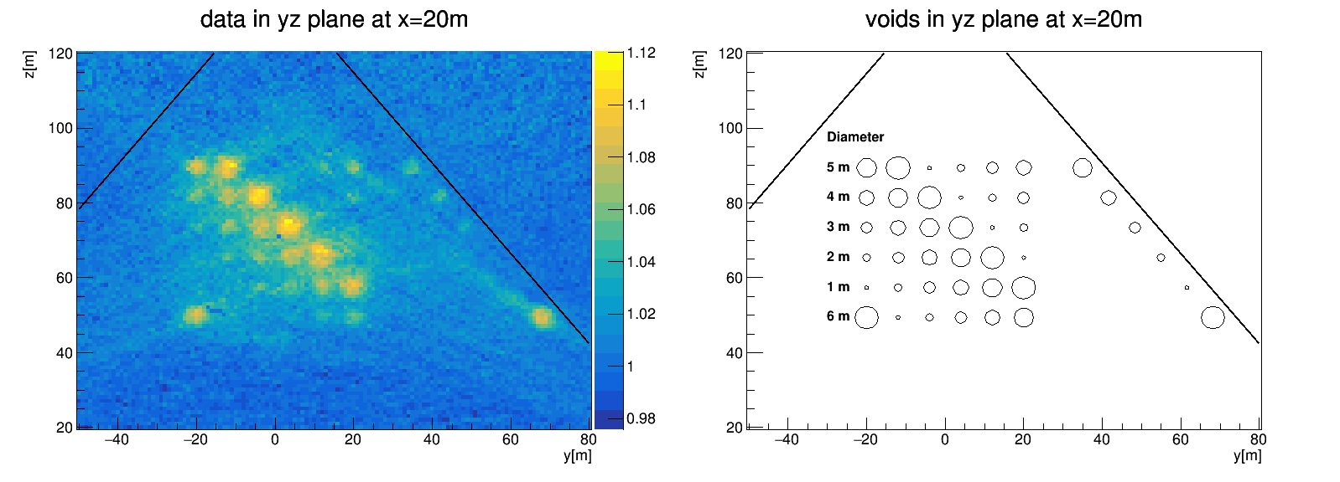
FAQ
No cut
10 GeV cut

Slide 8
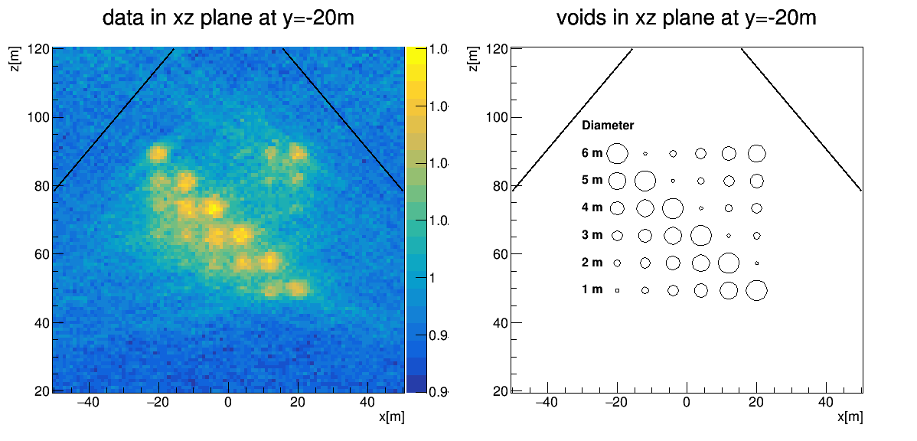
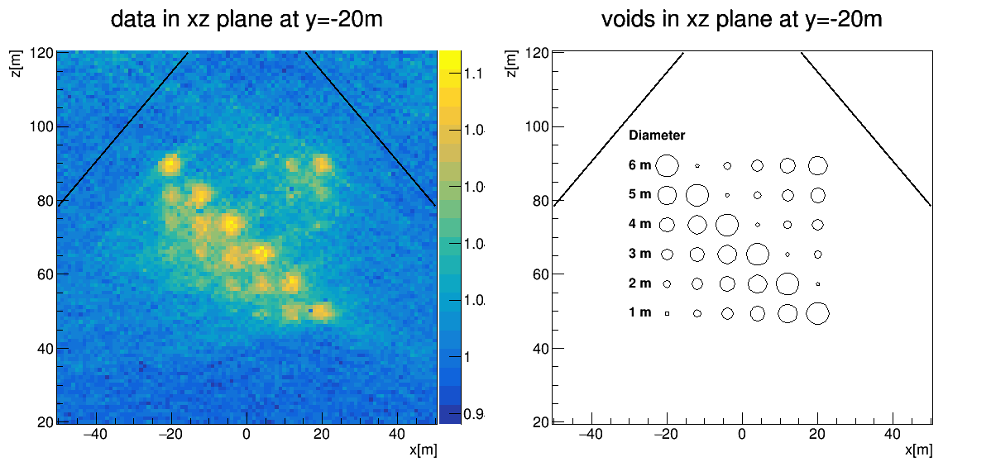
FAQ
No cut
10 GeV cut

Slide 9
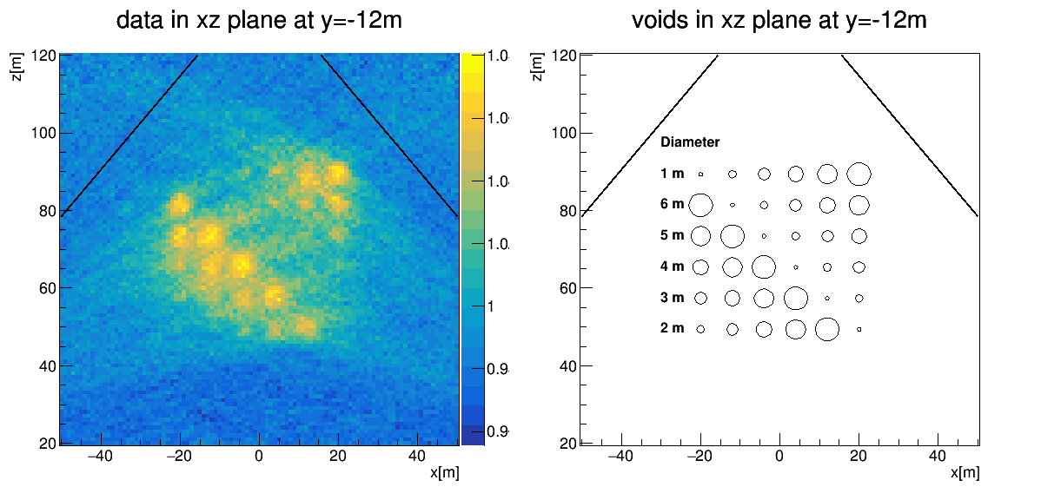
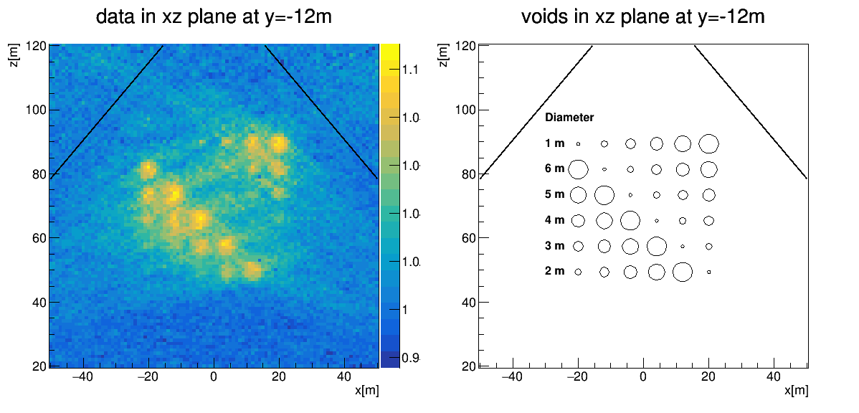
FAQ
No cut
10 GeV cut

Slide 10
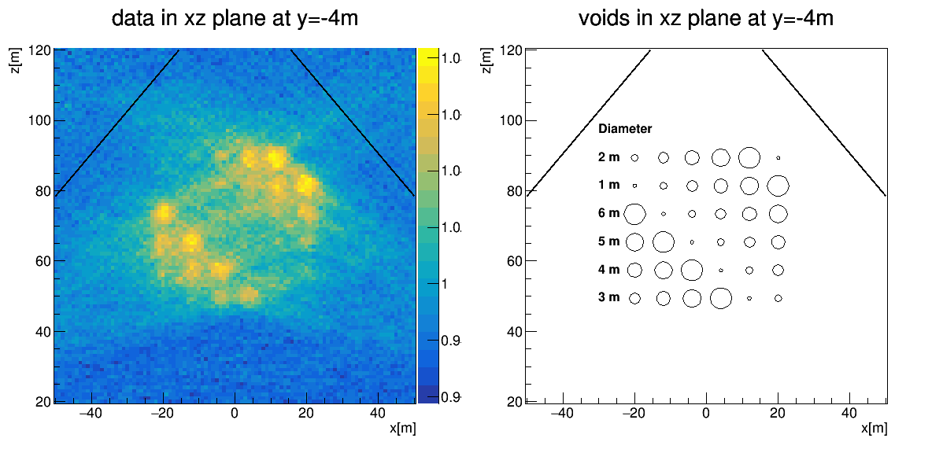
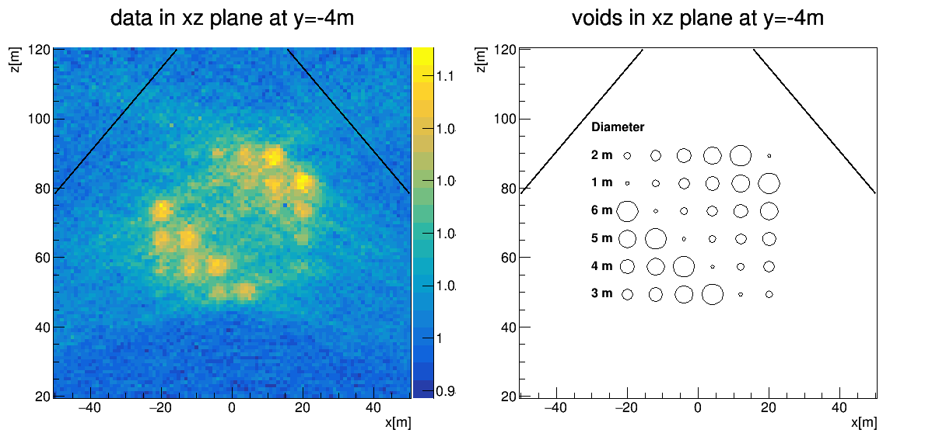
FAQ
No cut
10 GeV cut

Slide 11
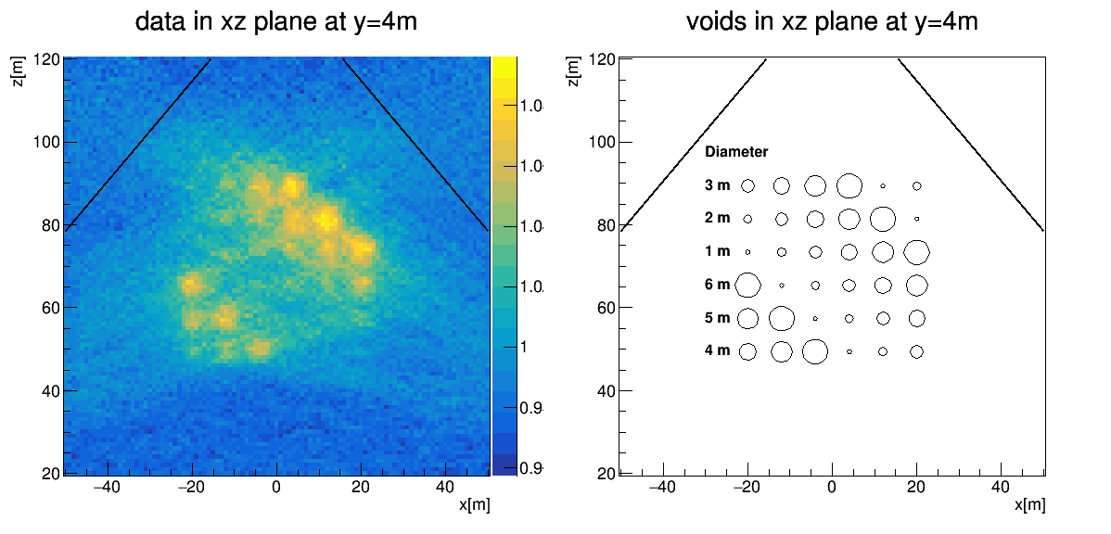
FAQ
No cut
10 GeV cut

Slide 12
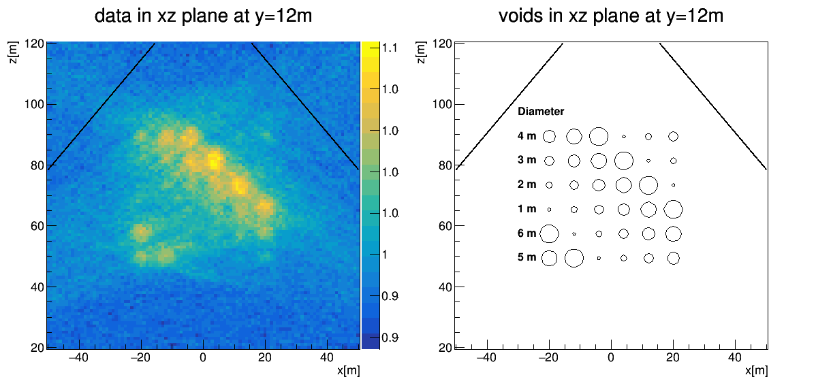
FAQ
No cut
10 GeV cut

Slide 13
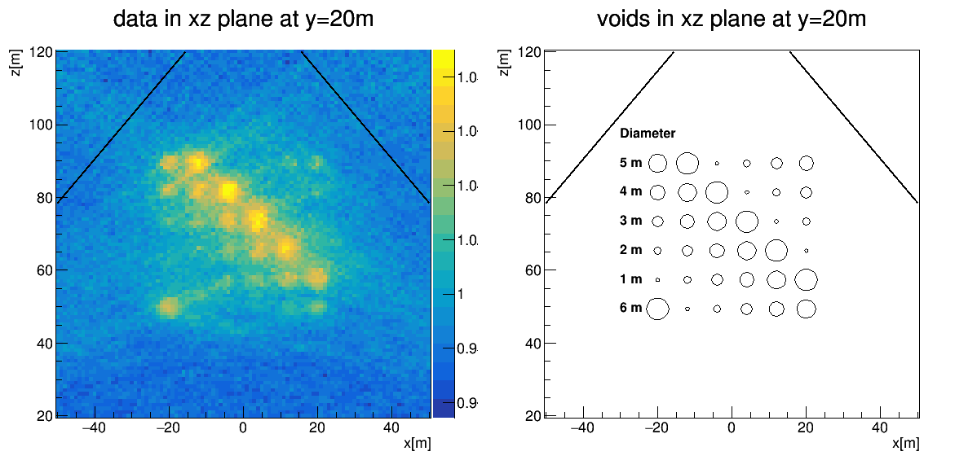
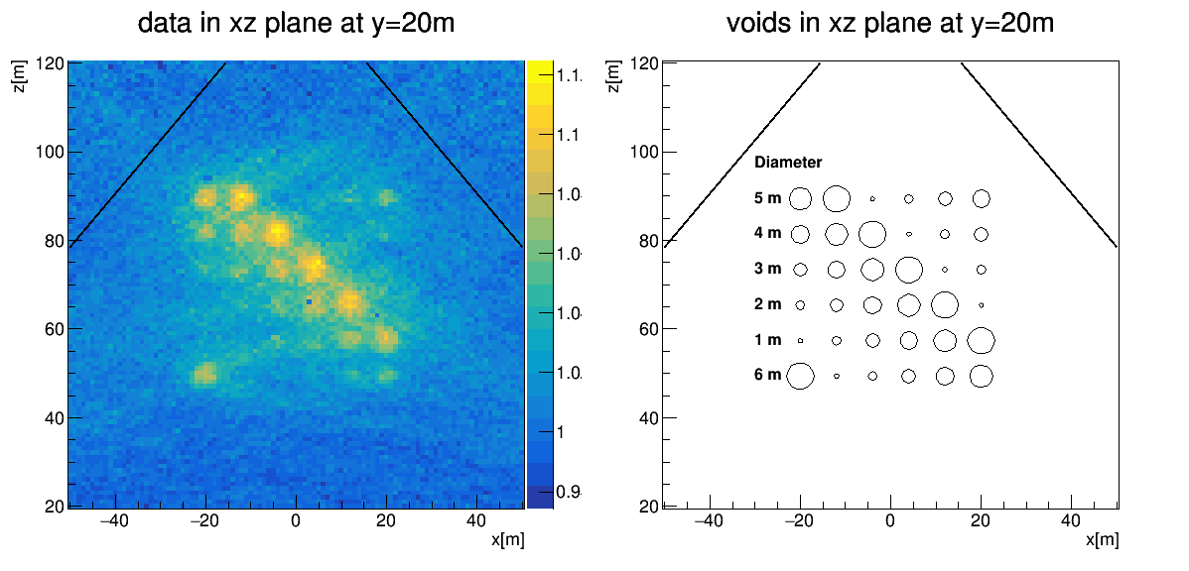
FAQ
No cut
10 GeV cut

Slide 14
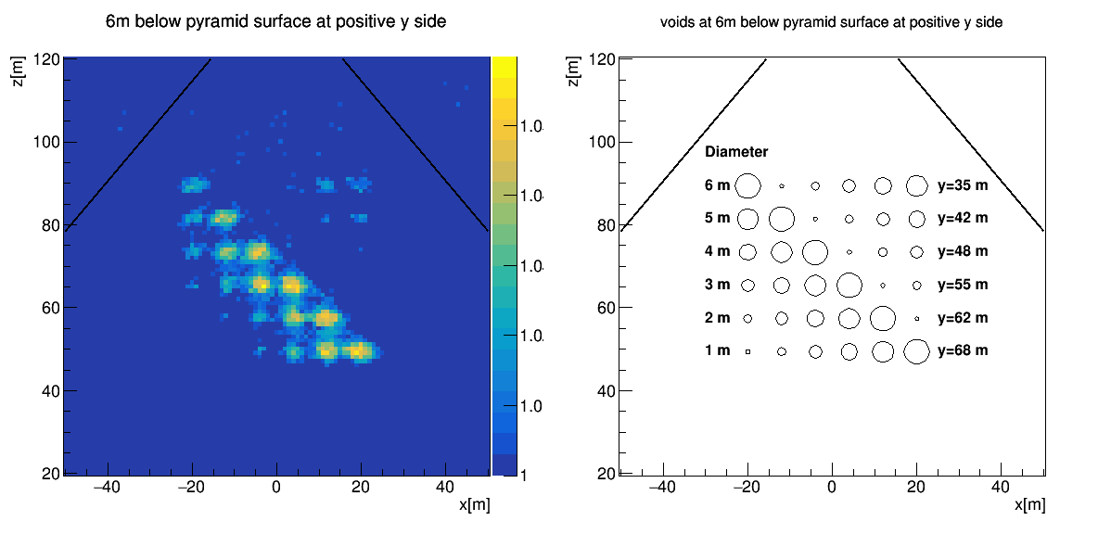
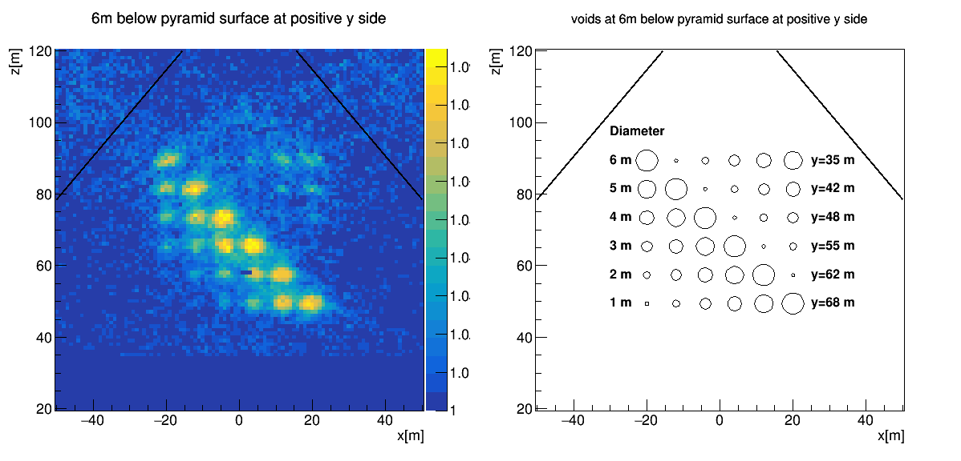
FAQ
No cut
10 GeV cut

