Slide 1
Reading Stage1 Files
Ralf Ehrlich
University of Virginia
Februar 2, 2021

Slide 2
Rebuilding the ROOT dictionary
In order to open the ROOT file the dictionary needs to be rebuilt.
Dictionaries are needed, if STL containers (e.g. map, vector) are used in the ROOT files.
Dictionaries need to be rebuilt, if the ROOT versions are different.
Steps to rebuild the ROOT dictionary.
Here it is assumed the EGPTrack.hh, EGPHit.hh, LinkDef.hh are in the same directory.
If not, a -Ipath_to_headerfiles needs to be added to the commands below.
CLHEP needs to be installed, with $CLHEP_INC pointing to the CLHEP include directory.
rootcling -f dict.cc -I$CLHEP_INC -rmf dict.rootmap -rml dict.so EGPTrack.hh EGPHit.hh LinkDef.hh
g++ -shared -o dict.so dict.cc -I$CLHEP_INC `root-config --cflags --libs` -fPIC
If everything worked, the following files should have been created:
dict.rootmap, dict.so
Now the file CosmicsStage1_EGP_0.root can be opened.
Try to run the example script
root -l analyzeStage1.C

Slide 3
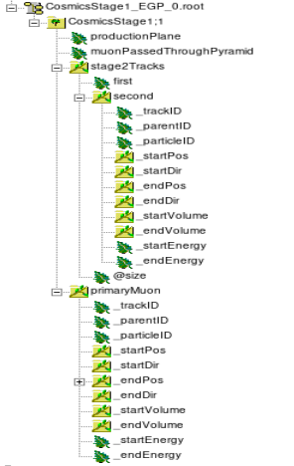
Content of stage 1 file
The production plane where the primary muons are generated before they are projected to the sky. Type: int
0: positive x side, 1: positive y side, 2: negative x side, 3: negative y side
Indicator of whether the primary muon went through the pyramid. Type: bool
All tracks which hit a container (and can be used in stage 2). Type std::map<int,EGPTrack>
-first (int): The unique track ID, where 1 is assigned to the primary. That’s most likely the only track you are interested in.
-second (EGPTrack): The track itself.
-@size (size_t): The number of tracks hitting a container in an event.
Primary cosmic muon. Type: EGPTrack This information is available for every event even if the moun does not exit the pyramid or hit a container.

Slide 4
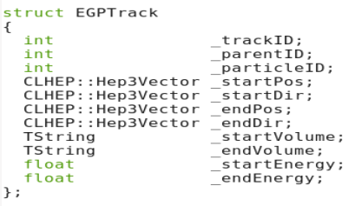
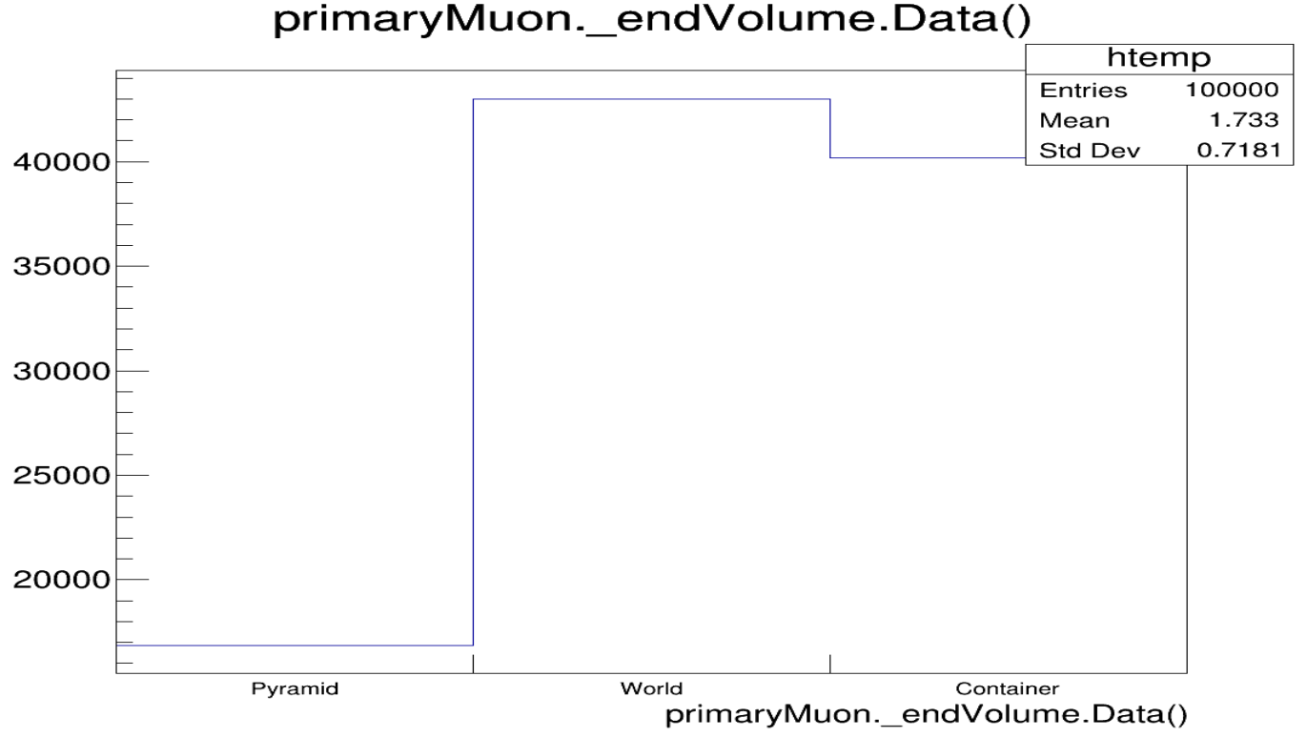
Definition of the EGPTrack class
The unique ID of each track assigned by GEANT4. The primary track has ID 1. The trackID of the parent. It is 0 for primaries.
PDG particle code, e.g. 11 e-, -11 e+, 13 mu-, -13 mu+, 22 gamma (see https://pdg.lbl.gov/2007/reviews/montecarlorpp.pdf)
The content of the CLHEP::Hep3Vector entries can be accessed via x(), y(), z(), phi(), theta(), and other functions defined in the CLHEP class ThreeVector.h.
The TString class is a ROOT class. Available functions can be found on the ROOT website. The _endVolume variable of the primaryMuon branch can be used to find muons which hit the container.

