Slide 1

Supporting Your Researchers to Use OSG
Lauren Michael, Facilitation Services Lead

Slide 2

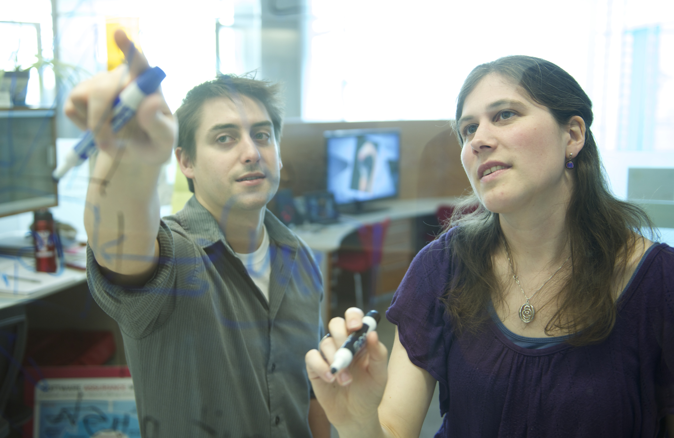
Access to OSG via OSG Connect
Learning Opportunities for Researchers and Campus Staff
‘Local’ Submit Points into OSG

Slide 3
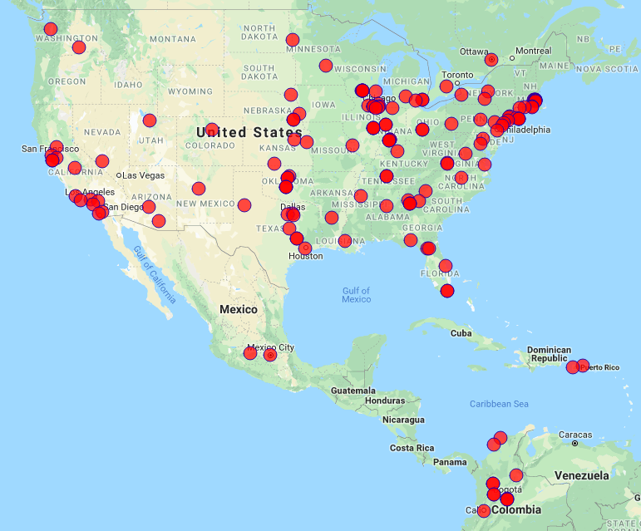
Who Participates?
Individual researchers and groups
Multi-Institution Collaborations
  Atlas/CMS (Higg Boson), and others
Academic Institutions and
National Laboratories
Science Gateways
Advancing this spectrum requires a
diversified portfolio of services.

Slide 4
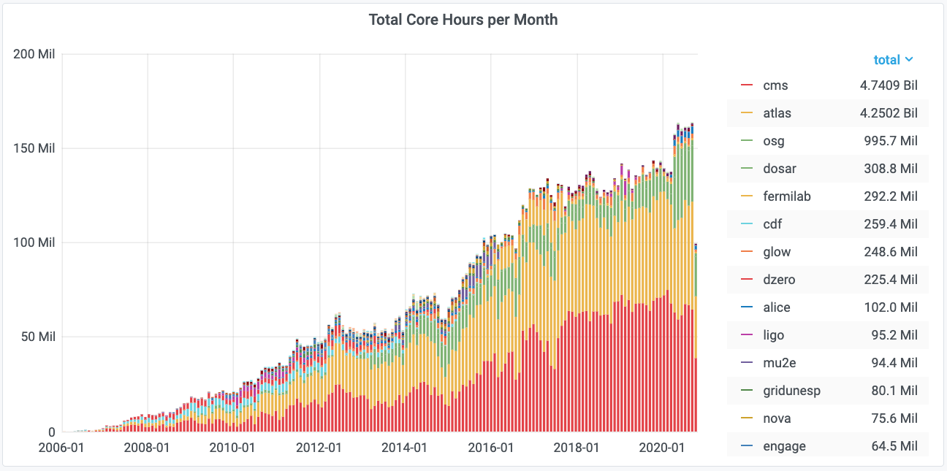
Research Communities Supported
(“virtual organizations”)
https://gracc.opensciencegrid.org

Slide 5
“Open Science Pool”
(‘osg’ VO)
single researchers/groups (OSG Connect),
smaller multi-institution collaborations, gateways & campus submit points
https://gracc.opensciencegrid.org

Slide 6
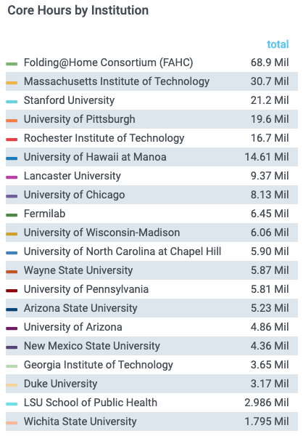
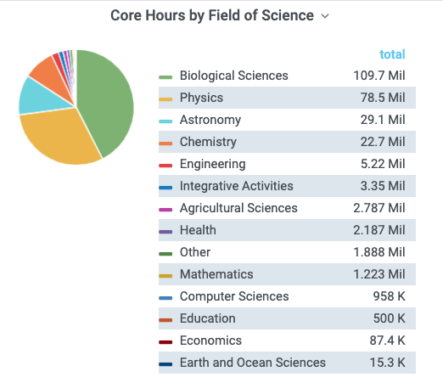
Open Science Pool

Slide 7
Services Overview

Slide 8
OSG for researchers:
OSG Connect
(FREE) access to OSG and dHTC Facilitation, with OSG-supported access points
osgconnect.net > “Sign Up”
available to researchers at any U.S. academic, government, or non-profit organization
includes:
  initial consultation with an OSG Research Computing Facilitator
  online documentation and examples
  (roughly) unlimited scratch; support for staging software and large input w/ automatic caching
  no “allocation” or proposal required

Slide 9
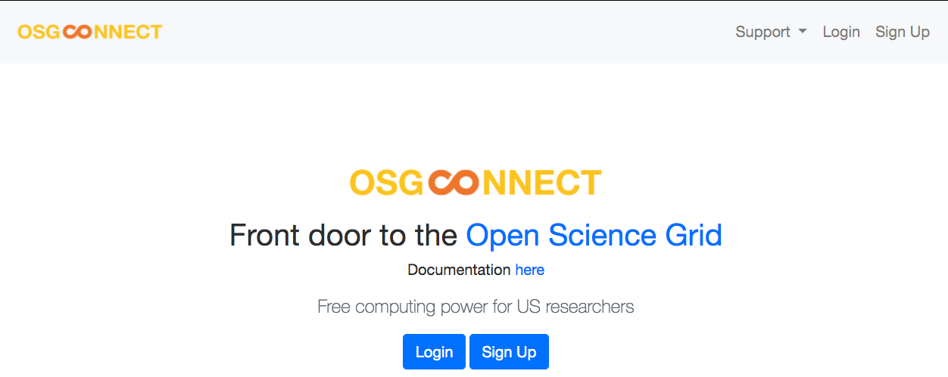
For individual researchers:
OSG Connect

Slide 10
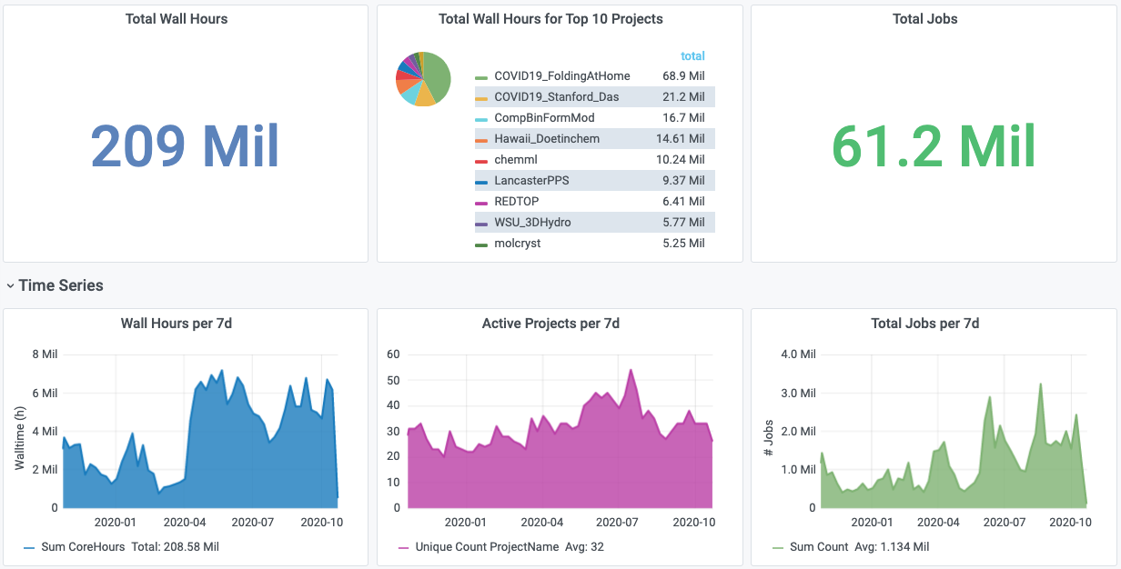
OSG Connect (in the last year)

Slide 11
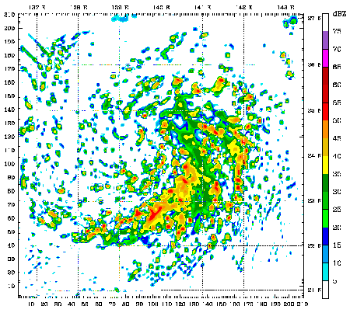
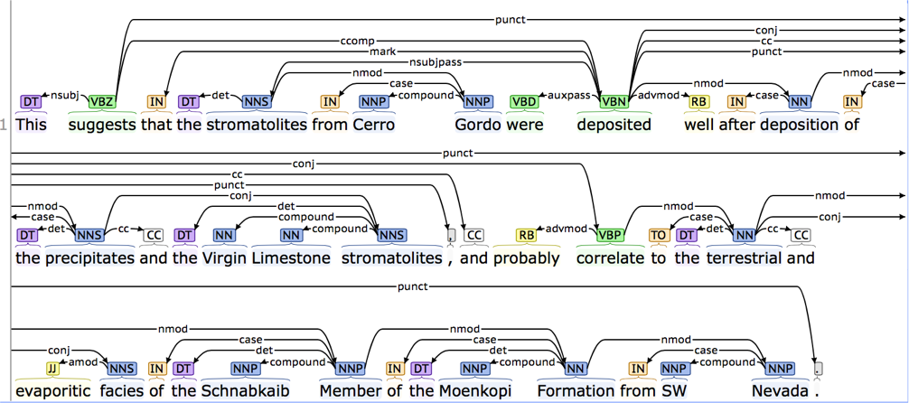
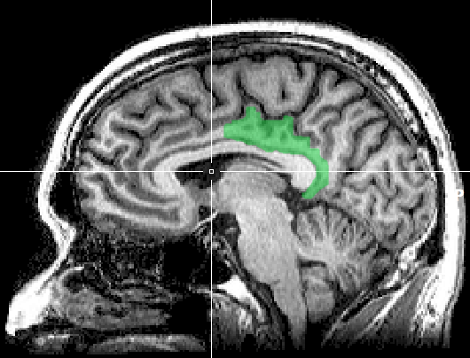
Is it HTC-able?
Is your problem potentially computable as lots of independent pieces? For example …
multi-start simulations
text analysis (most genomics …)
parameter sweeps
statistical model optimization
(MCMC, numerical methods, etc.)
(multi-)image and
sample analysis

Slide 12
Signs of HTC-able work
Any mention of numerous samples, images, models, parameters, etc.
Nearly anything written by the researcher (e.g. c/fortran, Python, R)
  Break out of loops!
  Common internal parallelism could really be HTC (e.g. Matlab’s ‘parfor’, ‘distributed server’, etc.)
Some community softwares that use multi-threading or multiprocessing (e.g. OpenMP)
  many are simply looping over data portions or independent tasks
  HTC-able: break up input (or ‘parameter’ space), turn off multi-threading, combine results
Long-running jobs; see above explanations

Slide 13
Is it OSG-able?
Is your work computable as lots of laptop-sized pieces?
Per-Job Resources | Ideal Jobs! (up to 10,000 cores, per user!) | Still Very Advantageous! | Probably not…
cores (GPUs) | 1 (1; non-specific) | <8 (1; specific GPU type) | >8 (or MPI) (multiple)
Walltime (per job) | <10 hrs* *or checkpointable | <20 hrs* *or checkpointable | >20 hrs
RAM (per job) | <few GB | <10 GB | >10 GB
Input (per job) | <500 MB | <10 GB | >10 GB
Output (per job) | <1 GB | <10 GB | >10 GB
Software | ‘portable’ (pre-compiled binaries, transferable, containerizable, etc.) | most other than →→→ | licensed software; non-Linux

Slide 14

Research Computing Facilitation
accelerating research transformations
proactive engagement
personalized guidance
teach-to-fish training
technology agnosticism
upward advocacy
collaboration liaising

Slide 15
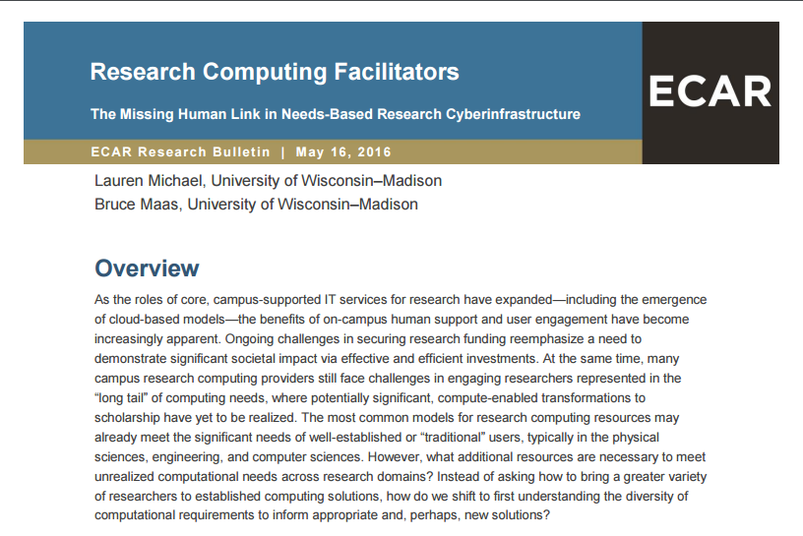

Slide 16
What’s Different about OSG Facilitation?
HTC/dHTC is frequently new to users
  ‘splitting up’ work, optimizing throughput (over per-job performance), etc.
  many have HTC-able work and don’t know (you may not, either)
OSG job logistics are different than using local resources
  built-in data movement instead of shared filesystem
  software portability tools instead of system-wide installation
  inherent interruption/retry
  testing and troubleshooting on non-local resources
Potential scalability and research transformation!

Slide 17
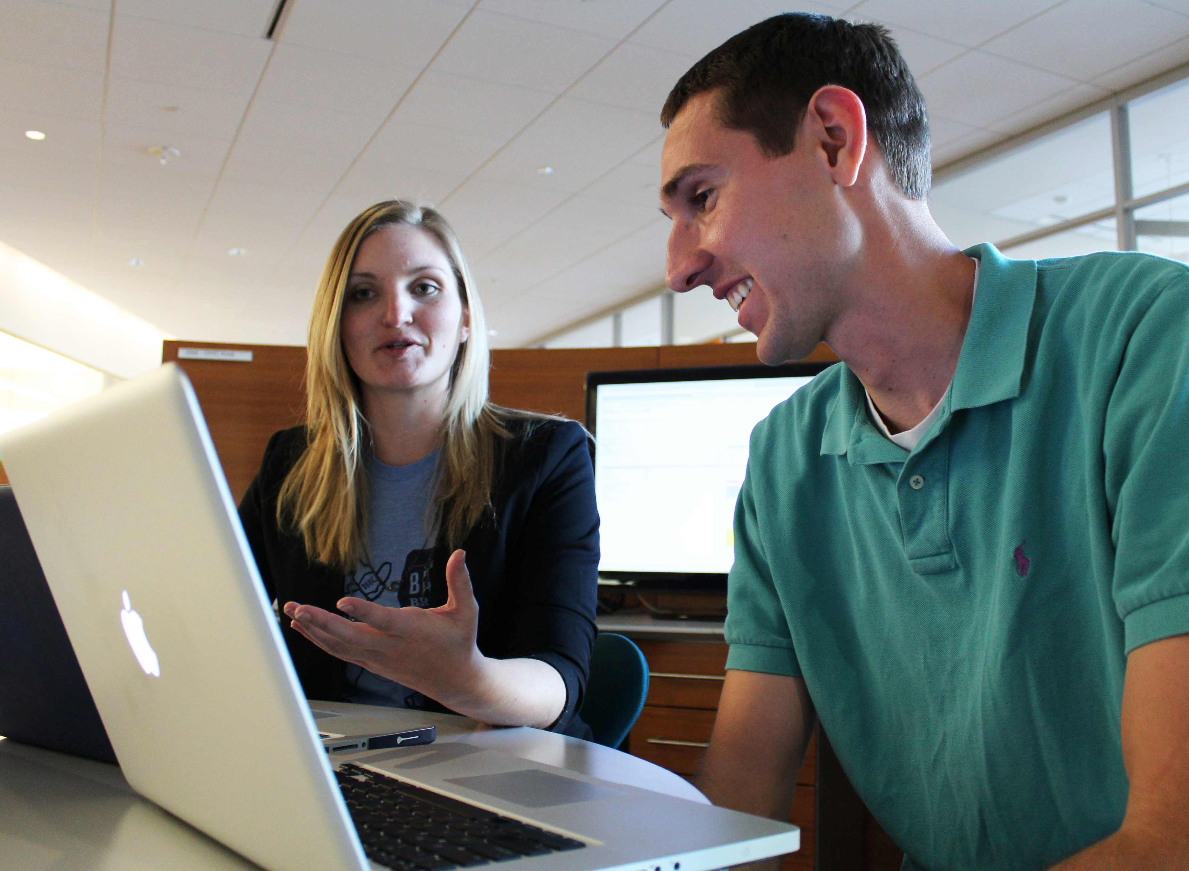
HTC Facilitation Strategy
Meet with every potential new user.
Ask progressively for details.

Slide 18
HTC Facilitation Strategy
Meet with every potential new user.
Ask progressively for details.
Tell me about your research …
… and how does computing fit in?
What is your near-term bottleneck?
How are you running it now?
(the compute/data requirements?)
(your computing background?)
How much/big would you like to run?

Slide 19
HTC Facilitation Strategy
Meet with every potential new user.
Ask progressively for details.
Set expectations.
If you …
  > execute your work this way (HTC)
  > requiring these learning steps and
  this much work.
Then you …
  > can reach your research goal after this much time and effort, and
  > could really achieve this much more research outcome.

Slide 20
What is the Open Science Grid?
a consortium of researchers and institutions
who share compute and data resources for
distributed high-throughput computing (dHTC)
in support of open science

Slide 21
distributed High Throughput Computing (dHTC)
n cores
time
versus internal parallelism (multi-threading, MPI, etc.)
Scheduling: only need 1 CPU core, each (shorter wait; faster to peak)
No special programming required (laptop-style, no multi-threading, etc.)
Easier recovery from failure (if one core fails, job requeued, other cores/jobs continue)
Number of concurrently-running jobs is more important
CPU speed and homogeneity are less important

Slide 22
Is it OSG-able?
Is your work computable as lots of laptop-sized pieces?
Per-Job Resources | Ideal Jobs! (up to 10,000 cores, per user!) | Still Very Advantageous! | Probably not…
cores (GPUs) | 1 (1; non-specific) | <8 (1; specific GPU type) | >8 (or MPI) (multiple)
Walltime (per job) | <10 hrs* *or checkpointable | <20 hrs* *or checkpointable | >20 hrs
RAM (per job) | <few GB | <10 GB | >10 GB
Input (per job) | <500 MB | <10 GB | >10 GB
Output (per job) | <1 GB | <10 GB | >10 GB
Software | ‘portable’ (pre-compiled binaries, transferable, containerizable, etc.) | most other than →→→ | licensed software; non-Linux

Slide 23
HTC Facilitation Strategy
Meet with every potential new user.
Ask progressively for details.
Set expectations.
If you …
  > execute your work this way (HTC)
  > requiring these learning steps and
  this much work.
Then you …
  > can reach your research goal after this much time and effort, and
  > could really achieve this much more research outcome.

Slide 24
HTC Facilitation Strategy
Meet with every potential new user.
Ask progressively for details.
Set expectations.
Follow up with the personalized plan for #3.
Make ongoing support accessible.
Over-emphasize your willingness to help!

Slide 25
HTC Facilitation Training
Shadow OSG’s Research Computing Facilitators
Join OSG RCFs in facilitating use of OSG Connect by researchers from your institution
  Get an account, yourself. Tell your researchers to include you in OSG support conversations.
on-site shadowing at UW-Madison
  We can include you in our researcher consultations for a week, with scheduled time for discussion/reflection.
face-to-face community engagement at HTCondor and OSG events (PATh events)

Slide 26
dHTC Training and Community Events for Campus Staff
Learn dHTC skills and engage with others!
Annual Community Meetings, including content specific to campus research:
  OSG All-Hands Meeting (~March)
  HTCondor Week (~May)
Annual OSG User School
  materials online! (recently virtual)
Trainings, Workshops, and Presentations at:
  conferences, e.g. PEARC, CC*, RMACC, etc.
  virtual communities, e.g. CaRCC, MAGIC, etc.

Slide 27
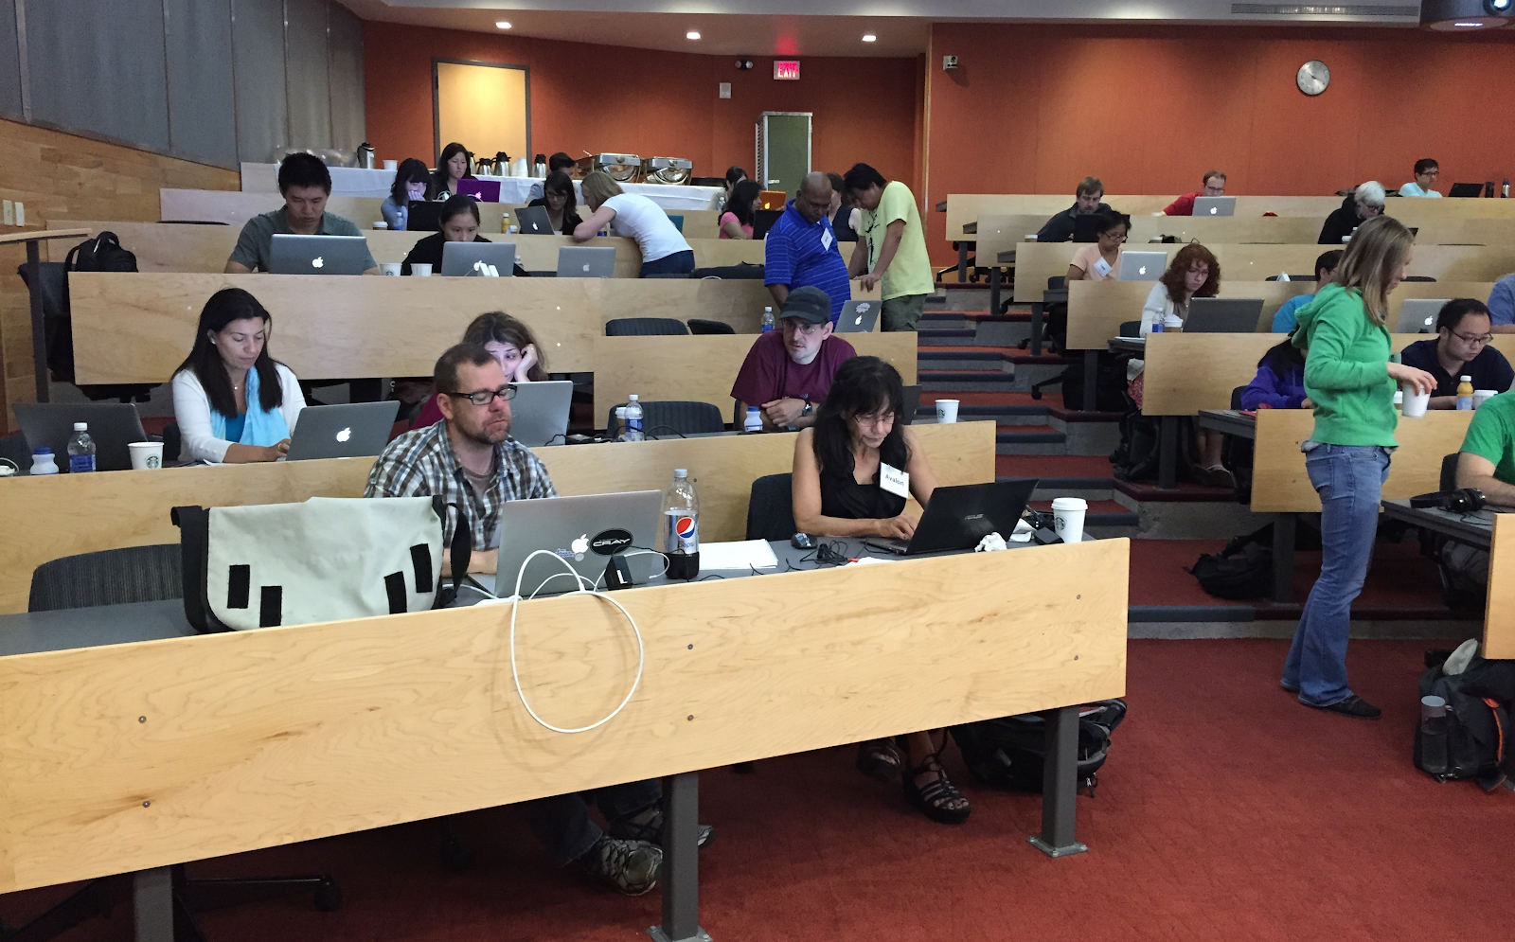
OSG User School
week-long summer education program on HTC and OSG compute execution
targeted for researchers and research computing staff
spring application/review
all materials publicly available
  2019
  virtual pilot in 2020

Slide 28
Entry Points that YOU Control
… like having a cluster where you don’t have to administer the ‘worker’ nodes, and can provide all of the user support.
The institution has primary responsibility for:
  user facilitation
    incl. software portability (OSG modules available), troubleshooting
    leverage support from OSG staff (co-facilitation, etc.)
  administering user authorization
  (some) HTCondor administration on the submit node
  administering/integrating any institutional data storage
Resource sharing not required!

Slide 29
Services Overview

Slide 30

dHTC and OSG Services for Campuses
Build ‘Local’ dHTC Capacity with
Share Local Resources via OSG
Support Your Researchers to Use OSG
  TODAY! (via OSG Connect)
  dHTC and dHTC Facilitation training
  Local submission points into OSG
Support for CC* Proposals
All “FREE” and OPEN, with Facilitation for Campuses

Slide 31
Next Steps
You and Your Researchers Can Use OSG, NOW!
  osgconnect.net > Sign Up
Discuss dHTC Services for Your Campus
  support@opensciencegrid.org
Consulting and Letters of Support for CC* Proposals
  cc-star-proposals@opensciencegrid.org (to OSG leadership, only)

