Slide 1
DAQ and Slow Control Network
G. Lehmann Miotto
Network discussion meeting
Oct 14th, 2020

Slide 2
DAQ and Slow Control Purpose
Slow Control
Control and monitor the detector and its infrastructure
Normally subdivided in
Detector Control System (monitoring and detector operation)
Detector Safety System (keeping the detector safe)
In DUNE it is not clear whether the DDSS is in the scope of slow control!
DAQ
Acquire physics and calibration data
Configure, control and monitor the data acquisition process

Slide 3
DAQ/SC from a network point of view
DSS:
High availability also during abnormal situations, low bandwidth
DAQ:
High throughput, redundant,
ability of applying QoS
DCS:
Can physically piggy bag on DAQ network, some care needed since it covers partially different locations
Regular information exchange
Controlled, limited information exchange

Slide 4
Relation to other networks
?
FNAL
100G
10G
SURF
Technical NW
Experiment NW

Slide 5
DAQ / SC equipment locations
Detector mezzanines
Cryogenic mezzanines
MCR Ross Dry
CO-1: Loss of power in the Ross Dry MCR (even beyond the time covered by UPS) should not cause a loss of communication to the underground DAQ/SC systems, for the purposes of control and monitoring.
CO-2: Loss of power (or cooling failures) in the DAQ barrack of one detector, shall not cause a complete loss of communication to the SC equipment installed on the corresponding detector mezzanine.

Slide 6
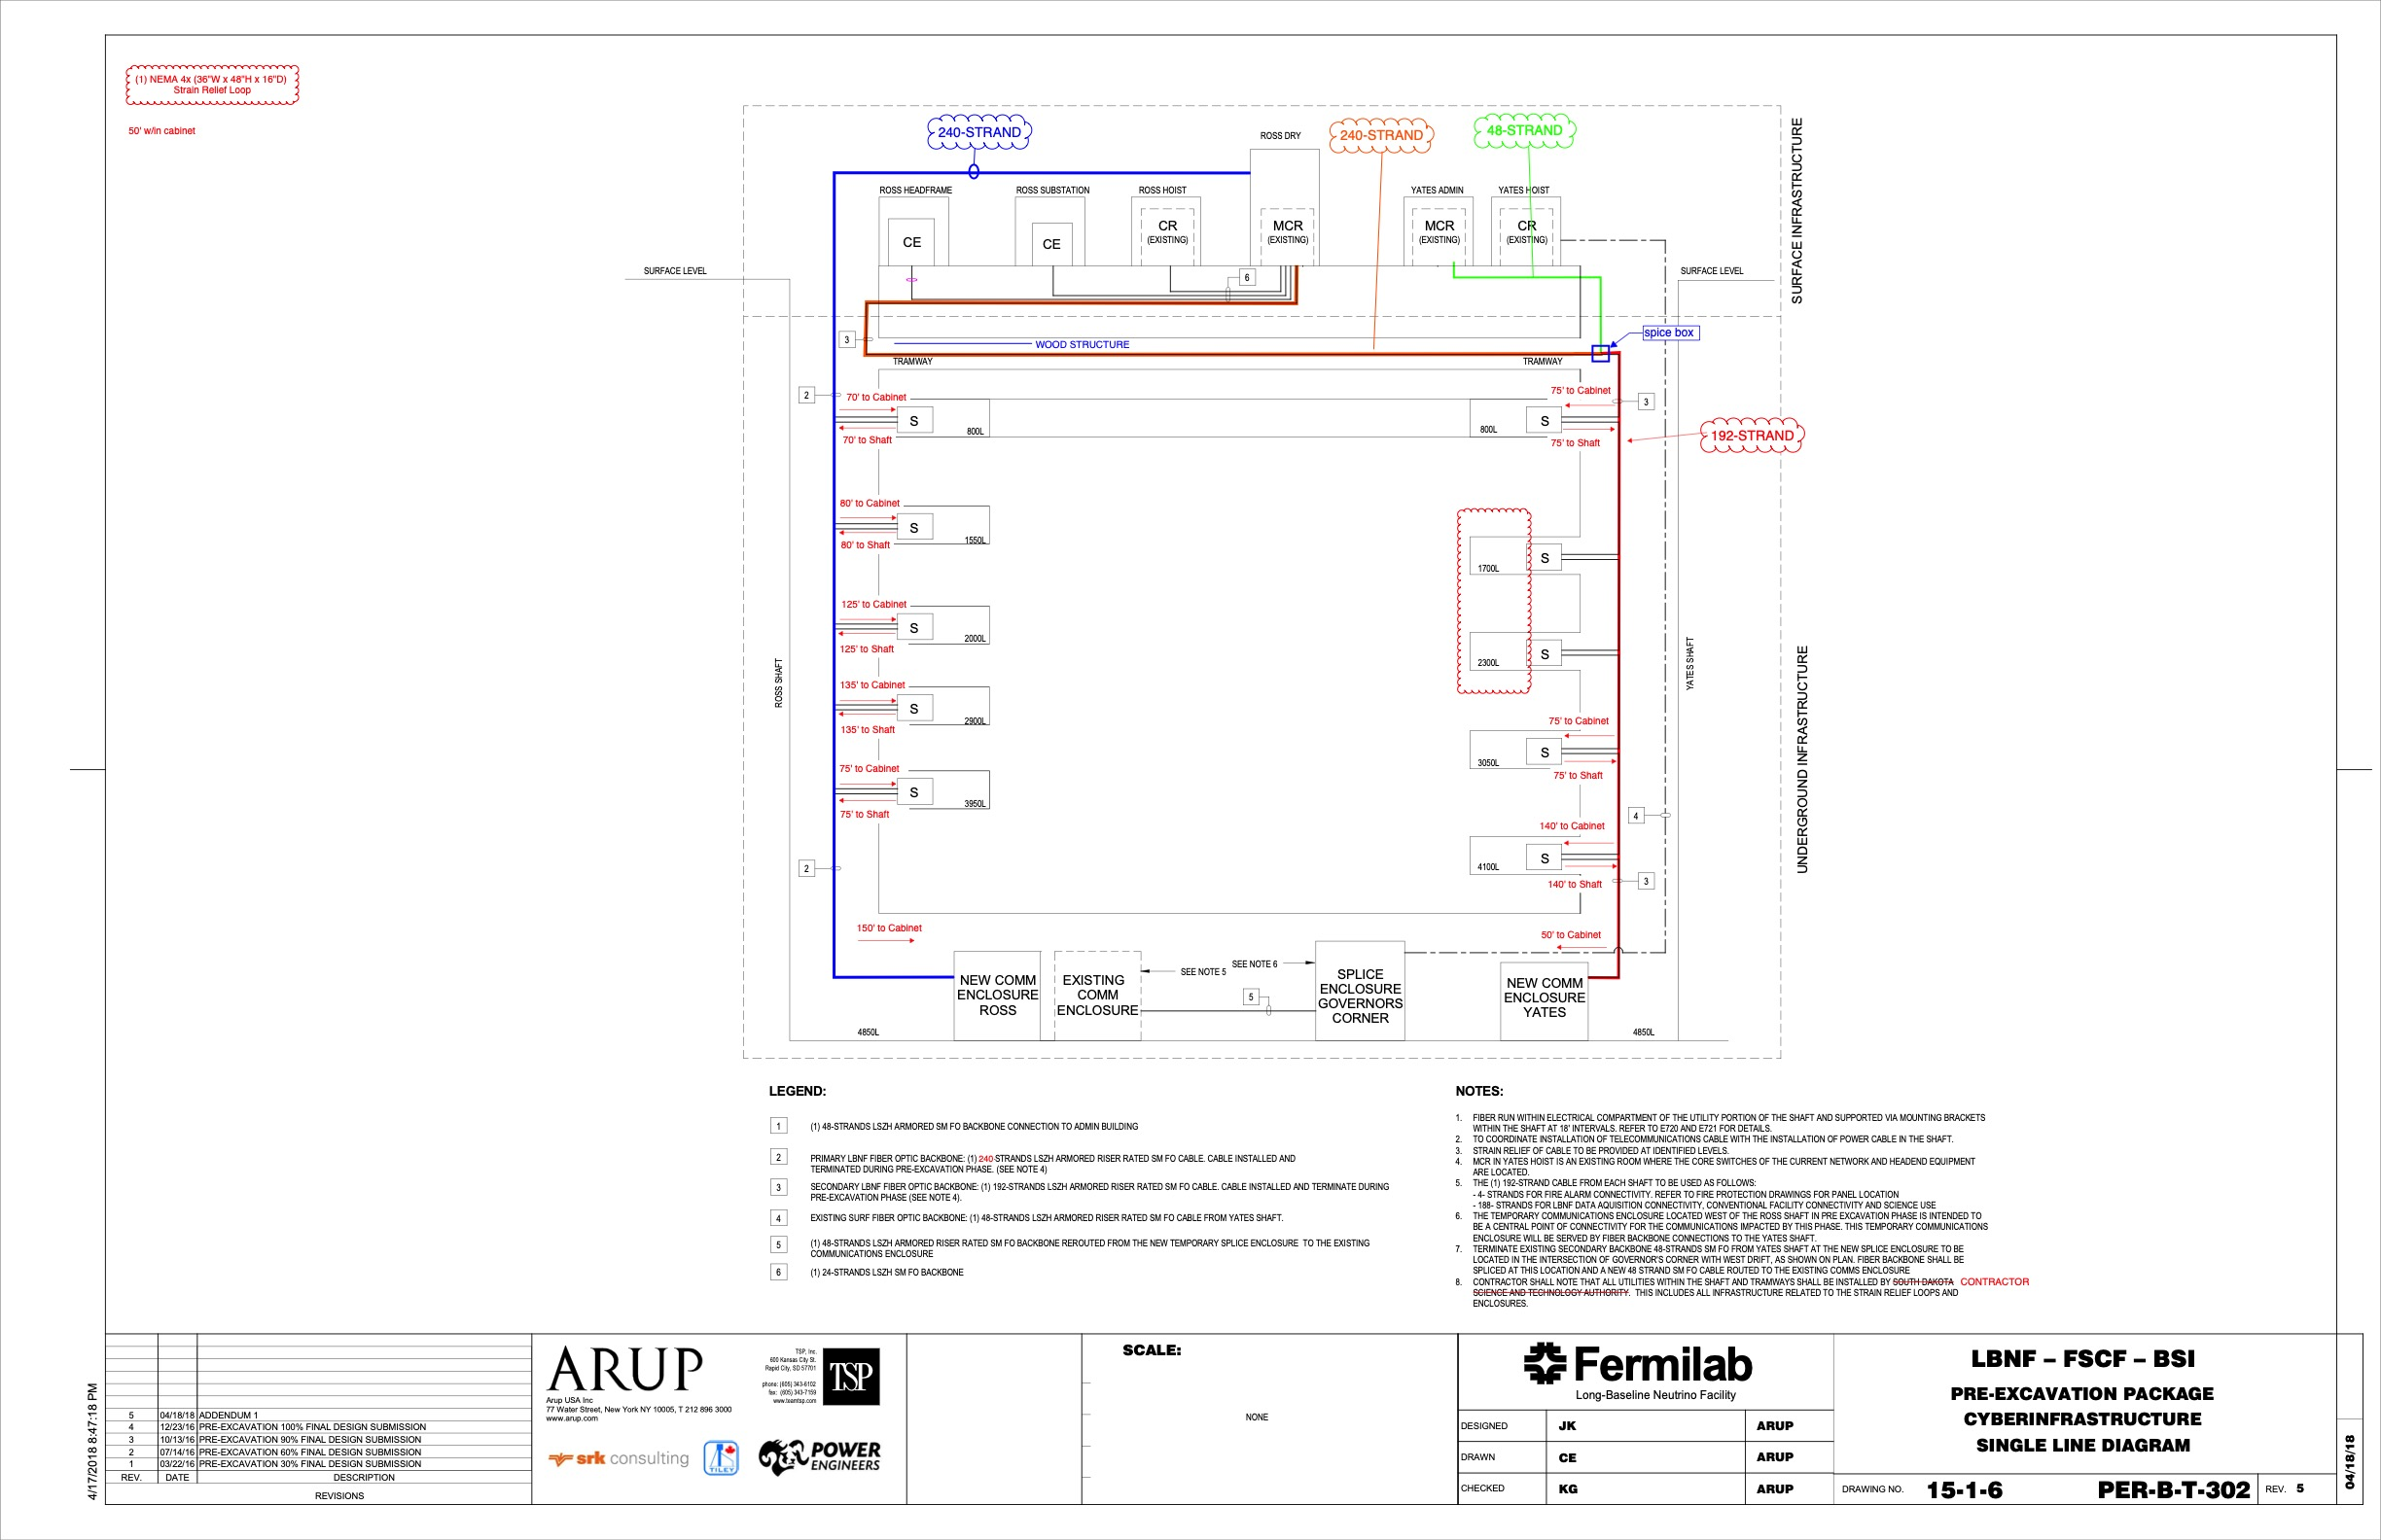
Underground to surface
Fiber paths relevant for DUNE DAQ/SC in blue and red. The green path may be used as a extra backup control path for SC (DDSS), if that path is indeed used by DUNE.

Slide 7
Preliminary layout of equipment in DAQ barrack
Not necessarily here

Slide 8
Preliminary view of equipment in detector mezzanines
To DAQ/SC hubs
To DAQ/SC hubs
?
?
Ctrl-Up
Ctrl-Up
Tech NW
Tech NW
Ctrl SW
…
…
Ctrl SW
…
…
Ctrl SW
…
~70 racks, ~10 (?) Ctrl SW, 1-2 Ctrl-Up

Slide 9
Preliminary view of equipment in MCR det 1+2

Slide 10
For discussion
The DAQ/SC networks are a subset of the overall network needed by DUNE
The DDSS component of SC should probably be joined together with cryogenics, cooling, ventilation, …
The DCS and DAQ can share hardware and have similar uptime requirements (DAQ has additionally a high performance aspect)
How do they fit into the general picture?
Present understanding of financial responsibility for CONSTRUCTION
DAQ/SC consortium : DAQ SW, DAQ/SC hubs, Ctrl-UP, IPMI SW (350k 1st det + 250k 2nd det)
I&I : Ctrl SW (400k for 1st det)
Facility: long fiber runs from MCR to CDR/CUC
DAQ/SC consortium: fiber runs CUC-detector caverns (for DAQ/SC), local patch cords, fiber runs to top of cryostat for WIBs, PDs control and monitoring (300k 1st det)
Individual consortia: fibers + copper cables to detector mezzanines, nw connections inside detector mezzanine racks
??? : Tech network for DDSS (if part of SC)
???: other SURF site NW
EsNET: WAN links

