Slide 1

Cathode R&D Needs
and Status for European HE-/Nuclear Physics projects
SNOWMASS 2021,
Electron Source workshop
February, 16, 2022
Presented by Kurt Aulenbacher
Thanks to:
Boris Militsyn, Walid Kaabi, David Elsner, Joachim Enders, Jennifer Groth, Rong Xiang, Flo Hug
Supported by German Science ministry, BMBF, through project 05K19UMA

Slide 2
Outline
Electron accelerators for nuclear physics in Europe – operating & planned
Photocathode research for such accelerators

Slide 3
Operating/planned European Accelerators with Photoemission sources- Overview
Big research centers: DESY, HZDR, PSI, CERN, Daresbury, INFN many more: e.g., CsTe, and Magnesium photocathodes, also in SRF guns. Also trying to use GaAs in SRF gun at Dresden.
Could be well suited for nuclear/particle physics but – with a few exceptions - only used for applied research.
University based electron accelerators in Germany
–dedicated to nuclear physics: Bonn (ELSA), Darmstadt S-DALINAC, Mainz (MAMI,MESA):
Only Mainz currently operating with spin-polarized source, ongoing basic research at Darmstadt, Bonn not operating photosource, but ready to continue (if needed by hadron physics experiments)
Upcoming machines: See European Strategy for particle physics “Accelerator R&D Roadmap” arxiv_2201.07895: bERLinPRO, MESA, PERLE
PERLE, (later: LheC) plan to use unpolarized electrons, up to 10mA current (ERL!), up 1nC bunch charge may upgrade to polarized, depending o the physics case
Planned projects: ILC, CLIC : polarized

Slide 4
Upcoming European Accelerators
MESA (construction)
bERLinPro
(commissioning)
PERLE
(planning)
MESA is aiming at round the clock operation
for nuclear physics mainly with spin-polarized beam,
arxiv_2201.07895

Slide 5
“spin-polarized”-, i.e. GaAs-related cathode research

Slide 6

“spin-polarized”-cathode research
TU-Darmstadt (TU-D)
Accelence: Joint graduate research center “Physics and technology of energy recovery linacs”
(Darmstadt and Mainz)
NF3 and Lithium Co-deposition studies in cooperation with JLAB/UITF

Slide 7
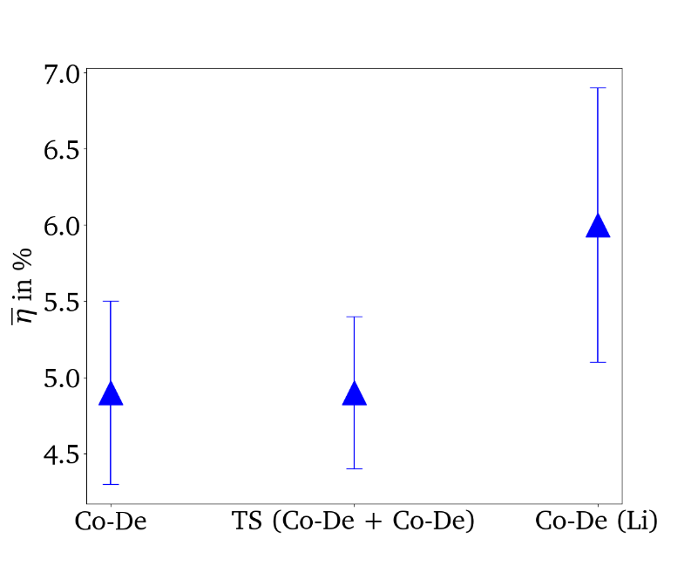
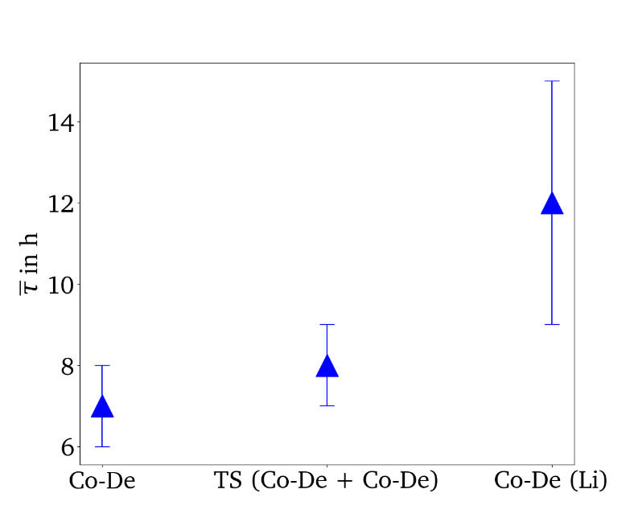
TU-D Studies with NF₃ and Lithium @JLAB/UITF
Quantum efficiency η
Lifetime τ
PhD Thesis Maximilian Herbert

Slide 8
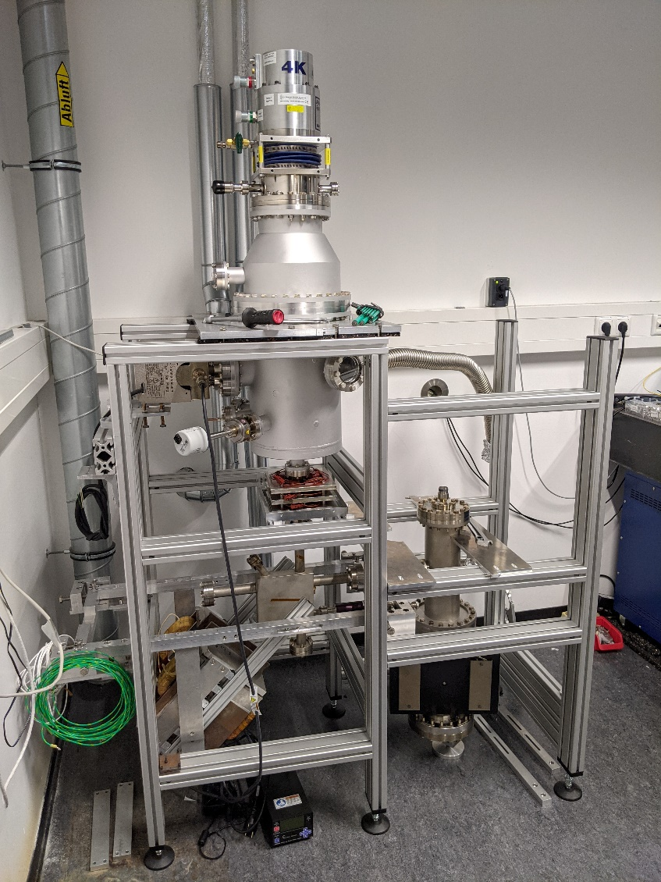
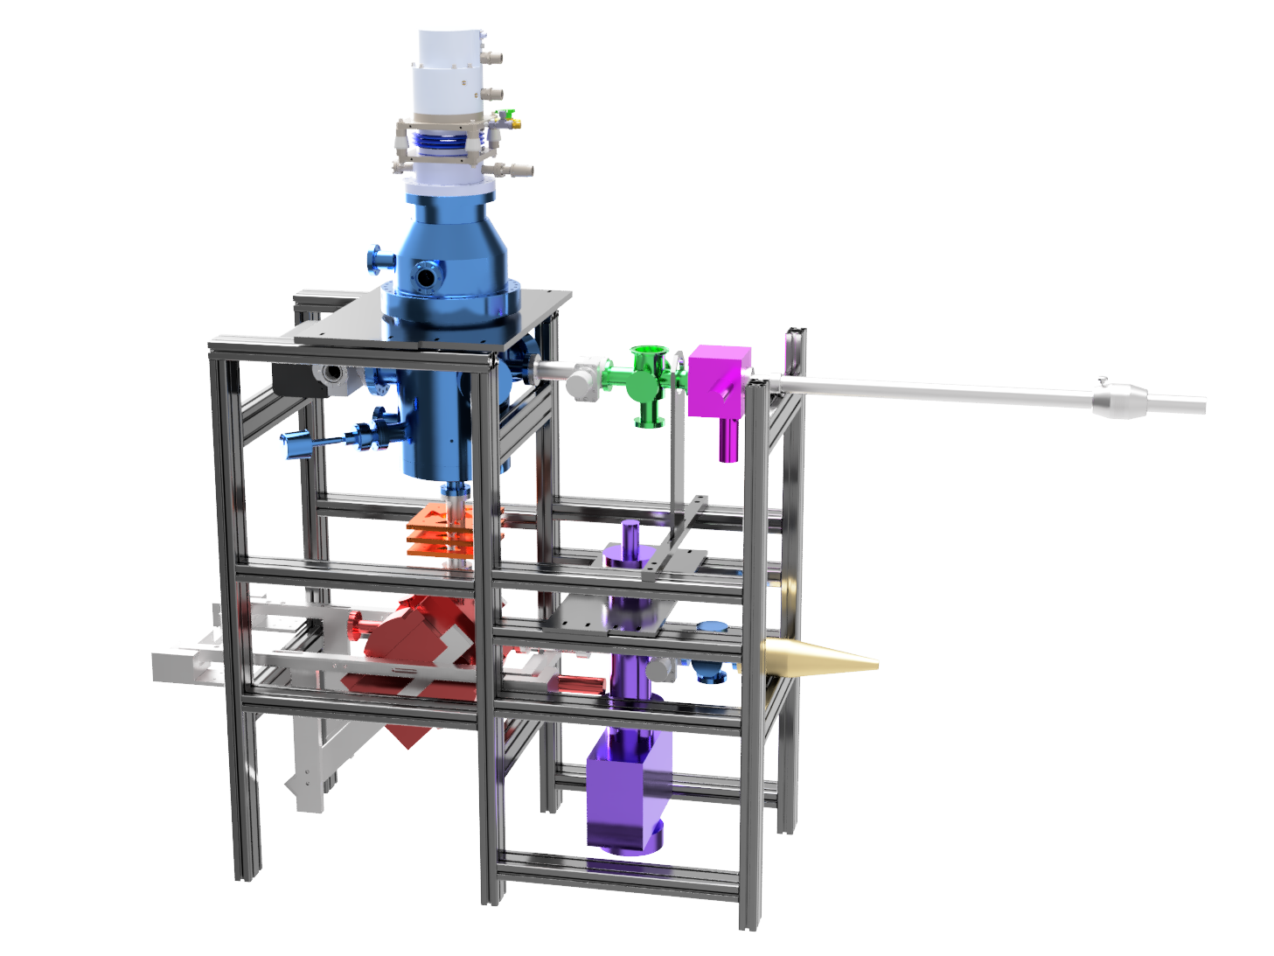
TU-D: Cryosource
PhD thesis Tobias Eggert/TU-Darmstadt
Create 4K environment for (hotter) GaAs- cathode in DC-gun.
source chamber
load chamber
alpha magnet
faraday cup
laser fiber
IGP and NEG pump

Slide 9
MESA (Mainz Energy-recovering Superconducting Accelerator)
- An electron accelerator for nuclear/particle physics at U-Mainz
Picture&lattice layout : D. Simon

Slide 10
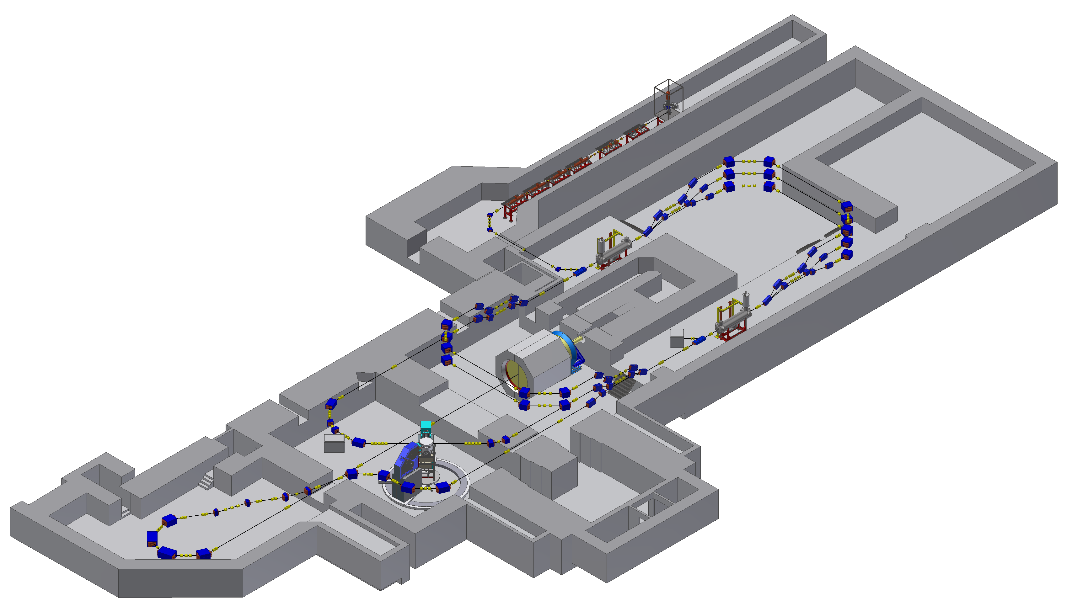
MESA Accelerator Layout
Double sided recirculation design with normal-conducting injector and superconducting main linac
Two different modes of operation:
(1300 MHz CW beam)
- EB-operation (P2/BDX experiment):
polarized beam,
up to 150 µA @ 155 MeV
- ERL-operation (MAGIX experiment):
(un)polarized beam,
up to 1 (10) mA @ 105 MeV
Gun
MELBA
MAMBO
Recirculation arcs 1-3-5
MEEC-1
155 MeV dump
MEEC-2
P2
5 MeV dump
Recirculation arcs 2-4
ERL loop
MAGIX
Ext. beamline
Picture&lattice layout : D. Simon

Slide 11
Uni Mainz : Polarization drift study
Observed drift of beam polarization during measurement
can reach 1%/day, and may depend on photocathode activation ?
Measurements by „conventional“ 3.5 MeV Mott-polarimeter at MAMI

Slide 12
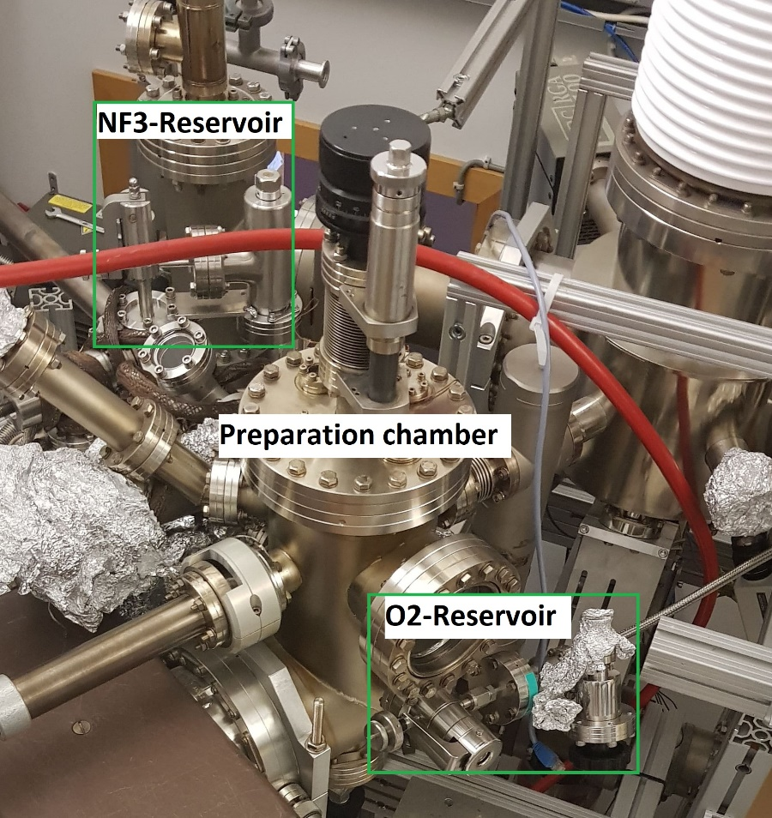
Uni Mainz : Polarization drift study
So far, Oxygen was used
Now, in dedicated test set up, Oxygen and NF3 can be used, e.g. for alternating activations
Test set up has similar source compared to the one operating at MAMI (“PKA2”)
..and is equiped with Spin rotator and Mott polarimeter
Intention-I: Compare drift of polarization under Oxygen and NF₃ activation
Intention- II Compare QE/Lifetime behavior → draw conclusion for MESA operations
PKA2
PhD thesis started – Jennifer Groth

Slide 13
Uni Mainz : Surface Photovoltage (SPV -long pulse)
Near band-gap excitation may provoque surface photvoltage at surface
→ leads to reduced QE because of modified NEA-state

Slide 14
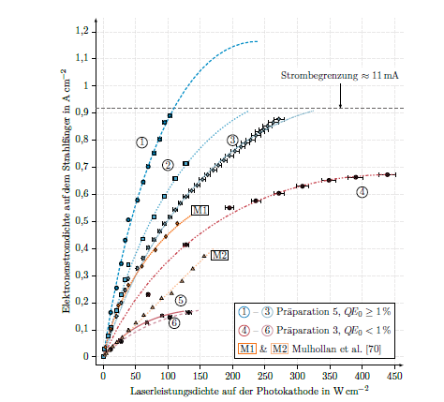
Small „ThErmalized“ source At MAINZ (STEAM)- long pulse SPV
Operation with up to 150keVbeam
and up to 10mA -
Surface photovoltage in NEA GaAs at 10mA leads to Q.E. dependend saturation current density in DC-operation (400mus long pulses, 800nm excitation wavelength )
S Friederich-PhD thesis Mainz, 2019
S. Friederich et al .doi:10.18429/JACoW-IPAC2019-TUPGW028
STEAM (inverted source design,
based on JLAB idea )
installed at test apparatus “MELBA”
December 2021 Commissioning
of STEAM at MESA has started.
Commissioning of injector in 22/23
Beam operations for P2
(150muA average current, P>0.85 )
envisaged for end 2024.
.

Slide 15
Commissioning of STEAM and „MELBA 2.0“ for MESA
Demanding beam dynamics when Spin rotators „ON“
(P2 mode -polarized beam from at STEAM)
OPAL simulations: 0.2 pC bunches with good beam quality (ε_{norm}<1μm) possible → sufficent for P2
1pC bunches possible without Spin manipulation → MESA stage 1, ERL programme
Due to SPV, „green“ excitation preferable (if unpolarized beam desired by experiment)
> 1pC bunches possible with „robust“ source & shorter beamline
→ (unpolarized MESA Injector Source Two, MIST), not funded

Slide 16
Uni Mainz : Surface Photovoltage (shortpulse)
R= I(30ps)/I(0ps)
PhD thesis Nahid Scahill
-self modulation of picosecond pulses at very low QE?
Fits with models based on SPV (inspired by Mulhollan et al.)
Or PEA+thermionic emission

Slide 17
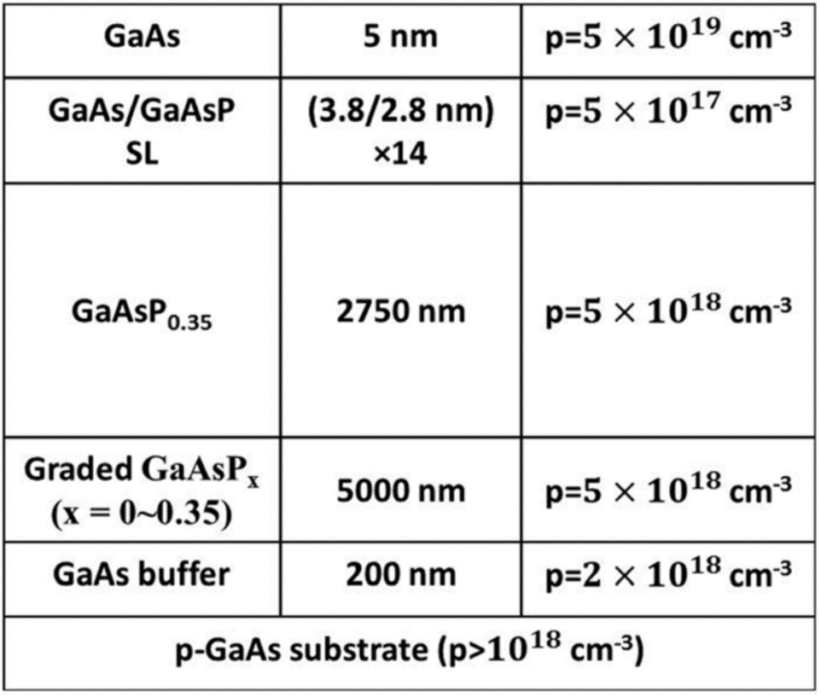

Longitudinal Halo Study at Mainz
Strained Superlattice-cathode
GaAs/GaAsP”Strained Superlattice” :
(T. Maruyama et al. Appl. Physics. Lett. 85,13 (2004) 2640)
Study of pulse response
$$SLAC/SVT−Superlattice$$
Peak width dominated by experimental resolution
As expected, Intensity drops into noise floor after a few picoseconds. Parasitic peaks due to double reflexes? (PhD Thesis Nahid Scahill)

Slide 18
“Polarized” Photocathode acquisition problem
Strained Superlattice-cathode
$$SLAC/SVT−Superlattice$$
Commercial supplier no longer available
Due to absence of large-scale polarized accelerator activity in Europe liited interest in setting up infrastructure
Investigating possible new suppliers and
Help by government “applied” physics institutes (“Fraunhofer)?

Slide 19
Conclusion
Upcoming (Planned/discussed) electron machines in Europe for nuclear/particle (N/P)-physics will need high
average current from (probably) unpolarized photosources
→ large interest in progress but little research activity so far
Progress with unpolarized cathodes may be achieved at other facilities which are not dedicated to N/P-physics
(bERLinPro, DESY,…. ) → relatively easy to transfer results towards N/P-project
“University scale machines” exist and there is high demand for improving conditions, in particular operational lifetime of spin polarized sources
Research in this direction is feasible with university means and will also be used whereever such spin polarized beams are needed.

Slide 20
Thank you

