Slide 1
Microwave Transmission Technique for Measuring E-cloud
Hexuan Wang
Mentor: Charles Thangaraj

Slide 2
Motivation
Sources of Electron Cloud
High intensity proton beams
Secondary emission of electrons
Effects of Electron Cloud
Create a wake field that throws the particles off course
Affect beam intensity
Causing density-dependent phase shift in the radio frequency.

Slide 3
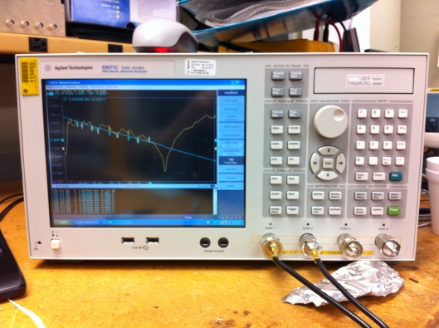
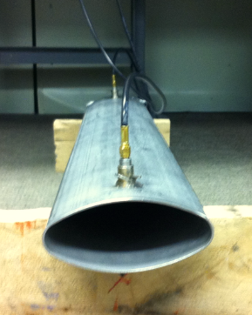
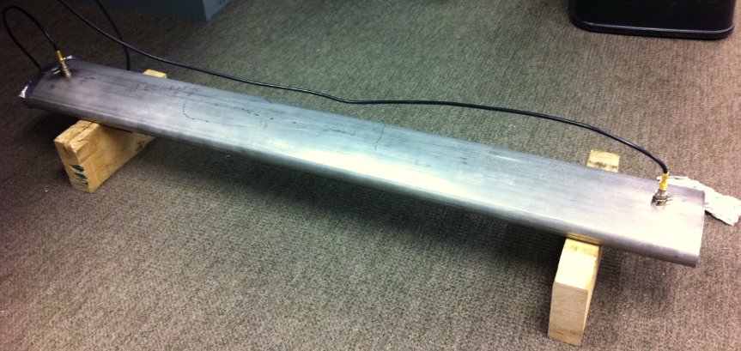
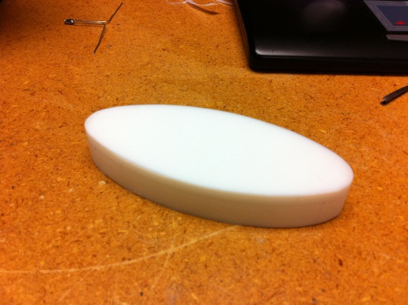
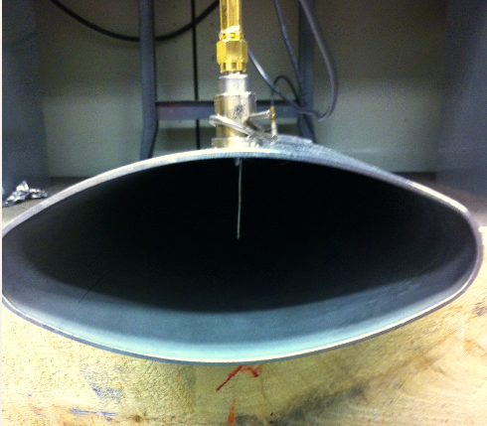
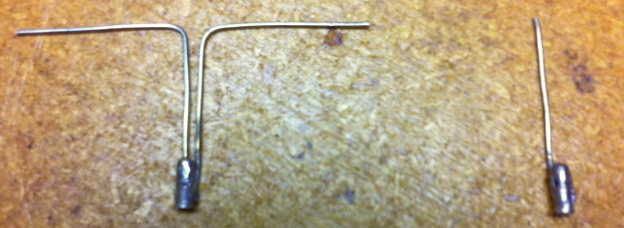
Microwave Reflection Technique
antennas
Electron cloud
Network analyzer
b=2.1’’
L=36inch
a=4.6’’
Dipole Monopole
Dielectric (EC)

Slide 4
Results
Cavity shows resonance.
$f^{2}=\left(\frac{c^{2}}{4l^{2}}\right)n^{2}+{fc}_{}^{2}$
Dielectric induces phase shift and frequency shift.
Bigger phase shift at resonance.
Reflection enhances phase shift.

Slide 5
Future Work
Characterize how phase shift changes as dielectric size changes.
Characterize how the aperture size and orientation affects the transmission properties of the beam pipe and phase shift.

