Slide 1
ROOT I/O in ATLAS
Performance and future needs

Slide 2
Content
How we do stuff
Data
Root versions
Periods
IO performance
D3PD
AOD/ESD
Details on basket optimization
Wish list

Slide 3
How we do stuff
Up to now
ROOT 5.26/00e
Full split, CL 6
2010
Basket size fixed to 2 kB
Automatic basket re-ordering “by event” for all official ESDs and AODs. Physics groups asked to do the same for DPDs.
2011
Basket re-ordering turned off
AutoFlush at 30MB for the largest tree. Other trees with fixed basket sizes.
Test for future (17.0.X)
ROOT 5.28/00
Split 0
Memberwise streaming
AutoFlush at 5/10 events for ESD/AOD
Compression level 4/5 for ESD/AOD

Slide 4
IO performance
Standards
Same machine
Only user
Same core
From local disk
Clean cache

Slide 5
Data used in tests
data11_7TeV.00180664.physics_Egamma.merge.NTUP_PHOTON.f371_m824_p541 (217M)
data11_7TeV.00180664.physics_Egamma.merge.NTUP_JETMET.f371_m824_p515 (1.4G)
data11_7TeV.00180664.physics_Egamma.merge.NTUP_SUSY.f371_m824_p543 (159M)
data11_7TeV.00180664.physics_Egamma.merge.NTUP_EGAMMA.f371_m824_p536 (256M)
data11_7TeV.00180664.physics_Egamma.merge.AOD.f371_m824 (1.9G)
data11_7TeV.00180664.physics_Egamma.recon.ESD.f371 (1.4G)
Run 180664
4.2 pb⁻¹
8.37x10³²
<µ> = 7.40
Written using ROOT 5.26/00e
full split
AutoFlush(30MB) for the largest tree
no reordering
compression level 6

Slide 6
Formats details - current
Format | branches | Event size | Zip |  | mem
 |  |  | level | factor
ESD | *12799 | 1272.34 | 6 | 3.40 | 34.90
AOD | *8231 | 177.73 | 6 | 3.38 | 33.44
DPD - EGAMMA | 2500 | 23.96 | 1 | 2.86 | 41.09
DPD – PHOTON | 1490 | 13.94 | 1 | 2.53 | 28.57
DPD – JETMET | 5671 | 90.12 | 1 | 2.88 | 28.39
DPD - SUSY | 2132 | 14.95 | 1 | 3.65 | 28.61
DPDs have one main tree whose content is completely “flat”
* Improved from 15k and 10k. Could be brought down to 2-3k with 3-4 man-months.

Slide 7
Format details - future
ROOT 5.28/00
Split 0
Memberwise streaming
AutoFlush at 5/10 events for ESD/AOD
Compression level 4/5 for ESD/AOD
Format | branches | Event size [kb] | Zip |  | Mem [MB]
 |  |  | level | factor
ESD | 807* | 1338.63 | 3 | 3.56 | 19.88
AOD | 658* | 191.67 | 3 | 3.48 | 5.52
8%
5%
* Two very large and fast containers remain fuly split for size benefits.

Slide 8
EGAMMA DPD
ROOT 5.26/00e
 |  | Real time[s] | CPU time[s] | HDD reads | Transferred [MB] | HDD time [s]
Egamma std | 100 | 91.7177 | 86.15 | 5068 | 254 | 11
 | 10 | 22.7486 | 17.16 | 5433 | 254 | 11
 | 1 | 14.135 | 8.82 | 4979 | 237 | 10
Egamma 30MB | 100 | 90.0158 | 84.97 | 2399 | 254 | 11
 | 10 | 21.4114 | 16.27 | 2389 | 254 | 11
 | *1 | 14.2702 | 8.86 | 4971 | 237 | 10
Egamma reordered | 100 | 87.4844 | 86.65 | 2015 | 251 | **4
 | 10 | 17.4086 | 16.08 | 2651 | 251 | 4
 | 1 | 12.9264 | 8.67 | 3061 | 236 | 8
TTC decreases number of HDD reads but brings nothing in terms of HDD time
Improves a bit CPU time
*TTC effectively off
**Roughly maximum expected from this disk

Slide 9
EGAMMA DPD
ROOT 5.28/00e
Amazing improvement in CPU time!
Even before we where limited by HDD seeks when skipping events
No so much better that we are getting HDD seeks limited even for 100% of data read
Two jobs or one read/write job brings CPU efficiency down to unacceptable level
Calculations typically done in analysis jobs wont hide disk latency on 4 or 8 core CPU
Needs better file organization
Even reordering files would have sense
 |  | Real time[s] | CPU time[s] | HDD reads | Transferred [MB] | HDD time [s]
Egamma std | 100 | 25.9067 | 21.11 | 5099 | 254 | 10
 | 10 | 16.9521 | 10.59 | 5431 | 254 | 12
 | 1 | 13.5074 | 7.95 | 4973 | 237 | 10
Egamma 30MB | 100 | 25.687 | 20.64 | 2400 | 254 | 11
 | 10 | 14.7156 | 9.53 | 2399 | 254 | 11
 | 1 | 13.9386 | 7.97 | 4986 | 237 | 11
Egamma reordered | 100 | 20.6555 | 20.29 | 2052 | 251 | 3
 | 10 | 11.2896 | 9.64 | 2661 | 251 | 4
 | 1 | 11.003 | 7.79 | 3047 | 236 | 7

Slide 10
ROOT 5.26/00e
The same effect in all DPDs
More pronounced with smaller CPU time
Effect expected to be worse for AOD/ESD due to more and smaller baskets

Slide 11
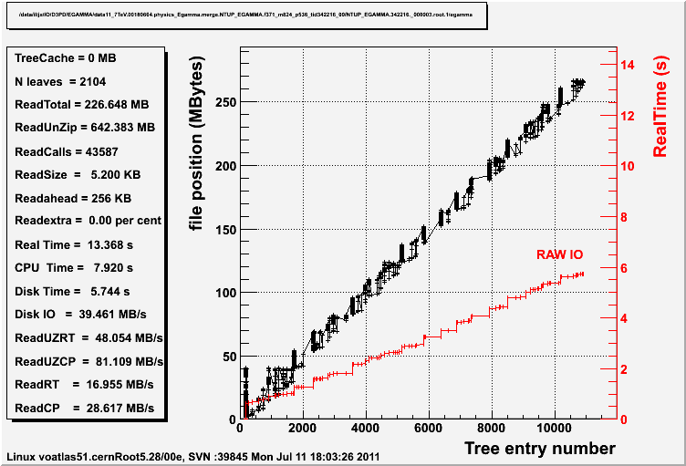
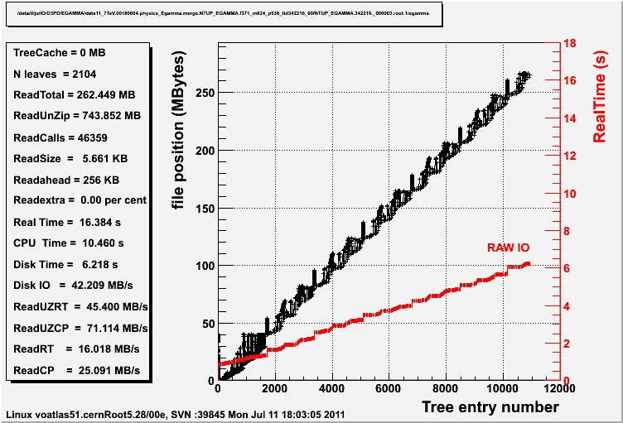
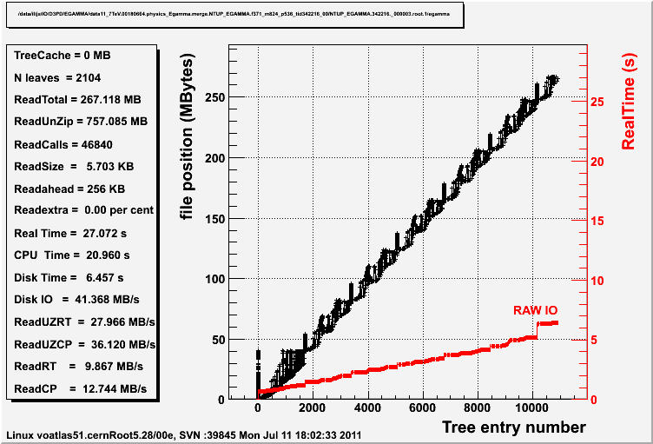
EGAMMA DPD no TTC
Disk time and Disk IO shown here are wrong
1% events
10% events
100% events

Slide 12
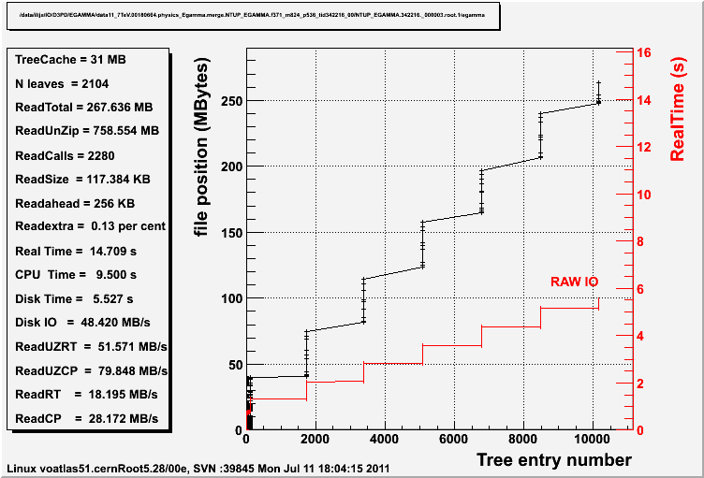
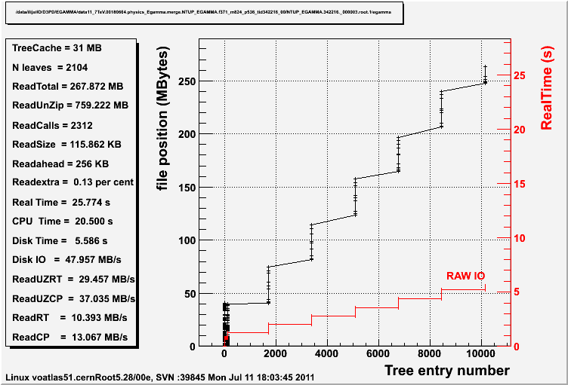
EGAMMA DPD with TTC
1% events
10% events
100% events

Slide 13
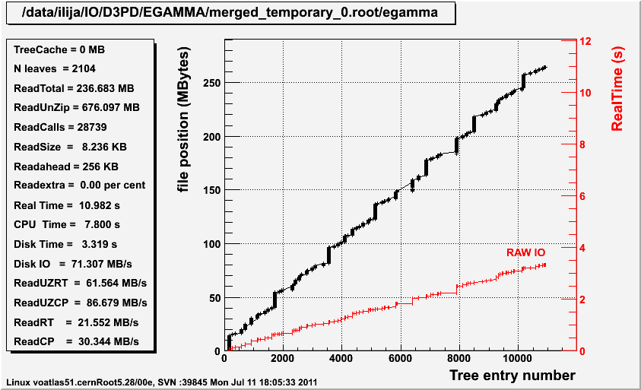
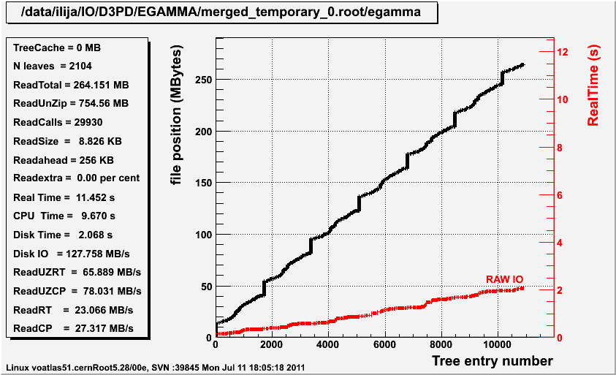
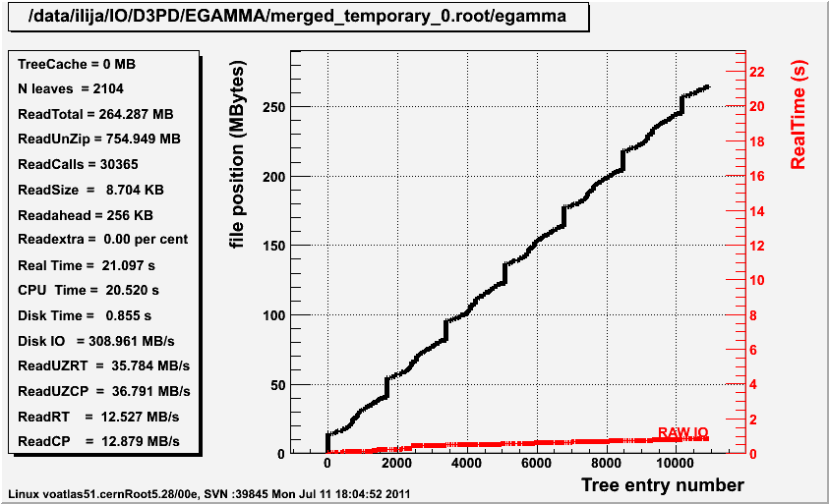
REORDERED no TTC
1% events
10% events
100% events

Slide 14
Athena reading – CPU only
Format | Root read speed [MB/s] | Athena reading
 |  | Full* [MB/s] | Speed [MB/s] | Time [ms]
ESD | 13.05 | 3.41 | 5.93 | 192.45
ESD 17.0.1 | 19.71 | 3.85 | 7.27 | 161.00
AOD | 4.57 | 2.85 | 3.15 | 43.00
AOD 17.0.1 | 10.32 | 4.91 | 6.42 | 25.86
Two effects folded
Improvements in TP converters
New ROOT version
* Includes time to recreate certain objects (ie. CaloTowers)

Slide 15
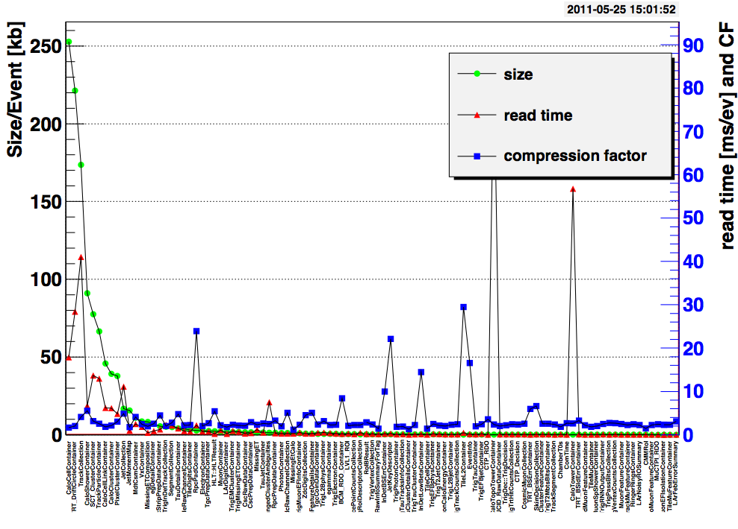
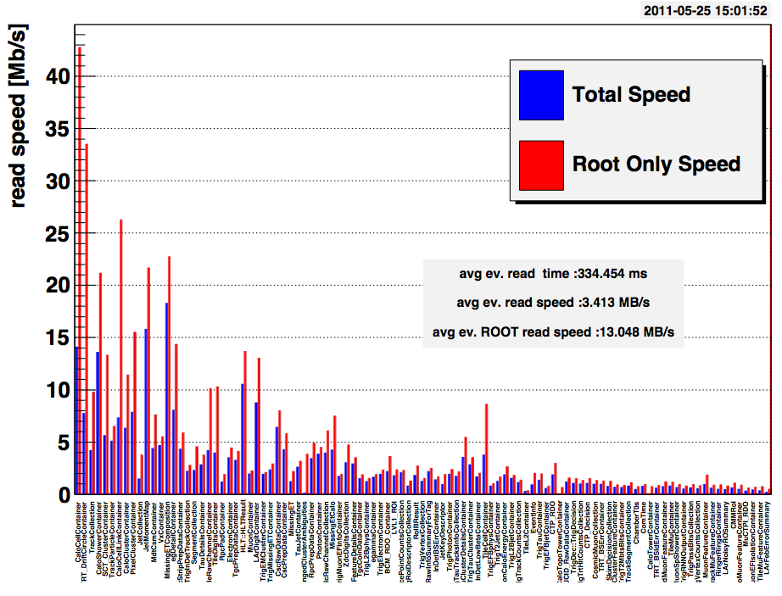
ESD

Slide 16
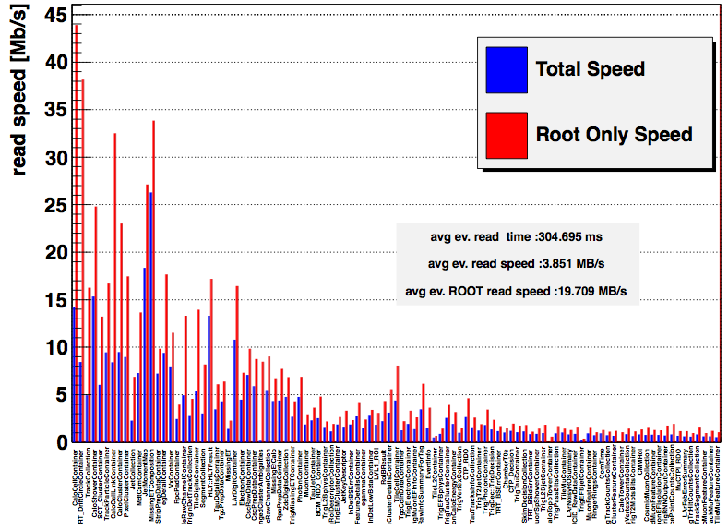
ESD new

Slide 17
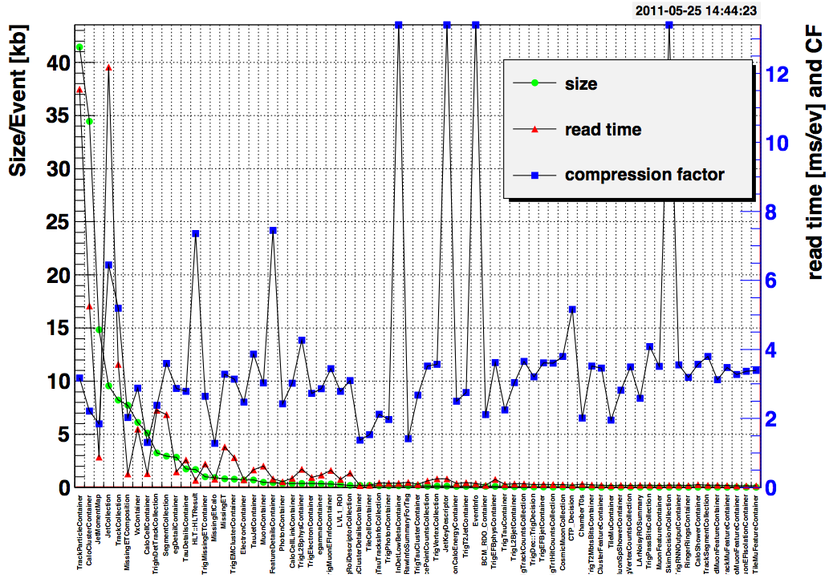
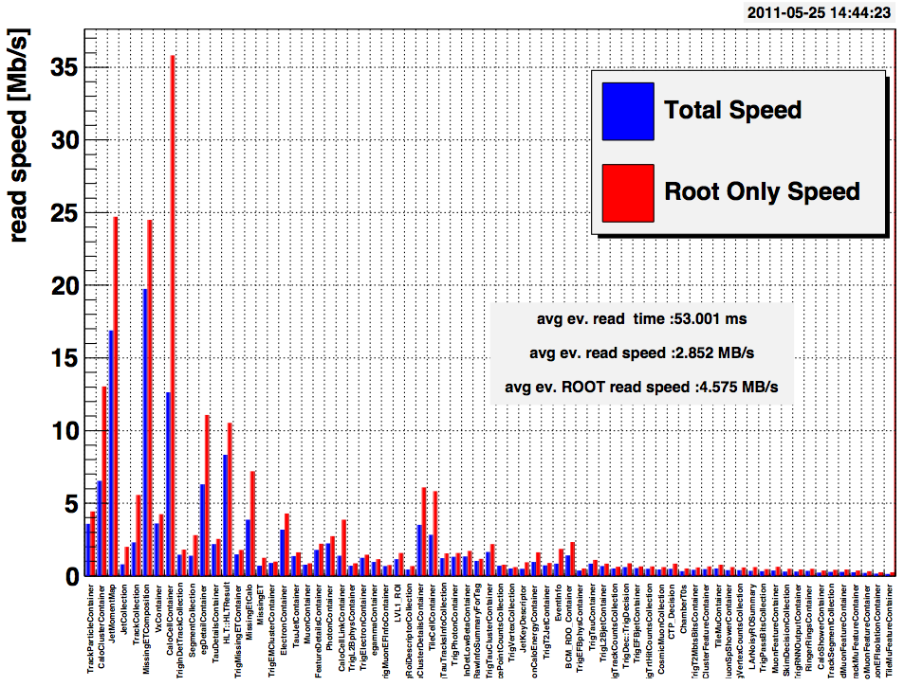
AOD

Slide 18
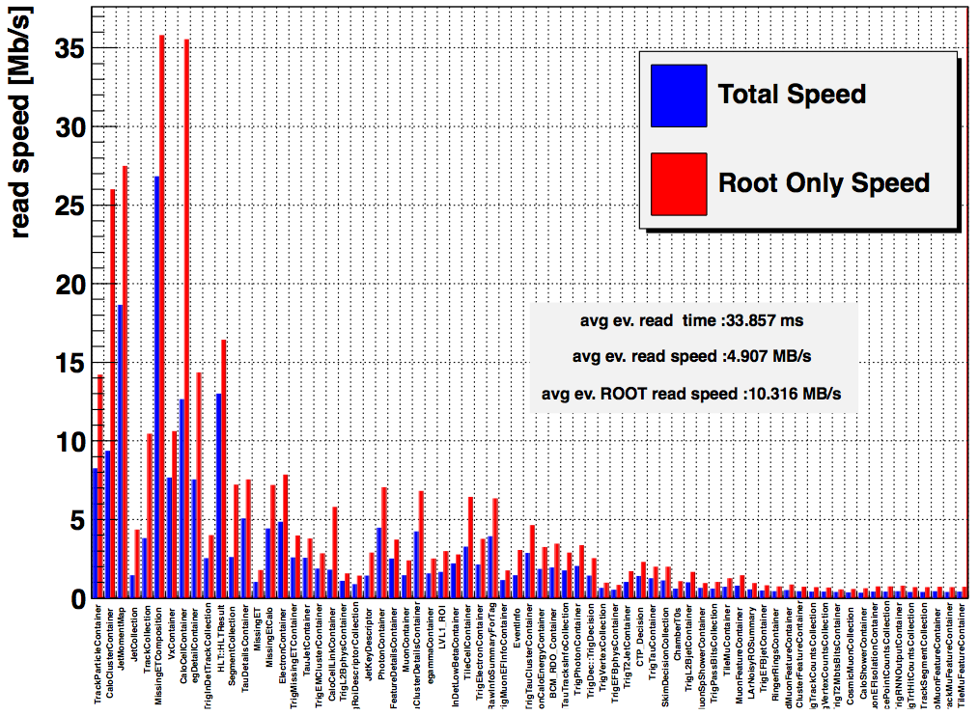
AOD new

Slide 19
Wish list
Find why AutoFlush and TTC don’t reduce HDD reads/time sufficiently
Rewritten basket optimization function
Have a global switch for basket optimization
ATLAS has been caught by inadvertent basket optimization, when TTrees, which should not be optimized and not take 30 MB of memory, reach 30MB and their memory footprint increases. It's harder to manually switch AF fro almost all TTrees OFF than switching in ON for a few TTrees.
Maybe it would be helpful to make bmin/bmax configurable.
Make minimal compression (hardcoded to '1’ configurable to allow switching OFF branch compression if gains are too small.
No unreasonable basket sizes (see backup slides)
A new tool to merge, re-order, re-optimize files
Or just add this functionality to hadd
TTC on reading multiple TTrees
Parallel read/write
Parallel unzip
Regular ROOT - experiments meetings. Specially at new releases, informing us on implications of updates/changes.

Slide 20
Backup

Slide 21
Reminder
Baskets are written to file as soon as they get full
That makes parts of the same event scattered over the file
In 2010 we were re-writing the files with the baskets reordered.
In 2011 we relied on ROOT AutoFlush mechanism
baskets
events
std
doubles
floats
file
AutoFlush – after first n events to write are collected, baskets are resized in order to have the same number of baskets per branch. In that way all the branches should be “synchronized”.

Slide 22
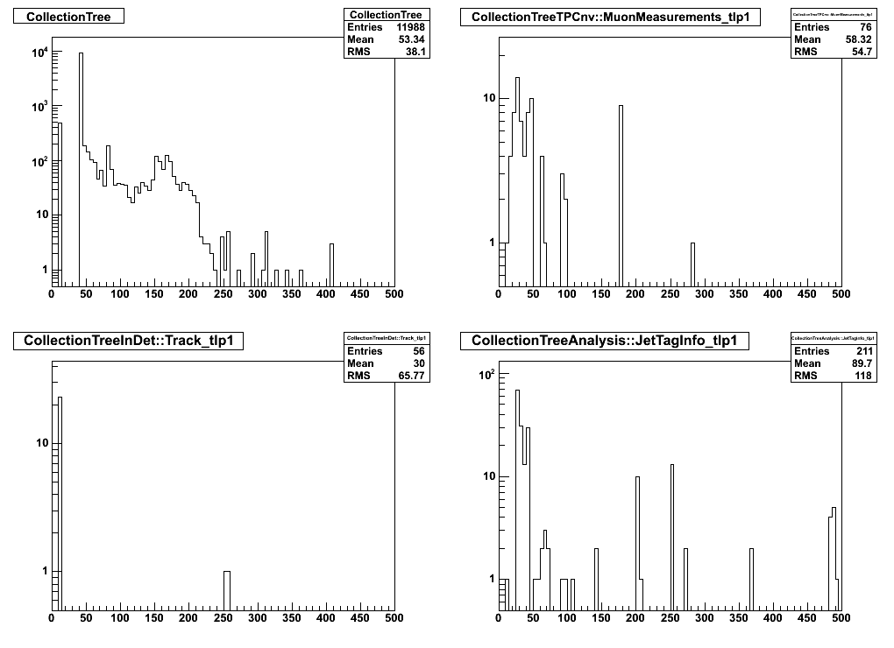
ESD
Baskets per branch
Baskets per branch
No “synchronization” effect observed!

Slide 23
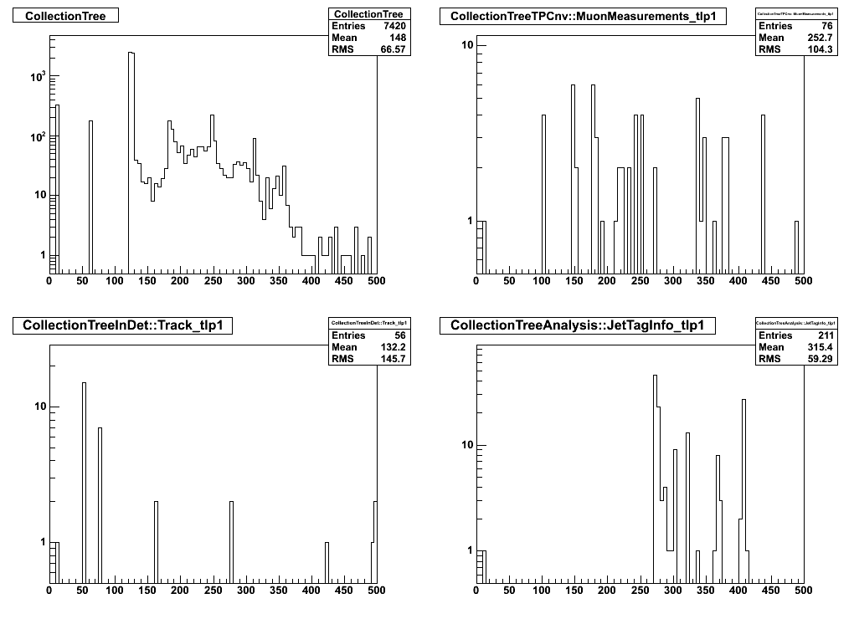
AOD
Some synchronization ?

Slide 24
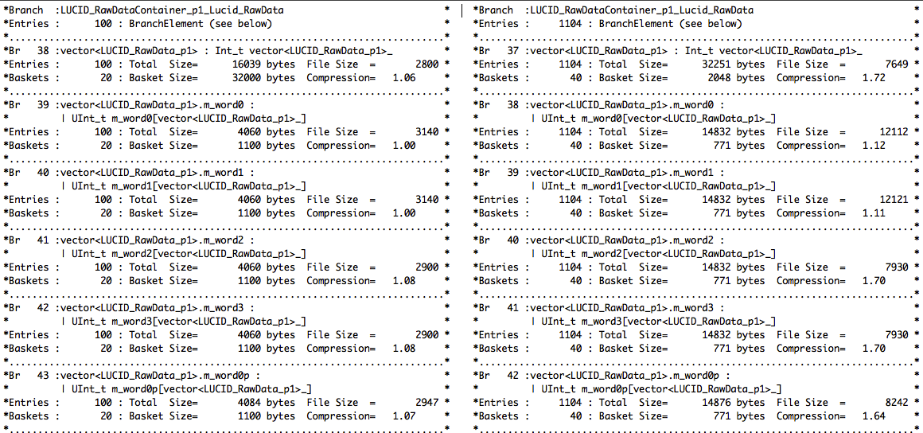
In print
Looking at the same object in two ESD files
original one 1105 events
first 100 events extracted
All the same settings
20 baskets for something needing 1? CF incorrect?
Again wrong but less obvious.

Slide 25
Table shown graphically on slide 10
 |  | Real time[s] | CPU time[s] | HDD reads | Transferred [MB] | HDD time [s]
Egamma | 100 | 93.32 | 87.67 | 5060 | 254 | 11
 | 10 | 22.46 | 17.06 | 5428 | 254 | 11
 | 1 | 14.31 | 8.74 | 4987 | 237 | 10
JetMEt | 100 | 193.61 | 163.34 | 31354 | 1378 | 63
 | 10 | 100.31 | 62.37 | 37579 | 1370 | 72
 | 1 | 65.15 | 34.52 | 26309 | 922 | 57
Susy | 100 | 19.86 | 17.08 | 3149 | 157 | 5
 | 10 | 11.32 | 7.74 | 3532 | 157 | 6
 | 1 | 10.05 | 6.25 | 3687 | 156 | 6
Photon | 100 | 17.52 | 14.55 | 3613 | 216 | 6
 | 10 | 11.37 | 7.81 | 3705 | 216 | 7
 | 1 | 10.34 | 6.93 | 3770 | 216 | 7

Slide 26
JETMET D3PD
 |  | Real time[s] | CPU time[s] | HDD reads | Transferred [MB] | HDD time [s]
JETMET std | 100 | 187.37 | 159.08 | 31120 | 1377 | 60
 | 10 | 100.275 | 62.75 | 37581 | 1370 | 72
 | 1 | 62.0891 | 34.85 | 26293 | 922 | 52
JETMET 30MB | 100 | 182.456 | 155.52 | 11905 | 1377 | 60
 | 10 | 81.1254 | 54.38 | 11915 | 1377 | 60
 | 1 | 64.1876 | 35.32 | 26325 | 922 | 55
JETMET reordered | 100 | 155.516 | 152.38 | 10154 | 1295 | 23
 | 10 | 68.8036 | 54.3 | 19928 | 1288 | 34
 | 1 | 50.0002 | 32.31 | 16701 | 906 | 35

