Slide 1
DUNE Surface to Underground Fiber Testing – Review of 10% testing doc
T. Shaw
22OCT2020

Slide 2
Fiber Status
Suface (Surface MCR) to Underground (Communication Enclosures) Fibers have all been run.
Everything is cut, terminated, and tested.
100% of the fibers were tested. The report we have in hand includes the portion (10%) of the testing that the commissioning agent (Questions & Solutions Engineering) witnessed.
Information on the rest of fibers is available – we need to download from contractor site.

Slide 3
Test terminology
The terminology in report is how they have identified the cables. The label is actually “MCR TO ROSS 4850 ROLL UP 3-6” (for example). In this example the cable label is read as “From (MCR) to (ROSS 4850 ROLL UP), tube (3) strand (6)”. The room on the 4850 level near the Ross shaft (where the termination cabinet for the fiber in the Ross shaft is located) is nick-named the Roll Up Door room because access to the room is through a garage type coiling door. There is no hinged walk-through door. The “X-X” is the fiber tube # - fiber strand #. For a 240 strand fiber there are 20 tubes each containing 12 strands. A 192 strand fiber will also have 20 tubes but 4 of them will be empty.

Slide 4
Cables terminated into LC connectors
All fibers are terminated in cassette-type patch panels. The MCR in the Ross Dry has patch panels mounted on a free standing 19” rack. The cables were left long enough so that they would reach into the future MCR room.
The cable that runs down the Ross shaft is terminated in the same cassette-type patch panels located in a locked communication enclosure mounted inside the 4850 Roll Up Door room. The fiber cable between the Ross MCR and the 4850 Yates is spliced in a utility type waterproof splice enclosure in the Yates Tramway near the top of the Yates shaft. 48 strands break out from here and go to a rack mounted cassette-type termination patch panel in the Yates admin building server room. The remaining 192 strands go down the Yates shaft and terminate in cassette-type patch panels located in a locked communication enclosure in a small room behind the Yates shaft on the 4850.

Slide 5
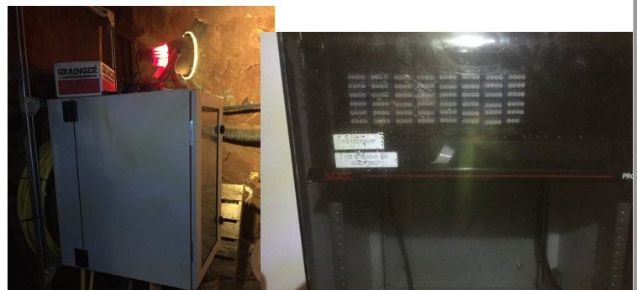
Picture at base of Yates

Slide 7
Fiber Measurements
Losses we were advised to expect in March
Info from SURF: Worst fiber (page 19) had a 2.59 dB Loss at 1310 nm, 1.75 dB at 1550nm. No others exceeded 2. All well within limits.

Slide 8
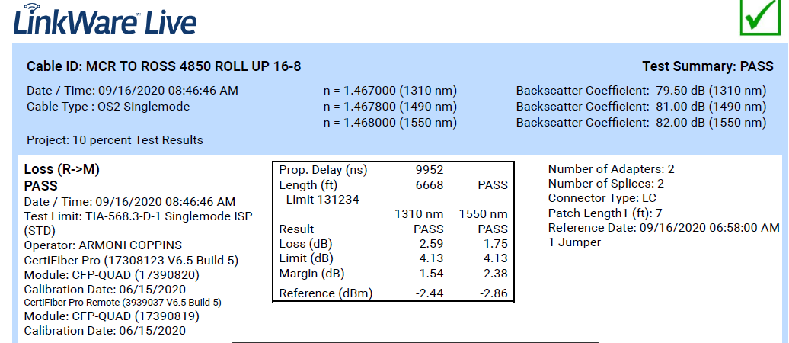
Fiber with worst loss

Slide 9
