Slide 1
Wire-Cell PPS Status
Haiwang Yu for WC-PPS team
HEP-CCE All-Hands Meeting
November 4-6, 2020
Notes:
Hello, I am Haiwang from BNL. I recently joined 𝜈e-cc tagging effort in the WireCell team here.

Slide 2
Outline
Introduction to Wire-Cell (WC)
Algorithms
Framework
WC and PPS
A specific WC sub-package for PPS
Kokkos porting progress
container
building system
kernel
scatter adding
FFT
WC PPS year 1 summary and plan

Slide 3
Wire-Cell Toolkit (WCT)
Wire-Cell Toolkit (WCT) is a software package initialized for Liquid Argon Time Projection Chamber (LArTPC)
Supports LArTPC simulation, signal processing, reconstruction and visualization.
Follows data-flow programming paradigm
Written largely in C++17 standard
WCT includes central elements for DUNE data analysis, such as signal and noise simulation, noise filtering and signal processing
can be interfaced to LArSoft - a widely used software framework for LArTPC
currently deployed in production jobs for MicroBooNE and ProtoDUNE
Some algorithms are suitable for GPU acceleration
Modular design; can port different modules relatively independently
Partial CUDA ports exist for two modules: sigproc (signal processing), gen (simulation)
proof-of-concept, not all the components are ported
gen module is a hot spot in many tasks - current target for PPS exploration.

Slide 4
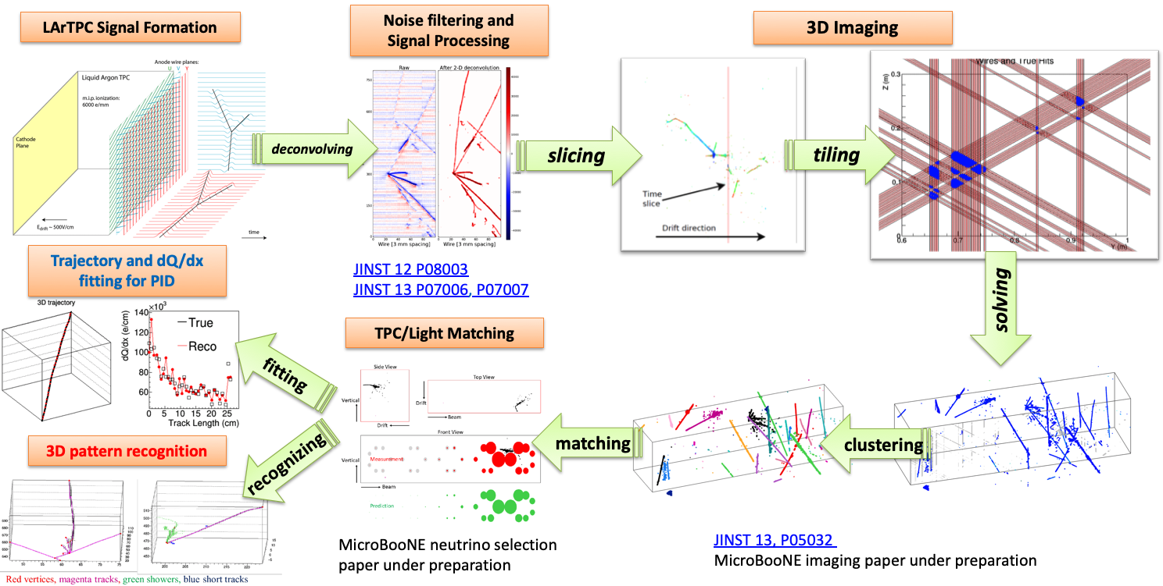
Algorithms in Wire-Cell

Slide 5
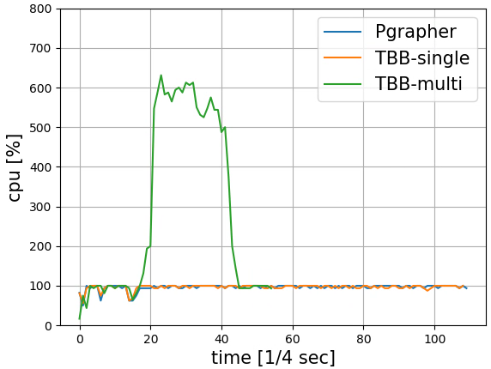
WCT data-flow programing
CPU usage for executing the graph below
Wire-Cell Toolkit (WCT) follows data-flow programing paradigm
modular design
testbed for task-level parallelization + accelerators
A WC graph for signal processing of 6 APA’s

Slide 6
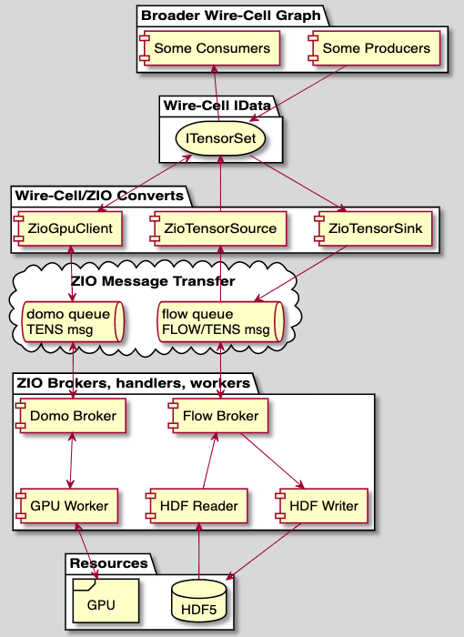
WCT + ZeroMQ based distributed computing
Brett: ZIO design
https://brettviren.github.io/zio/whytos.html
ZIO: ZeroMQ based distributed computing framework developed by Brett.
WCT has interface to use ZIO to realize distributed computing
Testbed for distributed computing + accelerators

Slide 7
Benefit to DUNE and other LArTPC related experiments
Example computational cost w/o GPU acceleration:
Cosmic rays ⟶ Geant4 simulation ⟶ Detector response simulation (WC)
GPU accelerators could greatly speed up the whole process.
Platform: I9-9900K, 32 GB memory, Nvidia GTX 2080 Ti 11GB, Samsung 970 500GB NVMe SSD
Sample: 500 APA Planes using cosmic generator
 | Unit Time | Total Time
Generator | 2 sec/event (6 APA) | 0.3 hour/500 events (3000 APA)
G4 | 23 sec/event (6 APA) | 3.2 hour/500 events (3000 APA)
Detector response | 68 sec/APA | 9.4 hour/500 APA
*APA: Anode Plane Assembly

Slide 8
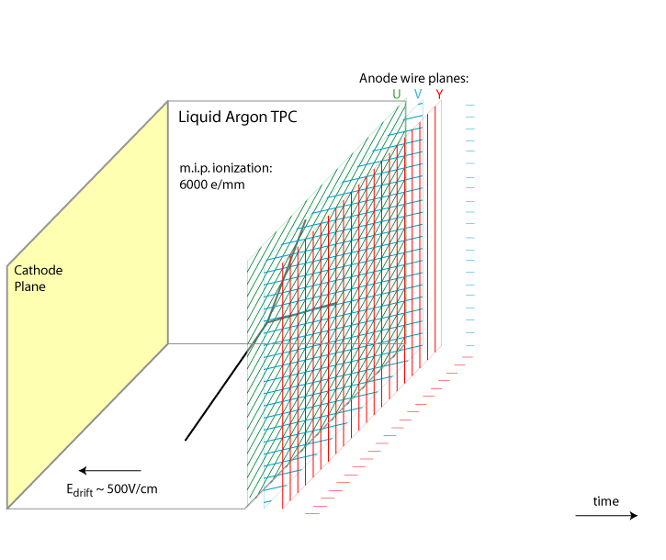
The simulation module in WCT, wire-cell-gen
Main steps of detector response simulation
electron cloud (energy deposition, edep) diffusion simulation
set of scalers ⟶ set of 2D matrices (patch, 20 × 20)
add up all patches to a large grid (larger 2D matrix, 10k × 10k)
grid ⟶ FFT ⟶ × detector response ⟶ iFFT ⟶ result
Signal formation in LArTPC
https://lar.bnl.gov/wire-cell/
Computational time breakdown (in seconds, CPU serial)
ported to GPUs w/ CUDA

Slide 9
wire-cell-gen Kokkos porting plan/progress
Infrastructure
container
building system
Core algorithms porting:
kernel porting/development
portable random number generator
scatter adding
FFT - vendor libraries
Code refactoring
maximize concurrency for better acceleration efficiency
Full benchmark
task-level ST/MT + accelerator
ZIO + accelerator

Slide 10
Development using containers – Kyle Knoepfel
Wirecell can be used either standalone or as library to LArSoft.
For DUNE, we use LArSoft’s art framework module to pass data to the WCT components.
The LArSoft + WCT computing environment is provided via a Docker image, which also includes two Kokkos installations:
https://hub.docker.com/repository/docker/hepcce2/larwirekokkos
To run on Cori, the Docker image is converted to a Shifter image.
A Shifter container is started, which sets up the appropriate software.
Users may select which kind of Kokkos backend they would like to use by invoking enable_kokkos_omp or enable_kokkos_cuda
Code is compiled with C++17, using GCC 8.2 and CUDA 11 (nvcc/nvcc_wrapper)

Slide 11
Building WC against Kokkos with multiple backends
Using Kokkos with different backends needs different compilers:
Kokkos-CUDA needs nvcc
Kokkos-OMP can use gcc
Current strategy:
give source code using Kokkos a customized extension “.kokkos”
inspired by “.cu” for CUDA
then setup compiling tasks based on external waf-options
currently default is using gcc
when “cuda” is found in “kokkos-options”, use “kokkos_cuda” compiling task with nvcc
waf based build system update
https://github.com/WireCell/waf-tools/pull/9
Corresponding source code update
https://github.com/WireCell/wire-cell-gen-kokkos/pull/3

Slide 12
Typical event computing time breakdown
get_charge_vec: 73.0
set_sampling: 63.8
CPU
ImpactTransform: 100.0
to global grid: 9.2
convolution: 27.0
convolution: 27.0
get_charge_vec: 31.3
set_sampling: 20.2
CUDA
ImpactTransform: 59.2
to global grid: 11.1
convolution: 27.9
convolution: 27.9
CUDA version only has set_sampling running on the GPU
to_global_grid needs reduction.
convolution needs FFT.
Port the existing CUDA kernel to Kokkos; need portable RNGs in Kokkos (default is uniform RNGs)
Kokkos::atomic_add for scatter reduction
Kokkos doesn’t provide a wrapper for different vendor FFT; communicated the need to the Kokkos team; being investigated.

Slide 13
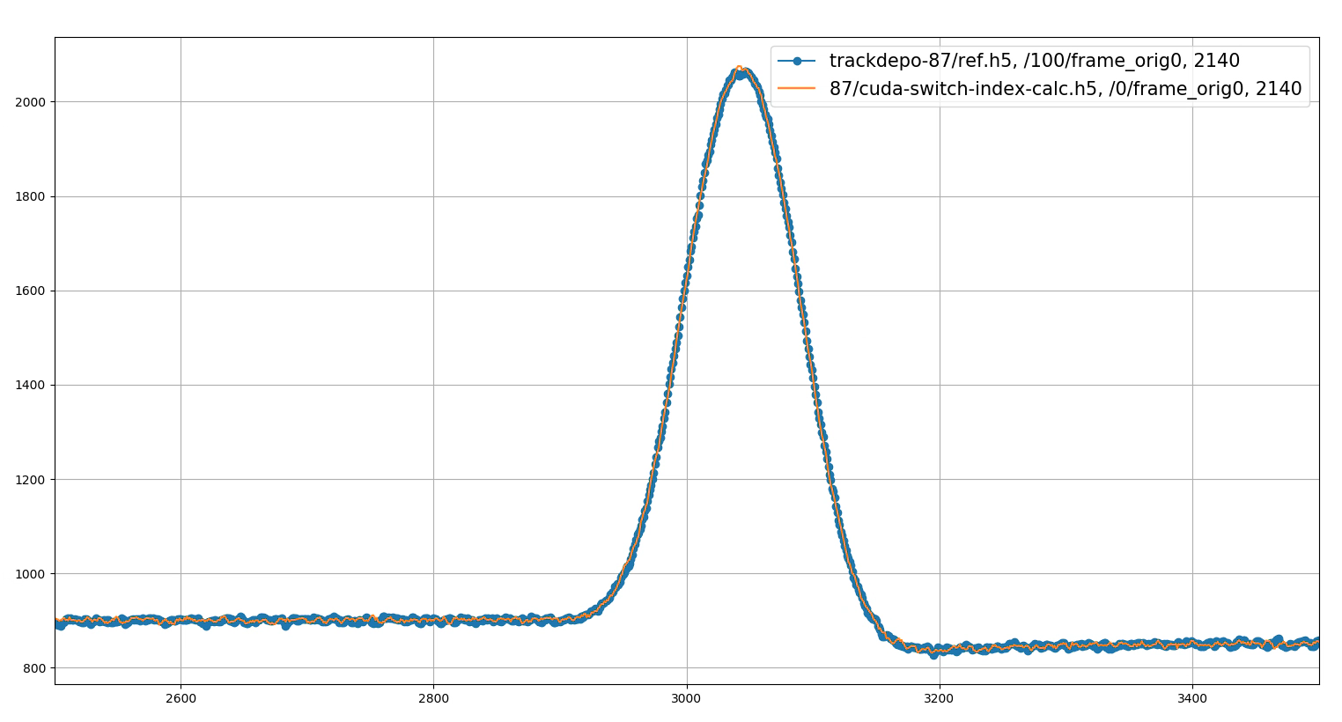
kernel: set_sampling - CUDA version – Kwang Min Yu
electron cloud diffusion simulation
electron cloud diffusion simulation
gaussian smear + binomial fluctuation
energy deposition ⟶ initial electron cloud
1 edep ⟶ a patch sampled with 15 × 30 resolution
(t0, x0)
drift
Validation and initial test
CUDA set_sampling validation against original single-threaded CPU version
After a bug fix, CUDA version agrees well with the CPU version
~ 3× speed up CUDA/CPU on my platform (i9 9900K, NVIDIA RTX2080Ti)
CUDA version vs. CPU version

Slide 14
Kokkos random number generator for “set_sample” kernel porting – Kwang Min Yu
“set_sampling” CUDA version uses curand to generate normal distribution RNGs
Kokkos has only implemented uniform RNGs
can transform to normal dist RNGs with Box-Muller transformation (more efficient on GPUs)
for (int k = 0; k < samples; k++) {
double u1 = rand_gen1.urand64(range_min, range_max1) / range_max1;
double u2 = rand_gen2.urand64(range_min, range_max2) / range_max2;
normals(i * samples + k) = sqrt(-2*log(u1)) * cos(2*PI*u2);
normals(i * samples + k + 1) = sqrt(-2*log(u1)) * sin(2*PI*u2);
}
Random number pool generator
wire-cell-gen needs one random number for each grid point.
Implemented an RNG pool so many random numbers are generated at once.
Improves data coalescing and reduces overhead of RNG calls.

Slide 15
to global grid - atomic adding reduction
This step add all the patches (20 × 20) from “set_sample” to a much larger grid (10’000 × 10’000 )
0
1
N
 |  |  |  | X
 |  |  | X
 |  |  | X | X
 |  |  | X
 |  |  | X
,
...
Unit test of Kokkos::atomic_add

Slide 16
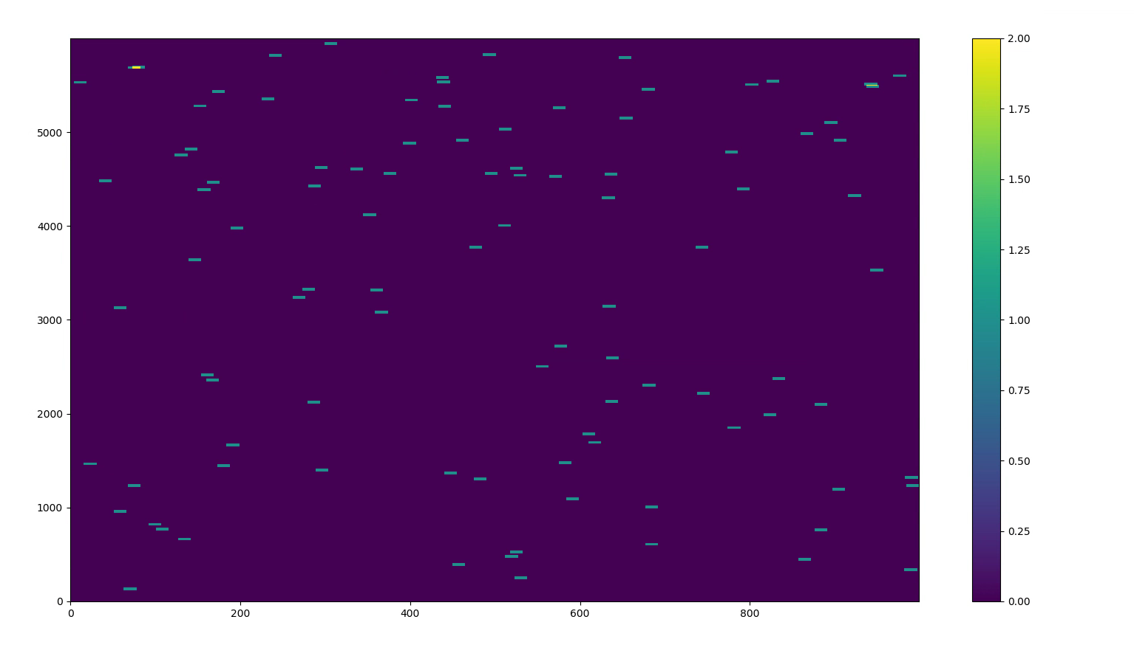
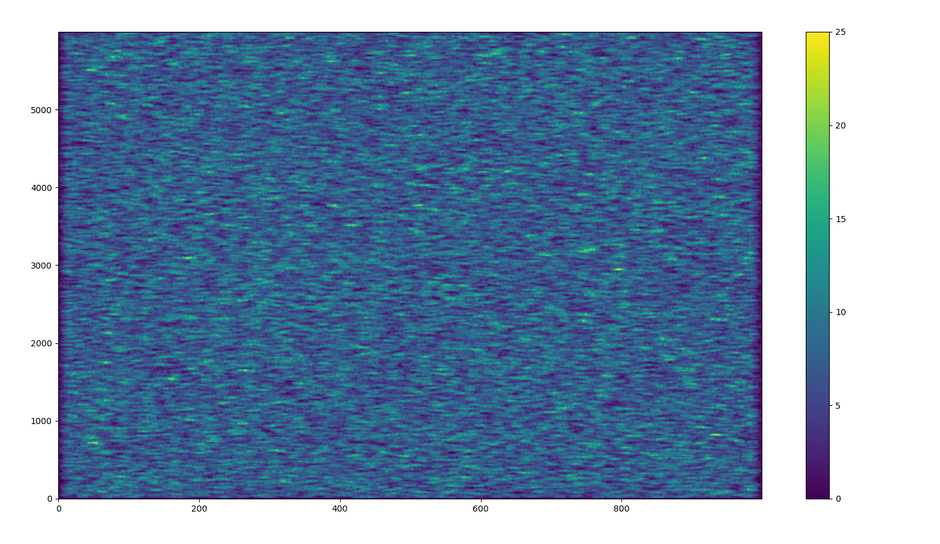
Atomic adding results validation
100 patches
atomic adding results were checked to be correct
single patch
sum
100 patches
100’000 patches

Slide 17
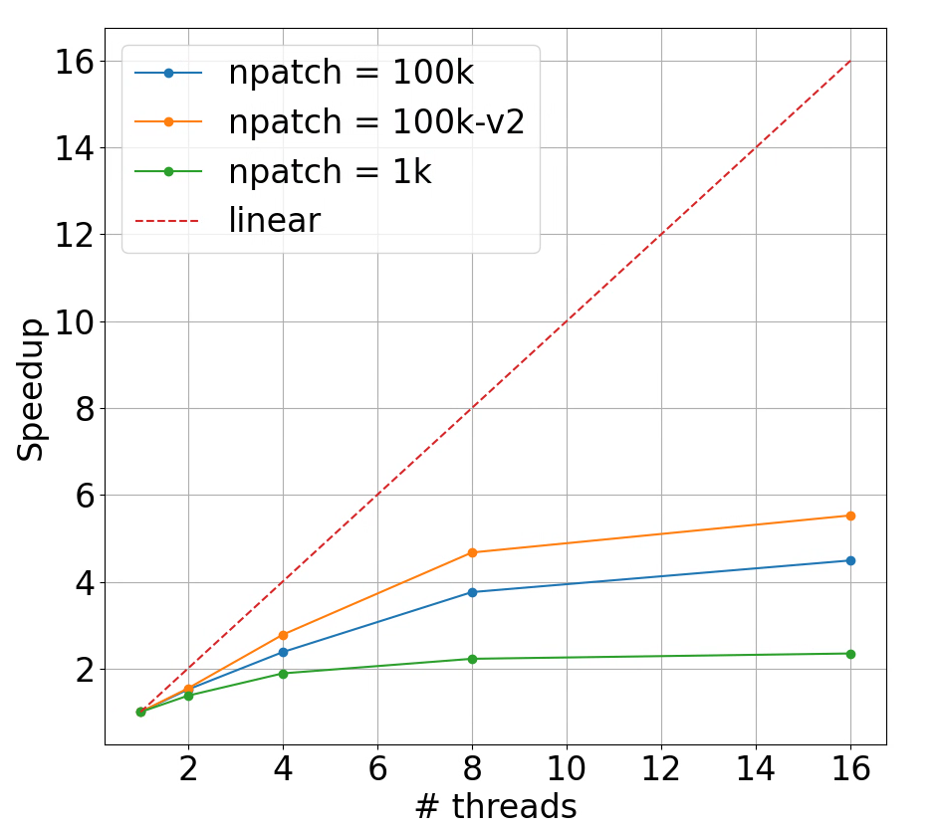
Initial thread scaling test for Kokkos atomic add reduction with OpenMP backend
platform: i9 9900K, NVIDIA RTX2080Ti
Thread scaling is not ideal but there are some speedup
Investigating more solutions:
Kokkos::ScatterView

Slide 18
Initial look of atomic_add with Kokkos-CUDA
CUDA/OMP
10’000 patches: 18 times
100’000 patches: 6 times
Kokkos-OMP
16 threads
Kokkos-CUDA
Nvidia RTX2080Ti

Slide 19
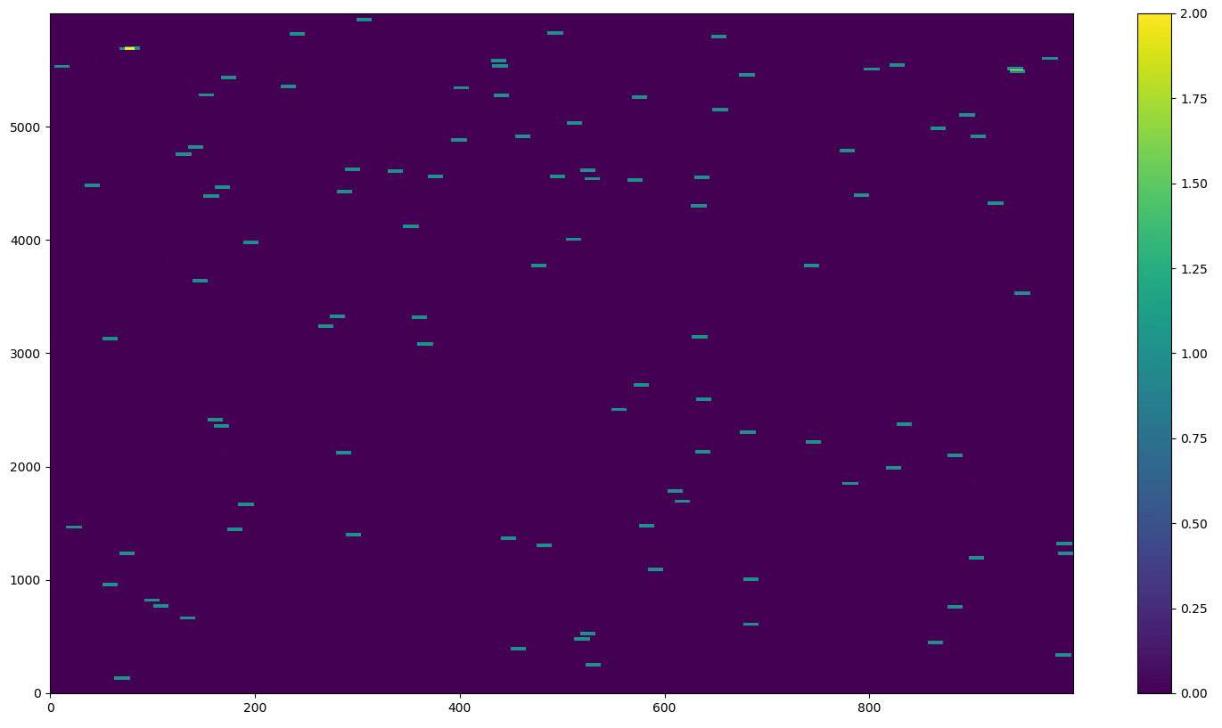
atomic_add with Kokkos-CUDA validation
Identical results with OMP backend
Kokkos w/ OMP 100 patches
Kokkos w/ CUDA 100 patches

Slide 20
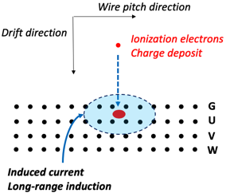
Kokkos FFT?
Core of detector response simulation is the following integral or convolution in frequency domain.
We used Eigen’s fftw FFT backend to do this in the CPU version.
We could use cuFFT of CUDA. But NOT portable.
Seems there is no general interface (based on Kokkos::View) to use various FFT vendor libraries.
There is a ongoing discussion with the Kokkos team. No conclusion yet.
LAMMPS Kokkos
If no immediate solution from the Kokkos team, we could make some wrappers for various FFT libraries for now for portable purpose

Slide 21
Summary of Year 1 Progress
Validated original CUDA implementation in wire-cell-gen
Developed/Improved test and development infrastructure
separated wire-cell-gen from WCT for ease of experimentation
unit tests
building system for Kokkos serial/OMP/CUDA
larwire containers on Cori with built-in Kokkos
Core algorithm porting
Implemented Kokkos normal distribution RNGs and random number generator pool
Prototyped reduction with Kokkos atomic_add
Unit tests so far. Need to integrate into wire-cell-gen and WCT for complete testing.
Code refactoring - ongoing
maximize concurrencies for efficient acceleration
re-design cleaner interface to non-Kokkos part of WCT
Takeaways
WCT provides a unique use case for combining task-level parallelization with accelerators
The WC PPS team solved several key issues in porting
To expose more concurrency in WCT, some major code restructuring is needed.
Support for libraries in Kokkos is still incomplete compared to CUDA libraries.

Slide 22
Future plan
Near future: first working Kokkos porting of wire-cell gen
CPU source code refactoring
Finish porting kernels to Kokkos
FFT portable solution?
initial testing with WCT integration
Further future:
Validation, profiling, summarize experience – publication?
Other portable strategies, e.g. SyCL, parallel STL etc.
Other parts of Wire-Cell

Slide 23
Thanks!
1/8/20
Haiwang for Internal Discussion

Slide 24
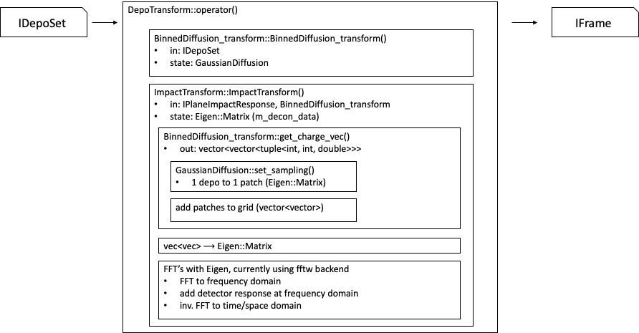
Current DepoTransform component structure

Slide 25
More Kokkos in WireCell?
Kokkos graph execution engine?
Kokkos::View as WireCell::Array backend?
Seems still no Kokkos FFT: https://github.com/kokkos/kokkos-kernels/issues/609
Kokkos::View as memory transferring tool between host and device?

