Slide 1
PIP-II Report
PIP-II Team
Project Management Group
21-October-2020

Slide 2
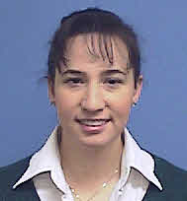
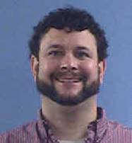
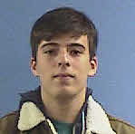
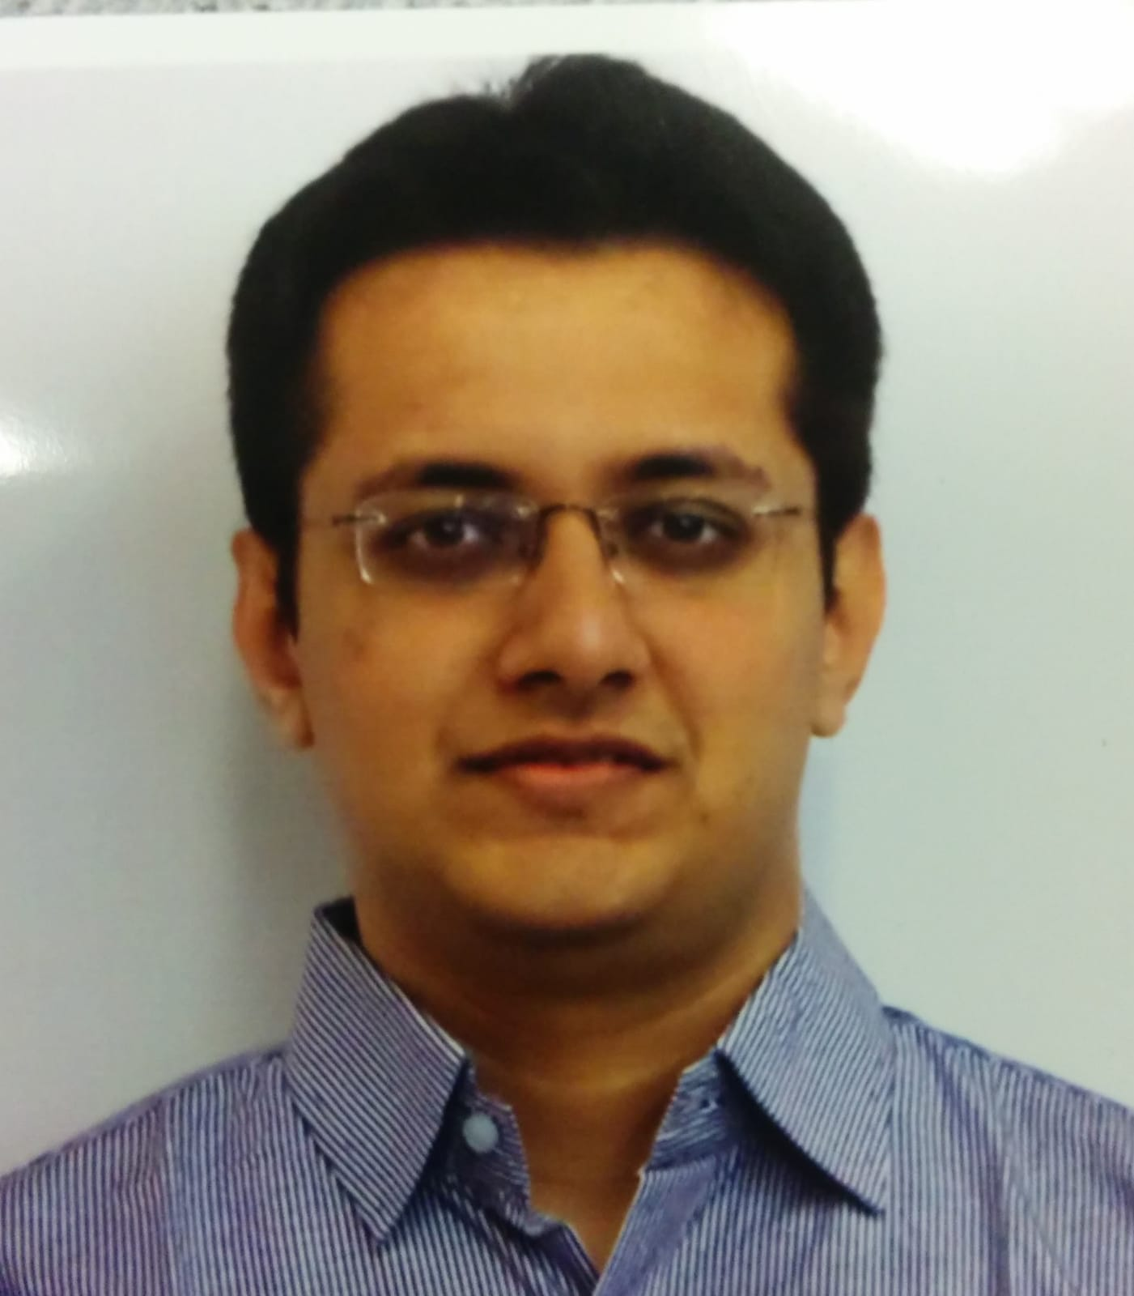
Welcome new Colleagues!
Aria Soha
  Deputy L2 Manager for LI&C
Matt Luedke
  Quality Engineer (SRF/Cryo)
Mathias El Baz
  CNRS visitor, Beam Instrumentation
Harsh Maniar
  LLRF Engineer
Yi Jia
  Cryo Engineer
PIP-II Financial Manager job posted

Slide 3
WBS 121.01 Project Management
CD-2 Refresh IPR:
  As reflected in their comments, the committee was particularly impressed with:
    Adapting to Covid-19 and model for forecasting impacts
    Project controls team
    CAMs
    In-kind management systems
  Only recommendations:
    Proceed to CD-2 ESAAB
    Before CD-3, review and refresh older vendor quotes.
Next steps before CD-2 ESAAB
  Complete ICE
    Meetings held 10/13-14. Outbrief scheduled 10/22
  Briefing to SC leadership, PMRC – dates TBD

Slide 4
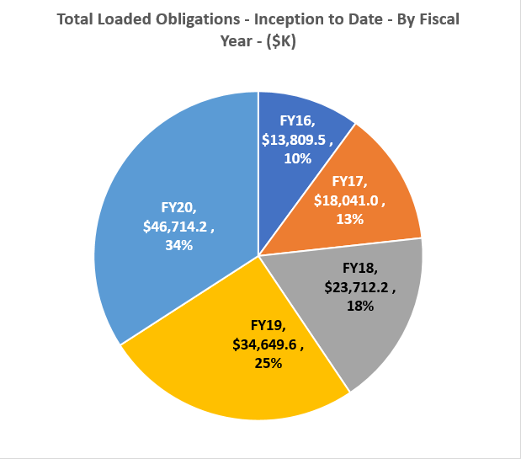
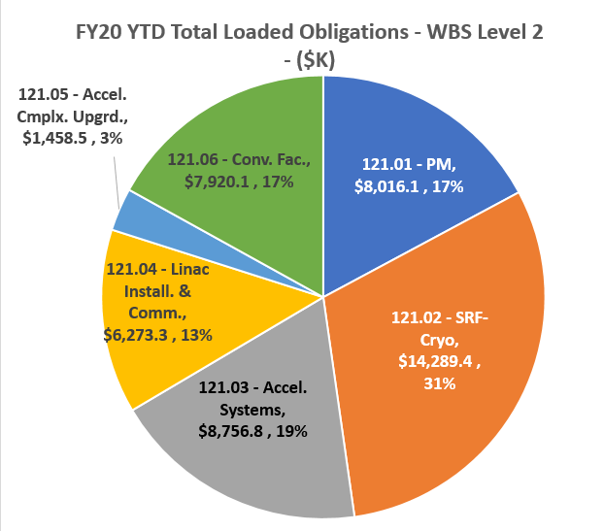
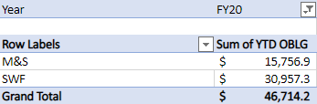
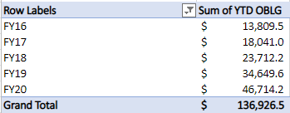
Financials through Sept. 2020

Slide 5
EVMS
PIP-II September 2020 w BCRP315
September 30, 2020
Currency in: $K | Current Period |  |  |  |  |  |  | Cumulative to Date
Work Package.WBS (2) | Budget | Earned | Actuals | SV ($) | SV (%) | CV ($) | CV (%) | Budget | Earned | Actuals | SV ($) | SV (%) | CV ($) | CV (%) | SPI | CPI
121.01 PROJECT MANAGEMENT (PrjM) | 713 | 682 | 325 | (31) | -4% | 357 | 52% | 22,436 | 22,229 | 21,434 | (208) | -1% | 794 | 4% | 0.99 | 1.04
121.02 SRF and CRYO SYSTEMS (SRFs) | 775 | 998 | 564 | 223 | 29% | 433 | 43% | 44,939 | 40,039 | 42,980 | (4,900) | -11% | (2,941) | -7% | 0.89 | 0.93
121.03 ACCELERATOR SYSTEMS (AccS) | 281 | 456 | 391 | 174 | 62% | 65 | 14% | 23,626 | 20,287 | 23,958 | (3,340) | -14% | (3,672) | -18% | 0.86 | 0.85
121.04 LINAC INSTALLATION and COMMISSIONING (Inst) | 507 | 435 | 294 | (72) | -14% | 142 | 33% | 29,513 | 27,960 | 29,260 | (1,553) | -5% | (1,300) | -5% | 0.95 | 0.96
121.05 ACCELERATOR COMPLEX UPGRADES (AccU) | 77 | 96 | 64 | 19 | 24% | 31 | 33% | 3,427 | 2,639 | 3,289 | (788) | -23% | (649) | -25% | 0.77 | 0.80
121.06 CONVENTIONAL FACILITIES (CnvF) | 2,512 | 296 | 278 | (2,217) | -88% | 17 | 6% | 13,777 | 10,533 | 8,172 | (3,244) | -24% | 2,361 | 22% | 0.76 | 1.29
Total | 4,865 | 2,962 | 1,916 | (1,903) | -39% | 1,046 | 35% | 137,719 | 123,687 | 129,094 | (14,032) | -10% | (5,407) | -4% | 0.90 | 0.96
Overall positive cost variance – mostly due to $924k favorable year-end indirect adjustment.
  Cumulative CPI improved 0.01 (0.95->0.96)
Large schedule variance due to cryoplant building construction late start (see Conventional Facilities slides). Otherwise a good month for schedule.
  Cumulative SPI worsened 0.01 (0.91->0.90)
Preparing for S=P=A reset (pending CD-2 approval)

Slide 6
ESH
•COVID-19
–PIP-II COVID-19 Recovery Plan continued
•The laboratory has progressed through the Limited Operations Phase of the recovery plan
–Too early to tell when the lab will enter the next phase
–An individual who has been at CMTF tested positive for COVID-19
•The individual’s COVID-19 exposure occurred off site
•The individual and two other close contact individuals at CMTF have been quarantined
•All involved are doing well and currently symptom free
–Overall activities continue to go well
•Concern over rising COVID-19 case rates in the local area
•Reviews
–Presented laboratories COVID-19 response at the DOE/SC CD-2 Refresh Review
–ORC Reviews
•Additional SSR1 RF amplifiers are being installed
–Anticipate ORCs for the first two amplifiers in the next week or two
•Construction Safety
–Started weekly construction site safety walkthroughs with ESH Section, DOE FSO, PIP-II and Barton Malow staff
•Walkthroughs are conducted every Wednesday afternoon
•As was done for the site prep work, will be using Predictive Solutions to document walkthroughs, observations and safety concerns
•ES&H Support
–Added Infectious Disease Pandemic to the PIP-II Hazard Analysis Report and
PIP-II Construction Project Safety and Health Plan for the CD-2 Refresh Review
–Working on radiation shielding information for the FDR
–Continue supporting procurement, design and Quality Control Plan reviews

Slide 7
QA
Partner PIP-II QA Plans are still in various phases of development and maturity.
Most recently received the preliminary WUST PIP-II QA Plan for review and have provided comments/feedback.
The Quality Control Coordination Group (QCCG) will be initiated in November 2020.
The Quality Control Coordination Group (QCCG) is charge with the development and alignment of quality control activities between Partners and Fermilab for the PIP-II Project.
  This is critical for Partners who have similar deliverables.
The QCCG will also discuss quality assurance topics as Partners continue to develop, refine, and implement their Quality Assurance plans.
All Partners have provided individuals who will actively engage with this working group.

Slide 8
International
Some IKC Highlights from the DOE/SC CD-2 Refresh Review
From the Cost & Schedule Sub-Committee
Regarding the international in-kind contributions:
The management process created to negotiate, document, and monitor/control the agreements is very good.
The project documents are excellent. The schedule interfaces / milestones and method for monitoring progress are also excellent.
Establishing the role of an in-kind contribution manager is crucial to the project cadence and is a best practice.
From the Project Management Sub-Committee
IKC scope is properly documented in PPDs and agreed to with Partners

Slide 9
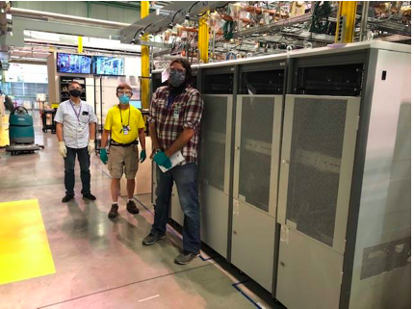
International – Work in Progress
Final P6 IKC changes (e.g. Addendum 1) & PPDs final checks;
  Delivery of the 5 325 MHz SSAs

Slide 10
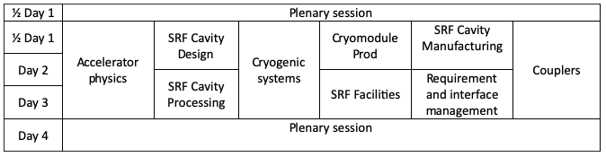
International – Work in Progress
Finalize IKC Monthly Report;
Review and Revise IKC Acceptance Plans;
Draft Acceptance Criteria;
Draft IKC sub-sections in Final Design Report;
PIP-II Technical Workshop Organization on-going;
  The PIP-II Technical Workshop is a forum for discussion between the broader collaboration on key technical topics.
Dates: Dec. 1st-4th
Times: 07:30-noon
Workshop Indico Link
Finalized PPD MS integrated in P6 are ready to be tracked;
We start to prepare for CD-3;

Slide 11

Procurements
Item |  | Req # | Est SubK Value | Status | Expected Award Date
650MHz B=0.92 5-Cell Cavity Assemblies |  | 302069 | $455K | Subcontract # 669124 was placed with RI on 9/23/20. Need additional funds added due to currency fluctuation. Requisition in process for additional funding. Order however is placed with vendor. | 9/22/2020
650 MHz Couplers |  | 308644 | $640k | RFP closed on 10/2/20. Two vendors submitted proposals. Technical evaluation was complete 10/16/20 with pricing and delivery added. Anticipate award early November. | 11/13/2020
Construction phase support services for PIP-II Cryogenics Plant Building |  | 307598 | $800K | Received proposal from Gensler for task order on IDIQ Subcontract No. 651024. Authorization to Incur Precontract Costs executed on 9/8/2020. Drafting task order on Gensler IDIQ . Expected award date 11/5/20. | 11/5/2020
A/E services for 100% design of the PIP-II Linac Complex |  | 308956 | $1.7M | Modification to add requirements under Task Order 665242. Received proposal from Gensler. Preparing Procurement file. Authorization to Incur Precontract Costs executed. Expected award date 11/5/20. | 11/5/2020
650MHz B=0.61 5-Cell Cavity Assemblies |  | 310118 | $607K | RFP issued 9/16/2020. RFP closing 10/30/20. Anticipated award date of 12/4/2020. | 12/4/2020
PIP-II PMG | September 2020

Slide 12
Procurements
Item |  | Req # | Est SubK Value | Status | Expected Award Date
Niobium Cavity Material |  | 305748 | $535K | Additional funds added to requisition to account for import tariffs. Currently, Procurement file being prepared for review. Anticipate routing for approvals by 10/30/2020. | 11/13/2020
SSR2 Resonator Cavities |  | 305165 | $960K | Dual source. Negotiations with Simic conducted on 9/9. Additional surface finish requirements requested – cost estimate received from Simic10/14/20. RI award in process. Preparing Procurement files for both sources. | 11/20/2020
SSR2 Coupler Assembly and Ceramic Window / Antenna Assembly |  | 308167 | $190K | One proposal received, which was higher than FRA estimate. Need technical and cost clarification from vendor on proposal. Zoom meeting scheduled for 10/22/20. | 11/20/2020
*Top 5 = High Lab Visibility; Critical Path Procurements; Critical Procurement Issues
PIP-II PMG | September 2020

Slide 13
SRFCRYO Systems – HWR
Supported beam operation from 5 cavities.
  CAV1 and CAV2 need frequency tuning at room temperature after beam test.
  CAV3 needs to replace its warm window
A combined Q0 measurement including CAV6 is planned.

Slide 14
SRFCRYO Systems – SSR1
  Two cavities exceed gradient specification required for PIP2IT beam test
  Both cavities have microphonics detuning ~15 Hz (< 20 Hz specification)
  RF amplifier used to power SSR1 cavities is a DAE deliverable; five more units are being installed.
  All solenoids tested and meet specification. Heat load tests are in progress.
  Strong back design validated preliminarily.
Cavity Position | Cavity Serial # | Nominal gradient required (MV/m) | Maximum gradient (MV/m) | Note
CAV1 | S1H-NR-106 | 10.00 | 11.5* | No MP after conditioning FE onset 10.5 MV/m
CAV2 | S1H-NR-110 | 8.78
CAV3 | S1H-NR-112 | 8.05
CAV4 | S1H-NR-109 | 10.00
CAV5 | S1H-NR-114 | 9.76
CAV6 | S1F-IU-104 | 10.00
CAV7 | S1H-NR-113 | 8.54
CAV8 | S1H-NR-111 | 10.00 | 11.0* | No MP after conditioning FE onset 10.5 MV/m
*Admin. limited

Slide 15
SRFCRYO Systems – SSR2
SSR2: Niobium production at vendor completed
  Material samples received from vendor. Testing is in progress.
  Vendor is waiting for material shipping instruction, pending cavity contract award and vendor acceptance.
SSR2: Cavity procurement is in progress
  (See previous procurement slide)
SSR2: Power coupler procurement is in progress
  Discussion with vendor to clarify the cost driver (See previous procurement slide)
SSR2: cryomodule design in progress.

Slide 16
SRFCRYO Systems – LB650
Preproduction cavity niobium procurement is in progress
  (see previous procurement report)
Preproduction cavity procurement is in progress
  (see previous procurement report)
 | # cell | Processing/test currently planned | Priority
S65-001 | 5 | 800C 3h, 2/0 N dop, 7um EP, RF test (Jul, Aug, 5 Nov 2020) | high
S65-002 | 5 | 800C 3h, 2/0 N dop, 7um EP, RF test (Jan 2020), 40um EP, RF test (Mar, 29 Oct 2020) | Very high
B61-EZ-001 | 5 | 180um EP, 800C 2h, 30um EP (in schedule, tuning tools should arrive 10/21? Delayed due to covid-19 case at vendor) | Very high
B61S-EZ-001 | 1 | 180um EP, 800C 3h, 30um EP (in schedule ?, waiting for field probe), RF test (w flux expulsion), 16 Nov 2020 | Very high
VECC-LB650 | 1 | To arrive at FNAL as fabricated | high
ESS cavity | 6 | 200um BCP, 600C 10h, 30um BCP @ INFN, RF test | On hold
VTS shutdown since 9/15, expected to recover on 10/26

Slide 17
SRFCRYO Systems – HB650
 | # cell | Processing/test | Priority
B92D-RRCAT-502 | 5 | 150 um EP + N-doping + 5 um EP @ RRCAT, RF test (Aug 2020), optical inspection, replica on quench spot, local grinding, 60um EP (23 Oct) | High
B92D-RRCAT-504 | 5 | 140um EP + 800C + 10um EP @RRCAT, to be shipped to FNAL, EP reset to be scheduled
B92D-RRCAT-506 | 5 | to be shipped to FNAL as fabricated
B9AS-AES-005 | 1 | N-doping, 7um EP, RF test (Jan 2020), 5um EP, RF test (Jul 2020)
B9AS-AES-009 | 5 | N-doping, 7um EP, RF test (Aug 2019), 3um EP, RF test (Dec 2019), 3um EP, RF test (Jun 2020)
B9A-AES-007 | 5 | Pending helium vessel jacketing
B9A-AES-008 | 5 | Jacketed. Pending tuning recovery | Very high
B9A-AES-009 | 5 | Pending helium vessel jacketing
B9A-AES-010 | 5 | Ready to ship. Pending export control approval | Very high
VTS shutdown since 9/15, expected to recover on 10/26

Slide 18
SRFCRYO Systems – HB650
Procurements
B92 cavity procurement is in progress
  Pending vendor contract acceptance (See previous procurement report)
650 MHz coupler procurement
  Technical evaluation completed. Requesting clarification on cost breakdown (See previous procurement slide)

Slide 19
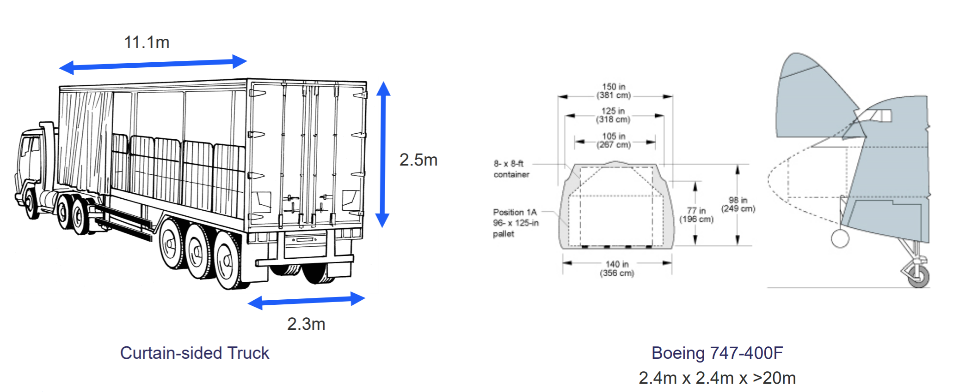
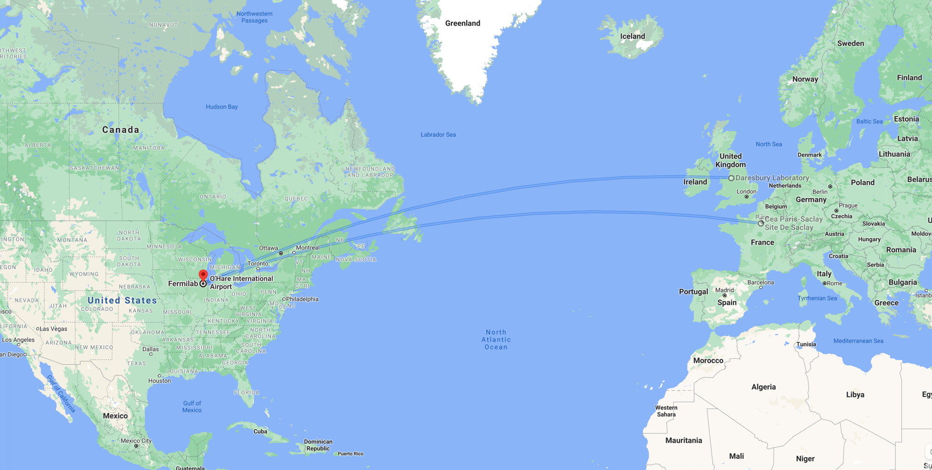
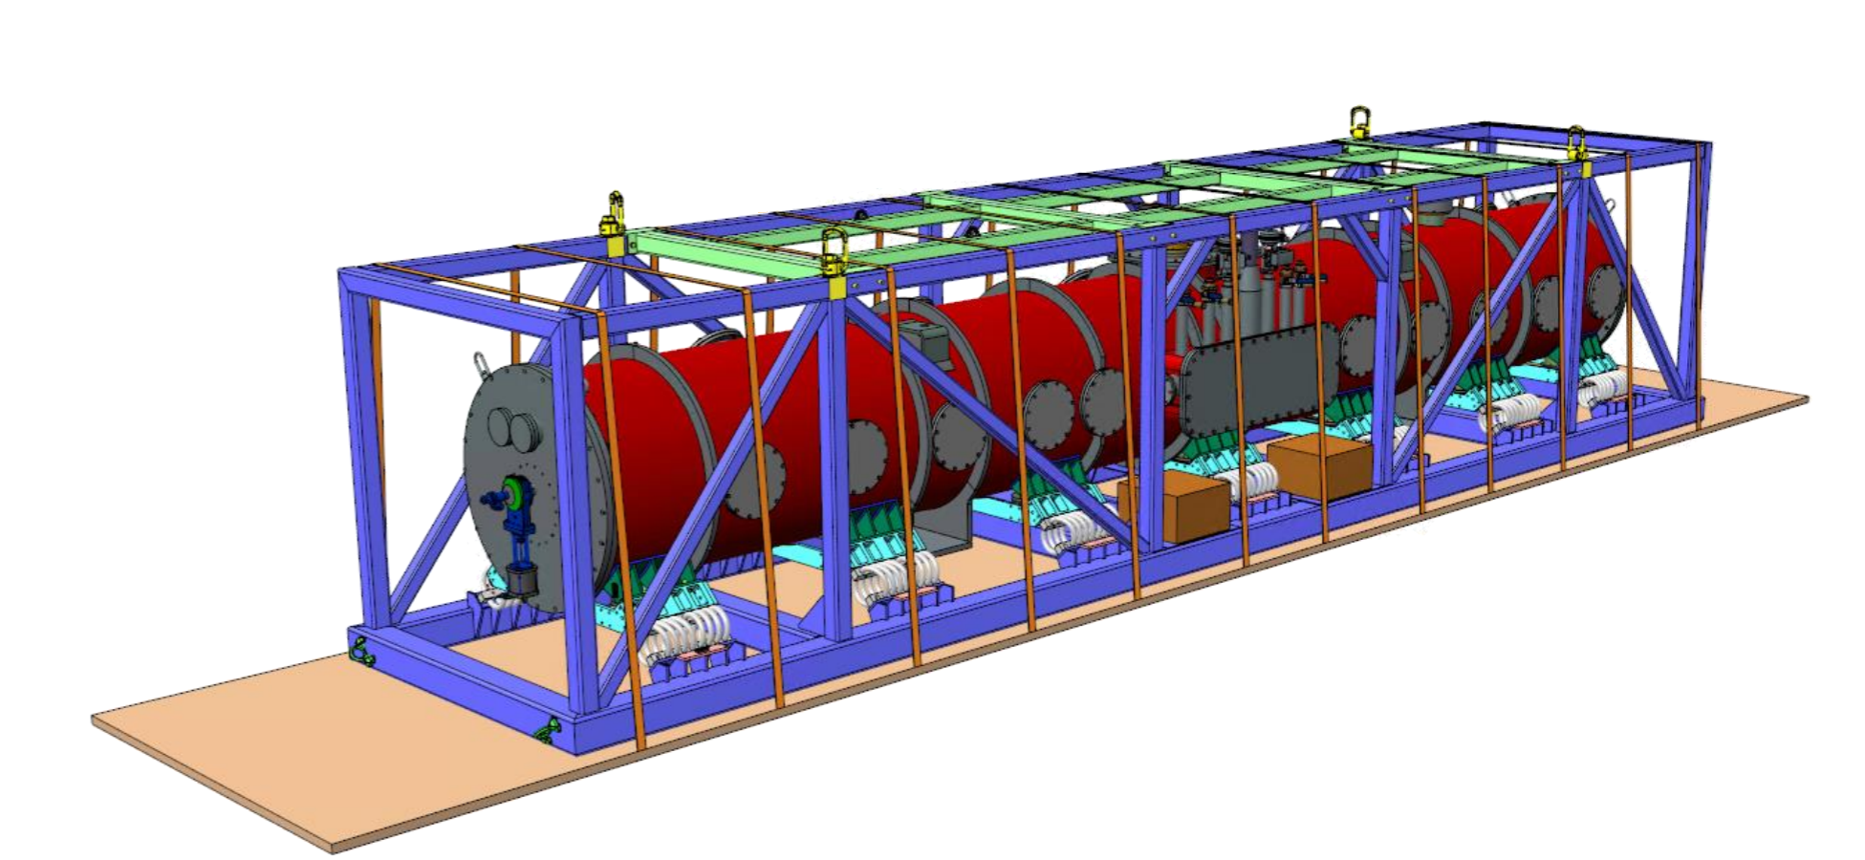
SRFCRYO Systems – HB650
HB650 Transportation Tooling FDR was completed on 9/22/2020 led by UKRI.
  Review responses released in TC
  Plan to close recommendations
  before 12/31/2020
Courtesy of M. Kane of UKRI/STFC

Slide 20
SRFCRYO Systems – Cryogenics
Cryoplant award is in progress.
  DAE approved requisition.
Cryoplant integration preliminary design is in progress
Cryoplant capacity improvement BCR was approved.
  Heat load summary review is in progress
  Performance improvement procurement is in progress
CDS final design was completed successfully on 8/12/2020.
  Addressing review recommendations.

Slide 21
Accelerator Systems
Acc Sys overall
  PIP2IT support from virtually every L3 subsystem
  Prep for CD-2 IPR
  Draft Final Design Report writing in progress as personnel bandwidth allows
MPS
  Ongoing expansion and firmware upgrades to support beam through cryomodules and HEBT
  MPS/PIP2IT Configuration Control committee functioning
  Anticipating installation of last major input piece, low energy diamond detector, in November

Slide 22
Accelerator Systems
LLRF
  PIP2IT on-site work – supporting all RF systems
    GDR demonstrated on HWR cavities
  I-CRADA draft with Poland/WUT and TUL under review by FSO
  Developing an agenda for a Pulsed RF workshop at request of IIFC

Slide 23
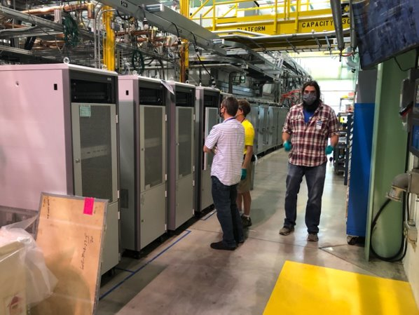
Accelerator Systems
HPRF/RF distribution
  PIP2IT
    Next 5 325 MHZ 7 kW SSR1 amplifiers from BARC/ECIL have arrived
    Shipment includes spare components
    Operational SSA switched back to cavity #1
    EPICS interface under development
  40 kW 650 MHz SSA design path progressing
    Anticipate arrival of prototype in coming weeks

Slide 24
Accelerator Systems
Magnets/Power supplies
  PIP2IT on-site work essentially complete
  Design considerations for switcher magnet
    Kicker vs. ramped dipole
  New SPM for IKC magnets
Vacuum
  PIP2IT vacuum continuous from WFE to HEBT absorber
  HEBT instrumentation installation ongoing, expect completion in early November

Slide 25
Accelerator Systems
Controls
  Ongoing PIP2IT support
  Controls IDIQ task req submitted
    Multicasting clock events in EPICS
Interlocks
  Quality Control Plan written and approved
Beam Instrumentation
  PIP2IT
    Laser profile monitor (expect first light in October, first profiles in November

Slide 26
Installation and Commissioning
PIP2IT - COVID Update
  Detailed work planning, social distancing, and PPE usage continues to be strictly followed
  A Fermilab employee tested positive for COVID who had been at CMTF for a short period of time on Oct 8th
    The employee contracted COVID offsite
    Contact tracing was completed – resulted in two CMTF employees being quarantined due to having close contact with individual
    Nobody involved has shown any symptoms to date (quarantine scheduled to end on Oct 22nd)
    PIP2IT schedule has not been impacted
  Tracking weekly progress to quantify efficiency during COVID recovery phase (only past 2 months shown below)
    September (assumed 100% efficiency) – 100% actual
      No lost shifts and no installation delays related to COVID
    October (to-date)– (assumed 100% efficiency) – 100% actual

Slide 27
Installation and Commissioning
PIP2IT Installation and Commissioning
  WFE
    Kicker assembly continues – on track for November installation
  SSR1
    Cold RF testing in progress
    Five additional 7kW amplifiers arrived from India and are being installed at PIP2IT
  HEBT
    Installation complete
  Beam Commissioning
    Beam commissioning through cryomodules (HWR & SSR1) began on Oct 8th
    See ”Commissioning” slides for details (Eduard)

Slide 28
Installation and Commissioning
Progress from other L3’s
  Test Infrastructure
    650 Test Stand Cryo Transfer Line (CTL) FDR successfully completed
      Procurement/fabrication beginning
  Building Infrastructure
    Updating electrical/mechanical requirements & specifications
    Working closely with CF to support 90% design review
    Electrical system PDR successfully completed
  Linac Installation
    CAD model updates (mechanical & electrical utilities, utility plant and gallery layout, model imports to CF)
    Alignment network design progressing
    Linac warm-unit design continues – supported by NIU engineers

Slide 29


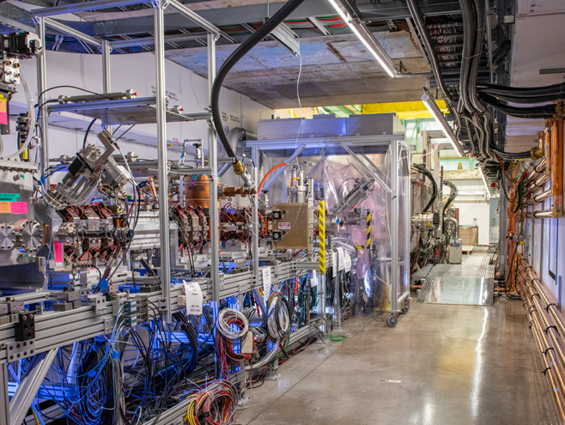


Commissioning: PIP2IT-Testbed for PIP-II Front End
Nearly full-scale of first ~25 MeV of PIP-II accelerator
Arbitrary bunch-by-bunch chopping capability
Testbed for AI/ML applications to accelerators
Under commissioning now. First beam through cryomodules on Oct 8
Conversion to PIP-II CMTF

Slide 30
Beam Commissioning – Start of Commissioning
Operational Readiness Clearance (ORC) review for PIP2IT Operations, held on August 25-26th, preceded beam commissioning through CMs and HEBT
  Approval to operate PIP2IT with beam to HEBT was obtained in Mid September, followed by final connections of the vacuum enclosure
Beam commissioning started last Thursday, Oct 8th
Beam was transported to HEBT Beam Dump on first shot with nearly full transmission
  This demonstrates that alignment of CM components is on or near the specifications
Orbit has been aligned and full coasting, 2.1 MeV beam transported to HEBT
Ion source
Dump
RFQ
MEBT
HWR
SSR1
HEBT

Slide 31
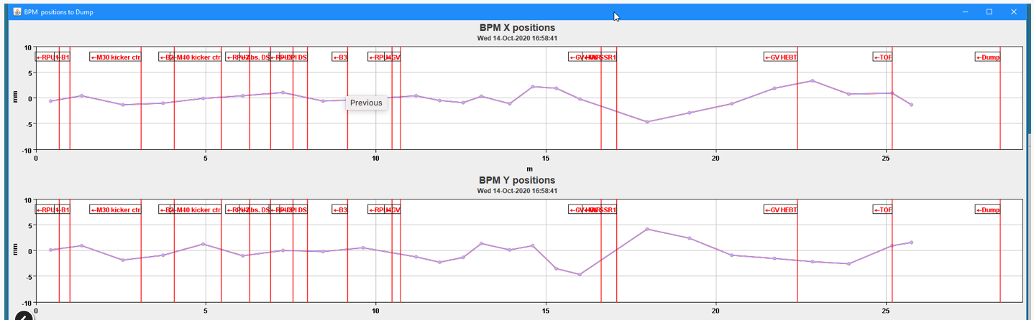
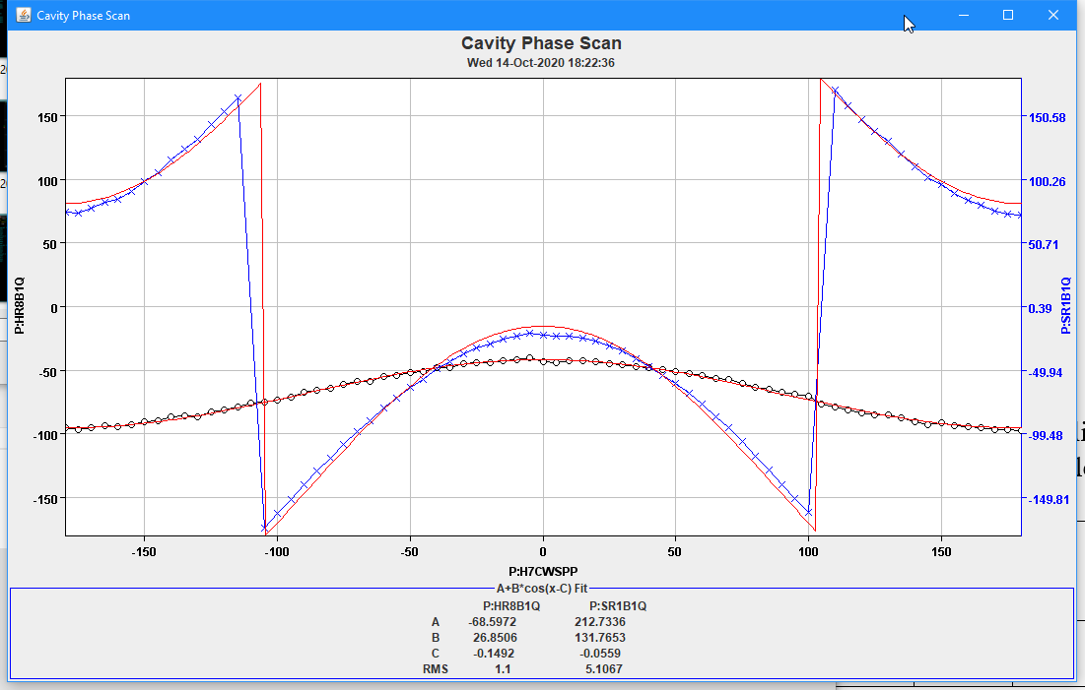
Beam Commissioning - Acceleration in HWR CM
On Tue, Oct 13, HWR Cav4 was phased and the beam was accelerated in Cavity 4 to an energy of roughly 2.45 MeV.
On Wednesday, Oct 14, Beam was accelerated in all HWR cavities to an energy of ~6 MeV demonstrating acceleration in all currently available HWR cavities
Accelerated Beam Orbit
Cavity Phasing

Slide 32
Beam Commissioning - Near Future Plans
Retune the HWR cavities more aggressively to accelerate the beam to ~8.5 MeV at the end of HWR
Test SSR1 Cavity 8, test acceleration, bunching. Test as early as today.
Move SSR amplifier to Cav1, Add more amplifiers that arrived from India
Accelerate beam with SSR1 cavities as we add more amplifiers
Shutdown in November to add more equipment

Slide 33
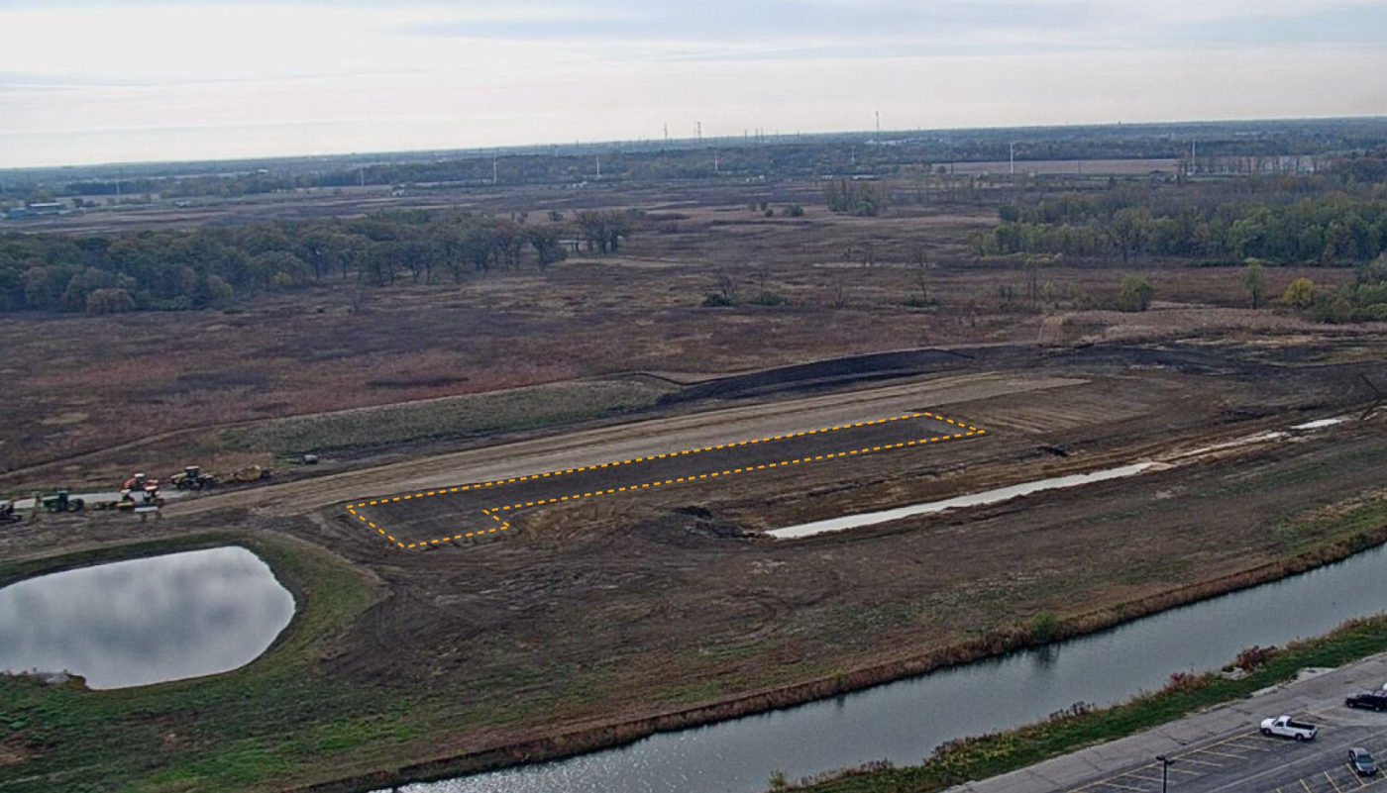
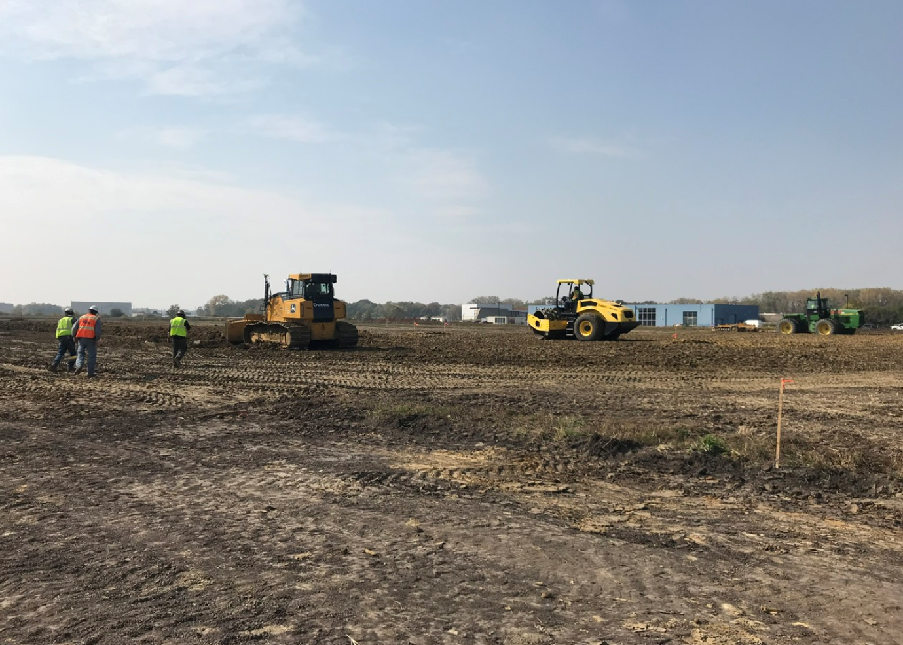
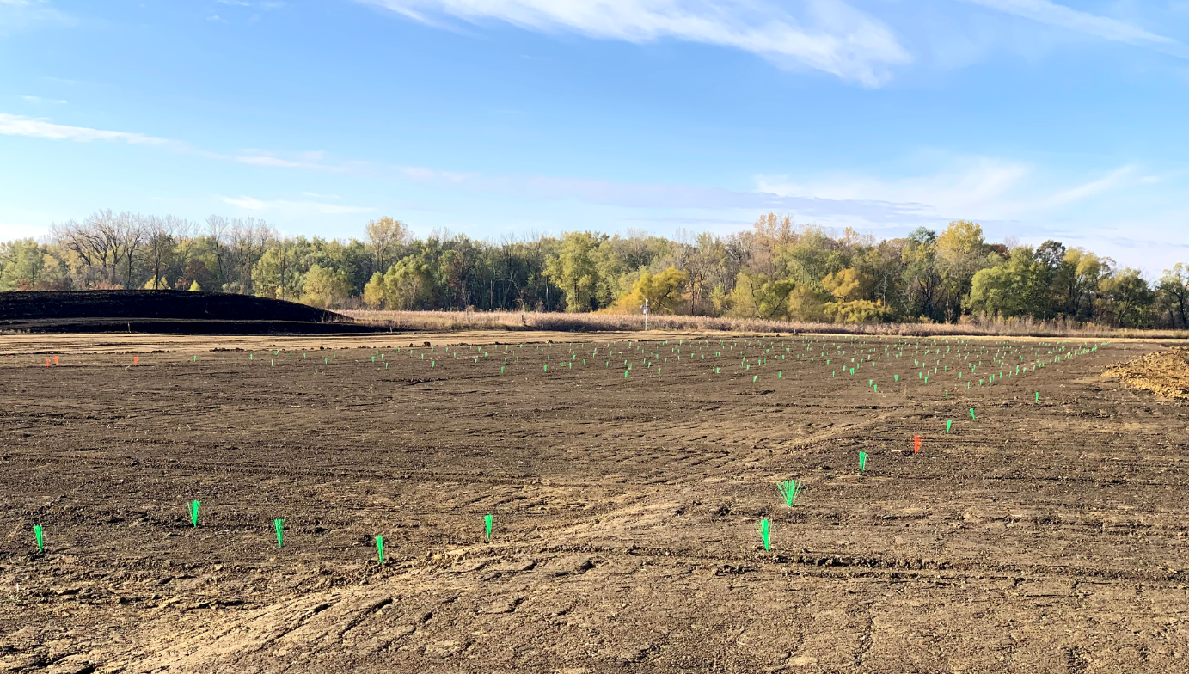
Conventional Facilities
WBS 121.06.07.02 - Cryogenics Plant Building
  Foundation preparation continues
    Raised the existing grade by ~3 feet
    Layout of rammed aggregate piers (starts this week)

Slide 34
Conventional Facilities
WBS 121.06.07.02 - Cryogenics Plant Building
  Other issues
    Claim for additional topsoil being reviewed internally
    Behind schedule, working on a recovery schedule
    FY21 funding:
      Initial funding (from FY20) allows for obligations through November 2020 and costs through December 2020.
      Req in process to add first FY21 installation of $2.5M. Extends them through ~February 2021.
WBS 121.06.05 - Linac Complex
  Final Design
    Kick-off meeting held on14OCT20
    75% page turn in December 2020
    90% design review in January 2021
    100% design complete in March 2021

Slide 35
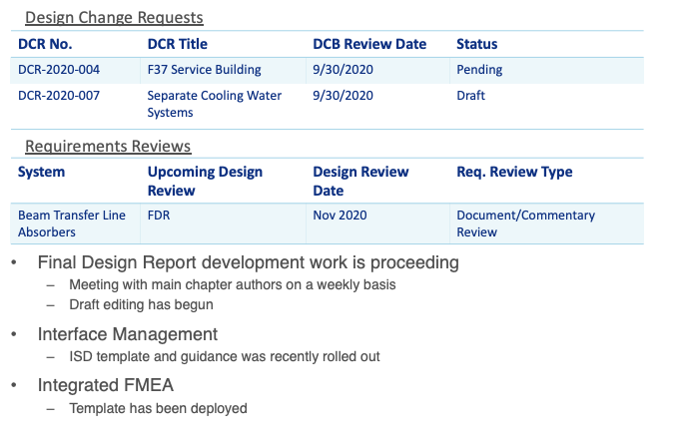
Technical Integration

