Slide 1
LAr Cryostat Design and Qualification
G. Vallone, E. Anderssen, D. Boettcher, M. Leitner
DUNE Cryostat Qualification Meeting
10/30/20

Slide 2
Index
Introduction
LAr Cryostat
Design Description
Structural Analysis
Frame/Window Joint Design
Qualification Plan
Conclusion

Slide 3
Introduction
A LAr cryostat is being developed for the DUNE project:
We can’t really proceed with the design/test/calculations unless we agree on the applicable standards and limits
The main result of this (and future) discussion should be the Memorandum of Agreement document, listing the applicable standards for design, manufacturing, assembly, and the test and commissioning plan
Meeting topics:
LAr structure design description and preliminary FEA results
Applicable standards discussion
Experimental test plan
Work plan
Further documentation (drafts):
Memorandum of agreement
Experimental test plan

Slide 4
Index
Introduction
LAr Cryostat
Design Description
Structural Analysis
Frame/Window Joint Design
Qualification Plan
Conclusion

Slide 5
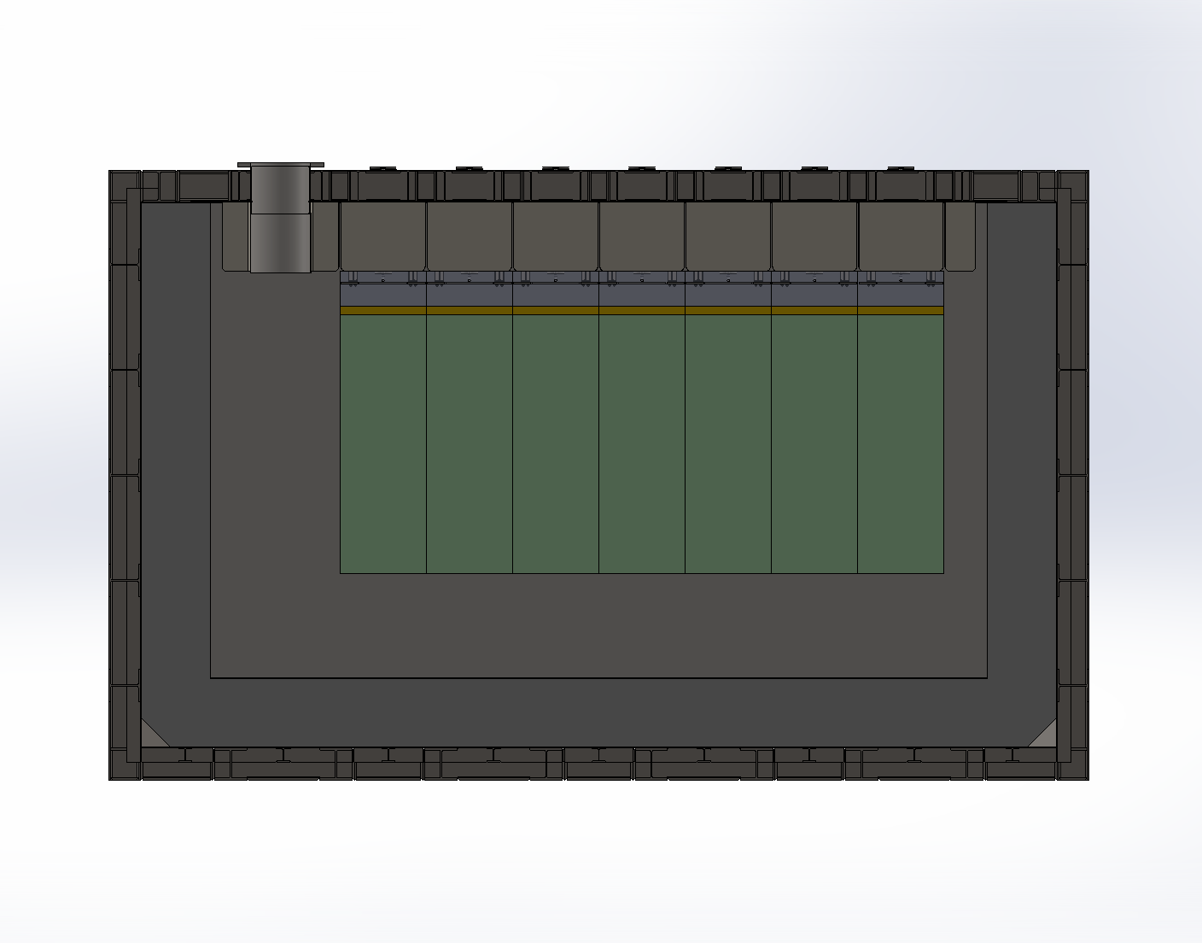
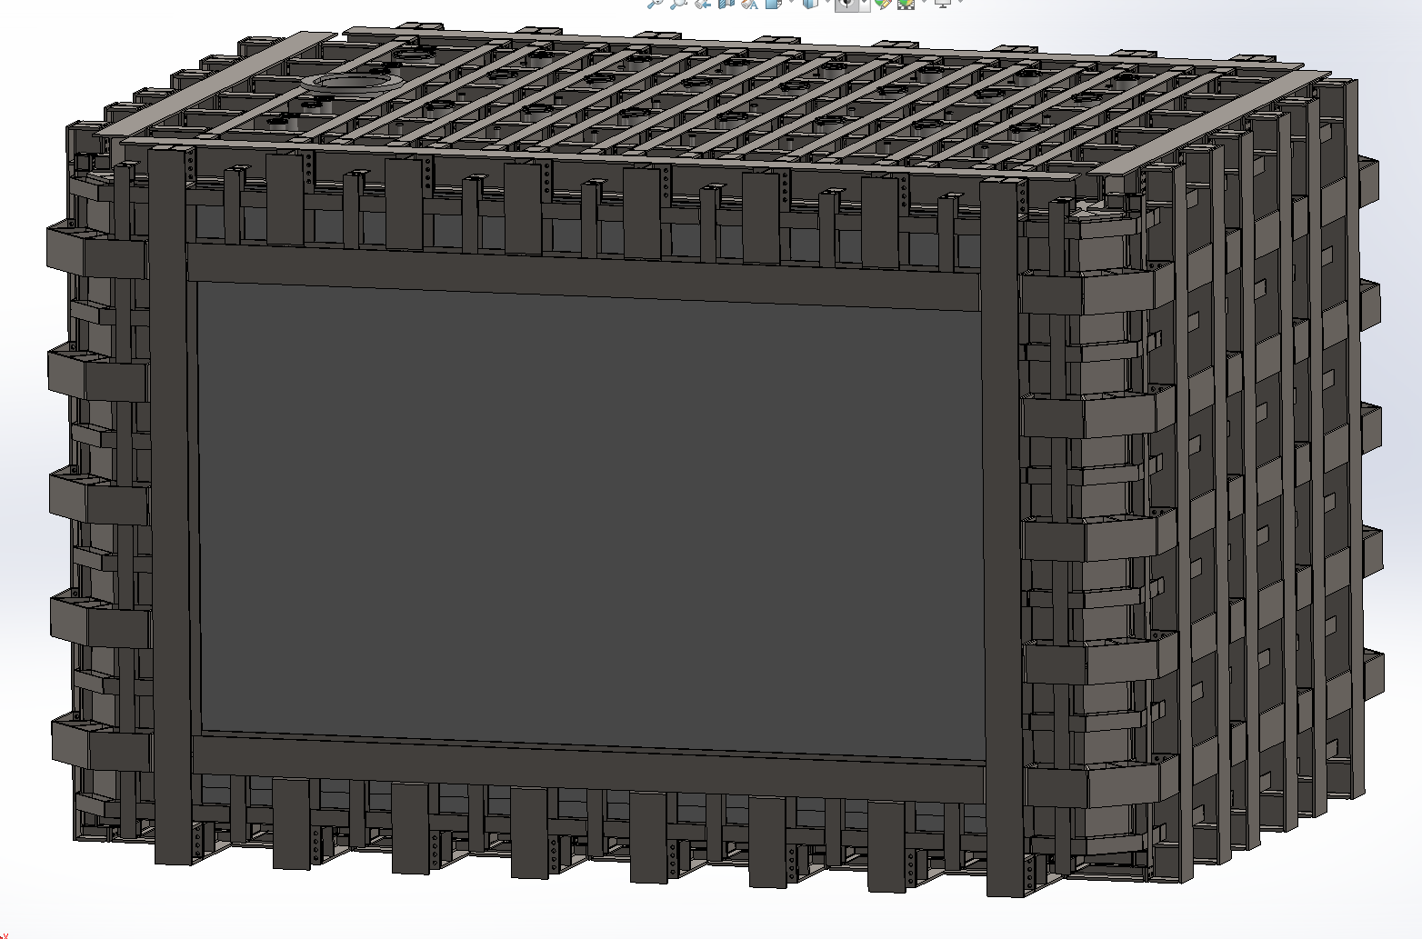
Plate Design
Steel Plate 1
Steel Plate 2
Steel Frame
Box Beams
Polyurethane
Liquid Ar
Detector
Composite Window
Liquid Argon enclosed by stainless steel plates / Polyurethane sandwich
One side covered by a composite window (described later) to reduce the impact on the particle beam
Window size: L8156*W3810*T372 (max)

Slide 6
Plate and Joint Design – More Details Later
Plate design:
25 mm thick fiberglass skins, polyurethane core
Joint design:
Box beam around the plate for torsional stiffness
Scarf joint to transition to fiberglass. A tapered lap joint would not able to satisfy the strength requirements (with a reasonable length).
Production process is more complicated
Design process:
Finite element models: 2D analysis to quickly optimize the geometry, detailed analysis on a 3D model, 3D submodels for critical regions
Experimental verification $→$ Update Finite Element models

Slide 7
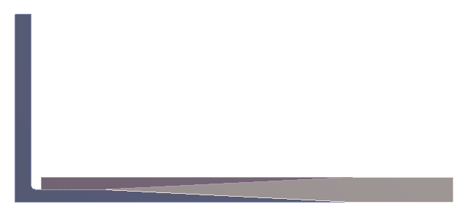
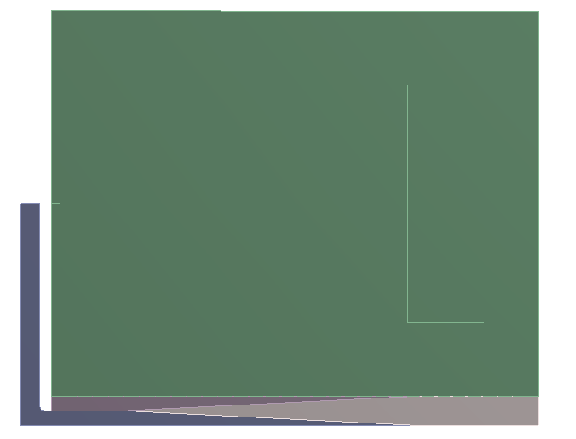
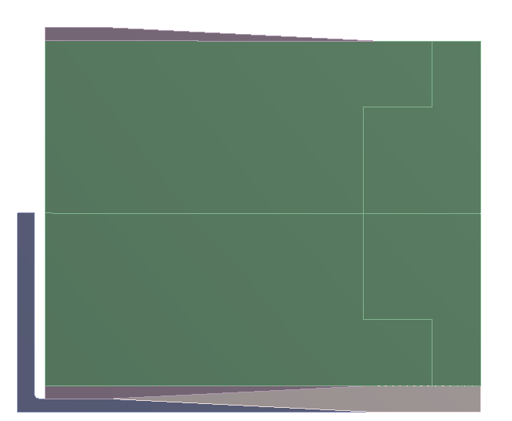
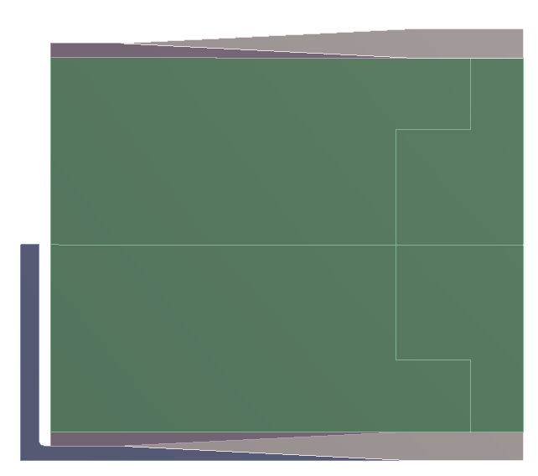
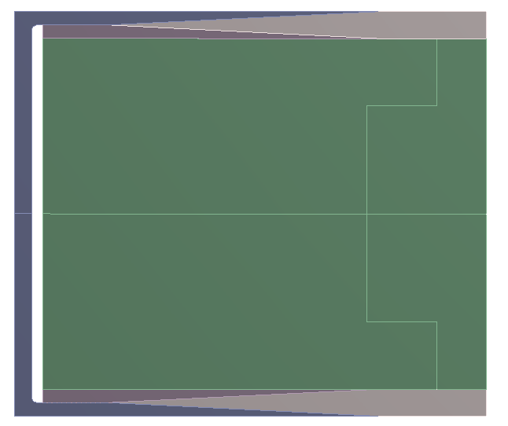
Scarf Joint – Production Process
1
2
3
4
5
6
Lay-up the bottom face sheet on the steel c-joint bottom half
Glue the bottom joint steel ‘shoe’
Glue the core
Glue the top joint steel shoe
Lay-up the top face sheet
Weld the c-joint, then weld to the box beam

Slide 8
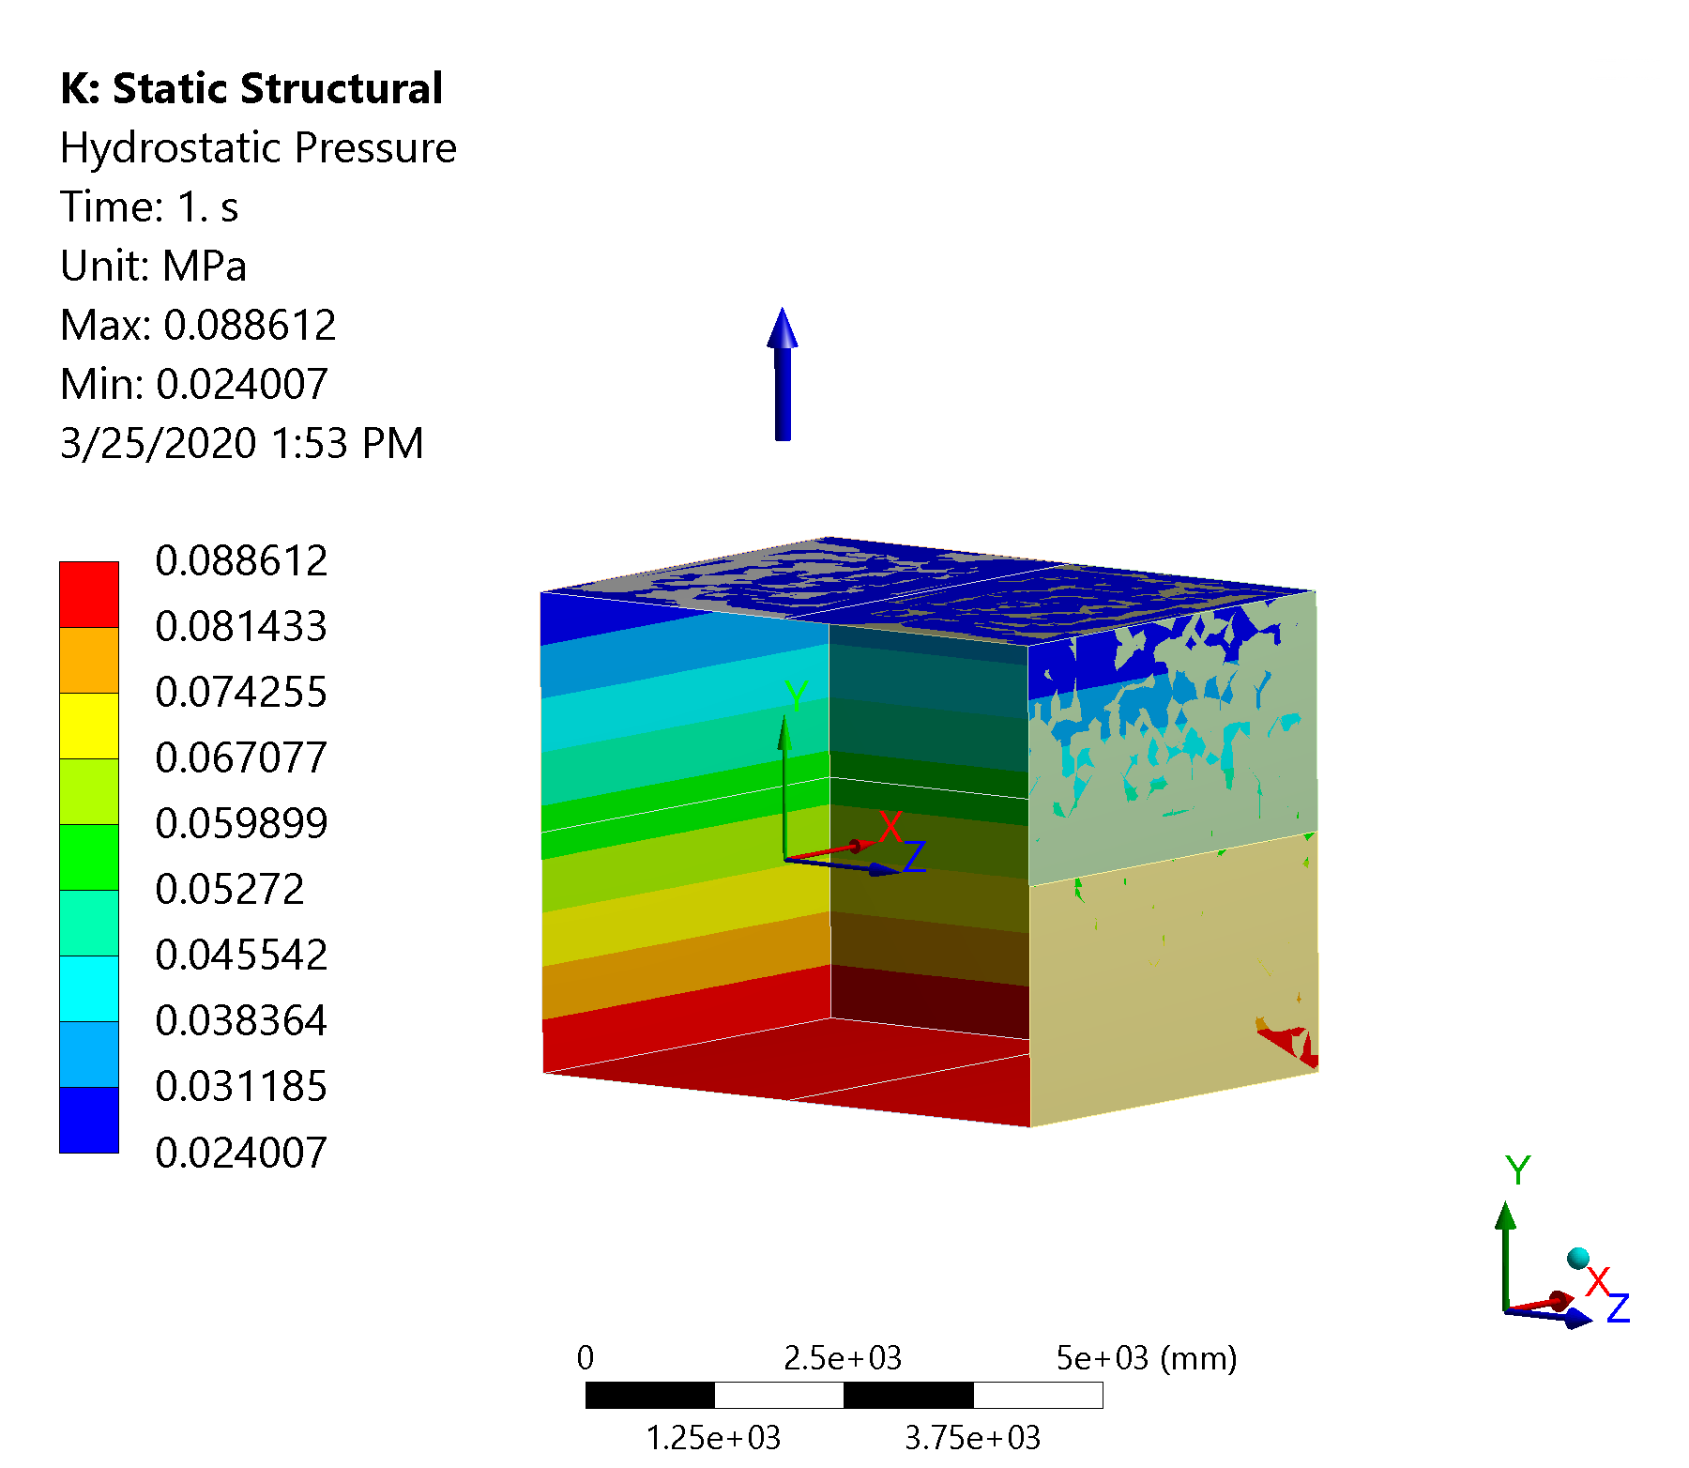
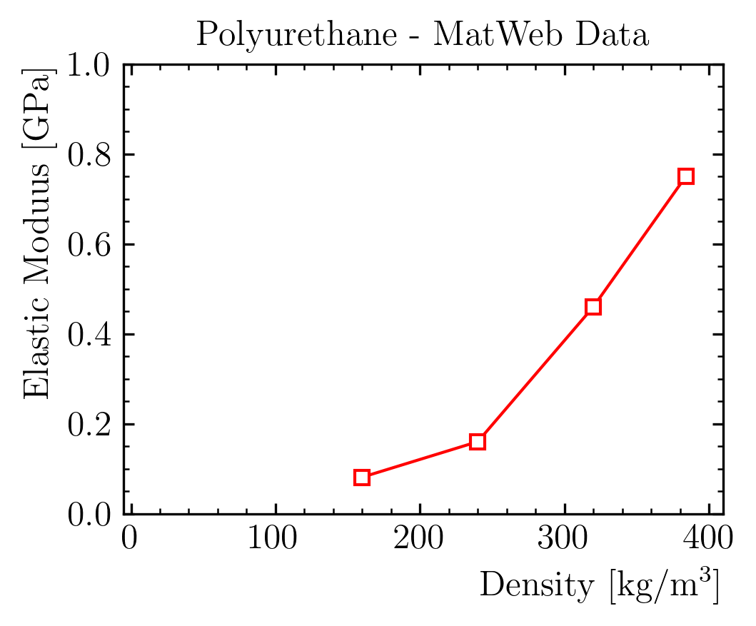
FEA Model Description – Geometry and Material Properties
Geometry:
YZ symmetry
Steel plates, frame: shell elements
Composite plate, foam: solid elements
Foam properties:
Density = 90 kg/m³
E = 10 MPa – Seems a reasonable order of magnitude
𝜈 $→$ 0.5 (incompressible)

Slide 9
FEA Model Description – Boundary Conditions and Loads
Boundary conditions:
Floor b.c. only on y, but probably friction will lock also the other directions
Interfaces: everything bonded
Loads:
Liquid Argon Hydrostatic Load - Density = 1400 kg/m3 - Liquid Level Height = 4.5 m w.r.t. membrane floor
Overpressure Load = 350 mbar
Gravitational Acceleration

Slide 10
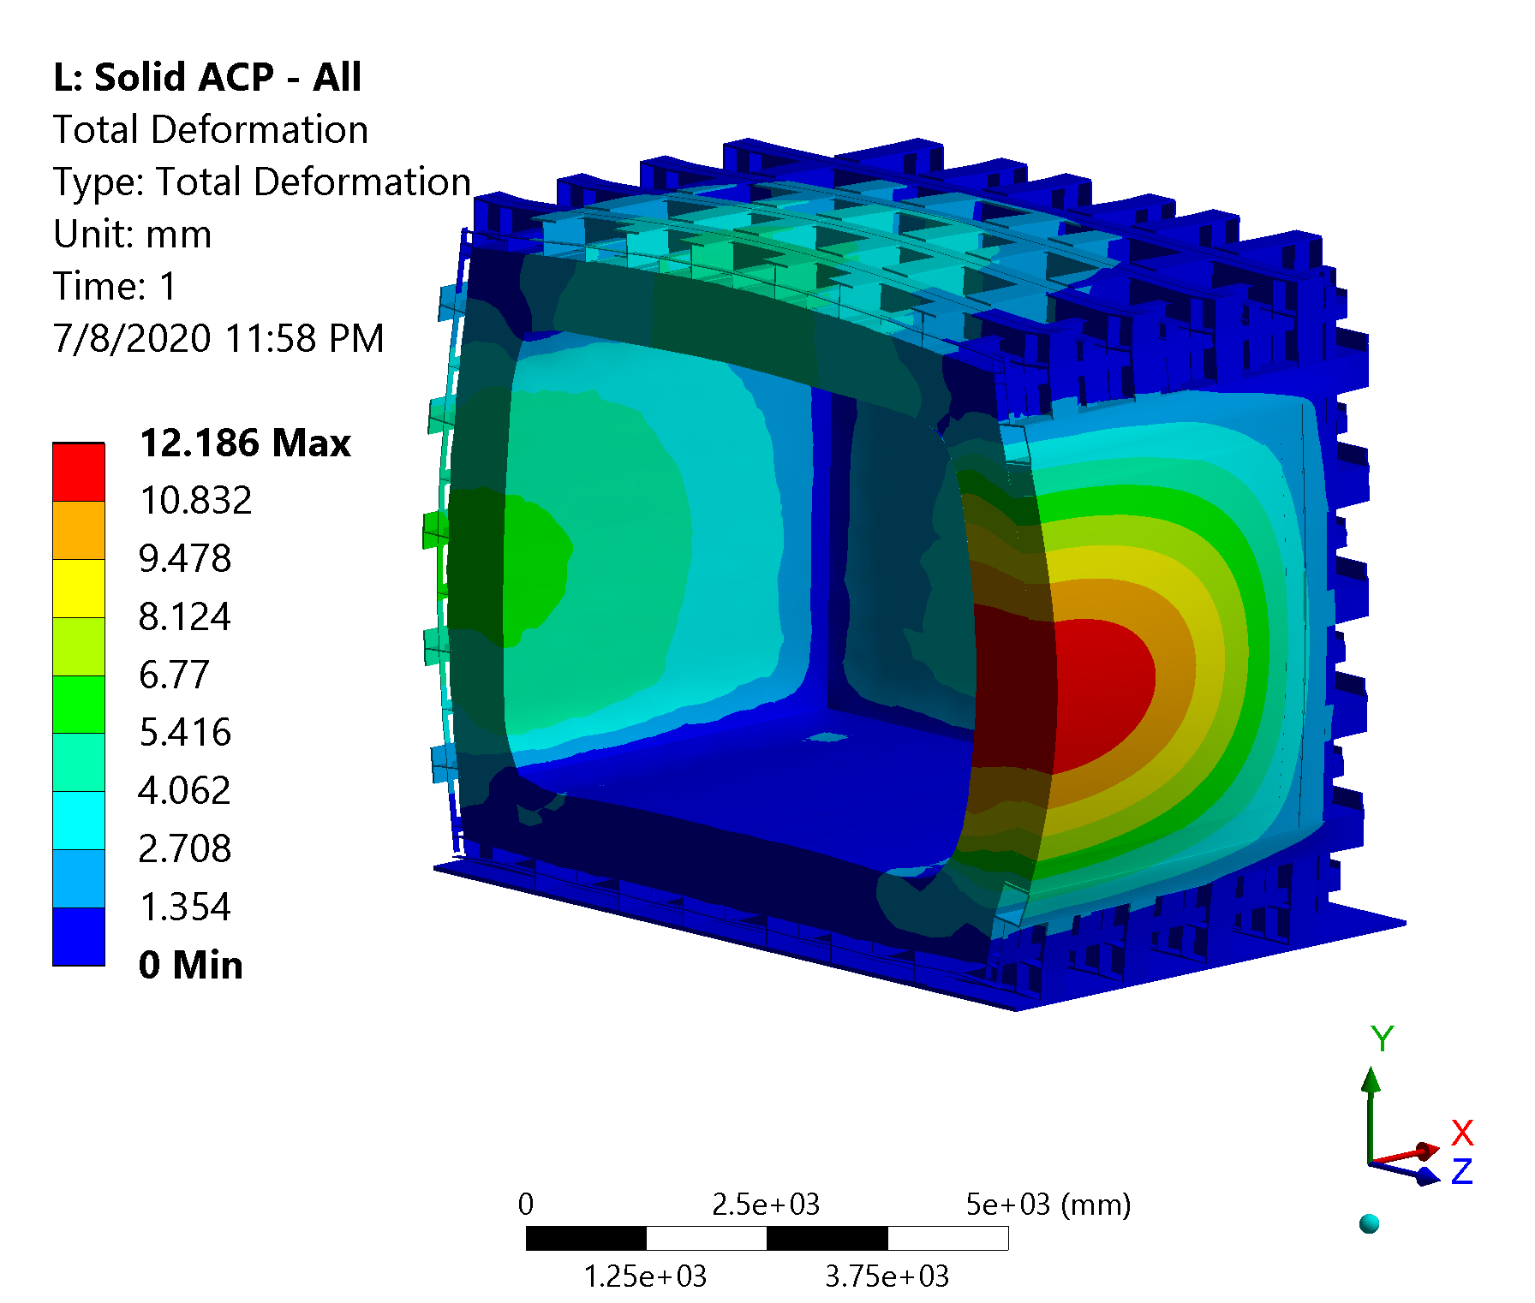
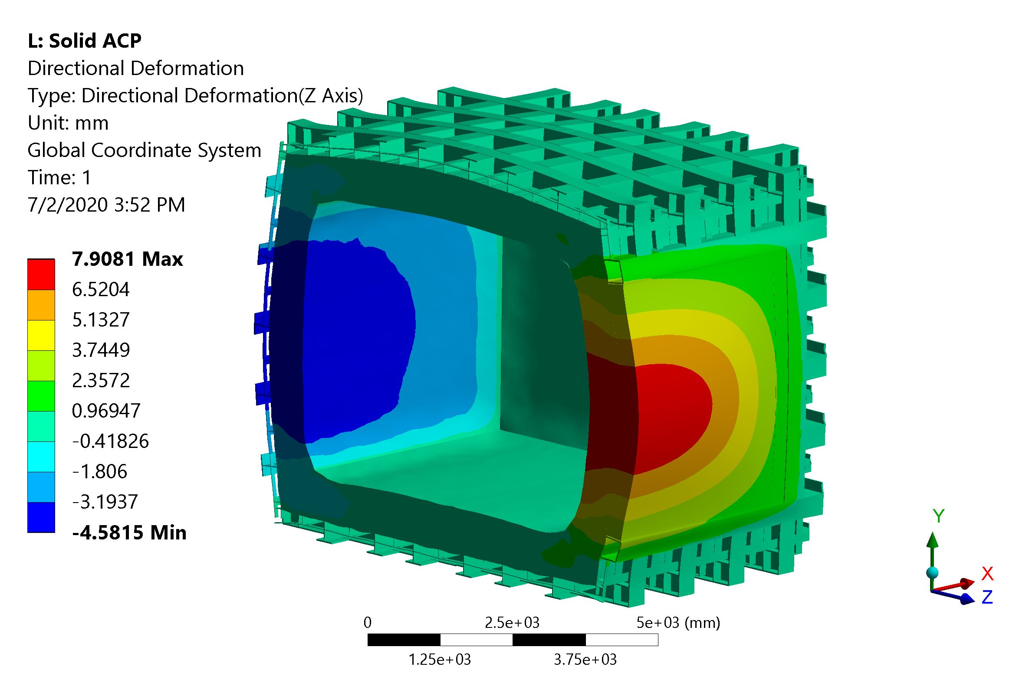
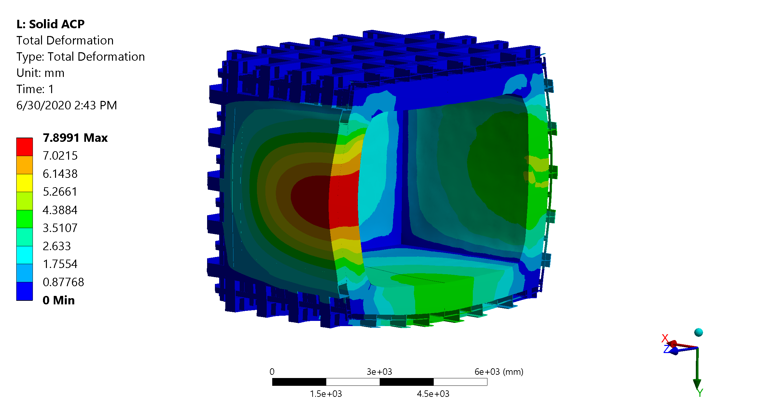
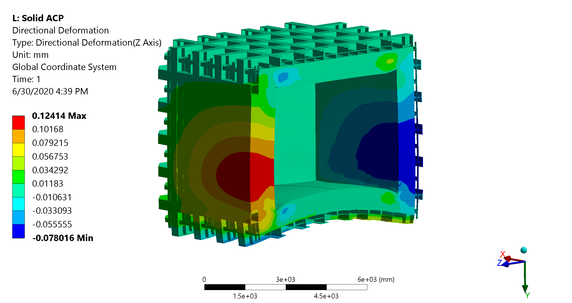
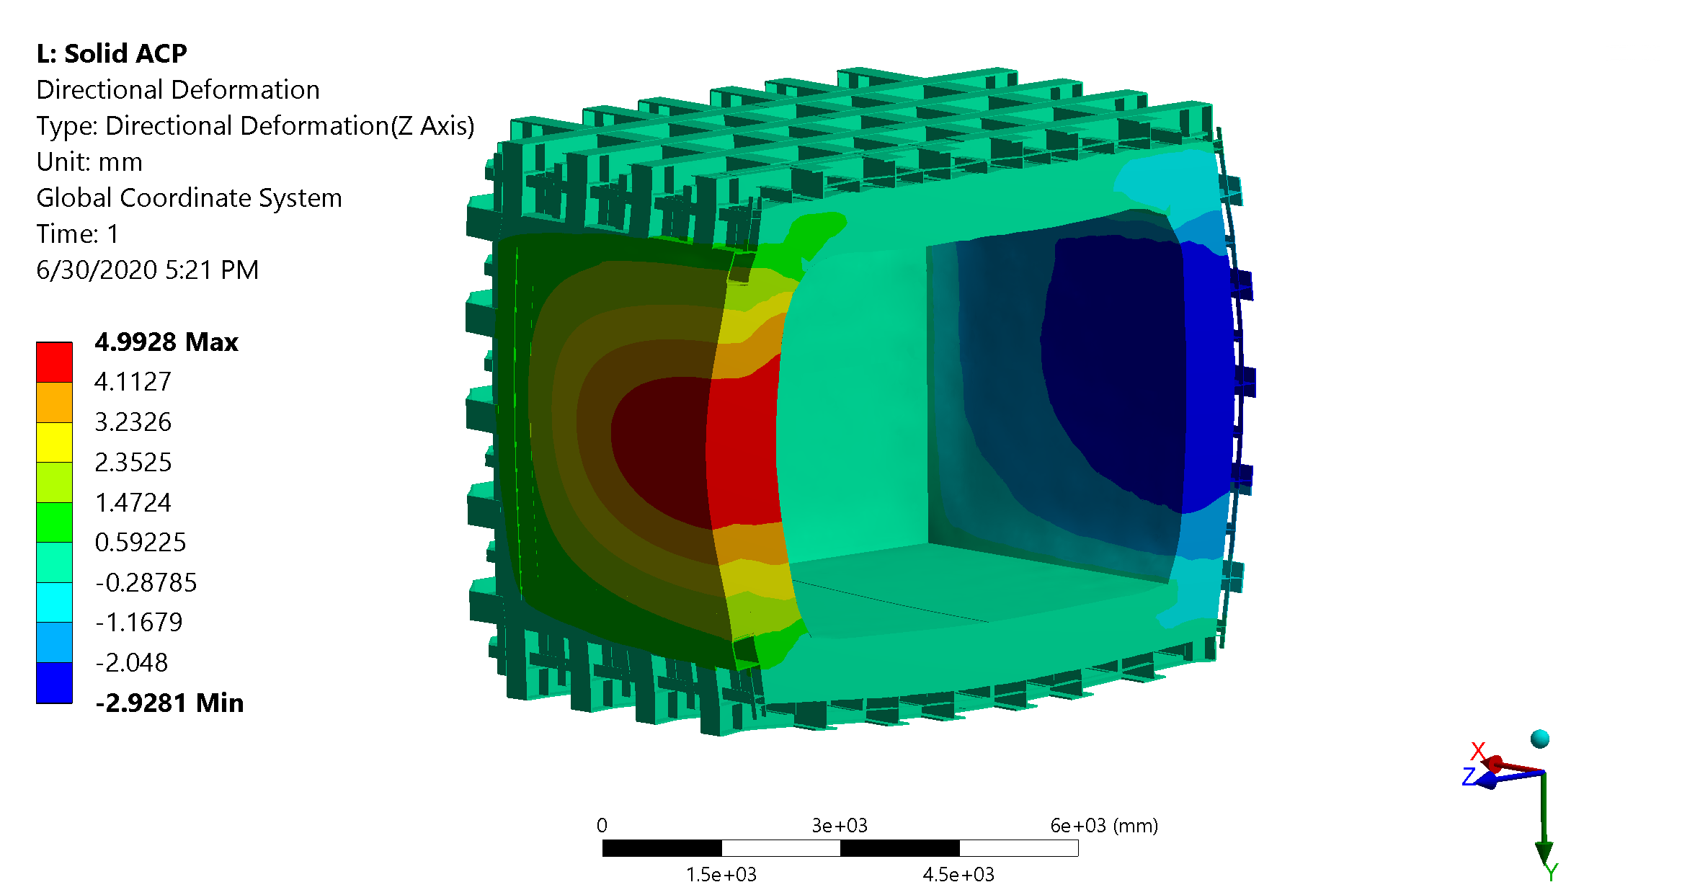
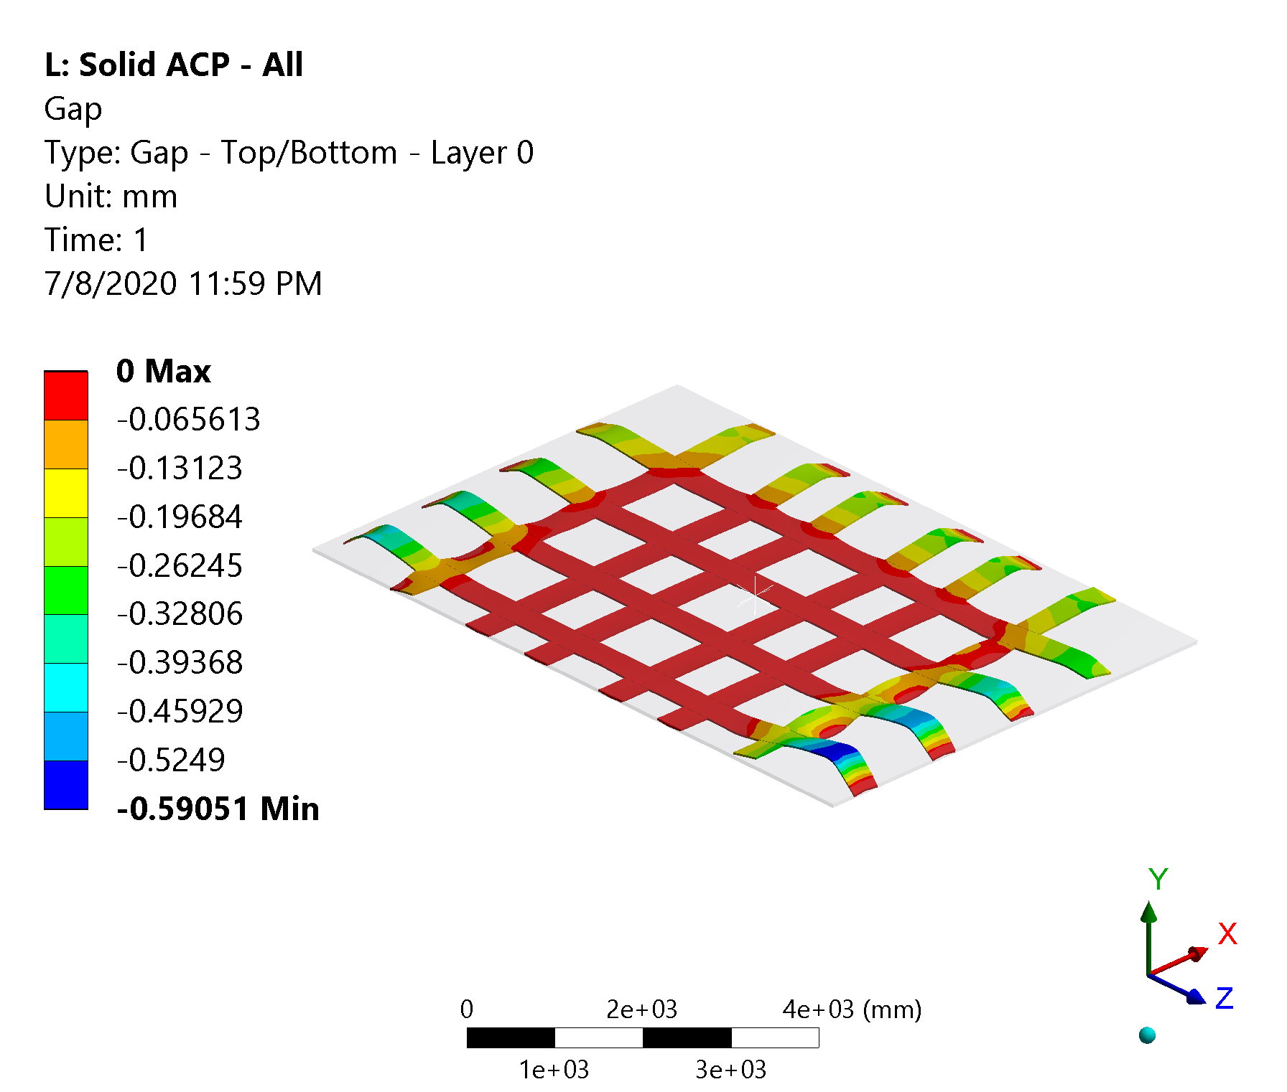
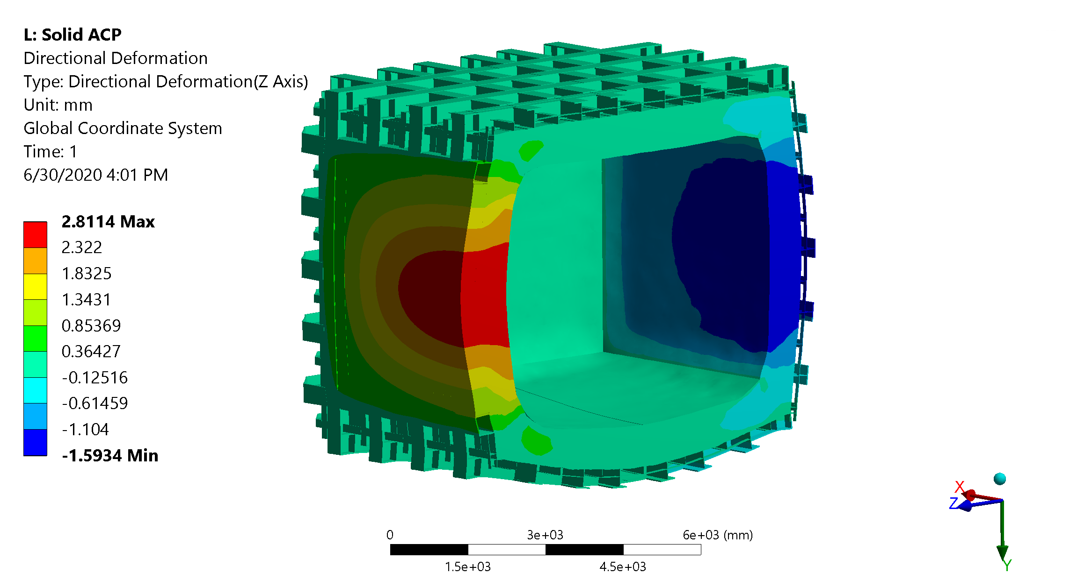
Structural Analysis – Displacements
Simply Supported
Anchored to the Floor
Contact elements on the bottom of the cryostat:
Similar results with friction (0.1) and frictionless
There is some lifting close to the corners. This allows for some additional rotation of the corner.
Adding stiffeners in the corners can further reduce the deformation
Anchoring the floor can reduce the deformation from 12 mm to 8 mm

Slide 11
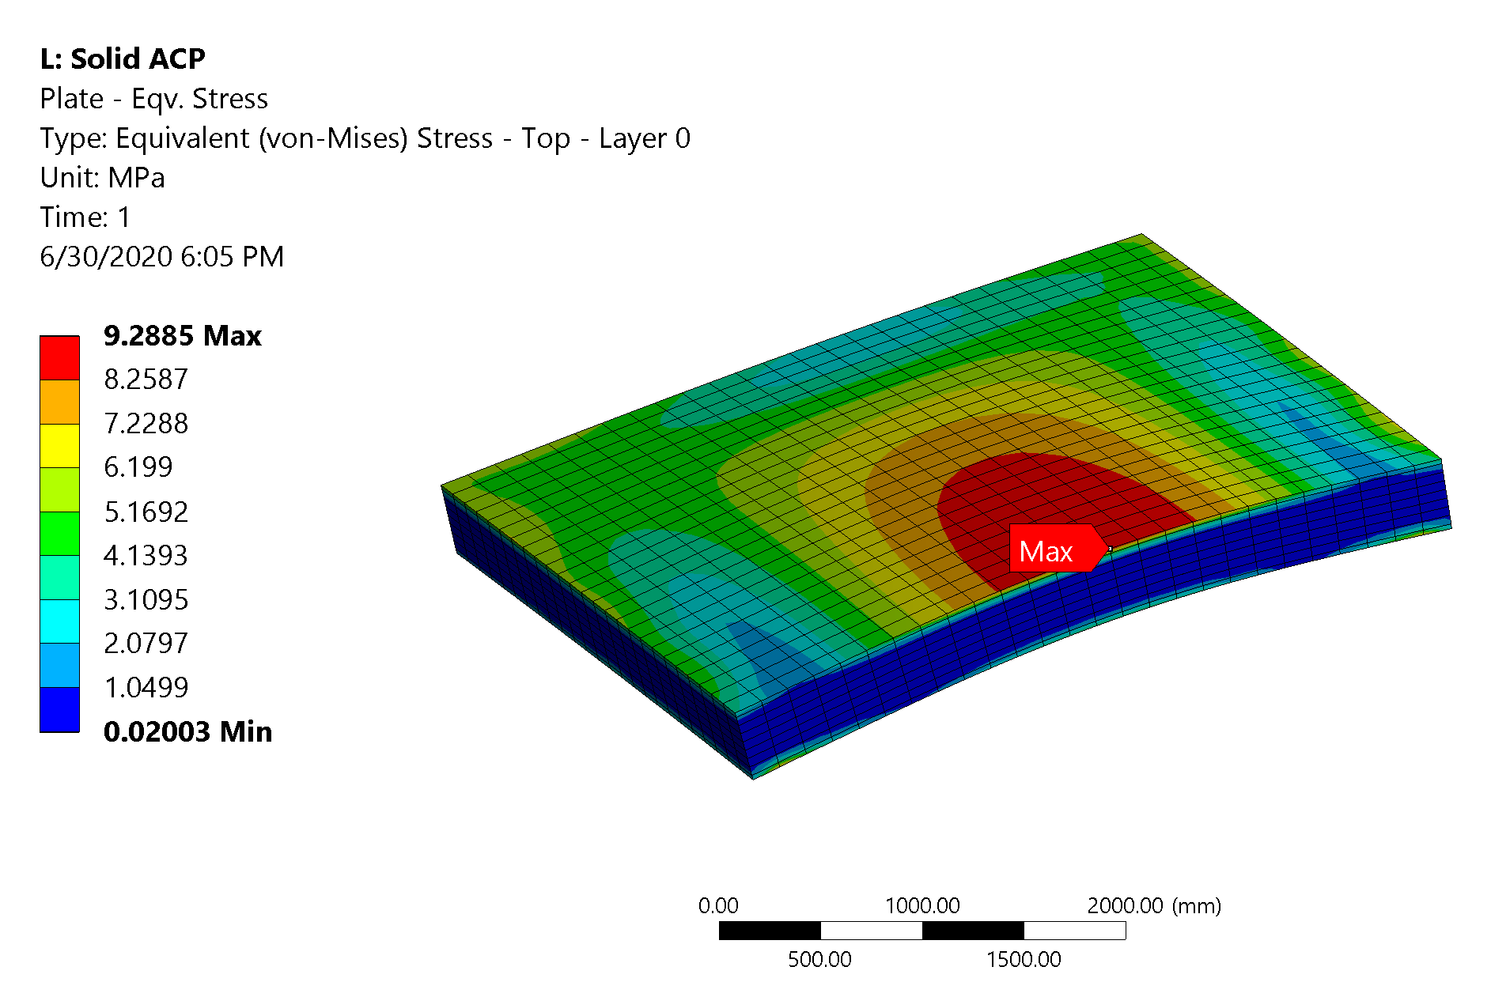
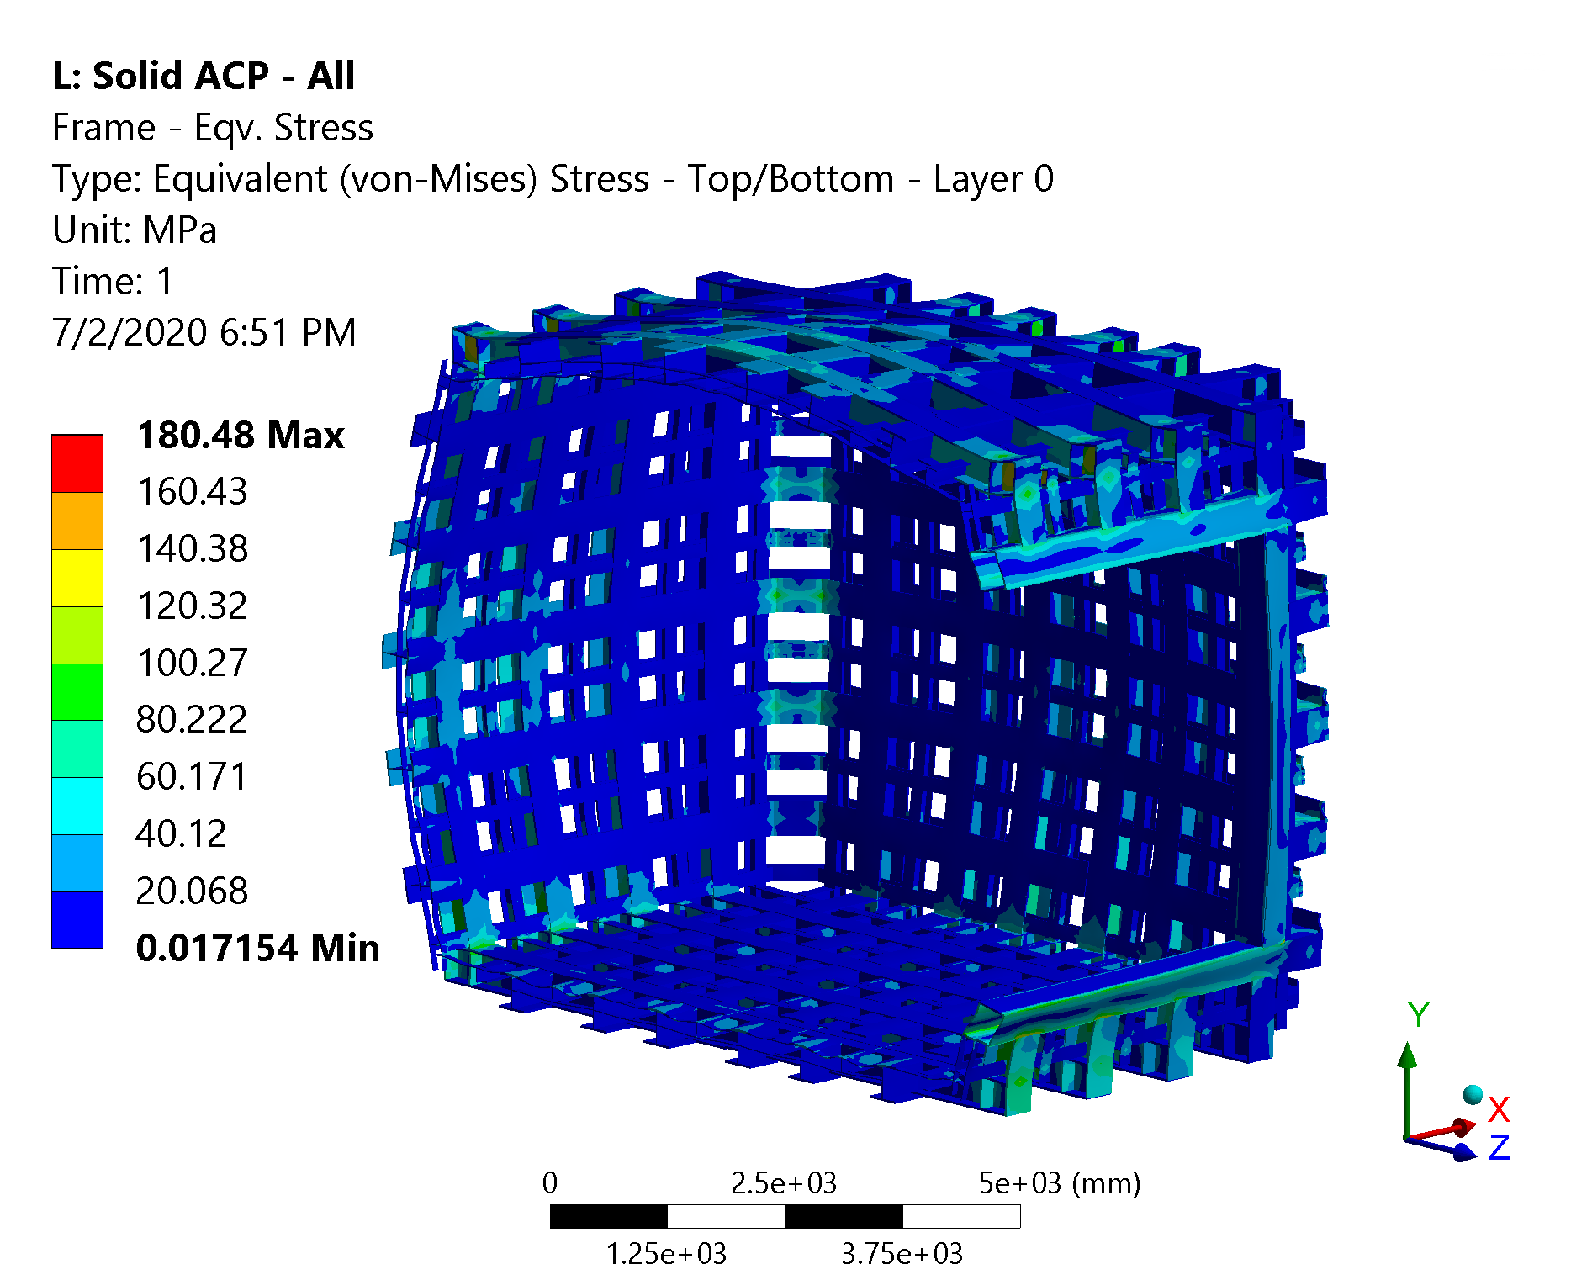
Structural Analysis – Stress Analysis
Negligible stress on the plate
Stress on the steel structure is low almost everywhere
Few joints see local stress spikes (still lower than the yield limit)
Max stress ~ 180 MPa on the square beam joint
This can be reduced adding local reinforcements (as in ProtoDUNE)
Preliminary results, beams/joints to be verified following structural codes

Slide 12
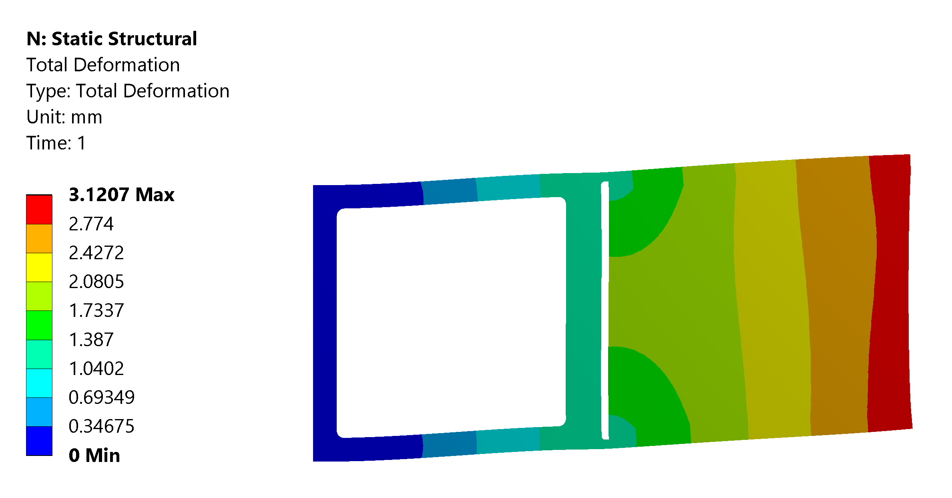
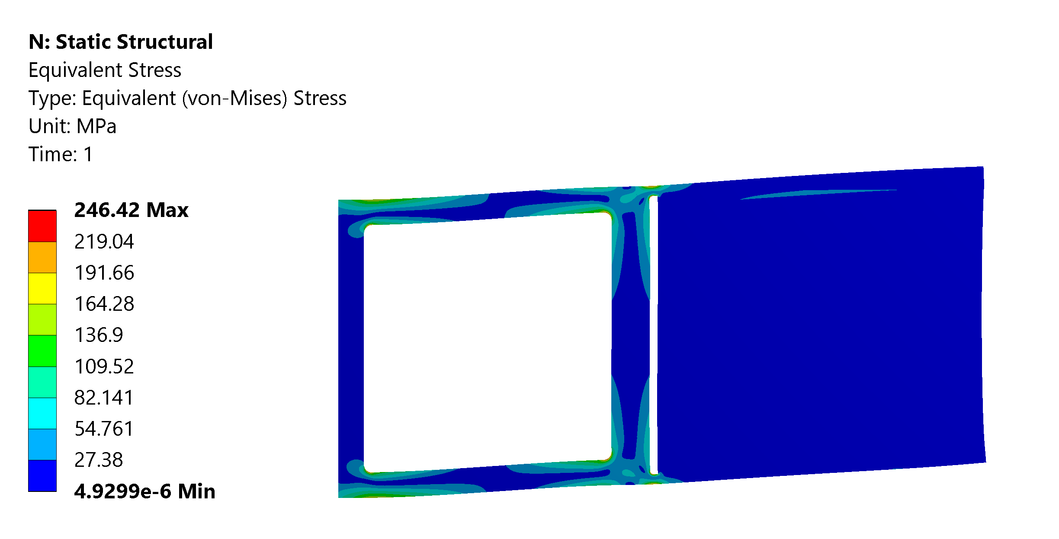
Scarf Joint – 2D Model Results - Compliance
Joint compliance is almost all in the box beam constraint
This is what we want, and a joint behaving like this will guarantee similar results to the one provided by the 3D analysis
Negligible stresses in composite components
Local stresses in steel:
May need some reinforcement / higher radius
We might decide to accept a small amount of plastic deformation there
Here we are considering an ‘exaggerated’ scenario where there is no longitudinal support

Slide 13
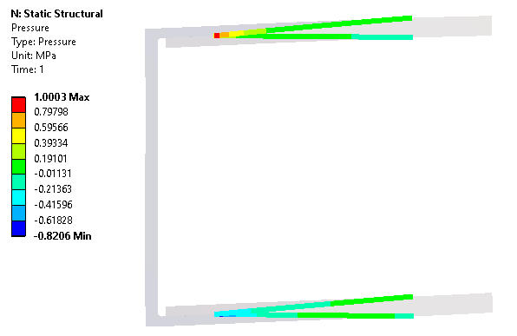
Scarf Joint – 2D Model Results – Glue Strength
Stress allowed in the glue:
5 MPa average on shear stress
10 MPa average on tensile
We are ~1 order of magnitude below
Also the maximum stress in the glue is lower than our average criteria

Slide 14
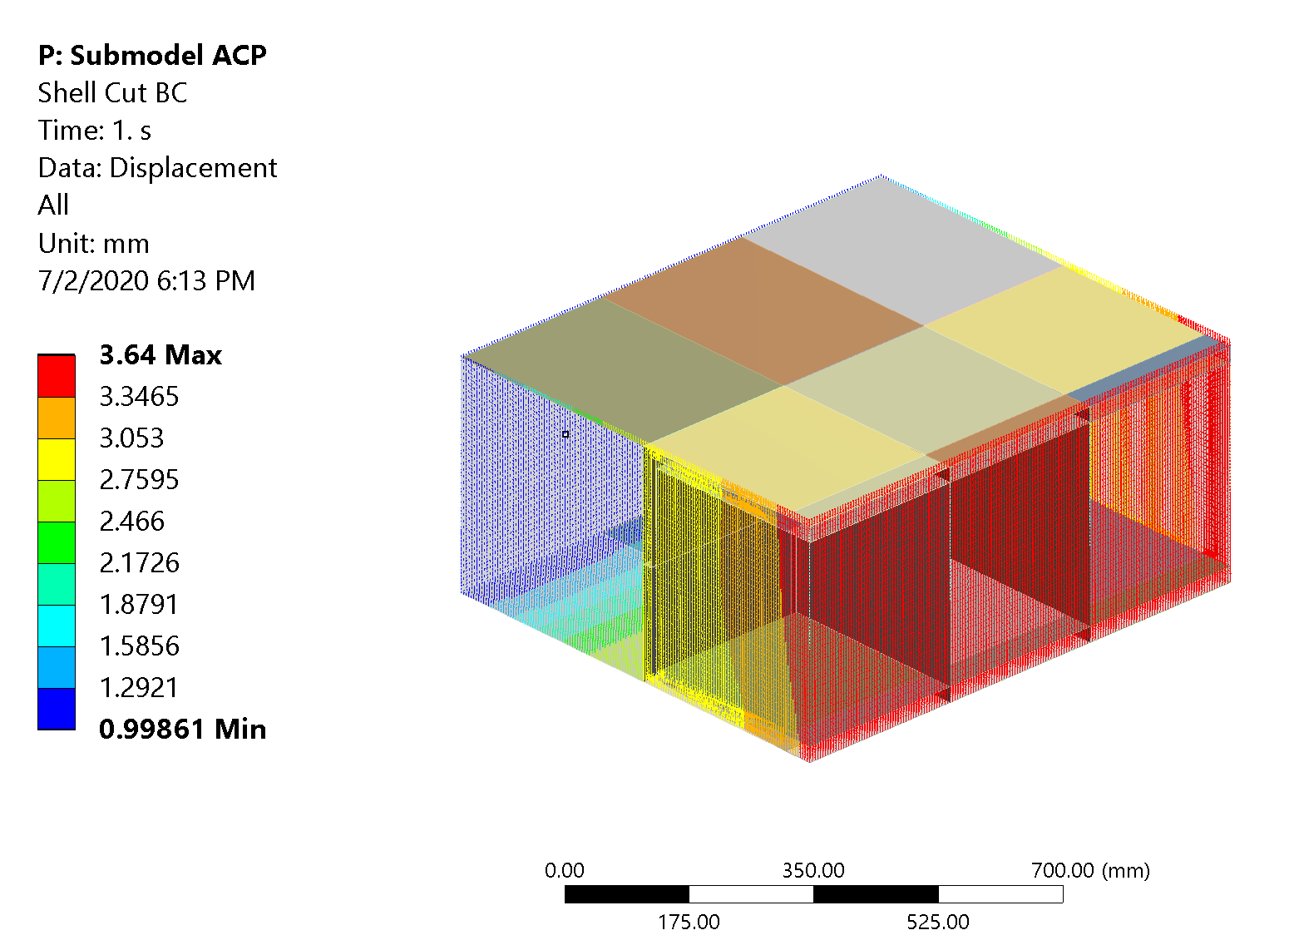
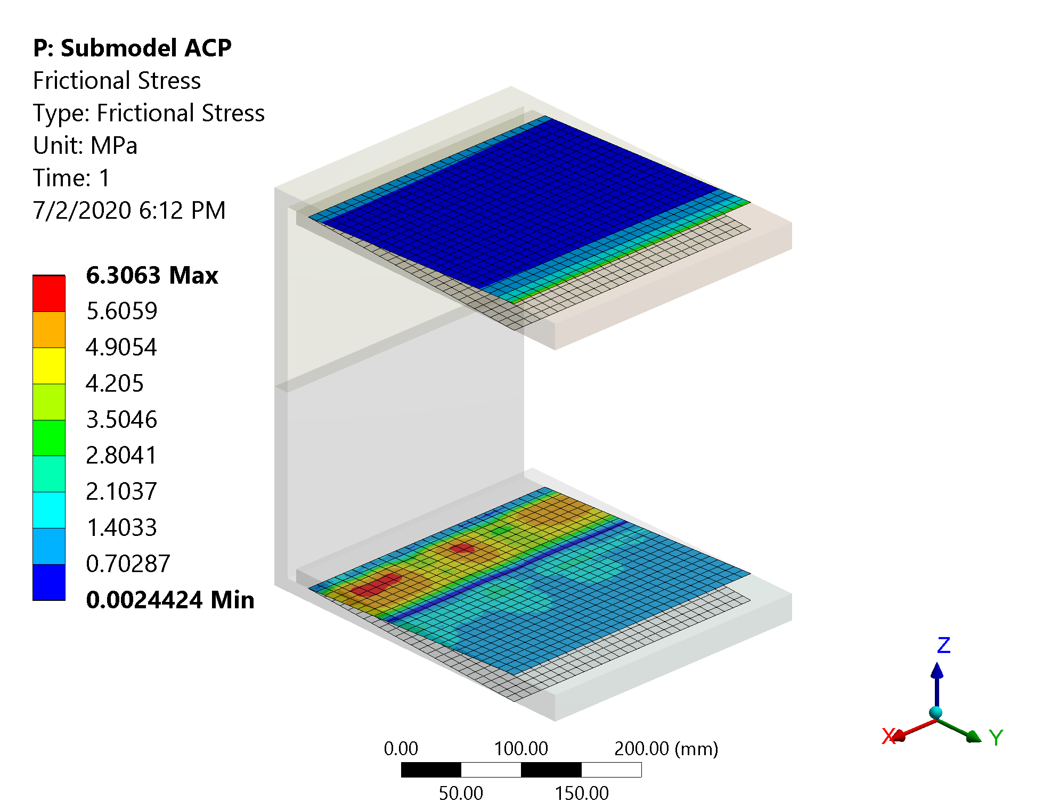
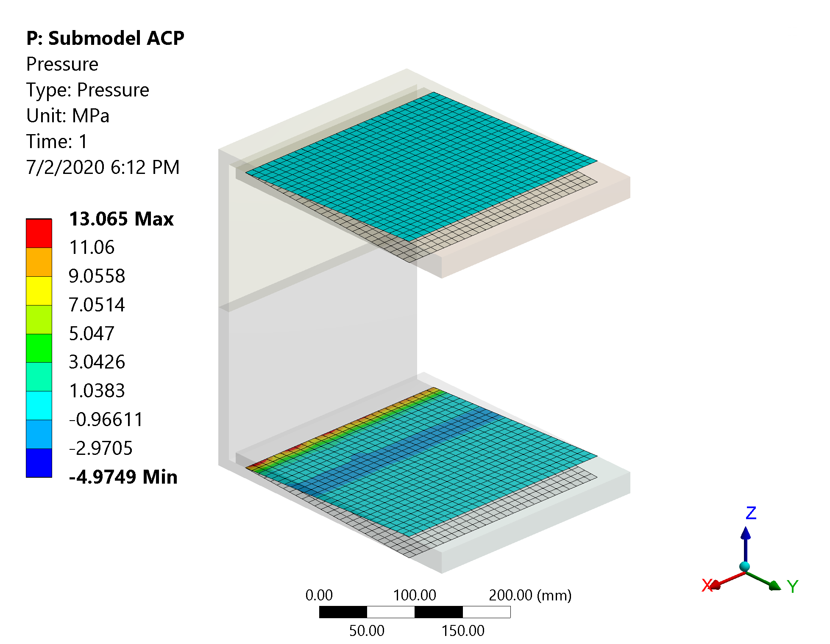
Structural Analysis – Stress Analysis on the Joint
Joint submodel analysis:
displacements interpolated from the global model and applied on the cut boundary
Stress allowed in the glue:
5 MPa average on shear stress, 10 MPa average on tensile
Max frictional stress ~ 6 MPa, Max. tension ~ 5 MPa
Criteria satisfied with significant margin

Slide 15
Index
Introduction
LAr Cryostat
Design Description
Global Structural Analysis
Frame/Window Joint Design
Qualification Plan
Conclusion

Slide 16
Applicable Documents/Standards - 1
Fermilab Safety Manual (April 2020):
FESHM 5031.7: Membrane Cryostats
FESHM 5031.7: Requirements for Membrane Cryostats
TA5031.7 – Form for membrane cryostats
Applicable codes:
EN-14620 (December 2006): Design and manufacture of site built, vertical, cylindrical, flat-bottomed steel tanks for the storage of refrigerated, liquified gases with operating temperatures between 0 °C and -165° C
Warm support structure, steel components:
EU codes (Equivalence to US codes from: Acceptance of Steel and Aluminum Structures Designed per the Eurocodes at Fermilab):
Eurocode 1990 (April 2002): Basis of structural design
Eurocode 1991-1-1 (April 2002): Actions on structures – Part 1-1: General actions – Densities, self-weight, imposed loads for buildings
Eurocode 1993 (May 2005): Design of steel structures:
Part 1-1: General rules and rules for buildings
Part 1-8: Design of joints
Eurocode 1998 (December 2004): Design of structures for earthquake resistance
Loads from USGS design maps for FNAL

Slide 17
Applicable Documents/Standards - 2
Applicable codes (continues):
Warm support structure, steel components:
EN 1090-2: Technical requirements for the execution of steel structures
Warm support structure, steel/window joint:
EN1990 Annex D – Design Assisted by Testing
Warm support structure, composite window:
ASME RTP-1-2013 – Reinforced Thermoset Plastic Corrosion-Resistant Equipment

Slide 18
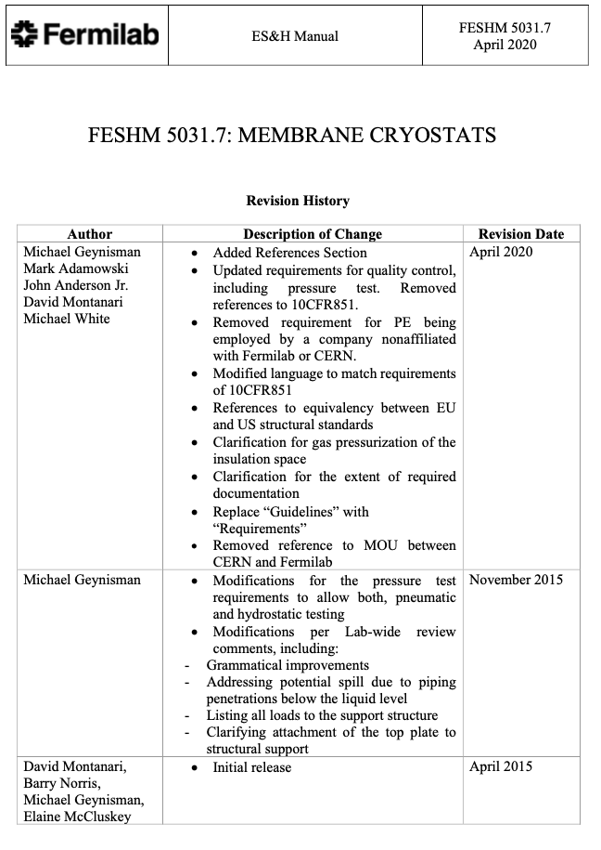
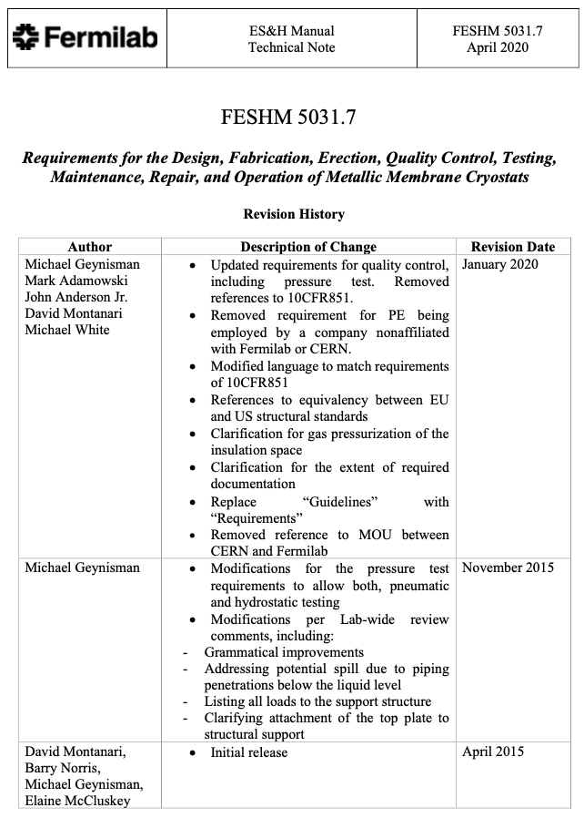
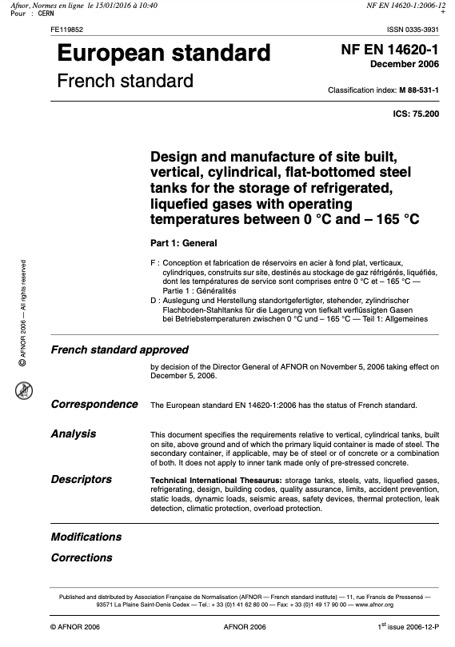
Applicable Documents/Standards – Covers - 1

Slide 19
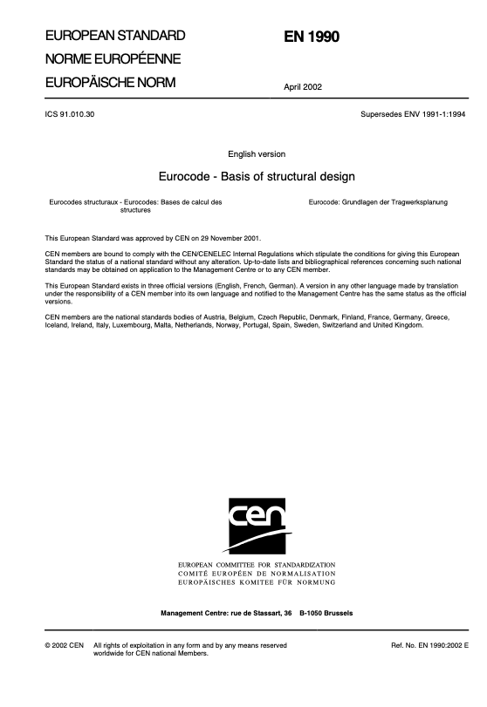
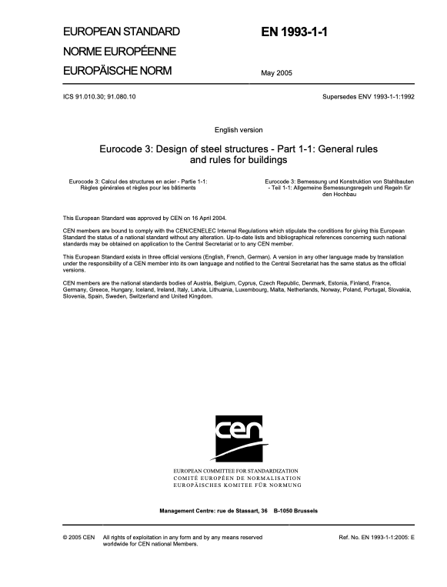
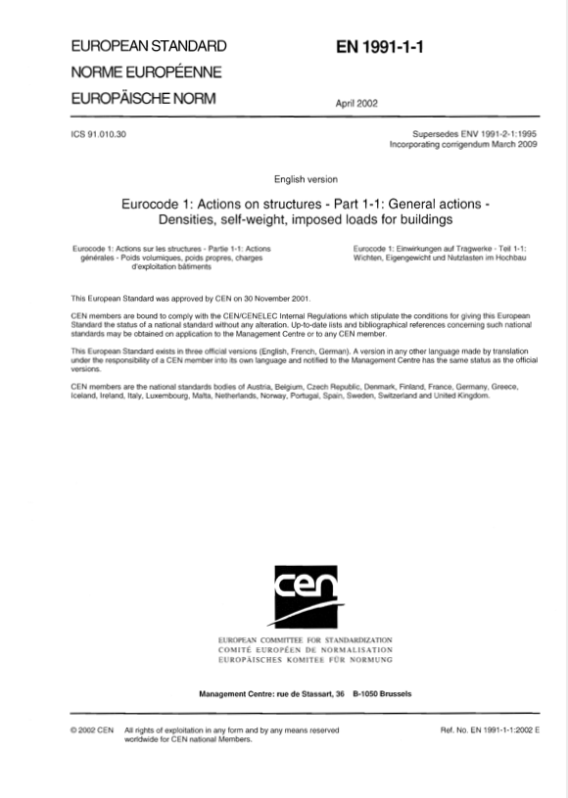
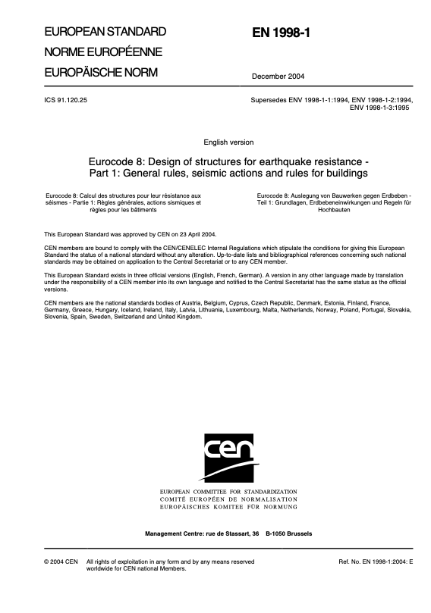
Applicable Documents/Standards – Covers - 2

Slide 20
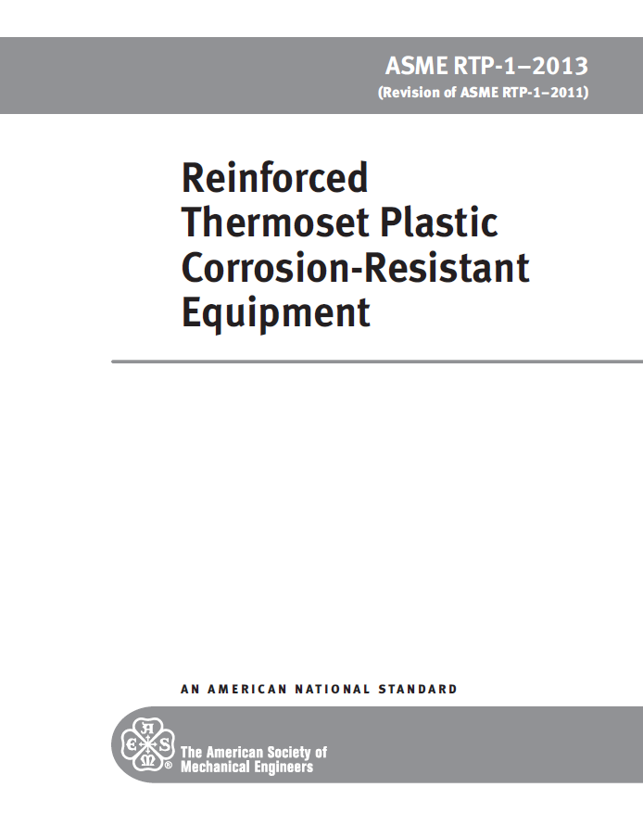
Applicable Documents/Standards – Covers - 3

Slide 21
General Plan
Membrane cryostat, steel structure:
FESHM, EN14620, EN1990/3/8 satisfied following protoDune/SBND
Manufacturing and Assembly
Manufacturing and assembly following EN1090-2, which provides requirements for the execution of steel structures, to ensure adequate levels of mechanical resistance and stability, serviceability and durability
The structures follow a strict quality control, inspection and testing plan as per EN1090 (i.e. quality of welds execution attested by an authorized independent inspection agency)
Quality control of the composite parts (joints and window) will follow ASME RTP-1
Tests and commissioning
Destructive test for the weakest structural part of the steel frame
Stiffness and strength tests of the steel to composite joints
Structural tests of the window laminate required by ASME RTP-1
Pneumatic test of the cryostat
Hydrostatic + overpressure (up to design gas overpressure, 350 mbar) test
Gradual load increase with step-by-step comparison with FEA results
Acoustic emission will not be used (stress ratio 9 on laminate, per ASME RTP-1)

Slide 22
Joint - EN1990 Annex D – Design Assisted by Testing
EN1990 Sec 5.2 used to design the steel/window joints:
Design may be based on a combination of tests and calculations.
Testing may be carried out, for example, in the following circumstances:
if adequate calculation models are not available;
to confirm by control checks assumptions made in the design.
Test scope:
Determine the stiffness and strength of the frame/window joint
Window (glass fiber reinforced plastic) verification based on BPVC
Test plan will be described in a dedicated talk
EN1990 Sec 5.2 - Annex D:
Conversion factor for scaling, etc.
Partial factor as appropriate (joints, see EN1993-Part 1-8)
Average
Conversion
Factor
Partial
Factor
Coeff. of
Variation

Slide 23
Composite Sandwich Plate – ASME RTP-1
Materials:
Allows for flat cored plates but requires:
Polyester or vinyl ester resins – might be required because of corrosion resistance (we do not need that), and might not be the best ones for our use case
Balsa wood core – great mechanical performances, but might not be necessary…
We could prove that our material choice has equivalent performances
Design:
Design by analysis, with stress ratio 9 if no Acoustic Emission is performed
8 otherwise, but we are not sure on how AE acceptance criteria would interact with the steel structure. Also, requires multiple fillings to verify the AE variation.
Strength: Tsai-Wu or first play failure
Testing:
Requires mechanical tests on the laminate
Pressure test: fill at full designated liquid capacity
Compatible with FHSM requirements and tests/commissioning procedures defined for protoDune/LBNF

Slide 24
Composite Sandwich Plate - Alternatives
Three possible paths for the composite components (not the joints, already covered in EN1990):
ASME BPVC Sec X, Fiber-Reinforced Plastic Pressure Vessels:
Might be classified as class 2 vessel
Sandwich construction not considered
Special joints not considered
ASME RTP-1, Reinforced Thermoset Plastic Corrosion-Resistant Equipment:
Allows for a flat sandwich plate
Special requirements on the materials, core might be an issue – must be balsa core, polyester or vinyl ester resins
Special joints not considered
Euro guidance - Prospect for New Guidance in the Design of FRP or European recommendations (e.g. CUR96):
Harmonized with the Eurocode
Materials ok
T has to be > -20 C
We can satisfy the requirements from one of these standards AND Eurocode 1993 AND EN-14620
We might need to write our design criteria specifying with more detail which rules are applied where

Slide 25
Conclusion and Next Steps
Conclusion:
A preliminary design was discussed, with relative preliminary FEA results
We have identified a set of standards and a procedure with key steps
Frame/window joint verification:
A preliminary test plan was already defined, discussed in the next talk
Next steps:
Iterate based on committee feedback

Slide 26
Back-up slides

Slide 27
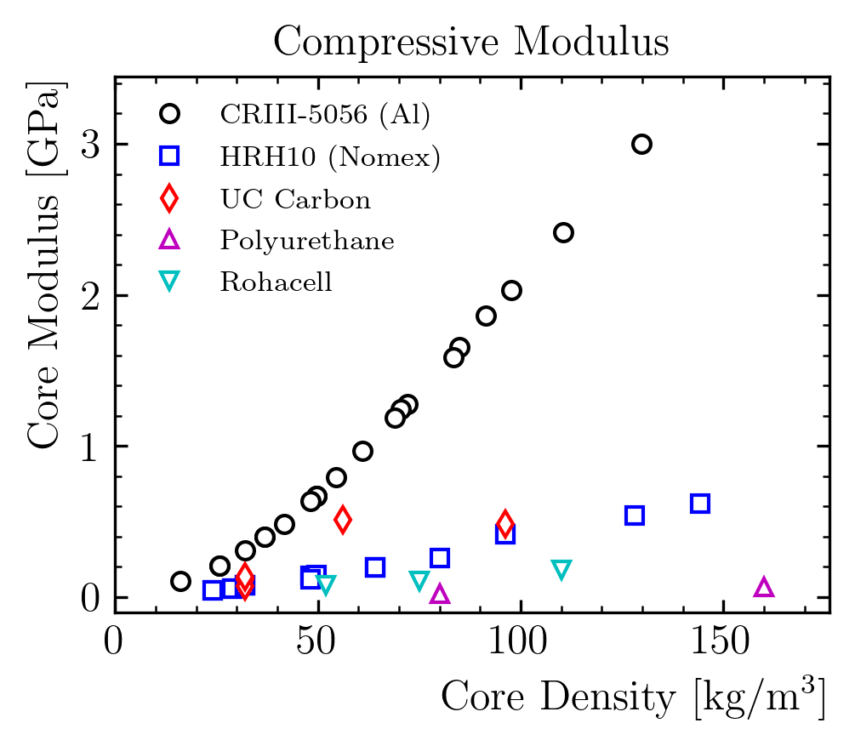
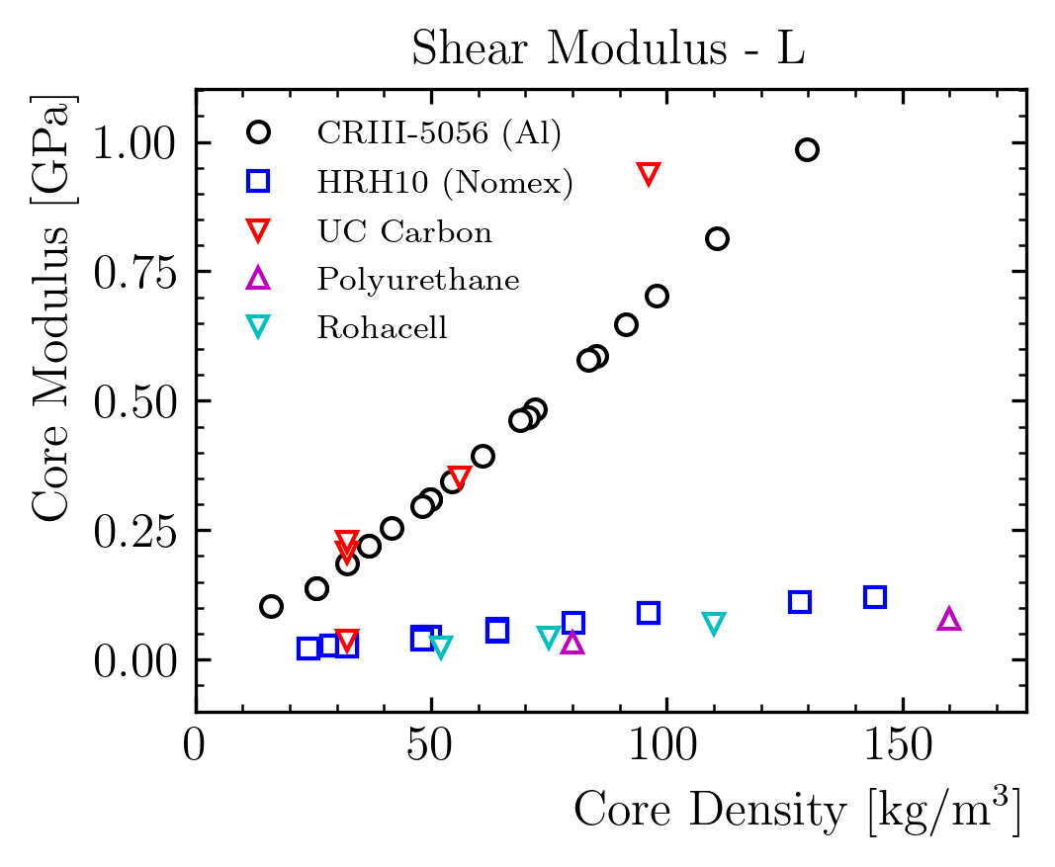
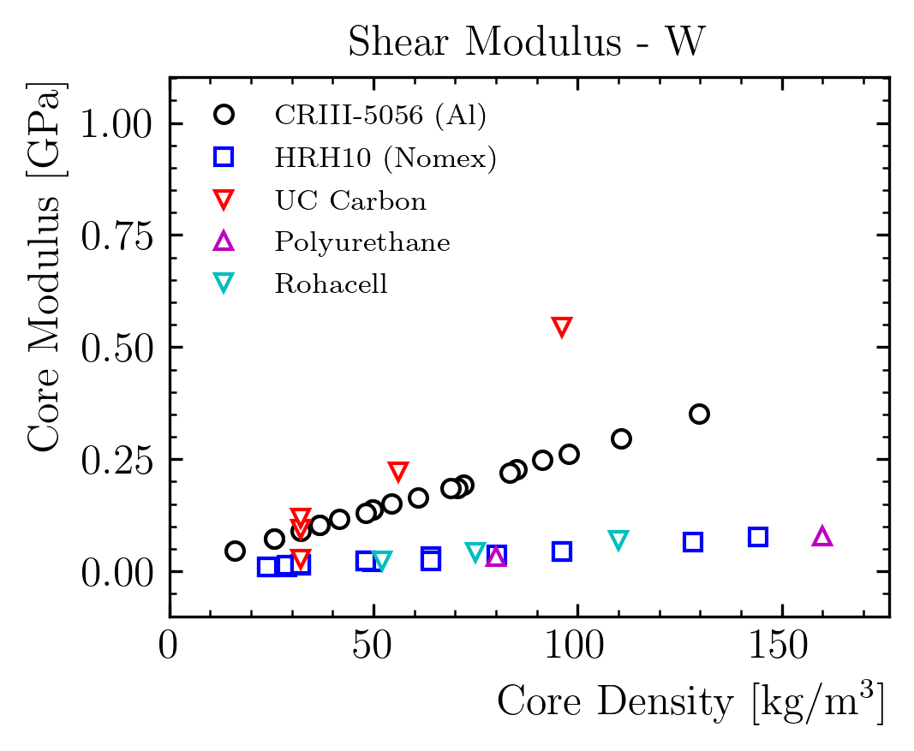
Window Design: Which are the Available Parameters?
Sandwich design
Better than locally stiffened designs for distributed loads (e.g. pressure)
Available parameters:
Skin thickness / Core thickness
Skin material
Core material
Carbon and Aluminum outperform other materials, but they are much more expensive

Slide 28
Window Design: Surface Density Contribution of the Window
Layer | Material | thickness | rho | rho*t | Contrib.
/ | / | mm | kg/m³ | g/cm² | %
Liquid | Argon | 300 | 1396 | 41.9 | 62.7%
Plate | Steel | 2 | 7000 | 1.4 | 2.1%
Insulation | Polyurethane | 808 | 90 | 7.3 | 10.9%
Window | Composite | 372 |  | 16.2 | 24.3%
Steel Avg. | Steel | 58.3 | 7000 | 40.8
Steel Max. | Steel | 372 | 7000 | 260.4
Total |  |  |  | 66.78 | 100%
Surface density of each component
Target (total) is ~ 50 g/cm²
Composite window contribution ~ 16% of the total
Advantage on steel:
factor ~2.5 on average
1 order of magnitude on the beam locations

Slide 29
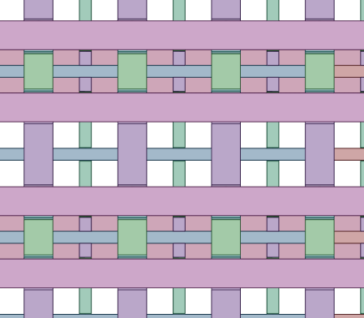
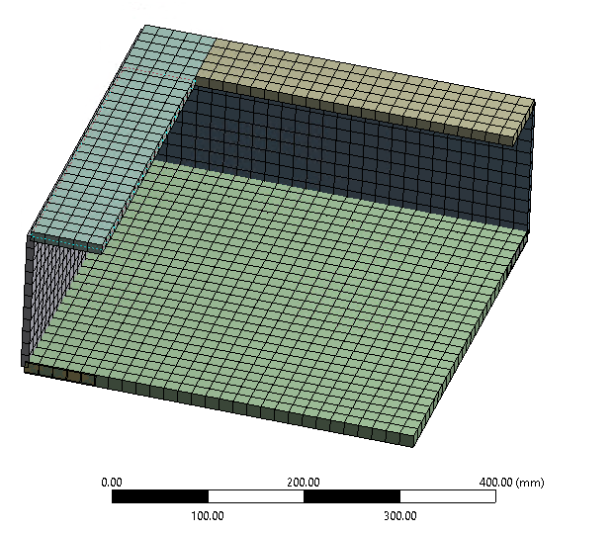
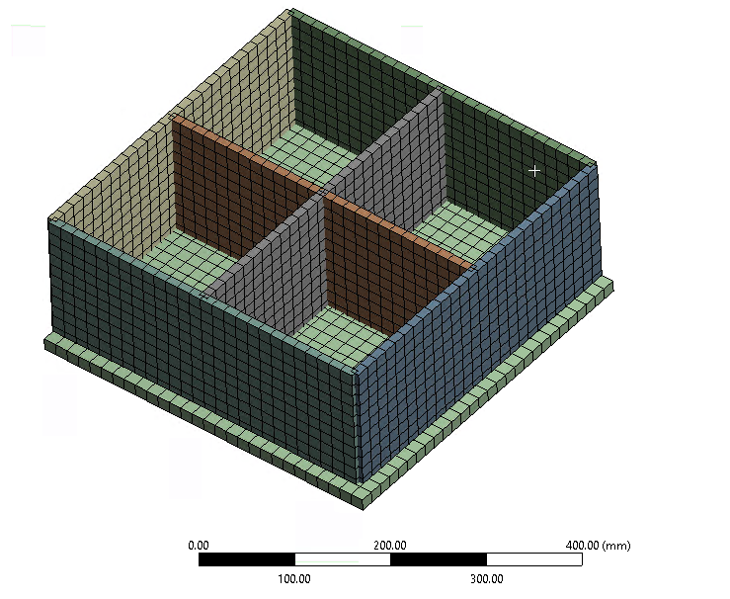
Secondary Support – Possible Designs
Comparison ‘corrugations’ vs ‘small beams’
‘Square region’ case / similar performances expected on the rectangular one
The role of these reinforcement is to contain the local deformations
It is a ~secondary structure
Corrugations were adopted for simplicity in SBND
Might be wort to estimate an equivalent plate stiffness for our beam model

Slide 30
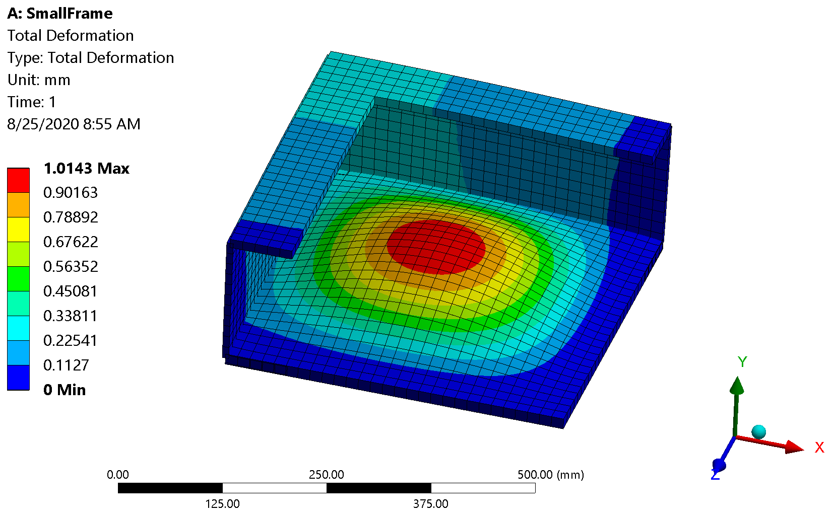
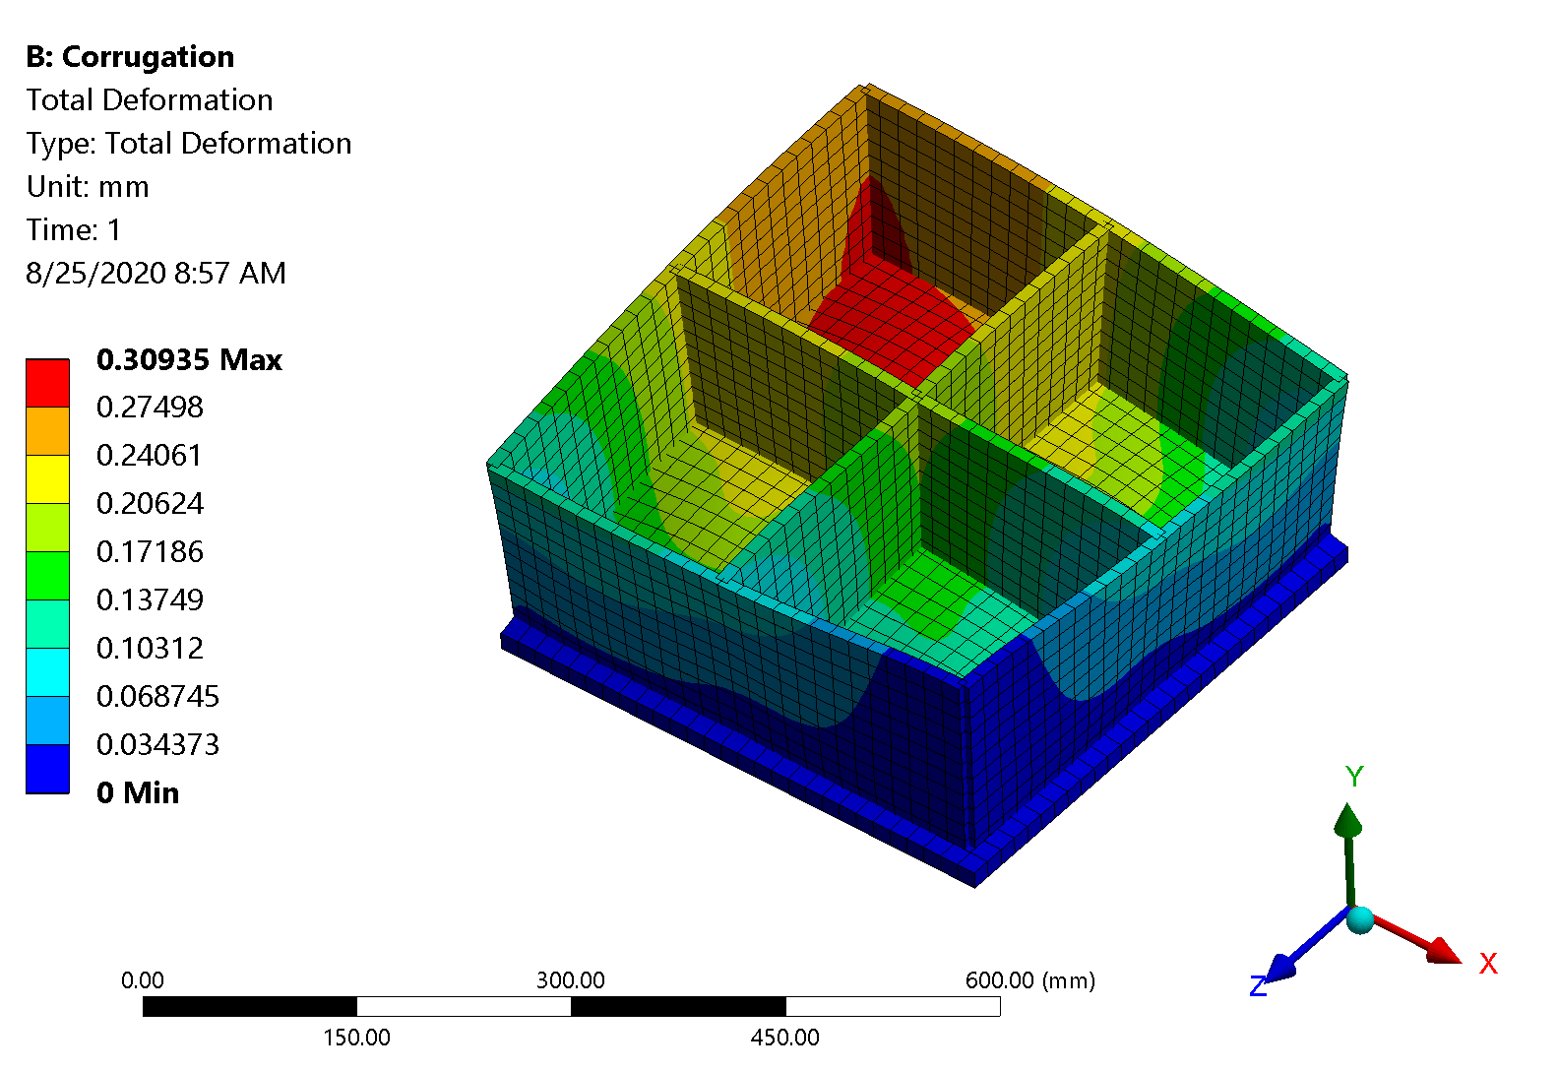
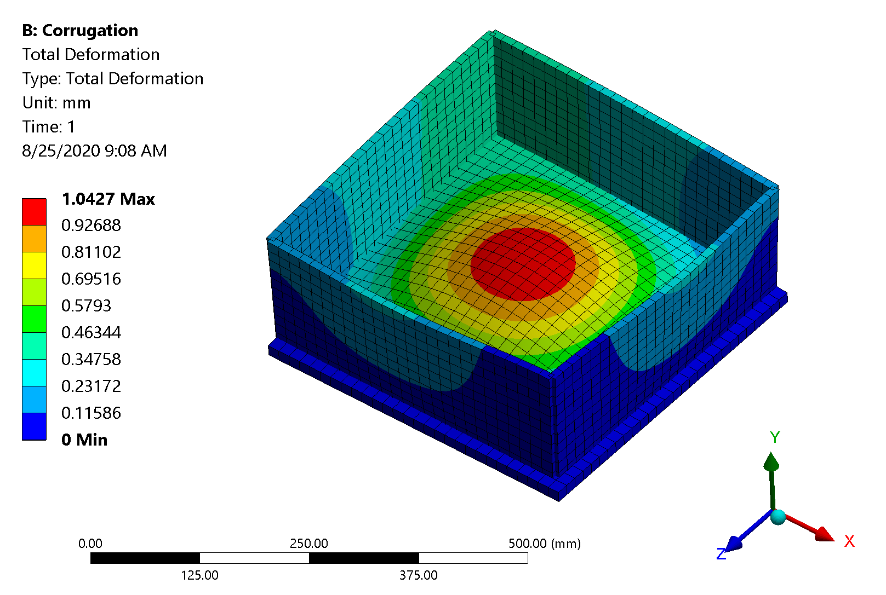
Secondary Support
Design 1
Max. deformation is in the middle of the non-reinforced region for the beam
Corrugation design 1 has better performances, but also more material
Design 2 has same mass and similar performances
Performances driven only by the maximum distance between stiffeners $→$ minimize
We can go for the corrugation design
Design 2

Slide 31
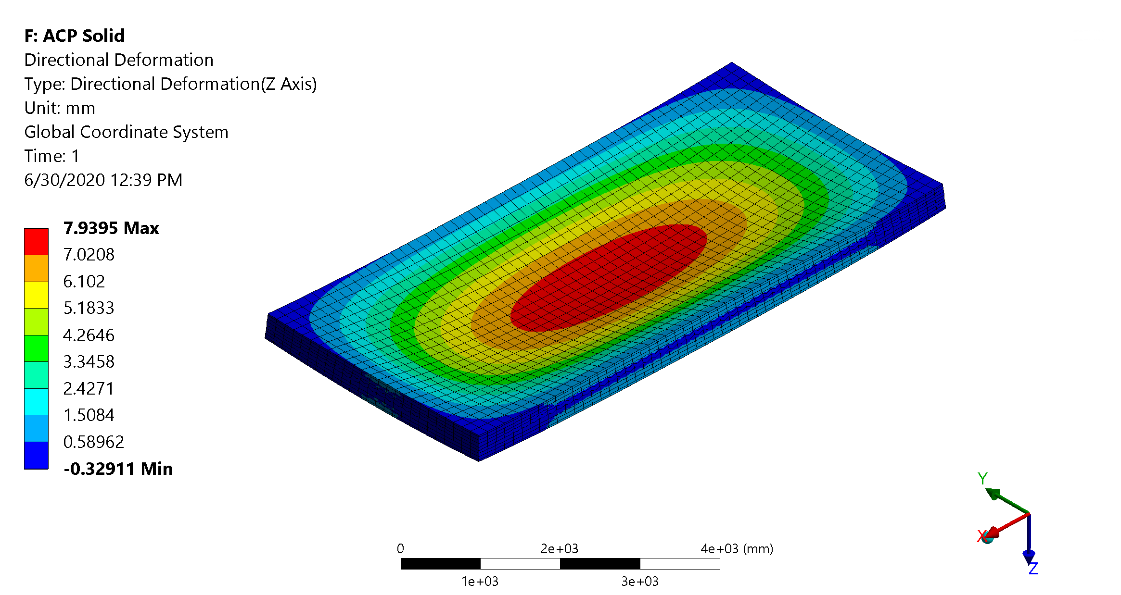
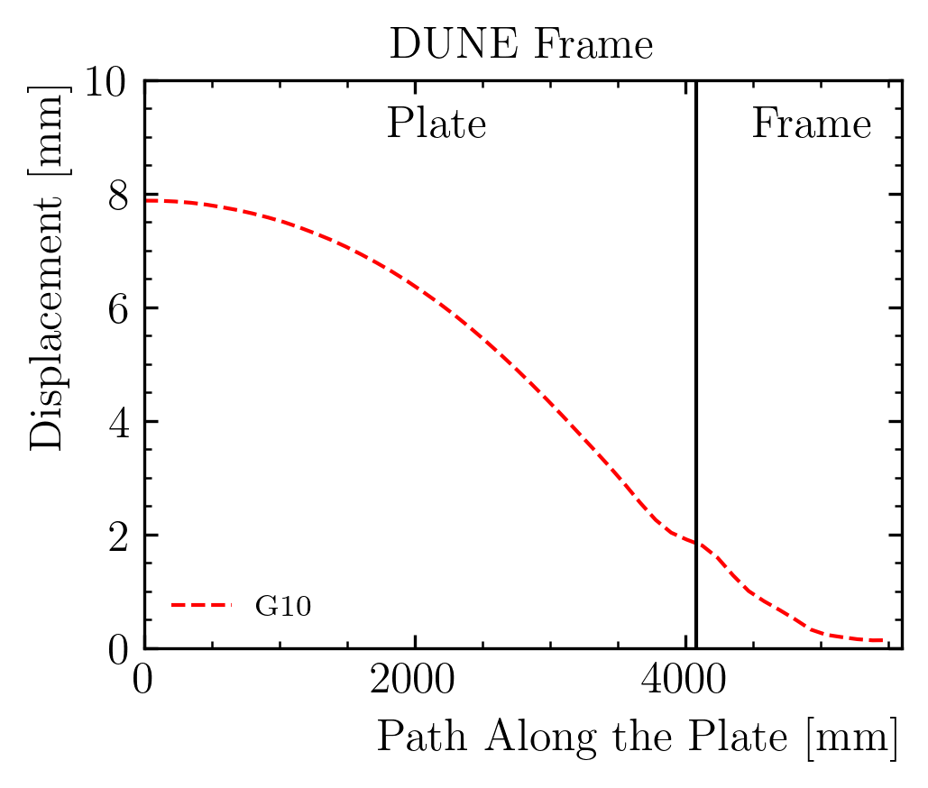
Structural Analysis – Impact of the frame on the displacement
Supported
Fixed
Plate stiffness – simply supported and fixed on the outer edge
Displacement: 7.9 mm or 2.6 mm
Most of the deformation is coming from the frame!
Edge rotation ~ 3.3 mm
Support motion ~ 2 mm

Slide 32
Structural Analysis – Stress Analysis
Negligible stress on the plate
Stress on the steel structure is low almost everywhere
Few joints see local stress spikes (still lower than the yield limit)
Max stress ~ 180 MPa on the square beam joint
This can be easily be reduced adding local reinforcements (as in ProtoDUNE)

Slide 33
Applicable Documents/Standards - 3

Slide 34
Work Plan - Description
Our current work plan divided in 3 ‘phases’:
Phase I is the discussion with the committee:
We can’t really proceed with the design/test/calculations unless we agree on the applicable standards and limits
The main result of this discussion will be the Memorandum of Agreement document, listing the applicable standards for design, manufacturing, assembly, and the test and commissioning plan
In Phase II we can proceed with:
Structural calculations
Test campaign for the composite parts and steel/composite joints
Phase III will produce the ‘deliverables’:
Test results summary
Calculation note
Quality control and acceptance testing plan (Quality assurance)
Fabrication and erection plan

Slide 35
Loads Definition - 1
Loads can be defined following:
Eurocode 1991-1-1: Actions on structures – Part 1-1: General actions – Densities, self-weight, imposed loads for buildings
ASCE/SEI 7 document (Minimum Design Loads for Buildings and Other Structures)
In both cases, we get a series of coefficients that we need to apply to define two ‘load-cases’:
Serviceability Limit State (SLS): related to deformations/vibrations/damages that might affect appearance/discomfort. In our case would be related to the detector performances
Ultimate Limit State (ULS): limit that concern the safety of people and of the structure
Design value for the actions considers a characteristic value (F), possible unfavorable deviations from the average value (𝜓>1) and a combination coefficient (𝛾<1)
𝜓 values are in three ‘tiers’ with growing ‘likelihood’. In our case is not very interesting as all our load combinations (permanent loads) should be very predictable ~ (e.g. no snow, wind, traffic…)

Slide 36
Load Definition – 2 – Ultimate Limit State
For ULS load combination:
In our case:
Self-weight: 1 or/and 1.3
Hydrostatic pressure: 1.3
Overpressure: 1.5
Sloshing load, horizontal acceleration (should also be G): 1.5 – what if engine fails?
Note: we must check if self-weight is favorable w.r.t. pressure/overpressure
SBND: 1.35, 1.35, 1.4 – slightly different than expected
Permanent
Loads
Variable
Loads
Prestress

Slide 37
Load Definition – 3 – Serviceability Limit State
For SLS load combination:
Other combinations are considered in the standard, with different coefficients for the variable actions Q, which we are not considering
Seismic design situations:
Characteristic Combination

Slide 38
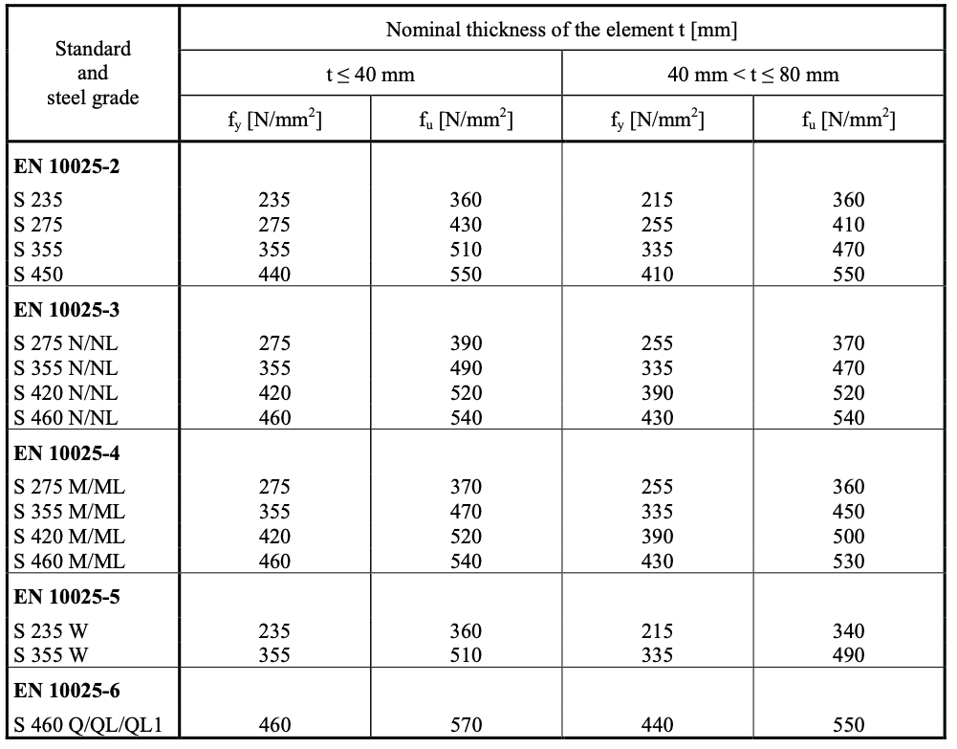
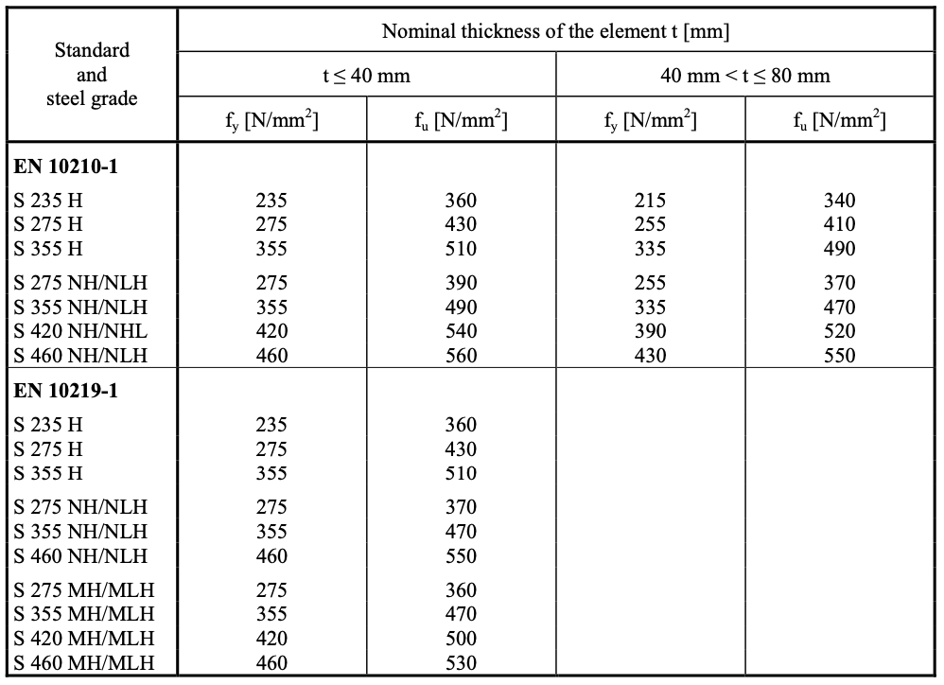
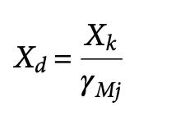
Material Selection and Limits
Steel selection – properties from EN1993-1-1
SBND used S355, start from the same material and evaluate costs in the meanwhile:
f_{y} = 355 MPa, f_{u} = 470 MPa
Material resistances must be scaled with safety coefficients:
𝛾_{M0} = 1 (resistance), 𝛾_{M1} = 1 (stability), 𝛾_{M2} = 1.25 (connections/joints)

Slide 39
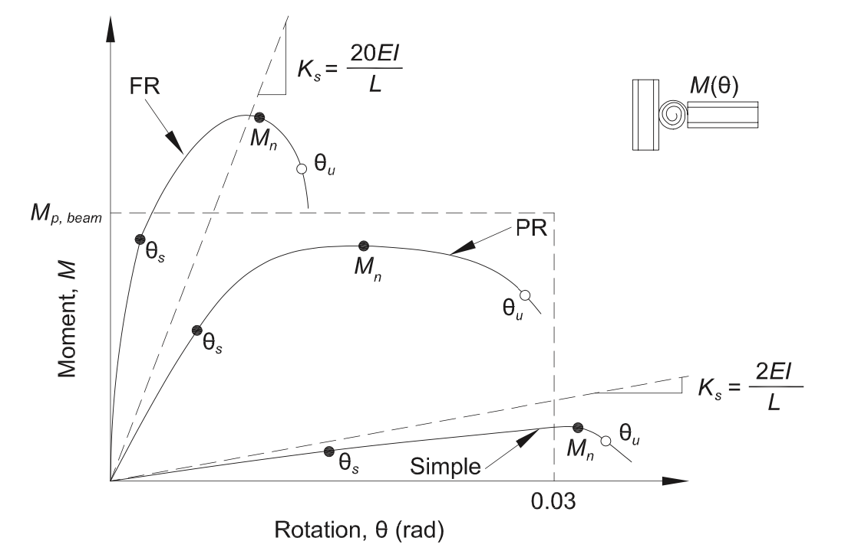
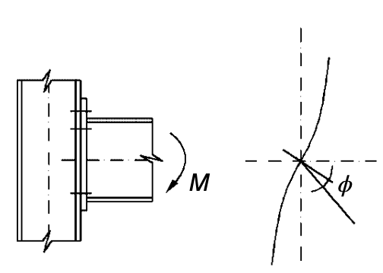
Connections/Joints – 1 – Joint Classification
Flexibility: in our beam model we can connect different beams with rigid, semi-rigid or flexible (pins) joints
If Ks>20EI/L we can use rigid joints (we did this until now)
Strength: full, partial, flexible – with respect to the members connected

Slide 40
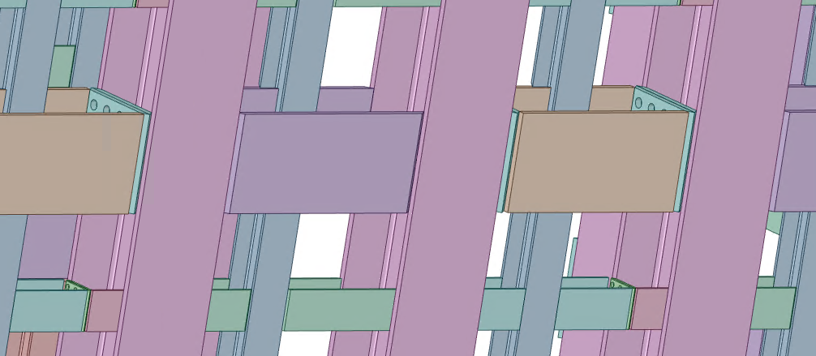
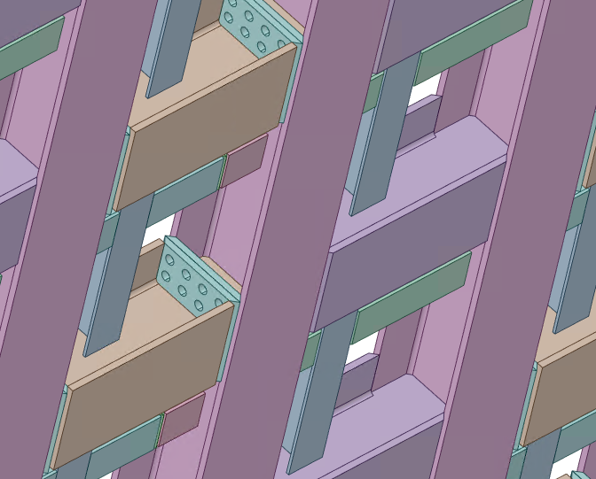
Connections/Joints – 2 – LAr Design Joint Types
Column
Beam
Plate C1
Weld Type 1
We are using 4 types of connections:
3 welded, 1 bolted connection
Need to check if this is complete or if we want to change it
Need to check each connection ‘type’
Beam to column connection: alternating weld/bolts with reinforcement plates

Slide 41
Connections/Joints – 2 – LAr Design Joint Types
Weld Type 2
Weld Type 3
Corner connection for beams: welded with reinforcement plates
Corner connection for columns: welded with reinforcement plates

Slide 42
FE Modeling
Beam model, more suited for ULS under development
Used to extract actions and verify strength and stability per EN provisions
We will have to add also the prison frame to this model
Joints must be modelled as rigid/semi-rigid/flexible based on the classification results
SLS considerations from shell model (presented at CDR) still valid

