Slide 1
DUNE Design Validation Plan Improving Technological Readiness
Dennis Boettcher & Giorgio Vallone
21 Oct 2020

Slide 2
Index
Introduction
Test Validation
Material
Joint
Beam
Plate
Work Plan / Schedule

Slide 3
Understanding TRL (Technology Readiness Level)
 |  | From Technology Readiness Assessment Guide, US Department of Energy, DOE G 413.3-4A, 9-15-2011
TRL 6 | Technology Demonstration Engineering or pilot-scale, similar system validation in a relevant environment Subscale Full Window | Engineering-scale models or prototypes are tested in a relevant environment. This represents a major step up in a technology’s demonstrated readiness. Examples include testing an engineering scale prototypical system with a range of simulants. Supporting information includes results from the engineering scale testing and analysis of the differences between the engineering scale, prototypical system/environment, and analysis of what the experimental results mean for the eventual operating system/environment. TRL 6 begins true engineering development of the technology as an operational system. The major difference between TRL 5 and 6 is the step up from laboratory scale to engineering scale and the determination of scaling factors that will enable design of the operating system. The prototype should be capable of performing all the functions that will be required of the operational system. The operating environment for the testing should closely represent the actual operating environment.
TRL 5 | Technology Development Laboratory scale, similar system validation in relevant environment Sandwich Beam Test | The basic technological components are integrated so that the system configuration is similar to (matches) the final application in almost all respects. Examples include testing a high-fidelity, laboratory scale system in a simulated environment with a range of simulants1 and actual waste2 . Supporting information includes results from the laboratory scale testing, analysis of the differences between the laboratory and eventual operating system/environment, and analysis of what the experimental results mean for the eventual operating system/environment. The major difference between TRL 4 and 5 is the increase in the fidelity of the system and environment to the actual application. The system tested is almost prototypical.
TRL 4 | Technology Development Component and/or system validation in laboratory environment Scarf Joint Test & RTM Manufacturing Demonstration | The basic technological components are integrated to establish that the pieces will work together. This is relatively "low fidelity" compared with the eventual system. Examples include integration of ad hoc hardware in a laboratory and testing with a range of simulants and small scale tests on actual waste. Supporting information includes the results of the integrated experiments and estimates of how the experimental components and experimental test results differ from the expected system performance goals. TRL 4-6 represent the bridge from scientific research to engineering. TRL 4 is the first step in determining whether the individual components will work together as a system. The laboratory system will probably be a mix of on hand equipment and a few special purpose components that may require special handling, calibration, or alignment to get them to function.
TRL 3 | Research to Prove Feasibility Analytical and experimental critical function and/or characteristic proof of concept FEA/Design Analysis for window (See Giorgio’s Analysis) | Active research and development (R&D) is initiated. This includes analytical studies and laboratory-scale studies to physically validate the analytical predictions of separate elements of the technology. Examples include components that are not yet integrated or representative tested with simulants. Supporting information includes results of laboratory tests performed to measure parameters of interest and comparison to analytical predictions for critical subsystems. At TRL 3 the work has moved beyond the paper phase to experimental work that verifies that the concept works as expected on simulants. Components of the technology are validated, but there is no attempt to integrate the components into a complete system. Modeling and simulation may be used to complement physical experiments.

Slide 4
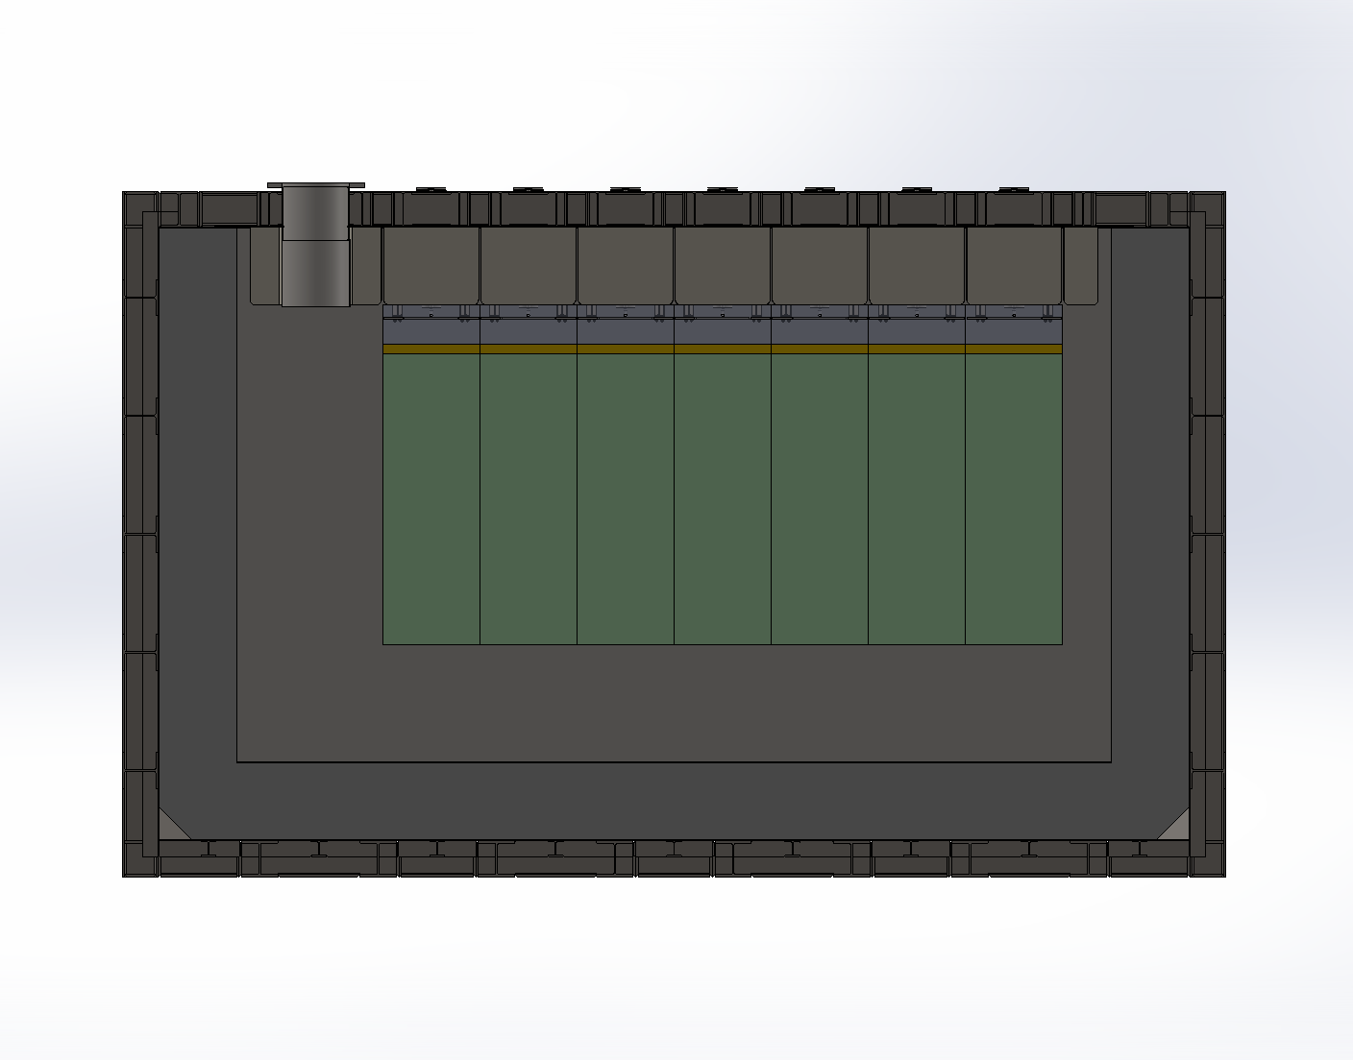
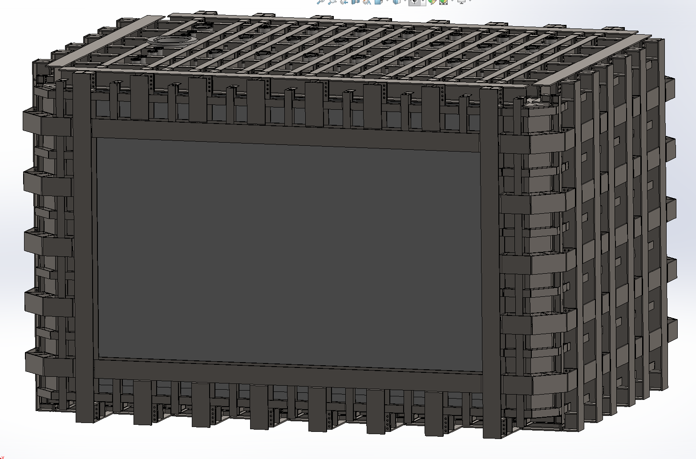
Cryostat Description
Steel Plate 1
Steel Plate 2
Steel Frame
Box Beams
Polyurethane
Liquid Ar
Detector
Composite Window
Liquid Argon enclosed by stainless steel plates / Polyurethane sandwich
One side covered by a composite window (described later) to reduce the impact on the particle beam
Window size: L8156*W3810*T372 (max)
G. Vallone

Slide 5
Geometry
Window size: 8156*3810*372(max)

Slide 6
MANUFACTURING TEST PLAN
Material
Joint – Full Laminate Thickness
Beam – Full Sandwich Thickness, TBD L & W
Plate - Subscale

Slide 7
MANUFACTURING TESTS
Room Temperature Cure
Not limited by size (Does not need to fit in autoclave or oven)
Slow Cure (to allow resins to fully transfer through fibers)
Can be manufactured without significant equipment (does not require specialized facility)

Slide 8
Manufacturing
The Window is VERY large for a composite structure. This means ideally autoclave should be avoided.
The Window may not be easily transported. Shouldn’t require specialized facilities.
May need to be made at the site at room temperature. Which leads us to RTM process.
Resin Infusion / RTM / VARTM is Resin Transfer Moulding. It is an out-of-autoclave process. Compact dry fibers onto a mold, then fill the voids between fibers with resin by using vacuum.
Must be selective with resin

Slide 9
Manufacturing Validation Test – Infusion Speed
The Resin chosen needs to cover 3810mm before the pot life of the resin is expired. Many resin pot life is only 20-45 minutes. Then it begins to slowly cure over 24 hours. We MUST ensure complete wetting of fibers across this 3810x8156mm distance before that 45 minute mark. We can test this with a small length first. This will validate the materials chosen (measure time, fiber volume, resin volume) and develop process for manufacturing
Infusion shown at 2:40 mark

Slide 10
RTM Example
2 meters
8 meters
2 meters
4 meters
8 meters

Slide 11
Measure RTM time & travel length

Slide 12
MANUFACTURING VALIDATION OBJECTIVES
Objectives:
Successful cure at room temp
Demonstrate good RTM process throughout large part
Validate material choices
Polyester, Vinyl Ester Resins? Probably Not Ideal
Balsa Wood? Not Ideal

Slide 13
JOINT TESTS
Full Scale
Determine material properties of laminate
Evaluate quality of scarf joint

Slide 14
Scarf Joint Experimentation
Steel Shoe
Shoe Angle
25mm
Steel Shoe
Fiberglass
The objective of joint experimentation is to develop sufficient understanding of the scarf joint. The taper and shoe angle may be dependent of bond strength which we would like to verify.
This is a very simple test that can be developed very quickly to give confidence in the joint design.
Load in compression & tensile.
Fullscale thickness. Reduced width/lengths should be independent of stress/train curve

Slide 15
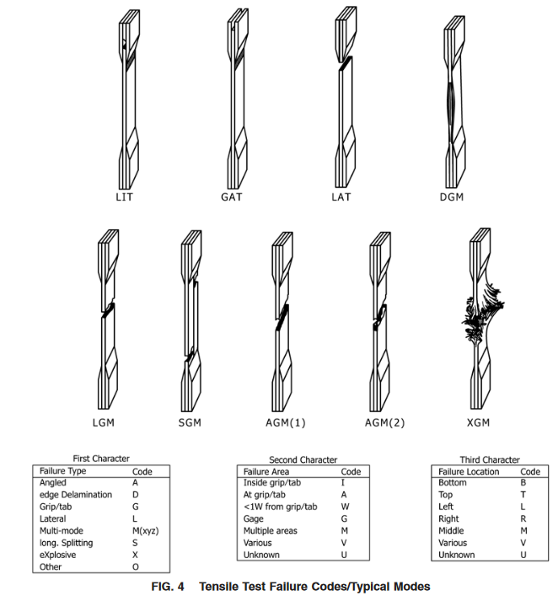
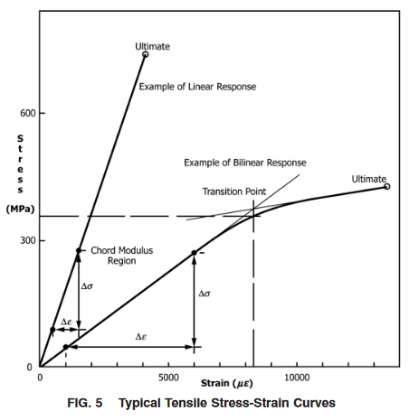
ASTM D3039 Standard Test Method for Tensile Properties of Polymer Matrix Composite Materials
Steel Shoes
Composite
Specimen 25mm x 250 mm

Slide 16
Tensile Test Coupon Dimensions
~25mm
Laminate
Steel Shoe
Scarf Joint

Slide 17
D3410 Standard Test Method for Compressive Properties of Polymer Matrix Composite Materials with Unsupported Gage Section by Shear Loading

Slide 18
Tensile Test Coupon Dimensions
150 mm
~25mm
Laminate
Steel Shoe
Scarf Joint

Slide 19
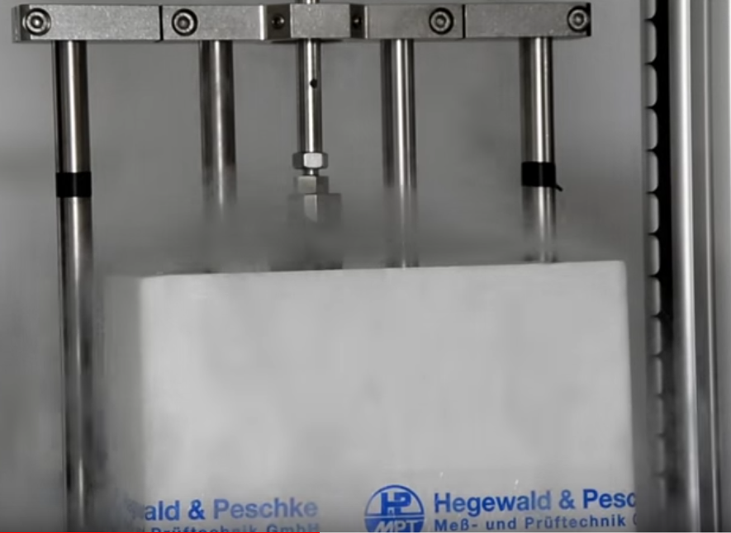
Elevated or reduced temperature test
A thermal chamber is installed on a Universal Test Machine. The chamber is designed to allow the test mounts from the base and crosshead of the Universal Tester to pass through the top and bottom of the chamber. Standard test fixtures are installed inside the chamber, and testing is conducted inside the controlled thermal environment the same as it would be at ambient temperature. The chamber has internal electric heaters for elevated temperatures and uses external carbon dioxide gas or liquid nitrogen as a coolant for reduced temperatures.
Thermal chamber on UTM
LN2 bath on UTM

Slide 20
Considerations: Heat Susceptibility
Glass Transition Point
Heat Flexure Temperature
Provided by vendors

Slide 21
Scarf Joint Tests (TRL5)
Scarf Joint Tensile Test x6
Scarf Joint Compression Test x6
Scarf Joint Tensile Test COLD x6
Scarf Joint Compression Test COLD x6
Laminate material properties measured separately (without joint)
Should be made with like-material and like-manufacturing process.
Sample Sizes based on Annex D
Objectives:
Tensile strength (MPa or PSI)
Tensile chord modulus of elasticity (MPA or PSI)
Tensile strain (%)
Poisson’s ratio Transition Strain (%)
Scarf Joint is STRONGER than composite laminate

Slide 22
BEAM TESTS
Full Sandwich Thickness. Reduced Width/Length
Bending mechanical properties
Integration with steel structure studies

Slide 23
Strip Loading Experimentation Full Thickness (PARTIAL LENGTH) Sandwich Beam
Loads
Steel Angle
Steel
Shoe
Strain Gauges
25mm
250mm
25mm
Core
Fiberglass
The objective of joint experimentation is to develop a full thickness partition of the window. This would only be a strip.
Loaded in bending (as cantilever).
Load estimates presented in Analysis

Slide 24
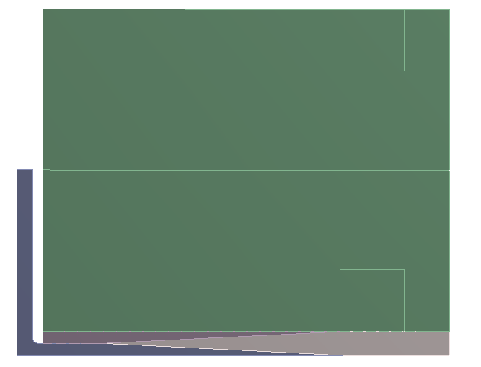
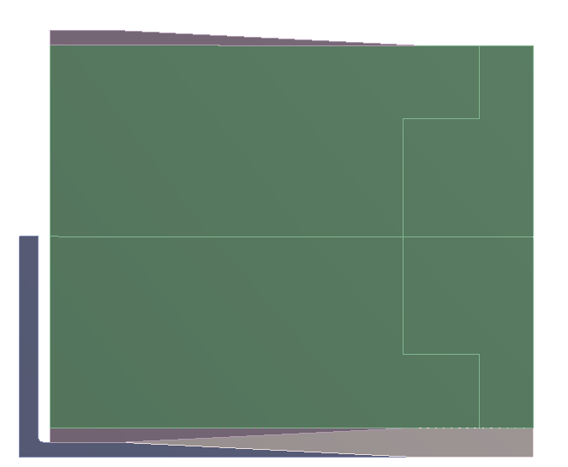
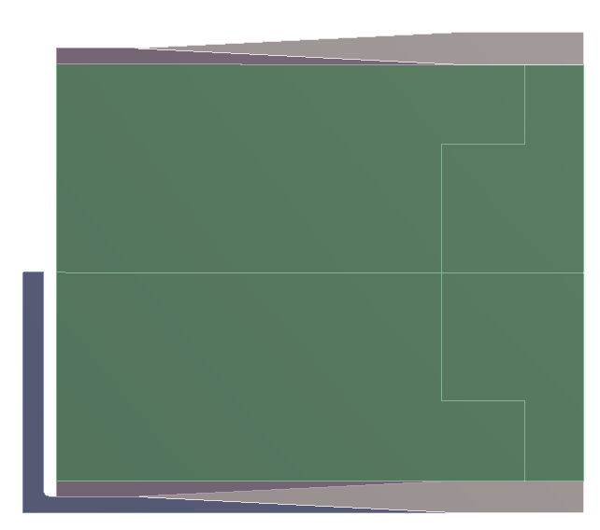
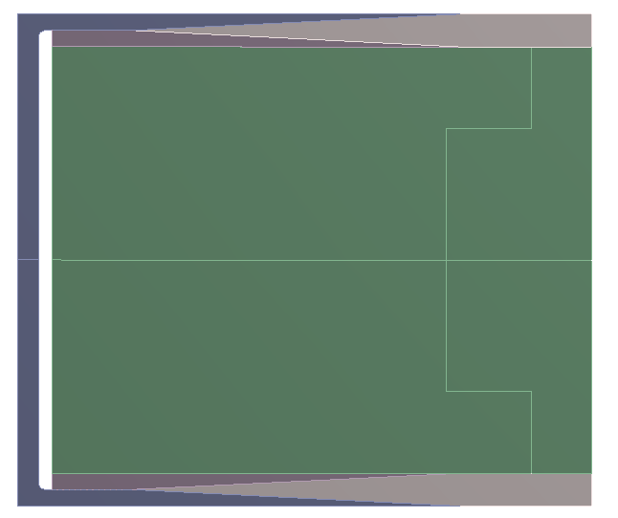
Scarf Joint – Production Process
1
2
3
4
5
6
Lay-up the bottom face sheet on the steel c-joint bottom half
Glue the bottom joint steel ‘shoe’
Glue the core
Glue the top joint steel shoe
Lay-up the top face sheet
Weld the c-joint, then weld to the box beam
G. Vallone

Slide 25
Sandwich Beam TRL5
OBJECTIVES
Sandwich Beam Cantilever Loading Test. X6 [Representative Point Load (based on hydrostatic load) ]
Validate manufacturing foam core composite within steel shoe scarf joint procedure
Welding Validation near proximity to foam and laminates
Thermal Cycling of foam laminate
Flammability
Face sheets are not at risk of delamination

Slide 26
PLATE TESTS

Slide 27
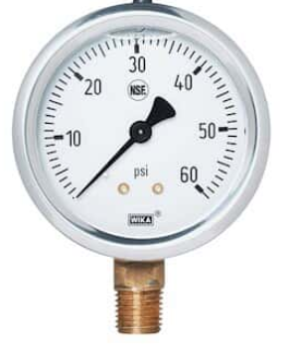
Partial Scale – Full Window
Simulated Steel Structure
Sealed Test Fixture
Window and Simulated Structure
¼ scale
Objectives:
Apply 3 bar = 43.5 psi load (can be easily applied with air).
This allows us to do leak tests also
Ref ASTM E1003 and
Measure Deflection of Window
Pressure applies
Strain in specific areas
NDT or DT bond inspection
NDT procedure would be good such that it can be repeated during real-build

Slide 28
Plate Tests
OBJECTIVES
Apply hydrostatic pressure load. Create stress/strain profile.
Validate FEA model
Verify gas leak rate

Slide 29
SCHEDULE / DURATION PROJECTION

Slide 30
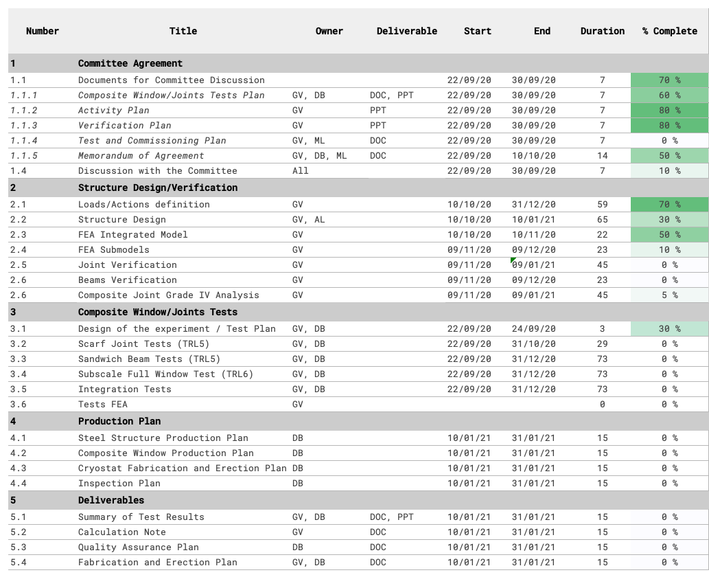
Work Plan - Activities
Peter

Slide 31
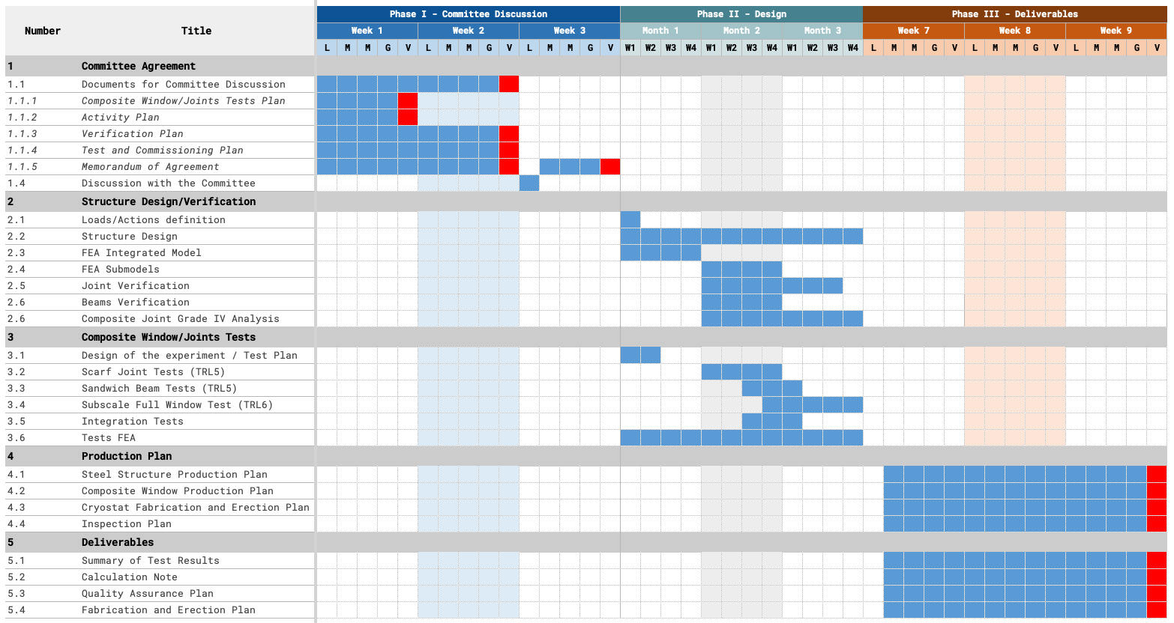
Work Plan – Preliminary Gantt

Slide 32
Estimated Schedule

Slide 33
End

Slide 34
Load
350 mBar H2O
4.5 m of Ar
1 bar load
3x factor of safety
3 bar = 43.5 psi load
TO Measure:
Deflection of Window
Pressure applies
Strain in specific areas
NDT or DT bond inspection
NDT procedure would be good such that it can be repeated during real-build

Slide 35
Plate Test ASTM D6416

Slide 36
Joint Design
Joint selection:
Box beam around the plate for torsional stiffness
A tapered lap joint is not able to satisfy the strength requirements (with a reasonable length). A scarf joint can sustain much higher loads
Production process is more complicated
Design process:
2D analysis to quickly optimize the geometry
Detailed analysis on a 3D model
Submodel critical regions if necessary (grade IV analysis)
G. Vallone

Slide 37
Bolted Scarf Joint Experimentation
Bolt/Rod
Steel Shoe
Nut
Fiberglass
There may be interest in a bolted joint that would aid in a secondary locking mechanism for the scarf joint.
Likely more difficult to machine the steel parts and perform layup
Secondary locking mechanism may be an advantage.

Slide 38
Alternative Joint Design
Test design 1:
G10 links might be connected or not (single piece or core)
Does not pass analysis

Slide 39
Width: 100cm
25mm
1 m
250mm
Steel Shoe
Foam Core
Fiberglass Laminate
Angle Iron

