Slide 1
To keep warm cavities in elastic range recommendation by RF-team is to limit warm cavity compression /stretching to 600um.
Important to look on the “Tuner –trust Table” column#3- leak check test.
LCLS II tuner assembly at FNAL
Tuner installed on the cavity when cavity back filled with N2 during tuner installation & with ins. vacuum 1bar ) and He Vessel volume -1bar)
Piezo preload set to 50kHz (or ~ 150-200um compression or forces ~600N)
Safety gap set to 300um
When He Vessel & beam-line will be pump down to 0 bar cavity compression will be limited to 300um + compression of the safety rods(small) .. We estimated it less than 400um
LCLS II HE tuner assembly at FNAL
Tuner installed on the cavity when cavity back pump down during tuner installation & with ins. vacuum 1bar ) and He Vessel volume -1bar)→ cavity compression is 60-70kHz ==200-250um(forces ~ 1kN)
Piezo preload set to 100 kHz (or ~ 300um compression or forces ~ 1.5kN)
Safety gap set to 300um
When He Vessel will be pump down to 0 bar cavity compression will be limited to 200um+300um +300um =800um.. We estimated it more than 800um that is beyond our specs.
One option is to limit safety gap to 150-200 um…But it is not practical.. And could lead to situations when piezos could be locked (after cool-down) with safety rod…It is big risk..
Second option is to stay at 50kHz preload (not 100kHz) … in this case we are on the edge of our specs.
Third option is increase piezo preload only for cavities with high T=2K_Landing frequency (we will assume that we could estimate “high T=2K Landing frequency” from warm non-restrained cavity’s frequency ..

Slide 2
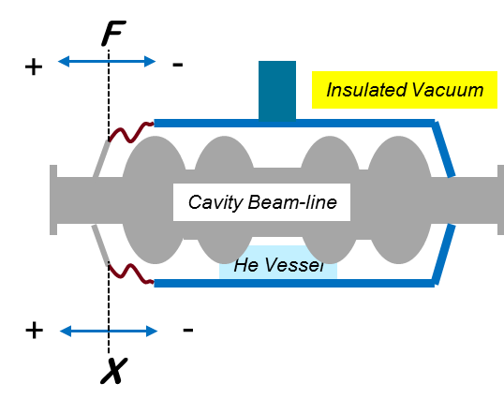
Forces (and stroke) on the cavity/He vessel system during life of the cavity
Requirements: |X_{T=300K}| < 0.6mm
 | steps when cavity need to be protected
 | Temperature =300K |  |  |  |  |  |  |  |  |  | T=5K | T=2K | T=5 K
 | 0 | 1 | 2 | 3 | 4 | 5 | 6 | 7 | 8a | 8b | 9 | 10 | 11
Insulated Vacuum, bar abs | 1 | 1 | 1 | 1 | 1 | 1 | 0 | 1 | 1 | 1 | 0 | 0 | 0
Cavity Beamline, bar abs | 1 | 1 | 1 | 0 | 0 | 0 | 0 | 0 | 0 | 0 | 0 | 0.03 | 0
Helium Vessel, bar abs | 1 | 0 | 3.3 | 0 | 1 | 3.3 | 1.5 | 1.4 | 0 | 2.5 | 1.5 | 0 | 4
Forces on cavity flange with absolutely restrained cavity, kN | F=0 | -2.6 | 6.0 | -3.8 | -1.2 | 4.9 | 3.9 | -0.1 | -3.8 | 2.7 | 3.9 | 0.0 | 10.4
How much (mm) cavity lenght will changes if flange non-restrained | X=0 | -0.55 | 1.37 | -0.79 | -0.25 | 1.08 | 0.82 | -0.03 | -0.79 | 0.57 | 0.80 | 0.01 | 2.18
Description of the steps during cavity assembly or opertaions | Cavity is relaxed after HV welding | He Vessel Leak Checkt at MP9 | He Vessel Pressure test at MP9 | He Vessel Leak Check in CM | Cavity leak check in Clean Room | Possible He Vessel pressure test in CM | Start of cooling down | Linac maintenance (e.g., tuner or interconnect access) | Tuner access and disconnect (e.g., replace piezo), what is max cryo system pressure |  | End of cooling down | Operating condition | Worst case cold loss of vacuum accident. Do piezos and tuner survive?
 |  | cavity protected with restarin brackets |  |  |  |  |  | cavity protected with Tuner
FEA simulations of LCLS II cavity/He Vessel configuration
Ivan Gonin.

