Slide 1
SRF R&D Progress and Research Program
Alexander Romanenko
Chief Technology Officer, Head of Applied Physics and Superconducting Technology Division
Accelerator Advisory Committee - 2020

Slide 2
Superconducting RF research program
World leading SRF R&D program at Fermilab
  Relies on the world class SRF facilities and talent
Program focused on advancing the state of the art in Q and accelerating gradients in bulk niobium cavities
  Pioneered nitrogen doping and efficient magnetic flux expulsion, now realized in LCLS-2 with hundreds of cavities with Q > 3e10 at 2 K in cryomodule and advancing further for LCLS-2 HE
  Achieved record accelerating gradients of 50 MV/m in TESLA shaped cavities
Also world leading program in Nb₃Sn
  highest accelerating gradient ever achieved for Nb3Sn of ~24 MV/m, with Q > 1e10 at 4.2K
  first coated 9-cell
Strategic targeted investments over the years into the relevant materials analysis tools
  State-of-the-art materials science lab enables faster progress

Slide 3
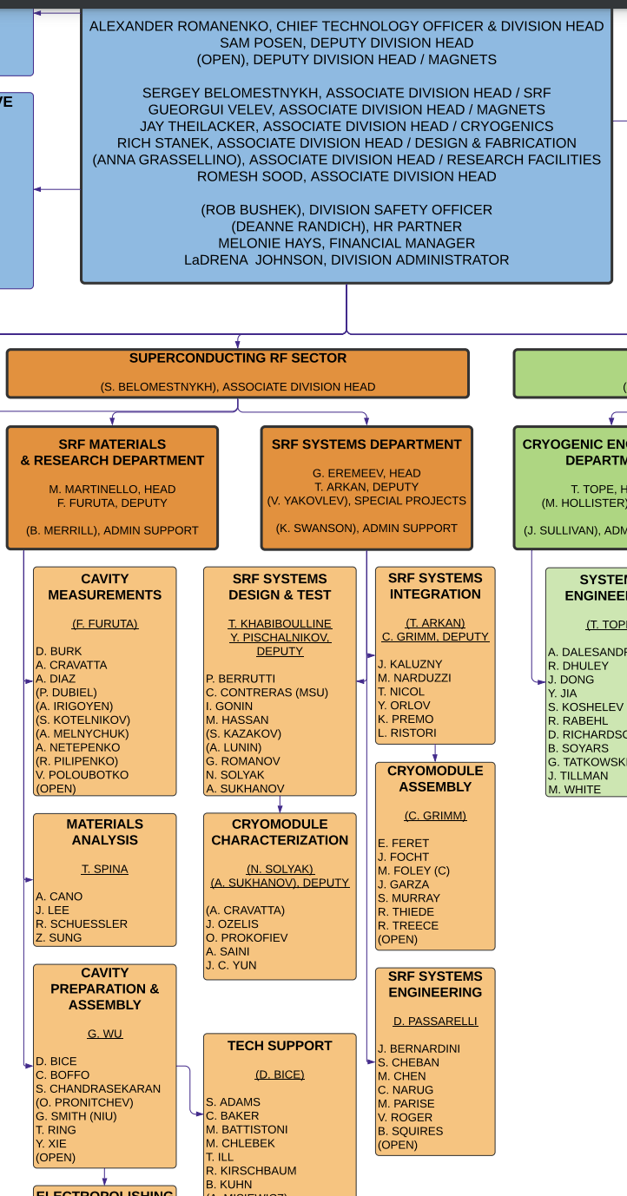
APS-TD organizational changes
New SRF departments with sharpened focus
  SRF Materials & Research
  SRF Systems
New leadership in both of SRF departments
OPEN position – Deputy Division Head for Magnet Technology
  To be posted in the next few days
  Further strengthening magnet R&D and production excellence

Slide 4
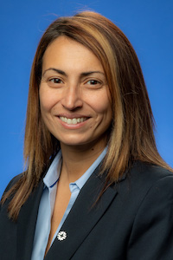
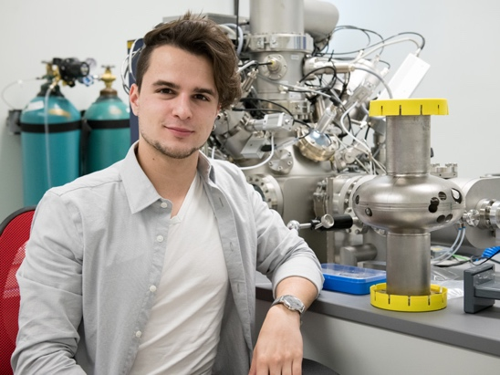
SRF Awards since last review period
Dr. Anna Grassellino (now NQI SQMS Center Director) named an APS fellow by the Division of Physics of Beams “for groundbreaking discoveries in nitrogen doping to increase the quality factor of superconducting radio-frequency cavities and in nitrogen infusion to increase the accelerating gradient”.
Dr. Daniel Bafia - APS Prairie Section meeting’2020 – best poster award
(just graduated from IIT based on research at FNAL)

Slide 5
AAC’2019 recommendation response
There appears to be a large phase space of parameters for producing high quality cavities, and a strong theoretical understanding can help to guide the optimum parameter selection. Continue to strengthen ties with universities to enhance efforts on SRF theory and SRF material science, and present results at the next AAC
Response: APS-TD and Fermilab-Northwestern CAPST continued and expanded the theoretical work at Northwestern and other universities. In addition to improved understanding of the gradient-limiting factors for SRF accelerators, the expanded theoretical efforts allowed to come up with several SRF-cavity based fundamental physics experiments targeted on understanding the possible origins of the dark matter, hidden fundamental forces of nature, explore possible existence of millicharged particles, as well as to put the best lab-based bound on the photon rest mass. Furthermore, this collaborative multi-institutional theoretical effort is an important part of two of the focus areas of the new Fermilab-based National Quantum Initiative Quantum Center – SQMS, which has Fermilab-led SRF technology in the quantum regime as its primary foundation.

Slide 6
Bulk Nb general R&D progress

Slide 7
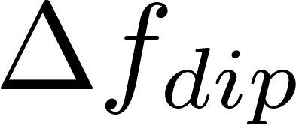
New Features in Cavities Linked to Ultra – High Q₀
Recently observed dip in the resonant frequency of SRF cavities near T_{c} found to be a signature of ultra-high Q₀ and dilute concentrations of impurities within the RF layer
Effect of Design Frequency on Dip
Effect of N Concentration on Dip
Dip magnitude (∆f_{dip}) depends on design frequency and impurity concentration
D. Bafia et al., Proc. of SRF’19
D. Bafia, PhD Thesis, IIT, 2020
Q₀ (16 MV/m) vs ∆f_{dip}
Q₀ varies linearly with ∆f_{dip}
  Complete model would give insight on how to tailor surface treatments that further push Q₀
Theoretical work at Northwestern via CAPST suggests that the origins of the dip lie in BCS theory
Findings to be submitted by D. Bafia et al. to PRL

Slide 8
650 MHz doping recipe development for FRIB and PIP-II
First treatments of cavities of this shape and frequency!
EP: Both cavities meet or exceed FRIB upgrade and PIP-II Q₀ minimum requirements at respective operating gradients
1st N-doping (2/0)
  Q₀ comparable to EP performance
  Both cavities benefit from reduced R_{BCS}
  R₀ somewhat high; likely increased flux trapping/sensitivity to trapping
Working to optimize new doping recipes & post-doping EP parameters for ~ 644-650 MHz
Q vs. Eacc: S65-001
= PIP-II LB 650 req.
= FRIB MB 644 req.
Q vs. Eacc: S65-002
K. McGee FNAL/MSU

Slide 9
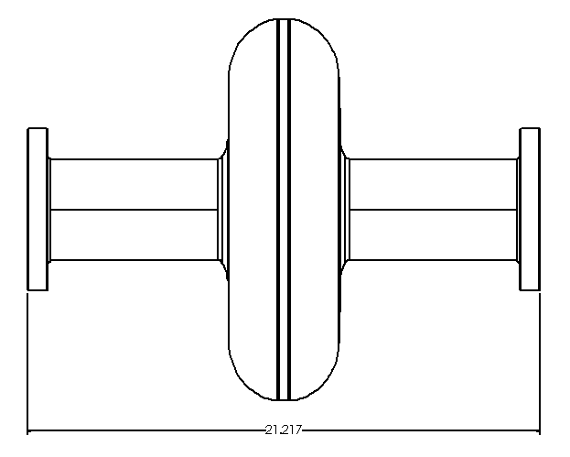
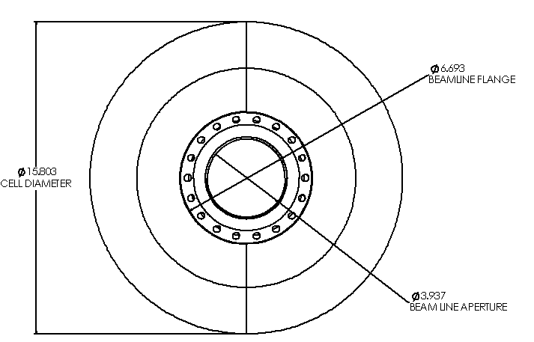
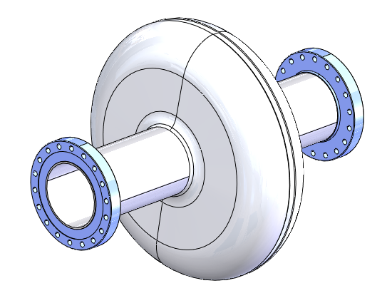
650 MHz doping recipe development for FRIB and PIP-II
Increased sensitivity to trapped flux
  Performance improved by electrically isolating the cavity from the test fixture
R_{BCS} decreased w/ N-doping
R₀ must be further reduced
Deeper investigation into optimal N-doping/EP as a function of cavity operating frequency to be continued in single-cell cavities
  Expect optimal recipe for ~ 650 MHz to differ from that developed in 1.3 GHz cavities
K. McGee FNAL/MSU

Slide 10
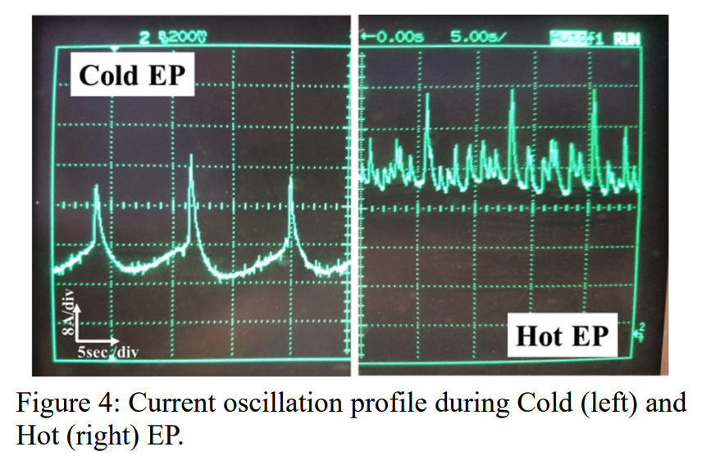
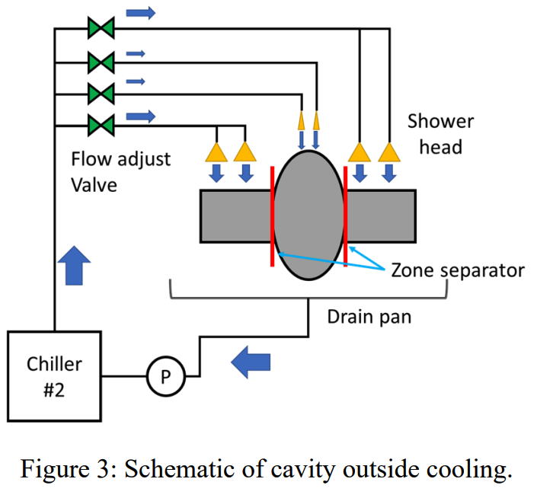
Electropolishing Understanding
When LCLS-II-HE 2/0 doping procedure was resulting in low gradients on 9-cell cavity, cold EP (~12 C vs ~20 C) was found to improve performance dramatically
Now we are performing a systematic study to understand the EP process and how it is affected by nitrogen content, temperature, voltage, geometry, and more
Key tools are surface analysis via SEM and optical microscopy and electrochemical impedance spectroscopy (EIS) to better understand the chemistry
F. Furuta et al., SRF2019, TUP022
L. Grassellino, E. Viklund (NU/FNAL)

Slide 11
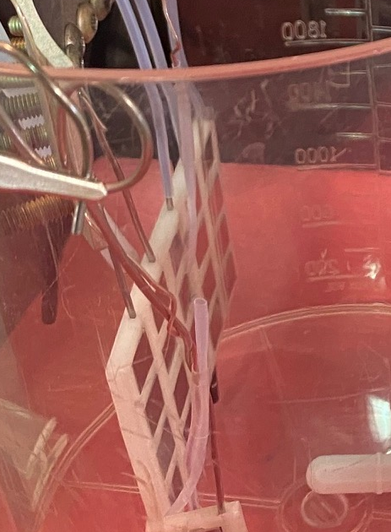
First Analyses on Samples
L. Grassellino, E. Viklund (NU/FNAL)
Regimes for Current Oscillations
Temperature [V]
Voltage [V]
Starting with samples we’re already looking into the different regimes of current oscillations – some occur at low voltages, some at high
Aiming to better understand the causes of current oscillations in the different regimes and connection between these regimes and surface roughness after EP
Start with undoped samples – later look at samples post N-doping
Build up a “map” of EP parameter space, use to optimize cavity EP

Slide 12
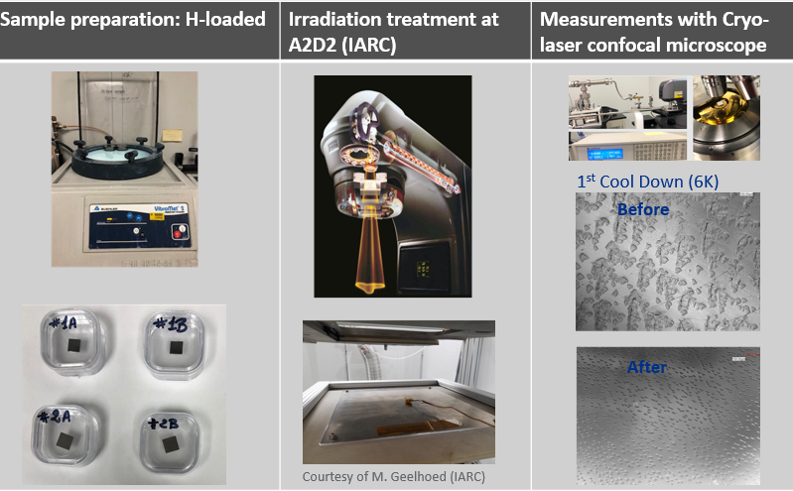
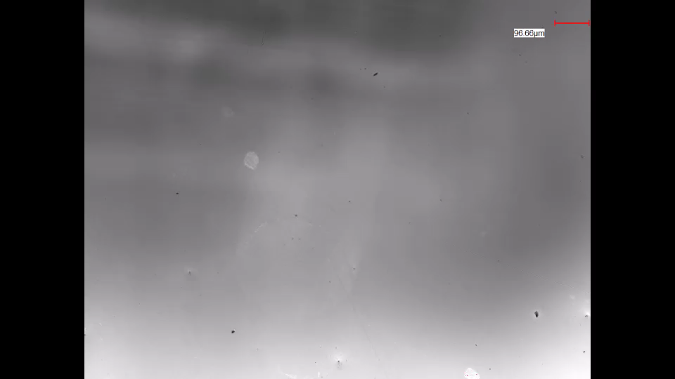
Irradiation studies on bulk Nb samples
T. Spina
300% hydride size reduction due to the enhancement of the radiation induced nucleation centers (v-H)
9MeV electrons up to 10²¹e/m² can improve v-H nucleation site formation thus leading to hydrides size reduction
What’s the effect on HFQS?
Irradiation experiment on Nb 1.3GHz cavity ongoing (see next slide)

Slide 13
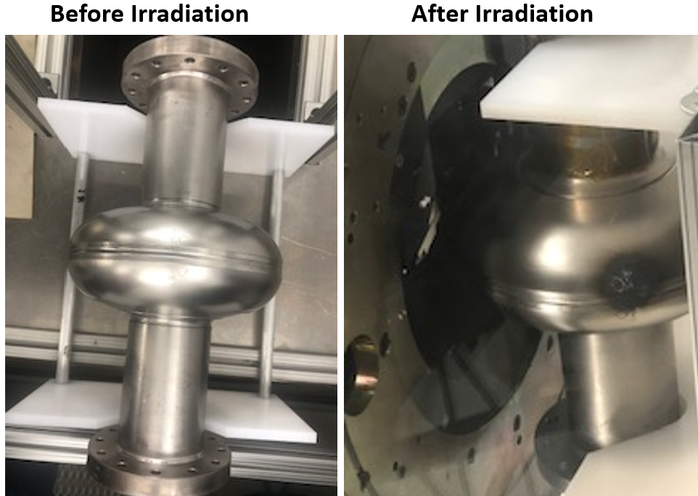
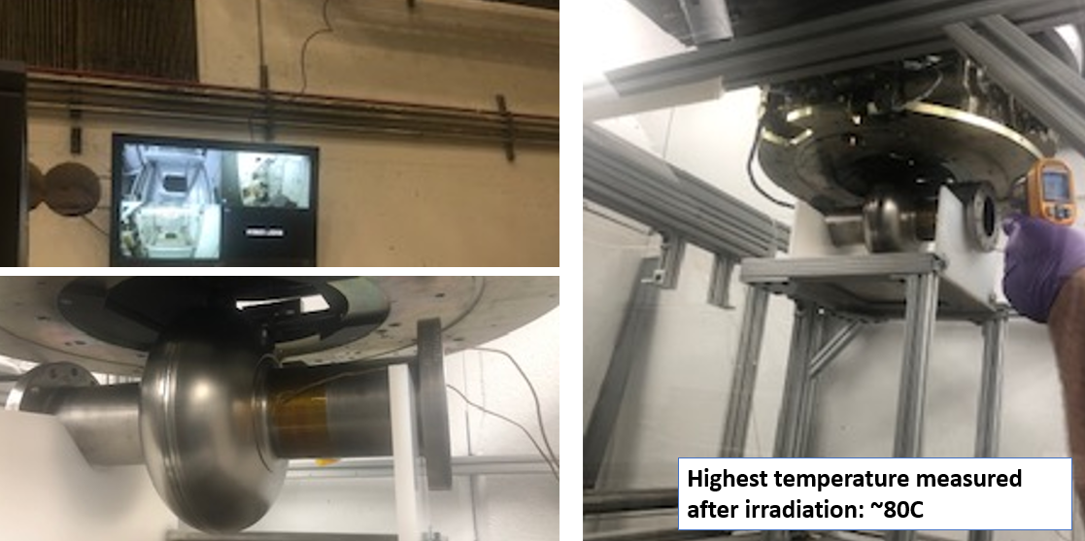
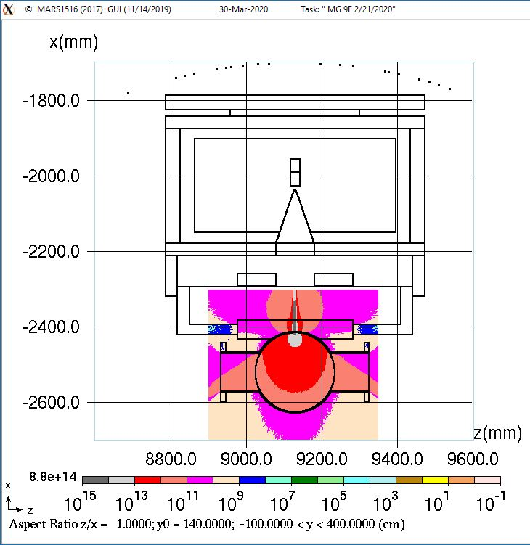
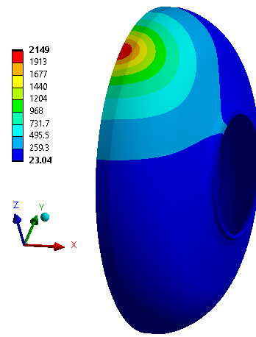
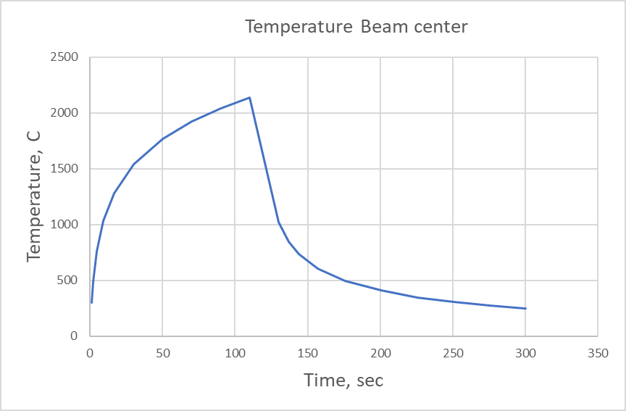
Irradiation studies on 1.3GHz Nb cavity
T. Spina
Monte Carlo simulation + FEM Thermal analysis to estimate temperature increase
Courtesy of M. Geelhoed and S. Bidhar

Slide 14

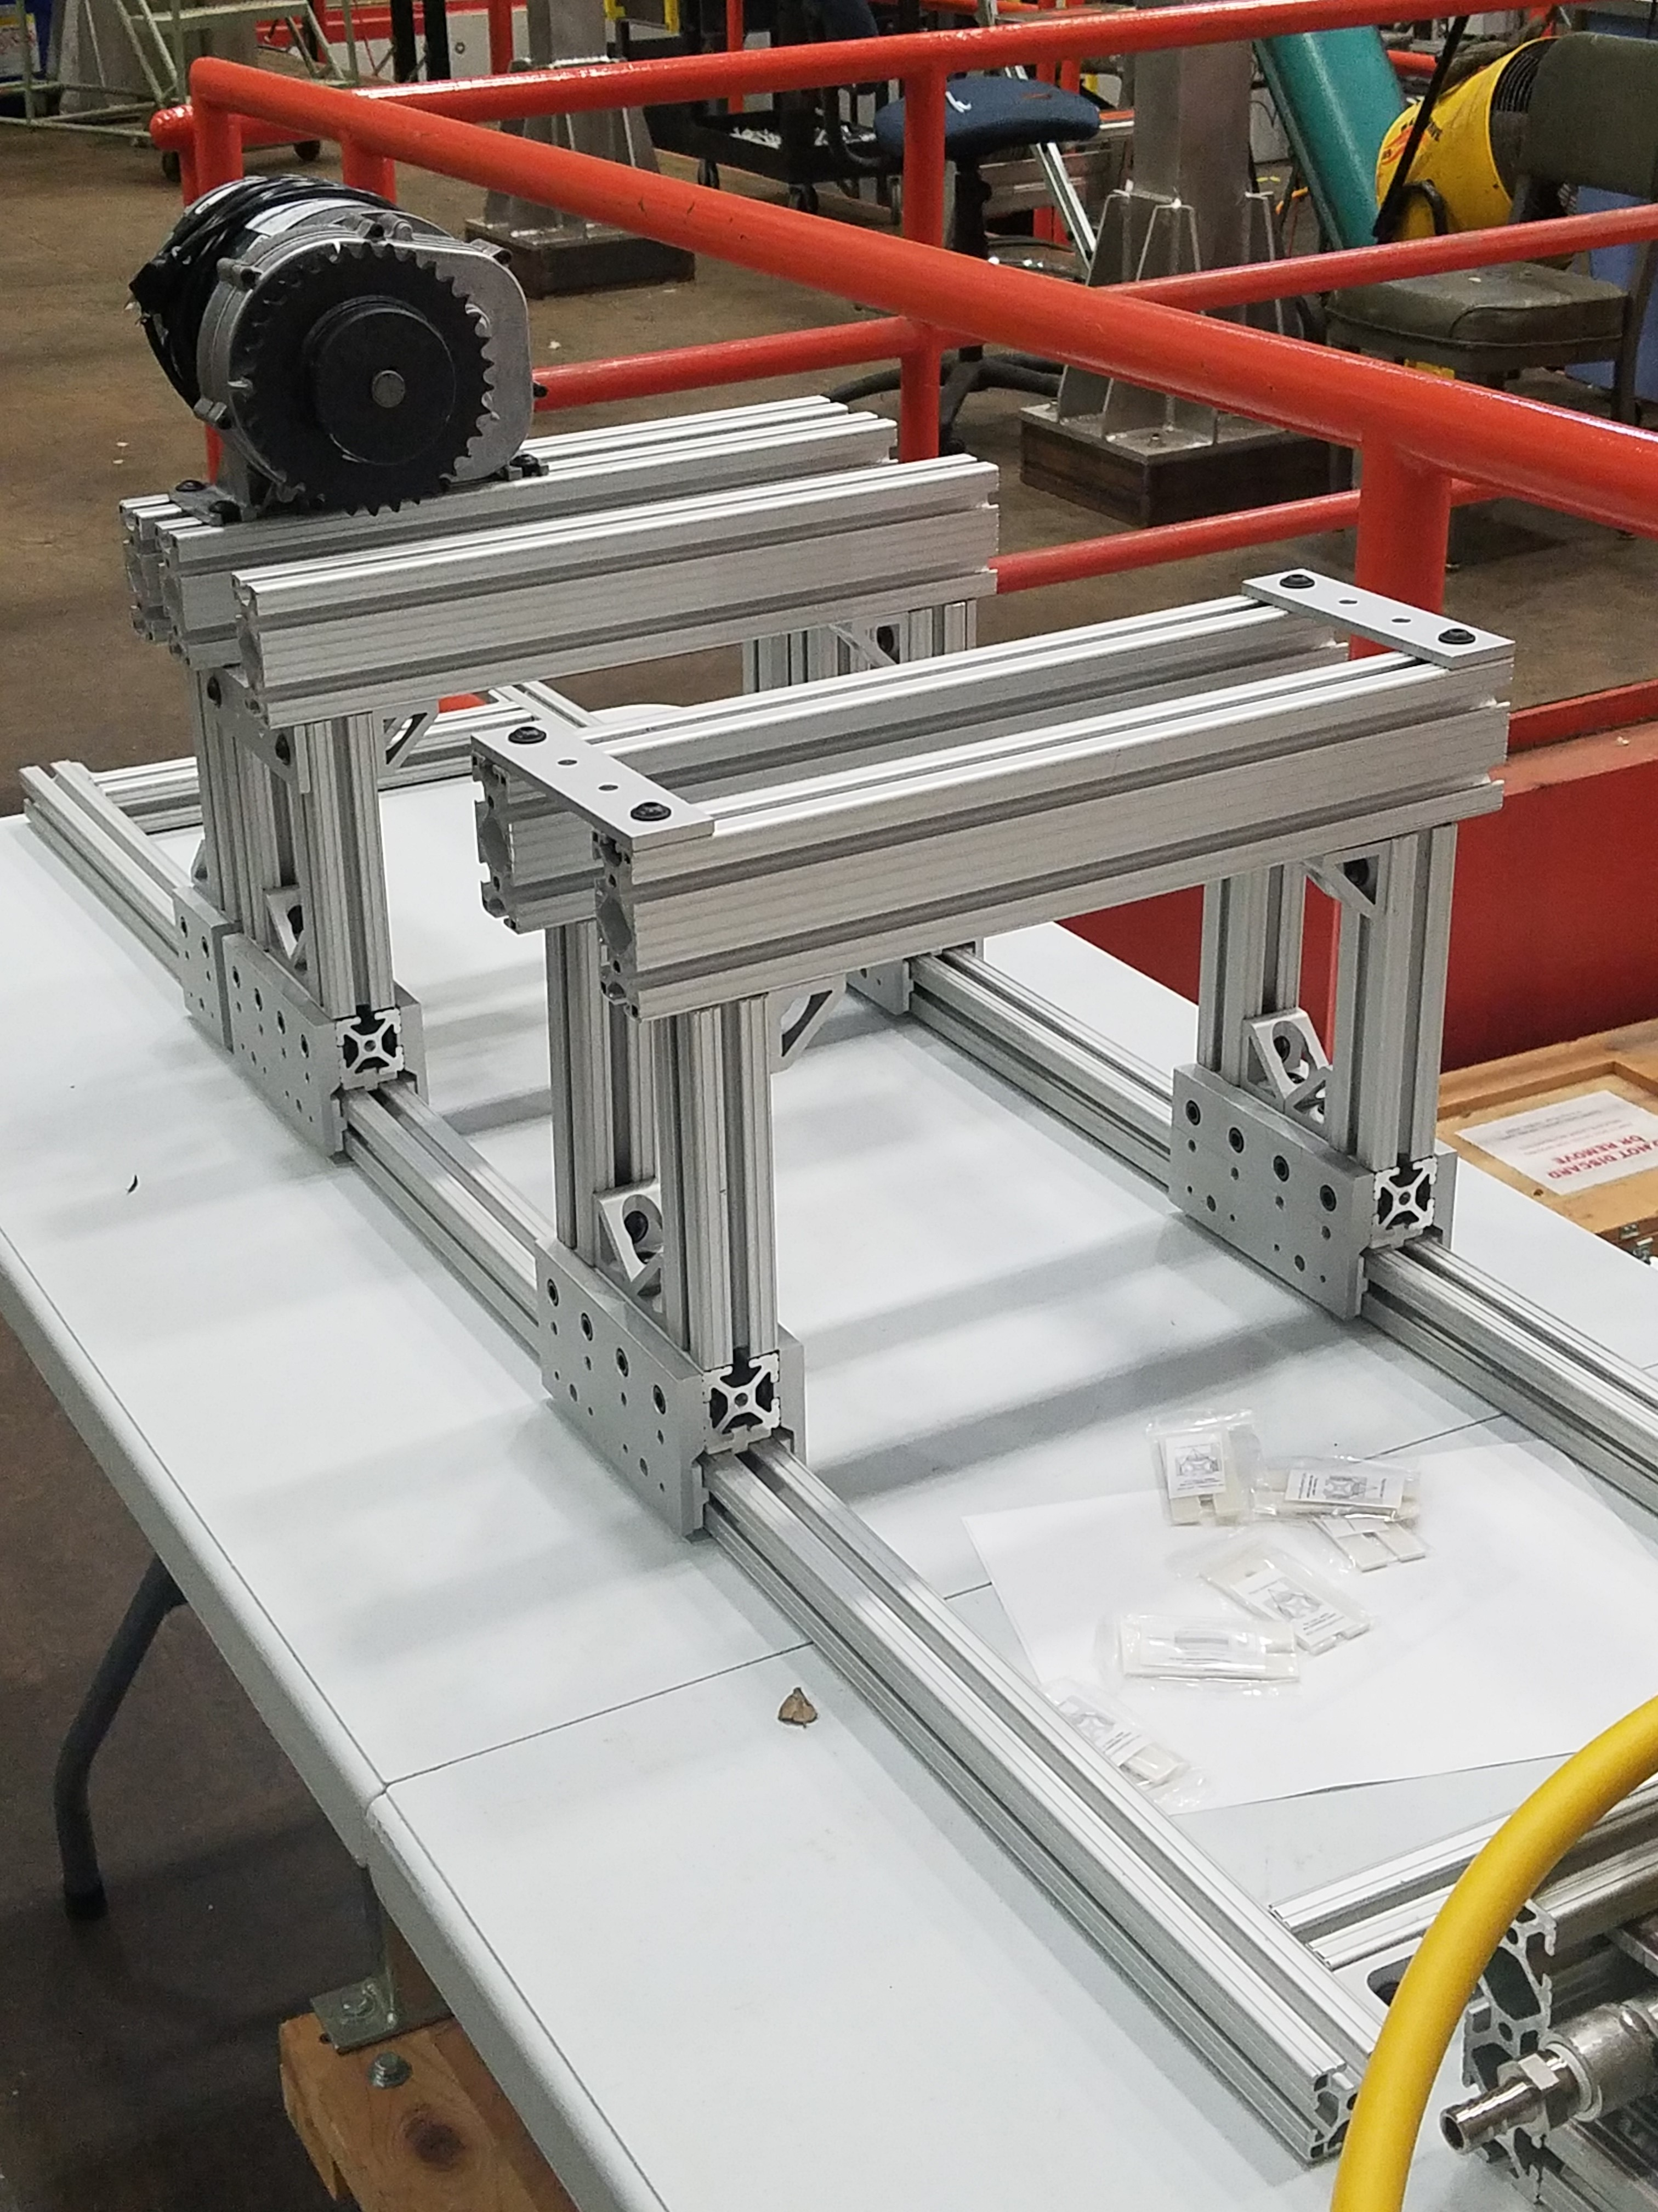
New irradiation set-up for cavity
T. Spina

Slide 15
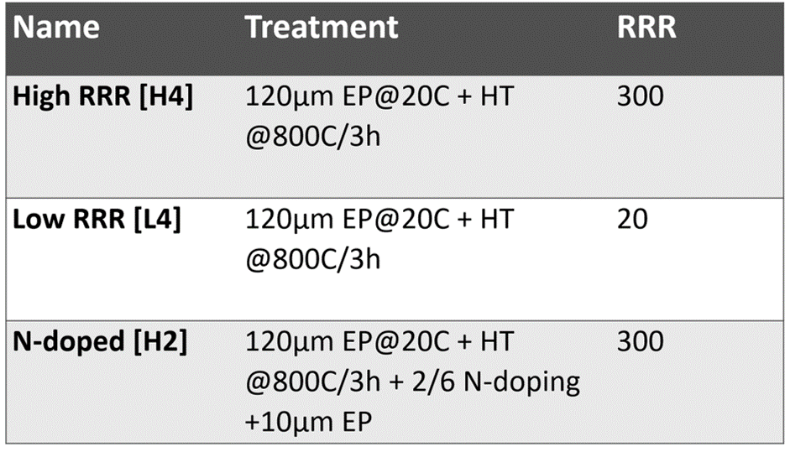
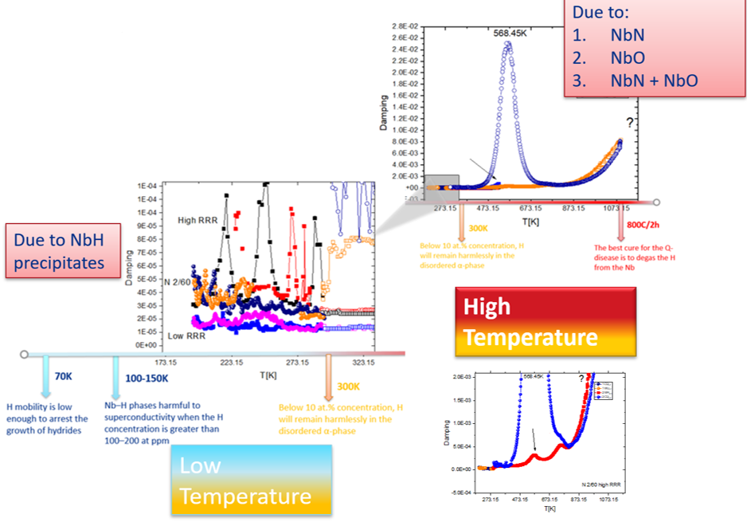
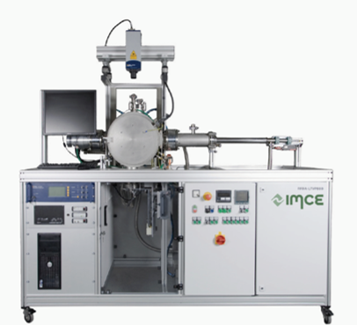
Internal friction measures on Nb bulk samples
T. Spina

Slide 16
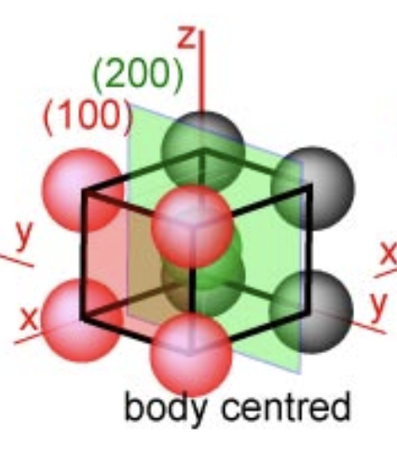
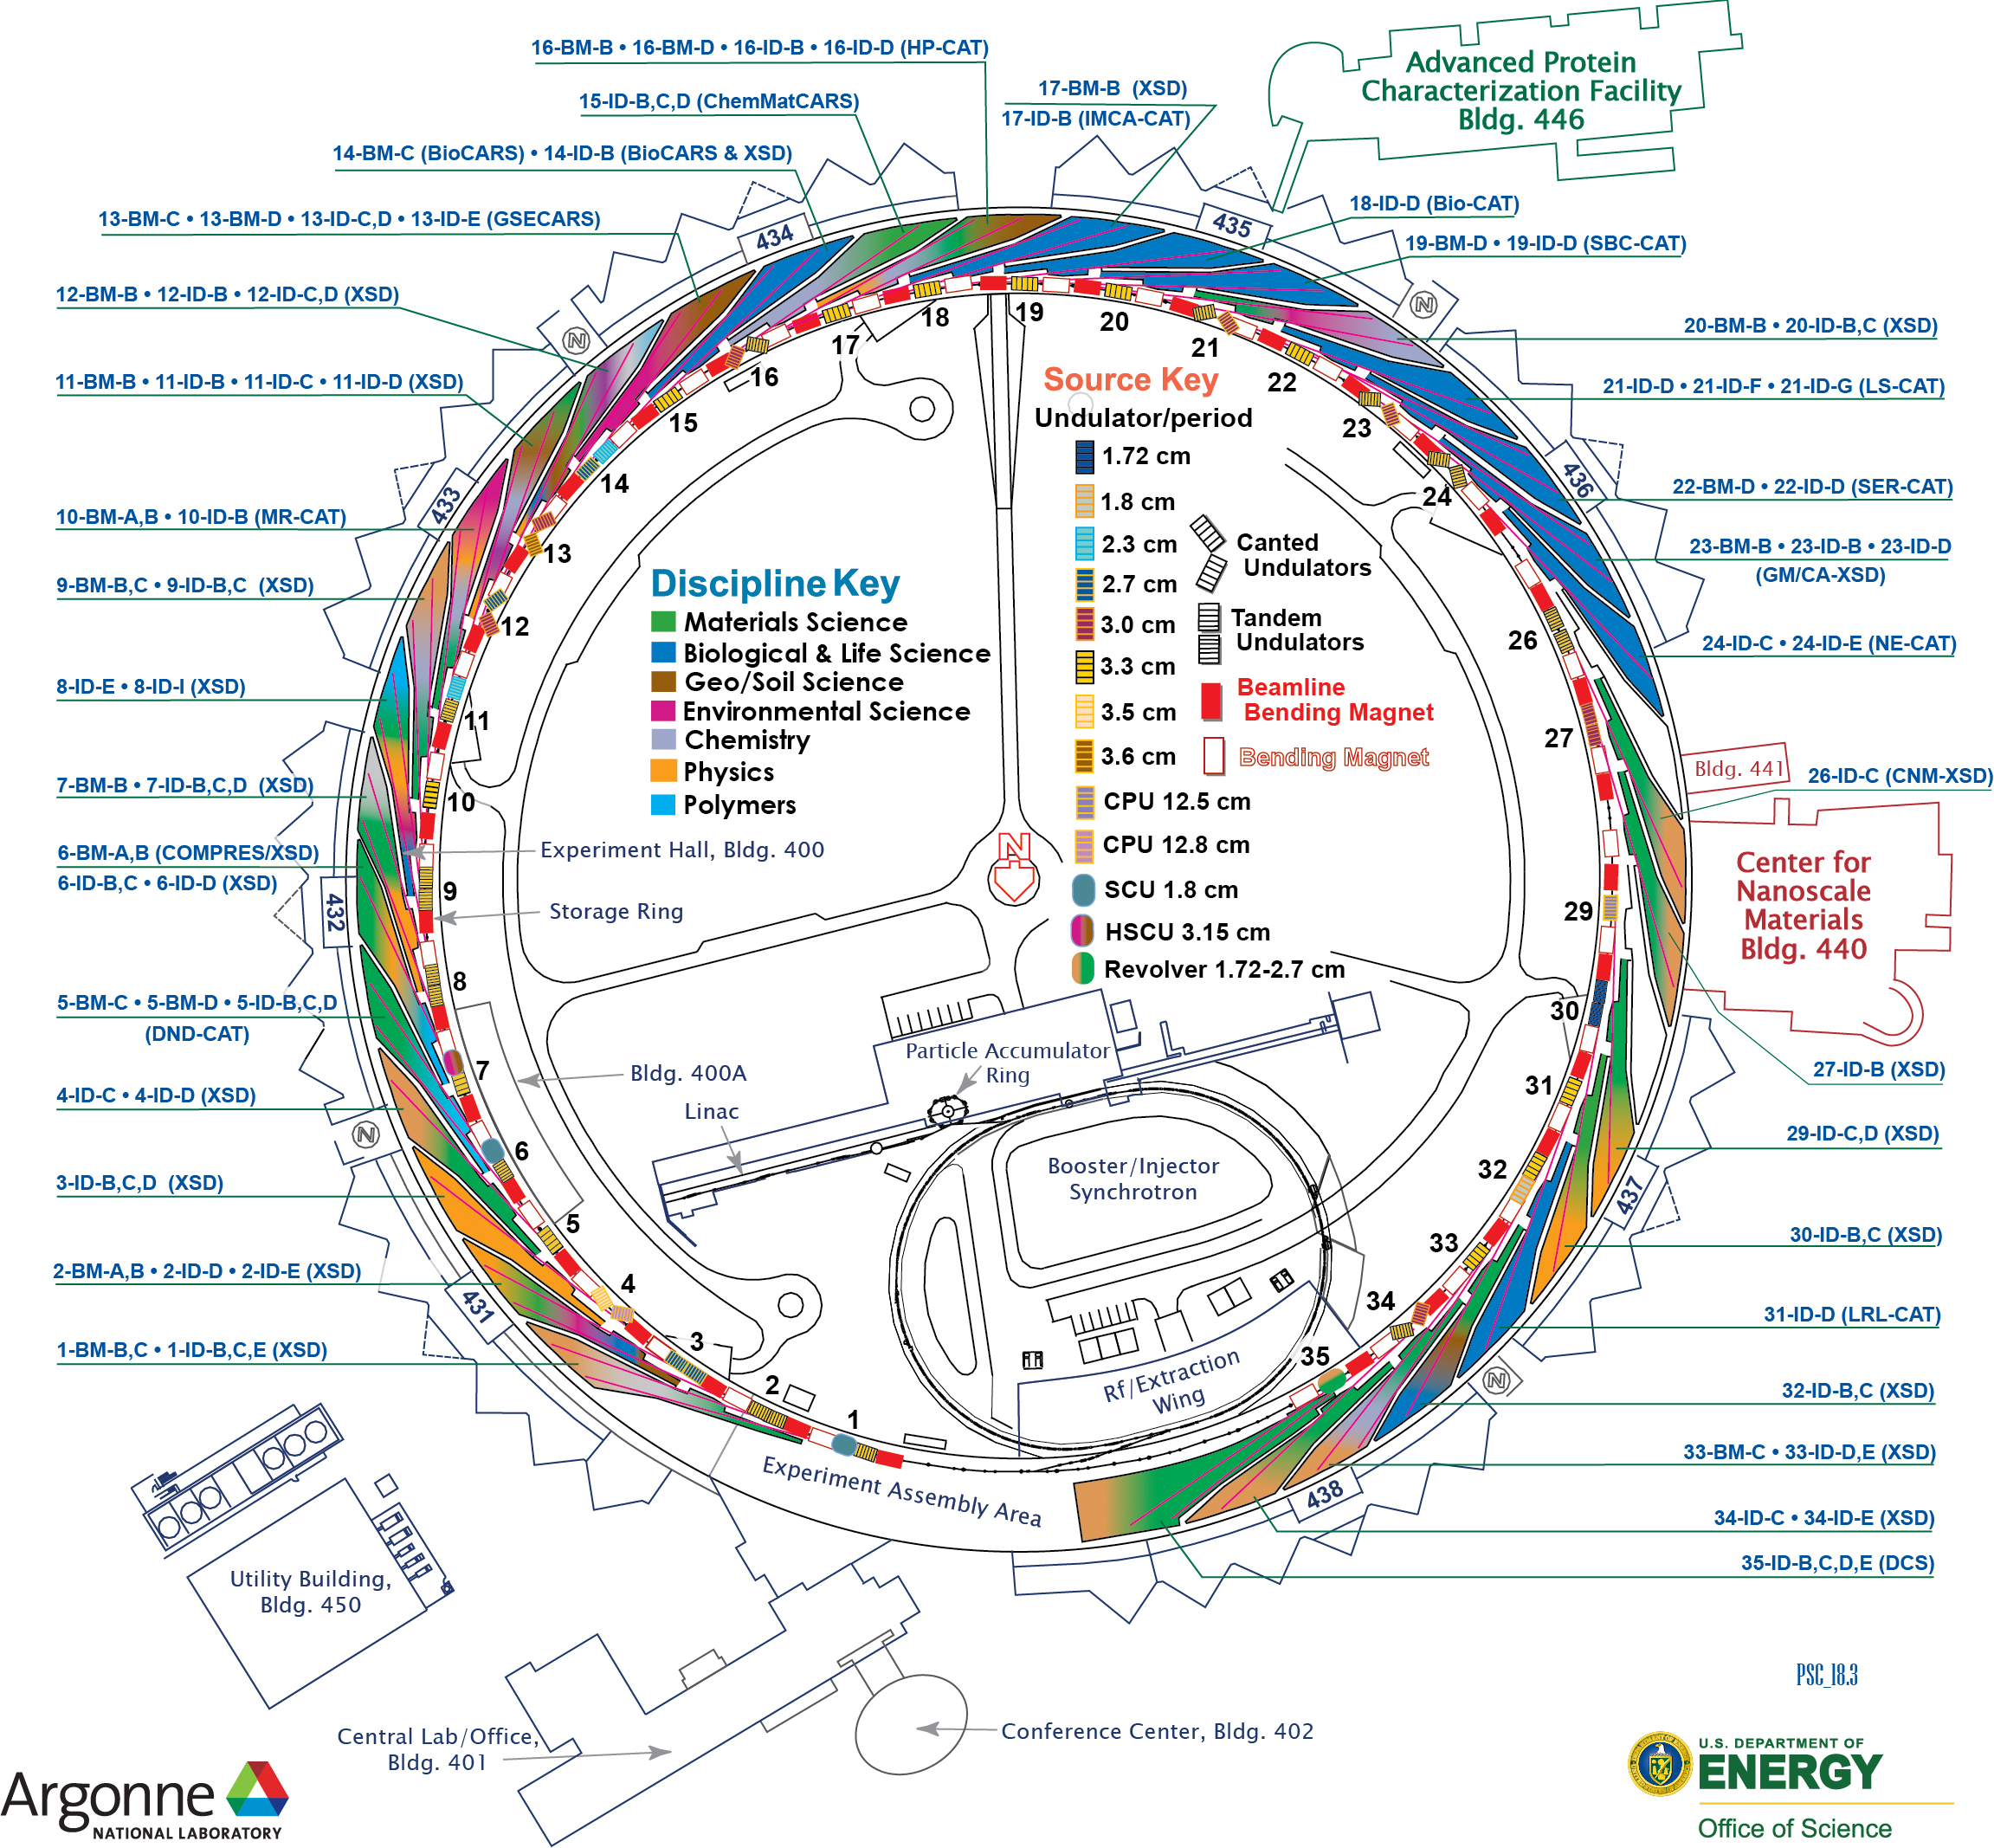
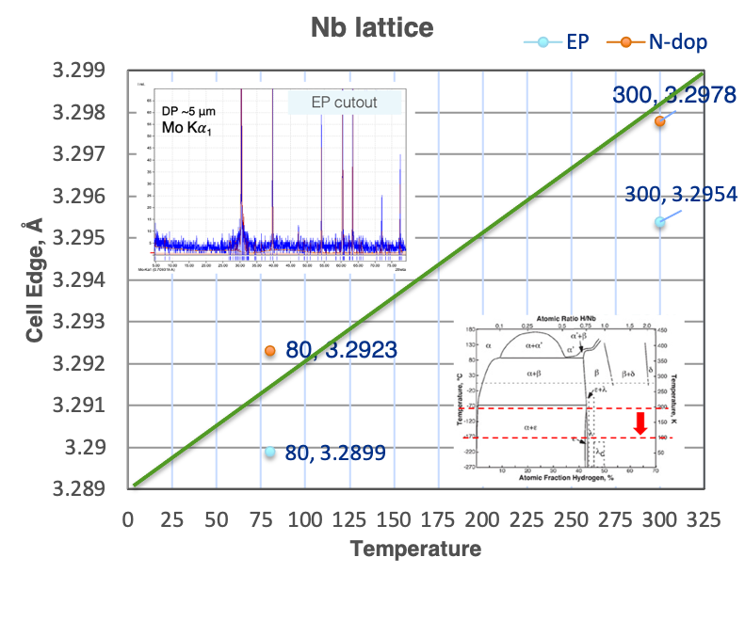
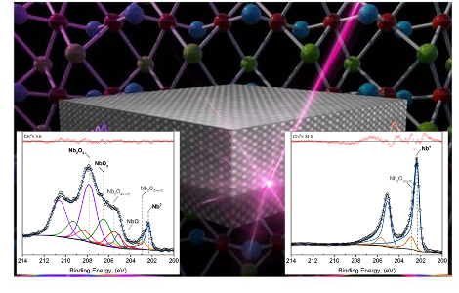
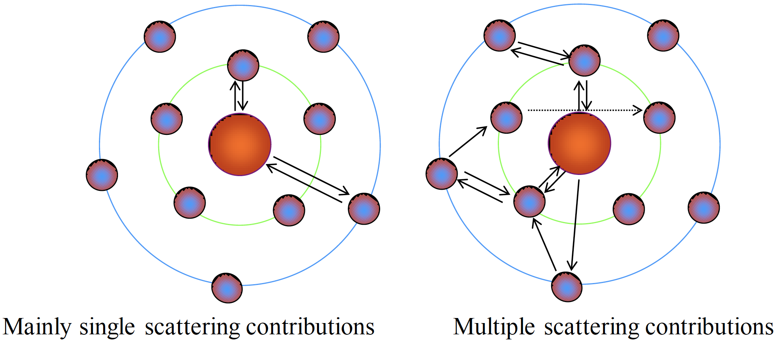
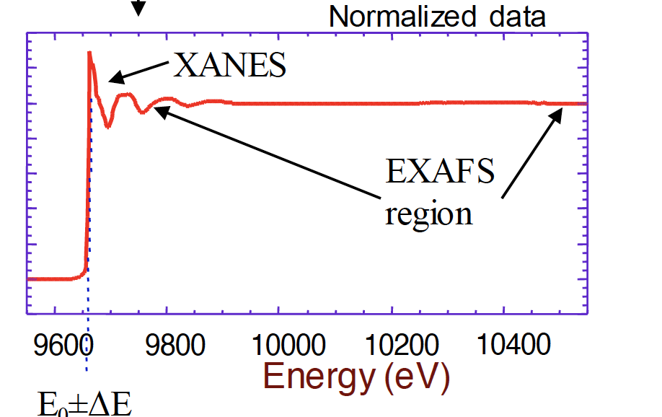
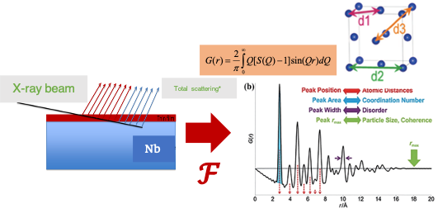
Structural and spectroscopic studies of Nb SRF technologies using Advanced Synchrotron Radiation Techniques
A. Cano
Average/local structure features of the natural surface oxide layer of Nb and Nb₃Sn/Nb SRF cavities
Study of the structural changes induced by segregation/re-dissolution of secondary phases
High-resolution XRD
XPS: ARXPS + HAXPES
Total scattering for x-PDF (Atomic Pair Distribution Function)
XAS: XANES + EXAFS (PDF)
Surface and bulk studies

Slide 17
ILC Cost Reduction R&D

Slide 18
ILC Cost Reduction Demonstration
S. Posen, A. Grassellino
Many new advances in SRF technology since ILC TDR
New treatments may enable significant reduction in ILC cost:
  Flux expulsion
  Two step bake (75/120)
  Cold EP
This year with ILC Cost Reduction R&D funds from DOE, Fermilab plans to assemble a cryomodule with cavities with new treatments
Goal is to reach higher gradient than has ever been demonstrated in CM test
Aim will be 38 MV/m average gradient with a stretch goal of 40 MV/m. The Q₀ goal will be 1.0x10¹⁰ at 38 MV/m
Achieving this would be a key demonstration of the potential for cost reduction for ILC.

Slide 19
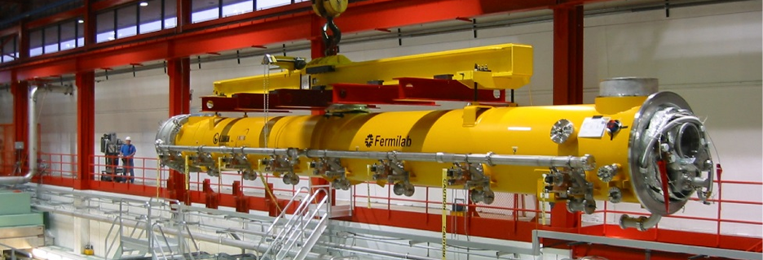
New Life for CM1
S. Posen, A. Grassellino
Limited budget, so parts will be disassembled and reused from CM1, the first SRF cryomodule assembled at Fermilab in 2007, as a part of a collaboration between Fermilab, DESY, and LASA
Structural elements will be reused (vacuum vessel, support posts, cryogenic piping).
The cavities will be replaced by high performing cavities that had achieved ILC specifications and been set aside ~10 years ago for future modules.

Slide 20
Assembly
S. Posen, A. Grassellino
Baseline treatment plan is high temperature furnace treatment to improve flux expulsion, new low temperature EP, and the new 2-step low temperature baking treatment.
Improved magnetic shielding will be used to minimize trapped flux now that it is understood that there is a substantial increase in trapped flux sensitivity at high fields.
Encapsulated piezo tuner designs will be used for improved reliability
Assembly will be carried out in FY20 and testing will take place in FY21 using existing facilities at FAST
Opportunity for collaboration on cavities for this module

Slide 21
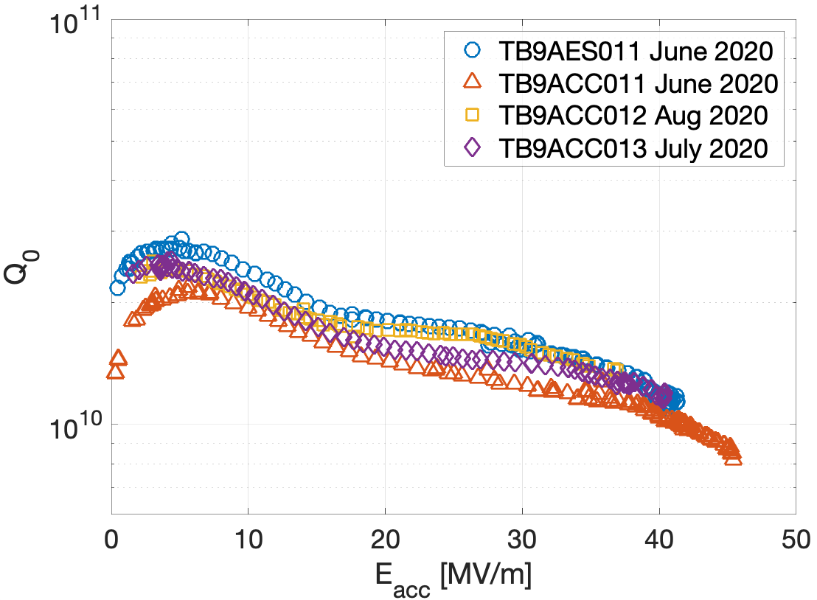
4 Candidates so far for HGC – all had Cold EP, 75/120 C bake
Some nice candidates already, max fields listed here:
TB9AES011 – 41.3 MV/m
(x-rays at max field ~1000 mR/hr)
TB9ACC011 – 45.5 MV/m
(x-rays at max field ~background)
TB9ACC012 – 36.9 MV/m
(x-rays at max field ~1 mR/hr)
TB9ACC013 – 40.4 MV/m
(x-rays at max field ~100 mR/hr)
Average of 41.0 MV/m
Two additional cavities are being retreated after first tests – 24 MV/m and 28 MV/m quench fields
S. Posen, A. Grassellino

Slide 22
Improved understanding of electropolishing process

Slide 23
Electropolishing Understanding
When LCLS-II-HE 2/0 doping procedure was resulting in low gradients on 9-cell cavity, cold EP (~12 C vs ~20 C) was found to improve performance dramatically
Now we are performing a systematic study to understand the EP process and how it is affected by nitrogen content, temperature, voltage, geometry, and more
Key tools are surface analysis via SEM and optical microscopy and electrochemical impedance spectroscopy (EIS) to better understand the chemistry
F. Furuta et al., SRF2019, TUP022

Slide 24
First Analyses on Samples
Regimes for Current Oscillations
Temperature [V]
Voltage [V]
Starting with samples we’re already looking into the different regimes of current oscillations – some occur at low voltages, some at high
Aiming to better understand the causes of current oscillations in the different regimes and connection between these regimes and surface roughness after EP
Start with undoped samples – later look at samples post N-doping
Build up a “map” of EP parameter space, use to optimize cavity EP

Slide 25
Nb3Sn progress

Slide 26
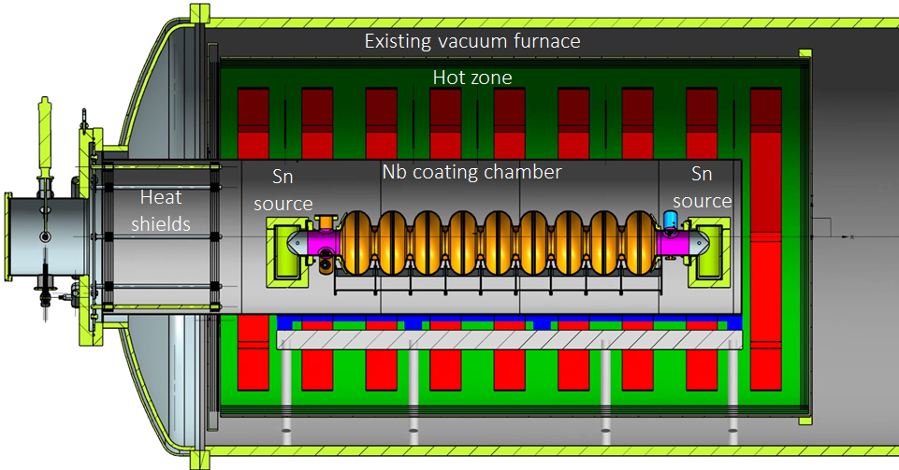
First Nb₃Sn 9-cell Cavities
S. Posen
Have been evaluating Fermilab Nb₃Sn coatings on 9-cell cavities: cavity type widely applied in accelerators such as European XFEL and LCLS-II
Set-up of a 9-cell ILC cavity in Fermilab coating furnace (two tin sources)

Slide 27
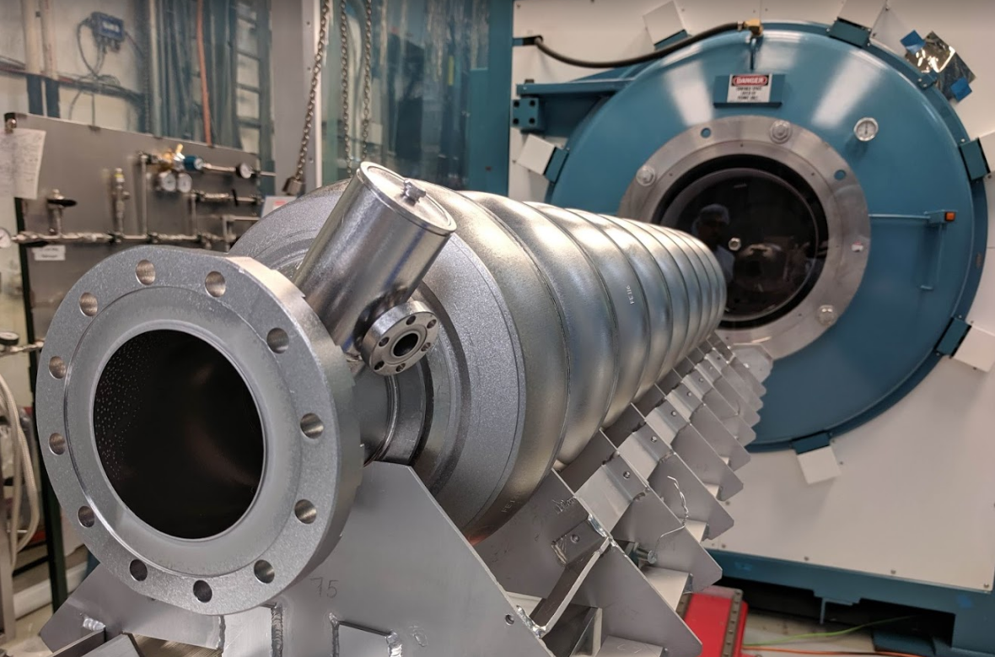
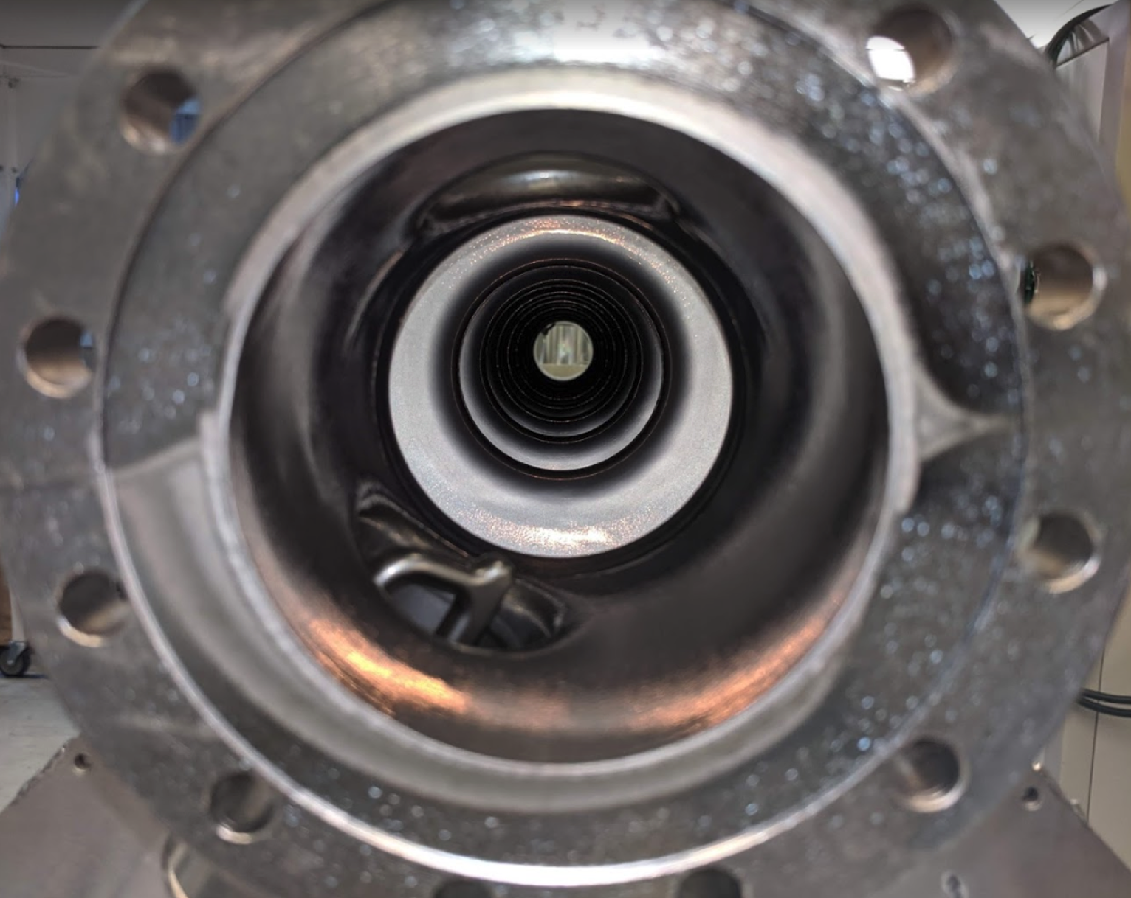
First Nb₃Sn 9-cell Cavities
S. Posen
9-cell Cavity TB9ACC014 After Coating

Slide 28
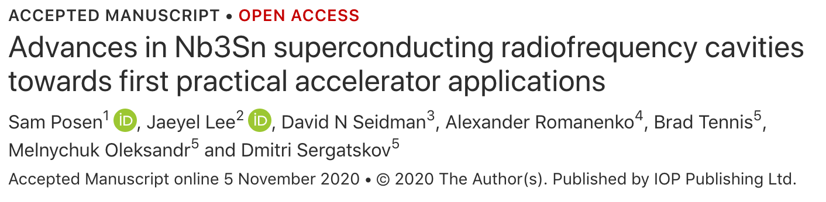
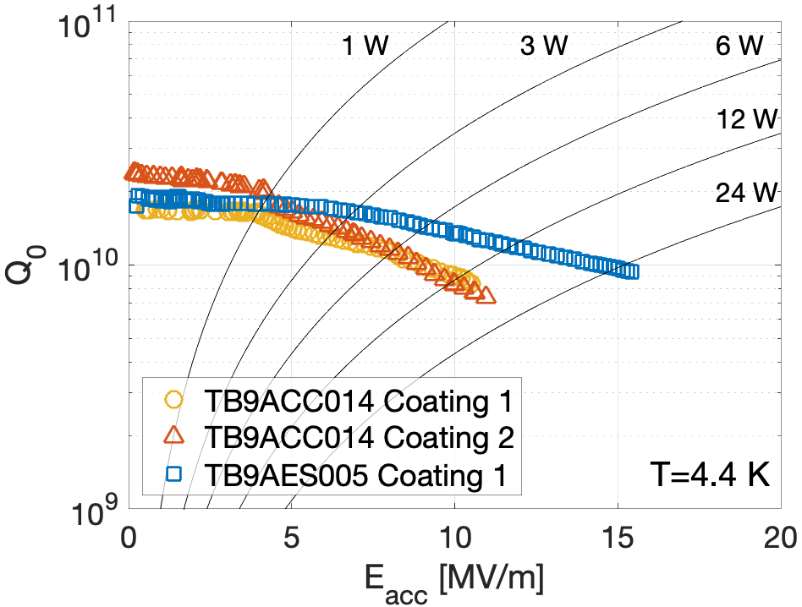
First Nb₃Sn 9-cell Cavities
Nb₃Sn-coated
9-cell cavities TB9ACC014 and TB9AES005
S. Posen
4.4 K Q₀ > 9x10⁹ at quench
Next step: coat a cavity that has Ti transition rings so that it can be dressed and tested in HTS
Includes correction for stainless steel flanges 2x0.8 nΩ

Slide 29
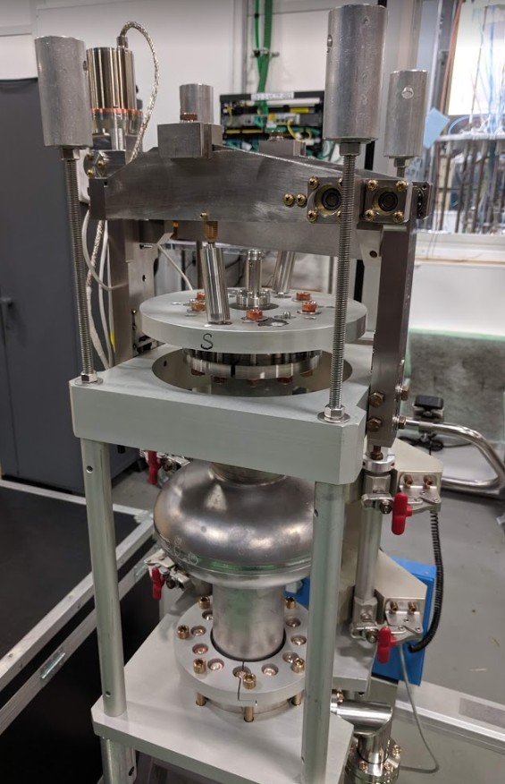
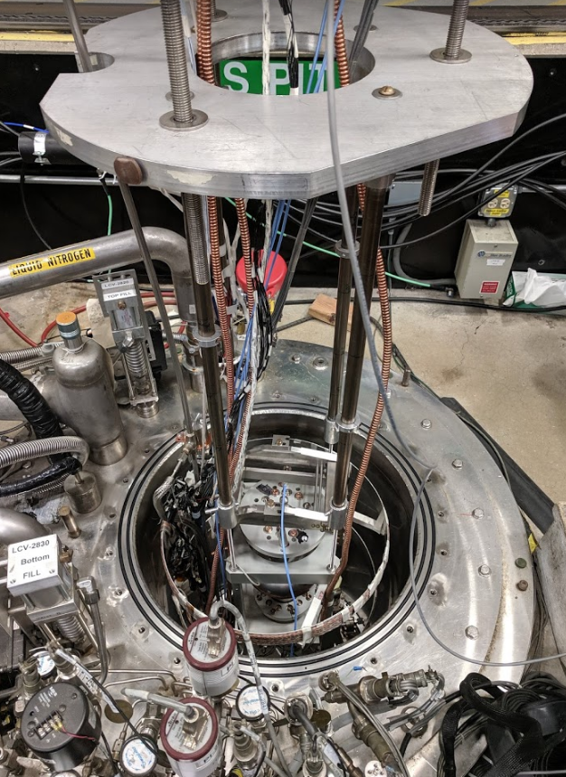
Frequency Tuner Test
S. Posen
Special thanks to Y. Pischalnikov and J.-C. Yun

Slide 30
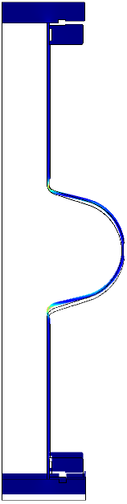
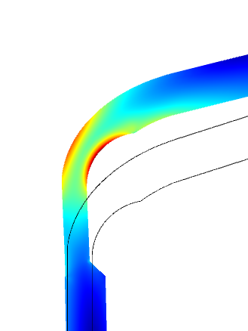
Frequency Tuner Test
S. Posen
Why worry about frequency tuning with Nb₃Sn?
Nb₃Sn wires show degradation under strain
Is tuning enough strain to degrade cavity performance?
$U_{z}$=fixed
ε_{max} ~ 0.029 %
$$σ_{max} \sim 37.5 MPa$$
zoom
$U_{z}$=100 µm
A Godeke 2006 Supercond. Sci. Technol. 19 R68

Slide 31
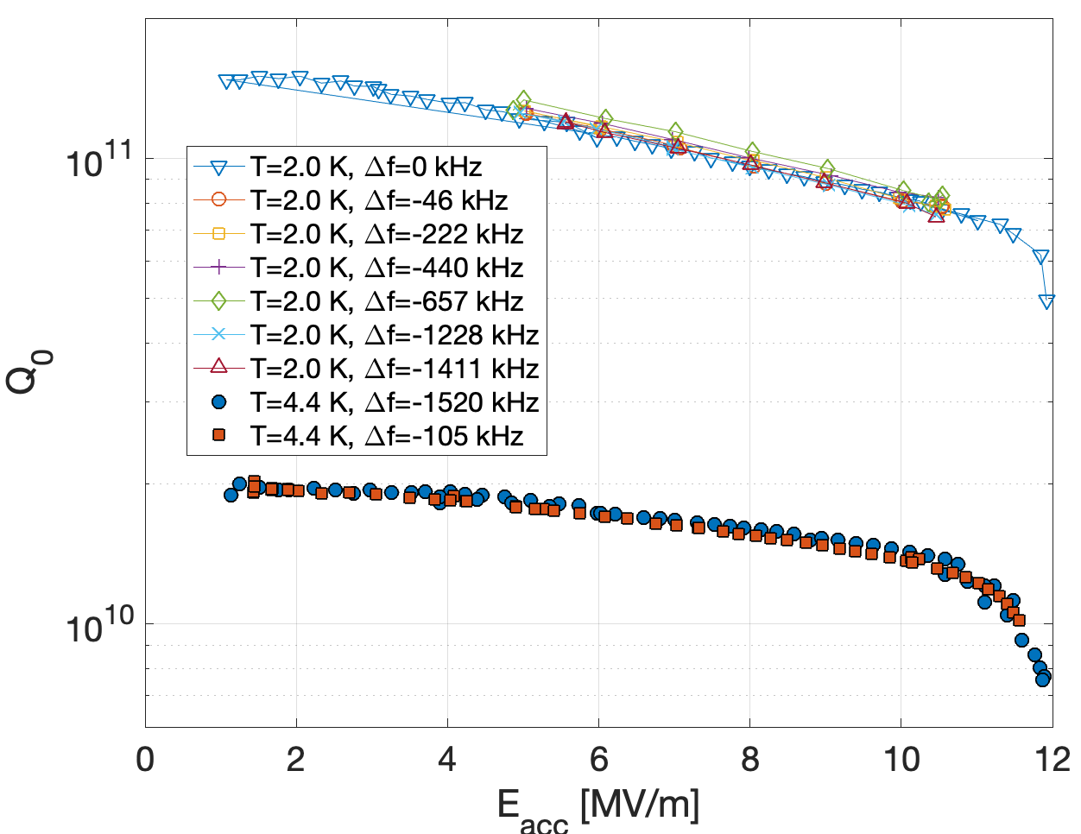
Frequency Tuner Test
S. Posen
T = 2.0 K
Tuned by ~1.4 MHz – required tuning range for cryomodule is only several hundred kHz
T = 4.4 K

Slide 32
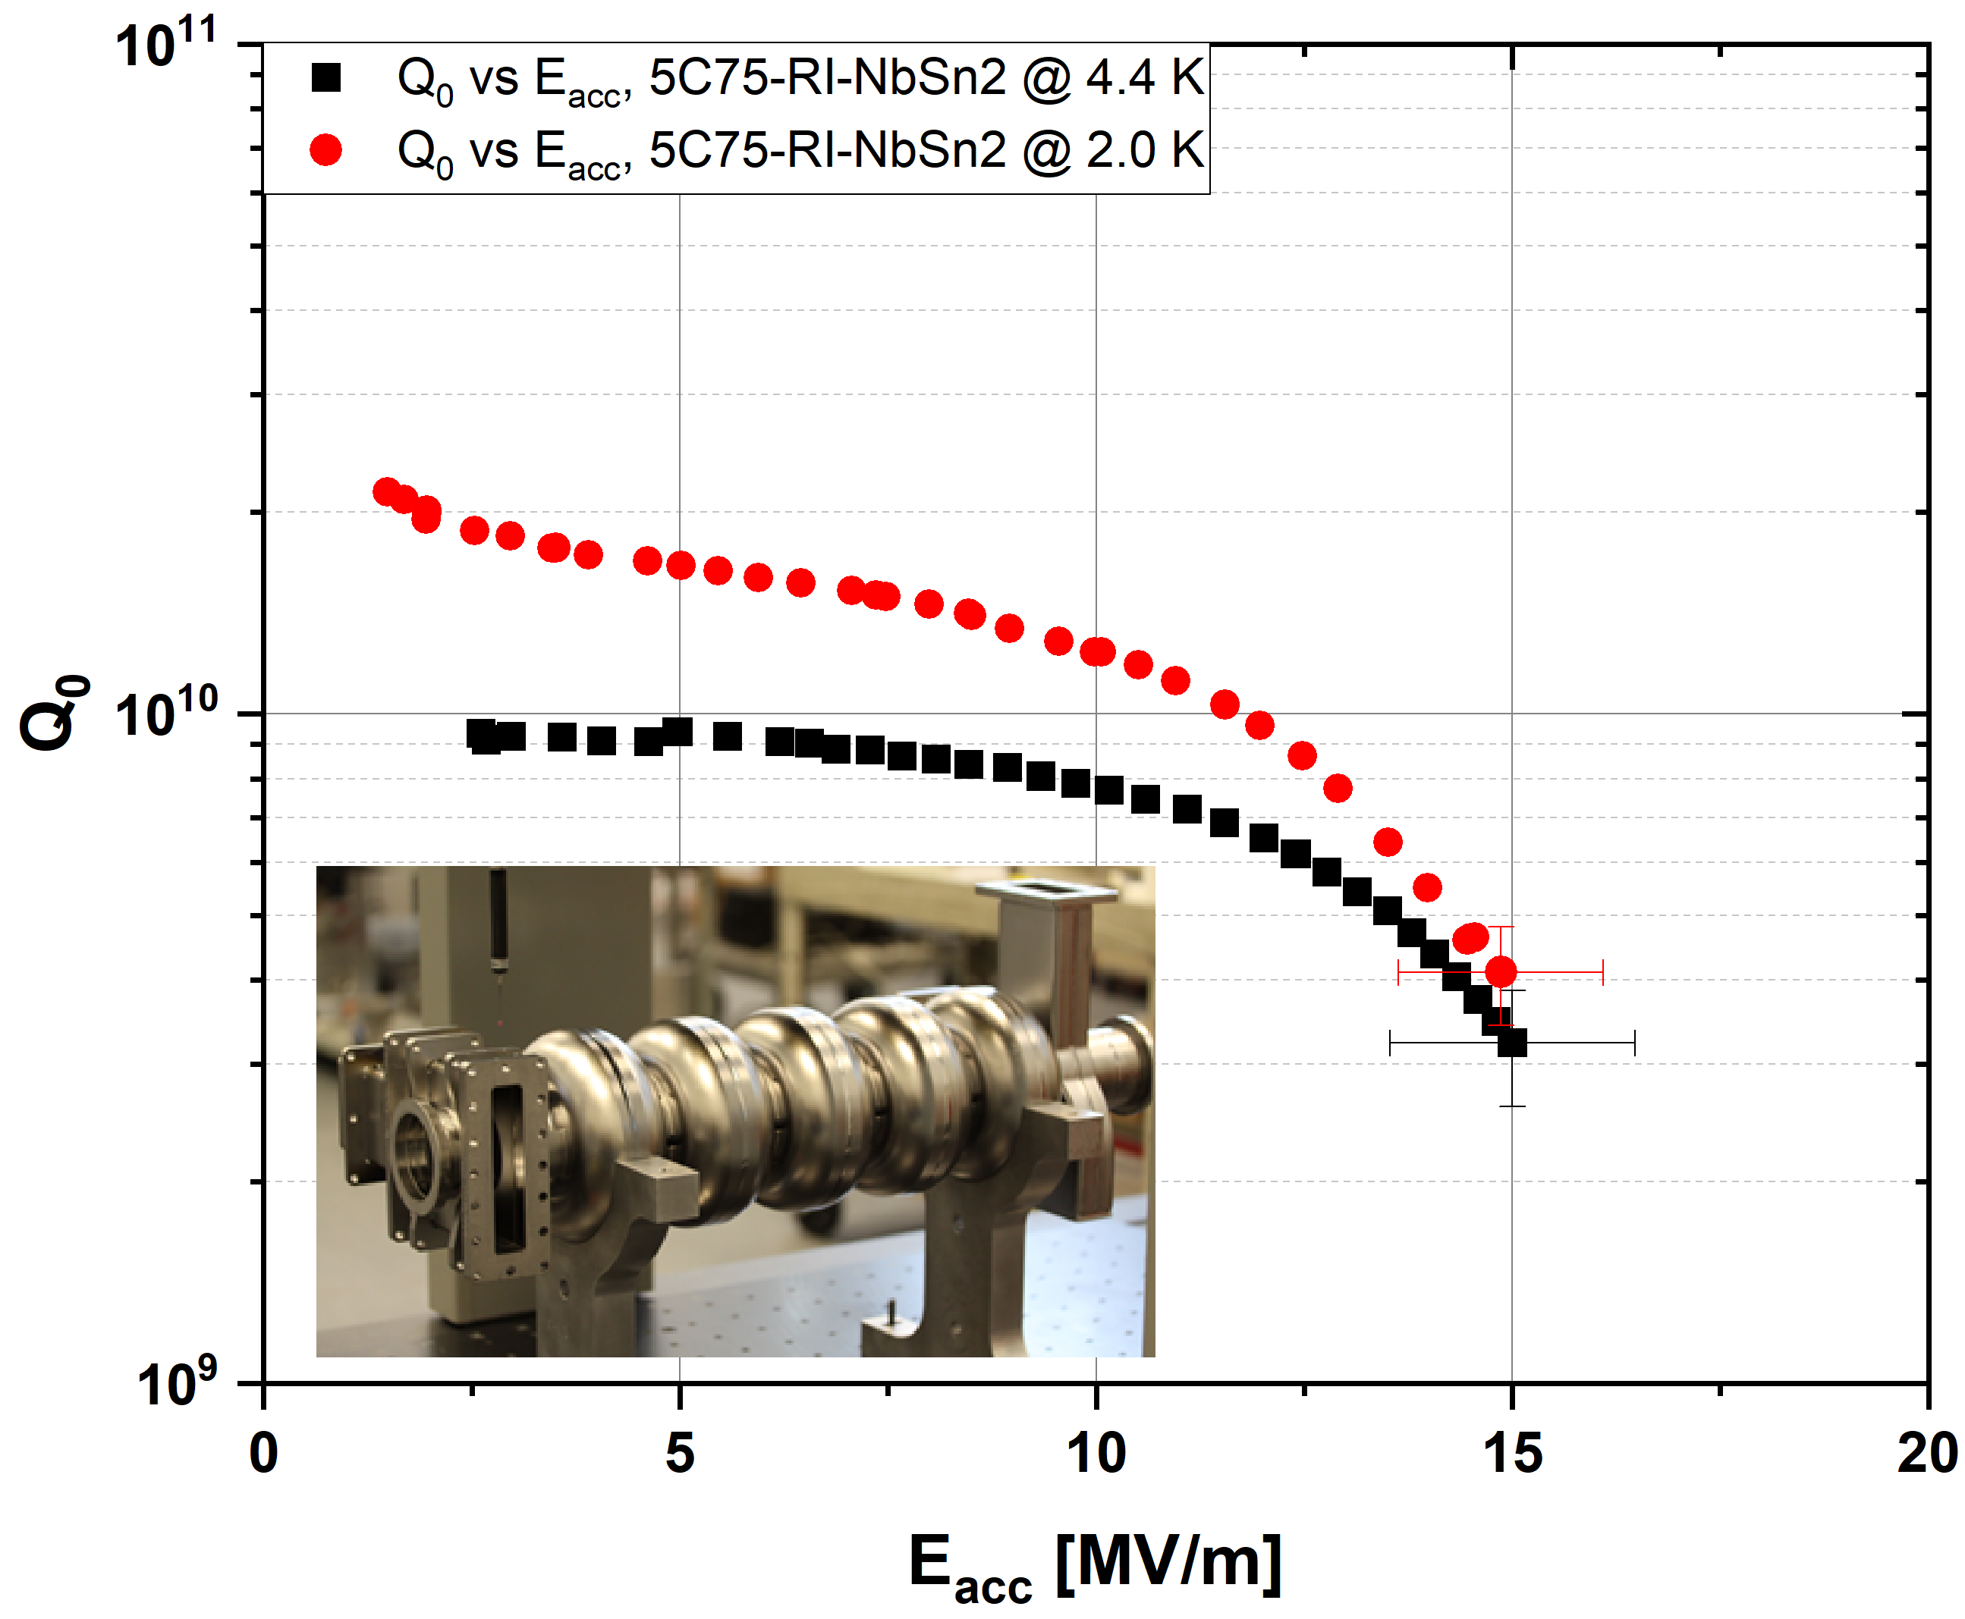
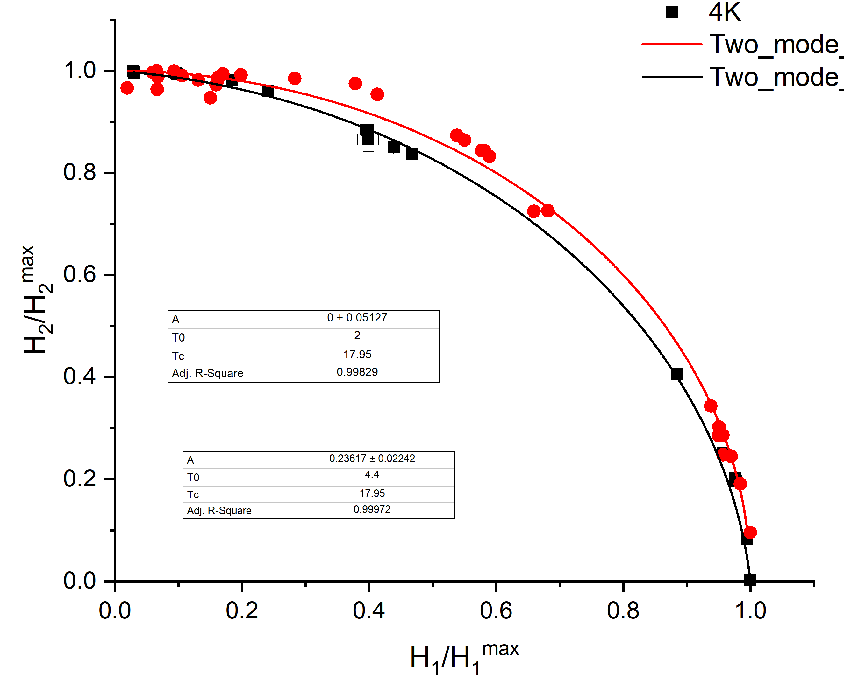
Push towards Nb₃Sn cryomodule
G. Eremeev
Record-high field gradients in practical multicell accelerating cavities
Progress in the development of practical cryomodules with novel SRF cavities
@ 4.4 K
α = 0.24 ± 0.02
High quality SRF cavities coated with novel material are used to study the fundamental material limitations
These studies indicate that cavity reach is limited by the thermal impedance and not by the critical magnetic field
@ 2.0 K
α = 0.00 ± 0.05
32
12/9/20
G. Eremeev | 1st Nb₃Sn SRF Workshop’2020

Slide 33
Plasma processing to suppress field emission

Slide 34
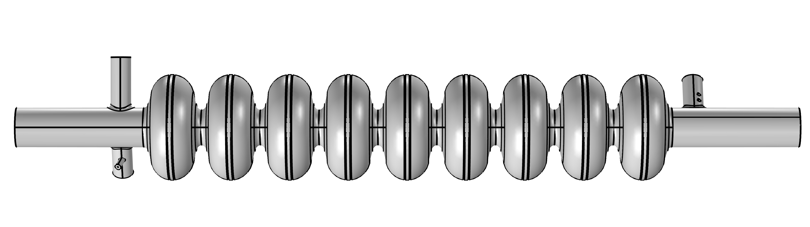
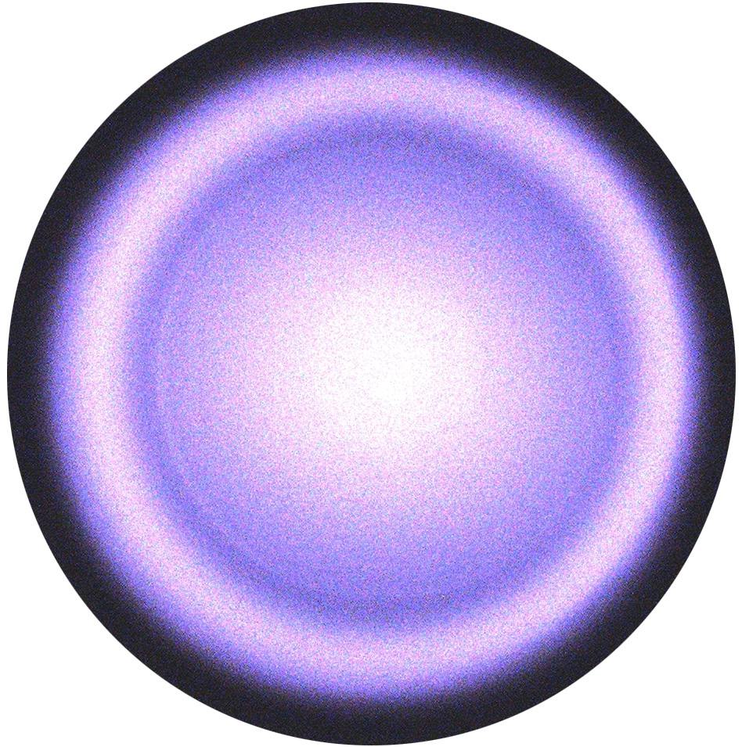
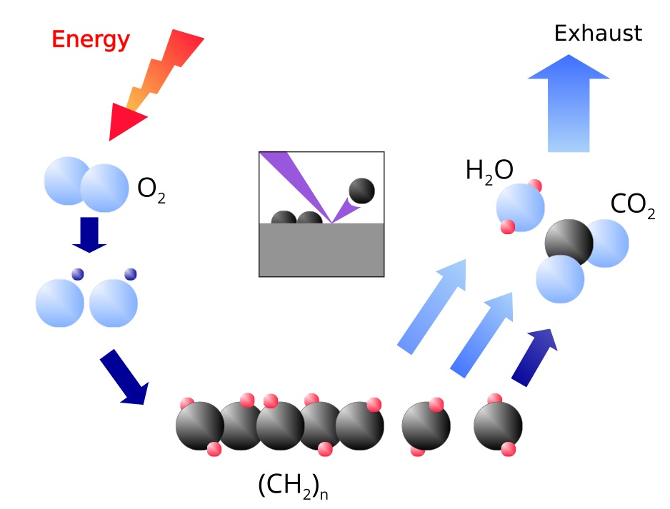
Plasma processing for LCLS-II 1.3GHz cavities (1)
B. Giaccone, M. Martinello
Plasma processing can mitigate hydrocarbon-related field emission (FE) and can be applied in situ in the cryomodule.
Ne-O2 mixture injected in the cavity at pressure ≈ 50-100 mTorr
Gas In
Gas Out
RF driving frequency
Glow discharge
O₂ is dissociated in the plasma and can react with hydrocarbons on cavity surface
Volatile byproducts are pumped out of the cavity
H_{x}C_{y} removal results in work function increase
Increase in FE threshold
Enables operations at higher accelerating field

Slide 35
Plasma processing for LCLS-II 1.3GHz cavities (2)
B. Giaccone, M. Martinello
The technique has been applied to single cell and 9-cell cavities with natural FE (FE of unknown source, not introduced artificially) or contaminated with different sources, showing promising results.
Test on clean N-doped single cell cavity
Test on cavity with Natural FE
Quench value registered during 1.4K baseline test
Plasma processing preserves the high Q factor and quench field typical of N-doped cavities!
Plasma processing completely removed FE!
After plasma processing, no radiation was detected in naturally FE cavity (1/2) and in cavity with artificial vacuum failure in cleanroom (1/1).
No significant improvement observed in cavities w artificial vacuum failure outside cleanroom (3/3). Particle analysis shows presence of metal flakes.

Slide 36
Targeted infrastructure upgrades

Slide 37
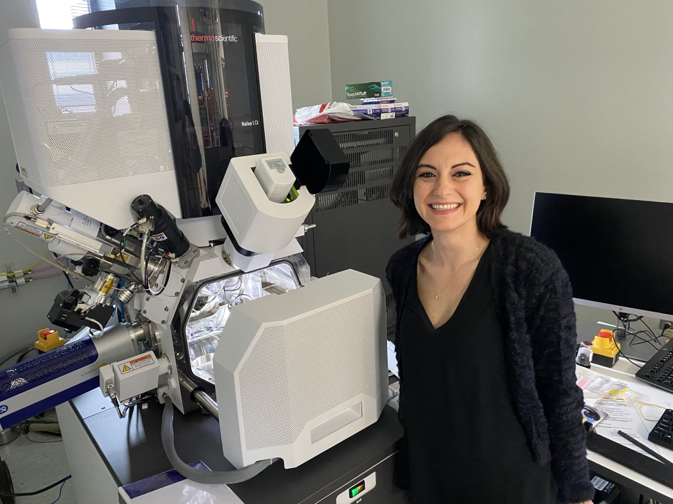
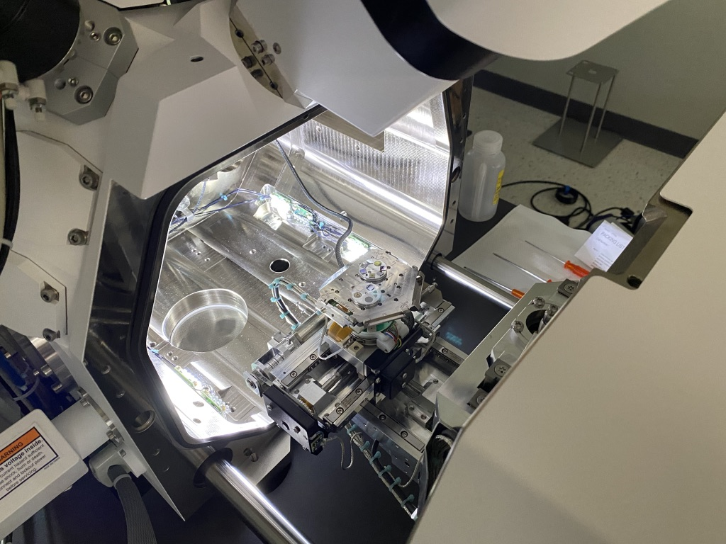
New FIB/SEM/STEM system with cryo
State-of-the-art electron microscope with the focused ion beam for TEM sample preparation and cross-sectional studies
Includes also STEM, EBSD, EDS, cryo stage, heating stage

Slide 38
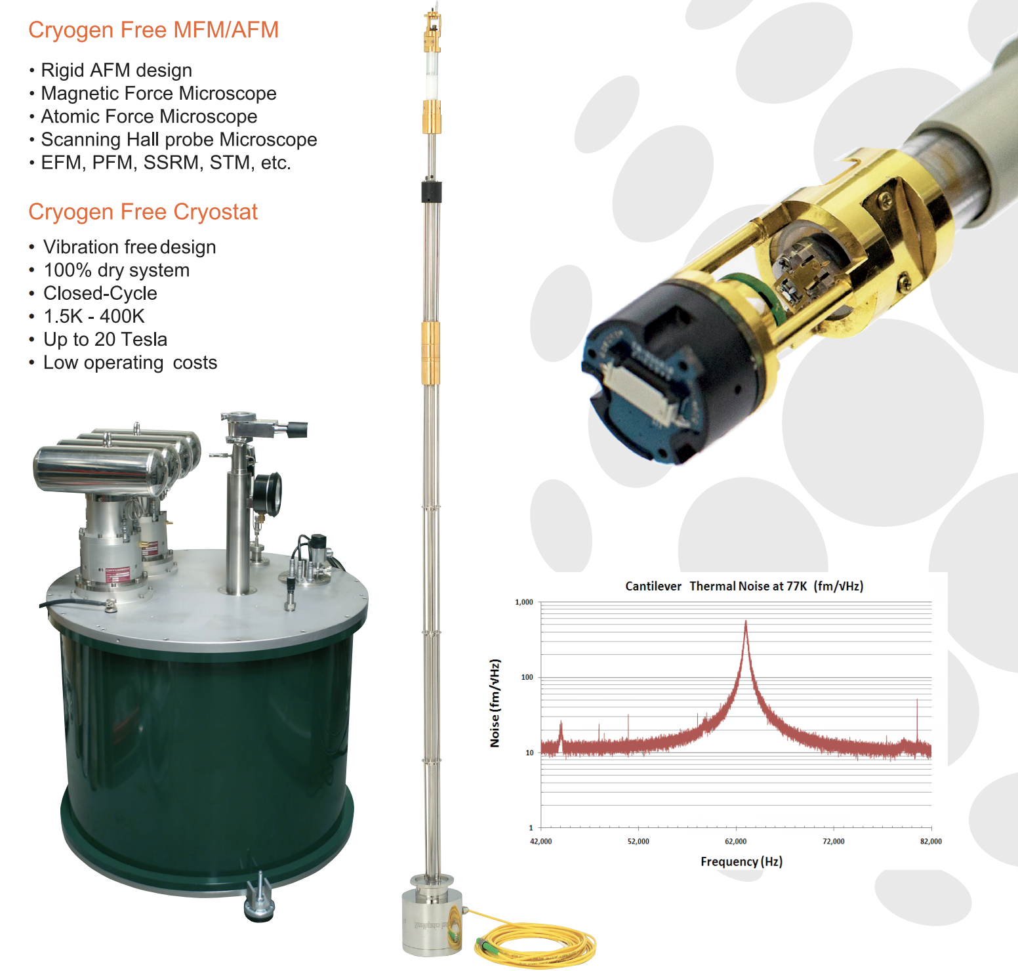
New Nanomagnetics AFM/MFM system with cryo
Dedicated system procured, installation by Aug 2021
Detailed surface studies of hydride formation etc
Magnetic flux trapping and expulsion

Slide 39
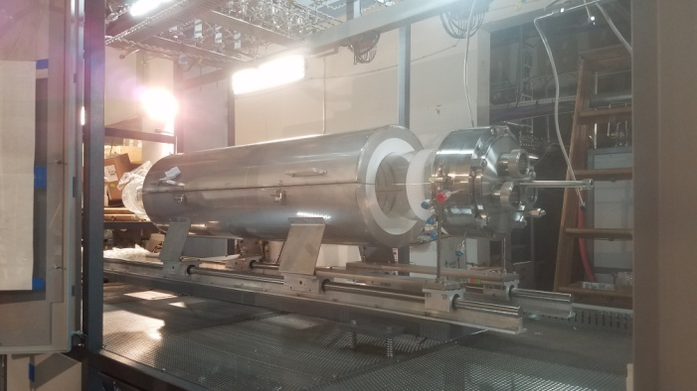
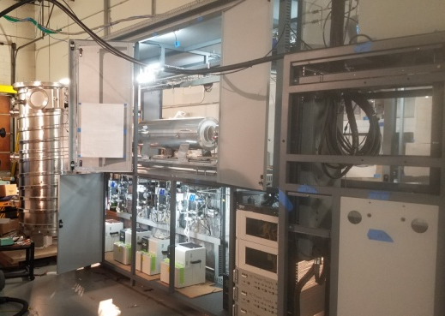



Multicell cavity CVD/ALD furnace – 50% production milestone
Front view of frame
Front chloride furnace mounted with inlet flanges
Back Lower Deck- high temperature bubblers installed and wired with insulating blankets and heaters
Rear chloride furnace mounted with inlet flanges
Back view of frame

Slide 40
Summary
Vibrant SRF R&D program with continuous stream of exciting results
Targeted research infrastructure improvements to stay at the leading edge
THANK YOU

