Slide 1
Cogging in the Fermilab Booster
Evgeniy Koval, NSU
Supervisor: Kiyomi Seiya

Slide 2
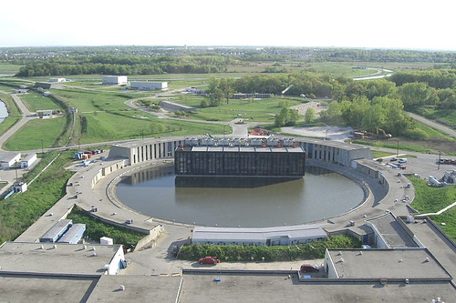
Booster
Booster parameters
Diameter...............................150 meters
Injection energy.............................400 Mev (kinetic)
Extraction energy...........................8 Gev (kinetic)
Cycle time....................................33 msec
Harmonic number, h........................84
Injection Frequency.........................37.77 Mhz
Extraction Frequency.......................52.81 Mhz
Typical bunch intensity...................3 x 10e10

Slide 3
What is Notch for?
Extraction kicker risetime ≈ 40 ns.
Bunch-to-bunch space at the extraction ≈ 20 ns
Instead of loosing beam at 8 GeV during extraction beam is removed at 400 MeV
Reduces energy loss 20x times

Slide 4
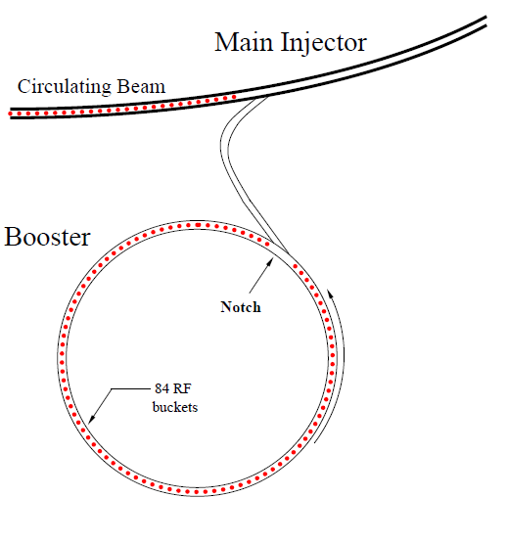
Booster Cogging
Extraction:
Notch should be synchronized with kicker pulse
Batch in booster should be aligned with the Main Injector beam
Since the accelerators are not synchronized procedure to align notch and beam in MI – cogging –is needed.

Slide 5
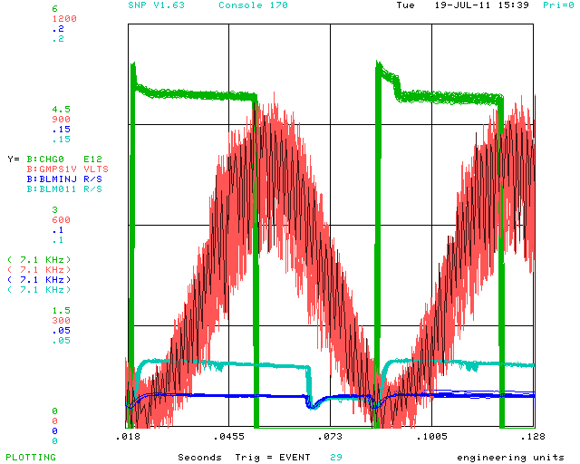
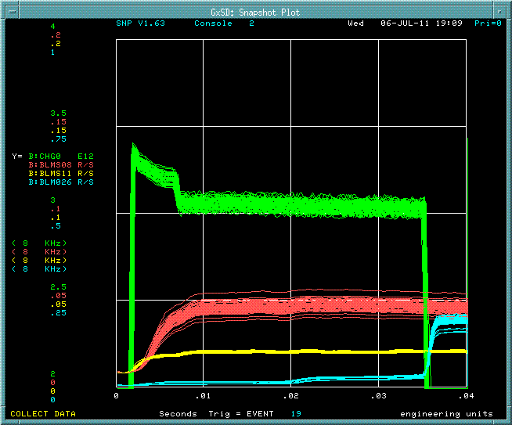
Current state of “Notching” in Booster

Slide 6
Main goals:
Complete simulations of booster cogging considering noise from the supply system
Compare real data with simulations
Calculation and measurement for possible solutions using corrector magnets

