Slide 1
Detector Safety System (DDSS) for the TPC Electronics and Connections to Slow Controls
Marco Verzocchi
Fermilab
29 October 2020

Slide 2
History & References (i)
TPC Electronics has been working with Terry, Linda, Trevor, and Ian on concept for DDSS since February
Links to meetings
Revisit ICEBERG, goals for DUNE (14 February)
Comparison of different options, desire for PLC system (5 May)
TPC electronics view of PLC system (14 May)
Project controls’ engineer initial ideas on PLC system (22 May)
Progress toward design (28 May)
Expanding to other systems (4 June)
Rack space needs, network connections (11 June)
How to describe the system / action matrix (2 July)

Slide 3
History & References (ii)
TPC Electronics has been working with Terry, Linda, Trevor, and Ian on concept for DDSS since February
Links to meetings
DDSS design (low voltage supplies, interface to PTC) (23 July)
DDSS design (bias voltage supplies, available in EDMS)
Action matrix in plain English language (10 September)
Starting to write documentation of action matrix, ideas on interface with slow controls (22 October)
Summary presentation given at the technical board meeting of 1 October
Includes motivation, design, action matrix
Rest of this presentation includes brief summary of TB presentation with additions from 10/22 meeting

Slide 4
Interlocks
Detector safety can be achieved through multiple level of protections
Detector safety needs to be taken into account during the design phase
Hard to make additions to a complete detector design
Multiple level of protection
One end: Slow controls
Identify trends, issue warning or alarms, response time O(1-10 s)
We really don’t know how well the slow control system scales with the number of components
SC system is active only if all the software on all nodes is operating
Middle: PLC based system (fast response, independent from SC, some programmability)
Opposite end: fuses, diodes
Very fast response, but in case of problems may need to replace components before resuming data taking
Once you’ve designed the system, you cannot modify the protection, unless you redesign components

Slide 5
How the design was developed
Identify the risks
Electrical and thermal dangers
May also have to consider instabilities in the cryogenic system
Decision on architecture
Protections
Slow controls, identify trends, set warning and alarm levels
PLC system to ensure that protections are always present, even when the slow control system is not operating
Low level hardware protection (fuses)
Granularity
Prefer a system where we have interlocks at the APA level, avoid turning off multiple APAs in case of problems clearly identified with a single APA

Slide 6
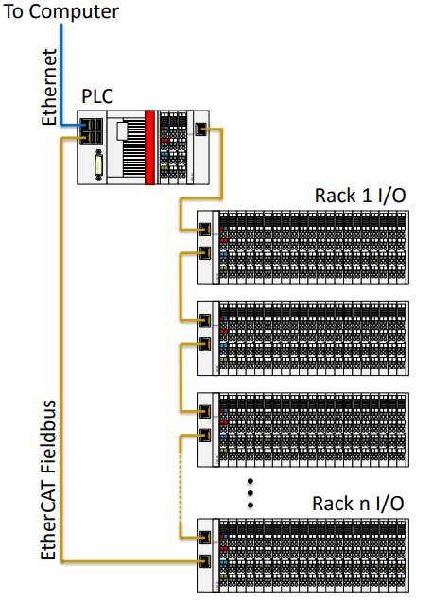
How is the system built ? (i)
System architecture
Controller – Beckhoff CX5120 PLC
Groups of I/O modules distributed across racks needing interlocks
Fieldbus organized in a loop topology, daisy-chained from rack to rack
Need two types of racks
Low voltage power supplies (repeat 25 times, one per row of APAs)
Bias voltage supplies (repeat 5 times, one every 5 rows of APAs)

Slide 7
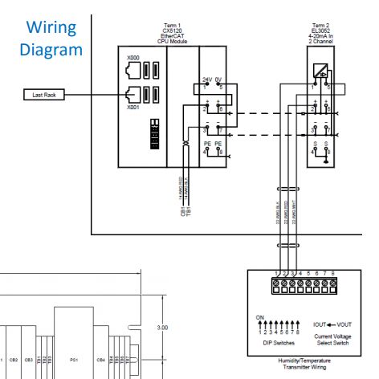
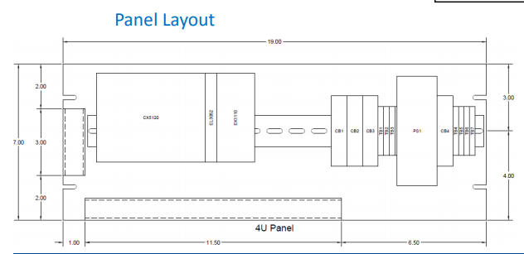
How is the system built ? (ii)
PLC Rack
One Rack (location TBD)
Programmable Logic Controller (PLC)
Contains all logic for DDSS
Communicates with slow controls
Temperature / humidity / dewpoint transmitter
Dewpoint factors into flange heater logic controller
Beckhoff CX5120 PLC

Slide 8
How is the system built ? (iii)
TPC low voltage racks
25 Racks (6 flanges per rack, 150 flanges total)
Fans (4 per flange)
24V discrete output to power fan
24V discrete input reads fan run status
Heaters (4 per flange)
24V discrete output to power heater
RTDs (temperature sensors) (2 per flange)
RTD input to read temperatures
Wiener PL506 interlocks (1 per flange) –
5V discrete output to single channel interlock
Power & Timing Control (PTC) (1 per flange)
EtherCAT communication over fiber optic cableController

Slide 9
How is the system built ? (iv)
Bias voltage racks
5 Racks •
ISEG Module Interlock
Relay for single channel inhibit (interlock)
658 channels total – 450 bias voltage and 208 field cage
Channels per rack varies rack-to-rack (average is 132)
DDSS designed to support up to 9 ISEG modules (144 channels)

Slide 10
Action Matrix (i)
Power and monitor the fans on the WIECs
If the fans do not provide sufficient cooling for the WIEC, turn off the bias voltage on the corresponding APA, then turn off the WIEC
Monitoring information to the Slow Controls: fans status (600 bits)
Receive from Slow Control GUI: enable/disable power to fans
Power the heaters on the CE flange
Monitor the temperature on the flange, compare it with the dew point in the cavern (humidity measurement from central PLC), and decide how much power should be provided to the heaters; if the temperature is too close to the dew point, turn off the bias voltage on the corresponding APA, then turn off the WIEC
Monitoring information to the Slow Controls: heaters status (300 bits), 300 temperature measurements, 1-2 humidity measurements
Receive from Slow Control GUI: enable/disable power to heaters

Slide 11
Action Matrix (ii)
Enable/disable low voltage power supply channels
In addition to reasons listed on the previous slide, could decide to turn off the LV supply in case of cryogenic problems, HV discharges, other global vetoes on powering the detector
Monitoring information to the Slow Controls: interlock status (150 bits)
Slow Control responsible for turning on/off low voltage power
Enable/disable bias voltage supply channels
In addition to reasons listed on the previous slide, could decide to turn off the LV supply if the FEMBs are not powered on, in case of cryogenic problems, HV discharges, other global vetoes on powering the detector
FEMB information sent to PLC via PTC interface, monitoring information on FEMB status sent from WIB/PTC to SC, it is worthwhile monitoring the interlock status from the FEMBs at the PLC (750 bits)
Monitoring information to the Slow Controls: interlock status (658 bits)
Slow Control responsible for turning on/off bias voltages

Slide 12
Interface with Slow Controls
Slow control system may not be able to perform certain operations because there is an inhibit signal coming from the DDSS
Slow control system needs to get list of current inhibits from the central PLC via Ethernet (central PLC will be an OPC UA endpoint)
It would be preferable to have a single GUI for DDSS and SC
Following slides are from the 22 October meeting and discuss ideas for how DDSS/SC communicate / share control of devices

Slide 13
Low Voltage Supplies
WIENER PL506 (6 channels, 1 per APA), 25 modules
All settings are controlled from Slow Controls
Non expert menu allows users to turn on/off individual channel
All other settings (ramp speed, voltage settings, thresholds for warnings/alarms, action to be taken in case of interlock failures) are restricted to expert users
Monitored by slow controls
Receive interlock signal from DDSS
Assume that monitoring information for interlock signal is sent from DDSS to slow control via the main PLC computer
Not sure this can also be monitored from the PL506 as well

Slide 14
Bias Voltage Power Supplies
WIENER MPOD (5 crates) with 45 ISEG modules total
All settings are controlled from Slow Controls
Non expert menu allows users to turn on/off individual channel
All other settings (ramp speed, voltage settings, thresholds for warnings/alarms, action to be taken in case of interlock failures) are restricted to expert users
Monitored by slow controls
Receive interlock signal from DDSS
Assume that monitoring information for interlock signal is sent from DDSS to slow control via the main PLC computer
Not sure this can also be monitored from the MPOD as well

Slide 15
WIB / PTC
The WIBs are entirely under the control of Slow Controls and DAQ
The WIB can receive interlock signals (via the PTC) from the DDSS, assume that these are monitored from DDSS, but could also be monitored via the WIB-SC connection
The WIB sends information used to build interlock signals (via the PTC) to the DDSS. Assume that the detailed monitoring of currents, voltage, temperature on the WIB (and status of the FEMBs) is sent directly from the WIBs to SC. Assume that the DDSS will send only monitoring information at the level “WIB xxxx is interlocked”
The same applies also for the PTC

Slide 16
OPC UA Endpoint
OPC UA is the protocol used for Slow Controls
Endpoint is software block that runs somewhere that controls the hardware
Each WIENER MPOD (*5) and each WIENER PL506 (*25) is a OPC UA endpoint
It is not yet clear to me whether
We deploy 900 OPC UA endpoints (1 per WIB/PTC) on the Zynq CPUs inside the FPGAs on the WIBs/PTC
We deploy fewer OPC UA endpoints (1 per row of APAs ?, only 1 per far detector module) in the computer(s) that run the slow controls program(s) for the TPC electronics
This is an architecture decision for the DAQ/SC group
Need input from the DAQ/SC group

Slide 17
Temperature & humidity sensors
We have 4 RTDs on each of the 150 flanges, only 2 of them are actually connected to the readout modules (Beckhoff EL3202-0010)
Information from the RTDs is used in the PLC logic to decide whether to turn on/off the heaters
We have 2 dedicated humidity sensors on the top of the cryostat that are read out through the Beckhoff EL3052 connected on the central PLC panel
Information from the humidity sensors is used in the PLC logic to decide whether to turn on/off the heaters
This information should also be transferred from the PLC to slow controls for monitoring

Slide 18
Status of heaters/fans (i)
Each flange has 4 heaters / fans
Slow control should have an overall “flange on/off” command
Sent from SC via PLC computer
Turns off all heaters and fans for that flange, which then generates interlock signal for low voltage and bias voltage supplies
This is essentially a “switch off the flange command”
Enable power to heaters and fans, at which point DDSS takes over their operation and the generation of interlock signals for the low voltage and bias voltage supplies

Slide 19
Status of heaters/fans (ii)
Information available for each heater
Power: ON/OFF (decided by the PLC)
Information available for each fan
Power: ON/OFF (decided by the PLC)
Spinning: ON/OFF (PLC readout via Beckhoff EL3202-0010)
This information should be sent from the PLC to Slow Controls
It is not clear that we want to allow SC to turn on/off individual heaters / fans
This should be an expert action, may require logging into the DDSS GUI

Slide 20
Conclusion
It would be preferable to present all the slow control information in a single GUI, independent of whether this come directly from the OPC UA endpoint on the detector (WIENER MPOD and PL506, WIBs, PTCs) or whether it comes through the DDSS/Slow Control interface (OPC UA endpoint on the central PLC)
This should also integrate the display of the status of interlocks (and possibly expert level interface to enable / disable interlocks ?)
Full access to PLC should be via separate GUI

