Slide 1
Proton PMG
Summer Shutdown Status
11/5/20
Cons Gattuso

Slide 2
Linac
Beam
Booster
Beam
MI
Beam
LBNF berm construction comp
NuMI Horn 1&2
Ready for install
cable termination@ MI 10/20
MI alignment due to
Berm construction
Muon Campus
D30 Shield wall
IERC Manhole Feeder work
Collimator insert/horz cont.
MI water system
Recovery from LBNF
Commission of new system
Muon Campus
Resonate Extraction

Slide 3
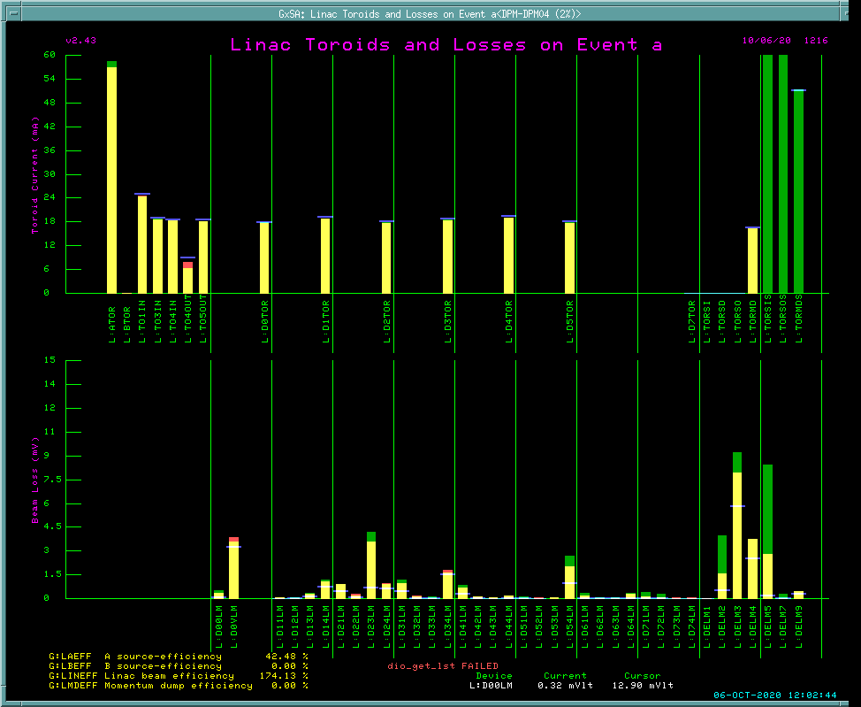
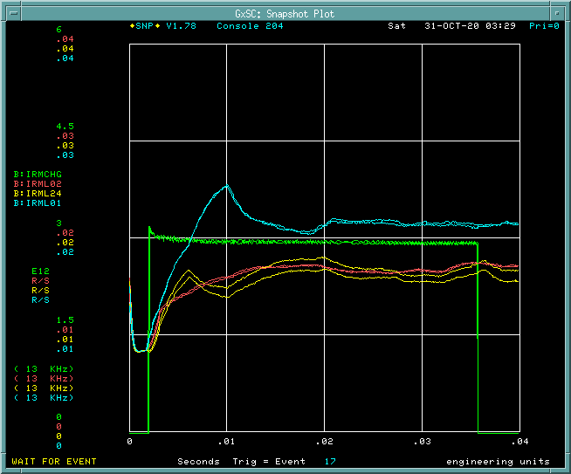
Proton Source Status/Startup
Linac Beam
Current
Booster Beam
Current
Booster Circulating
Beam
Booster Beam
Absorber
Linac losses
Running on Source A
~55 ma
Low intensity running for tune-up
Raising Intensity as losses permit

Slide 4
Booster Studies
Durations ~ 2 weeks
Total Number of Studies: 36
Dedicated: 21
Dedicated 1 Shot: 4
Parasitic: 11
900 kW and PIPII related: 17
Studies will continue if not completed during the scheduled studies every 4-6 weeks.

Slide 5
MI Startup Activities
General Timeline
Friday Nov 6th - Monday Nov 9th
Power Supply Startup
Monday Nov 9th
CDC testing
Tuesday Nov 10- Thursday12th
MI/RR Alignment
Wednesday Nov 11th (earliest)
Beam Sign Off *
Power Supply Startup:
This weekend
Secure the MI
Clear Bus and Hi-pot
Power Pulse Feeder with no load
Power the Pulse Power Transformers with no Ramp
Slow Ramp of MI to heat up buss/magnets/water system
Potential Hold off
Shielding Assessment needs to be modified and review prior to safety sign off. Could have it sometime next.
Alignment of RR/MM from LBNF site Prep impacts
Beam Startup (Most activities require 1E12/Booster batch) Operations will begin with MI only.
Beam Start Up * (earliest)
Wednesday Nov 11th – Friday Nov 13th
MI:
Establish 8 Gev beam. 6 Hours
Establish 120Gev beam. Smooth orbits. 6 Hours
High field orbit smoothing (possible quad moves) 16 Hours
This will require alignment
Completed when NuMI target/Horn are being moved (if needed)
Commission instrumentation
Tune up for operations. 4 Hours for each beam line
Beam Start Up * (earliest)
Monday Nov 16th – Wednesday Nov 18th
RR: 1 week
Establish beam and set operating parameters (orbits, tune, …)
Establish 2.5Mhz beam and extract to Muon start up
Lattice measurements and adjustments
Aperture scans
Commission instrumentation
Slip Stacking / Operating Point Studies
Establish operating intensity

Slide 6
External Beam line
BNB
This week: Power Supply Turn on and check out has commenced. We will resolve any issues this week.
Monday Nov 9th
CDC testing
Wednesday Nov 11th (earliest)
Beam Sign Off *
Beam to follow
Test Beam Lines
Week of Nov 16th : Complete walkthrough turn on power Supplies
Week of the 23rd : Establish beam to Switch Yard Absorber
* Potential Hold off
Shielding Assessment needs to be modified and review prior to safety sign off. Could have it sometime next.
Alignment of RR/MM from LBNF site Prep impacts

Slide 7
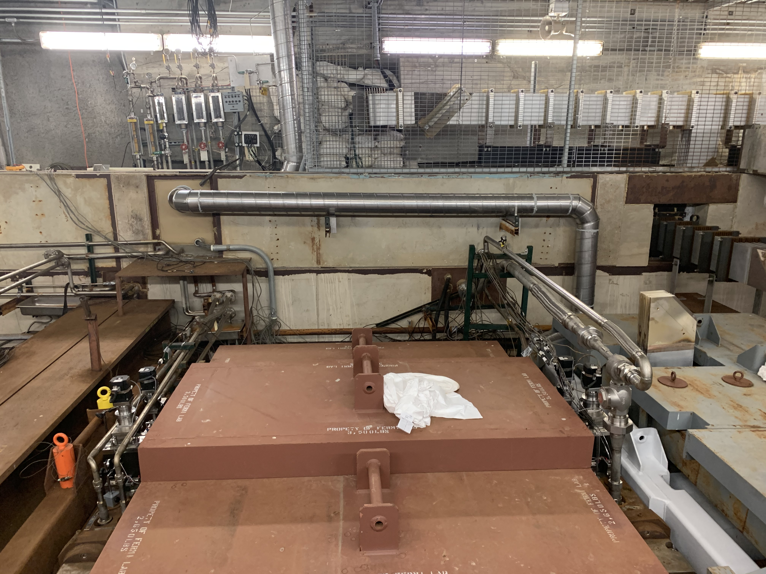
NuMI
Status of Beam line:
V108 Power supply work
PT transformer needs to be replace will be completed this week if all goes well.
Status of Target Hall :
Horn 2
Hi-pot successfully
Has been Aligned
Connect to stripline
Horn 1
HVAC work is complete
Alignment is complete
HI-pot failed
Horn 1 passed it Hi-pot prior to the installation of the Air-Cooling system and Alignment.
Air cooling duct bank
Water lines
Remaining work -
Install Horn-1 Strip line Jumper
High Pot SL + H1 + H2
Connect Strip Line Jumper at Cap Bank in PS room underground.
Interlocks/Safety System tests
Pulse Test horns.
Remove Target for beam-based alignment of horn.
This situation is sliding the NuMI schedule by about 1 week…
COVID issue have limited personnel on site associated with our Target Hall work.
No one tested positive, but we are self quarantining as per lab guidelines
A plan is being put together such that we can move forward as of Monday with the personnel on hand.
More information will follow as a plan develops.

Slide 8
Muon Campus
The schedule is based on previous start-ups where Muon first sees beam about 3-5 days after Main Injector/Recycler first receive beam, with higher intensity and faster cycle time beam after 6-8 days.
Machine Checkout and final Safety system test will take place between Nov 16th -20th
First Beam to Muon Campus Friday ~Nov 20th
Initial start-up in 8 GeV mode (Mu2e mode), where 8 GeV protons are sent from the Recycler (RR) to the Delivery Ring (DR).
~ Nov 20rd Spend about 2-3 days establishing circulating beam in the DR, correcting beamline and DR orbits, working on improving efficiency and possibly doing some beamline optics measurements with 1-bumps.
~Nov 23rd Switch to g-2 mode and send 3.1 GeV beam to the DR. Check beamline ion chambers for proper yield and tune up for maximum beam intensity to the DR.
When g-2 schedule allows, send muons down M4/M5 to the g-2 Ring and tune up positions. All of this can be done with lower intensity and cycle time beam.
~ Nov 27th : When RR and g-2 are ready, send g-2 8 cycles/NuMi cycle with moderately high intensity (~ 7E11 per pulse) so that they can check out their experiment and prepare for physics.
~Dec 7th : When g-2 is ready to take physics quality, switch to 16 pulse operation and ask RR to deliver 1E12 per pulse as soon as they are able.
During this Time experts will be working on tuning up the RRRF to narrow them up the bunches as much as possible, then g-2 does kicker timing scans.
There will be a need for significantly more Mu2e studies in FY21, which will need to be scheduled to minimize the impact to g-2.

