Slide 1
Snowmass All Frontier Conveners Meeting
Young-Kee Kim
November 2, 2020

Slide 2
Structure of Snowmass 2021 Report
Our plan has been to use the 2013 Snowmass Report Structure.
Let me walk you through it: step-by-step

Slide 3
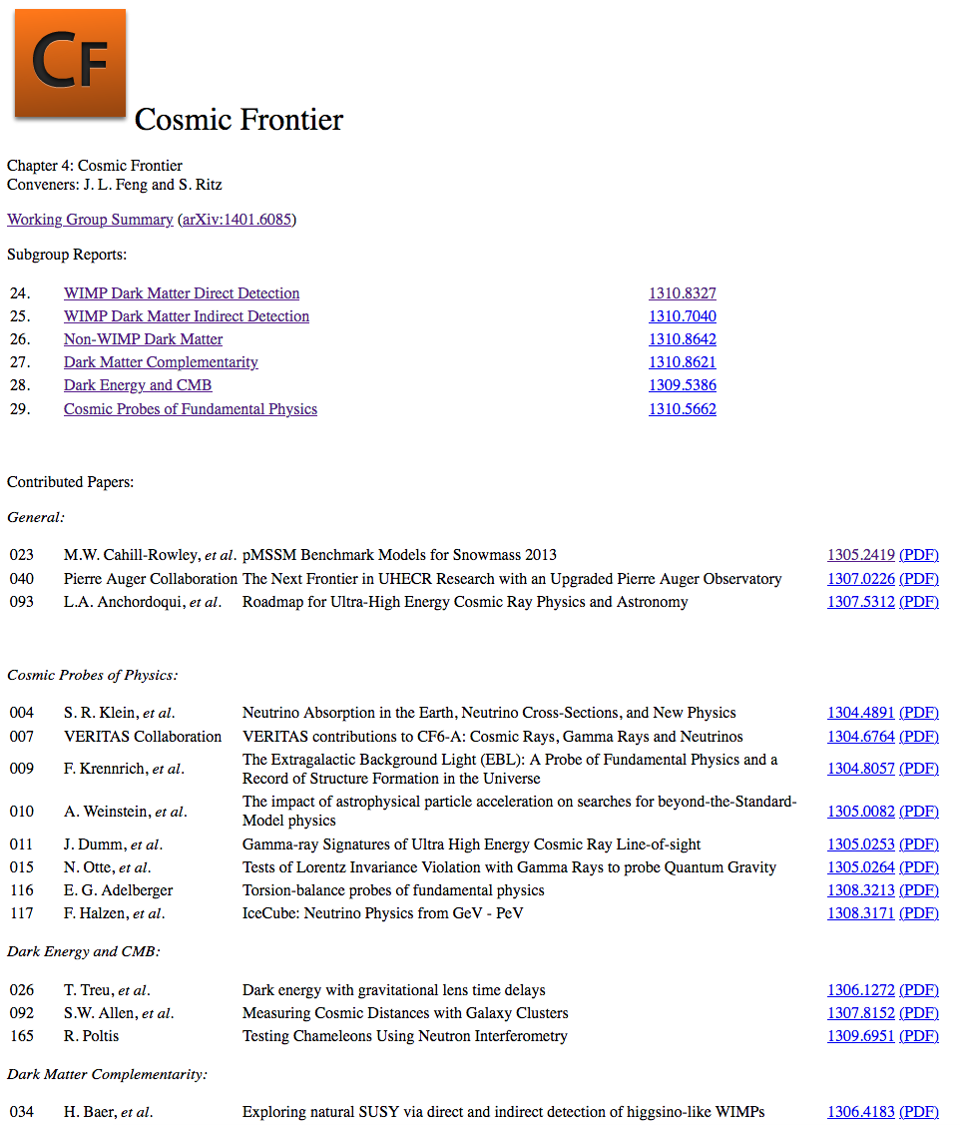
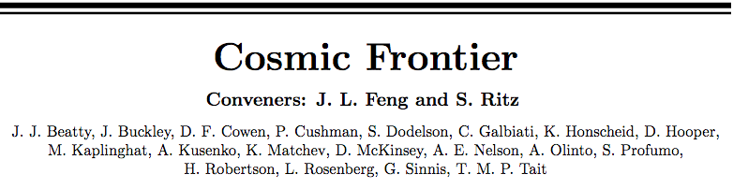
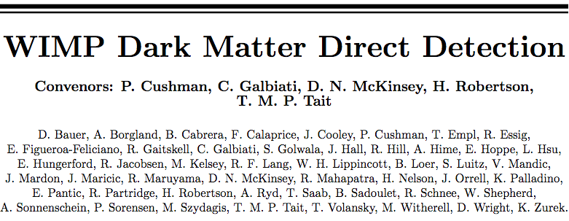
Snowmass Report Structure (2013)
Webpage (electronic version) – https://www.slac.stanford.edu/econf/C1307292/
WG Summary
Subgroup Report

Slide 4
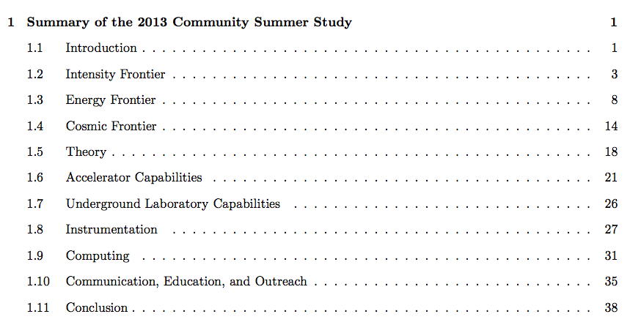
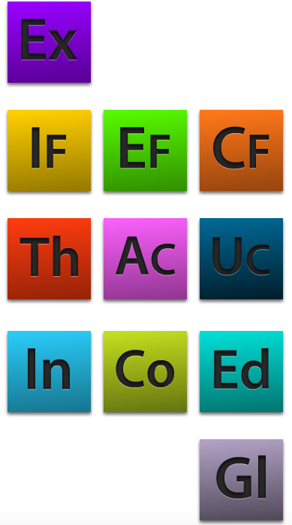
Snowmass Report Structure (2013)
Webpage (electronic version) – https://www.slac.stanford.edu/econf/C1307292/
Snowmass Summary (1 file, ~45 pages)
Executive Summary (7 pages)
Working Group Ex Summary (38 pages)
Each of 10 Working Groups (3 Frontiers, 5 Capabilities, Theory, C.E.O.)
WG Summary(1 file+arXiv): 15~60 pages (including subgroup summaries, a few pages each)
Subgroup Reports if subgroups exist (each subgroup report: 6~60 pages)
  Subgroup 1 (1 file + arXiv)
  Subgroup 2 (1 file + arXiv)
  Subgroup 2 (1 file + arXiv)
  …..
Contributed papers (arXiv links)
Snowmass Summary + 10 WG Summaries (382 pages)
Printed version + Electronic version(https://www.slac.stanford.edu/econf/C1307292/docs/SnowmassBook.pdf)

Slide 5
Snowmass Report Structure (2021) – Plan
Snowmass 2021 Report
The webpage of each frontier
report will look like this

Slide 6
Snowmass Report Structure (2021) – Plan
Snowmass Summary: 1 file (~50 pages)
  Executive Summary
  Introduction
  10 Frontier Executive Summaries
  Summary of multi-frontier topics: Dark Matter, Quantum Science, … (TBD)
  Conclusion
Each of Ten Frontiers
  Frontier Summary (1 file + arXiv link): < ~50 pages (including TG summaries, a few pages each)
  Topical Group Reports
  (TG report could range from a few pages of TG summary to ~50 pages)
    Topical Group 1 (1 file + arXiv link)
    Topical Group 2 (1 file + arXiv link)
    Topical Group 3 (1 file + arXiv link)
    …..
  Contributed papers
    Contributed paper 1 (arXiv link)
    Contributed paper 2 (arXiv link)
    Contributed paper 2 (arXiv link)
    …
Timeline:
TG Reports → Frontier Summaries → Snowmass Summary
Snowmass Summary + 10 Frontier Summaries (~500 pages): Printed version + Electronic version
To be discussed / determined: Printed version of Snowmass Summary (~50 pages)

Slide 7
Snowmass Report Structure (2021) – Proposal
Snowmass
Key Questions
Snowmass
Summary
Frontier
Summary
TG
Report
Frontier #1
Key Questions
Frontier #10
Key Questions
…………………….
TG #1 Key Questions
TG #2 Key Questions
TG #N Key Questions
TG #1 Key Questions
TG #2 Key Questions
TG #N Key Questions
…
…….
…

Slide 8
Contributed (“White Papers”)
Message from the Snowmass Early Career leadership
White papers are being organized in very different ways, with different goals and (in some cases) without communication with the community. We think conveners should clearly state (in all usual channels; email, Slack, Snowmass website) white paper policies. Our suggestions are:
  How are white paper topics being determined?
  If you’re an LOI submitter, will you be contacted about involvement with a specific white paper? Or must you organize the paper and inform conveners? What about authors who are not submitters?
  We are especially concerned about LOIs with more than one Frontier/Topical Group that may fall through the cracks: how do authors know which frontier to be talking to or waiting for input from, particularly if approaches vary between frontiers?
The information related to White Papers in the website needs updates to reflect the timeline presented at the CPM (perhaps also a page count suggestion). It could be useful to encourage all conveners to post their individual contribution policies on their own sections of the website, especially pertaining to coordination, who is responsible for communicating with whom, and internal deadlines.
In this process we learned that there’s no other way to raise concerns about the process. One could implement a feedback mechanism for Snowmass organizers or points of contact
It would be good to make sure all conveners are aware that early career liaisons should be included in all convener meetings, public and private, and enforce this policy.

Slide 9
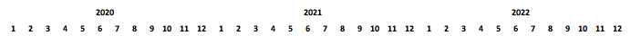
Snowmass Community Summer Study (July 2021)
Some want to consider to postpone it to later dates
Issues with later dates
  Snowmass schedule is strongly correlated to the P5 schedule.
  Options (avoid teaching periods) and concerns
    Early August 2021
      The COVID situation will be nearly the same as that of July 2021.
    Mid December 2021
      Traveling during winter time, Holiday season
      6 more months for the Snowmass process (Snowmass fatigue)
    Summer 2022
      Dragging on the Snowmass process for 2.5 years (from Spring 2020 to Fall 2022)
Snowmass Preparation
Snowmass
NAS reviews Particle Physics
National Academy of Science (NAS) reviews each field every ~10 years
P5

