Slide 1
Today
Some news from the Division
The Muon Strategic Plan for Research.
  This is the scariest Halloween story you will ever hear

Slide 2
Division news
Complete clean-up of Phase 1 spaces by Oct. 31.
Now is the time to fill out annual goals in Workday and encourage all of your Department members to do the same.
Program Support (overhead) has been cut
  Need to reduce discretionary work on reviews. Employees should get prior approval to serve on reviews from managers.
Benefits: VERY BIG CHANGES! Everyone needs to go through this during open enrollment and see what plan they want. See all hands email sent by Kate Gregory on 10/29.
5 new budget codes for training, reviews, committees. We will make a cheat sheet and distribute it.
Horst stepping down as Dept Head (basically going into phased retirement I believe)

Slide 3
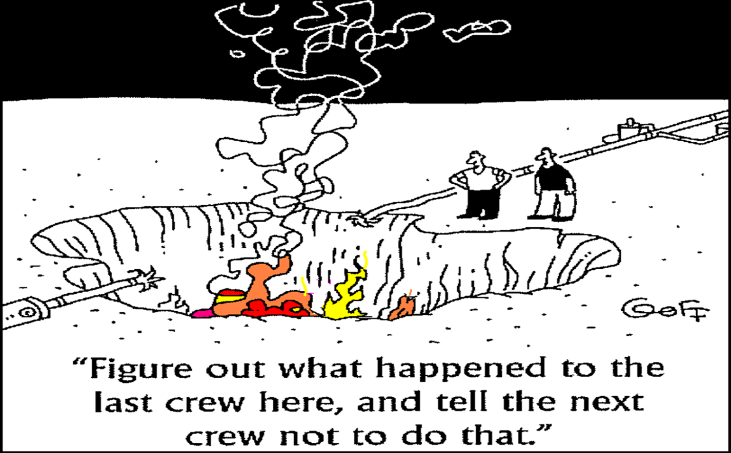
Division Safety news
Lab just completed a self assessment of how well we are using HPI
Basically interviewed a lot of managers and asked how we manage and asked what is working and what isn’t working
At this stage, I don’t believe they interviewed anyone who wasn’t a manager so there is a clear bias at this point.

Slide 4
Report – HPI Concepts
Fermilab’s HPI training teaches several concepts and tools that we can utilize to prevent unwanted outcomes:
  3-step communication
  After action review
  Checklists
  Communication before each irreversible step
  Confirmation terminology
  Pre-job briefing
  Just culture
  Peer check
  Speak concerns out loud
  The substitution test

Slide 5
Report – Major Themes
Planning
  Defined roles and responsibilities
  Identifying stop points for checking progress and documentation
  Team communication (Identified Tool – The weekly “look-ahead”)
Managing Workload
  Help prioritize workload and remove perceived time pressure
  Follow up and through with expectations
  Addressing performance issues
Lessons Learned (LL)
  Limited understanding of how LL are developed and distributed
Communication
  Personal - “constant communication,” “talking, lots of talking,” “check-ins with teams” and “face to face”
  Written – email, log books, texts, goal setting and technical docs
  Meeting – weekly and monthly with individuals and teams

Slide 6
Report – Best Leadership Practices
Think of yourself as training and mentoring the next generation of leaders.
Discuss today’s work, and always include what’s coming up over the next week/month.
Walk through new processes. Demonstrate the steps and discuss any issues that arise. Be open to questions.
Use peer reviews for critical steps.
“Pre-mortem” – think about what could happen and what you would do before you start.
Communicate outcomes and follow up verbal and/or written communication to confirm expectations.
Bad news does not age well. Communicate issues ASAP.
Have an open mind and take blame out of equation!

Slide 7
Strategic Plan (for getting money)
Two types:
  You have an idea of where you want to go, you make a strategic plan of how to get there
    This is a good way to sell your plan and get people on board with supporting you and getting you the resources you need
    In this case, you are asking for more money than you have
  You have a severe budget crisis and you need to re-scope into something smaller, you make a strategic plan of how to get there
    This is a good way to sell your plan and get people on board with supporting you and getting you the resources you need
    In this case, you are asking for more money than you expect to get
In both cases, you are salesperson selling something to a customer.
  In our case, the DOE is the customer and we are selling physics.
  You give them a price list and tell them what they will get for each price point and let them choose what they want to buy.
  So what you always see is ‘scenarios’ that say what you will get if you fund at a particular scenario.
  More than anything else, this is almost always an exercise. You are demonstrating that you have the ability to plan, you never wind up executing the plan.

Slide 8
Muons 2025
A strategic plan for evolving muon research from peak g-2 need to peak Mu2e need

Slide 9
Fermilab’s Muon Program
$400M DOE investment
1 mile of new/repurposed accelerators
Two new experimental halls
Two 413.3b construction projects
Upgrades take advantage of PIP-II beam

Slide 10


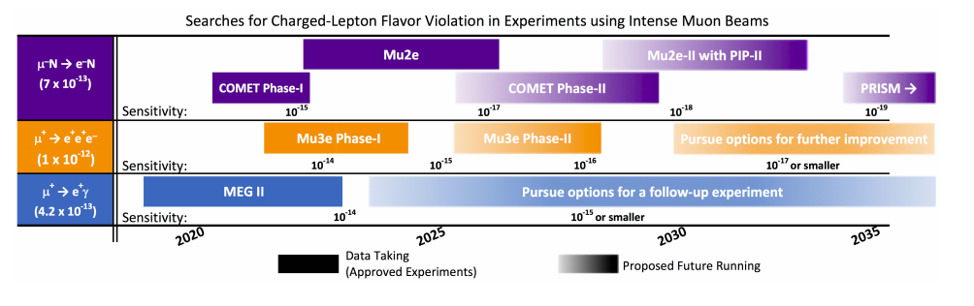
Community Support
Most straight forward P5 Recommendation:
Muon community is participating in the next round of planning

Slide 11
Physics Opportunities at the Muon Campus
Charged lepton flavor violation
  Direct relation to neutrino mass generation
  Mu2e: 4 orders of magnitude improvement in sensitivity
  Mu2e-II: at least another order of magnitude
Magnetic dipole moments
  Window into every model of new physics from 1 GeV to 1000 GeV
  Muon g-2 (mu+ running, current configuration)
CP and T violation
  Parasitic muon EDM searches with g-2
  One order of magnitude sensitivity improvement with current muon g-2 configuration.
  Second order of magnitude with modest upgrades.
  Only test with a bare particle, only test outside first generation
CPT violation
  Window into physics beyond quantum field theory
  Muon g-2 (mu- running, upgraded configuration)

Slide 12
Current program
Muon g-2 with positive muons
  Taking data in FY20-21
  Final publications a few years later
Mu2e
  Under construction
  Cosmic running starts in FY22
Mu2e-II
  Upgraded configuration with beam from PIP-II
  Letter of Intent submitted to the PAC
  Our flagship precision science experiment going into Snowmass 2021
  Runs concurrent with LBNF/DUNE
Muon g-2 with negative muons
  Extended run time and modest upgrades
  Would likely include upgrades to get 2nd order of magnitude on muon EDM sensitivity
  EOI in preparation. Intend to have this ready at time of release of the first g-2 result
  Could run before, after, or interleaved with Mu2e

Slide 13
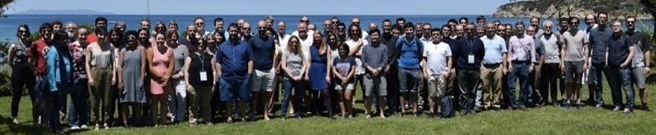
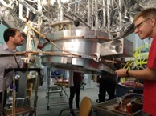
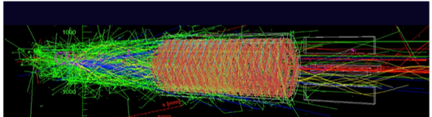
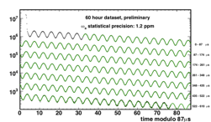
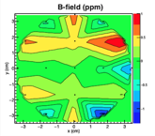
Work funded by the Research B&R
Project Support
Fermilab scientists are integral parts of
designing, planning, and executing construction
projects of experimental facilities
L1
L2
L2
L2
L2
L3
L3
L3
L3
L3
L3
L3
L3
L4
L4
L4
L4
L4
L4
L4
L4
L4
L4
L4
L4
Collaboration Leadership
Fermilab scientists have founded this
program and currently co-lead the program
with University users
Technical Leadership
Fermilab scientists build, maintain,
and understand complex experimental
instrumentation
Computing Leadership
Fermilab scientists process petabyte size data sets,
author and maintain reconstruction algorithms,
and provide simulations to support data analysis
Analysis Leadership
Fermilab scientists are experts in extracting physics results from
complex data sets, lead many physics working groups, and mentor
graduate, undergraduate, and high schools students

Slide 14
Prioritization
Project support
  Project success is the program’s highest priority.
Collaboration leadership
  Spokespersons have unique responsibilities in executing our experiments in a safe, efficient, and productive manner. Its very beneficial for one of the two spokes to be a Fermilab scientist.
Technical leadership
  We build experiments with users but there are usually subsystems that Fermilab designs, builds, and ‘owns’ that are considered an institutional responsibility for Fermilab.
Computing leadership
  The data sizes we deal with require professional expertise. Multi-petabyte is well beyond what can be handled by a collaboration without computing support.
Analysis leadership
  Scientists are evaluated based on the quality of their publications. However, these tasks can be adopted for the most part by our university collaborators.

Slide 15
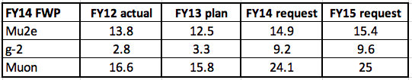
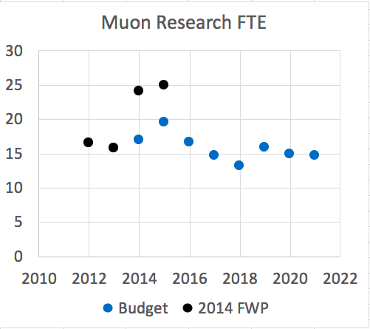
Research Funding: Planned versus budgeted
g-2 CD-0
FWP request to ramp up g-2 was not budgeted
Executing two experiments but with research support adequate for one
We appreciate the strong support from DOE and the fact that we’ve stayed relatively flat in an era of declining research budgets

Slide 16
Where are we today on research?
FY19 | Budget | Actual
FTE | 15.9 | 22.0
We have a $2.2M difference between our full request for FY20 and what is in the base FWP
We do not expect g-2 needs to decrease in the next two years (running in FY20 and FY21)
Mu2e research needs are expected to increase in the next 2 years as the experiment starts turning on
We have put together a strategic plan that brings together the physics opportunities and research priorities and spells out what is gained and lost in various funding scenarios

Slide 17

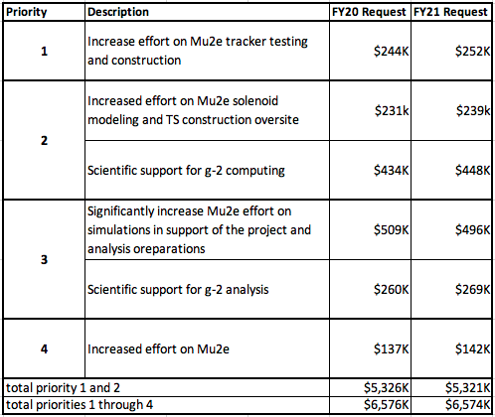
Scenarios based on FWP
Base
Scenarios
Low: FWP base
(4.4M labor)
Medium: ½ walk up (5.3M labor)
High: all walk up
(6.6M labor)
Muon items in FWP walkup (Labor only)

Slide 18
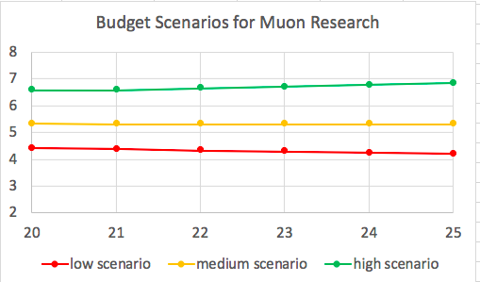
Scenarios based on FY20 FWP
1% escalation per year starting in FY22
Full walkup
Half walkup
SWF
($M)
Flat flat at FY21 level
No walkup
FY20, FY21 numbers from the FWP
1% down per year starting in FY22
FY

Slide 19
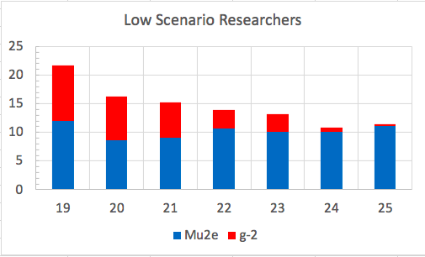
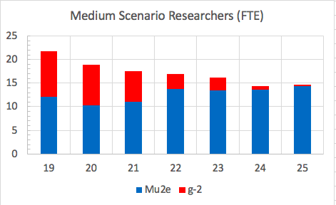
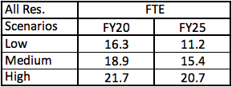
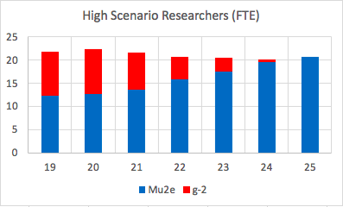
FTE evolution: All Research
-5.4 FTE in FY20
-2.8 FTE in FY20
-5.1 FTE FY21-25
-3.5 FTE FY21-25
~ flat

Slide 20
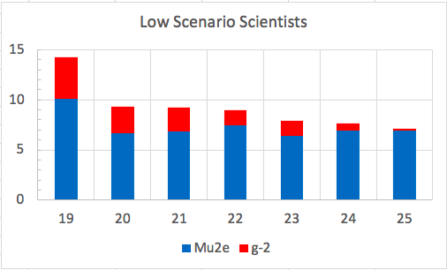
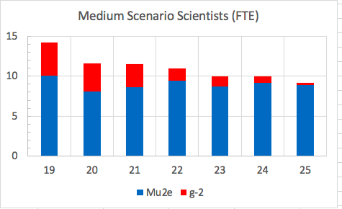
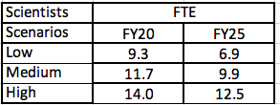
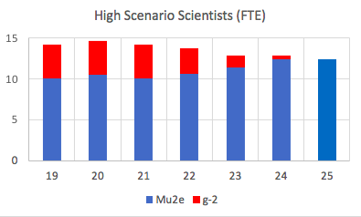
FTE evolution: Scientists
-4.9 FTE in FY20
-2.5 FTE in FY20
-1.8 FTE FY21-25
-2.4 FTE FY21-25
Gradual shift from scientists to postdocs as Mu2e project support rolls off
+0.5 FTE in FY20
-2.3 FTE FY21-25

Slide 21
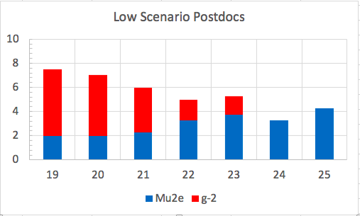
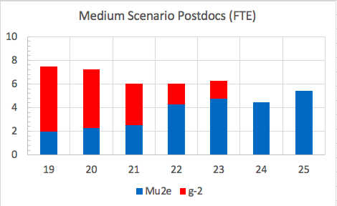
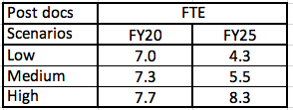
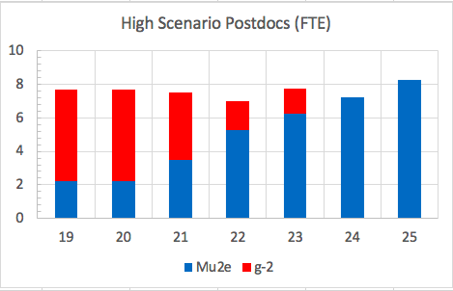
FTE evolution: Postdocs
-0.5 FTE in FY20
-0.2 FTE in FY20
-1.8 FTE FY21-25
-2.7 FTE FY21-25
-flat
PD reduction through attrition and delays in replacements in the low and medium scenarios

Slide 22
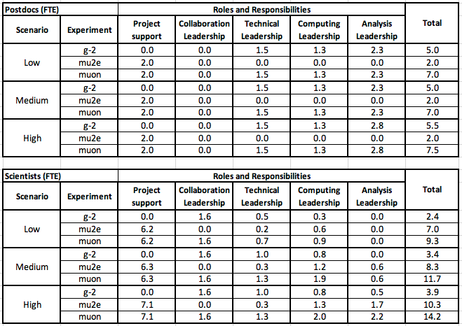
Roles, Responsibilities by scenario

Slide 23
Advancing work on future initiatives
Even in the high scenario, we will not be able to ramp up effort on future experiments
We are applying for non-base funding to advance both Mu2e-II and the negative muon g-2 run. (LDRD, Early Career, etc…)

Slide 24
Our Ask
We have a plan for each scenario. Tell us what scenario we are in.
If they said low or medium, we would request a bump so that we can make a orderly transition into that scenario. (one that would match into the expected roll off of g-2)
We only spent about 20 seconds talking about this and we did not get an answer about which scenario we are in.
When our budget showed up, it was in the low scenario.

Slide 25
So, what’s next?
We will use Grammar school logic to get through the year

Slide 26
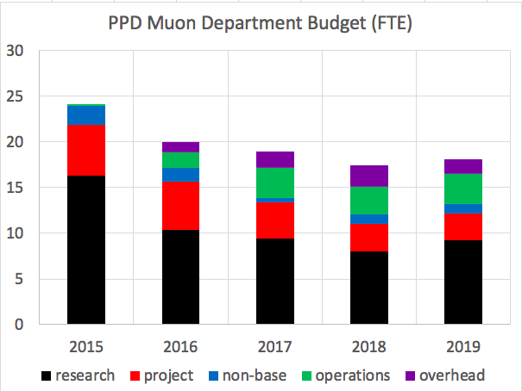
Opportunities of other funding streams
So we are asking for a little more money in all these buckets (except project) and we will probably overrun in all these buckets in a way that we are not the wack-a-mole this year.

Slide 27
Other opportunities
Keep taking vacation and sick leave when appropriate
  I believe everyone gets 3-4 weeks per year.
  For example, if no one took vacation, the 5.4 FTE problem would be a 6.05 FTE problem
Keep your eyes and ears open for other funding opportunities.
  We are not asking you to do different work. Just to describe your work in a few pages so we can get extra money for it.
    LDRD, ECA, detector R&D
      we have close to a 4 FTE request in LDRDs! Thank you everyone who is submitting!
    Quantum (NMR? Its supposed to be one of the best Q-bits)
    AI, machine learning.
  We expect this year for quantum and AI, you wont even have to write a grant. You just have to be working on it and we will get some help from the DOE.

Slide 28
Conclusions
We have had enormous success to date but we are missing opportunities and we’ve had to reduce scope to fit in a flat envelope.
We have made a strategic plan that matches into the FY20 FWP by reducing headcount in areas that are not the highest priority
  Low scenario turns off analysis and most computing support
  Medium scenario regains most computing support and keeps up our ability to process g-2 data and prepare for Mu2e data
  High scenario allows us to capitalize on the data we are taking now and increase support for the Mu2e project
  Non-base funding will be pursued to plan for the next experiments at the Muon Campus
We have a plan to get through FY20 without decreasing headcount that involves getting a little more money everywhere, running over a little everywhere, but by a level that keeps us in the noise
  We are choosing this year to share this information more broadly. In the past we have chosen not to share this to try and let people focus on their work. But this is pretty much how things have looked every year since I’ve been a department head.

