Slide 1
LBNF DSS & Clean Room & Infrastructure
Status
04/11/2020

Slide 2
Updates to V.7
Cryostat
DSS
End walls supports
SRA size
APA trolleys
CPA trolleys
Main rails
Switchyard and runaway rails
Ground Planes supports
Roof
Updates to the structure
Floor and Walls
Updates to the structure
TCO
Updates to the structure
Roof Handrails and Wooden floor
New gates (was interfering with Detector mezzanine)
Mezzanine Platform and Access
New Offices and DAQ room
Mezzanine Structure and Supports
Extension
Detector Mezzanine racks and cable trays
Cables trays modification
Detector
End Walls
Additional parts (APA/EW interfaces)
CPA
Additional parts (CPA/EW interfaces)
APA
New yoke
New cable supports
Field Cage
APA Cables
Were not appearing in V6
Mezzanine Proximity Cryogenics
Modifications to the layout due to interference with extended mezzanine structure
Piping going to CUC cavern (lower than before)
New insulation purge system (still need updates for V.8)
Additional Electrical Equipment
Routing modification due to Mezzanine Proximity Cryogenics modification

Slide 3
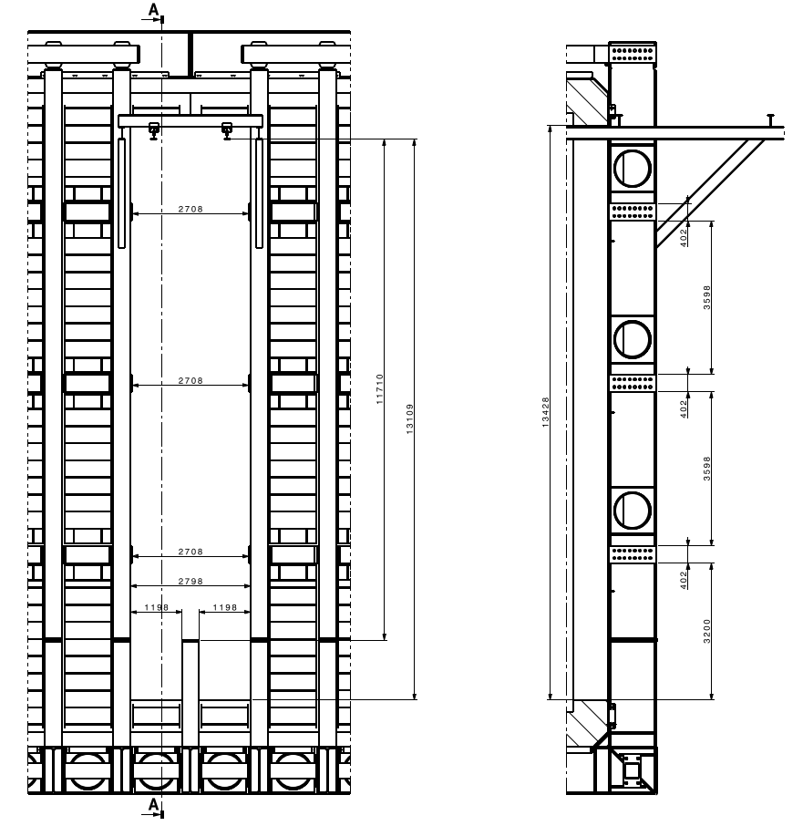
Detailed drawing of the TCO opening

Slide 4
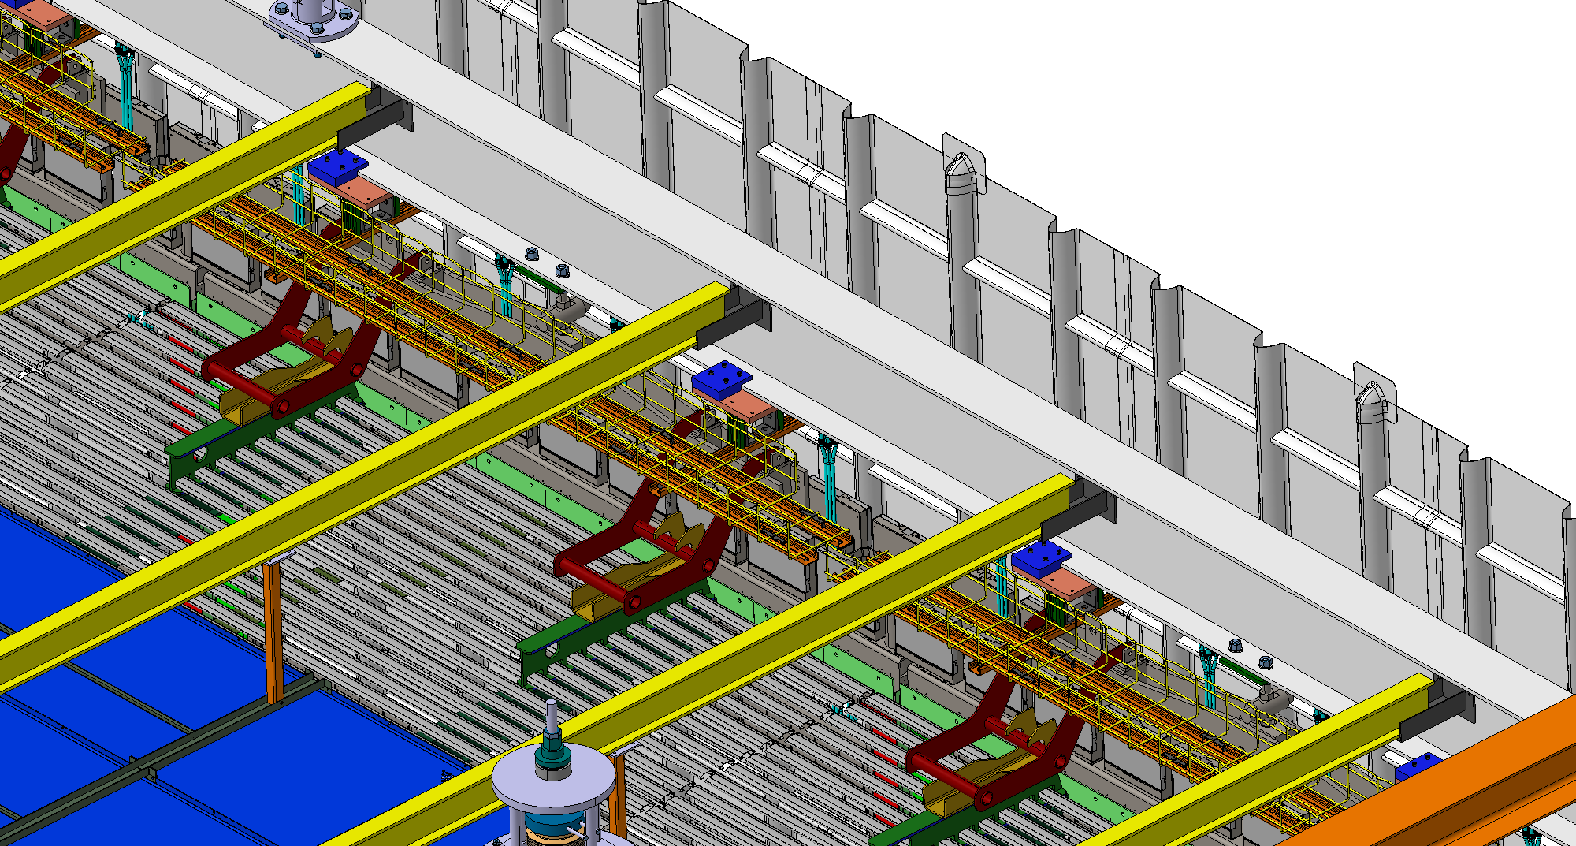
APA – New Cable Trays supports

Slide 5
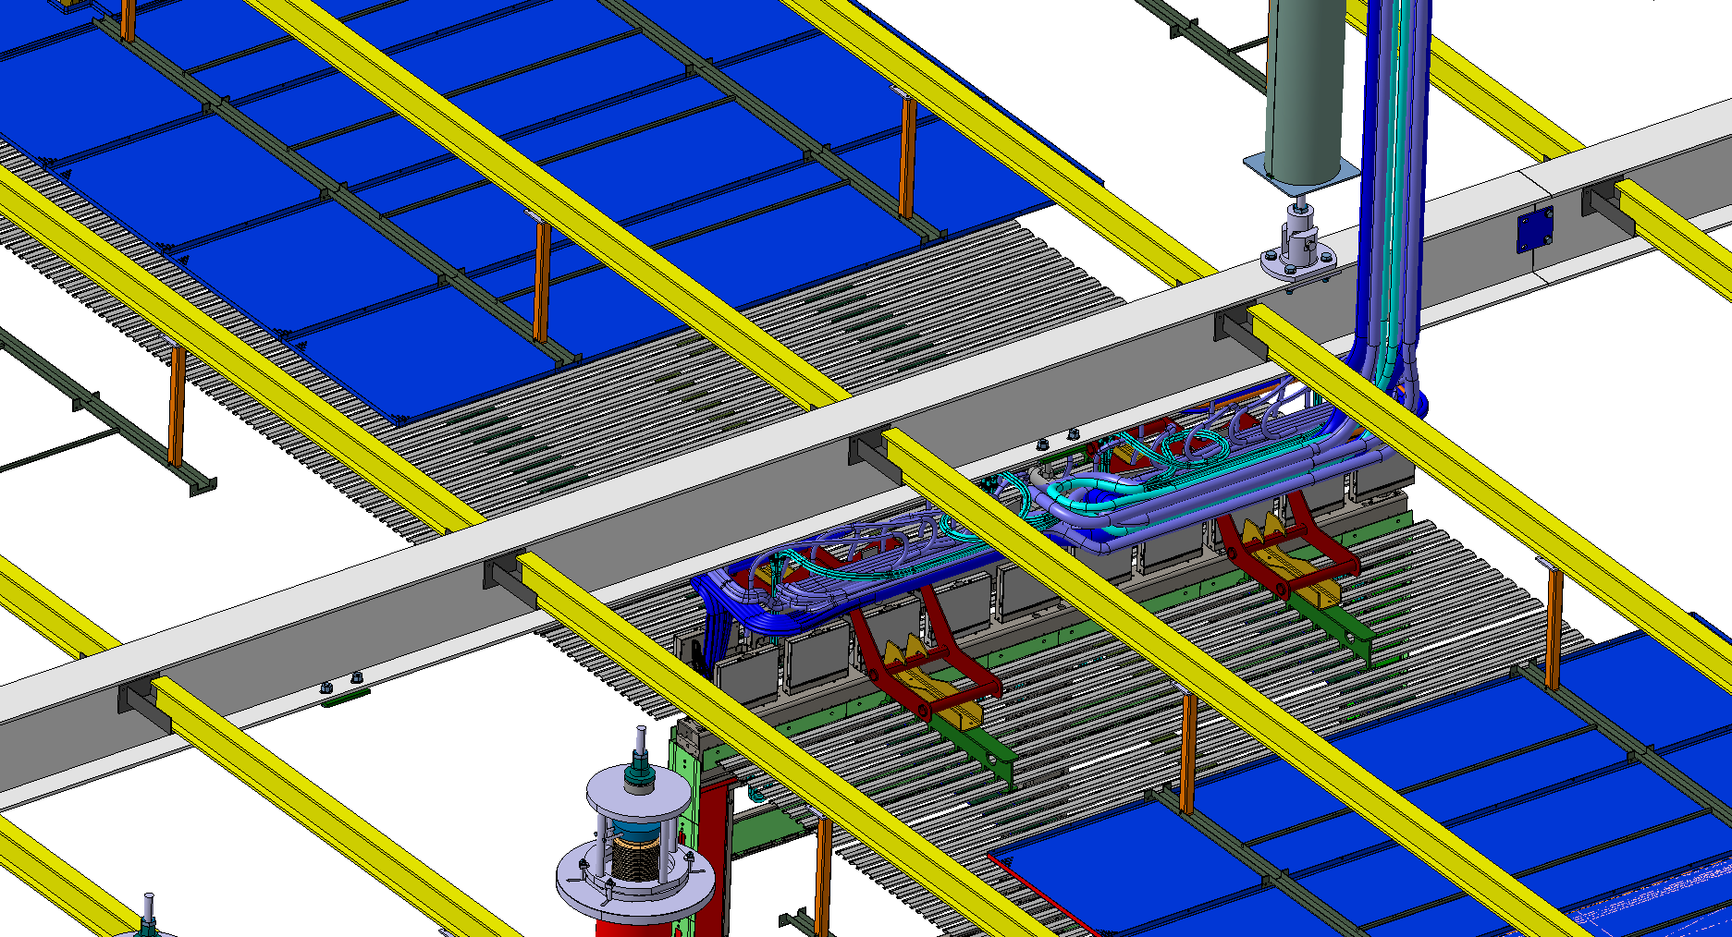
APA – Cables layout

Slide 6
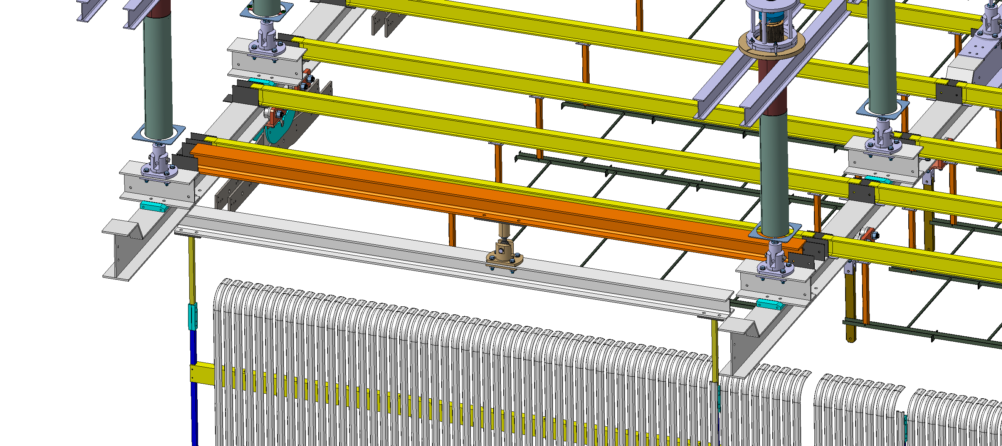
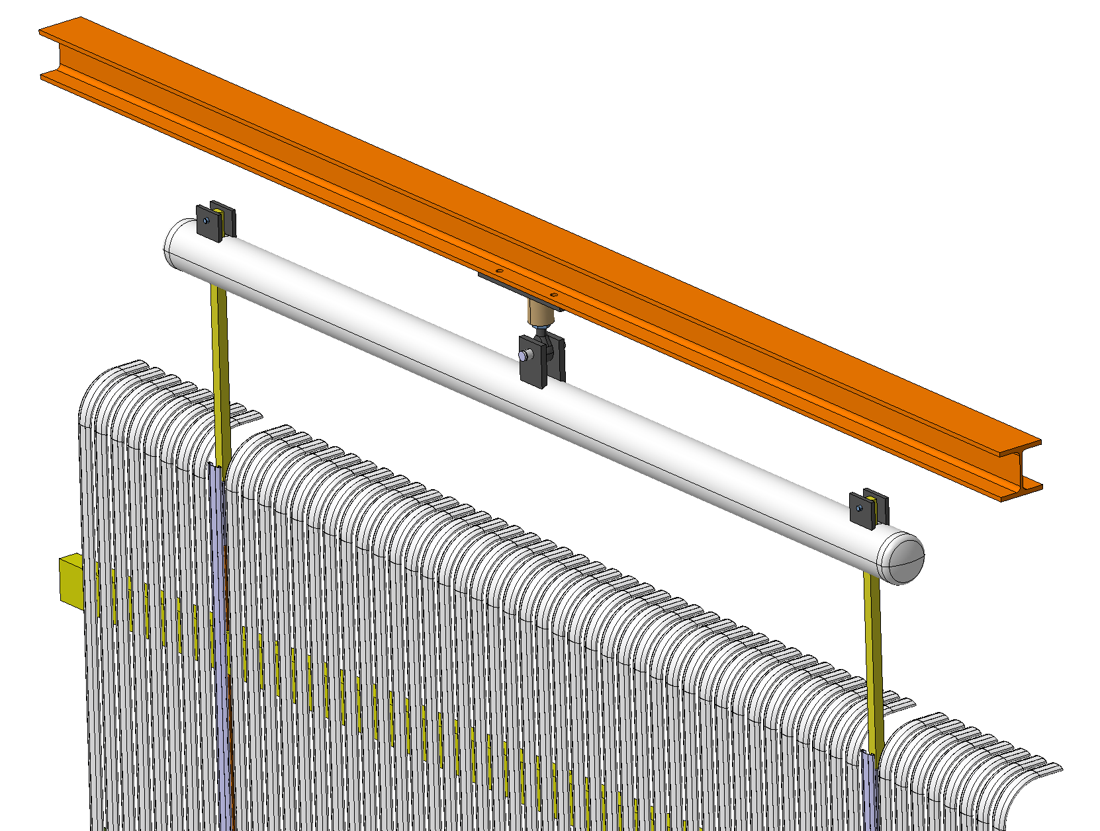
End Wall - Support
All information has been recently supplied to the HV consortium for making the final design.

Slide 7
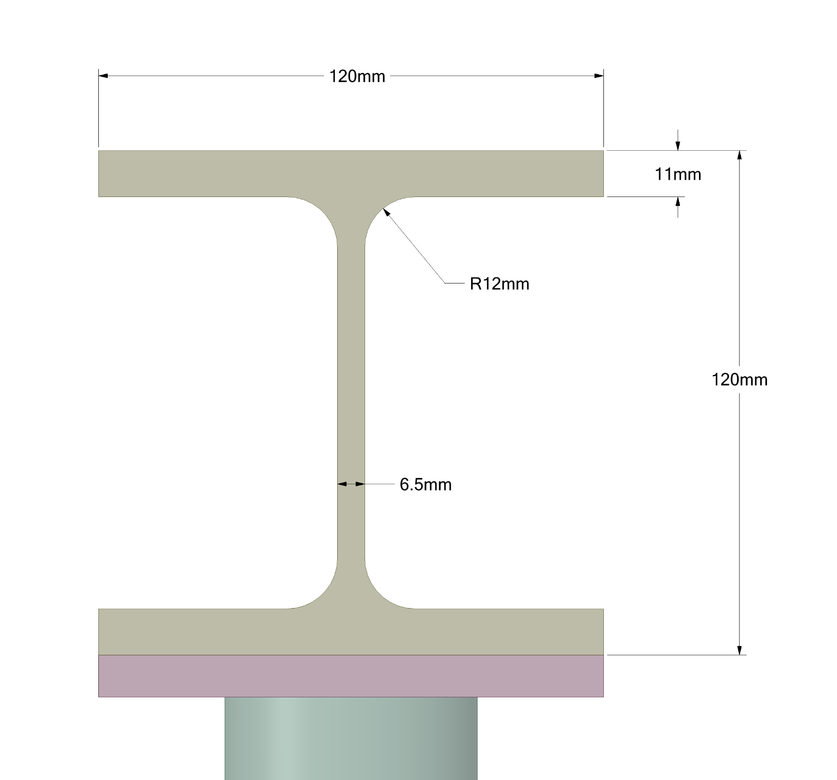
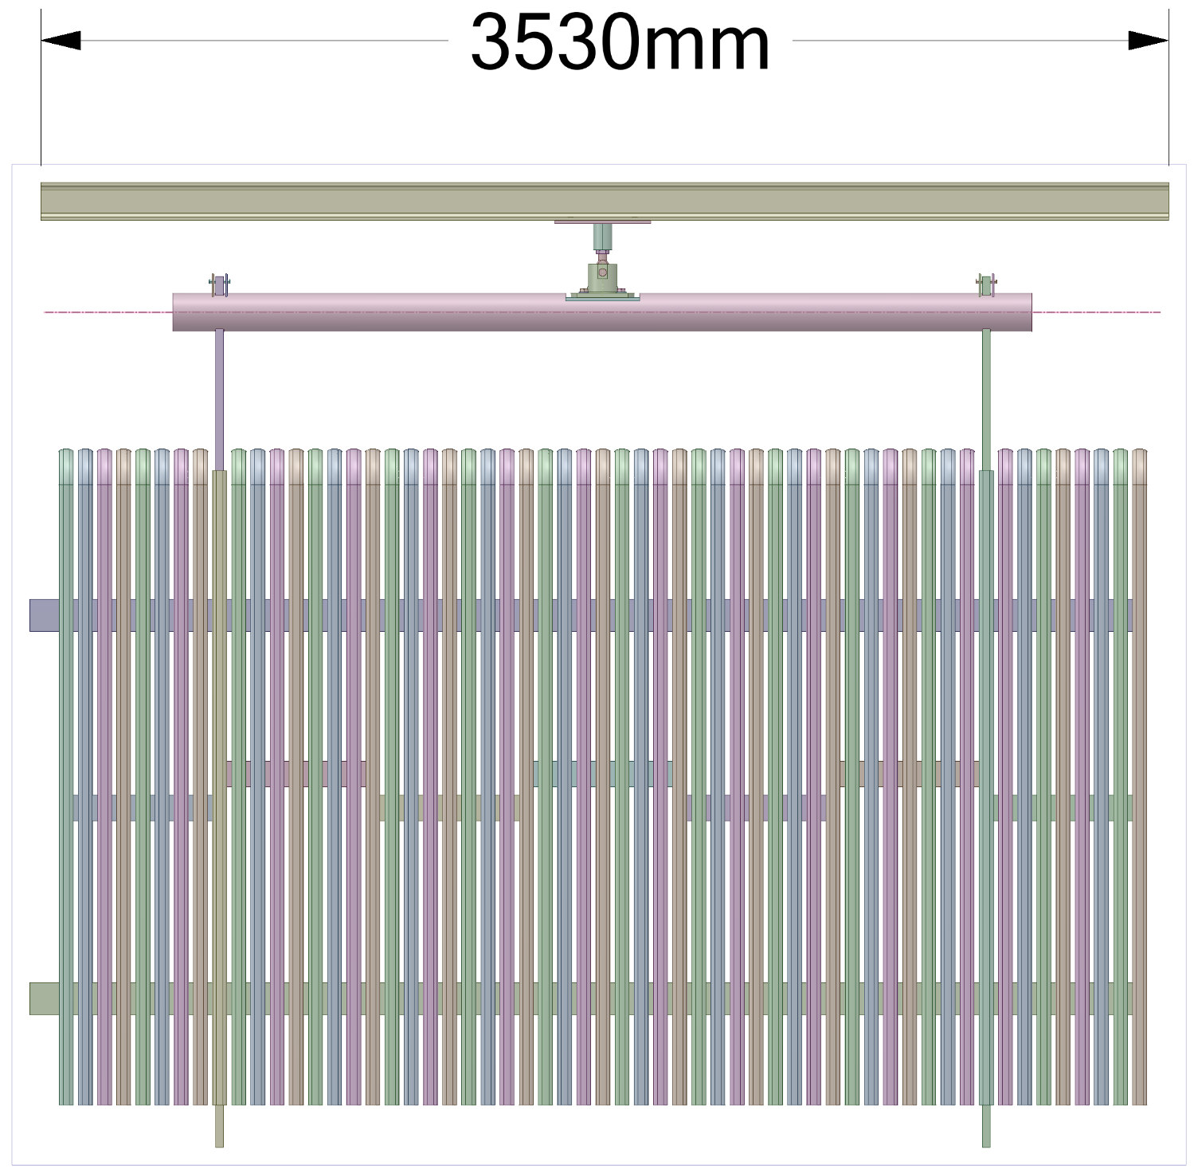
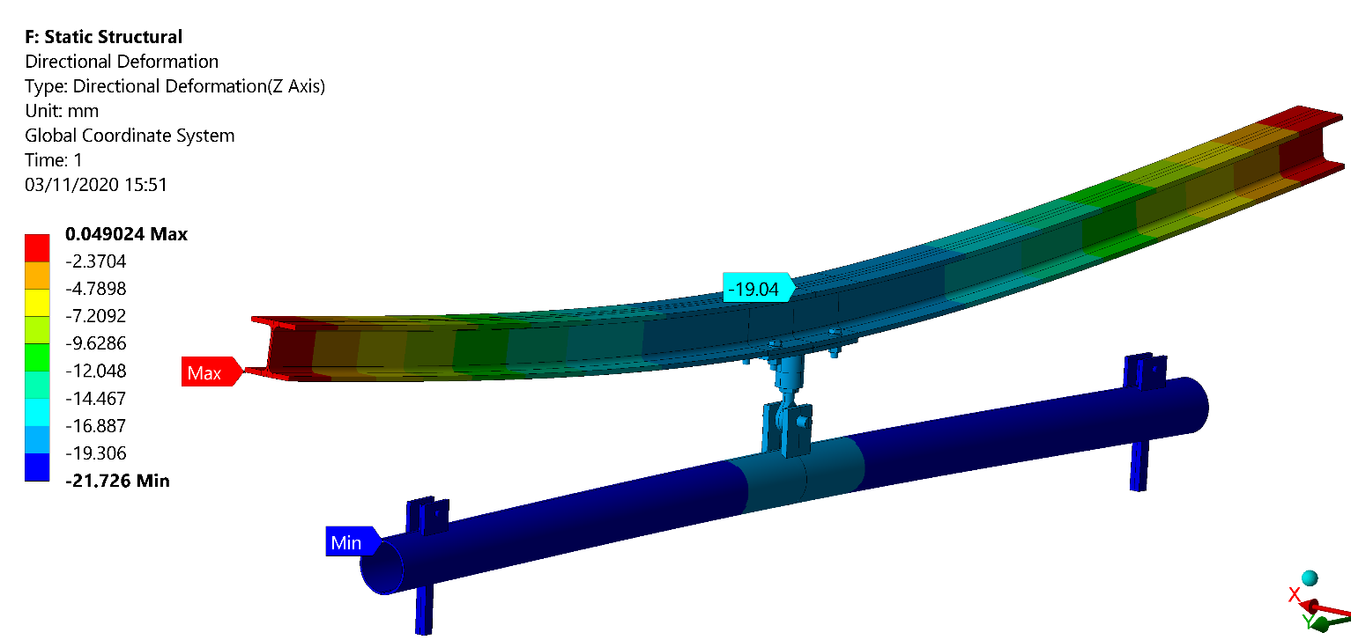

Slide 8
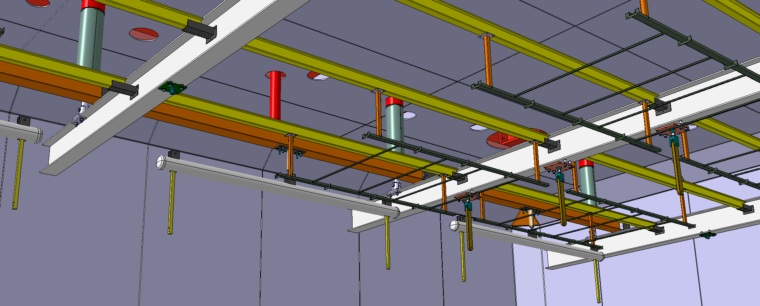
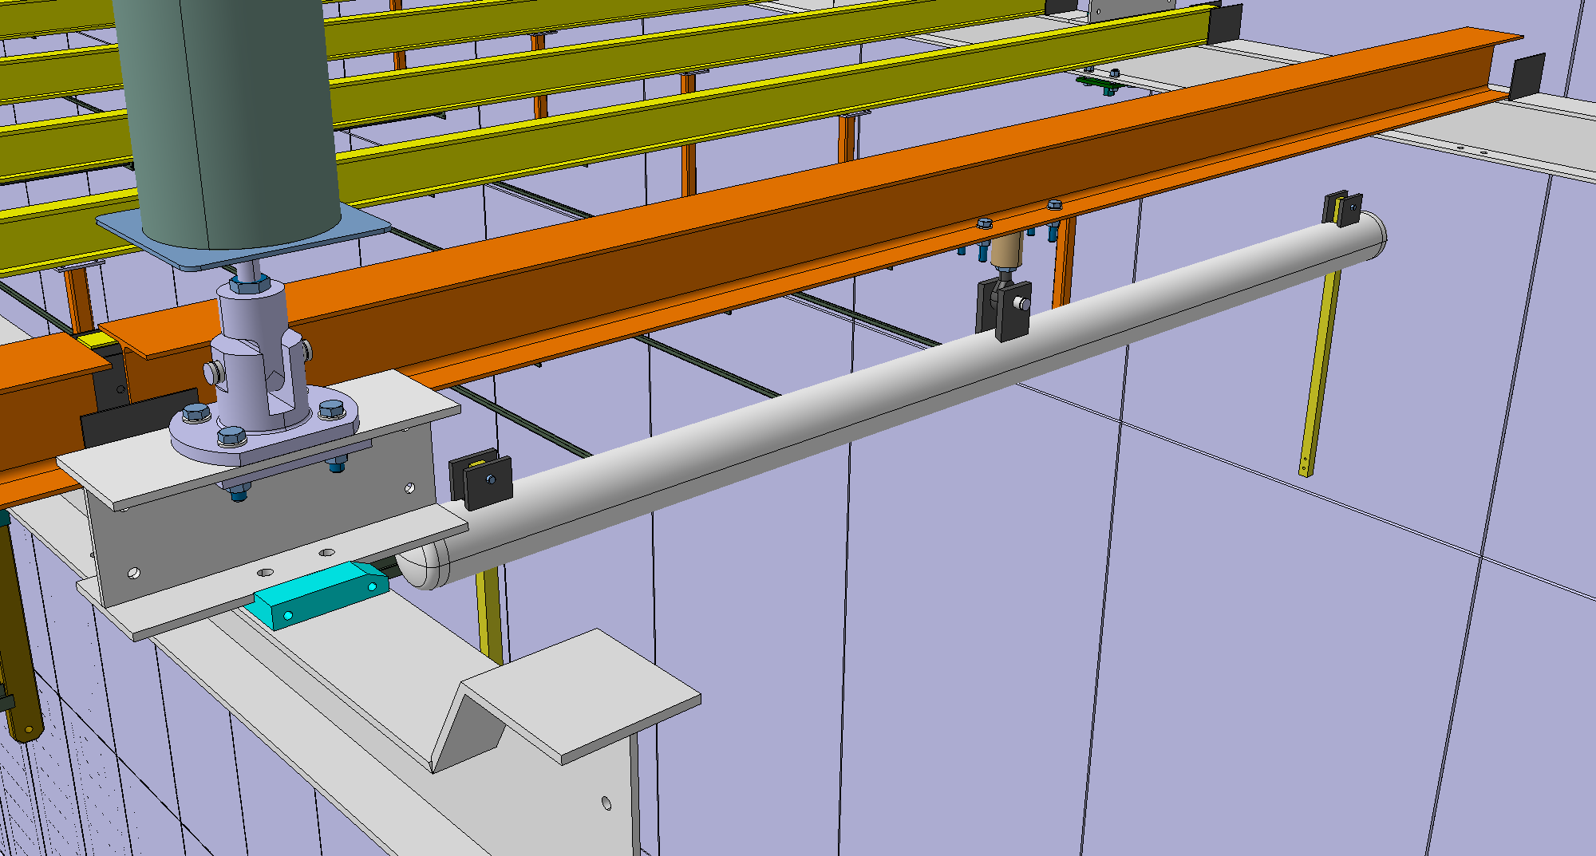
End Wall – Support – Current Configuration

Slide 9
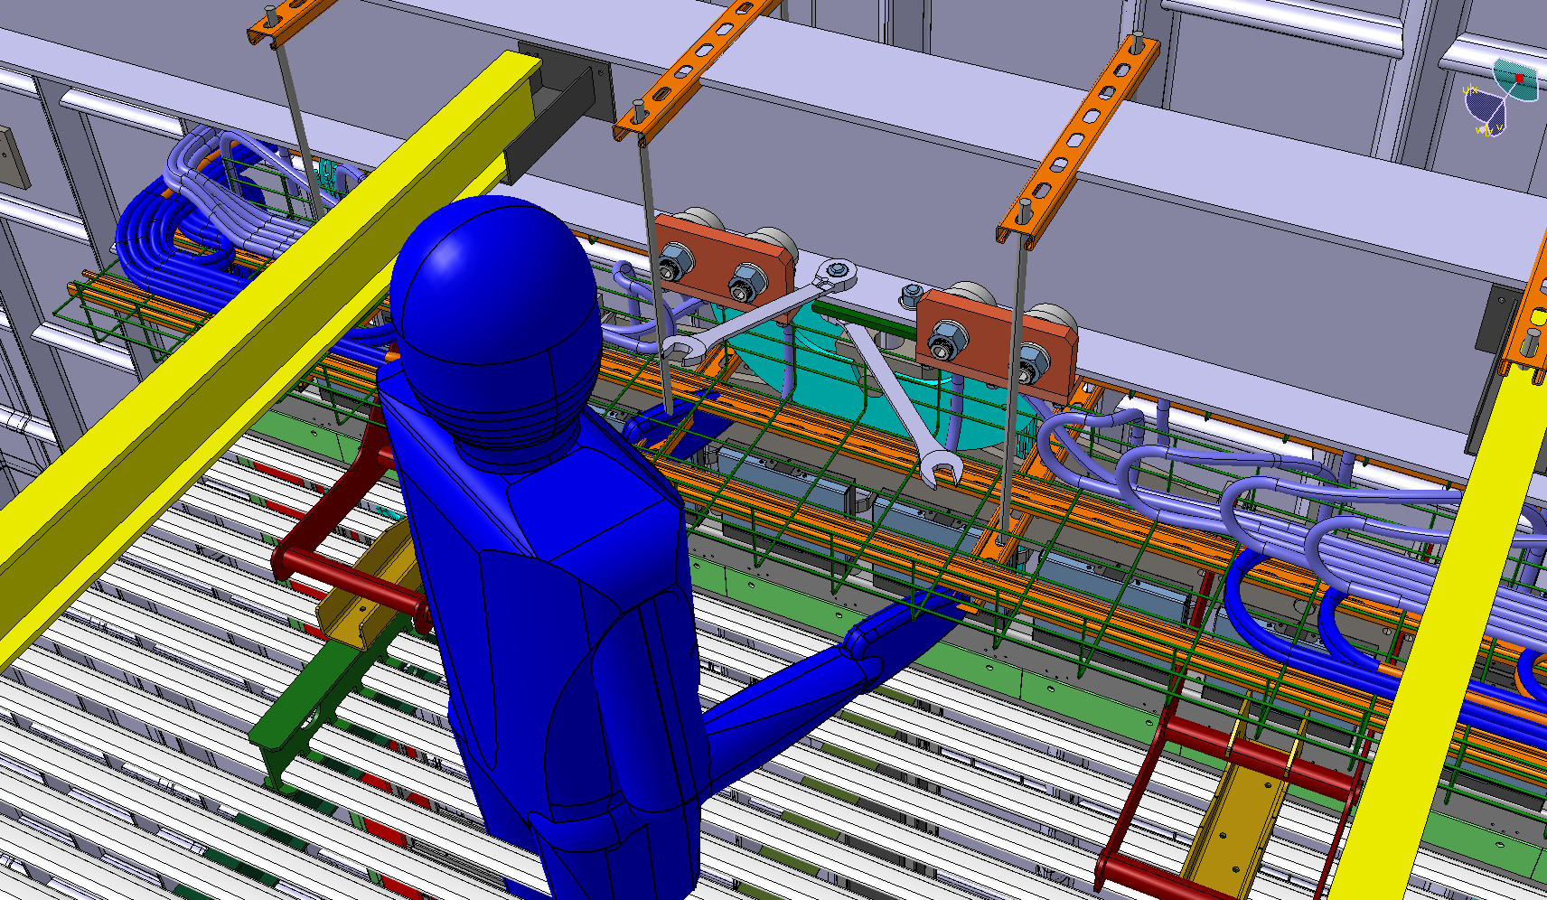
APA Trolley – Installation Studies

Slide 10
Clean Room - Status

Slide 11
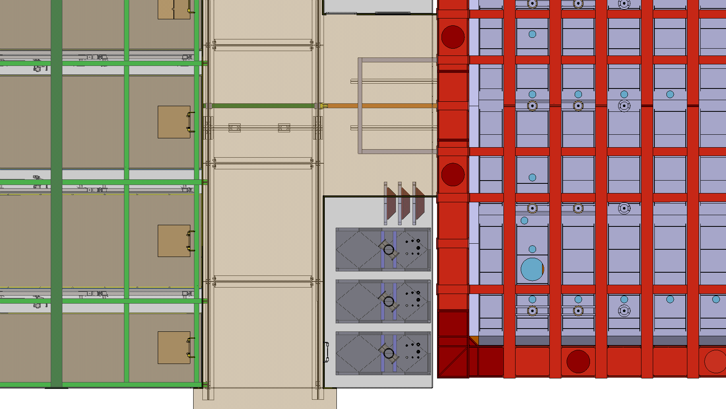
Cold Box – Door Opening & Storage

Slide 12
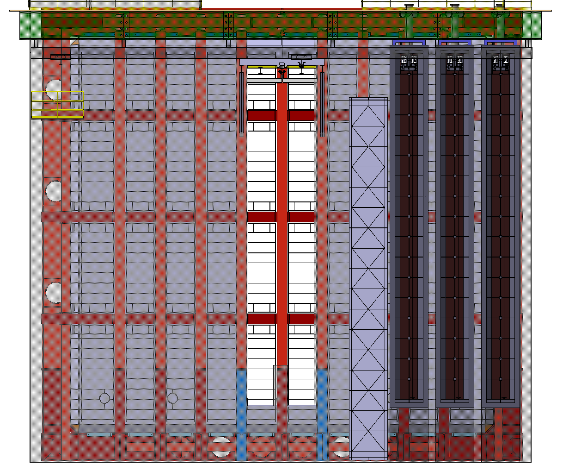
Cold Box – Door Opening & Storage
2600
3000

Slide 13
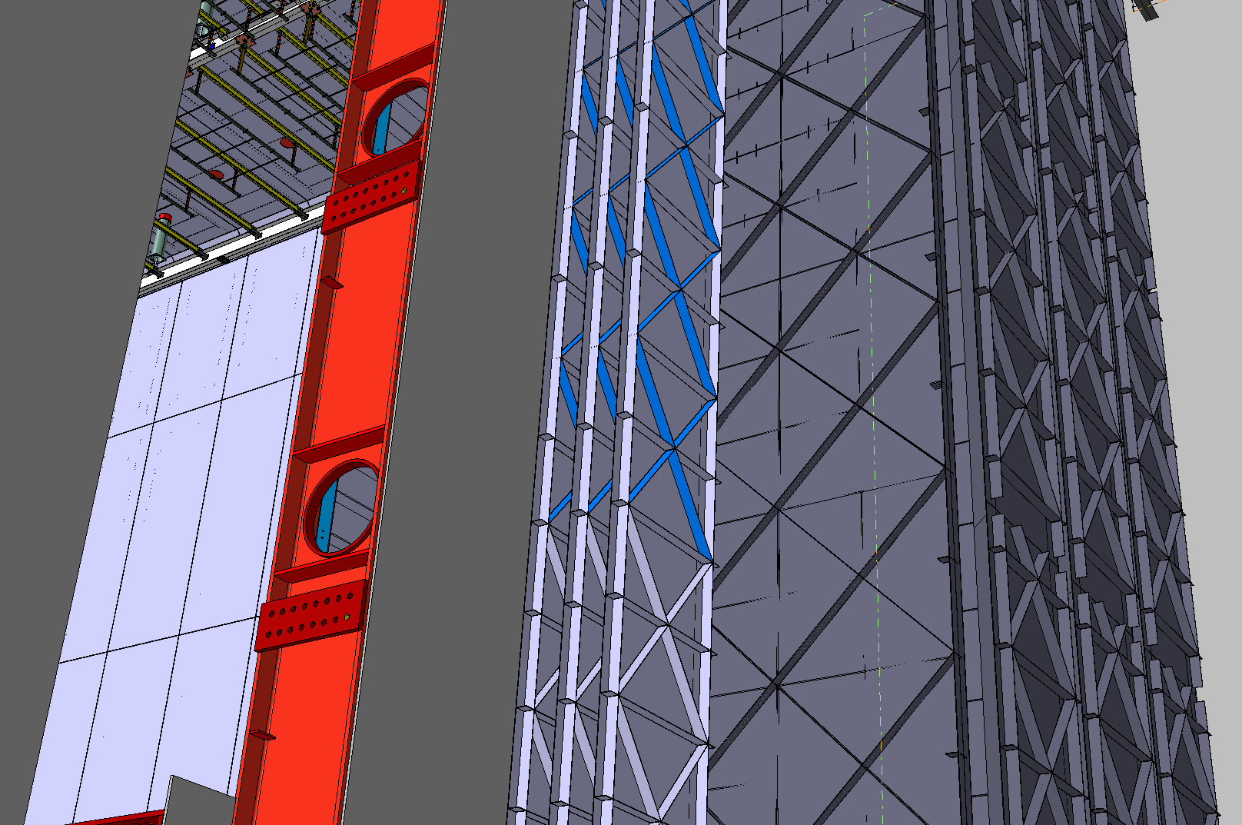
Cold Box – Door Opening & Storage

Slide 14
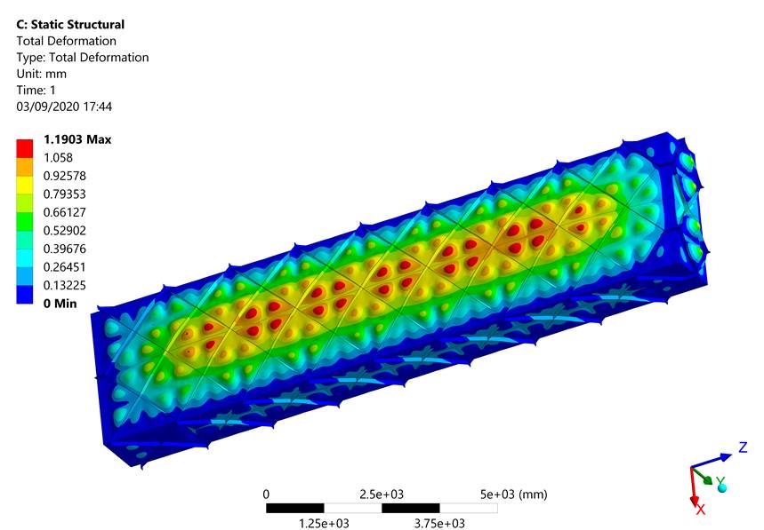
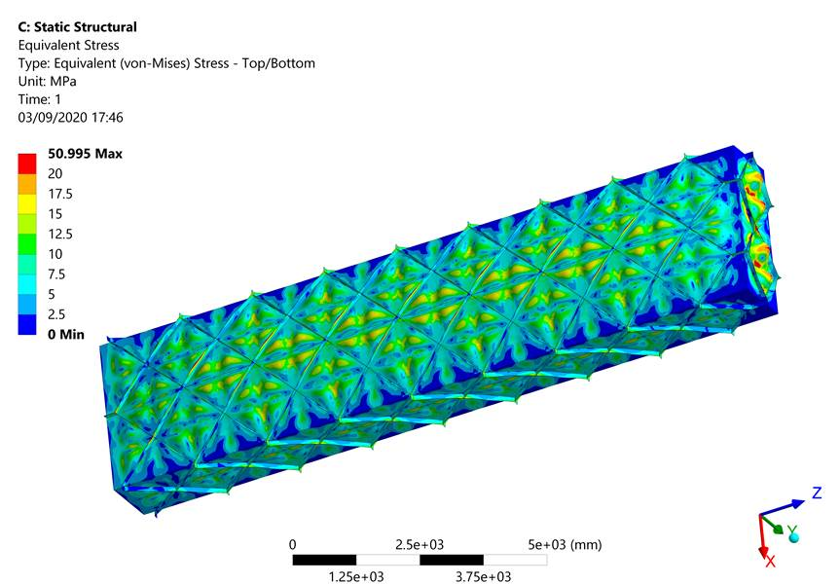

Slide 15
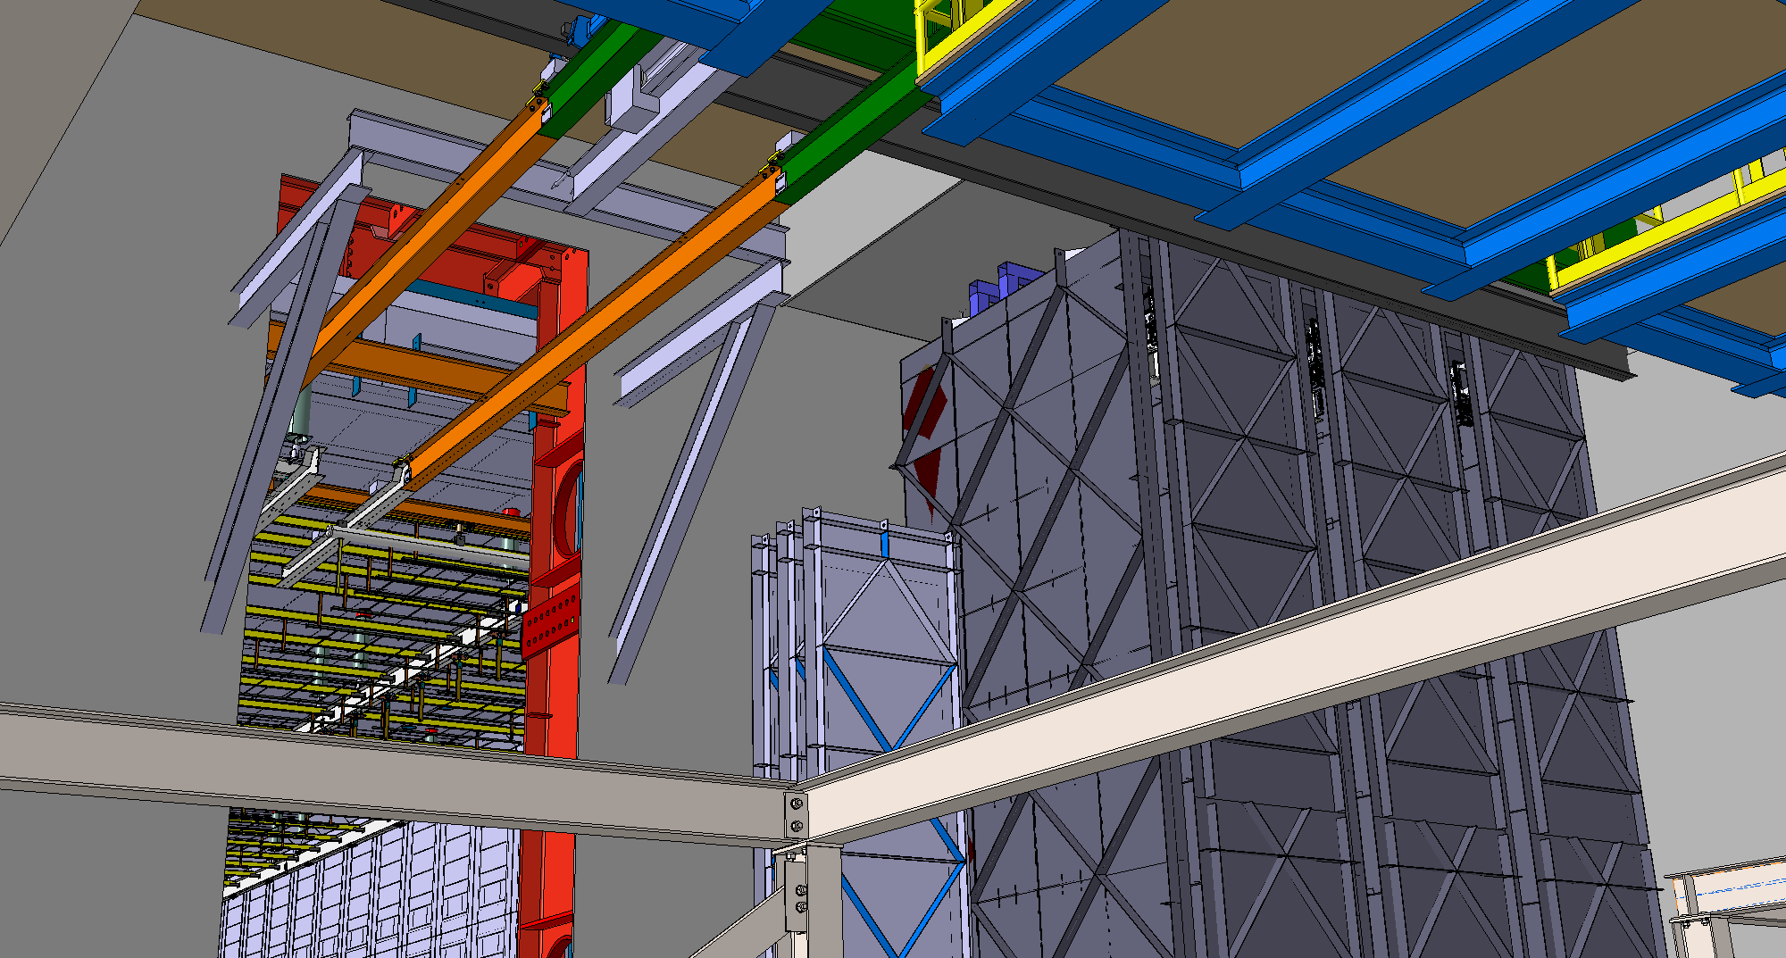
TCO Beam(s)

Slide 16
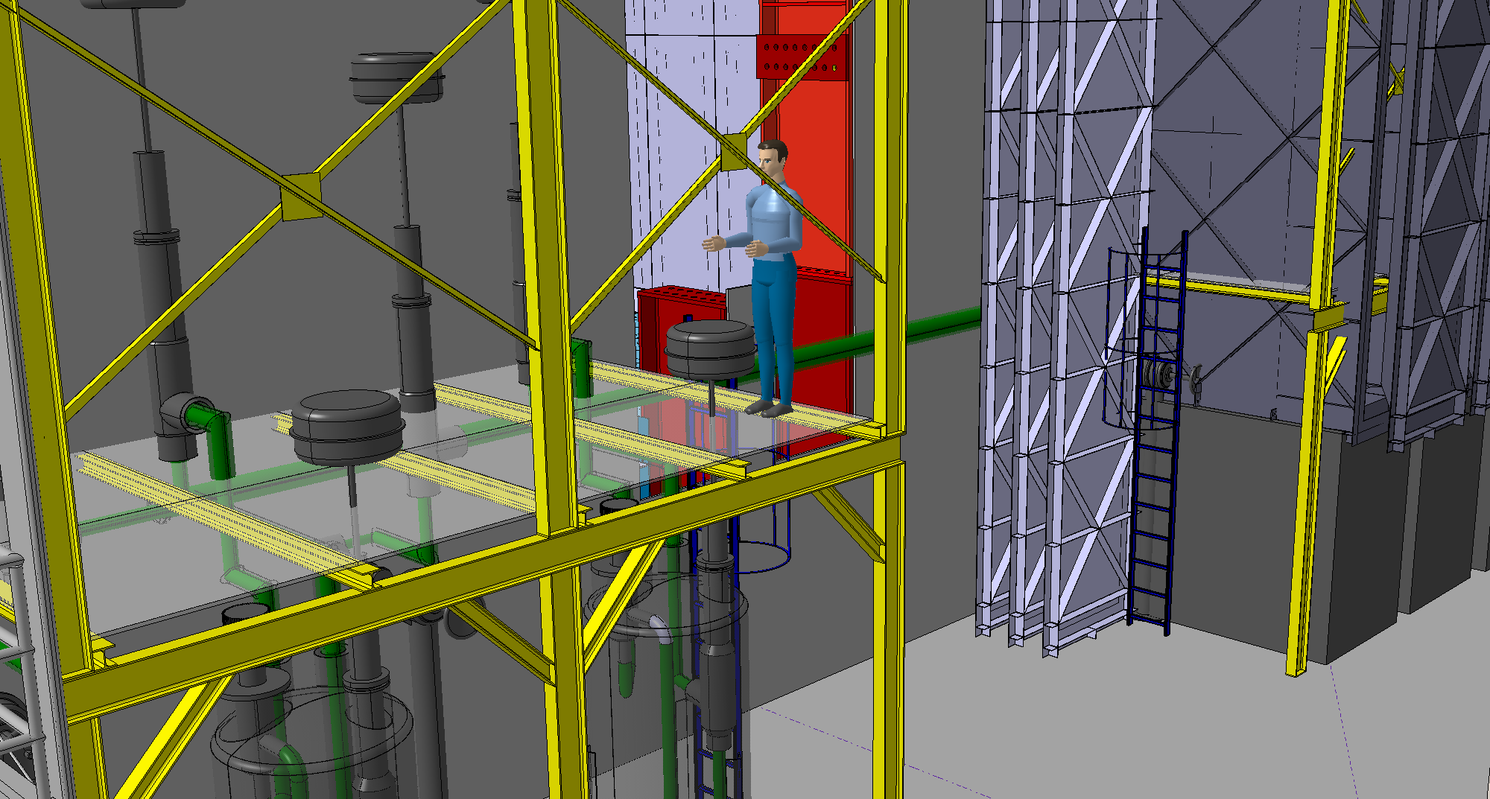
We need to define a “Time Stamps”
But also for the Clean Room !

Slide 17
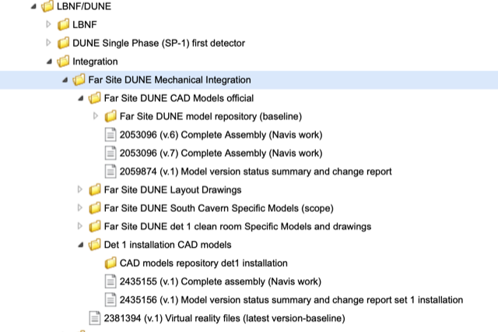
We need to define a “Time Stamps”
But also for the Clean Room !
EDMS Structure has been created
https://edms.cern.ch/project/CERN-0000213013

Slide 18
Thank you!

