Slide 1
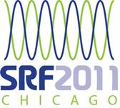
CENTRIFUGAL Barrel Polishing of Cavities Worldwide
C. Cooper*
Fermi National Accelerator Laboratory
K. Saito
KEK, High Energy Accelerator Research Organization
B. Bullock
Cornell University, LEPP – SRF Group
S. Joshi
Raja Ramanna Center for Advanced Technology
A. Palczewski
Thomas Jefferson National Accelerator Facility
J. Zhai
Institute of High Energy Physics
Listed contributors are the lead person for centrifugal barrel polishing at each facility.

Slide 2
Layout
1. Introduction to CBP
2. How CBP is done and incorporated into baseline processing
3. Recent Results from CBP at Fermilab & Future Work That Needs to be Done
4. Work done on CPB at other facilities
5. Summary
6. Future Work
7. Acknowledgments

Slide 3
1. Introduction to CBP

Slide 4
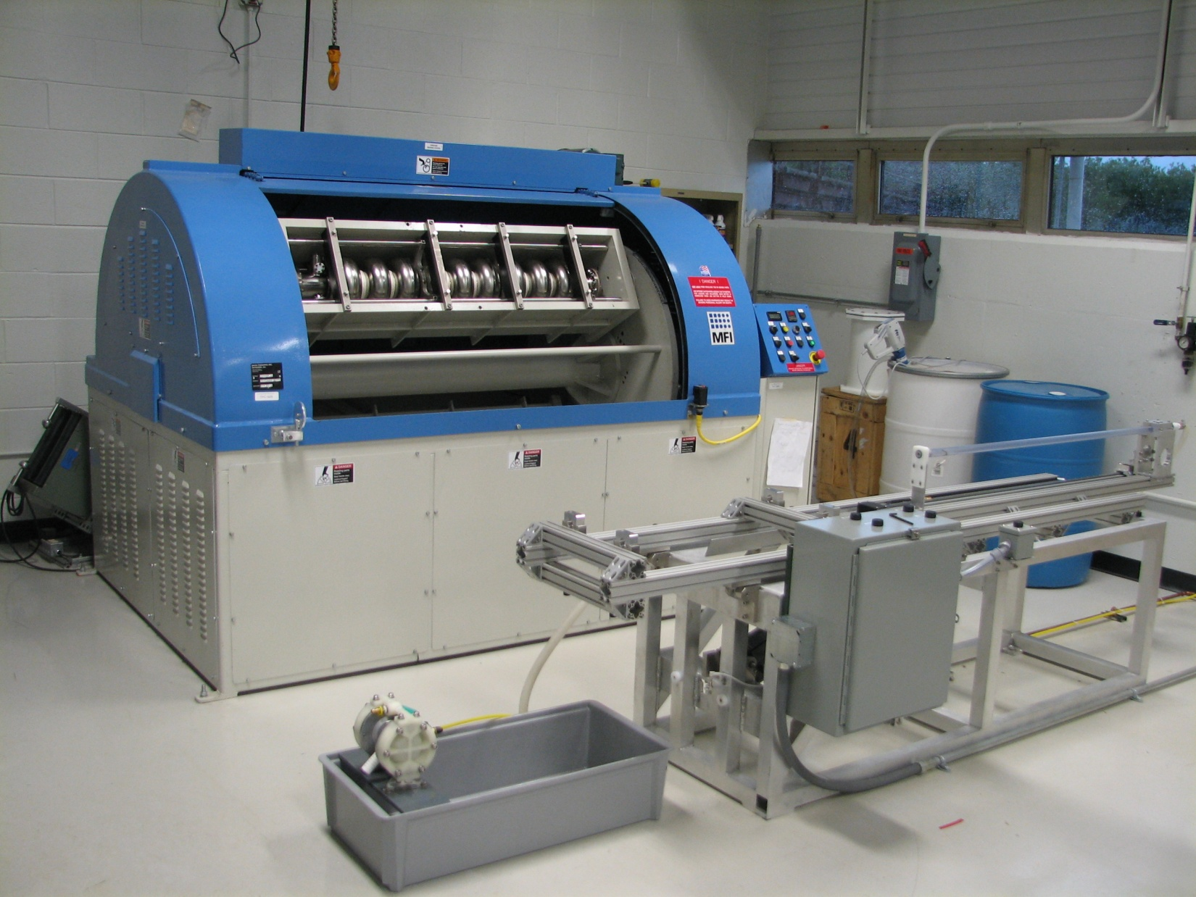
1. What is Centrifugal Barrel Polishing?
Centrifugal Barrel Polishing(CBP) is an alternative processing technique that polishes the inside of superconducting rf cavities by rotating the cavities at high speeds while filled with an abrasive media.
Individual Barrels rotate 115 RPM in opposite direction to main shaft
Main Shaft up to 115 RPM

Slide 5
1. Why do Centrifugal Barrel Polishing?
Creates a more uniform surface.
  Can increase accelerating gradient by removing surface defects.
  Remove artifacts of the Electron-beam welding process.
  Remove pits, bumps, scratches (Including some defects that can not be removed by chemistry).
    Make QC of sheets prior to forming easier
  Good quality control of surface roughness before chemistry.
Can yield surface finishes(Ra) on the order of 10s of nanometers. Best by EP alone is around 100 nanometers.
  Both accelerating gradient and quality factor may be increased
  Smoothest surfaces in general produced by mechanical polishing. Chemical purity recovered by chemistry. (Optics, Microchips)
Environmentally friendly.
  Most likely will still require a small amount of chemistry (on the order of 5-10 microns compared to 120 microns for EP).
Possibly remove electropolishing process.
Easily transferable to industry.
Could provide a better substrate for thin film deposition.
Should be a repeatable process that could increase cavity yield.

Slide 6
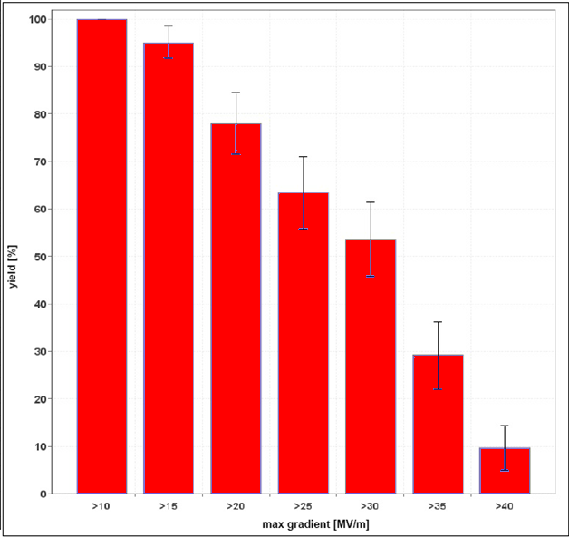
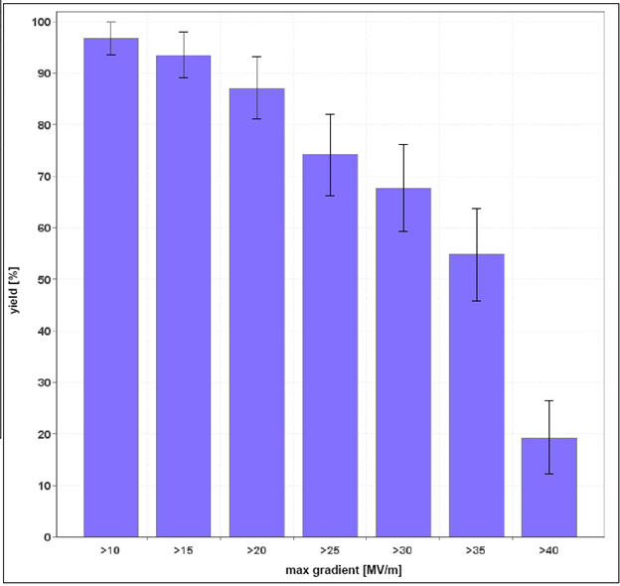

1. Current Yield
1st-pass cavity yield
at >35 MV/m is (29 +- 8) %
2nd-pass cavity yield
at >35 MV/m is (56 +- 10) %
90% Yield desired for economic feasibility
90% Yield desired for economic feasibility
From Camille Ginsburg- ALCPG Meeting – Eugene, Oregon Mar. 2011

Slide 7
2. How CBP is Done and Incorporated into Baseline Processing.

Slide 8
2. How CBP fits into Baseline Process
Baseline Cavity Process Path
Proposed CBP Process Path
Proposed “Hydrogen Free” CBP Process Path
120-150 Micron Electropolishing
High Temperature Bake
Light Material Removal
(Alcohol Rinse)
High Pressure Rinse
Assembly
(Low Temperature Bake)
RF Test
Water Rinse
120-150 CBP
High Temperature Bake
Light Material Removal
High Pressure Rinse
Assembly
(Low Temperature Bake)
RF Test
Light Chemistry
120-150 CBP
High Pressure Rinse
Assembly
(Low Temperature Bake)
RF Test
Light/No Chemistry
800 C for 2 hours – Hydrogen Contamination
20 Micron EP
For Sulfur Precipitate Removal
1200 psi, Ultrapure Water
Class 10 Clean-room
48 Hour, 120 C
Cooper Jefferson Lab Seminar – 4/2011

Slide 9
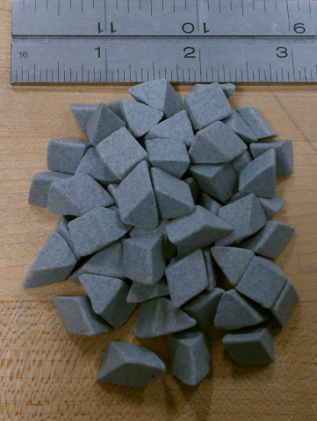
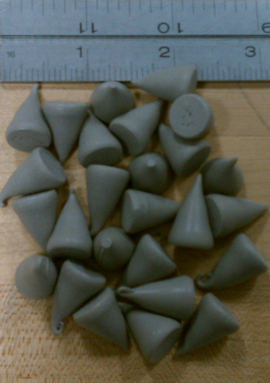
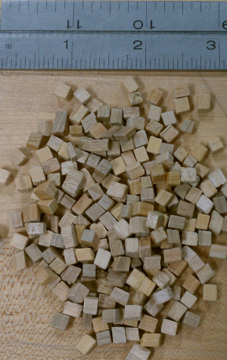
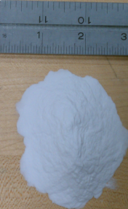
2. How CBP is Done
Put a 4-bar frame around cavity.
Install plugs to protect end groups.
Attach end cap, fill with media, attach other end cap.
Put cavity in CBP machine.
Run process.
Remove cavity from machine.
Drain spent media.
  Remove end group plugs.
Rinse.
Repeat

Slide 10
2. Single Cell Cavity Preparation
UHMWPE Transition Rings
Rest of frame all 316-SS
Wedge feet to ensure no movement of frame in barrel

Slide 11
2. Single Cell Cavity Preparation

Slide 12
2. 9-Cell Cavity Preparation

Slide 13
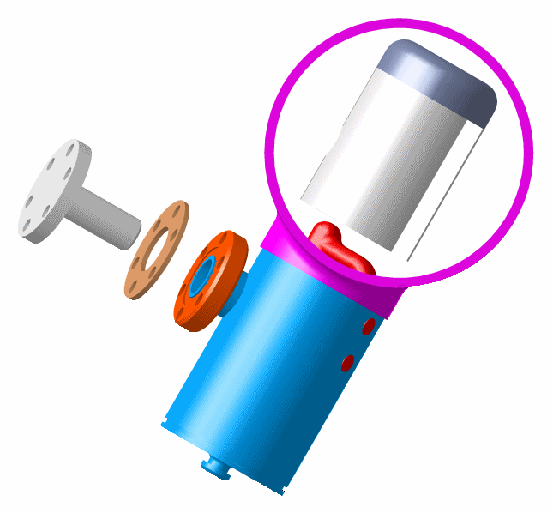
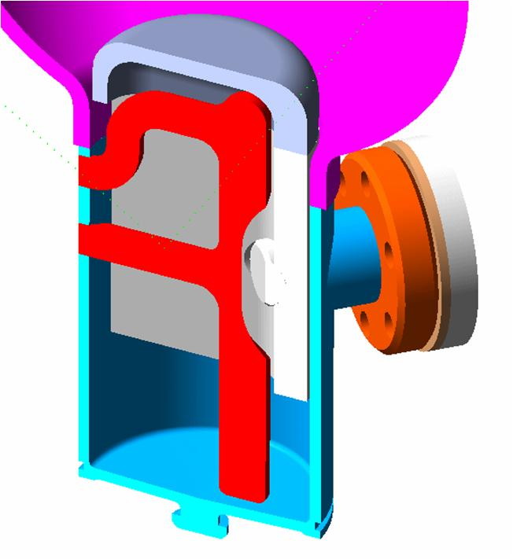
2. 9-Cell Cavity Preparation - Plugs
HOM Can Must Be Protected or the Antenna Would be Destroyed.
Caps are Made From Niobium to Avoid Contamination.

Slide 14
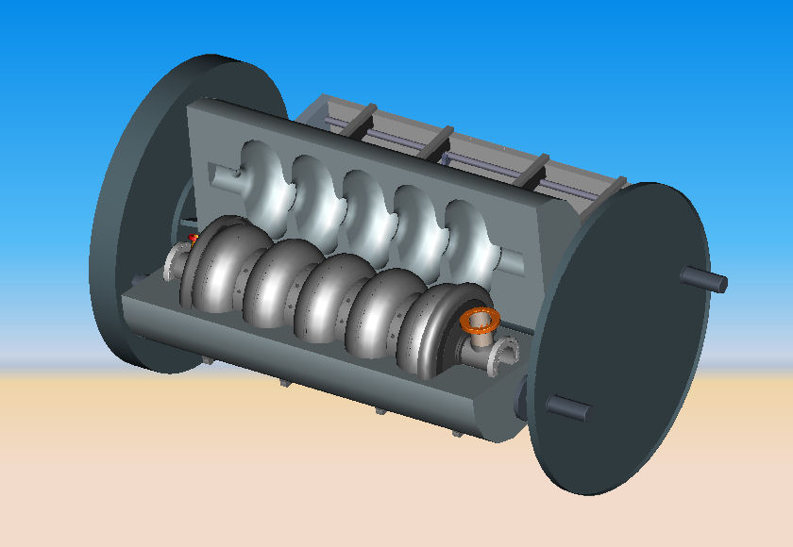
2.CBP of 650 MHz Geometry
650 MHz cavities will require a new machine.
Barrel will require the most design.
Must be interchangeable for different cavity geometries.
Must provide structural support and allow for appropriate cooling.

Slide 15
3. Recent Results from CBP at Fermilab & Future Work That Needs to be Done

Slide 16
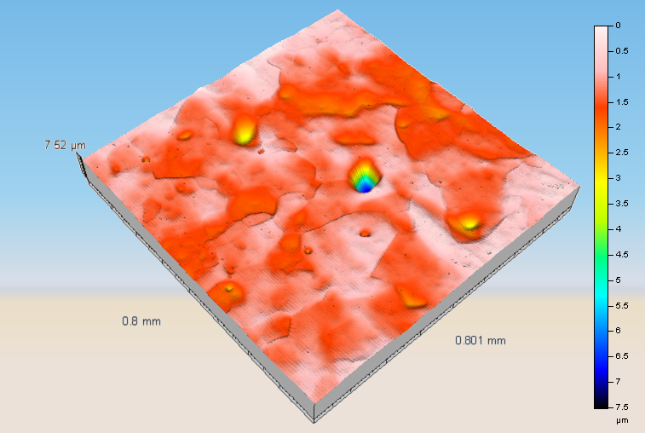
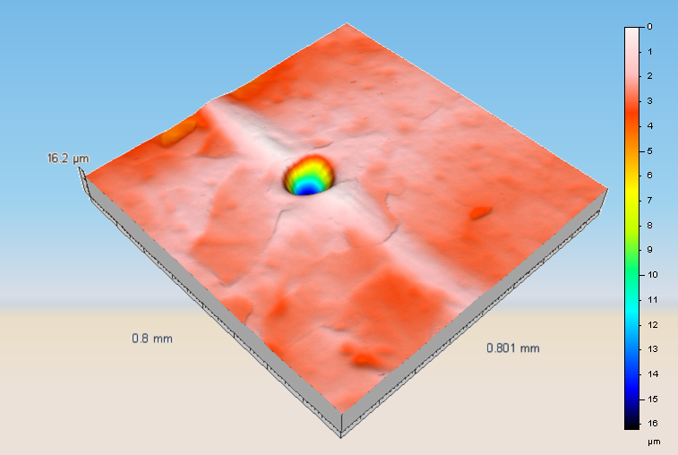
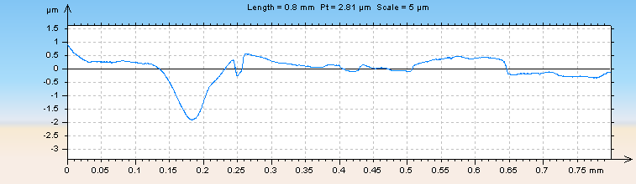
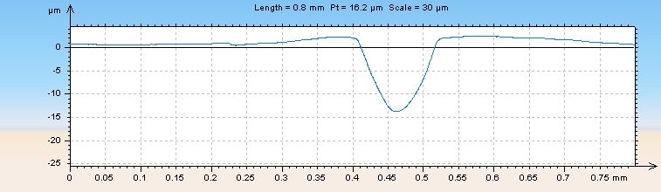
3. CBP to an intermediate finish
Cooper - SRF Materials Workshop, Tallahassee

Slide 17
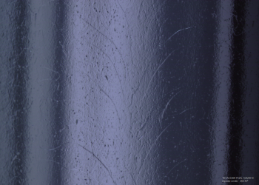
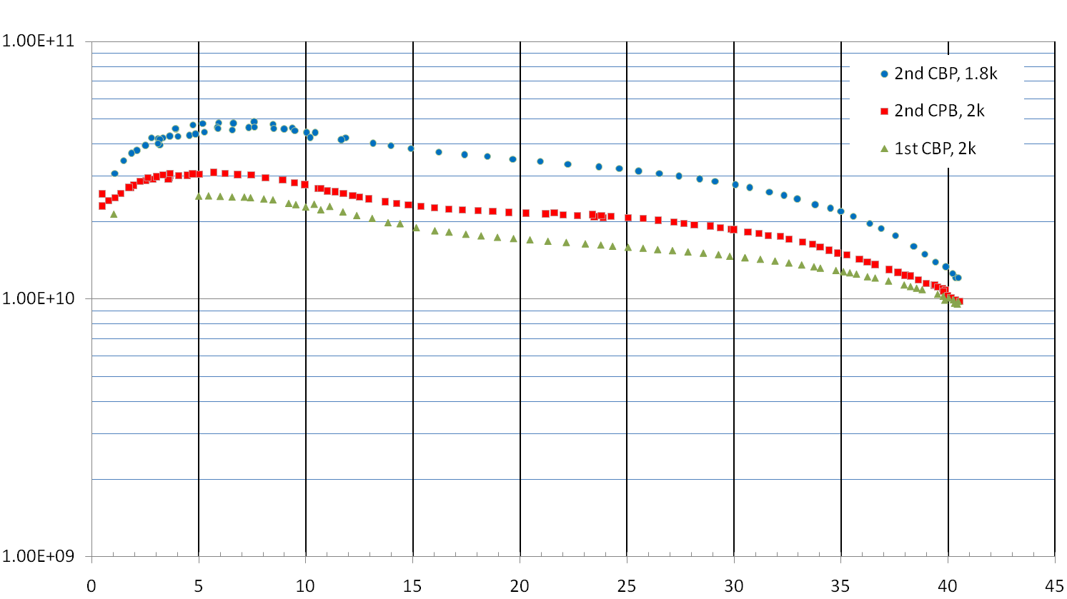
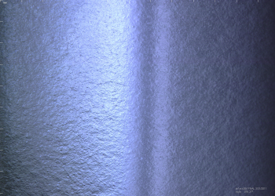
3. CBP of Single Cell 1.3GHz ACC004 with 2 Completely Different Sets of Media
CBP to inter. finish, 40 micron EP
1.8 K
2 K
Picture after first CPB with typical media & 60 micron EP
2K
Quality Factor
CBP to inter. finish, 60 micron EP
Picture after 2nd CPB with porcelain balls & 40 micron EP
E_{ACC} MV/m

Slide 18
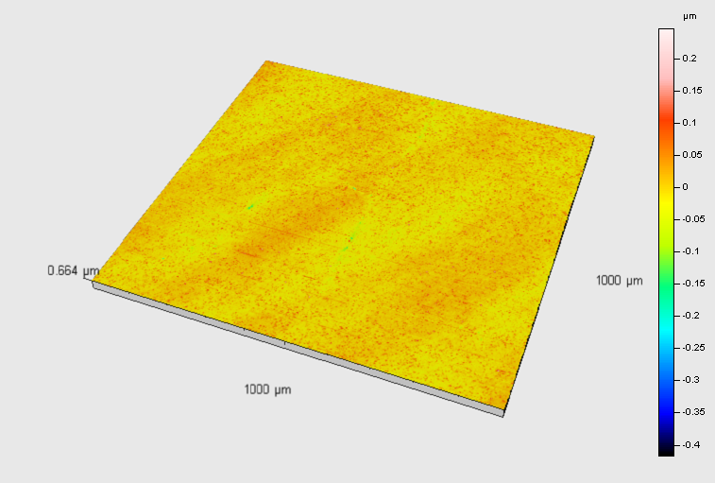
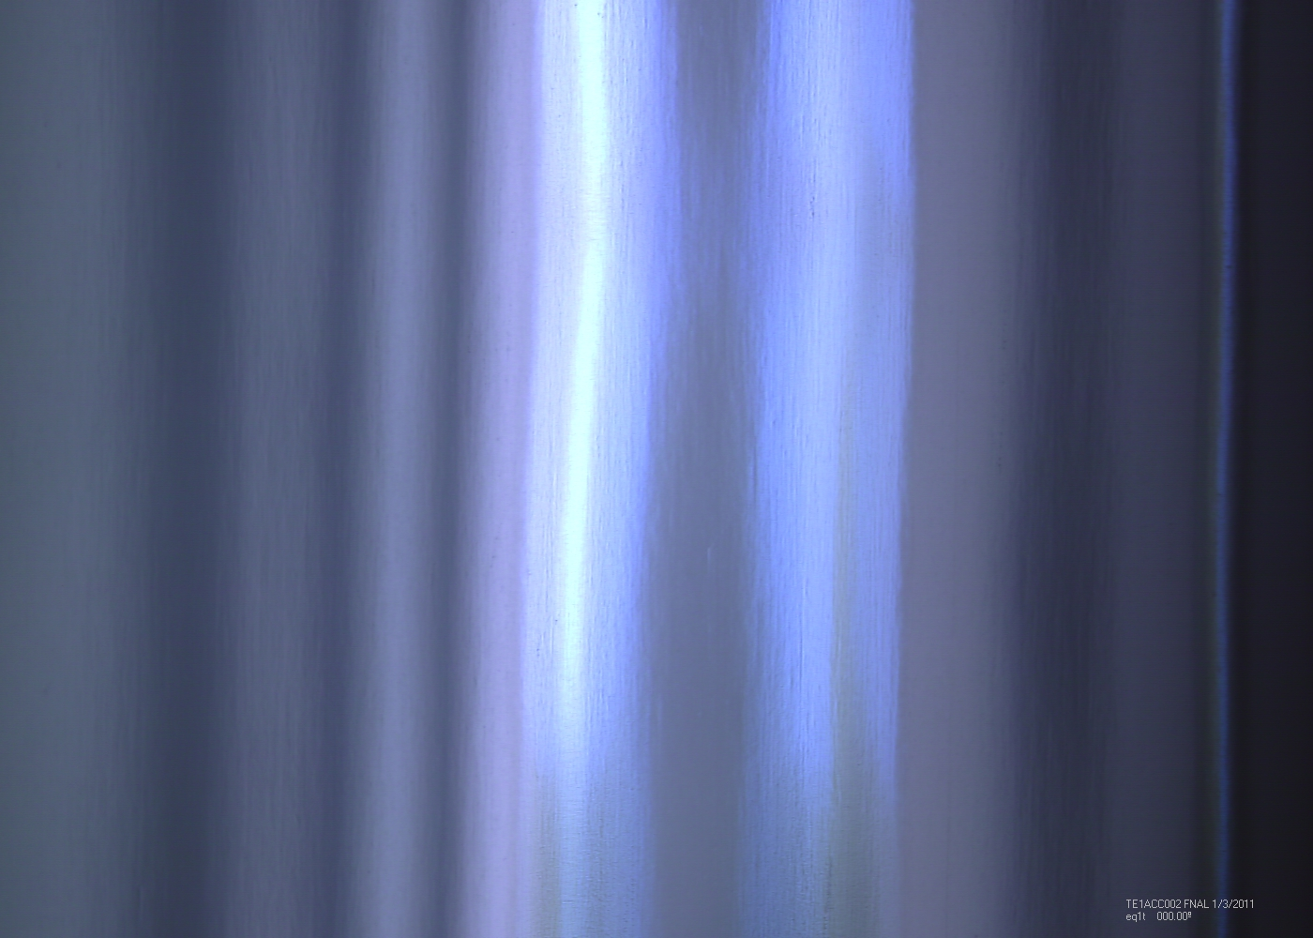
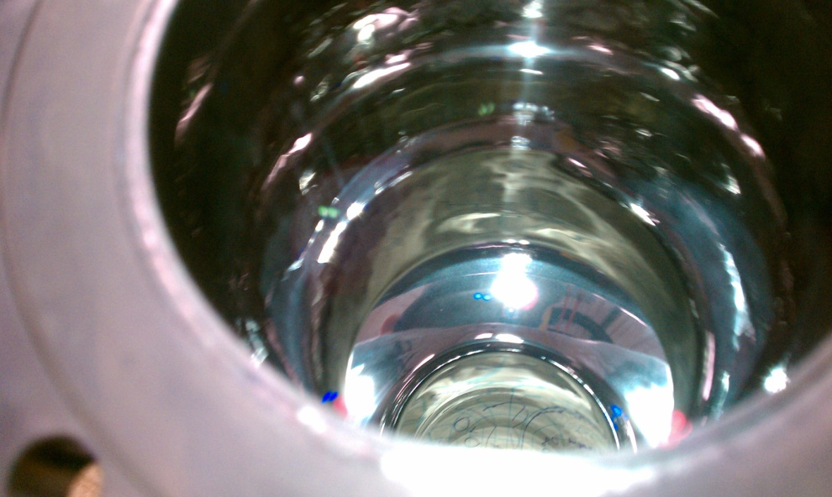
3. CPB of a Cavity to a Mirror Like Surface
Single Cell Polished to Mirror Finish
Ra = 0.0139 µm +/- 0.00216 µm
Rz = 0.139 µm +/- 0.0242 µm
Typical finish achieved by fine polishing.
Notice reflection of graph paper and writing

Slide 19
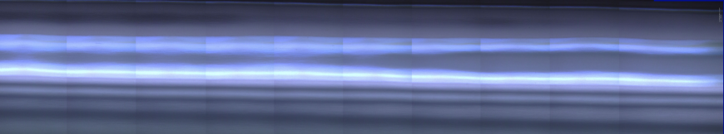
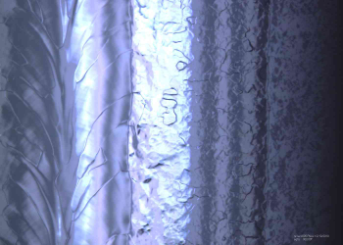
3. Mirror Finish
EPed Weld Bead

Slide 20
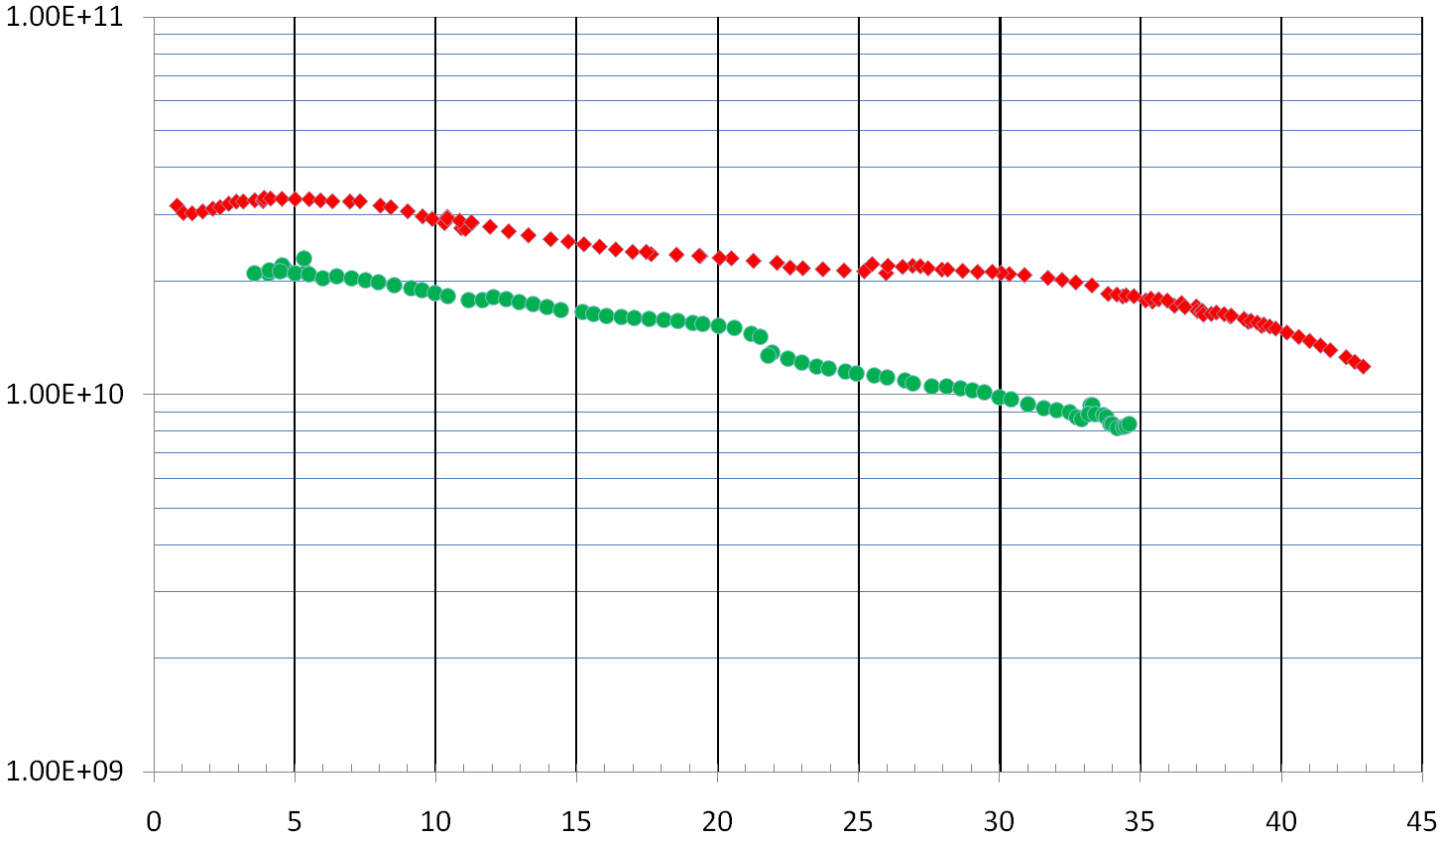
3. Cavity Improved Results after CBP compared to EP – ACC002
Mirror CBP – 20 Micron EP
Baseline EP
Gigi's program (using the approximate BCS theory) gives a residual surface resistance of 1.34 ± 1.19 nano-Ohms after CBP/20micron EP Testing by J. Ozelis
Cavity tested many times after baseline EP processing and reprocessing techniques. Best baseline results shown. Cavity improved greatly after CBP.

Slide 21
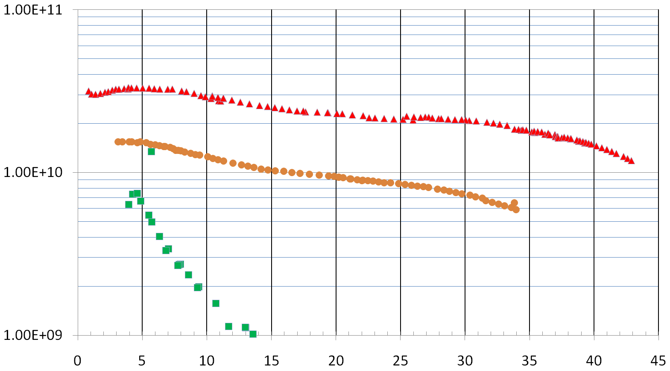
3. How much chemistry needed to remove artifacts of CBP with Mirror Finish?
ACC002 – HF Rinse & 20 Micron EP
AES005 – 10 Micron EP
ACC002 – HF Rinse Only

Slide 22
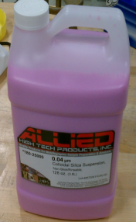
3. Transition from intermediate to fine polishing is key.
Step 4
(15 μm)
Intermediate Polishing, 20 hours
Samuels’ textbook: Intermediate stage is polishing by micro-machining. Fine stage is polishing by delamination.
Step 5
(.04 μm)
Final
Polishing, 40 hours
6
3
1
15
µm
0.5
0.1
Metallography polishing in this range is not successful for flat niobium samples because regions smear or are pulled out (large-scale delamination)
?
15 μm
6 μm
3 μm
1 μm
.5 μm
.1 μm
?
Water + 800 Mesh Alumina
Colloidal Silica
Tumbling niobium with the hardwood blocks and 1200 grit (10 μm) media pulled grains out.

Slide 23
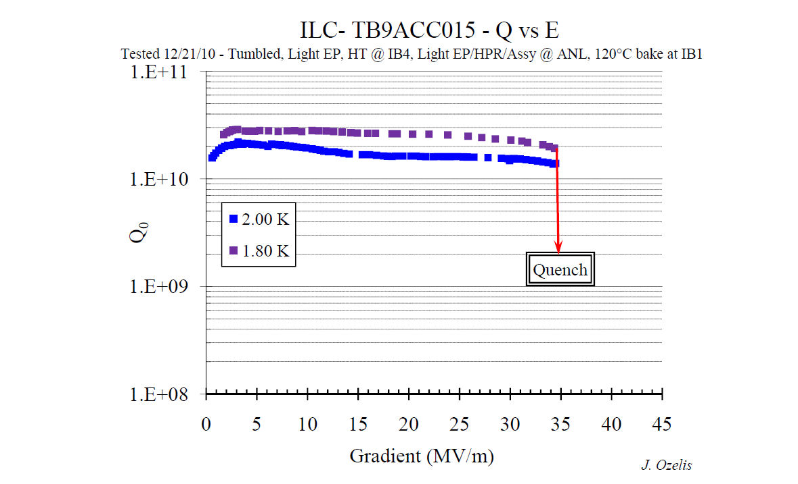
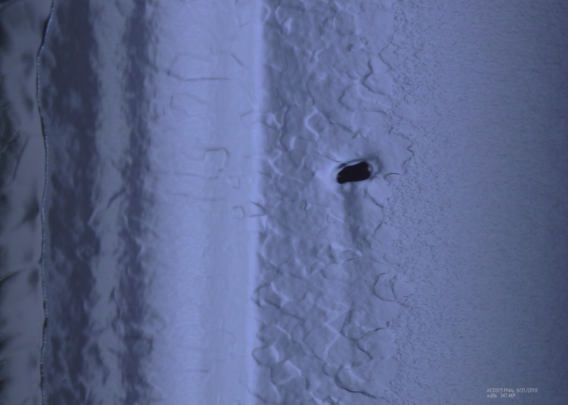
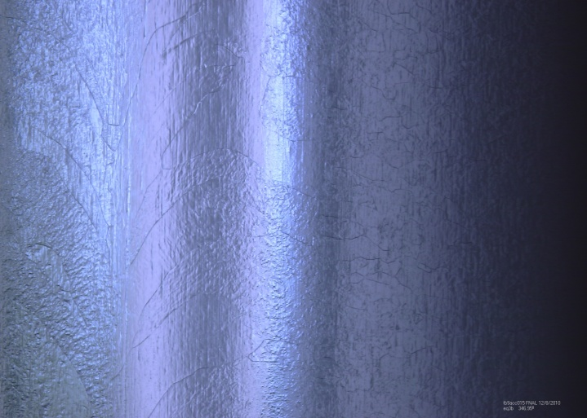
3. Results – Pit Repair – Nine Cell
After CBP
Before CBP
Originally limited here
After CBP and 40 microns EP – Pit completely removed
Had a large (~200micron) pit in cell 3 – verified at JLab to be performance limiting, previously processed by EP and tested at JLab to 19 MV/m

Slide 24
3. 9-Cell Cavity Results – All Repairs
Previously limited here
All 9 cell polycrystalline cavities. AES006 & ACC015 both had large surface defects that limited to performance to around 20 MV/m. ACC012 has last 1 and ½ cells replaced.

Slide 25
3. Does Centrifugal Barrel Polishing Affect Q-Slope ?
Quality Factor
Project X
E_{ACC}, MV/m
ILC
Recent high Q results on Tesla-Type cavities. Do grain boundaries have a negative effect on Q(Low, Mid, and High)?

Slide 26
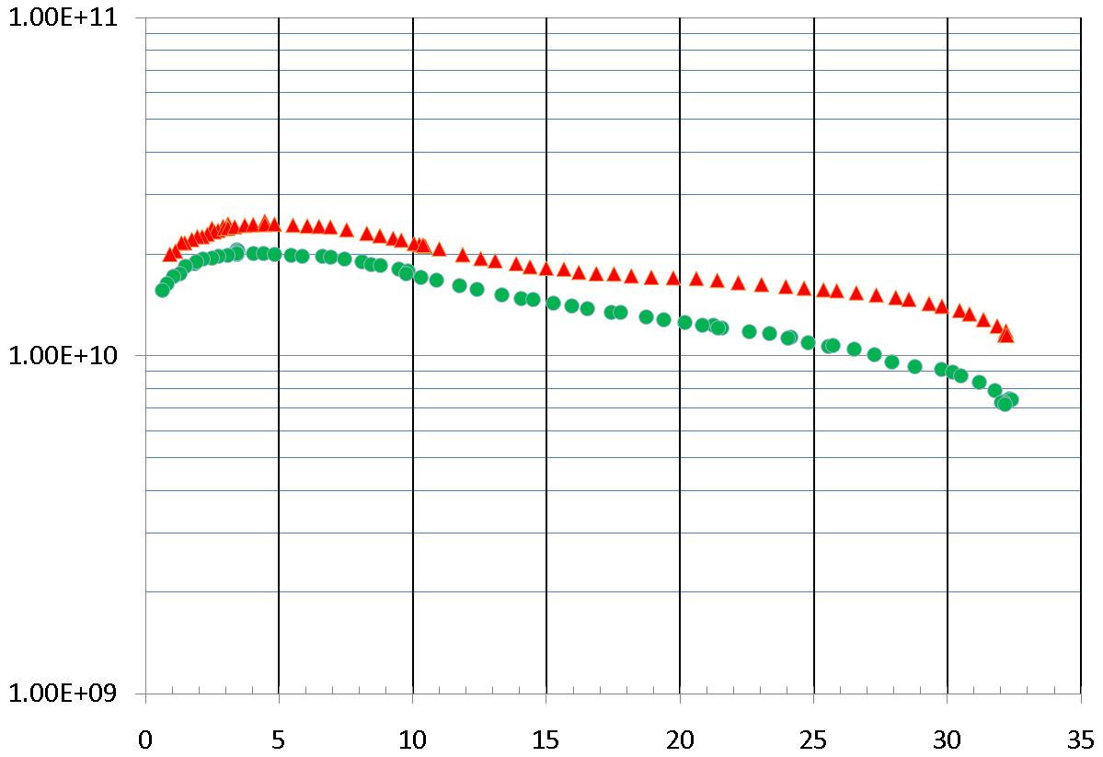
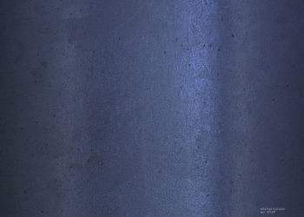
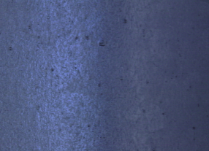
3. Results of NR-6 – Single Cell
NR-6 – CBP & 40 micron EP
Quality Factor
NR-4 - EP
Picture after CBP & EP
Gradient, MV/m
NR6 was tested after tumbling and reached as high as any of the other 6 single cell cavities from Niowave/Roark from that lot.
Weld bead was successfully removed but surface shows general pitting after processing. Apparent porosity in material.

Slide 27
3. Summary of Recent CBP Results
Can produce uniform mirror like finish.
  Mandates defining what a good surface is.
  What geometric feature is most important (RA,RQ, RZ, Contact Angle)?
Can reduce amount of chemistry needed on a cavity from 120 microns to 20 microns with CBP.
  Can be improved with process studied using coupon cavities.
Can repair large defects and defects that chemistry alone can not repair.
Apparent positive effect on quality factor (not decoupled from heat treatment).
  Currently being studied at Fermilab.
Can make weld bead more uniform, can not fix porosity unless it is limited to region very close to the surface.

Slide 28
4. Centrifugal Barrel Polishing by Facility

Slide 29
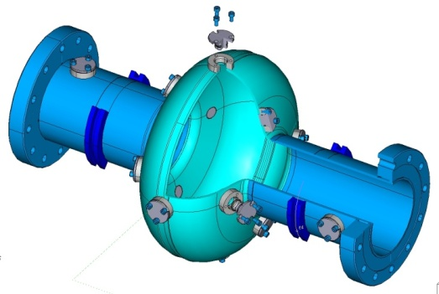
4. Fermilab
Currently doing CBP on 1-cell and 9-cell 1.3 GHz Tesla type cavities.
Examining new media to try to minimize/eliminate post CBP chemistry by reducing remaining contaminated layer.
Examining the effect of CBP on quality factor and accelerating gradient.
Designing new barrel for 650 MHz geometry.
Waiting on 1-cell large grain and re-entrant cavities.
Waiting on coupon cavity.
C. Cooper, L.D. Cooley “Mirror Smooth Superconducting RF Cavities by Mechanical Polishing with Minimal Acid Use”, in sub. Supercond. Sci. Technol.

Slide 30
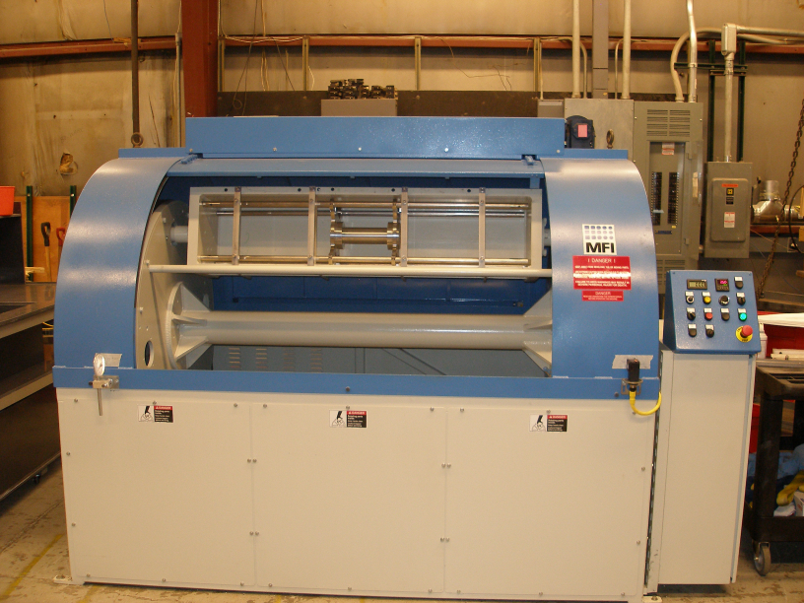
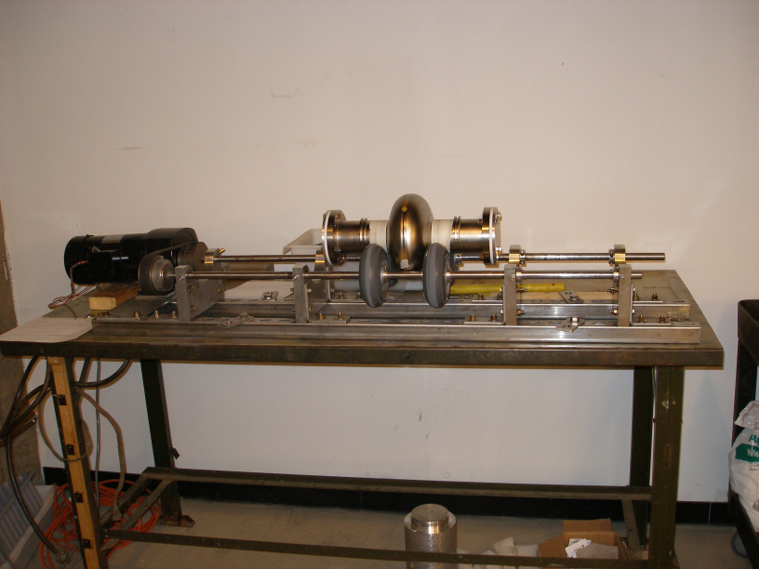
4. Cornell
Has been moved, reinstalled, and functional as of this month.
Will investigate new media.
Will CBP re-entrant cavities
  *Could better show benefits of doing CBP to a mirror finish*
Will examine CBP coupled with Vertical Electropolishing
From B. Bullock at Cornell

Slide 31
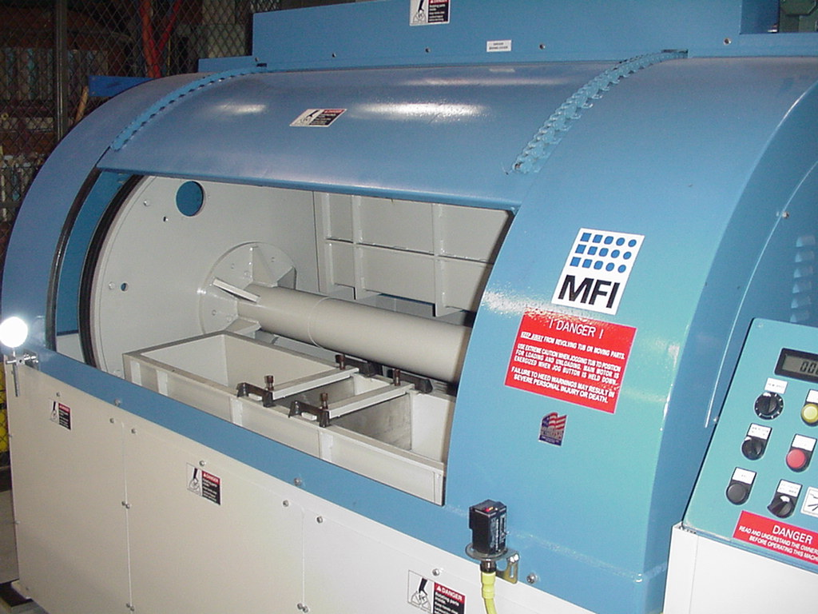
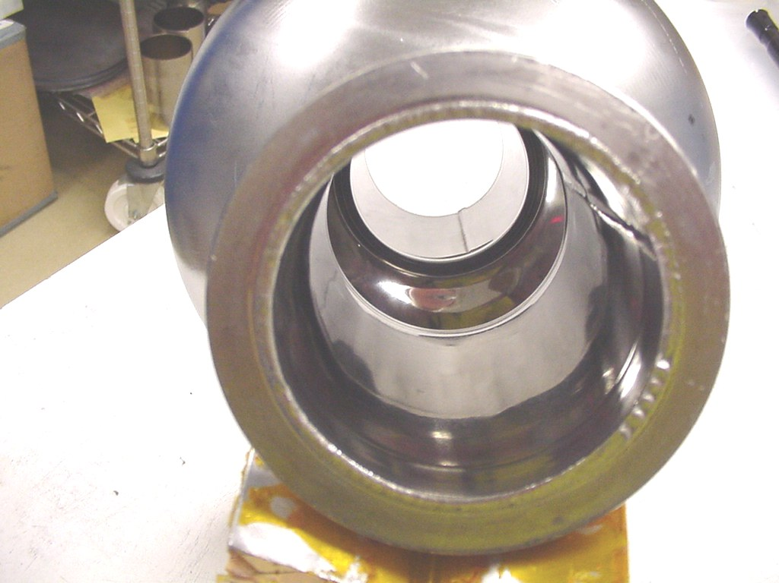
4. Jefferson Lab
Did some initial work on single cell cavities.
Currently making new tooling for single cells and concentrating on coupon work.
From Peter Kneisel & Ari Palczewski

Slide 32
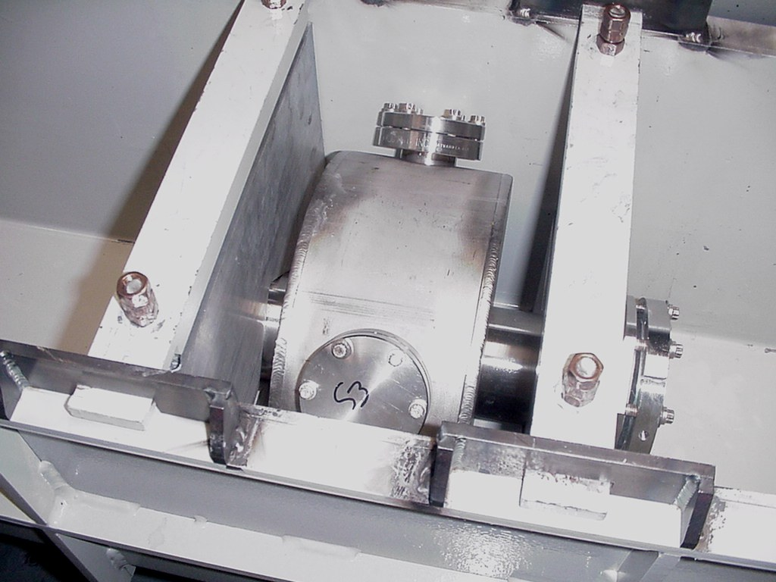
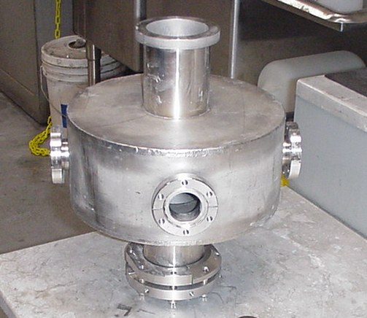
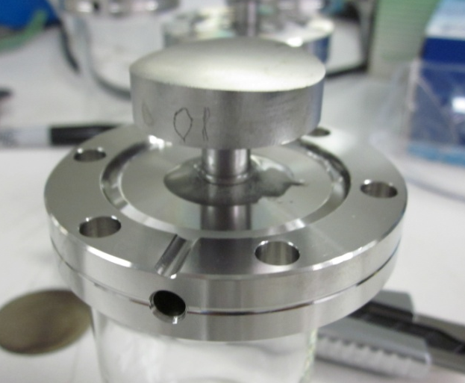
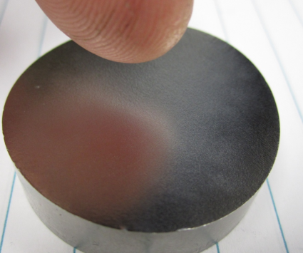
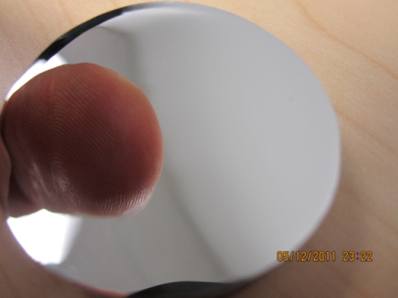
4. Jefferson Lab
Stainless steel housing, 4 coupons (currently large grain) at 9 inch diameter.
*Coupon work most helpful in finding what each media does to surface*
Picture of coupon at beginning (left) and after final CBP (right)
Using Fermilab Recipe
THPO071 Detailed Surface Analysis of Incremental Centrifugal Barrel Polishing (CBP) and EP of Single-Crystal Niobium Samples

Slide 33
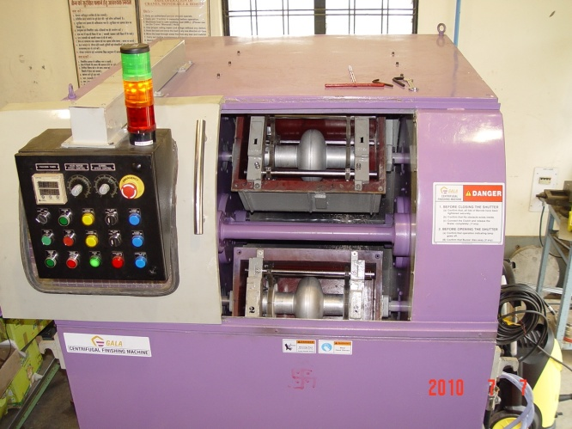
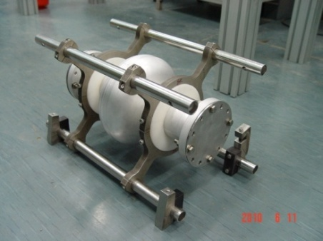
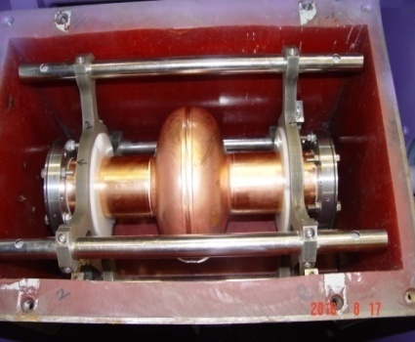



4. RRCAT
Processed prototype aluminum and copper single cell Tesla type cavities using unique media. 0.20 micron surface finish achieved
*Finding media for other materials is important for thin film work*
Turret and Barrel rotate in opposite direction
Turret speed – 0 – 200 rpm ( variable )
Barrel speed – 0 – 200 rpm ( variable )
Barrel size – 320 X 320 X 500 mm (Single Cell 1.3 GHz)
From Satish Joshi

Slide 34
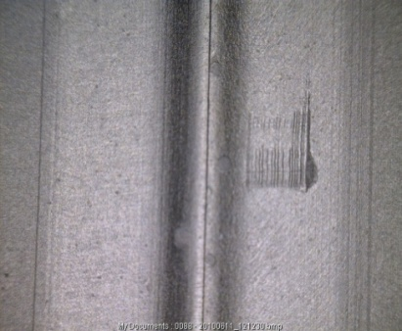
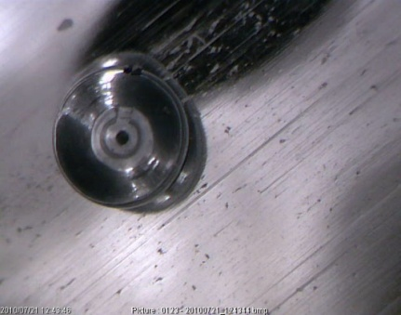
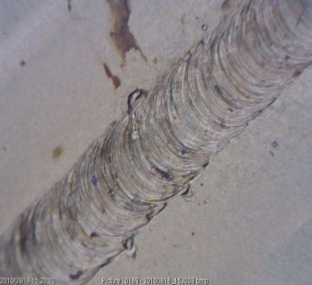
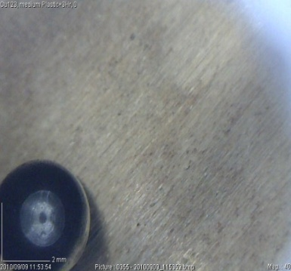
4. RRCAT
Pictures of aluminum cavity after CBP
Pictures of copper cavity after CBP
RRCAT will be processing niobium cavities soon and are designing a CBP machine for 650 MHz 5-cell and 1.3 GHz 9-cell cavities.
From Satish Joshi

Slide 35
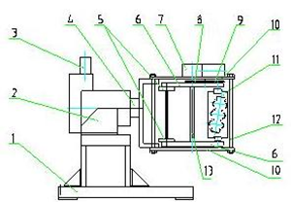

4. DESY
Rotates at up to 140 RPM with adjustable counter rotation rate at up to 400 RPM.
Can accommodate up to 3-cell Tesla Type cavities.
No current work on CBP at DESY.
G. Issarovitch et al., “Development of Centrifugal Barrel Polishing for Treatment of Superconducting Cavities”, 11th Workshop on RF-Supercond., Lubeck, Germany (2003) TUP56.

Slide 36

4. KEK
Pioneering work in the area of CBP.
  T. Higuchi et al., “Investigation of Barrel Polishing for Superconducting Niobium Cavities”, Proc. 1995 Workshop on RF Supercond., Gif-sur-Yvette, France, (1995) p. 723.
  T. Higuchi and K. Saito, “Development of Hydrogen-Free EP and Hydrogen Absorption Phenomena”, 11th Workshop on RF-Supercond. SRF 2003, Lubeck, Germany (2003)We015.
Currently have a standard CBP formulation.
Currently improving welding process.

Slide 37
4. Hydrogen free processing by CBP
T. Higuchi and K. Saito did work on CBP replacing water with a hydrogen free fluorocarbon (CF-77)*.
When doing CBP with water they found approximately 80 ppm of hydrogen in the niobium.
When doing CBP with CF-77 they found approximately 5 ppm of hydrogen. Compared to 1 ppm hydrogen in annealed niobium.
They were doing 50 micron chemistry after CBP which meant that standard EP put hydrogen back into the niobium.
Our current CBP process requires 20 microns chemistry which is similar to the “light” EP which is not thought to cause substantial hydrogen uptake.
Goal is to reduce (eliminate) amount of material that must be removed after CBP and use a chemical rinse instead of EP.
*T. Higuchi and K. Saito, “Development of Hydrogen-Free EP and Hydrogen Absorption Phenomena”, 11th Workshop on RF-Supercond. SRF 2003, Lubeck, Germany (2003)We015.

Slide 38


4. IHEP
Made in 2007
CBP on two IHEP single cell large grain low loss cavities
BCP only
40 MV/m (Test at KEK)
38 / 42

Slide 39



4.IHEP
Made in 2008. Two separate CBP treatments on IHEP-01 large grain 9-cell cavity (Jiyuan Zhai ’s talk WEIOB06)
  1st pass in 2009: 190 μm, remove all the EBW sputtering, 20 MV/m
  2nd pass in 2010: 150 μm, remove the quench defect of the 1st test
Rotation speed around the cavity and the machine axis : 100 - 150 rpm (adjustable independently)
different abrasives (SiC, Al₂O₃), binders (ceramic and plastic), stone shapes and filling amount.
39 / 42

Slide 40
5. Summary
Many people are interested in and currently working on CBP.
CBP is promising because:
  Reduction of acid usage.
  Possibility of increased cavity yield because of more homogeneous surface.
  Possibility of increased quality factor.
  Possibility of increased accelerating gradient for alternate cavity shapes.

Slide 41
6. Future Work
Coupon cavity work to do precise process tuning.
  Help determine what is a “good” SRF surface.
Examine various new media to minimize post CBP chemistry.
Develop 650 MHz tooling and machine.
Decouple effect of heat treatment and CBP see if quality factor is improved by improved surface geometry.
See if CBP is needed for maximum performance of reentrant cavities.
Thin film deposition on mirror like finish cavities.

Slide 42
7. Acknowledgements
Joint Argonne/Fermi Cavity Processing Facilities
Fermilab Technical Division SRF Development Department (Mark Champion) & SC Materials Department (Lance Cooley)
Joe Ozelis
Camille Ginsburg
Dave Burk & George Steuer

