Slide 1
Mechanical design considerations for beta=1 cavities
O. Capatina, S. Atieh, I. Aviles Santillana, G. Arnau Izquierdo, S. Calatroni, S. Chel, A. D’Elia, G. Devanz, R. Garoby, T. Junginger, J. Plouin, D. Maciocha, E. Montesinos, V. Parma, T. Renaglia, T. Tardy, N. Valverde Alonso

Slide 2
Introduction
Talk illustrated by SPL cavities development
A string of 4 equipped beta=1 bulk niobium cavities to be installed into a short cryo-module by 2013
G. Olry talk today on “SPL Cavity Development”
J. Plouin poster on Monday “Optimized RF design of 704 MHz beta=1 cavity for pulsed proton drivers”

Slide 3
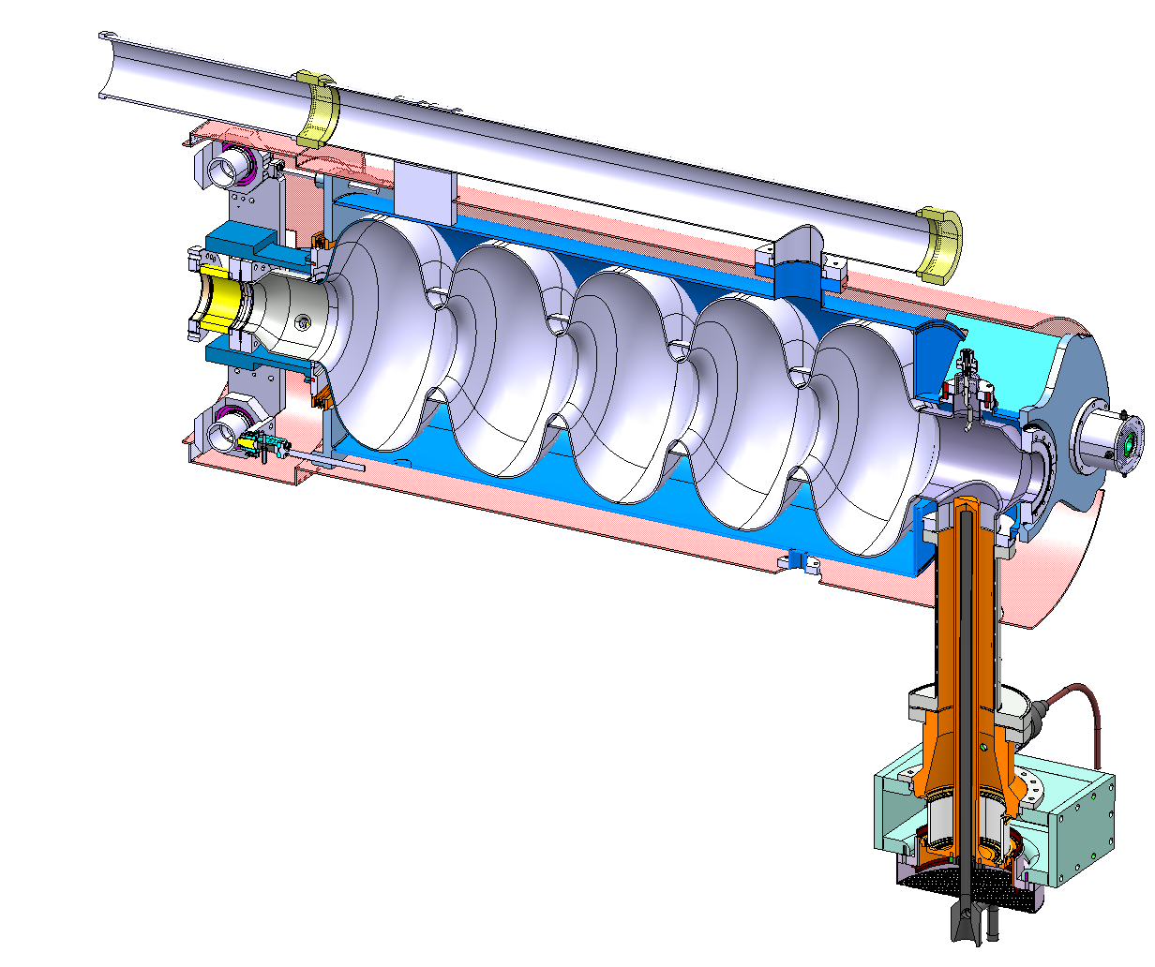
Overview
Cavity
Interfaces
Helium tank

Slide 4
Cavity
Mechanical dimensioning
Static (quasi-static)
Lorentz detuning
Maximum pressure / sensitivity to fluctuation
Deformation for tuning
Handling configurations
Natural vibration modes
Bucking

Slide 5
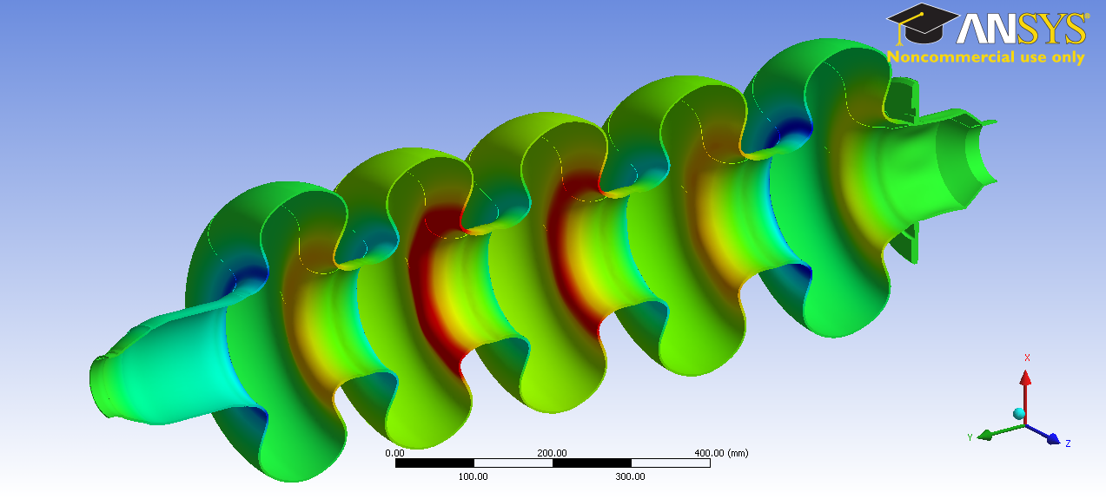
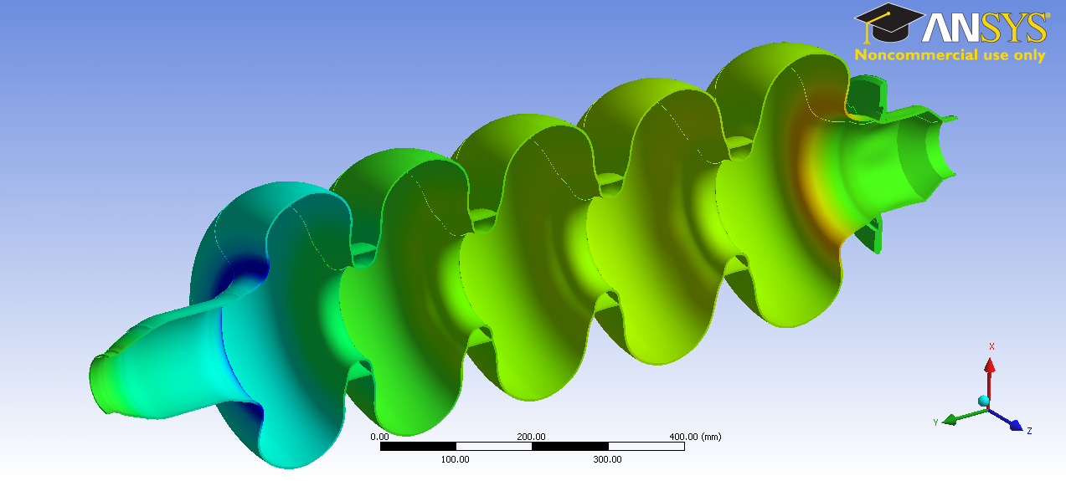
Cavity
Lorentz detuning

Slide 6
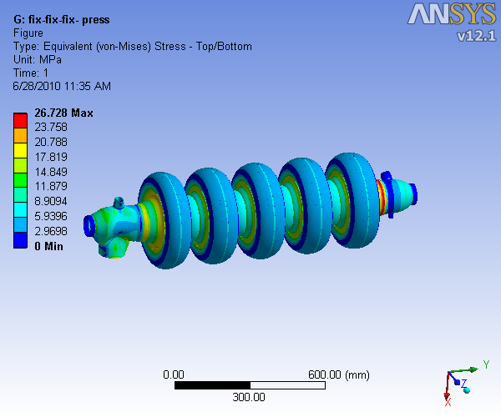
Cavity
External pressure of 2 bars – fix-fix boundary condition
Sensitivity to pressure fluctuations => one order of magnitude lower that the frequency bandwidth

Slide 7
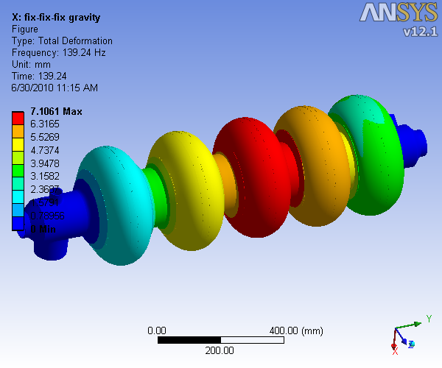
Mechanical behaviour for real dimensions
Dynamic (natural frequencies):
First longitudinal mode at ~140 Hz

Slide 8
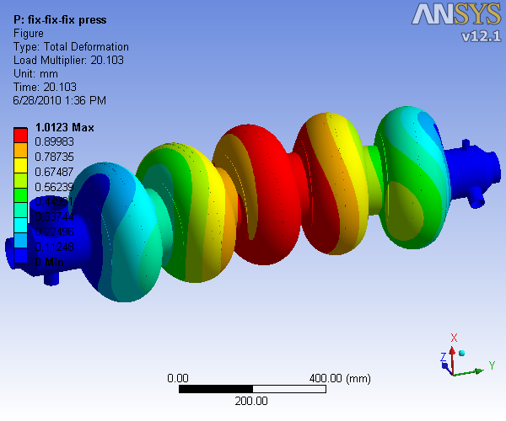
Mechanical behaviour for real dimensions
Bucking under external pressure for fix-fix boundary conditions: security factor 20

Slide 9
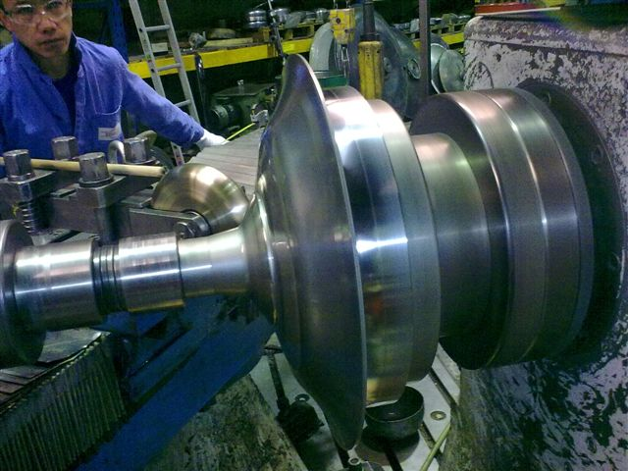
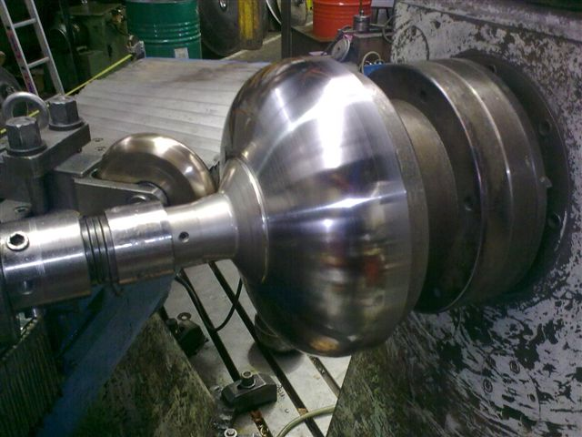
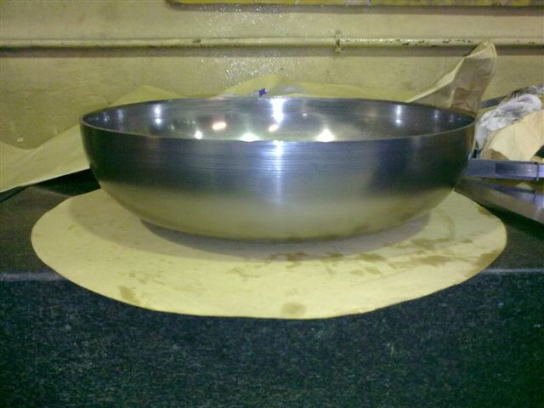
Cavity
Manufacture technology chosen: spinning + EB welding
First manufacturing tests results
Spinning => loss in thickness non uniform up to 0.6 mm

Slide 10
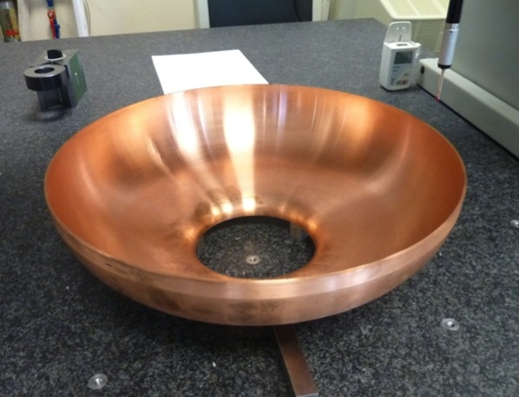
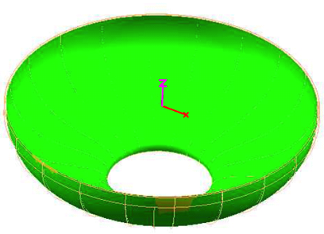
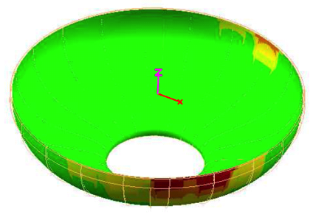
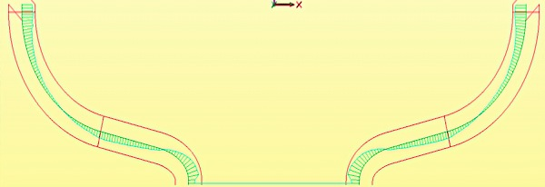
Cavity
The average shape accuracy achieved is ± 0.150 mm
The best half cell: shape accuracy ± 0.100 mm
By CMM
Measuring accuracy: MPE_{P} = ± 3 μm
T_{amb} = 20°C ± 1°C

Slide 11
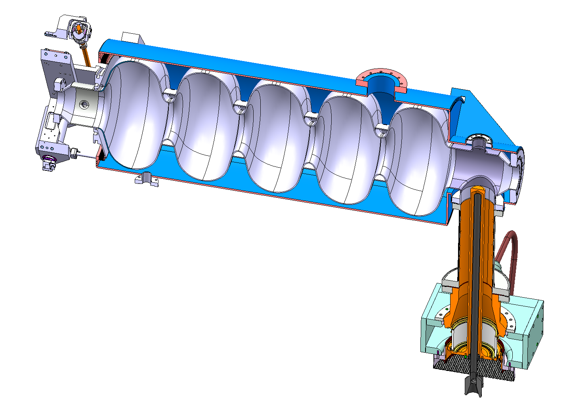
Interfaces
Titanium helium tank
Nb to Ti
Ti to SS
Stainless steel helium tank
Nb to SS

Slide 12
Interfaces
Niobium to titanium
DESY XFEL choice:
EB welding Nb to NbTi and NbTi to Ti grade 2
NbTi flanges
Choice motivated by the stability of the mechanical properties after HT at 1400ºC
Heat treatment no longer at 1400ºC but at 800ºC A properly selected Titanium (cheaper) could be then a valid option (instead of NbTi)
The grade 5 Titanium Ti6Al4V (alloy) for flanges and transition to helium tank

Slide 13
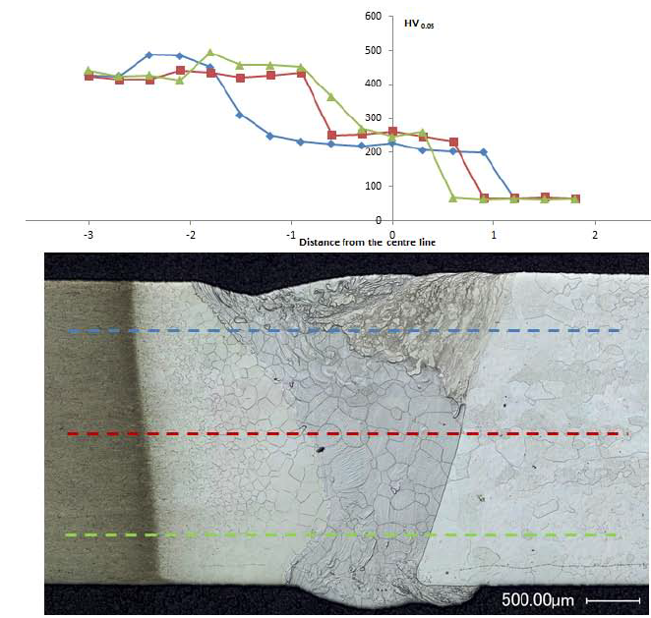
Interfaces
Niobium to titanium grade 5 (Ti6Al4V) EB welding successfully tested before and after heat treatment at 800 C
Ti6Al4V
Nb

Slide 14
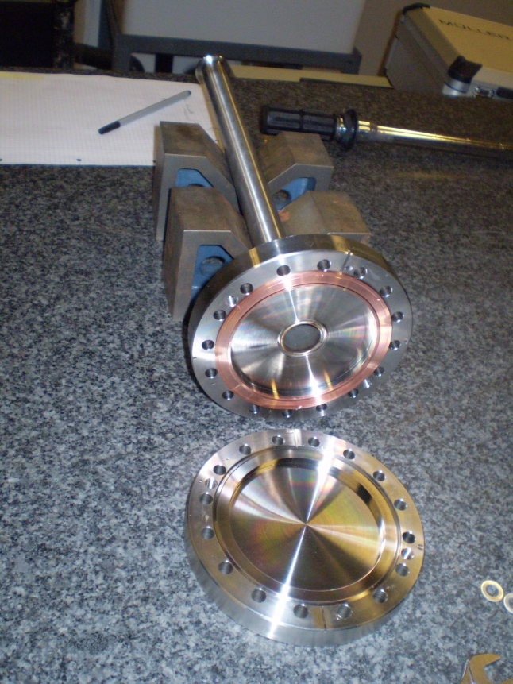
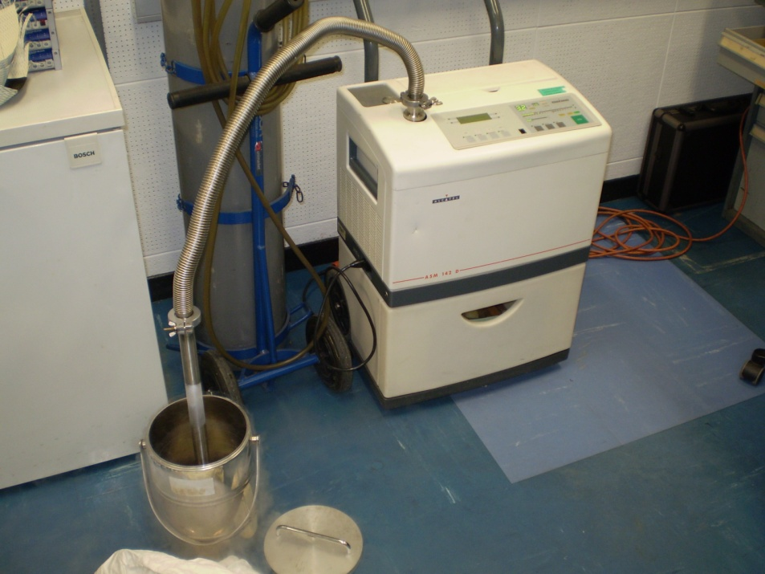
Interfaces
Titanium to stainless steel
By flange connection
CF flange SS 316LN + OFE copper + CF flange Ti6Al4V, liquid nitrogen tests

Slide 15
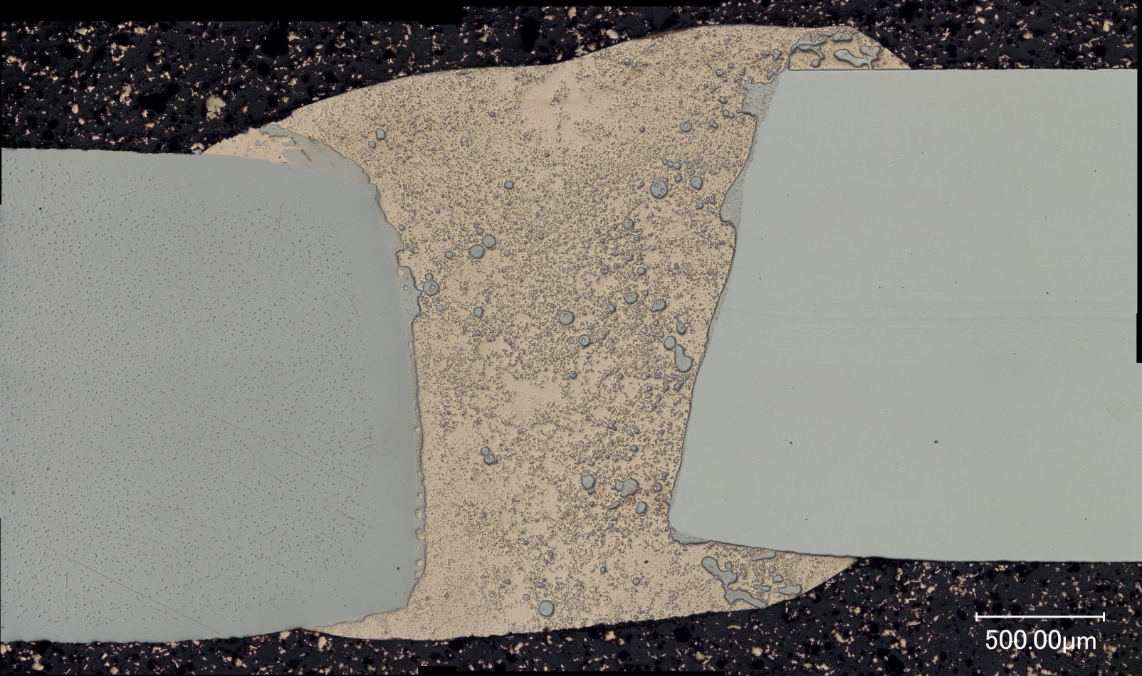
Interfaces
Niobium to stainless steel
Vacuum brazing
Electron beam welding tests ongoing
OFE Cu
SS 304 L
Nb

Slide 16
Helium tank
Material choice => interfaces => cavity
Stiffness => Lorentz detuning
Heat load to superfluid helium extraction

Slide 17
Helium tank
Helium tank + tuner act as boundary conditions to cavity => different stiffness gives different deformation of cavity due to Lorentz forces
Zero tank + tuner stiffness equivalent to free-free BC for cavity
Infinite tank + tuner stiffness equivalent to fix-fix BC for cavity

Slide 18
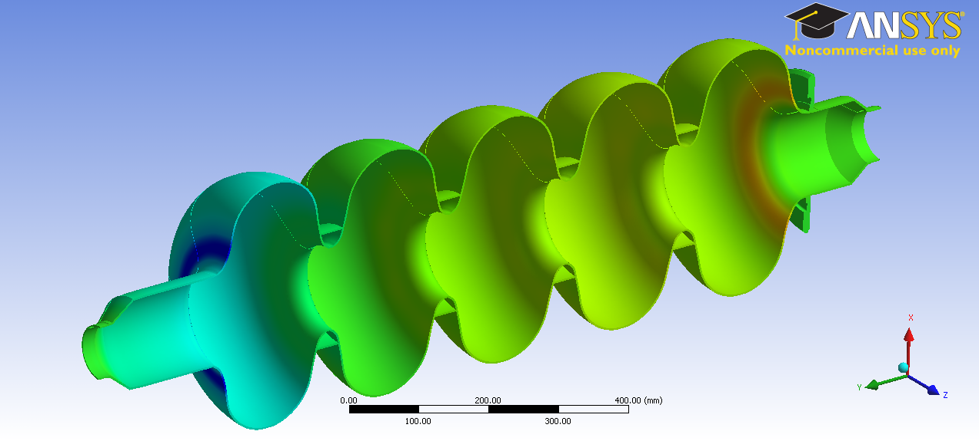
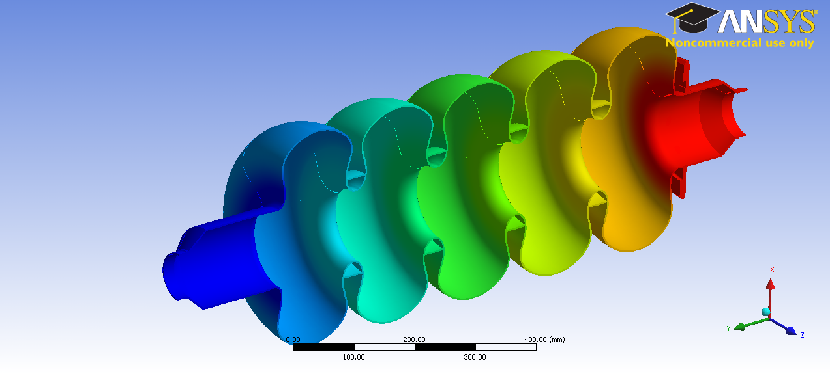
Helium tank
deformation under Lorentz forces
Fix-fix BC
Free-free BC

Slide 19
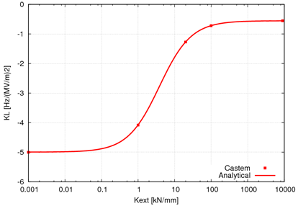
Helium tank
Lorentz detuning => min helium tank stiffness 100 kN/mm
∞ tank + tuner stiffness
Detuning coefficient K_{L}≈1.2 Hz/(MV/m)²
for real ext stiffness
0 tank + tuner stiffness

Slide 20
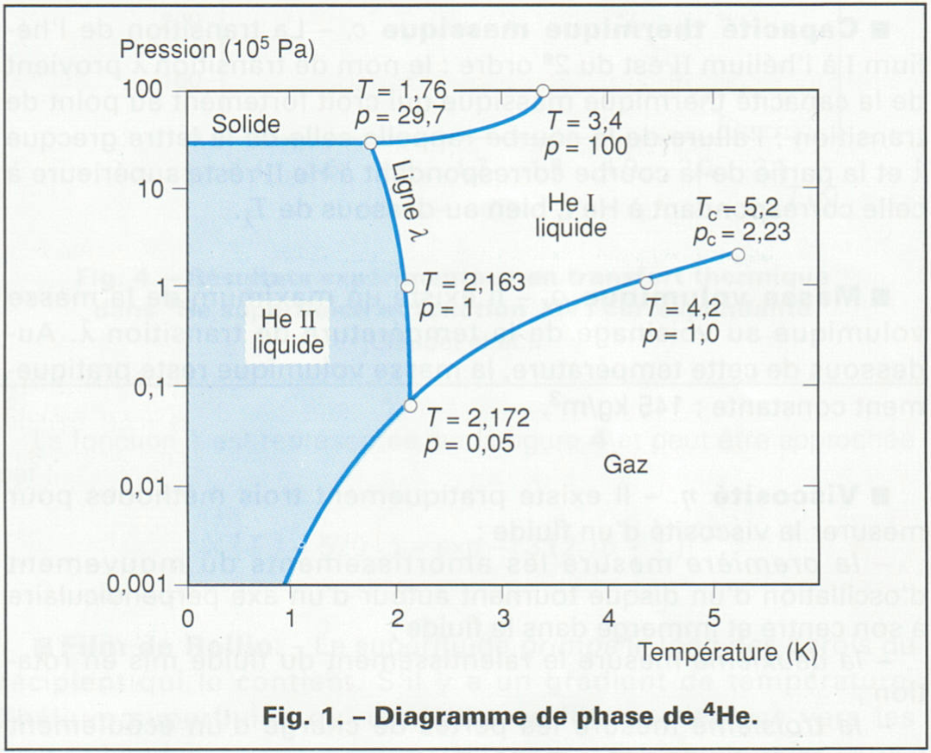
Helium tank
Operation point: saturated He II at 2 K
SPL operation

Slide 21
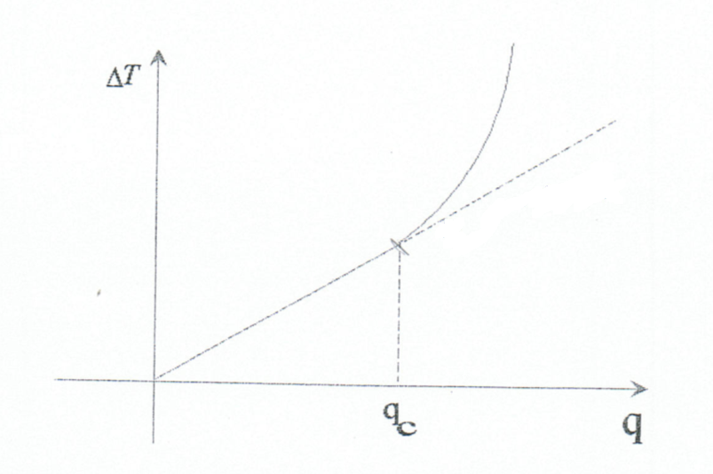
Helium tank
Heat flux in He II depend on bath temp. and channel dimension

Slide 22
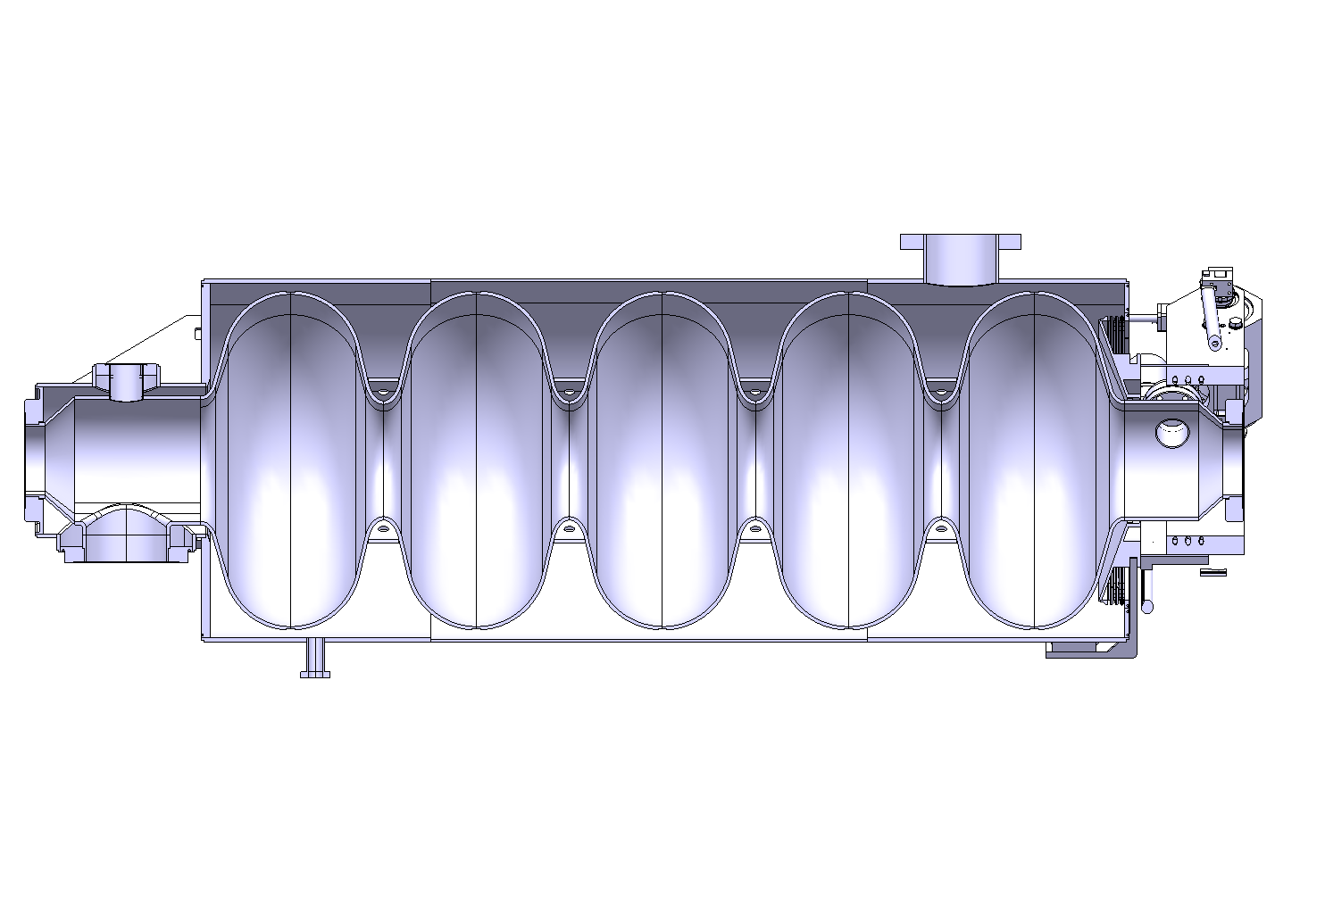
Helium tank
Heat load from 0.8 – 1.5 W/cm^2 => Tank dimensions accordingly to extract dynamic heat load 20 W
~ 10 cm
~ 50 cm

Slide 23
Conclusions
After RF design finalized, still some work to do
RF design, mechanical design, material, manufacturing, processing are very closely inter-linked
During the cavity development, the mechanical considerations should be taken into account from the beginning
Sometimes useful to have a critical view to existing solutions

