Slide 1
Status of the ReAccelerator facility RεA for rare isotope beam research
Daniela Leitner
J. Popielarski, A. Facco, C. Compton, M. Hodek, A. Lapierre, S. Nash, D. Morris, G. Perdikakis, N. Usher, W. Wittmer, Q. Zhao, X. Wu
and the ReA3 commissioning team

Slide 2
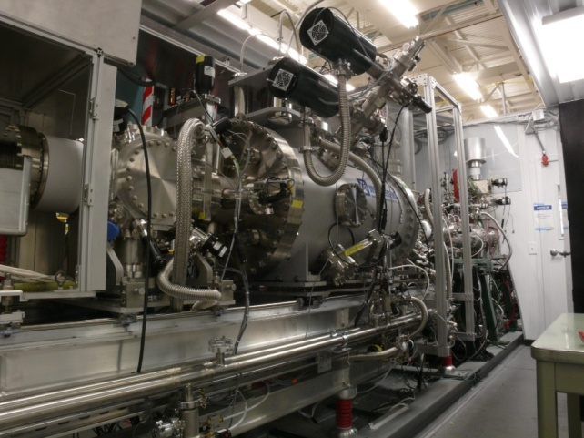
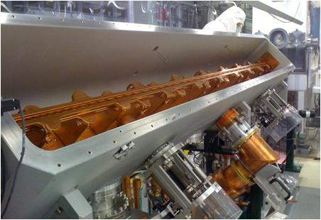
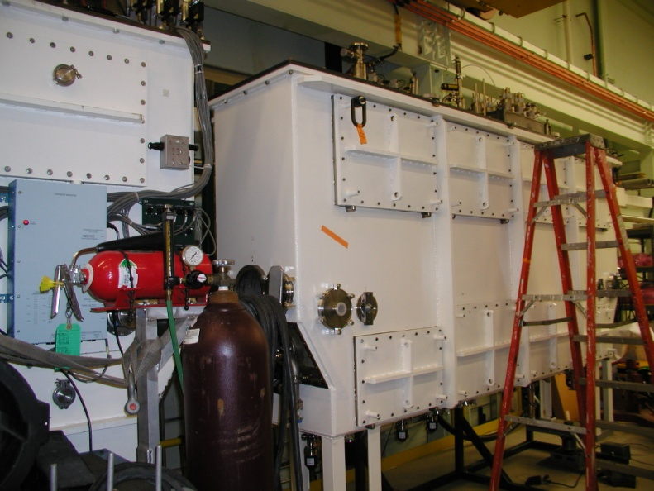
Outline
RεA Overview
Accelerator design
Operational experience with the first two cryomodules
Status of ß=0.085 cryomodule
First beam experiments
Outlook
Slide 2
D. Leitner, 28 July 2011
SRF’2011, Chicago

Slide 3
RεΑ Concept: 3 Stages
MHB
ReA3 (15 cavities)
(2012)
ReA6
(+10 cav.) (2014)
ReA12
(+16 cav.)
proposed
Q/A
RFQ
CM 1
4.1%
Cryomodule 2
β=4.1%
Cryomodule 3
β=8.5%
Cryomodule 4
β=8.5%
Cryomodule 5,6
β=8.5%
Mass
separation
1+→n+
CCF/FRIB
A1900
> 50 MeV/u
Experiments
(starting 2013)
Gas
Stopper
Requirements
Ion efficiency for all elements | > 20 % | EBIT charge breeder + high efficiency LINAC
Beam rate capabilities | 10⁸ ions/sec | Hybrid EBIS/T charge breeder
High beam purity |  | A1900, EBIT CB, Q/A
Low energy spread, short pulse length | 1keV/u, 1nsec | Multiharmonic external buncher and tight phase control in SRF linac
Slide 3
D. Leitner, 28 July 2011
SRF’2011, Chicago

Slide 4
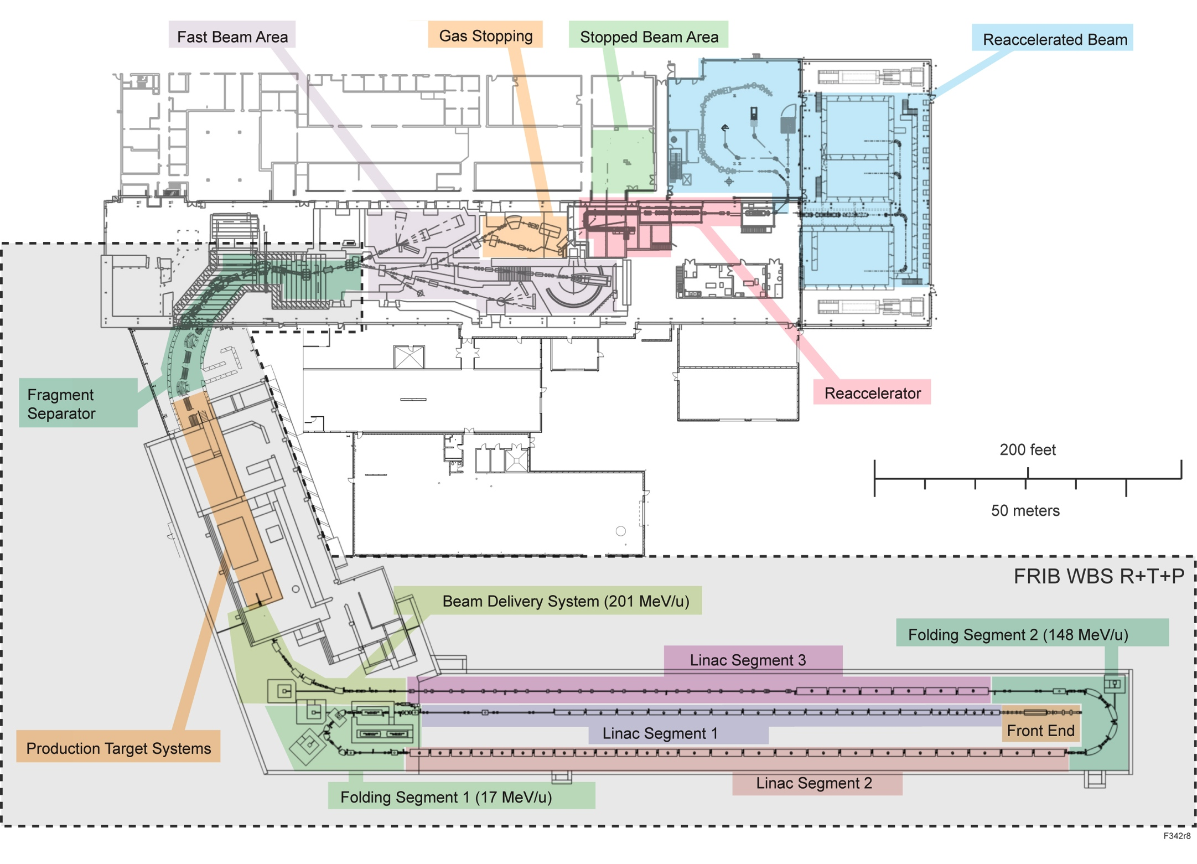
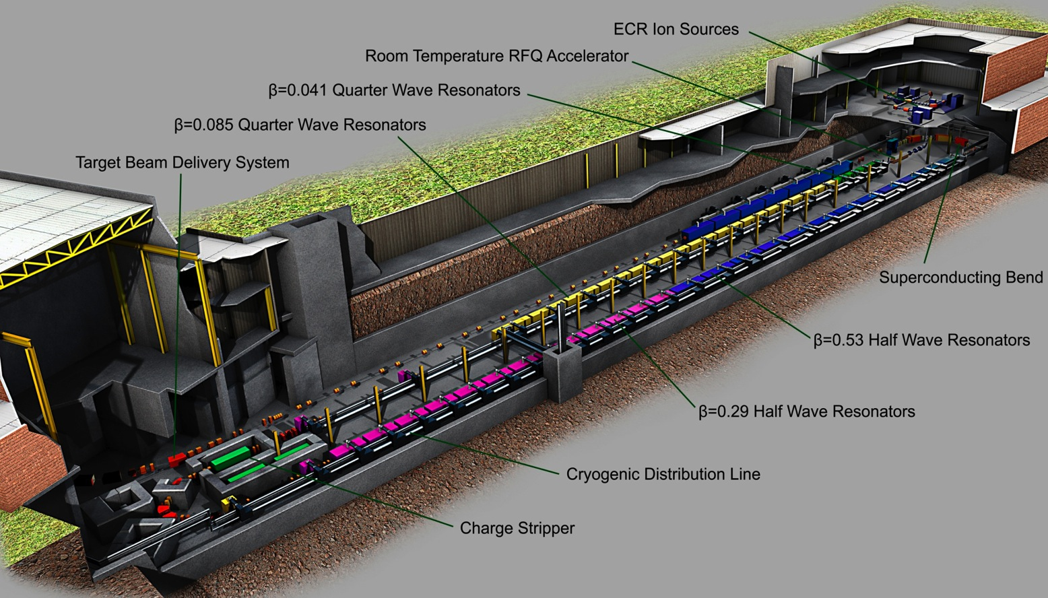
Facility for Rare Isotope Production at MSU
Stopped Beams
Low Energy Nuclear Physics Experimental Area
Gas Stopper
Re
Accelerator
Fast Beam Experimental Area
Fragment Separator
Target
Production Linac (2018)
200MeV/u Uranium
341 SRF cavities
ß=0.041, 0.085,0.29,0.53
MOPO009, MOPO051
MOPO055, MOPO058
TUPO004, TUP016,
TUPO056, TUPO057,
TUPO059, TUPO060,
WEI0A06, THP0067,
THP0068
Slide 4
D. Leitner, 28 July 2011
SRF’2011, Chicago

Slide 5
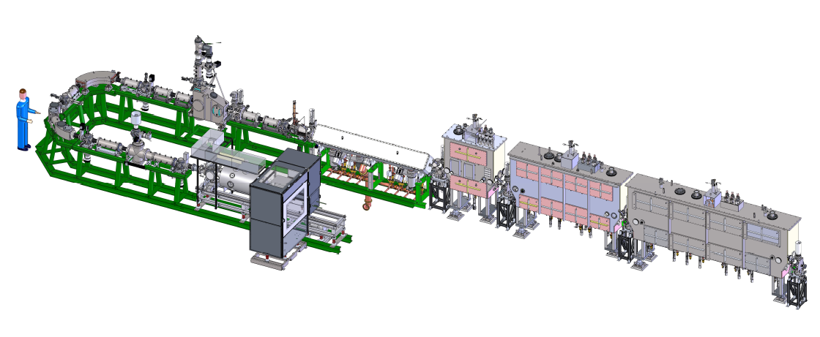
Stage1: ReA3 Project Scope
Installed
Pilot source (tuning of the LINAC for RIB)
Q/A
MHB
0.041 modules
RT RFQ
0.085 module
FY12
n+ rare
isotopes
1+ rare
isotopes
EBIT
ReA3 will start operating with the Coupled Cyclotron Facility 2013
ReA3 shares similar technologies as the FRIB driver LINAC
ReA3 is fully integrated into the FRIB design team
ReA3 provides data for the FRIB engineering, commissioning and installation planning, beam physics, and development of the control system
Slide 5
D. Leitner, 28 July 2011
SRF’2011, Chicago

Slide 6
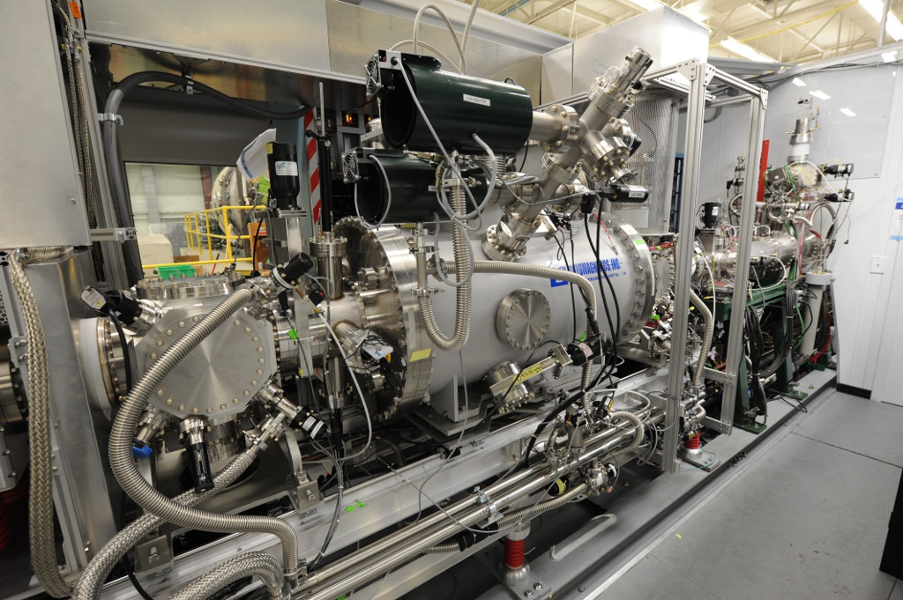
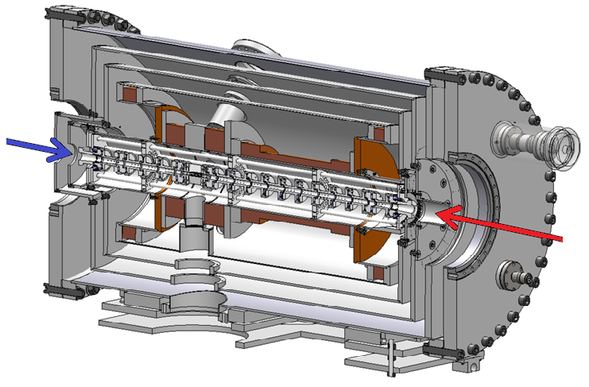
RεΑ – EBIT Charge Breeder: first ion beam 3/2011
Key parameters:
Magnetic field: B=6T,
Electron current: I_{e}=0.5 … 5 A,
Electron energy: E_{e} < 30 keV
Current density: j ~ 10⁴ A / cm²
collector
Magnet + Trap
E-gun
Slide 6
D. Leitner, 28 July 2011
SRF’2011, Chicago

Slide 7
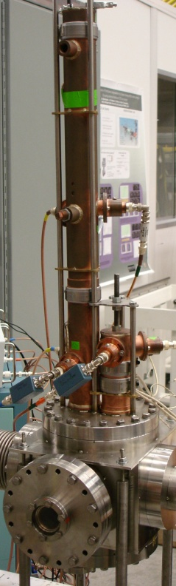
LEBT/RFQ: first beam acceleration 2/2011
Nominal requirement
  Power (CW): ~120 kW (40kW CW reached)
  Injection energy: 12 keV/u
  Extraction energy: 600 keV/u
  EBIT: beam pulse
  µsec < T >2ms, Rep rate: 1-10Hz
  Operated in pulsed operation
Pilot source
MHB
Beam bunch structure after the RFQ
LEBT
RFQ
Slide 7
D. Leitner, 28 July 2011
SRF’2011, Chicago

Slide 8
ReA3 – SRF Cavities: 2 Cavity Types
(FRIB Linac Segment 1)
3 cryomodules: 15 cavities
Status
First two cryomodules (β=0.041) were
installed and are being tested (performing above ReA3 specifications)
Cryomodule 3 (β=0.085),
cavities required more R&D: installation 2012
Type | λ/4 | λ/4
Optimum β | 0.041 | 0.085
Frequency | 80.5 MHz | 80.5MHz
E_{peak} | 16.5 MV/m | 20 MV/m
V_{acc} | 0.445 MV | 1.03 MV
B_{peak} | 29 mT | 46.5 mT
MOPO065
TUPO060
Slide 8
D. Leitner, 28 July 2011
SRF’2011, Chicago

Slide 9
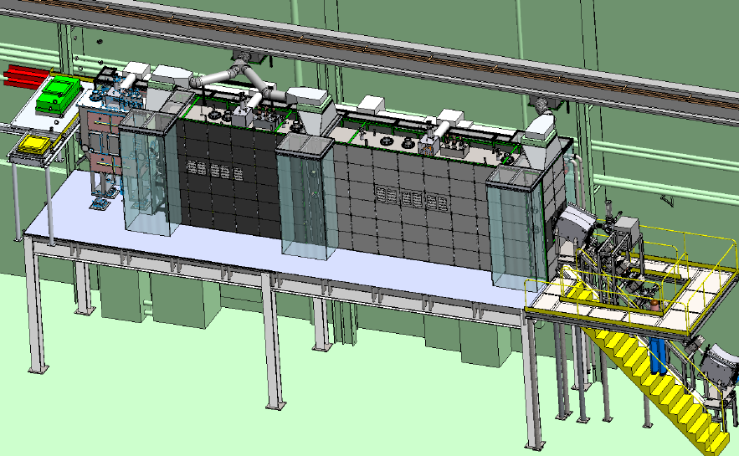
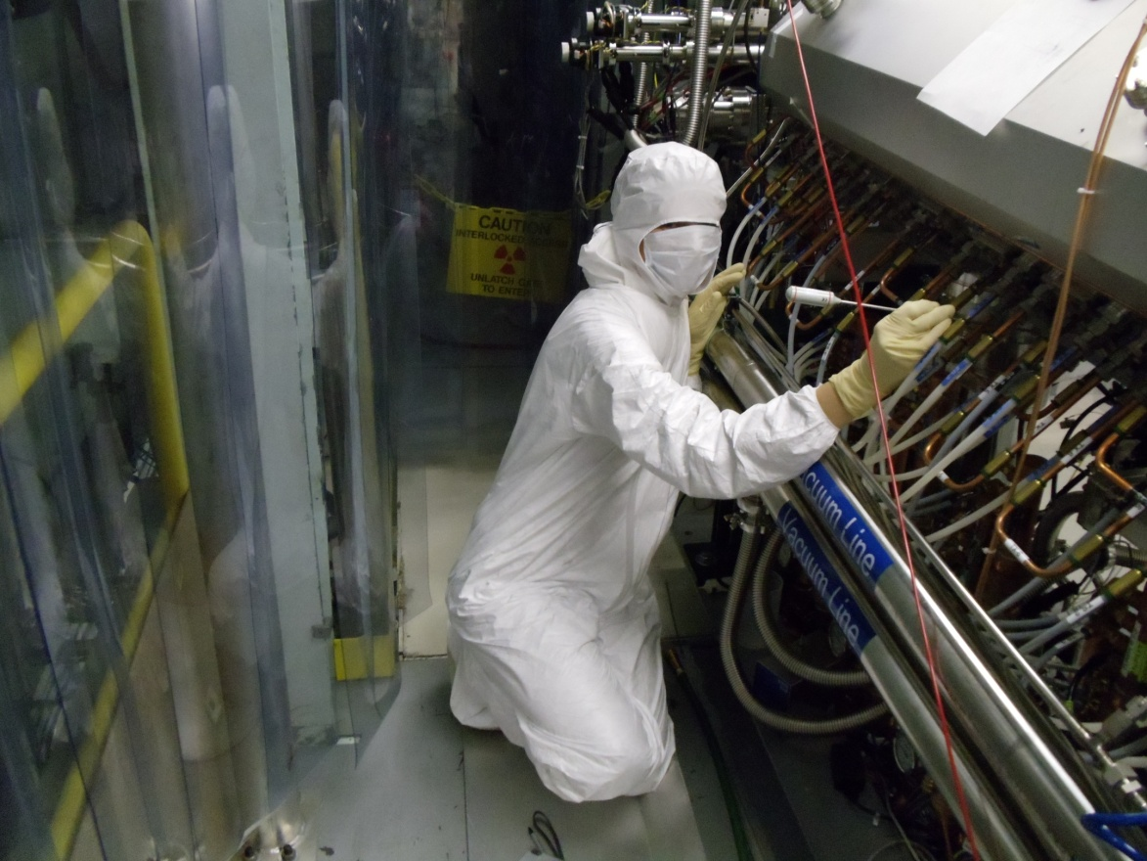
SRF-LINAC infrastructure
Clean rooms
Lead shield
RFQ clean room
diagnostic boxes
Slide 9
D. Leitner, 28 July 2011
SRF’2011, Chicago

Slide 10
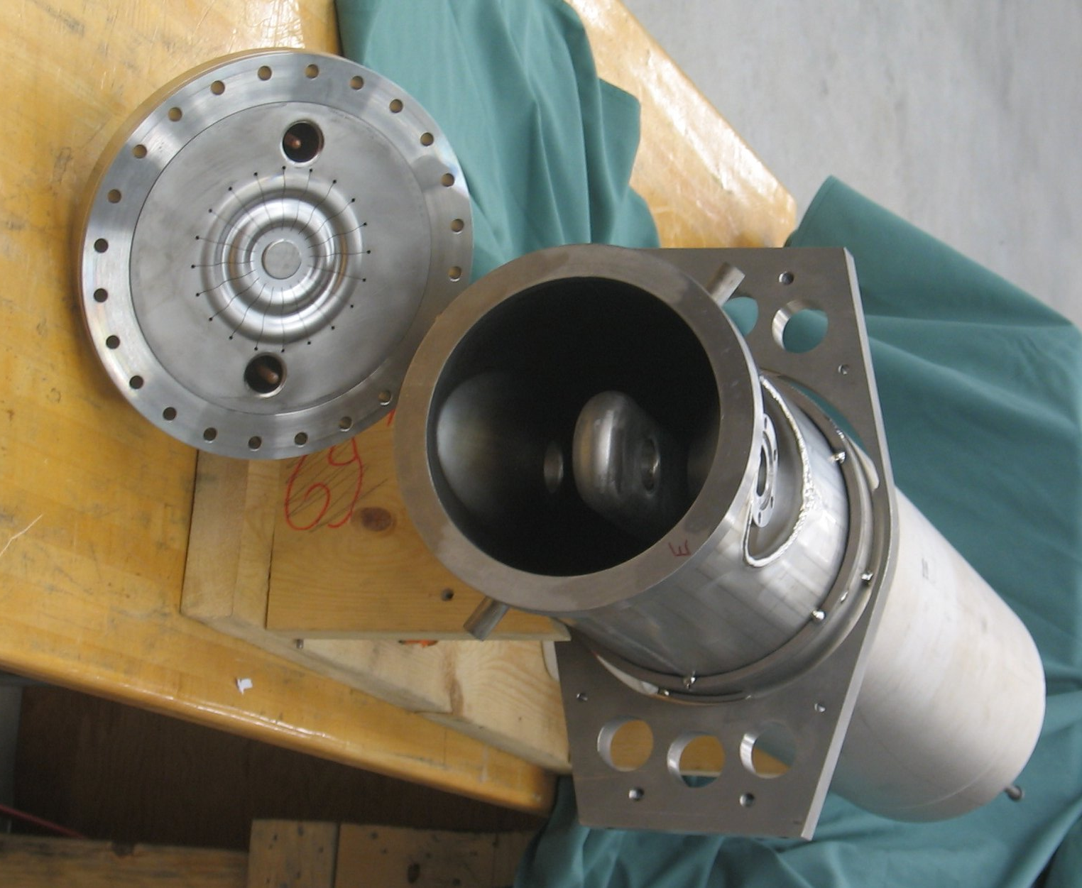
ß=0.041 cryomodules
Type | λ/4 (ReA) | λ/4 (FRIB)
b_{opt} | 0.041 | 0.041
f (MHz) | 80.5 | 80.5
V_{a} (MV) | 0.445 | 0.81
E_{p} (MV/m) | 16.5 | 30
B_{p} (mT) | 29 | 53
R/Q (Ω) | 433 | 433
G (Ω) | 15 | 15
Bandwidth (Hz) | 77-88* | 38.4
Design Q₀ | 5×10⁸ | 2x10⁹
Aperture (mm) | 30 | 30
T (K) | 4.5 | 2
Rf amplifier power [kW] | 1 | 2
Slide 10
D. Leitner, 28 July 2011
SRF’2011, Chicago

Slide 11
Q measurements outside and inside cryomodule
Final vertical dewar test at 4.3 K (7 cavities)
Q measurements in the cryomodule
Vertical Test
Installed in cryomodule
Q soak
FRIB
ReA
W. Hartung, et al., "Production Cavities and Cryomodules for a Heavy Ion Re-Accelerator at Michigan State University", SRF2009 (2009).
MOPO065: Systems Testing of Cryomodules for an Ion ReAccelerator Linac, J. Popielarski et al.
Slide 11
D. Leitner, 28 July 2011
SRF’2011, Chicago

Slide 12
Vibrations
x: σ=374 nm (4-100 Hz)
Amplitude and phase deviation frequencies are correlated with the displacement.
y: σ=562 nm (4-100 Hz)
z: σ=302 nm (4-100 Hz)
MOPO065: Systems Testing of Cryomodules for an Ion Reaccelerator Linac, J. Popielarski et al.
z: σ=124 nm (floor; 4-100 Hz)
FRIB Tunnel Specification for
RMS Displacement
σ=40 nm (4-100 Hz)

Slide 13
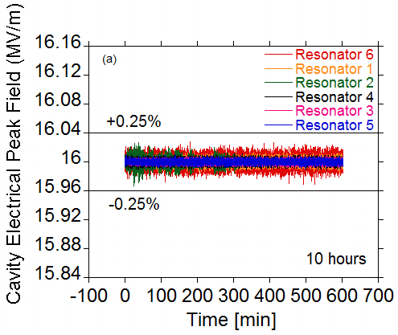
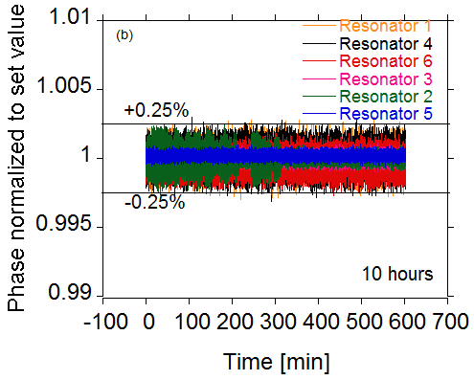
Stability measurements at ReA specifications
Measured Phase and Amplitude Stability
Cavity | Phase Std dev (deg) | Amplitude Std dev (%)
1 | 0.149 | 0.025 %
2 | 0.207 | 0.009 %
3 | 0.043 | 0.018 %
4 | 0.14 | 0.013 %
5 | 0.06 | 0.020 %
6 | 0.248 | 0.046 %
Requirements (FRIB):
  Amplitude: 0.25% RMS, ±1% pk-pk; Phase: 0.25º RMS, ± 1º pk-pk
Slide 13
D. Leitner, 28 July 2011
SRF’2011, Chicago

Slide 14
Cryomodule operation experience
At ReA3 specification: 24/7 operation, several weeks demonstrated
Cavities have been operated 20% above ReA specifications for several weeks 24/7, phase and amplitude locked
Experienced some drop outs due to external interlock transients (solved)
Cryogenic heat load is close to predicted values (after several thermo cycles)
The cavity alignment repeats after thermo cycles
Operational experience at higher field gradients (25 MV/m-35MV/m) so far has been limited due to ReA beam commissioning
Some interlock transients (understood)
Some amplifier failures (understood)
Slow rise in pressure at some power couplers (will add cooling)
Two cavities show field emission at higher gradients (longer conditioning at high power is necessary)
Slide 14
D. Leitner, 28 July 2011
SRF’2011, Chicago

Slide 15
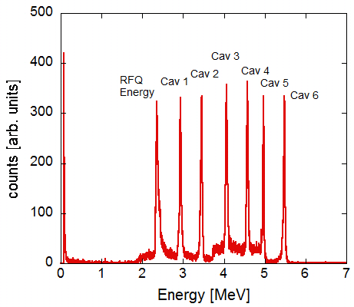
Commissioning status at ReA3:
Project Milestone Energy >1 MeV/u reached after CM2
Beam Energy Spectrum
Charge state selection
Pilot injector
RFQ
CM1
CM2
CM3, 7/2012
EBIT
Commissioning | Date
Acceleration through RFQ | Feb. 2011
High charge state beam from EBIT | Mar. 2011
Acceleration through CM2 (pilot source) | June 2011
Acceleration through CM2 (EBIT) | July 2011
RFQ output energy
Slide 15
D. Leitner, 28 July 2011
SRF’2011, Chicago

Slide 16
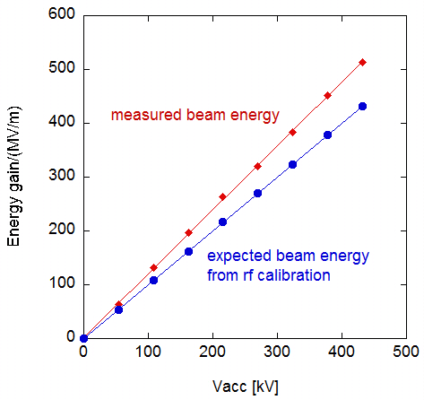
Energy calibration show a 5 to 15% energy deviation from rf calibration
Slide 16
D. Leitner, 28 July 2011
SRF’2011, Chicago

Slide 17
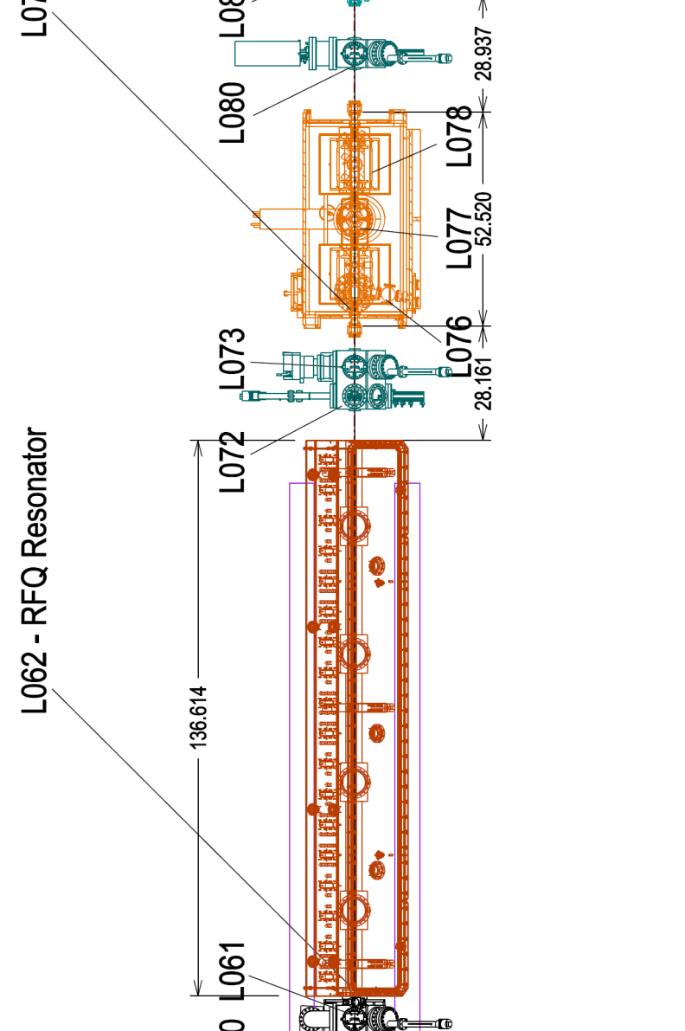
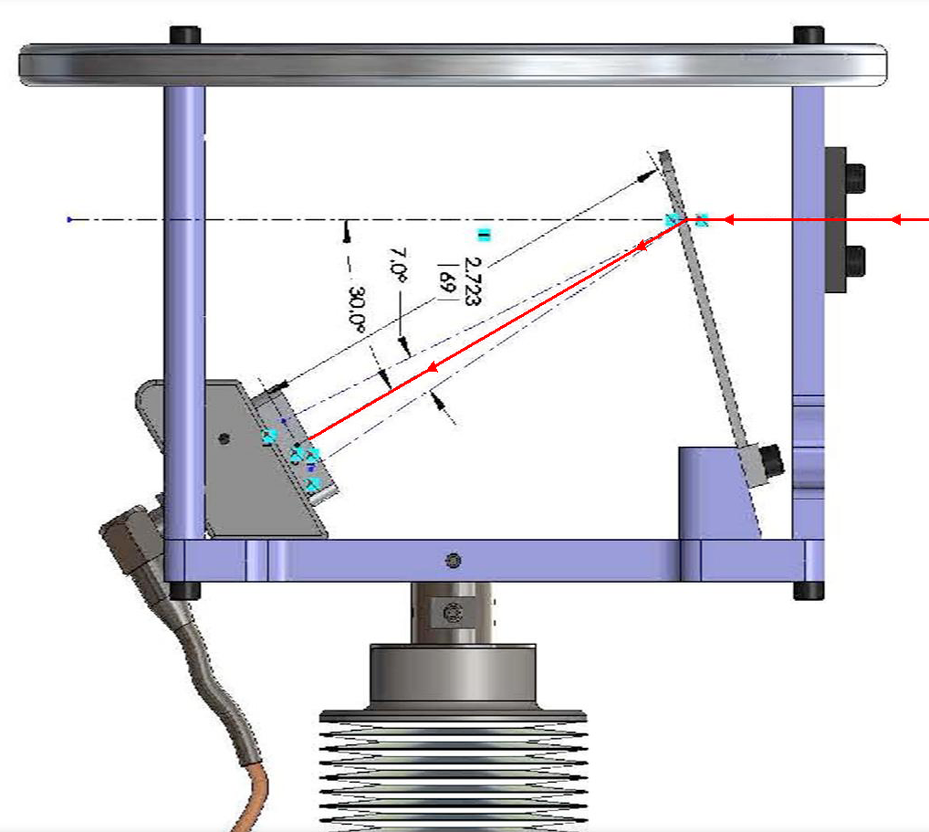
Accelerated Beam from ReA3 RFQ (Foil Silicon Detector)
Diagnostics
Beam
Diagnostics
RFQ
Slide 17
D. Leitner, 28 July 2011
SRF’2011, Chicago

Slide 18
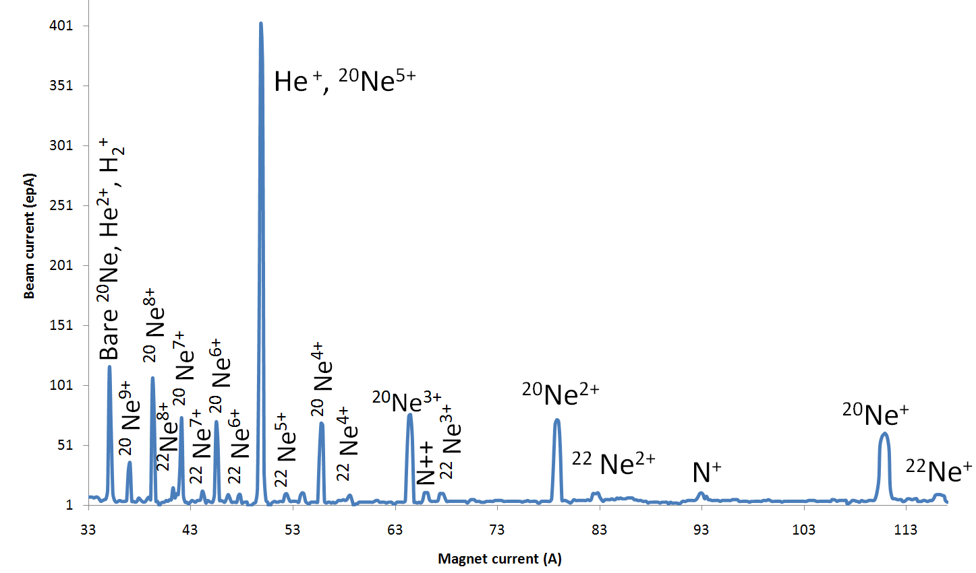
ReA3 – EBIT Charge Breeder Status
FC after mass analyzer
Further
accelerated
Neon gas was injected into the trap
Slide 18
D. Leitner, 28 July 2011
SRF’2011, Chicago
Notes:
Key parameters:
Magnetic field: B=6T,
Electron current: I_{e}=0.5 … 5 A,
Electron energy: E_{e} < 30 keV
Current density: j ~ 10⁴ A / cm²

Slide 19
Energy spectrum after CM2, only one cavity (L082) was energized for acceleration
L082 energized 22MV/m and 18MV/m
Acceleration of highly charge ions from EBIT (7/3/2011)
First demonstration of the complete accelerator!
Slide 19
D. Leitner, 28 July 2011
SRF’2011, Chicago
Notes:
Brad: Here is the first energy spectrum taken after the beam was accelerated through the RFQ and the second cryomodule.
The spectrum shown consists actually out of three spectra:
Spectrum #1: detector is retracted and the calibration source spectrum is taken 241Am
Spectrum #2: RFQ only, energy is 12 MeV, 600keV/u
Spectrum #3: RFQ+ one cavity: total energy roughly 20 MeV, the cavity was running at 22MV/m (or 133% of the nominal gradient specification for ReA3 of 16.5MV/m), for the smaller peak the same cavity was running at 18 MV/m
For the neon case we did not switch on the other cavities since we would have been out of range for the energy detector (we need to change the set-up so that we can see higher energies)

Slide 20
Stage1: ReA3 Project Scope
Installed
Pilot source (tuning of the LINAC for RIB)
Q/A
MHB
0.041 modules
RT RFQ
0.085 module
FY12
n+ rare
isotopes
1+ rare
isotopes
EBIT
ReA3 will start operating with the Coupled Cyclotron Facility 2013
ReA3 shares similar technologies as the FRIB driver LINAC
ReA3 is fully integrated into the FRIB design team
ReA3 provides data for the FRIB engineering, commissioning and installation planning, beam physics, and development of the control system
Slide 20
D. Leitner, 28 July 2011
SRF’2011, Chicago

Slide 21
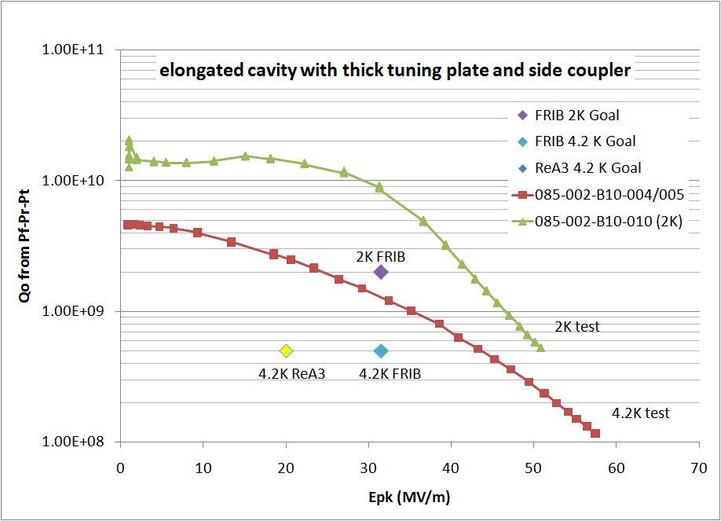
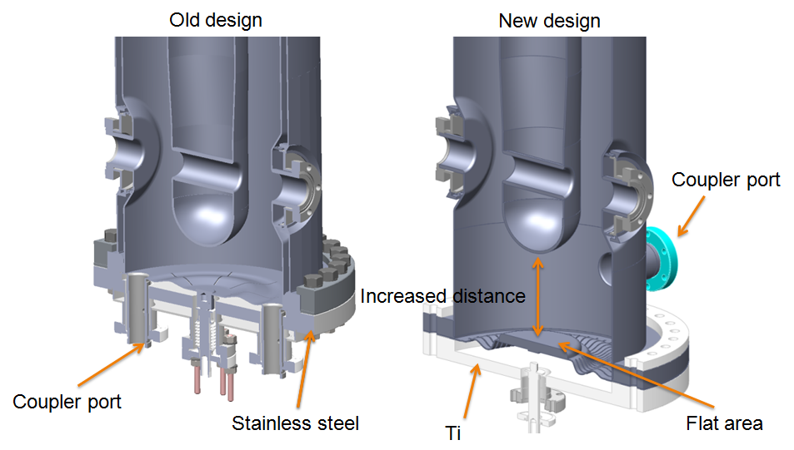
ReA3 Status of cryomodule 3 β=0.085 QWR
TUPO060
Old design modified to improve performance reliability
New design of the rf joint
Rf couplers moved to the side
Increased distance from inner conductor to tuning plate
Both ReA3 and FRIB requirements more than fulfilled in testing naked cavities with the new rf joint design and side coupler (3 tests in 2 cavities until now)

Slide 22
ReA3 Status of cryomodule 3 β=0.085 QWR
TUPO060
Old design modified to improve performance reliability
New design of the rf joint
Rf couplers moved to the side
Increased distance from inner conductor to tuning plate
Modification of cavities: January 2012
Cryomodule assembly : April 2012
Installation: July 2012
TUPO060: Dewar Testing of Beta = 0.085 Quarter Wave Resonators at MSU, J. Popielarski, A. Facco, W. Hartung, J. Wlodarczak

Slide 23
Summary
The ReAccelerator facility RεΑ is currently under commissioning at MSU
Constructed in 3 Phases: ReA3, ReA6, ReA12
First radioactive ion beam tests in 2012, limited user program with ReA3 is planned in 2013
ReA3 shares similar technologies as the FRIB driver LINAC
Commissioning is on track (Beam through the LINAC at nominal energies has been achieved, high charge state ion beam from the EBIT has been accelerated through the LINAC
First two cryomodules ß=0.041 work to specification
ß=0.085 cryomodule R&D: Both ReA3 and FRIB performance requirements were exceeded in recent cavity tests with the new rf joint design and side coupler (3 tests in 2 cavities until now)
ß=0.085 cryomodule installation July 2012
Slide 23
D. Leitner, 28 July 2011
SRF’2011, Chicago

Slide 24
Acknowledgement
The authors and the FRIB project thanks members of technical review teams that have provided feedback on this development effort and especially appreciate the invaluable contributions from collaborators in a weekly SRF teleconference: Curtis Crawford, Walter Hartung, Peter Kneisel, and Bob Laxdal.
The authors would like to acknowledge the colleagues at NSCL for the tremendous effort required to design, build, process, and test the ReA3 QWR’s and cryomodules as the design team continues to incorporate changes that will not only increase the reliability of the ReA3 project, but will serve to reinforce technology also being developed for FRIB.
Slide 24
D. Leitner, 28 July 2011
SRF’2011, Chicago

Slide 25
1st Stage: ReA3 Project Scope
MHB
Q/A
RFQ
CM 1
4.1%
Cryomodule 2
β=4.1%
Cryomodule 3
β=8.5%
Mass
separation
1+→n+
Gas
Stopper
CCF
A1900
> 50 MeV/u
Experiments
ReA3 will provide reaccelerated rare isotope beams with high efficiency for all beams and with full energy variability
Ion species | Q/A | Min. Energy (MeV/u) | Max. Energy (MeV/u)
H₂ - Ru | 0.3-0.5 | 0.3 | 4 – 6
Nb – Re | 0.33-0.4 | 0.3 | 4 – 5
Lu - U | 0.25 – 0.35 | 0.3 | 3 - 4
Slide 25
D. Leitner, 04 May 2011
201105 Diagnostics Peer Review

