Slide 1
SPL CAVITY DEVELOPMENT
G. Olry (IPN Orsay)

Slide 2
outline
Introduction
SPL layout
Working group
Beta=0.65 & Beta=1
RF design
Tuning system
Lorentz forces detuning
HOM studies
- RF coupler
Mechanical design of beta=1
Short-cryomodule
Poster MOP021: H-M. Gassot
Poster MOP034: J. Plouin
Poster TUP002: G. Devanz
Poster MOP040: W. Xu
Poster MOP059: W. Xu
Talk this morning THIOA06: O. Capatina
Poster MOP005: V. Parma
+ data from ESS/SPL collaboration meetings
Notes:
Cavité = souvent premier objet de R&D sur les projets d’accélérateurs

Slide 3
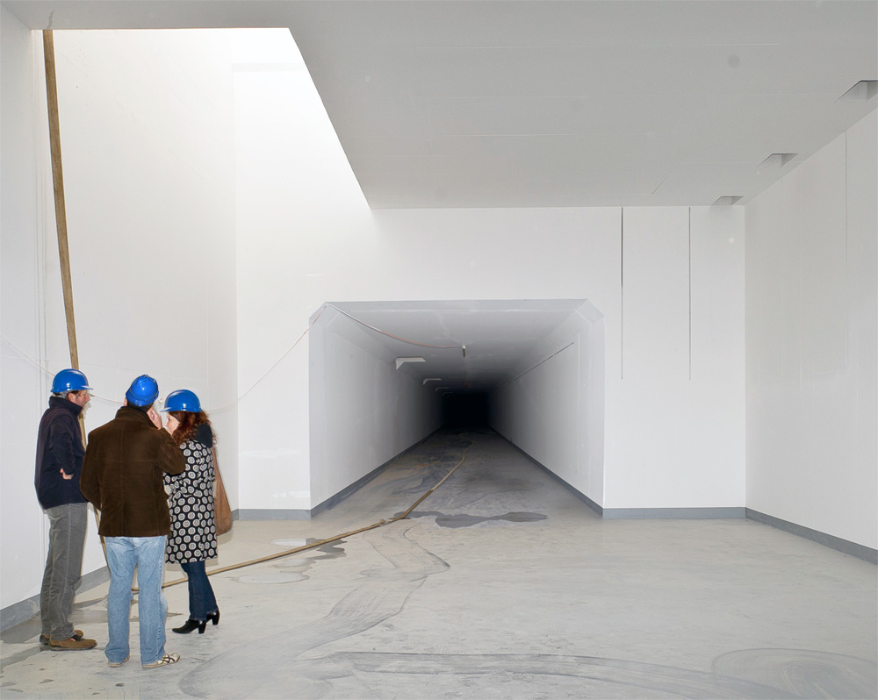
SPL layout
Entrance to new Linac 4 tunnel
~500m driver for new physics facilities @ CERN such as neutrinos and radioactive ion beams.
HP-SPL main beam characteristics : 5 GeV, 4 MW, 40 mA, 50Hz
SC cavities
60 beta 0.65, 704MHz, 5-cell elliptical cavities
184 beta=1, 704 MHZ, 5-cell elliptical cavities
Notes:
Cavité = souvent premier objet de R&D sur les projets d’accélérateurs

Slide 4
collaboration: who is doing what?
Beta 0.65
IPN Orsay: 1 cavity with Titanium Helium vessel
Beta 1.0
CEA/Saclay: 1 cavity with Titanium Helium vessel
Stainless Steel Helium vessels and tuning systems for the CERN cavities
CERN: 4 cavities with Stainless Steel vessels
2 ≠ RF coupler types
BNL: 1 « Universal » cavity
HOM
Rostock U.: HOM coupler design
Royal Holloway U. of London: Cavity-to-cavity coupling effects
BNL: Cavity-to-cavity coupling effects & HOM coupler design
SHORT-CRYOMODULE
CERN & IPN Orsay
Notes:
Cavité = souvent premier objet de R&D sur les projets d’accélérateurs

Slide 5
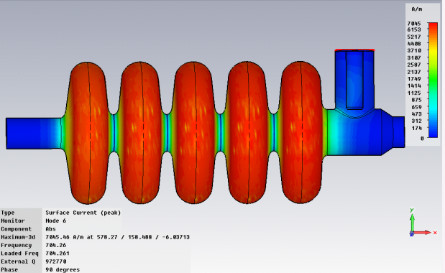
Beta 0.65
RF design
→ Operating gradient: 19 MV/m
Epk/Eacc<2.6 (<-> Epk=50 MV/m)
Bpk/Eacc<5.2 mT/(MV/m) (<-> Bpk=100 mT)
EM calculations
1/ in 2D with SUPERFISH
2/ in 3D with CST MWS → RF coupler integration
f (MHz) | 704.0
Epk/Eacc | 2.63
Bpk/Eacc (mT/MV/m) | 5.12
K (%) | 1.45
r/Q (Ohm) | 275
G (Ohm) | 197
Vacc @βg & 1 Joule (MV) | 1.11
Qo (@2K, Rres=2nΩ) | 3.9 10¹⁰
Transit Time Factor | 0.65
E field
Notes:
Cavité = souvent premier objet de R&D sur les projets d’accélérateurs

Slide 6
Beta 0.65
Poster MOP021: H-M. Gassot
Mechanical design
Von Mises stresses for 1.5 bar @ 300K < 50 MPa with 4mm
46 MPa
Cavity walls = 4mm
→ Niobium cost ~70 k€
Lorentz forces detuning factor : K_{L}~ -1.6 Hz/(MV/m)²
1 stiffening ring
94mm
beam axis
Notes:
Cavité = souvent premier objet de R&D sur les projets d’accélérateurs

Slide 7
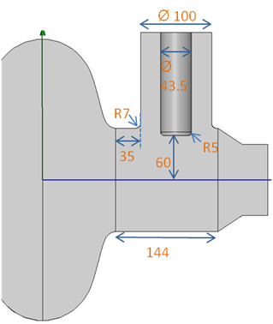
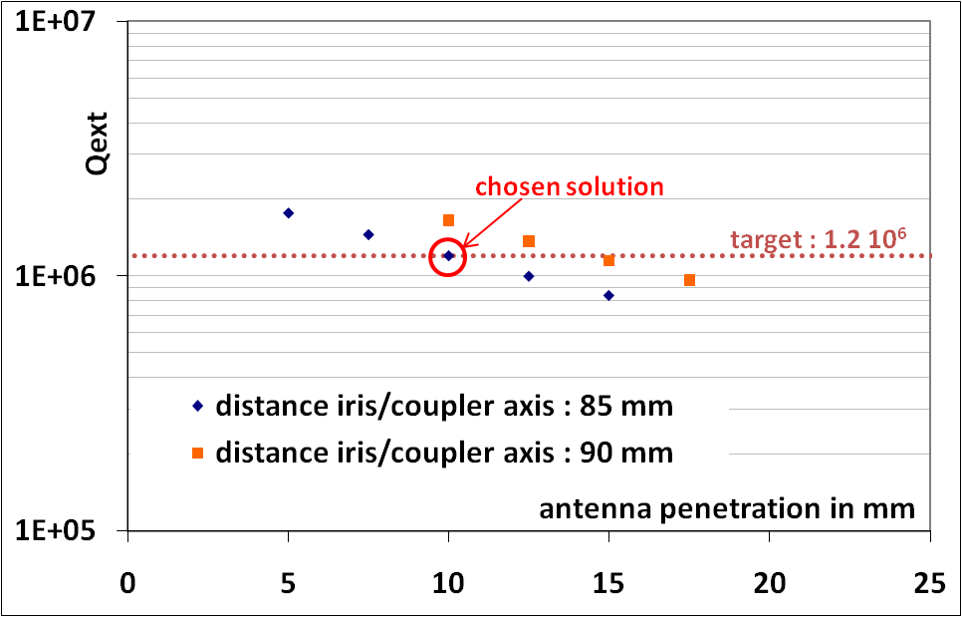
Beta=1
Poster MOP034: J. Plouin
RF design
→ Operating gradient: 25 MV/m
Epk/Eacc<2 (<-> Epk=50 MV/m)
Bpk/Eacc<4 mT/(MV/m) (<-> Bpk=100 mT)
EM calculations
1/ in 2D with SUPERFISH
2/ in 3D with HFSS→ RF coupler integration
Frequency [MHz] | 704.4
Bpk/Eacc [mT/(MV/m)] | 4.20
Epk/Eacc | 1.99
G [Ohm] | 270
Cell to cell coupling | 1.92 %
r/Q [Ohms] | 566
Lacc = Ngap.b.l/2 [m] | 1.0647
J. Plouin – High beta cavity for SPL- ESS/SPL collaboration meeting, Saclay, 30 june – 01 july 2011
Notes:
Cavité = souvent premier objet de R&D sur les projets d’accélérateurs

Slide 8
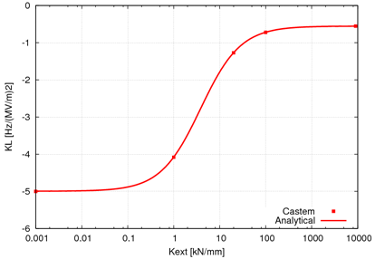
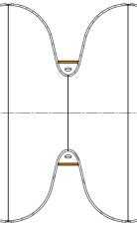
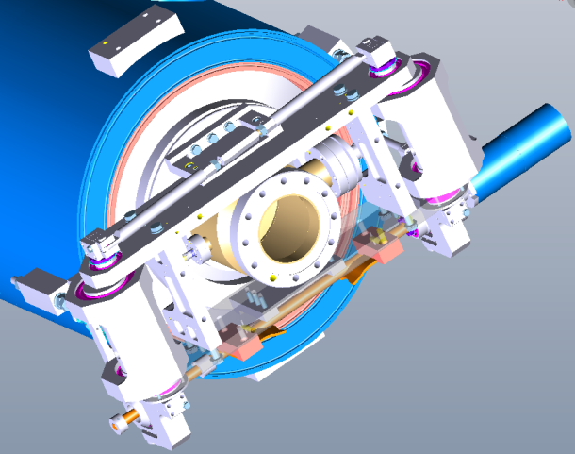
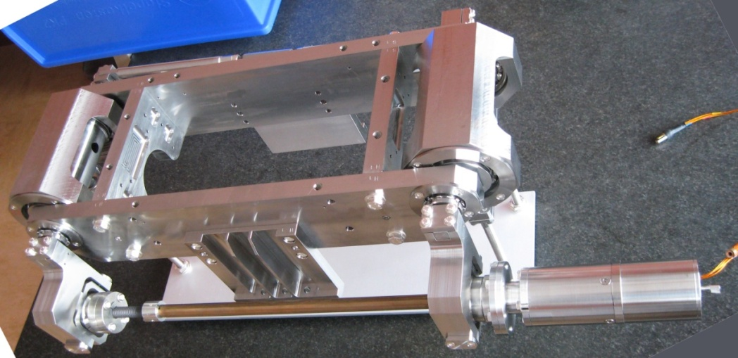
Beta=1
1 ring
Tuning system
Saclay V type with 1 piezo
Tuning sensitivity of 164 kHz/mm
Lorentz forces detuning factor : K_{L}~ -1.2 Hz/(MV/m)²
9 tuning systems delivered in May 2011
J. Plouin – High beta cavity for SPL- ESS/SPL collaboration meeting, Saclay, 30 june – 01 july 2011
Notes:
Cavité = souvent premier objet de R&D sur les projets d’accélérateurs

Slide 9
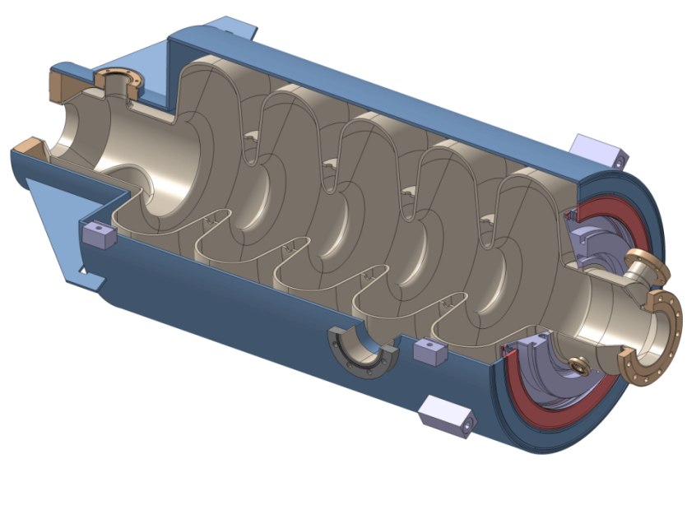
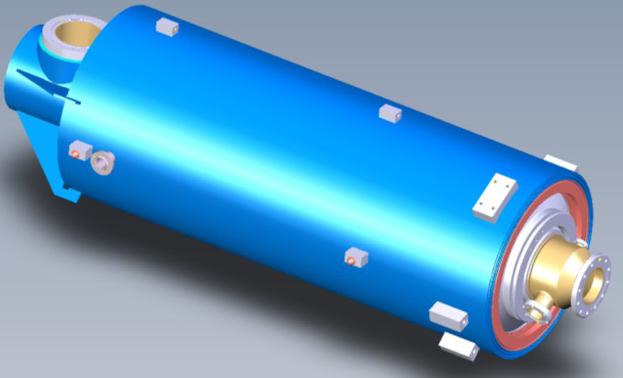
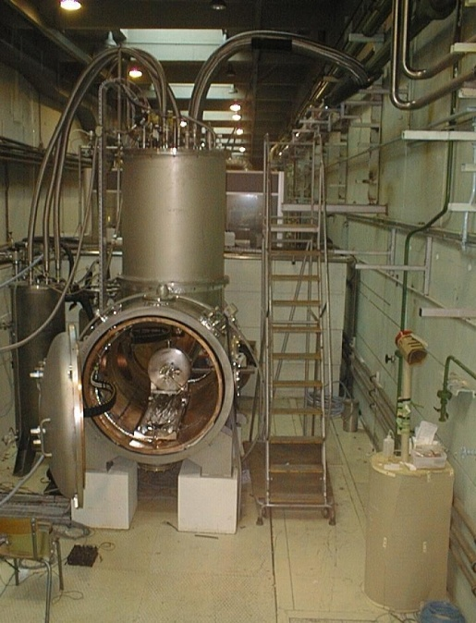
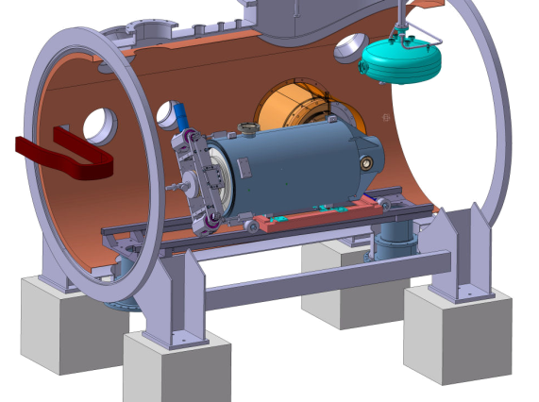
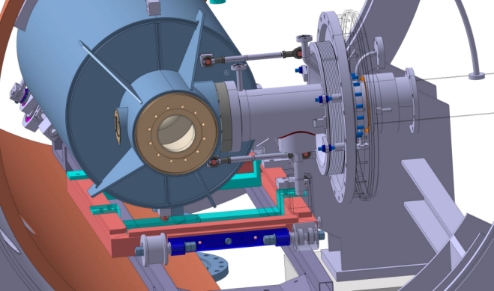
Beta 0.65 & Beta=1 common features
Orders: end of 2011
Same helium vessel design and same end-groups
Titanium He vessel
IPN Orsay beta 0.65
CEA Saclay beta=1
→ Final test in horizontal cryostat with the same auxiliary components (tuning system + RF coupler)
CRYHOLAB
Notes:
Cavité = souvent premier objet de R&D sur les projets d’accélérateurs

Slide 10
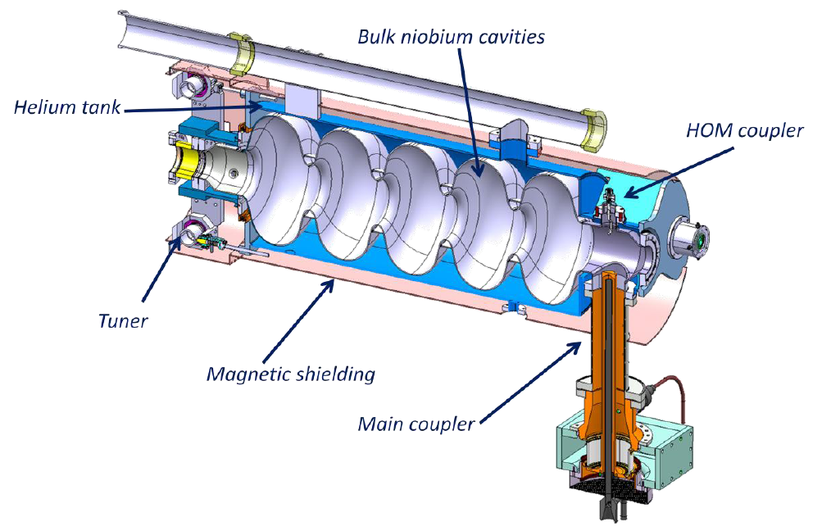
Beta=1
Talk this morning THIOA06: O. Capatina
Same RF design as the CEA Saclay beta=1 cavity
Notes:
Cavité = souvent premier objet de R&D sur les projets d’accélérateurs

Slide 11
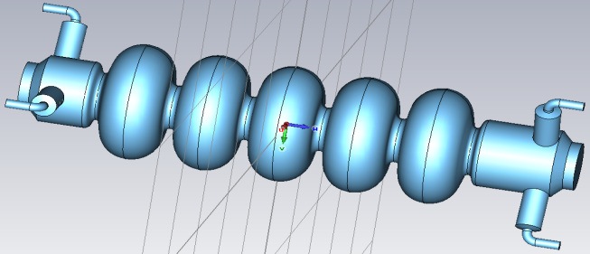
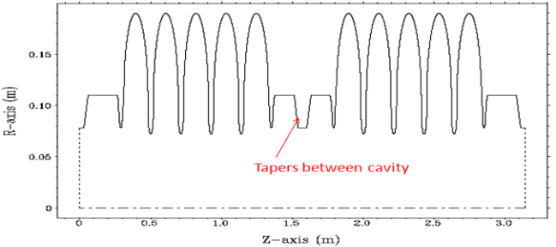
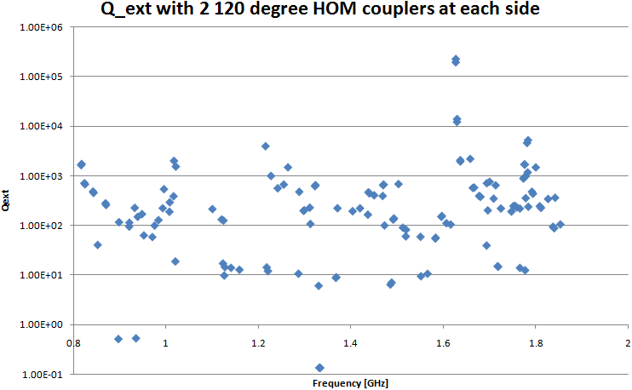
“universal” Beta=1
Poster MOP040: W. Xu
Poster MOP059: W. Xu
→For any kind of high current applications (e-, p, CW, pulsed...)
Fundamental mode: maximizing R/Q & G
HOMs damping optimizations:
very large beam tube aperture (up to 11cm),
6 HOM couplers (3/end-pipe)
tapers: avoid cavity-to-cavity coupling
→ propagation and power extraction of almost all monopole, dipole and quadrupole modes
Parameters | BNL3
Frequency [MHz] | 703.79
Number of cells | 5
Geometry factor [Ω] | 283
(R/Q)/Cavity [Ω] | 506.3
Epeak/Eacc | 2.46
Bpeak/Eacc [mT/MV/m] | 4.27
Coupling factor [%] | 3.02
10E+4
Q_{ext} of dipole HOMs.
Notes:
Cavité = souvent premier objet de R&D sur les projets d’accélérateurs

Slide 12
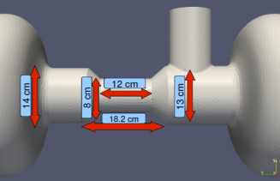
HOM studies
M. Schuh et al., Influence of Higher Order Modes on the Beam Stability in a High Power Superconducting Proton Linac, PRST-AB 14, 051001 (2011)
Beam-HOM interactions studies
Influence of parameters like HOM frequency spread, substructured pulses (=chopping patterns), cavity alignment, beam jitter…on long. and trans. planes stability
→No major effects on trans. plane
→Long. plane: chopping patterns could affect the beam
→HOM couplers are recommended with Qext<10⁵
Cavity-to-cavity coupling
Simulation on 4 beta=1 cavities
→ Check the influence of different taper geometries
Notes:
Cavité = souvent premier objet de R&D sur les projets d’accélérateurs

Slide 13
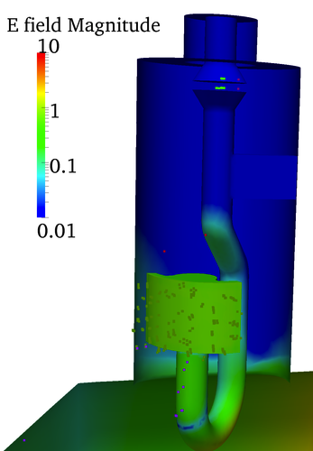
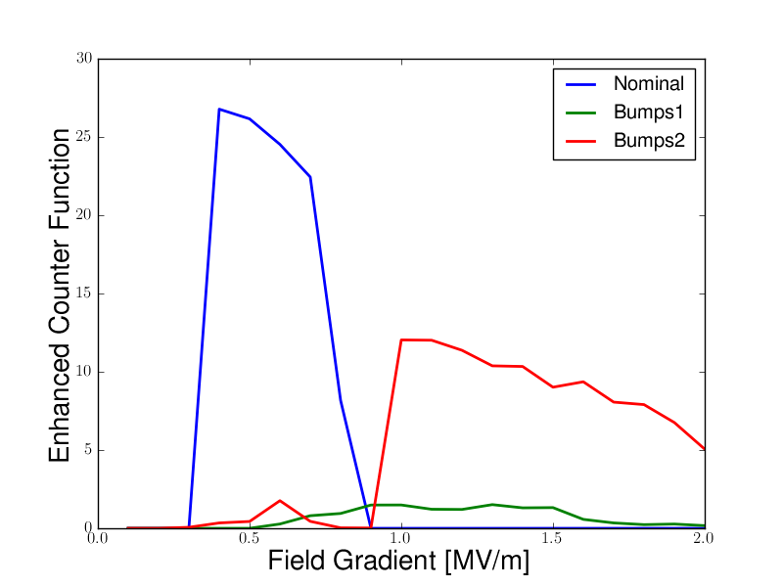
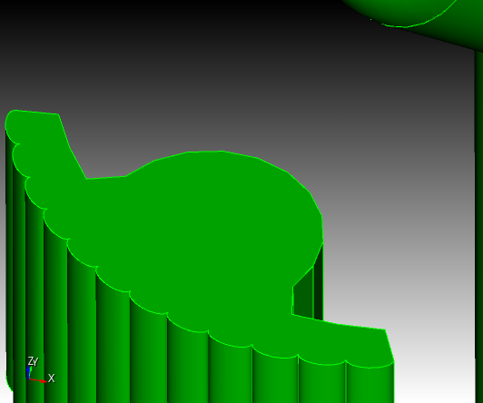
HOM studies
Multipacting (MP) simulations
Rostock 1st model shows MP barrier → geometry change (bumps)
H.-W. Glock, Universität Rostock
Notes:
Cavité = souvent premier objet de R&D sur les projets d’accélérateurs

Slide 14
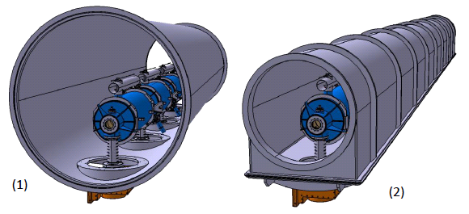
Short-cryomodule
Poster MOP005: V. Parma
Design and construct a ½-length cryomodule with 4 beta=1 cavities and auxiliary components (as close as possible to a machine-type cryomodule)
Test with all components assembled: mid-2014
Vacuum vessel alternatives
Cylindrical type (LHC like)
« Tunnel » type
V.Parma Joint ESS/SPL meeting, CEA, 30 June – 1 July 2011
Notes:
Cavité = souvent premier objet de R&D sur les projets d’accélérateurs

Slide 15
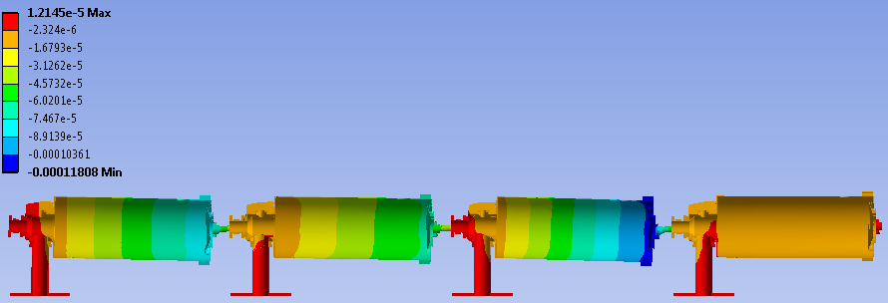
Short-cryomodule
Supporting scheme
→ RF coupler double-walled tube as cavity support
Intercavity supports
Last cavity support
RF coupler double-walled tube flange fixed to vacuum vessel
Self-weight vertical sagitta
Max: 0.12 mm
Body deformation amplified 300x
V.Parma Joint ESS/SPL meeting, CEA, 30 June – 1 July 2011
Notes:
Cavité = souvent premier objet de R&D sur les projets d’accélérateurs

Slide 16
acknowledgments
CEA Saclay: J. Plouin
CERN: O. Capatina, V. Parma
BNL: I. Ben-Zvi
Thank you for your attention

