Slide 1
HIE-ISOLDE Quarter Wave
Nb/Cu Cavity
M. Pasini, SRF2011 Chicago, Illinois, US

Slide 2
Overview
HIE-ISOLDE project
Choice of the geometrical parameters
RF design parameters
Steering compensation
Multipacting simulation
Nb Sputtering
First Tests results
New mechanical design
Cryomodule design
Summary
M. Pasini – SRF2011 Chicago, Illinois, US

Slide 3
The ISOLDE facility
M. Pasini – SRF2011 Chicago, Illinois, US

Slide 4
HIE-ISOLDE SC-linac
SC-linac between 1.2 and 10 MeV/u
32 SC QWR (20 @ β₀=10.3% and 12@ β₀=6.3%)
Energy fully variable; energy spread and bunch length are tunable. Average synchronous phase φ_{s}= -20 deg
2.5<A/q<4.5 limited by the room temperature cavity
16.02 m length (without matching section)
No ad-hoc longitudinal matching section (incorporated in the lattice)
New beam transfer line to the experimental stations
M. Pasini – SRF2011 Chicago, Illinois, US

Slide 5
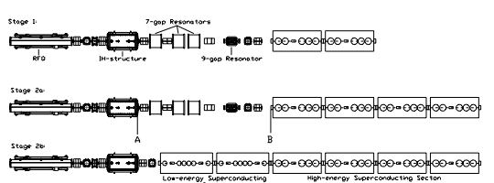
HIE-ISOLDE LINAC - layout
3 stages installation
1.2 MeV/u
3
MeV/u
5.5 MeV/u
8
MeV/u
10 MeV/u
M. Pasini – SRF2011 Chicago, Illinois, US

Slide 6
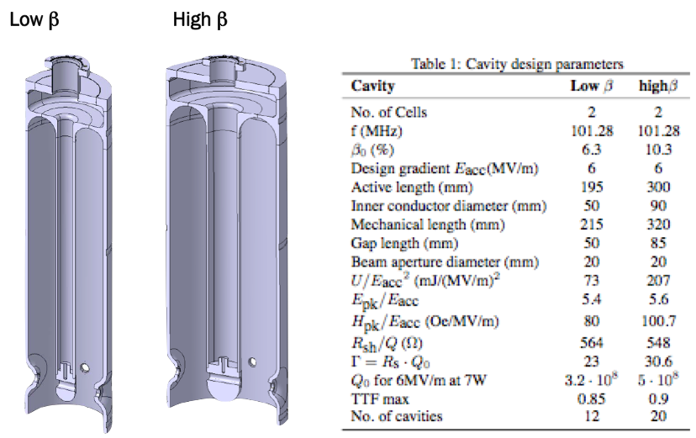
QWR cavities (Nb sputtered)
M. Pasini – SRF2011 Chicago, Illinois, US

Slide 7
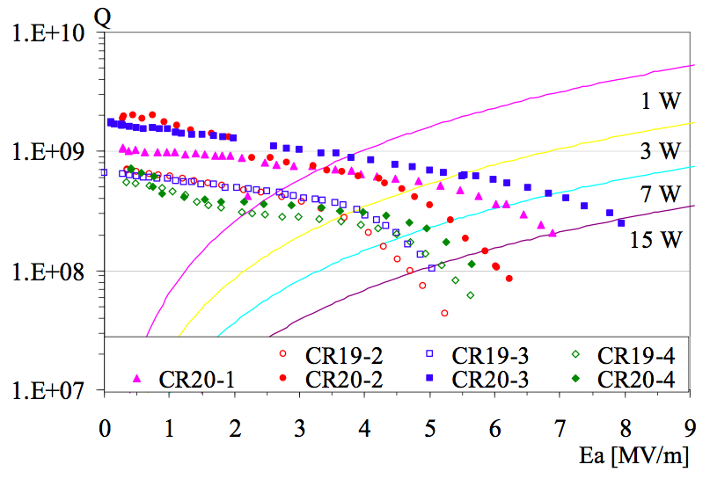
Choice of the gradient: 6 MV/m
A. Porcellato talk SRF2005
M. Pasini – SRF2011 Chicago, Illinois, US

Slide 8
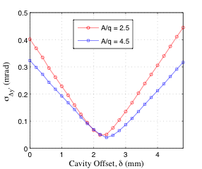
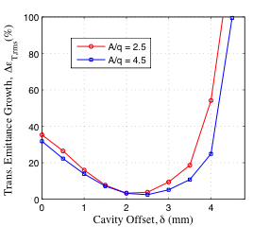
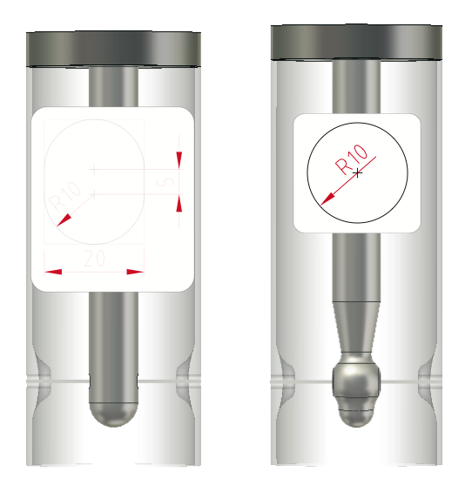
Optimisation of Beam Steering
Compensation
Optimised the Cavity Geometry for a Single Cavity Offset for all Cavities of a Given Family:
  FOR ALL BEAMS IN THE ACCEPTANCE: 2.5 < A/Q < 4.5
  MINIMISE EMITTANCE GROWTH
  MAXIMISE ACCEPTANCE ON OFFSET
  USE A RACETRACK SHAPED APERTURE IN THE HIGH BETA CAVITY:
OPTIMISATION ROUTINE
TRACK MULTIPARTICLE
SIMULATIONS
Courtesy of M. Fraser
M. Pasini – SRF2011 Chicago, Illinois, US

Slide 9
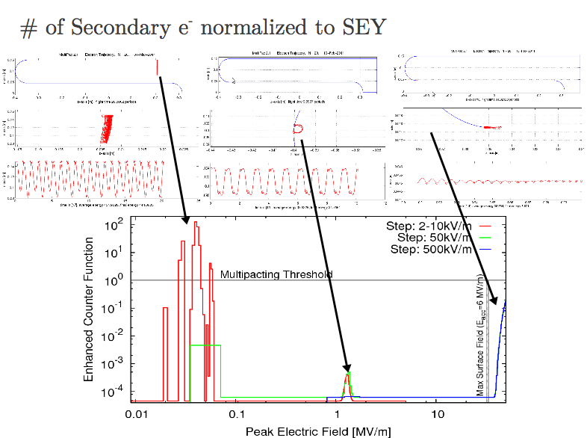
Multipacting simulations (2D)
Courtesy of C. Rama
M. Pasini – SRF2011 Chicago, Illinois, US

Slide 10
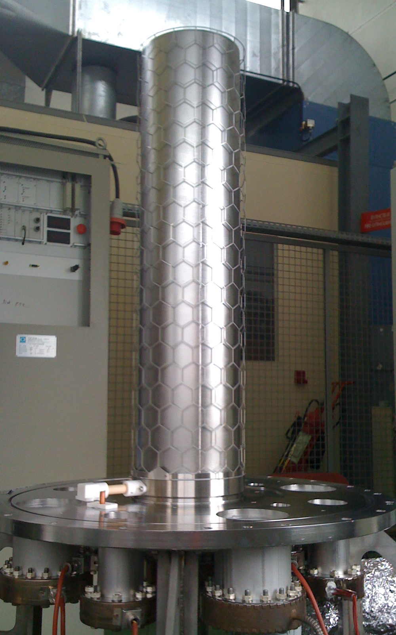
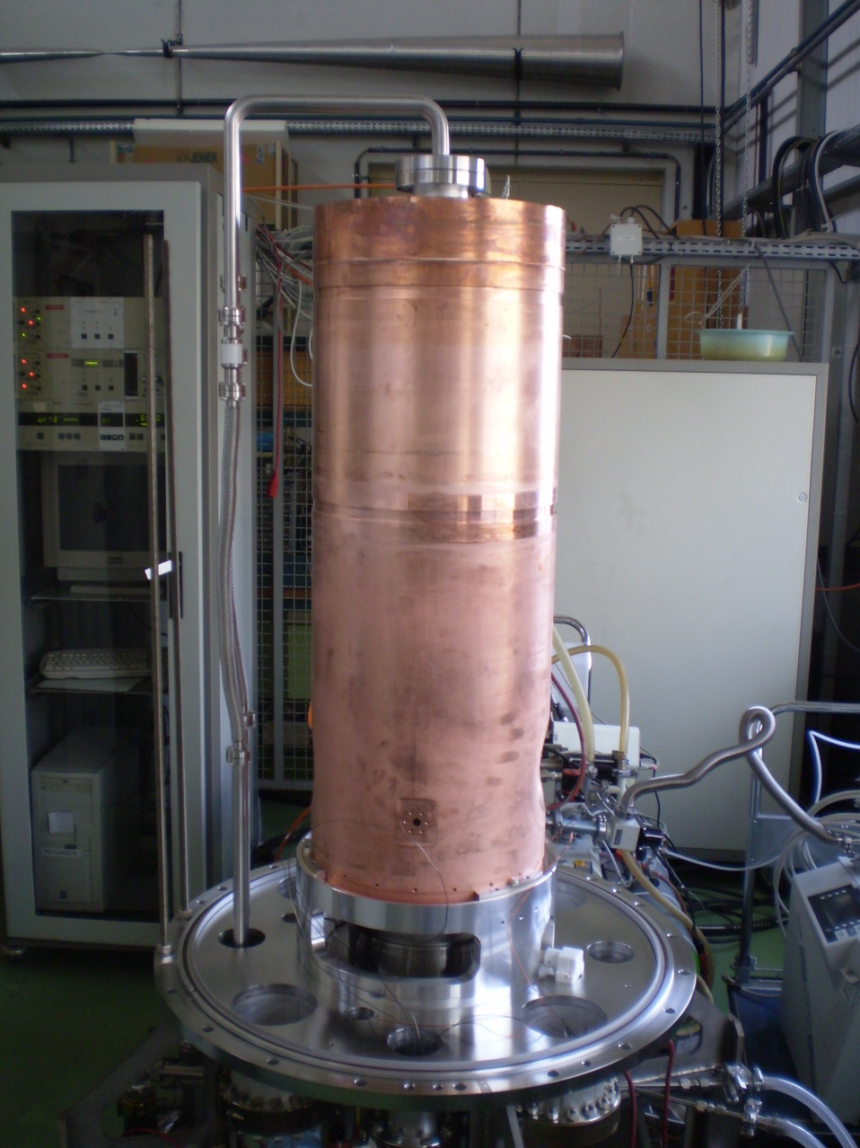
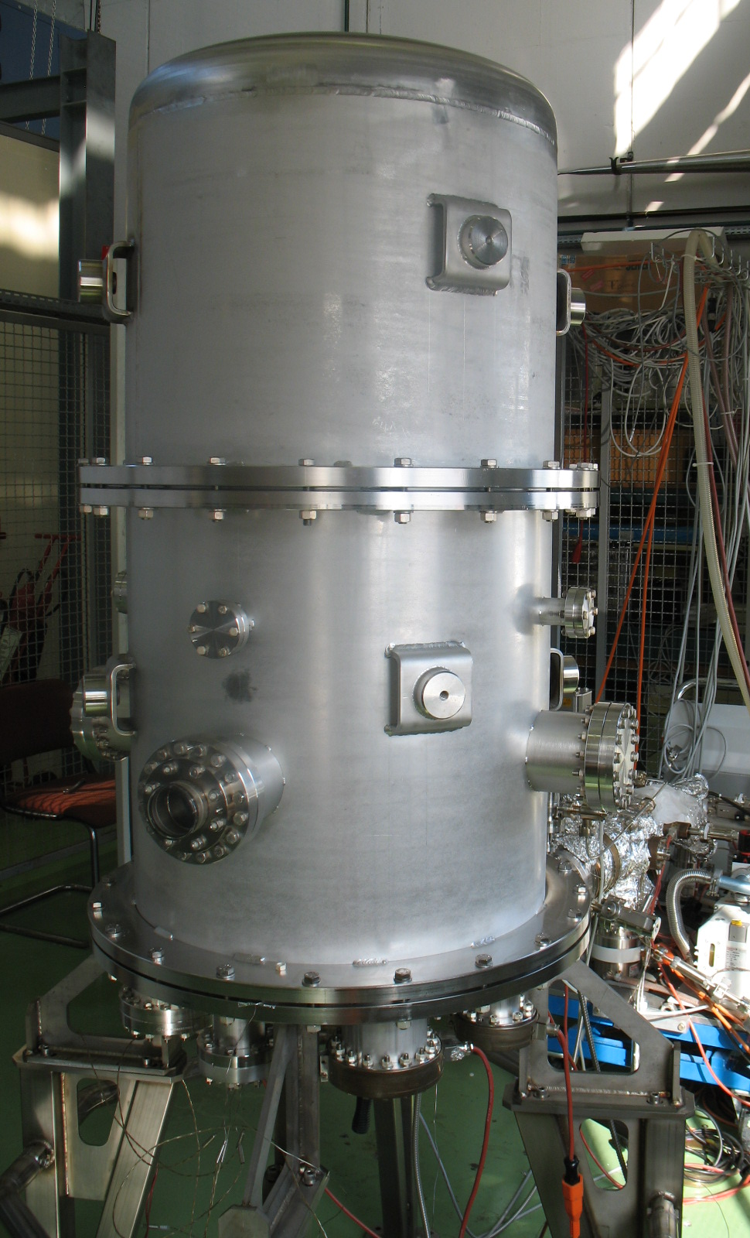
Nb sputtering (TUP067)
Courtesy of S. Calatroni
Diode and Magnetron sputtering
M. Pasini – SRF2011 Chicago, Illinois, US

Slide 11
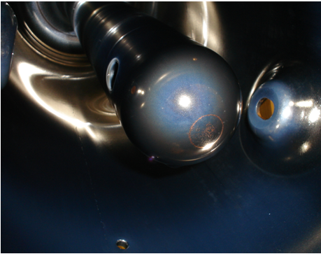
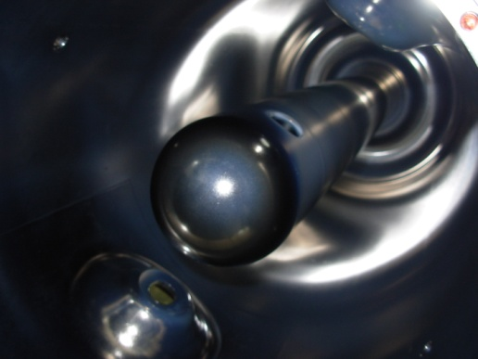
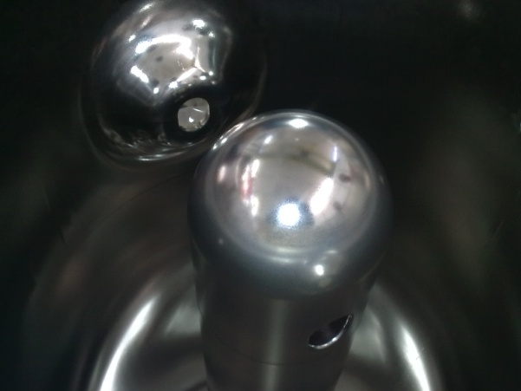
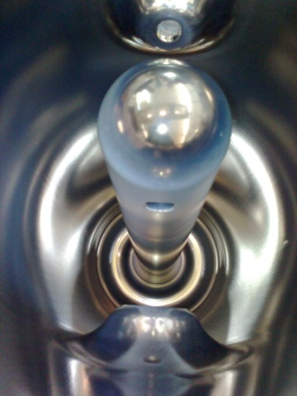
Nb Sputtering and RF Tests
Tested
UnTested
Q1.3 Magnetron
22.2.2010
Ion etching
None
Magnetron sputtering
Coating time= 8h20
P=1.5*10⁻² mbar
Cathode I= 3A; U=244V
Cavity I=3.24A; U=80V
Coil I=40A; U=50V
Tcavity=150°C
Q1.4 Magnetron
30.6.2010
Ion etching
During 10 min
P=3.6*10⁻² mbar
Cavity U=572V; I=0.76 A
Coil I=30A; U=34V
Magnetron sputtering
Coating time= 8h20
P=1.5*10⁻² mbar
Cathode I= 3A; U=244V
Cavity I=3.24A; U=80V
Coil I=40A; U=50V
Tcavity=150°C
Q1.5 Diode
15.4.2011
Ion etching
During 10 min
P=3.6*10⁻² mbar
Cavity U=540V; I=0.76 A
Coil I=30A; U=34V
Diode sputtering
Coating time= 38h
P=1.5*10⁻¹ mbar
Cathode I= 1.65A; U=450V
Cavity I=3A; U=80V
Tcavity=150°C
Q2.1 Magnetron
29.3.2011
Ion etching
During 10 min
P=3.6*10⁻² mbar
Cavity U=540V; I=0.76 A
Coil I=30A; U=34V
Magnetron sputtering
Coating time= 8h
P=8*10⁻³ mbar
Cathode I= 2.5A; U=360V
Cavity I=3.9A; U=80.4V
Coil I=30A; U=36V
Tcavity=150°C
HPWR 100 bar: OK
M. Pasini – SRF2011 Chicago, Illinois, US
Courtesy of S. Calatroni

Slide 12
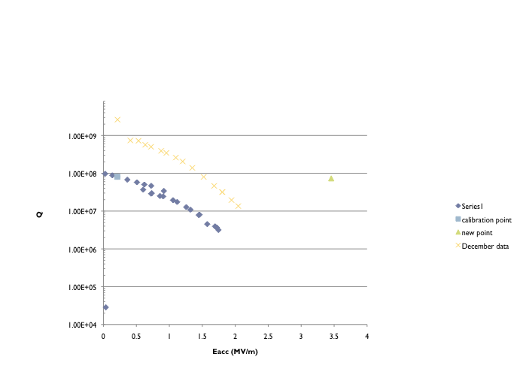
RF Test Results
October
Single point in March
February
6MV/m
M. Pasini – SRF2011 Chicago, Illinois, US

Slide 13
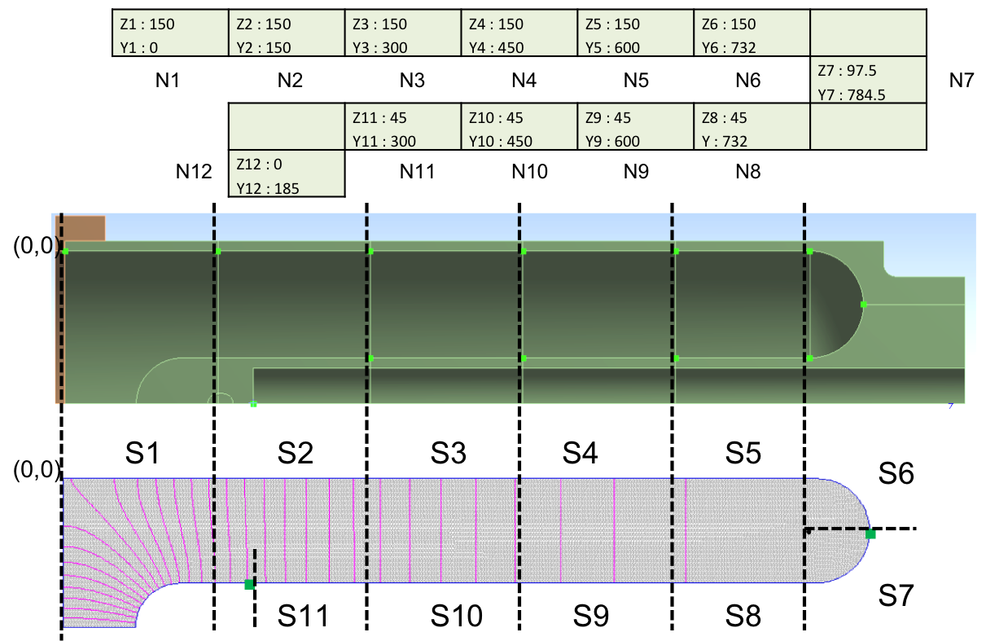
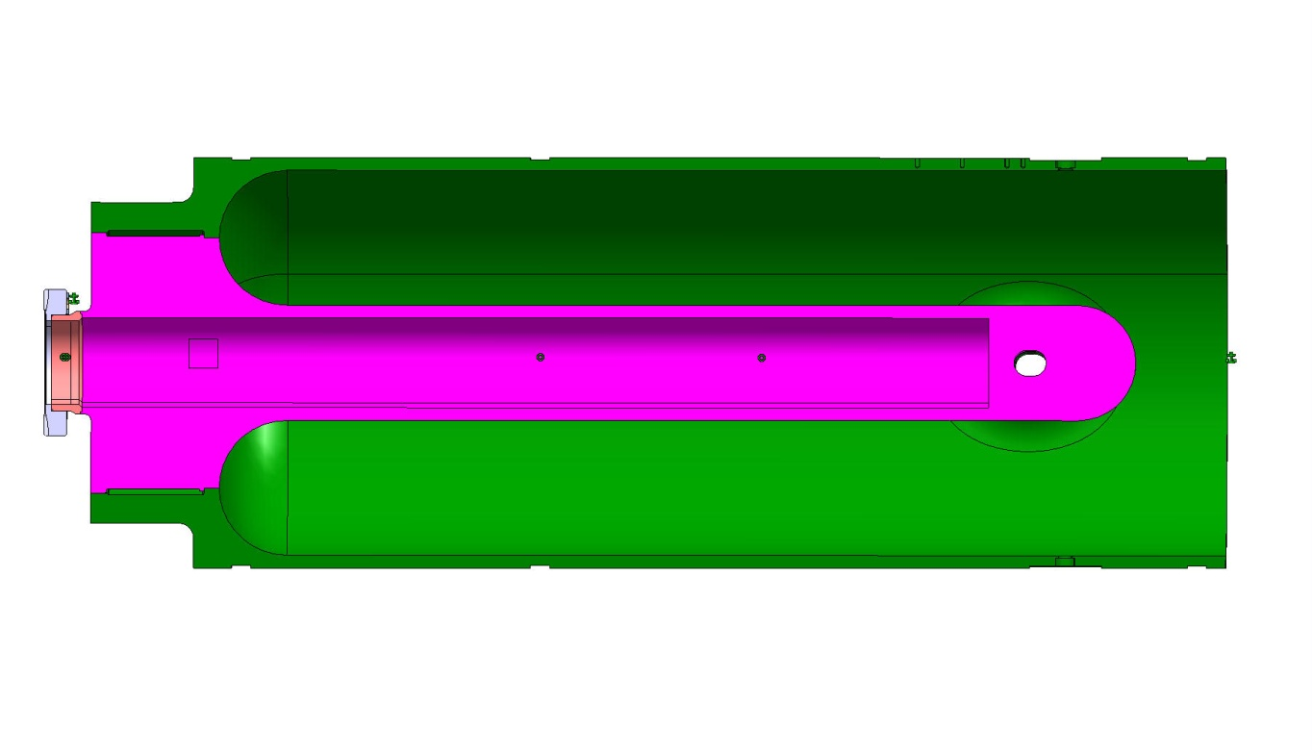
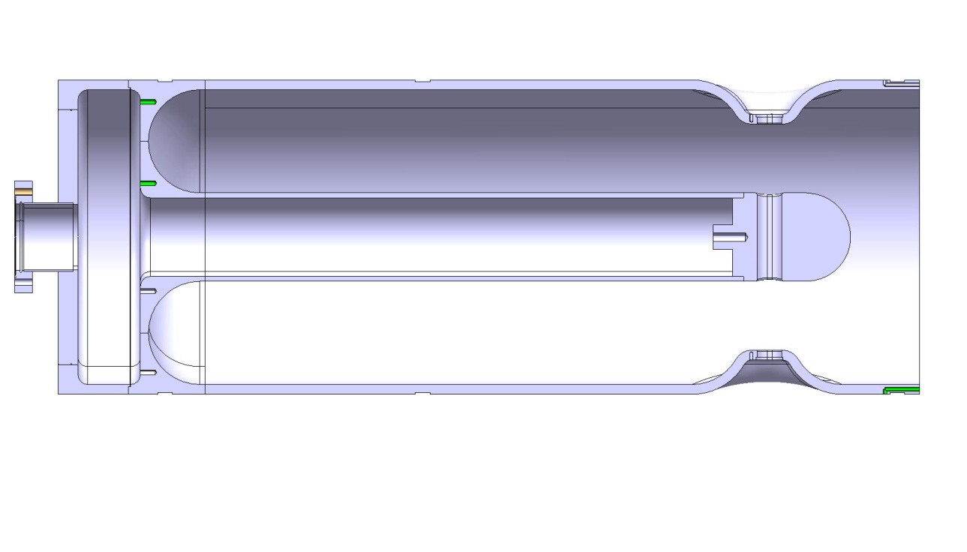
New mechanical design
Fron Ansys to SuperFish
Expected Pressure sensitivity of 0.01Hz/mbar
M. Pasini – SRF2011 Chicago, Illinois, US

Slide 14
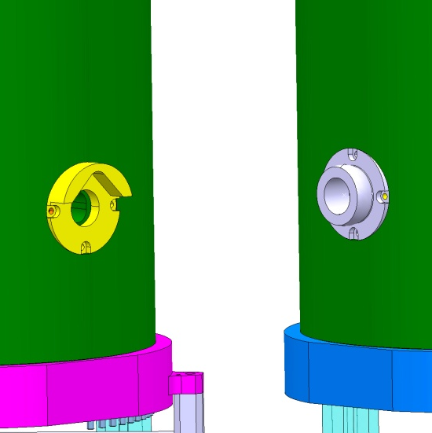
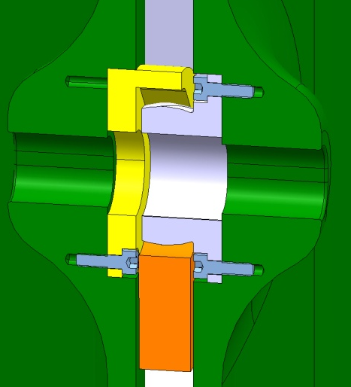
Cryomodule Design
Sphère
V de centrage
Courtesy of A. Bouzoud
M. Pasini – SRF2011 Chicago, Illinois, US

Slide 15
Summary
The project is ongoing: the development of the cavities is on the critical path and we need to get a good coating as soon as possible.
CERN has made an effort in updating a lot of the infrastructure that was dating back from the LEP cavities
Cryomodule design will be frozen by the end of the year
M. Pasini – SRF2011 Chicago, Illinois, US

Slide 16
Acknowledgments
HIE-ISOLDE design team: many CERN groups: RF, ABP, BI, VSC, MSC , CRG, MME and many others
External collaborators:
  INFN-LNL
  TRIUMF
  Cockcroft Institute
K.U.Leuven
ISOLDE collaboration
EU
Lund University
CERN

