Slide 1


Summary of the Symposium on Ingot Nb and New Results on Fundamental Studies of Large Grain Nb
Gianluigi Ciovati
Jefferson Lab

Slide 2
Outline
Part 1: Summary of the Symposium on Ingot Nb
  Multi-cell cavity fabrication and testing
  Sample measurements
    Superconducting properties
    Mechanical properties
    Thermal properties
  Studies of H in Nb
Part 2: New Results on Fundamental Studies of Large Grain Nb
  Studies on Q₀ improvement at E_{acc}≈20 MV/m
  Investigating RF “hotspots” with a laser beam
  RF measurements of Nb samples

Slide 3
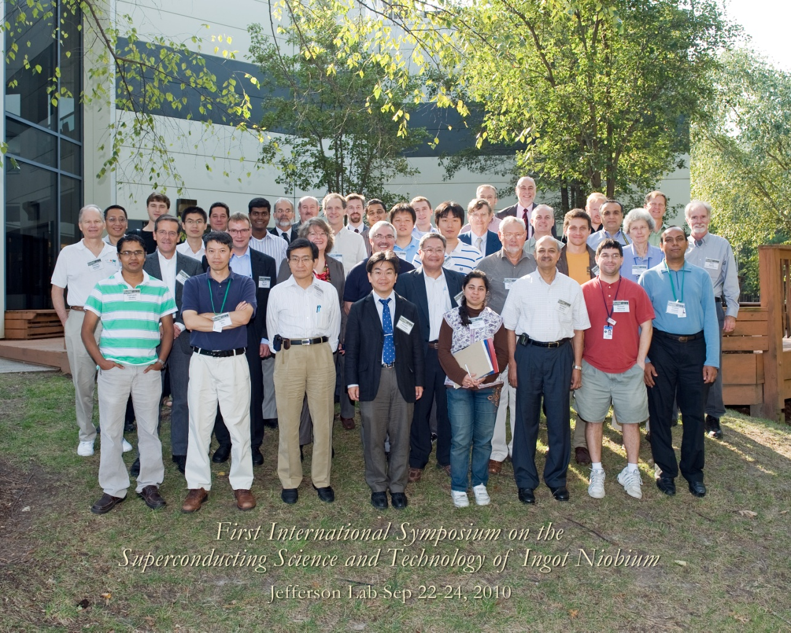
1st International Symposium on the Superconducting Science and Technology of Ingot Nb
Jefferson Lab, Newport News, Virginia, USA
September 22-24, 2010
57 participants from 15 universities/labs and 9 companies
Focus on the latest global developments on both technological and scientific aspects of ingot Nb related to SRF cavities

Slide 4
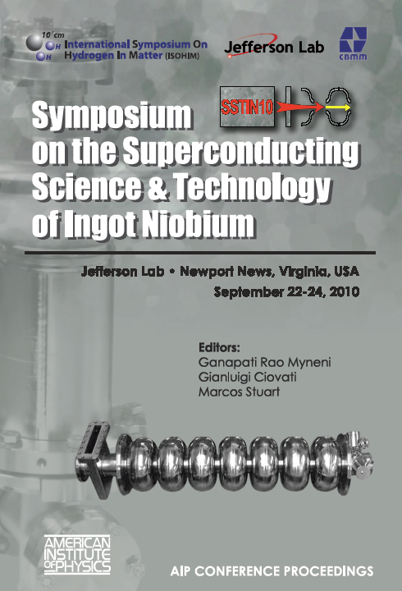
Proceedings are published
20 peer-reviewed articles
AIP Conference Proceedings 1352, (Melville, New York, 2011)

Slide 5
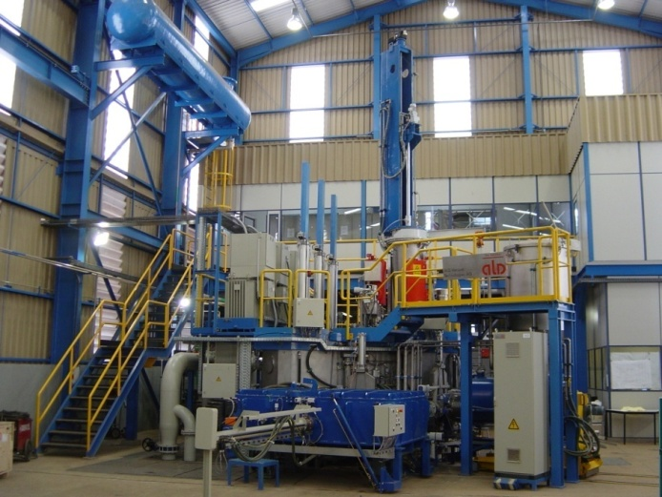
Ingot and Discs Production (1)
CBMM, Brazil
  New electron beam melting furnace to increase production (additional ∼150 ton/year)
  Production of high-purity Nb ingots with O, C, N < 10 wt-ppm, 530 wt-ppm < Ta < 1300 wt-ppm
L. de Moura et al, p. 69

Slide 6
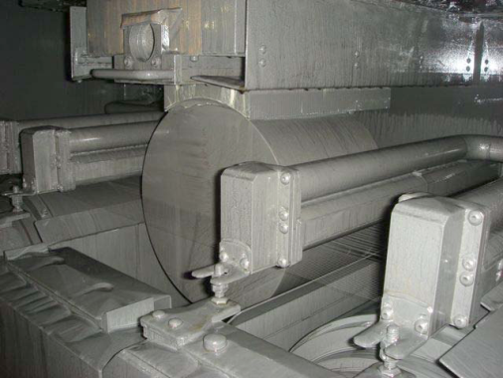
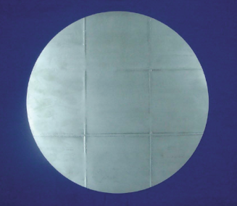
Ingot and Discs Production (2)
Tokyo-Denkai, Japan
  Installed multi-wire saw to cut multiple discs from Nb ingot
  Ultrasonic tomography of ingot
  Attempt to grow single-crystal ingot from welded single-crystal sheet as seed
H. Umezawa, p. 79

Slide 7
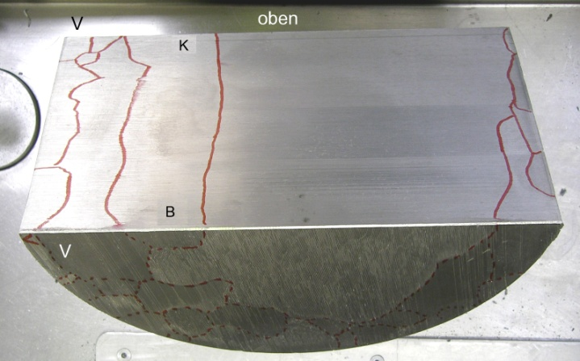
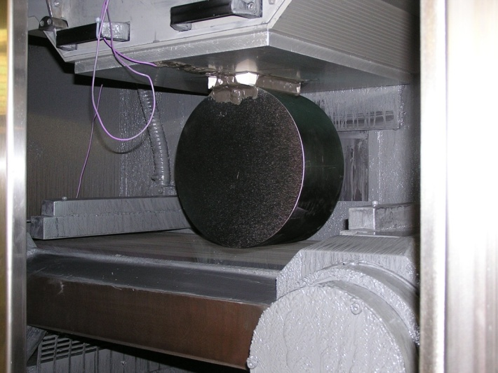
Ingot and Discs Production (3)
W. C. Heraeus
  R&D to produce a ∼2 m long ingot with a large (∼150 mm diameter) single-crystal in the center
  R&D on multi-wire saw machine
W. Singer et al, p. 13

Slide 8
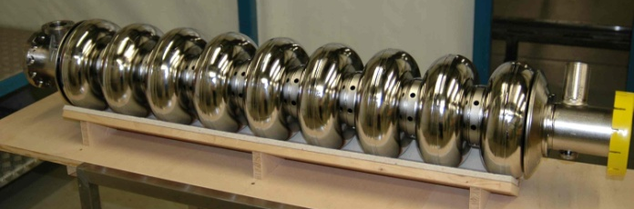

Cavity Fabrication and Testing (1)
Europe (DESY)
  Eleven 1.3 GHz 9-cell TESLA cavity built by ACCEL (now RI)
  Reproducible performance, E_{acc}=25-30 MV/m, BCP only
  E_{acc} further improved by ∼10 MV/m in 2 cavities after EP
  EPed cavities installed in two cryomodules in FLASH, operate at 27.5 and 33 MV/m
Large-grain 9-cell cavity: gradient world record! See poster by D. Reschke et al. TUPO046 this afternoon
XFEL
W. Singer et al, p. 13
D. Reschke et al., TUPO046

Slide 9
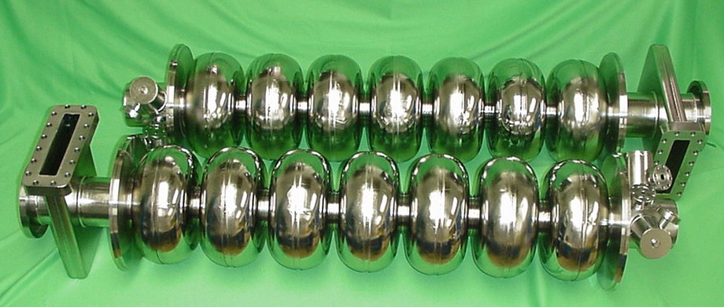
Cavity Fabrication and Testing (2)
Americas (Jefferson Lab)
  Built 8 multi-cell prototypes
  Problems with equator EBW in ∼1 weld/cavity limited performance
  High Q₀-values, low residual resistance
1497 MHz, 2.0 K
G. Ciovati et al, p. 25

Slide 10
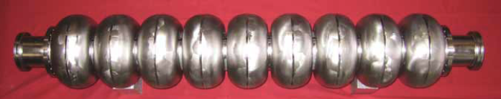
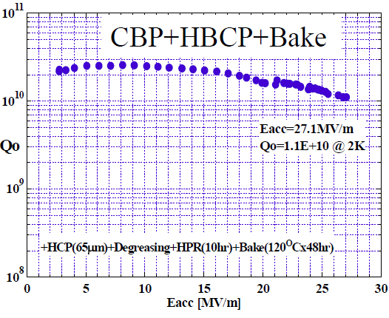
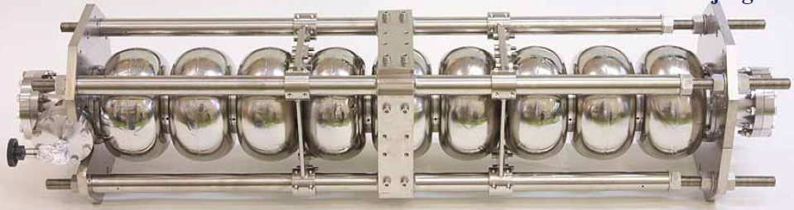
Cavity Fabrication and Testing (3)
Asia
KEK, Japan
  Built three 1.3 GHz Ichiro multi-cell prototypes
  Problems with equator EBW → change to inside weld configuration
  IHEP, China
  Built two 1.3 GHz Low-Loss multi-cell prototypes
  Tested one cavity at 2K, limited by field emission and quench at E_{acc}=20MV/m. EBW defect found at quench location
F. Furuta et al, p. 169
K. Saito et al., http://conferences.jlab.org/sstin/

Slide 11
Sample Measurements: SC Properties
DC magnetization and low-frequency penetration depth measurements on CBMM Nb samples of different purity were done at JLab:
  No significant dependence of H_{ffp} and H_{c2} on RRR-value or Ta content
  The low-frequency H_{ffp}-value at 2 K is significantly lower in BCP-treated than EP-treated samples (∼110 mT compared to ∼170 mT)
DC magnetization measurements on CBMM Nb samples done at RRCAT, India, confirm no significant dependence of critical fields on Ta content
A. Dhavale et al, p. 119
S. B. Roy et al., p.56

Slide 12
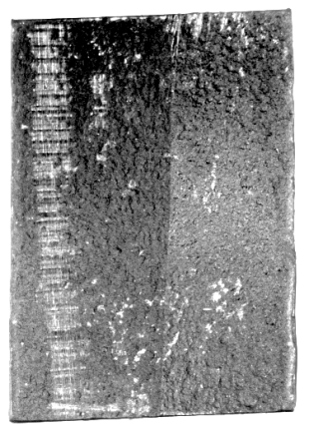
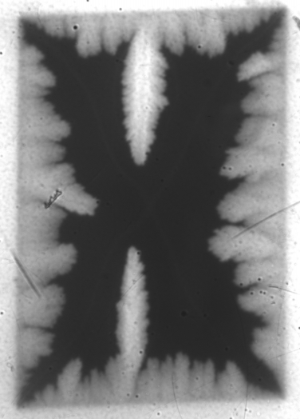
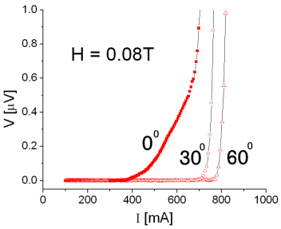
Sample Measurements: SC Properties
Magneto-optical imaging studies done at NHMFL/Florida State Univ. showed preferential flux penetration at a GB was clearly observed in the by-crystal samples when the grain boundary plane is close to parallel with the applied magnetic field
DC transport measurements showed evidence for flux flow across GB
  Highly sensitive to GB plane orientation wrt applied field
  Less marked in EP treated sample than BCP one
17.8⁰ GB
T=5.5K H=80 mT
A. Polyanskii et al, p. 186
Z. H. Sung et al., p. 142

Slide 13
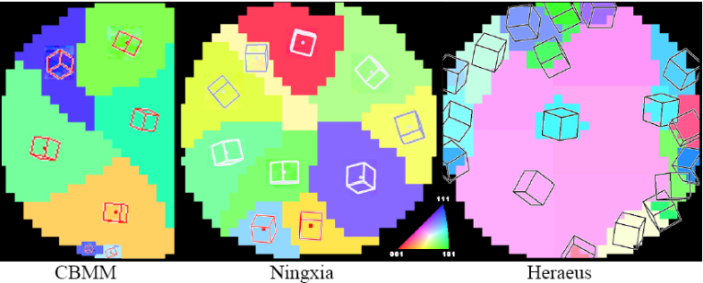
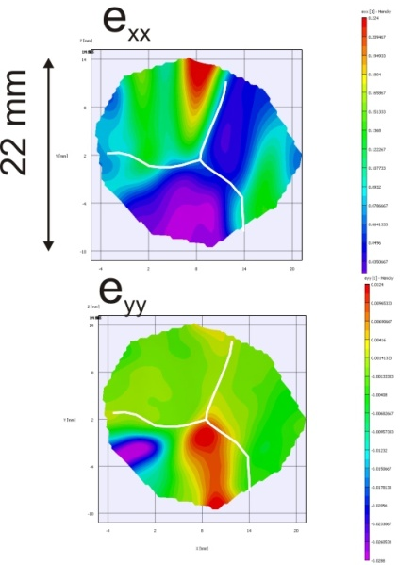
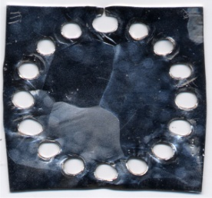
Sample Measurements: Mechanical Properties
Analysis of grain orientation from slices of Ingot from different companies done at MSU: no obvious commonalities or a preference for particular orientations
  Laue camera system developed for imaging full discs and/or half-cells
Studies are in progress at NIST to measure the local strain rate of tri-crystal plates subjected to multi-axial straining, → determine the slip systems which are locally active during the deformation
Di Kang et al, p. 90
T. Gnäupel-Herold et al., http://conferences.jlab.org/sstin/

Slide 14
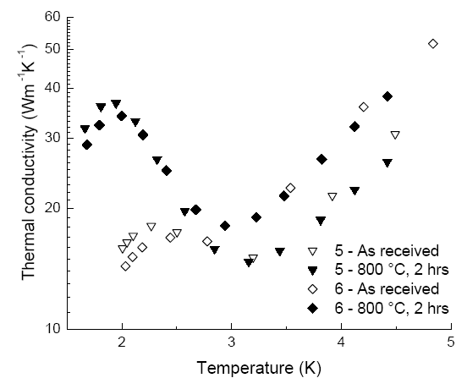
Sample Measurements: Thermal Properties
Thermal conductivity of CBMM Nb samples has been measured at MSU: strong phonon peak at 2 K after heat treatment, independent of Ta content
Similar results were measured at JLab
1322 ppm Ta
523 ppm Ta
S. K. Chandrasekaran et al., p. 131
A. Dhavale et al, p. 119

Slide 15
Studies of H in Nb (1)
NIST: basic thermodynamic evaluation of H absorption indicate that H uptake by Nb during processing is virtually unavoidable if water is present when processing conditions break the passivating surface film
NCSU: SIMS measurements show H level in Nb is greatly affected by the oxide layer
H
H
Nb
Nb
H
Nb
BCP
800°C/3h
HF rinse
R. E. Ricker and G. R. Myneni, p. 49 P. Maheshwari et al., p. 151

Slide 16
Studies of H in Nb (2)
A new quantum-mechanical model for a proton in Nb:
the proton at an interstitial site of a BCC lattice is treated as a wavefunction in a spherical potential well or radius a and depth V.
The well depth is the single parameter which is used to match the energy eigenvalues to the experimental activation energies for diffusion.
The calculation matches the experimental data with a resolution on the order of one hundred of an eV for H, D and T in Nb
Interactions among proton’s bound states with one another can lead to more complex electronic properties and possibly superconducting properties
Formation of a proton band within the metal → influence the magnetic and superconducting properties of the metal.
J. P. Wallace, p. 205

Slide 17
Some Discussion Topics
Is Ingot Nb the technology of choice for SRF cavities?
What are the essential specifications to request to Ingot manufacturers?

Slide 18
Part 2: New Results on Fundamental Studies of Large Grain Nb

Slide 19
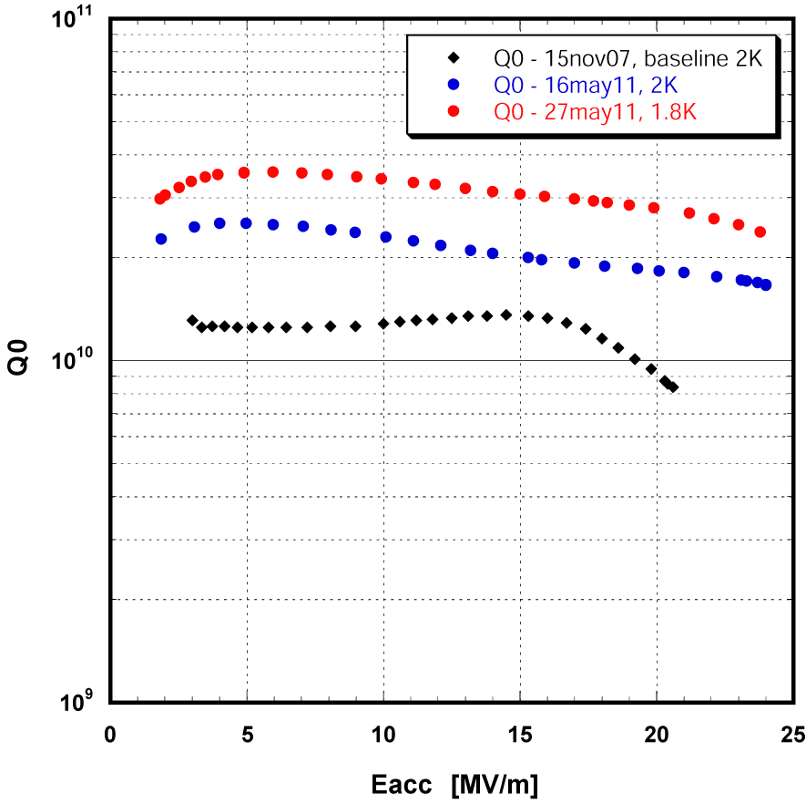
  Q₀ improvement at E_{acc}≈20 MV/m
Single-cell study
9-cell Cavities
Large-grain JLAB LG#1
CBMM material
∼30% improvement after heat treatment at 800°C– 1000 °C + 120°C/12 h
∼40% improvement by using ILC recipe on LG rather than FG Nb
Poster TUPO051 this afternoon
R. Geng et al., poster TUPO051 this afternoon

Slide 20

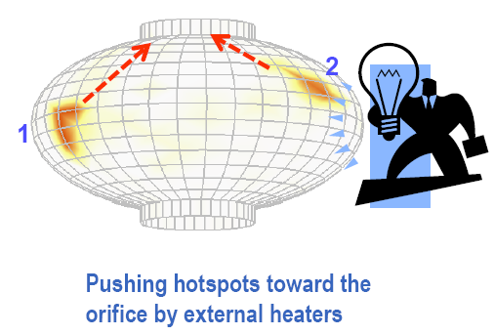
Breaking and moving hotspots with a laser beam
Eliminating vortex hotspots by thermal gradients
|∇T|_{c}≈1.7 K/mm
for Nb at 2 K
A. Gurevich, talk TU104 at SRF’07 Workshop, http://web5.pku.edu.cn/srf2007/home.html

Slide 21
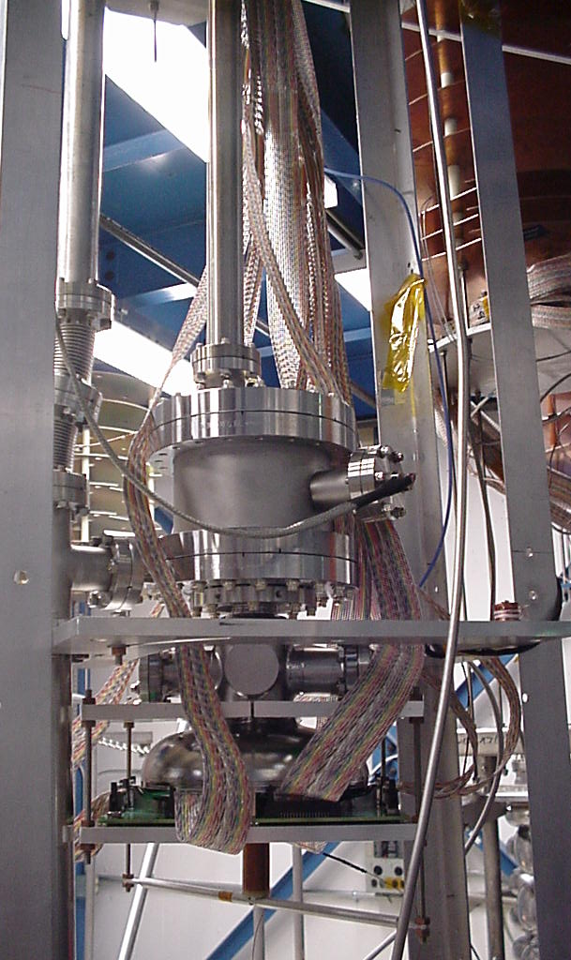
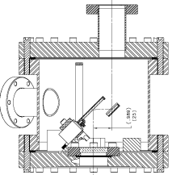
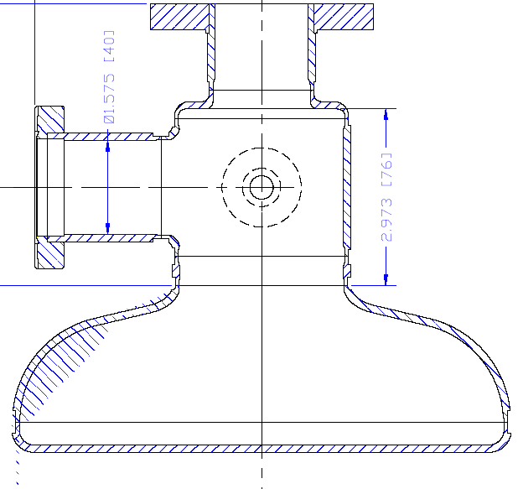
Laser Heating Experimental Setup
10 W laser
Mirror 2
Optical table
Positive lens
Attenuator box
Vacuum pipe
Mirror 1
Negative lens
Optical table
Nb Cavity
Cryostat

Slide 22
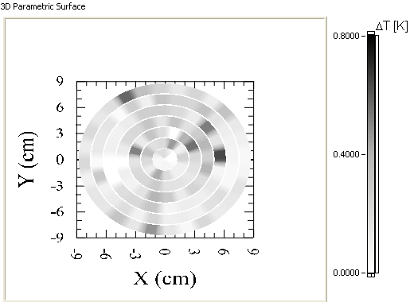
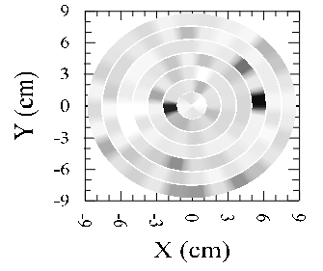
Initial Results
Baseline
After laser heating
Temperature maps at 2 K, B_{p}= 59 mT
Poster THPO016 on Thursday

Slide 23
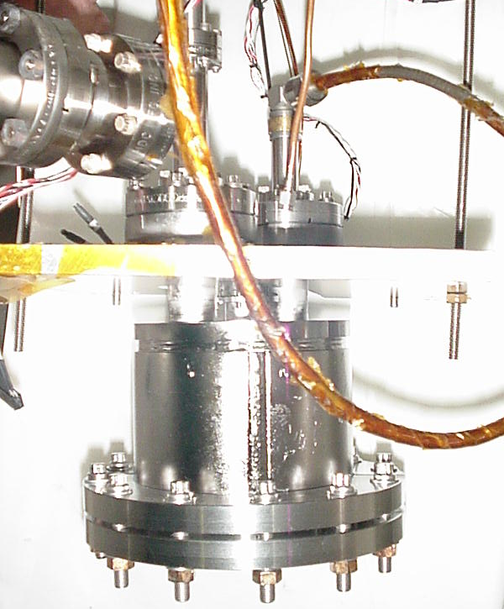
RF Measurements of Nb cylinders
Nb sample
120 mm
∅ 12 mm
Study correlations between DC, AC and RF superconducting properties
Limitation: He II critical heat flux at sample’s cooling channel
Can be used to study alternative materials to Nb
P. Dhakal et al., poster THPO057 on Thursday
P. Dhakal et al, THPO057

Slide 24
Summary
The large-grain Nb technology has been fully demonstrated at DESY with the installation of two 9-cell cavities in cryomodules in FLASH
Several studies now show that Ta content up to ∼1300 ppm does not degrade superconducting properties of Nb
A new quantum-mechanical model for H in Nb has been presented which can be the basis for theoretical studies of Nb-H systems
Flux penetration and flux flow at GB in Nb can occur but it’s not clear the difference between fine-grain and large-grain material
Large-grain Nb seems to be promising for CW SRF applications
The next Symposium will be combined with the 2nd International Workshop on Accelerator-Driven Sub-Critical Systems (ADS) in Mumbai, India, December 11-14, 2011

Slide 25
Acknowledgements
Thanks to all the participants of the Symposium!
Thank you for your attention

