Slide 1
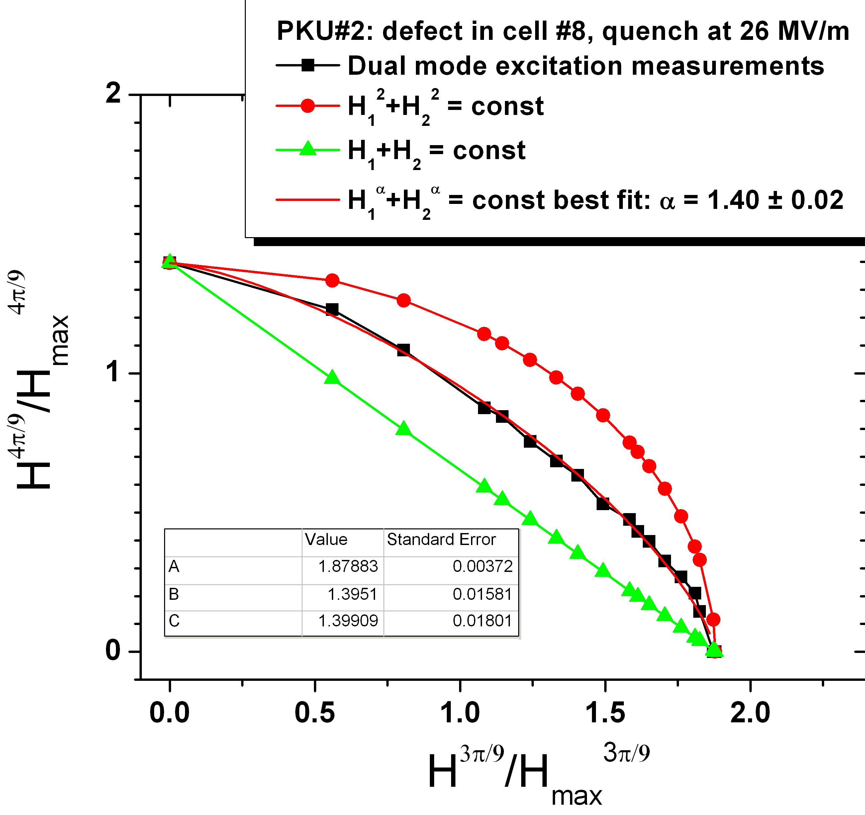
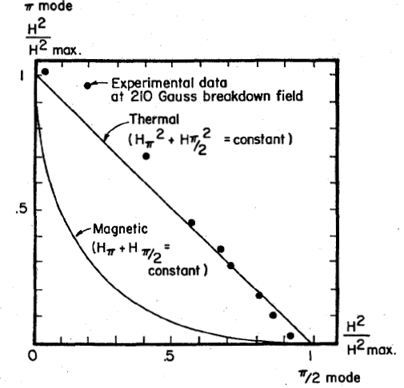
Understanding of Thermal and Magneto-Thermal Quench
Experimental data
Experimental data
Thermal breakdown
Courtesy H. Padamsee
Magneto-Thermal breakdown
Courtesy G. Eremeev

