Slide 1
Athmospheric Surface Treatments for improving 6Ghz Niobium cavities
V. Palmieri, A. Rossi, K. Atroshchenko, D. Rizetto, A. Camacho, S.Yu. Stark
*
INFN – Legnaro National Laboratories
University of Padua

Slide 2
Bulk Nb
6 Ghz @4,2K

Slide 3
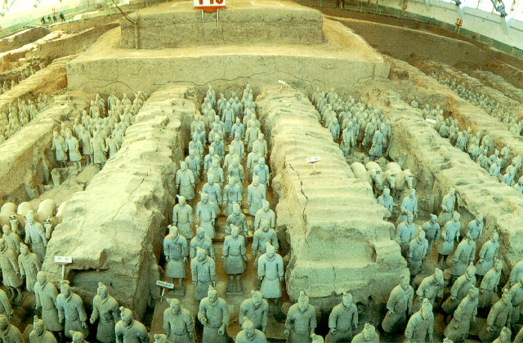
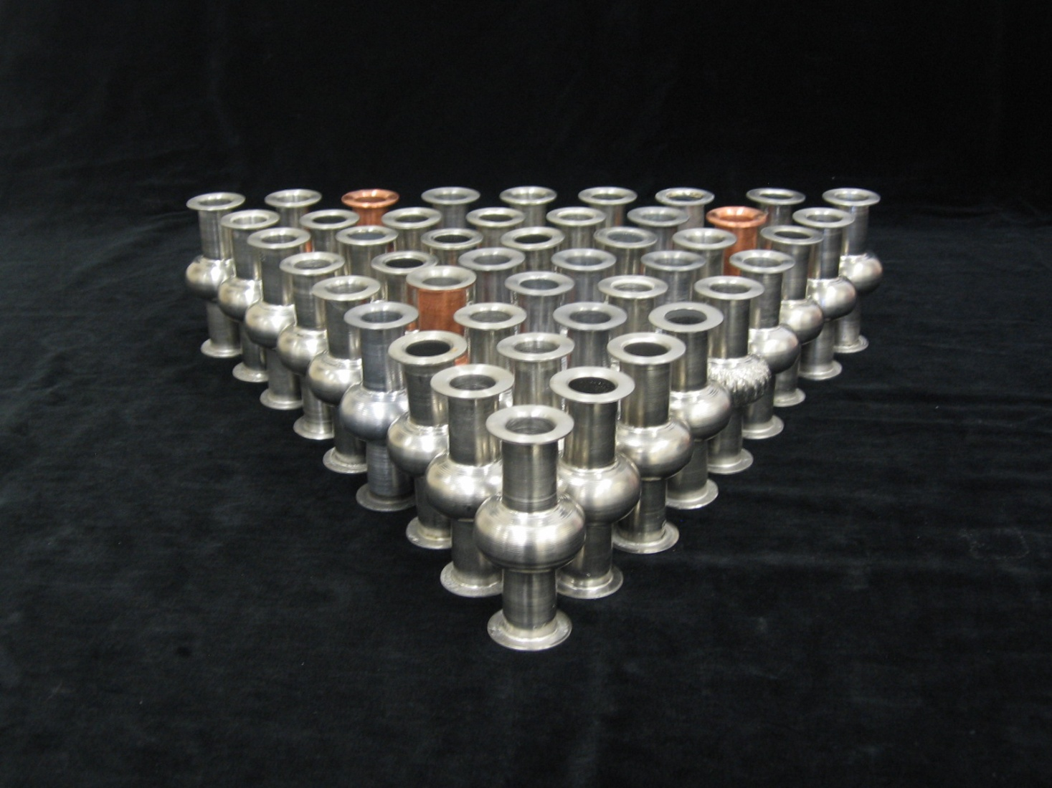
Low research budget → Large amount of cavities
6 GHz

Slide 4
Samples Pillbox cavities, etc Real cavities
Calorimetric methods
6 GHz cavities
Resistive
R_{S} Differential measurements
1,5 /1,3 GHz monocells
Inductive
H_{c1} Measurement
Microstrip Resonators
1,3 GHz 3-cell cavity
1,3 GHz 9-cell cavities

Slide 5
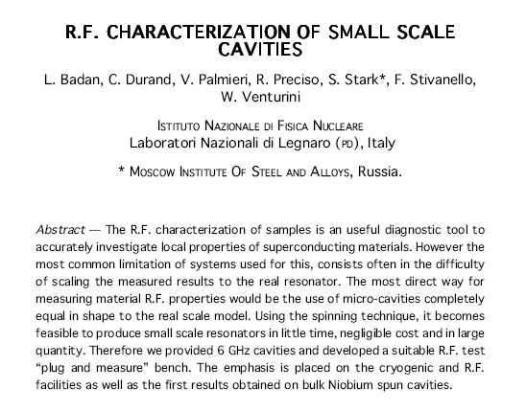
Proceedings of the 8th SRF Workshop, Abano Terme, 1997

Slide 6


Antonio₃ Rossi
L
L
M
Antonio₃ Rossi
Antonio₃ Rossi

Slide 7
6 GHz CAVITY MINILAB
No electron beam welding, neither for flanges
Obtained by spinning from Nb scraps
Short fabrication time
Fast and low cost BCP and EP treatments
Inexpensive Cryogenics
Quick RF Measurements

Slide 8
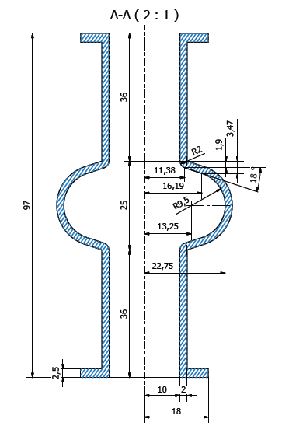
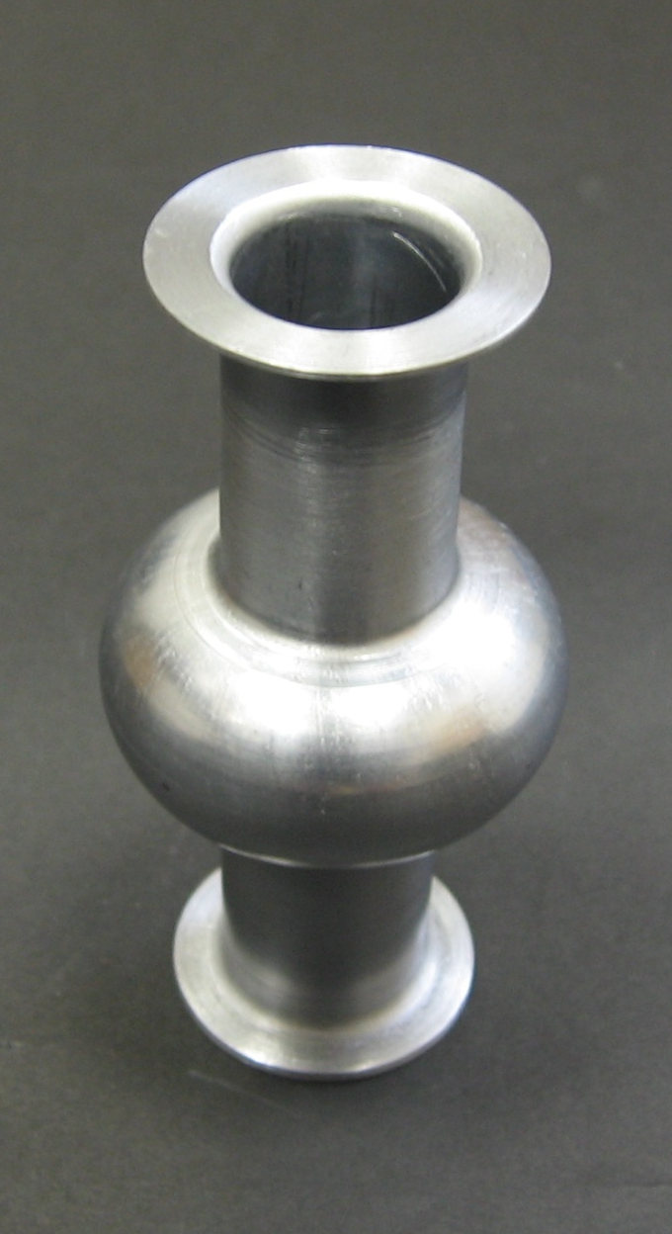
6 Ghz Cavity Geometry
36 mm
Seamless flanges
20 mm
[mm]
Flange Area = 7 cm²
Notes:
Modifica quote lunghezza cavità: cut off e cella

Slide 10
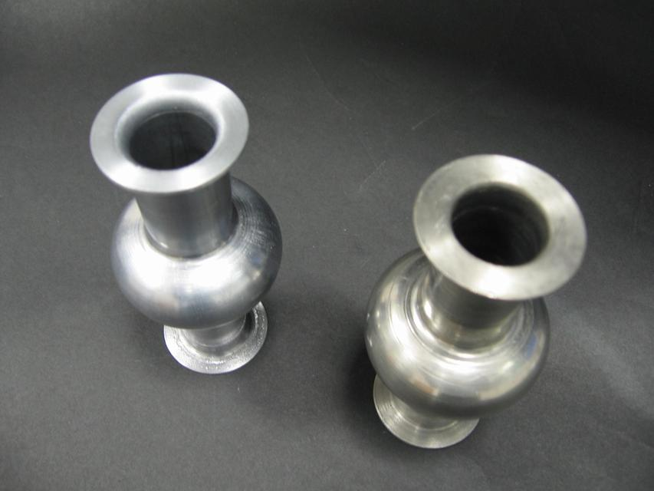
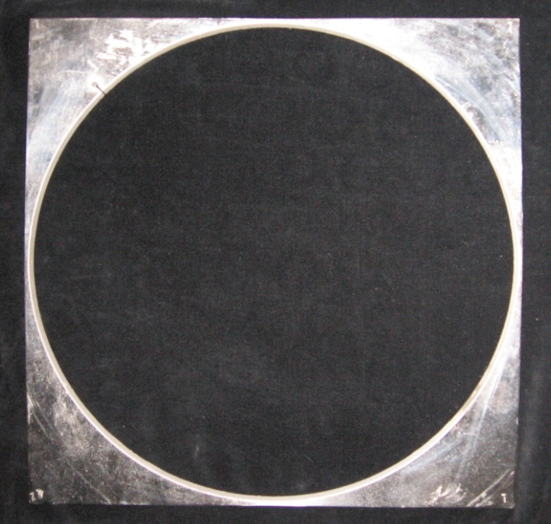
Cavity fabrication
By Spinning from scraps of spun 1.5 GHz
40 cm
6 GHz Cavity
1.5 GHz Cavity

Slide 11
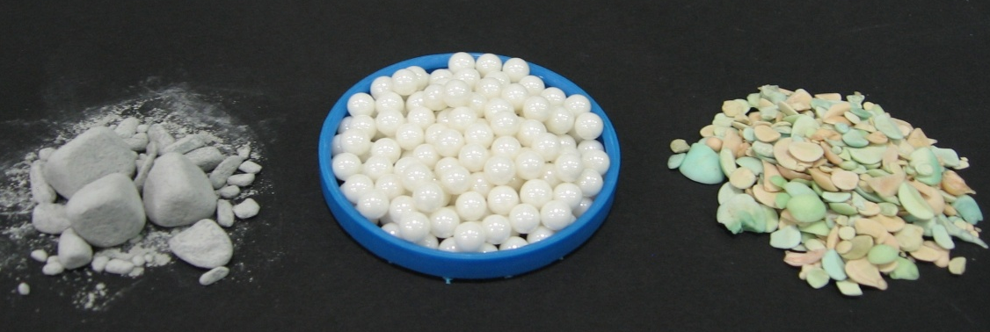
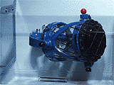
Mini Mechanical Tumbling
SiC
ZrO₂
Al₂O₃ + SiO₂

Slide 12
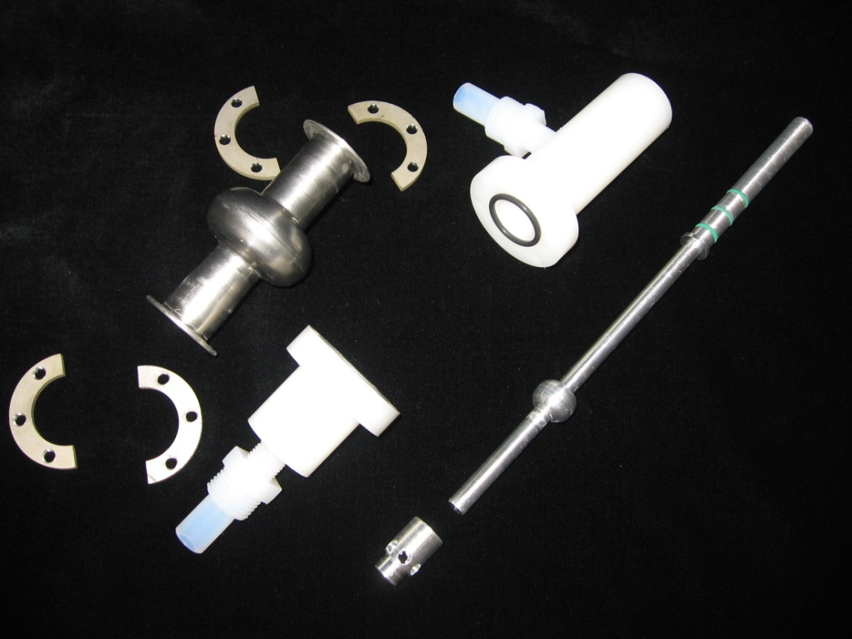
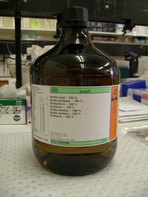
Mini EP

Slide 13
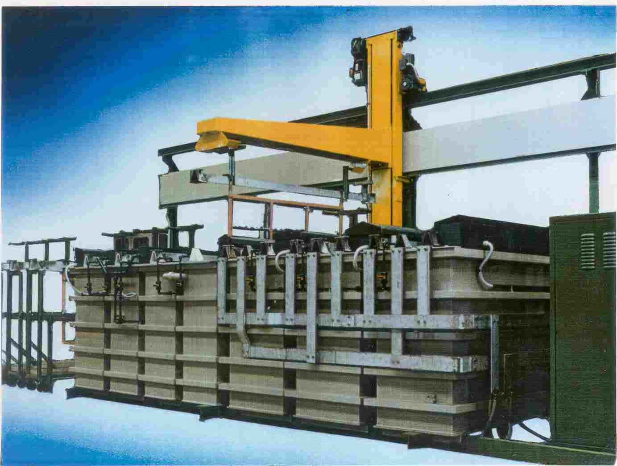

Slide 14
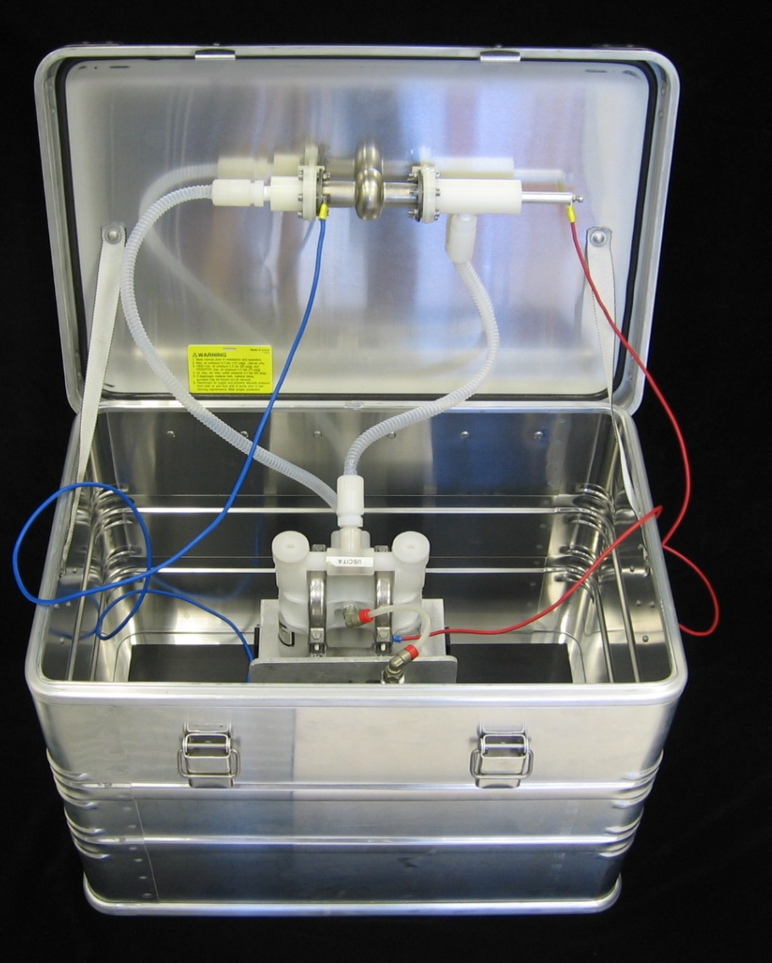
A Mini – BCP / EP Lab

Slide 15
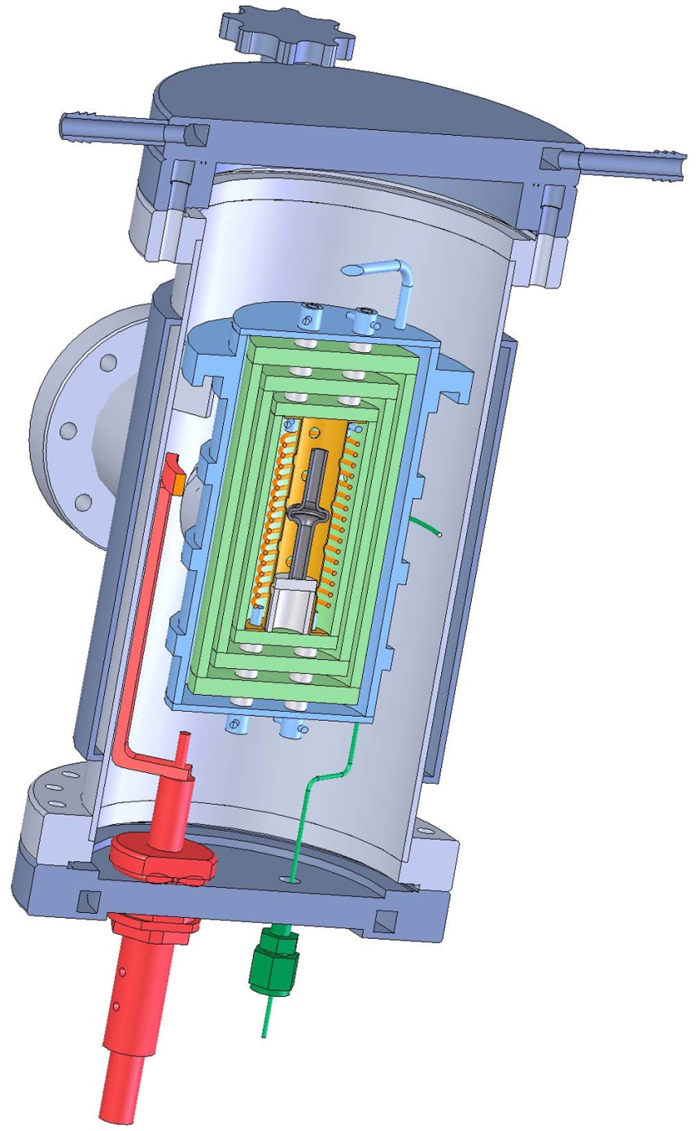
6 GHz CAVITY MINI-furnace

Slide 16
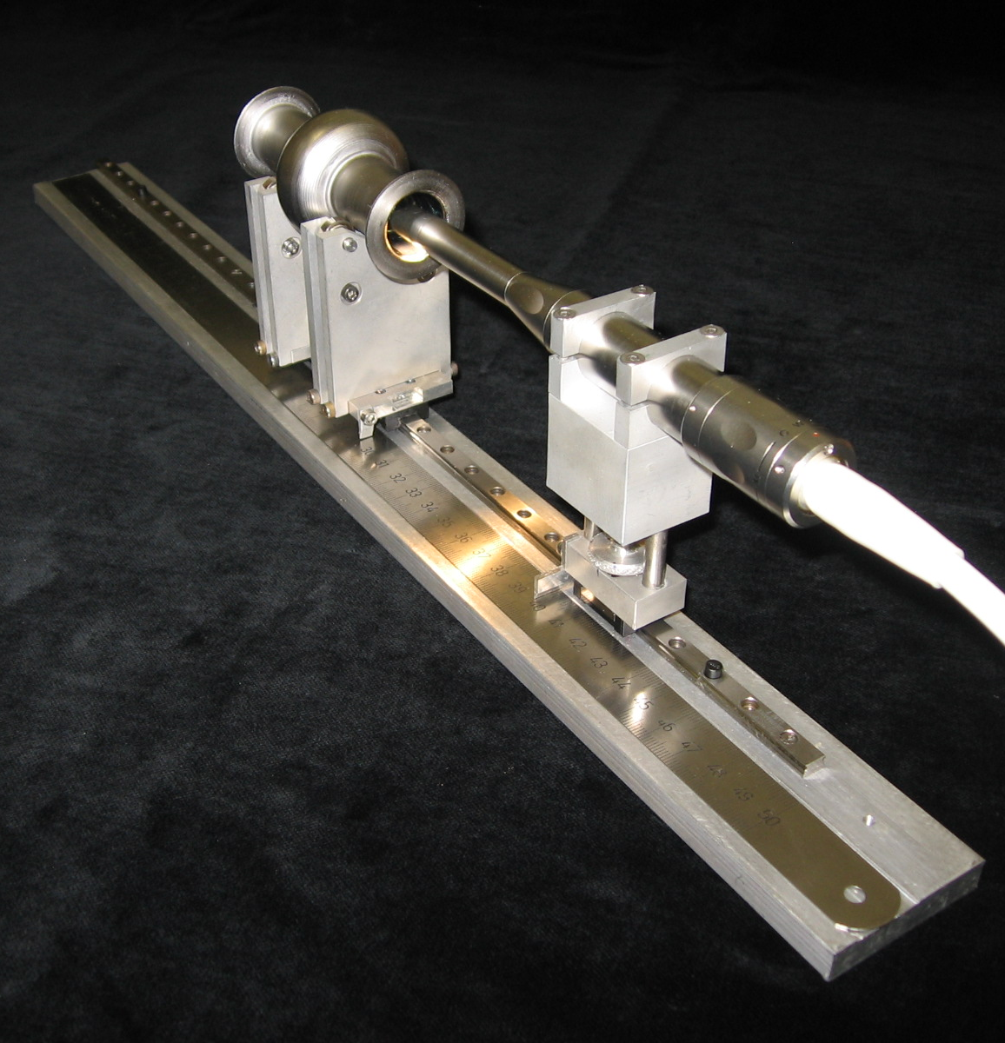
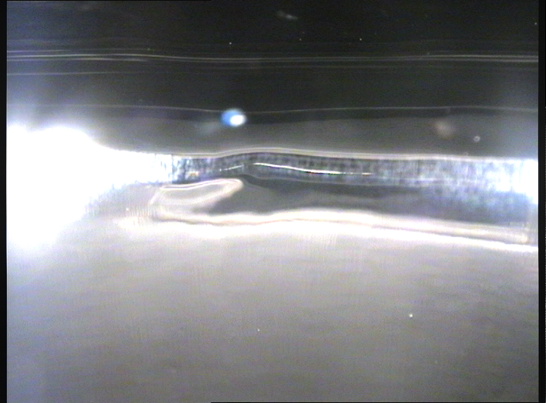
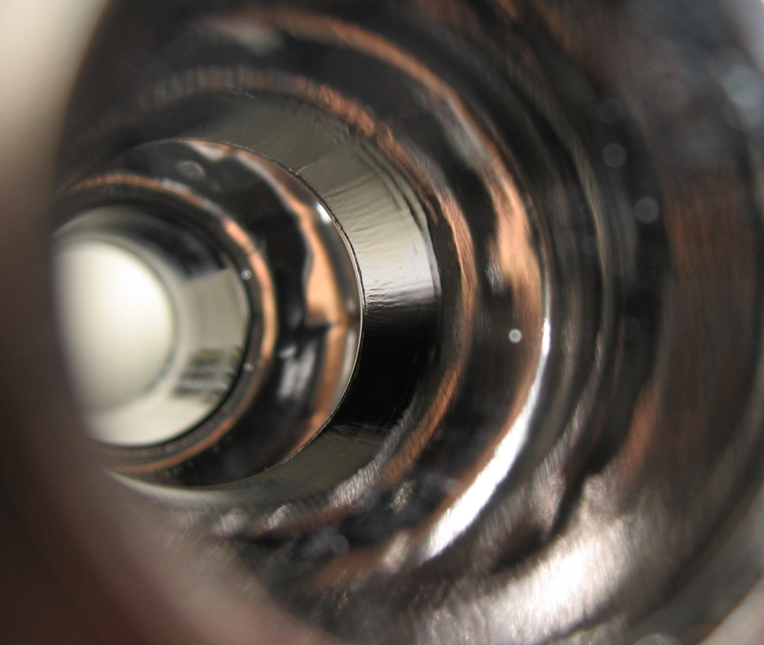
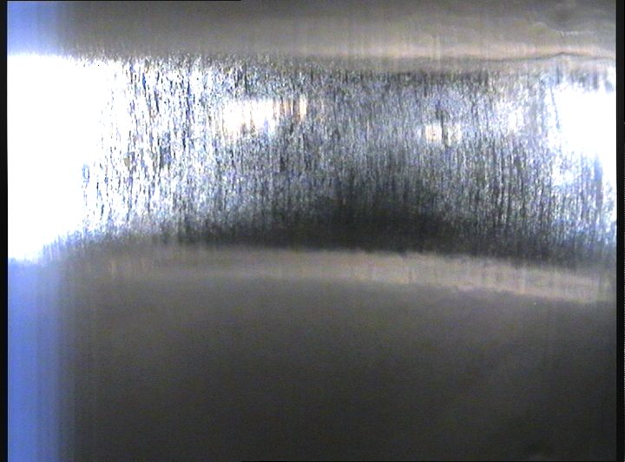
6 GHz CAVITY MINI-Camera

Slide 17
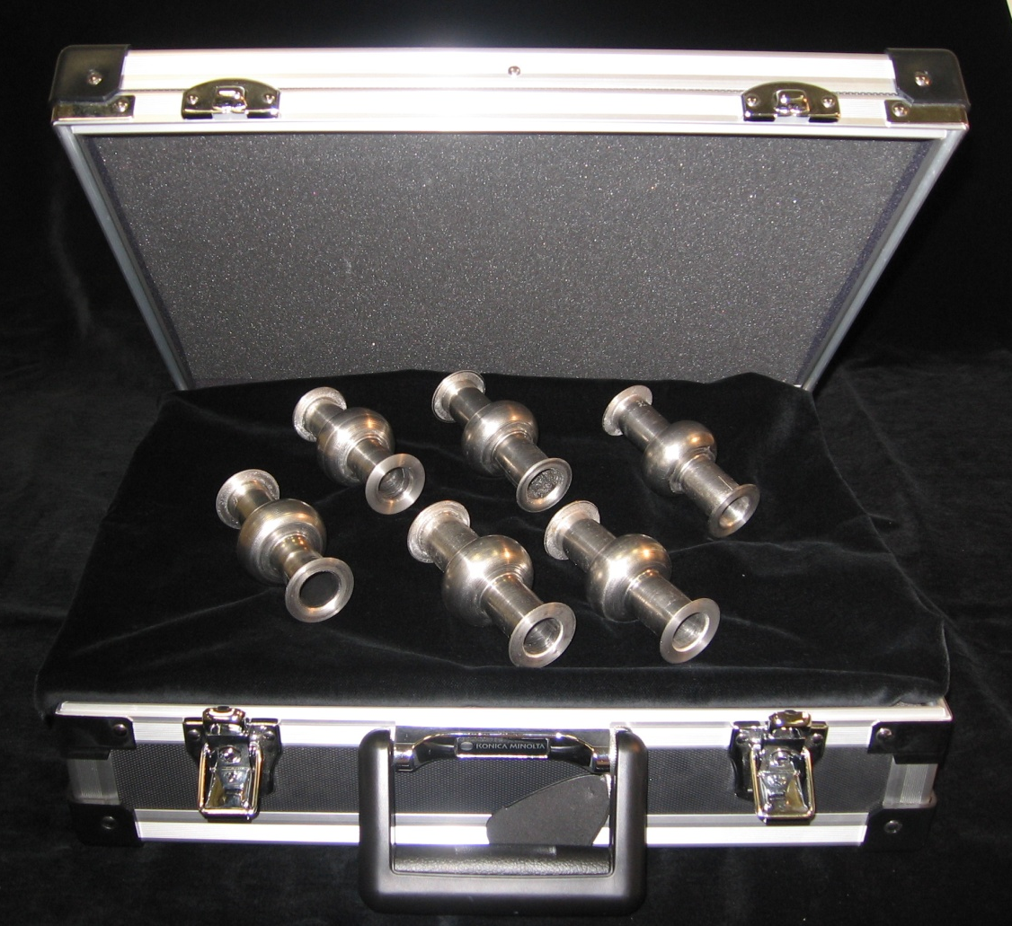
Ready for the RF measurement

Slide 18
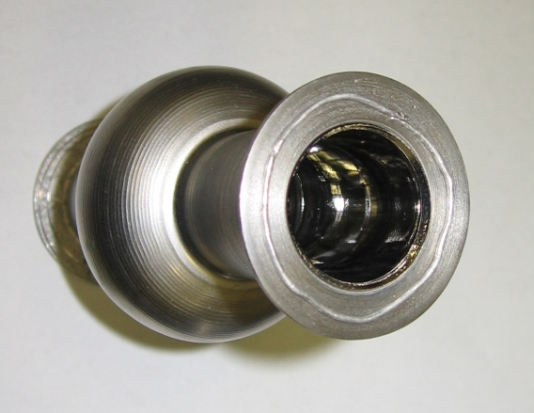
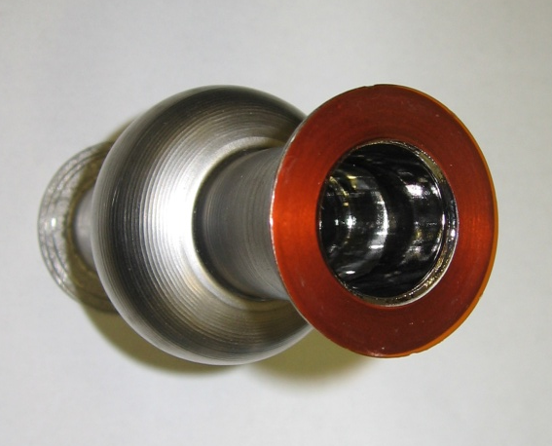
6 GHz CAVITY: MINI-Kapton gasket

Slide 19
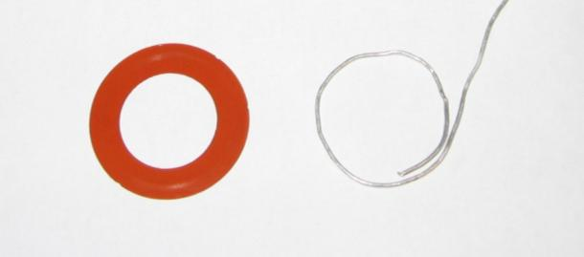
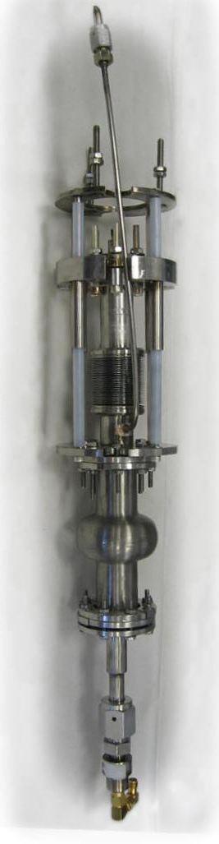
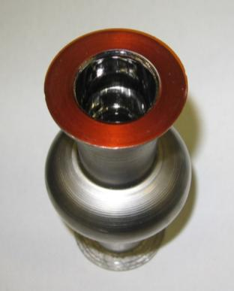
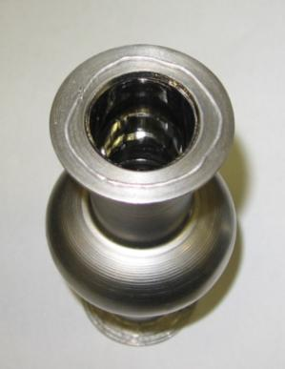
Cryogenic infrastructure
Easy RF Measurement system:
Pumping line
Vacuum seals:
(Two kinds)
Coupler
(mobile)
Kapton® disc
Indium wire
INSERT
Pick Up

Slide 20
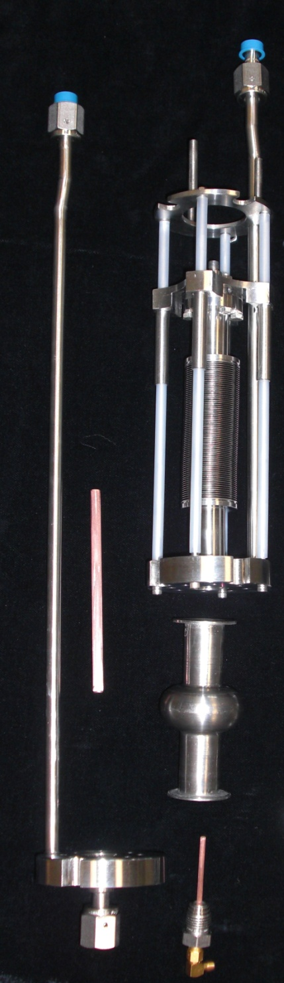
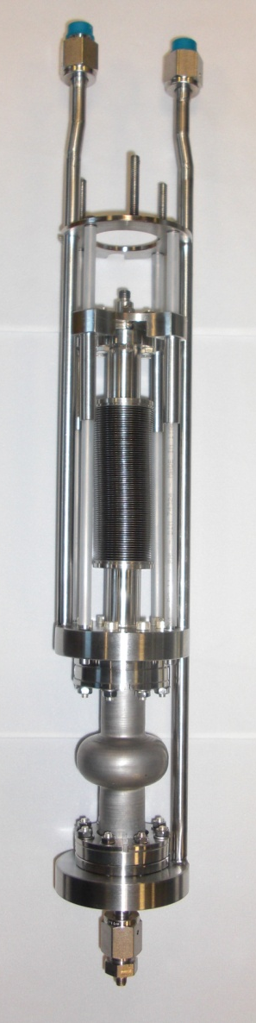
Cryogenic infrastructure:
The Bottom Part
Bottom Part
Pick-up-Pipe
Coupler - Pipe
Double Pumping line
Bellow
Coupler (mobile)
Coupler Flange
Coupler Antenna
Pick-up Flange
Pick Up
Pick-up Antenna

Slide 21
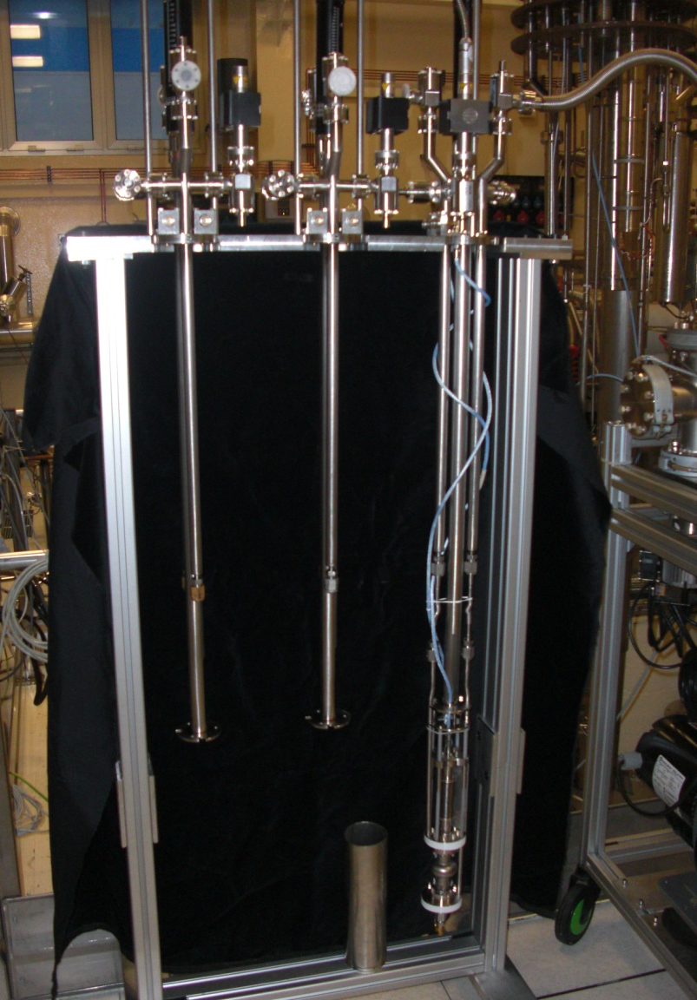
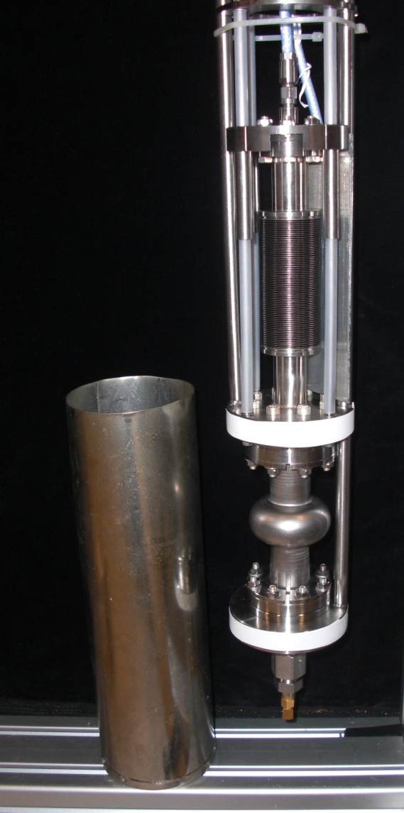
Cryogenic infrastructure:
Triple Stand
μ-metal
Screen
cavity

Slide 22

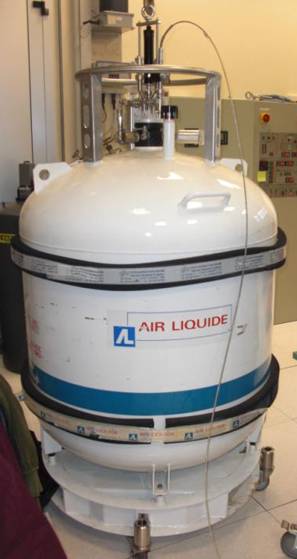
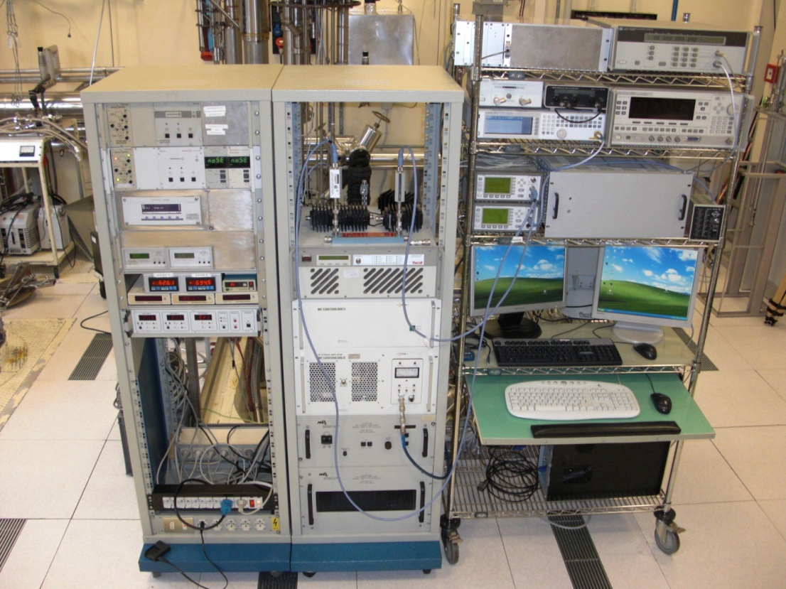
Quick RF Measurements
The insert has been conceived to even enter into a 450 lt Helium dewar
INSERT
DEWAR
RF measuring system

Slide 23
List of Dogmas
6 GHz cavities are not representative
Any other flange, that is not Nb-Ti, is not reliable
Kapton joints will not work
… and even if they work, they will not be used!

Slide 24
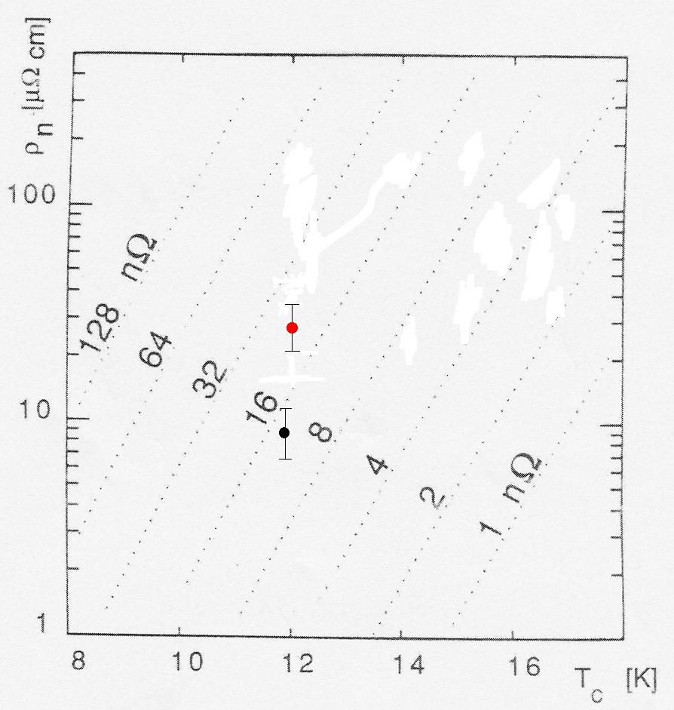
Nomogram (after Benvenuti, Palmieri, Vaglio)
T = 4.2 K
f = 500 MHz,
s = 4

Slide 25
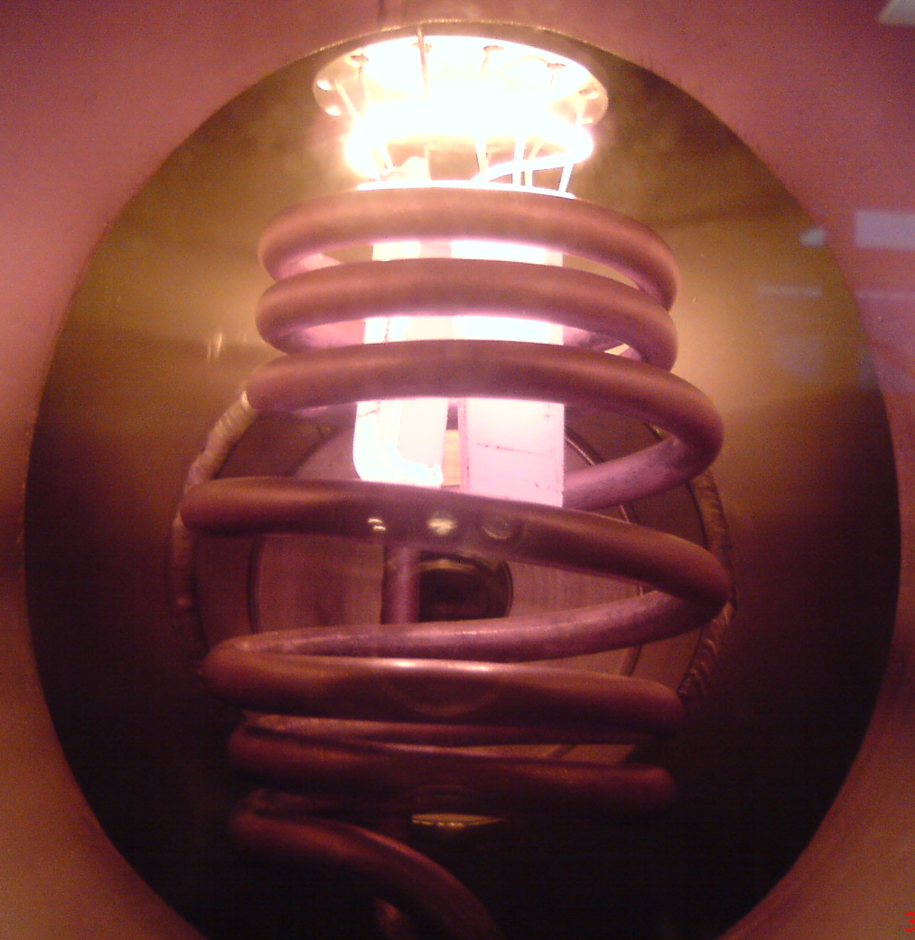

Slide 26
List of Dogmas
2000° C is a too high temperature
Over 1000°C you’ve contamination from crucibles and you will loose the dimensional control
You can’t work around melting point of Niobium

Slide 27
High Temperature Rapid Metathesis
(Nitriding in Mushy State)
The Process is:
Fast ( takes only few sec)
Cheap (Vacuum Technology Free)
Simple (No need of special expertise)

Slide 28
Bulk Nb
6 Ghz @4,2K

Slide 29
List of Dogmas
You necessarily need good vacuum
You must limit yourself to select only those A15 that can be prepared at T around 900°C
In any case B1 and A15 materials will never work

Slide 30
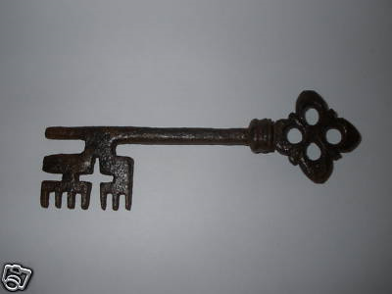

Slide 31
The Homologous Temperature
T [K]
θ =
T_{m} [K]
0
1
for Nb 2467 °C

Slide 32
T [K]
θ =
T_{m} [K]
Mushy State
0
0,8
1
for Nb
1924 °C
2467 °C

Slide 33
T [K]
θ =
T_{m} [K]
Premelting
Mushy State
0,9
0,96
0,98
1
2196 °C
2357 °C
2412 °C
2467 °C

Slide 34
Premelting
(also Surface melting)
Even below its melting point (T_{m}), quasi-liquid films can be observed on crystalline surfaces

Slide 35
Premelting
(also Surface melting)
The thickness of the quasi-liquid film is T - dependent
This effect is common for all crystalline materials

Slide 36
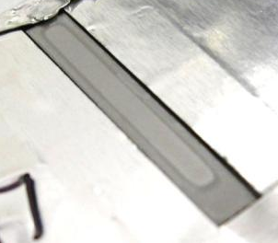
NbN
Nb
NbN
Nb
3 mm

Slide 37
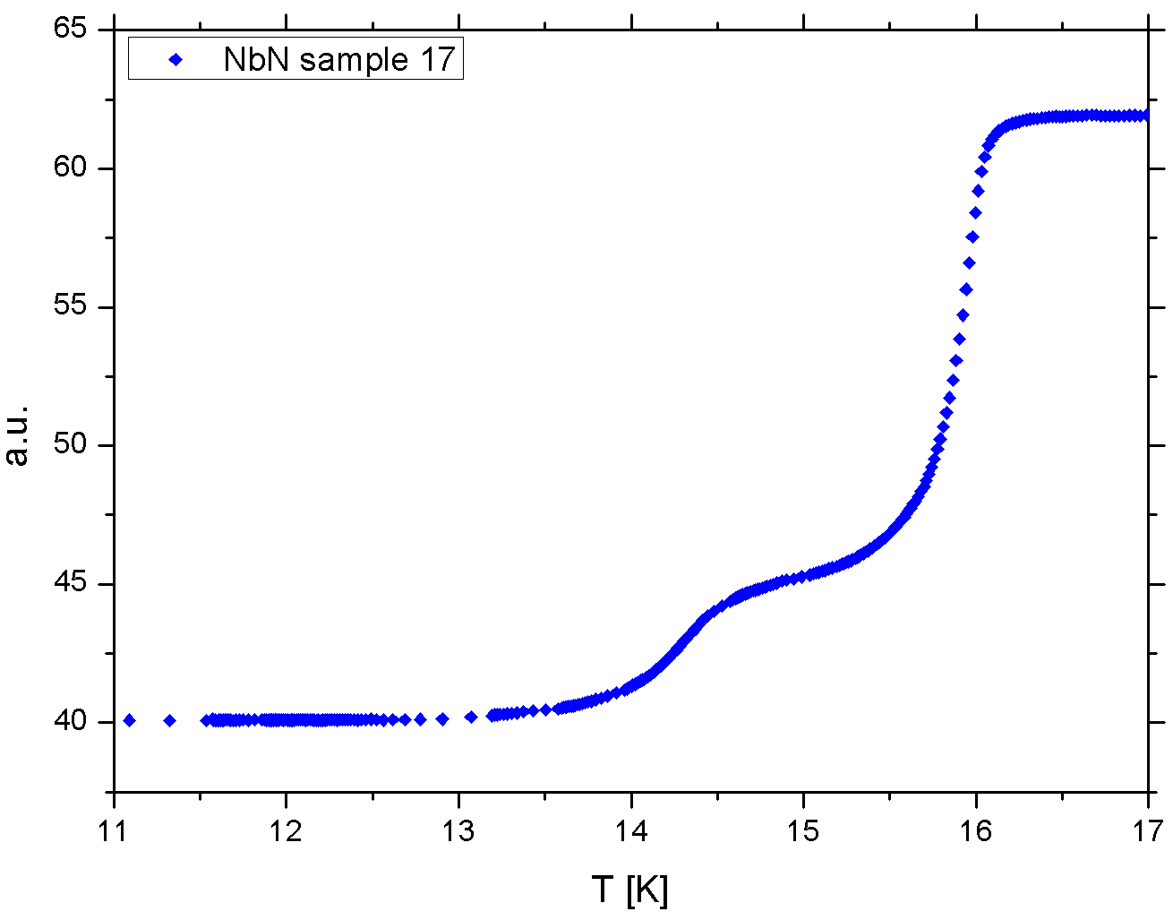
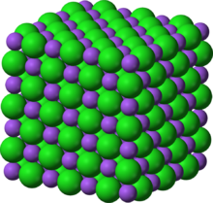
δ-Nb N
γ-Nb N

Slide 38
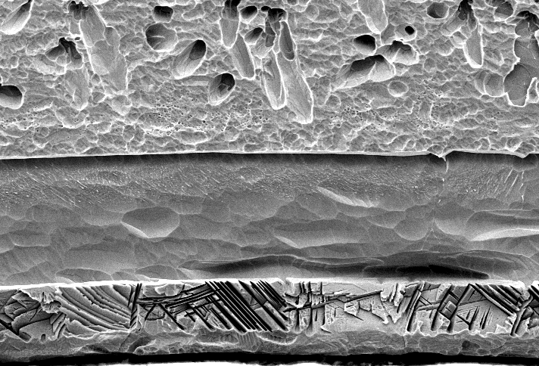
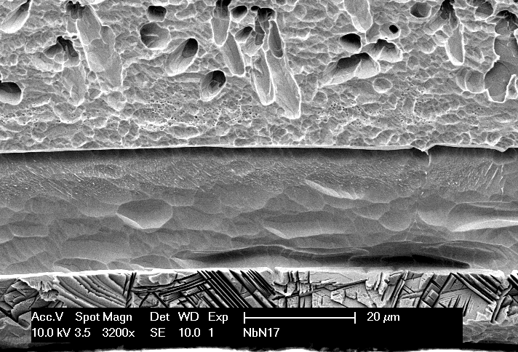
Surface layers

Slide 39

Nb₅N₆; N₄N₃
δ−NbN _{1-x}; η-NbN (hexagonal);
δ’−NbN (hexagonal);
β-Nb2N (hexagonal); γ-Nb₄N_{3-x}
α-Nb (N) (bcc solid solution)
Niobium

Slide 40
NbN
Bulk Nb

Slide 41
T_{m} of Nb
Temperature
3 – 30 sec
Time

Slide 42
As the δ-NbN → γ-Nb₄N_{3-x} phase transformation is a very fast, quasi-continuous
Transition,
it cannot be avoided by quenching

Slide 43
Annealing doesn’t work

Slide 44
NbN
Bulk Nb

Slide 45
NbN
Bulk Nb

Slide 46
Bulk Nb

Slide 47
Nb₂O₅
Melting point | 1512 °C
Evaporation temperature | 1700-1900 °C

Slide 48
When the N/Nb ratio > 0.84,
the δ-phase can be retained by quenching
At N/Nb ratio < 0.8 it transforms in γ-Nb₄ N₃

Slide 49
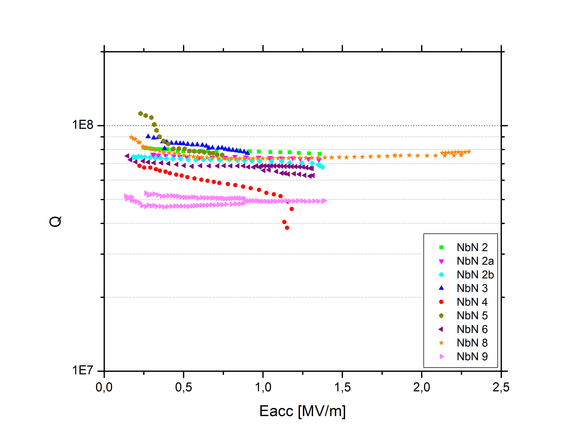
NbN @4,2K
T = 4,2 K
Bulk Nb

Slide 50
High Temperatures for
Nb Purification

Slide 52
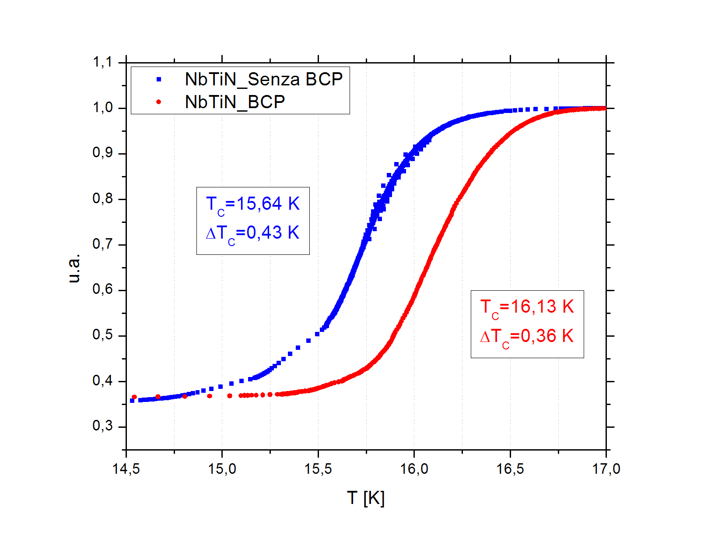
Bare Sample

Slide 53
Conclusions
6 Ghz cavities allow a fast and dense statistics
At 4,2 K the Q-value at low field increases of even a factor 5
The important parameters are given by the 3-T rule

Slide 54
6 GHz

Slide 55
Bulk Nb
6 Ghz @4,2K

