Slide 1
SRF Development for High Energy Physics
Mark Champion
SRF 2011

Slide 2
Introduction
The HEP community has shown increasing interest in SRF technology in recent years
ILC R&D program
Project X at Fermilab
Neutrino factories and muon colliders
However, the application of SRF technology to HEP research has a long history
Now let’s go back in time and take a look at that history

Slide 3
Stanford High Energy Physics Laboratory (HEPL) a.k.a. Hanson Experimental Physics Laboratory
1962: First measurements of superconducting cavity performance
Lead-plated S-band 2856 MHz muffin tin cavities
Qo ~ 1e8-1e9, Bp ~ 100 G (10 mT), 4 K
1965: First acceleration of electrons with a superconducting cavity
1972: First superconducting accelerator
Based on L-band 1300 MHz niobium cavities
Cavity performance limited by multipacting
the elliptical cavity shape was not yet developed

Slide 4
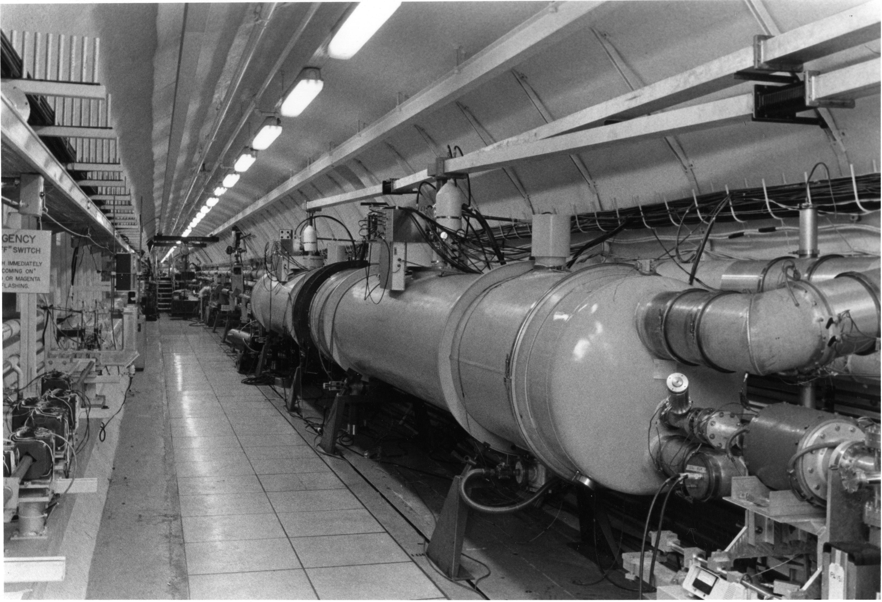
HEPL 1300 MHz Cryomodule Pair
Courtesy of T. Smith, HEPL

Slide 5
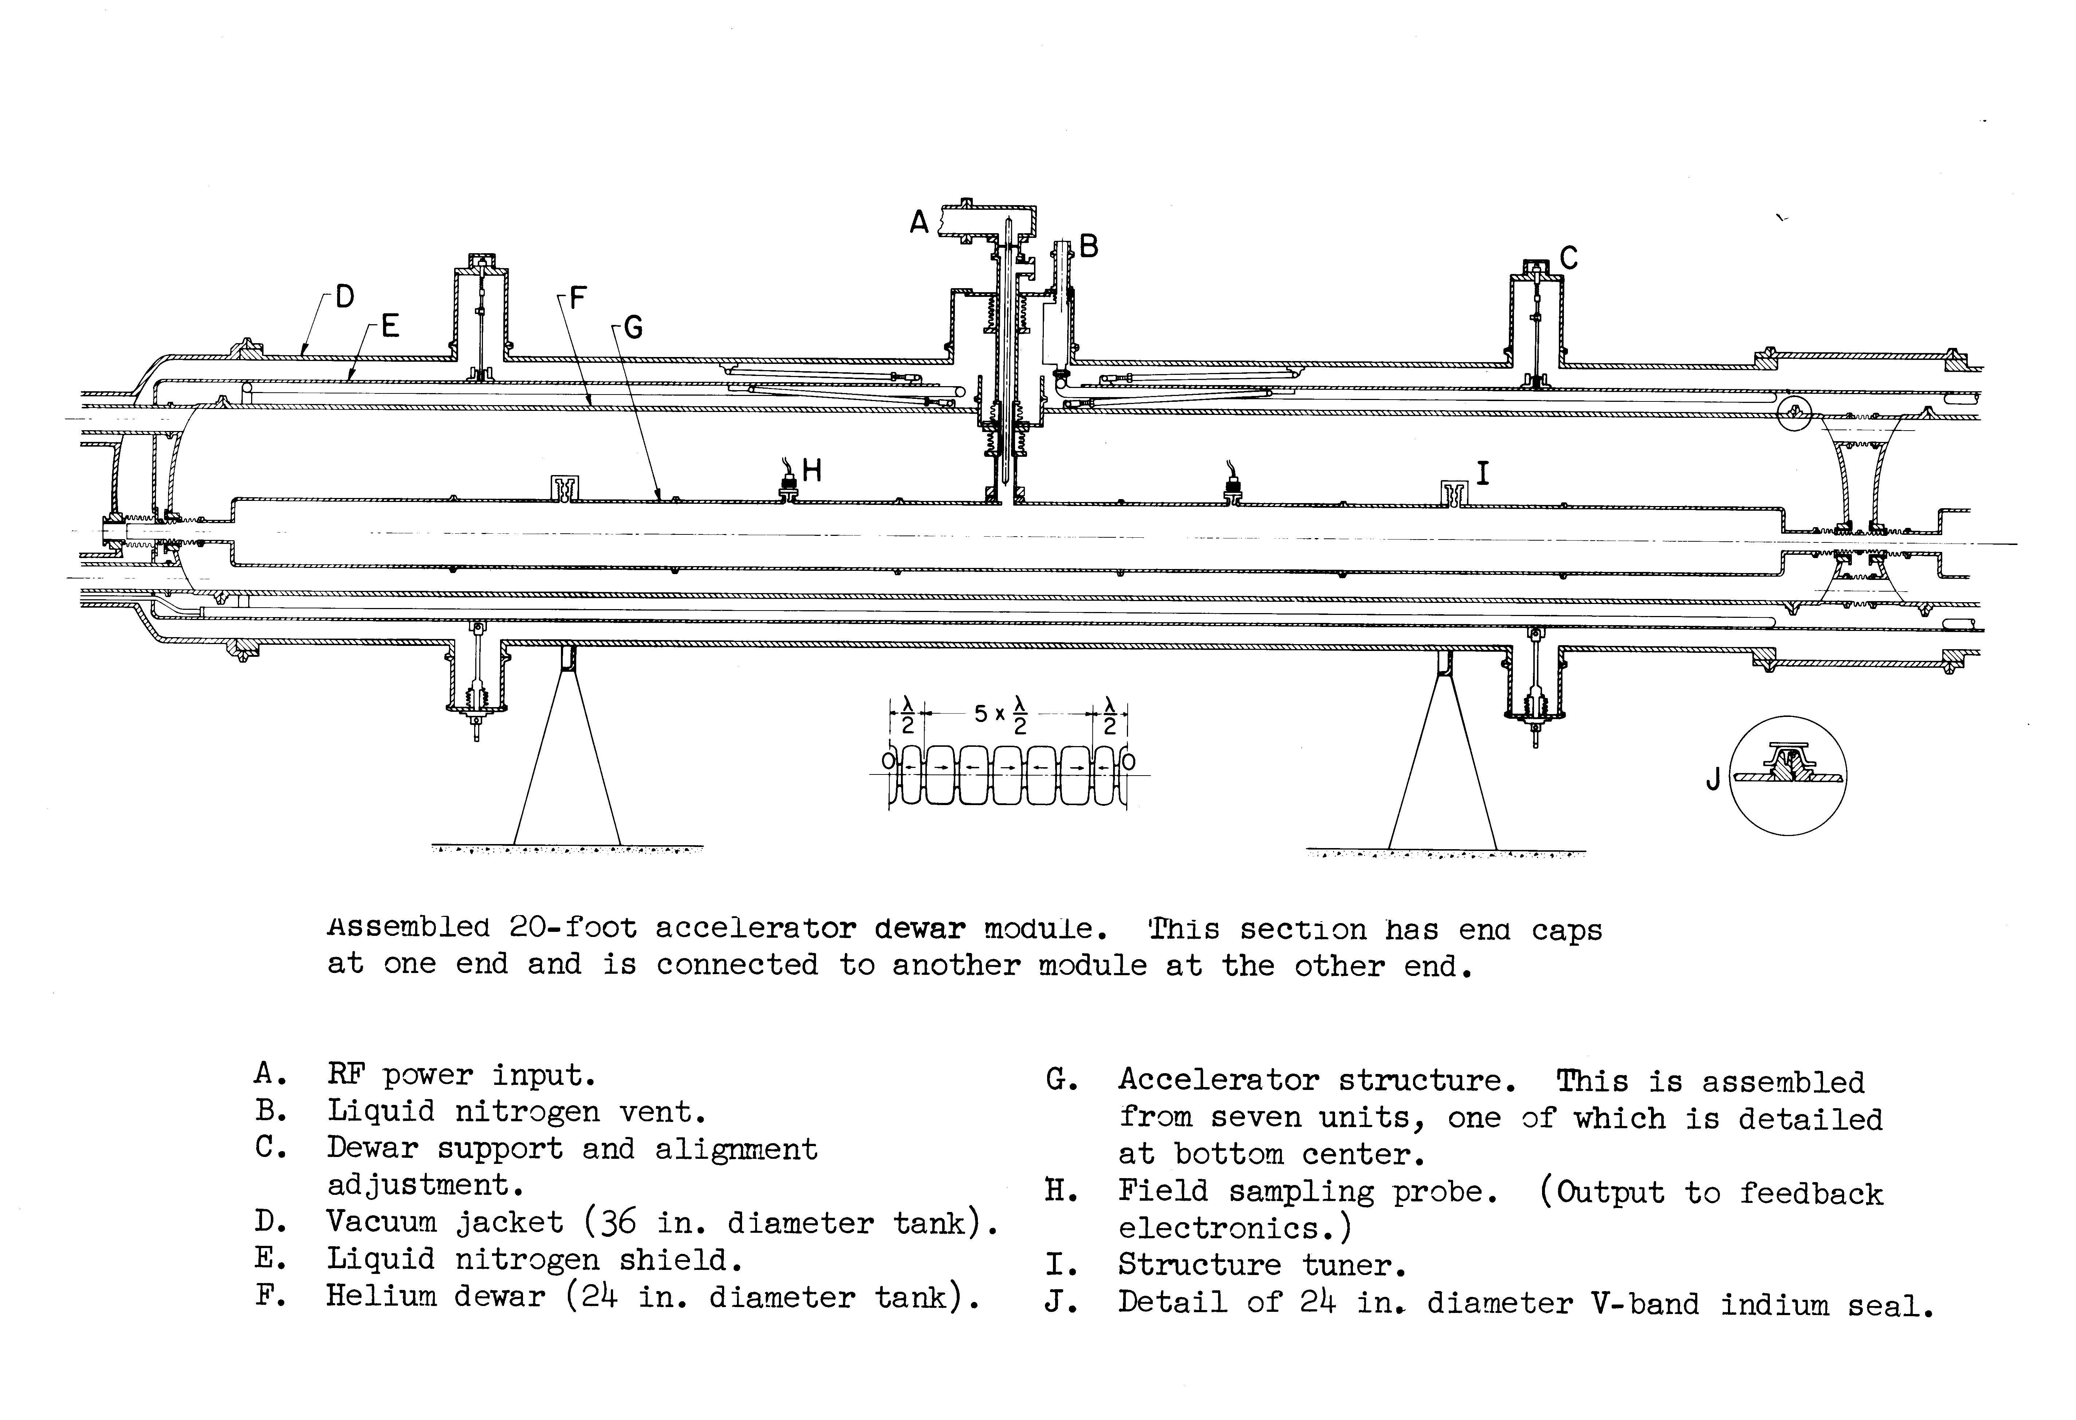
Layout of HEPL Cryomodule
55 cell, 1300 MHz, bi-periodic structure
~2.5 MeV/m

Slide 6
TRISTAN and KEKB
TRISTAN was an electron-positron collider constructed at KEK in the 80’s
32 five-cell 508 MHz elliptical SC cavities housed in 16 cryomodules
Installed in 1988 – 1989 (augmented existing NC cavities)
Eacc = 5 MV/m, Qo = 2e9 at 4.2 K, continuous wave
TRISTAN was shut down in 1995
KEKB was an asymmetric-energy electron-positron collider constructed at KEK in the 90’s
Reused much of the TRISTAN infrastructure and components
8 single-cell 508 MHz SC cavities housed in 8 cryomodules
Ecavity = 1.2 – 2 MV, Qo ~ 1e9 at 4.2 K, continuous wave
Heavy beam loading and HOM loading ( IB = 1.4 A )
KEKB has been shut down and is being upgraded to SuperKEKB

Slide 7
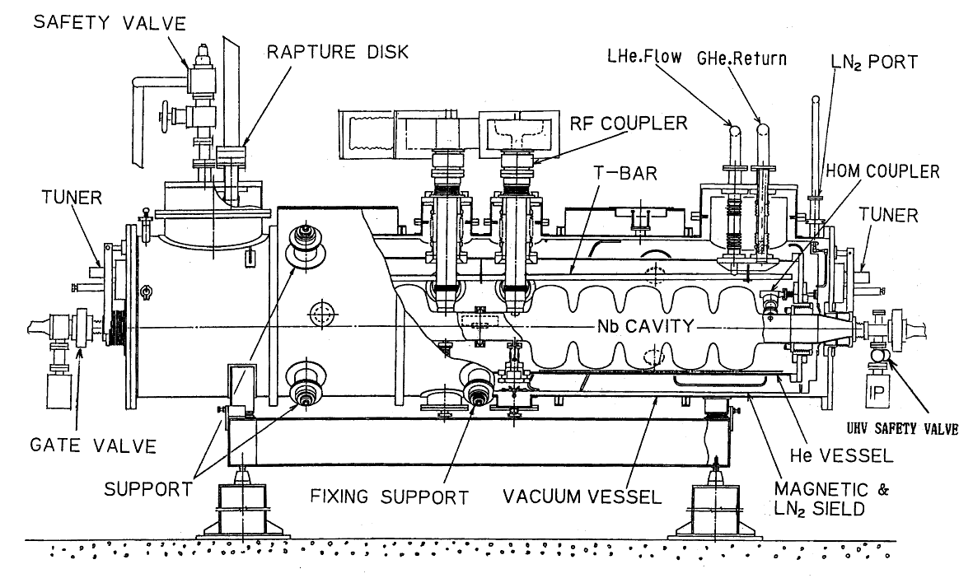
Cryostat for TRISTAN SRF Cavities
http://accelconf.web.cern.ch/accelconf/SRF89/papers/srf89g29.pdf
Courtesy of N. Toge, KEK

Slide 8
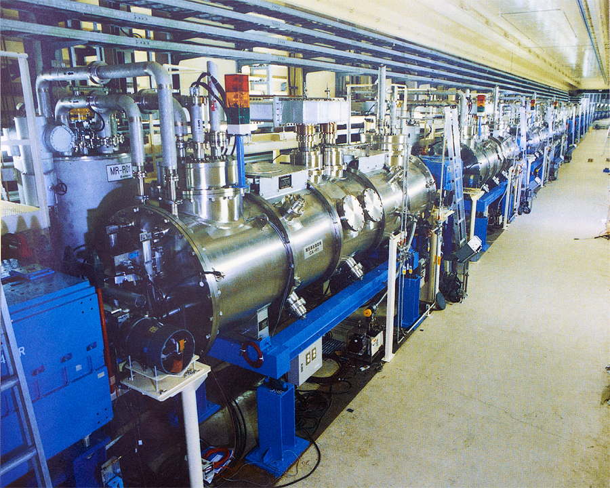
Cryomodules in the TRISTAN MR Tunnel
From KEK Annual Report 1988 - http://www-lib.kek.jp/ar/ar.html
Courtesy of N. Toge, KEK

Slide 9
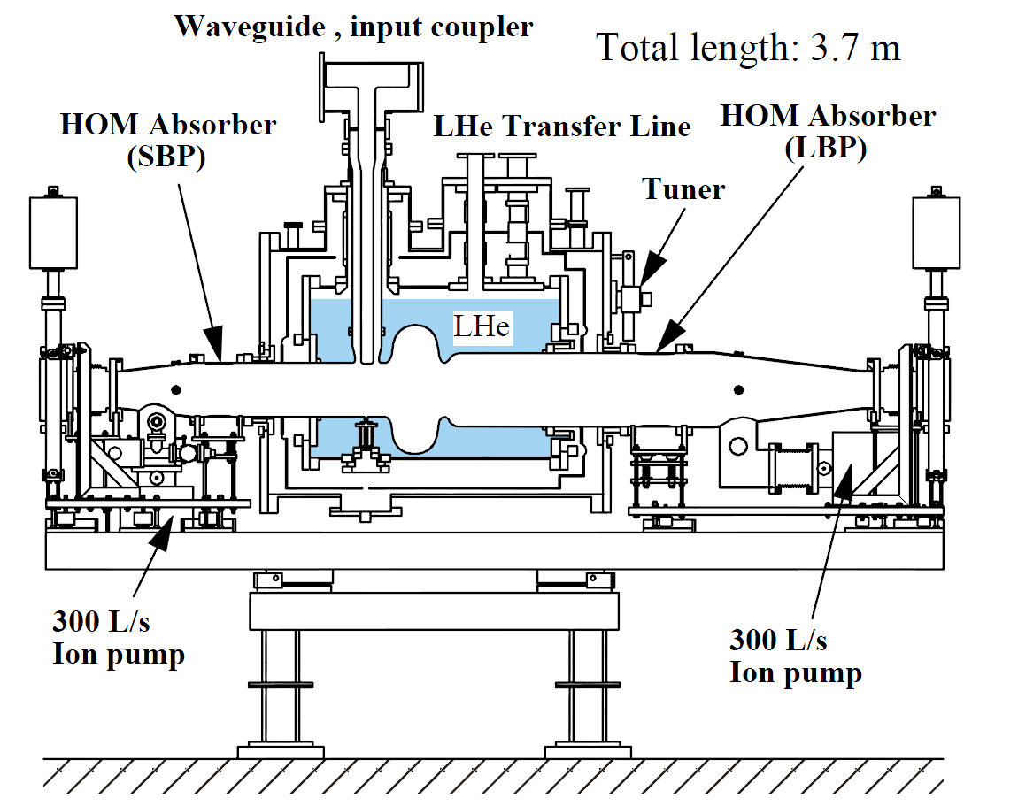
Cryostat for KEKB SRF Cavities
http://epaper.kek.jp/p99/PAPERS/THBL2.PDF
Courtesy of N. Toge, KEK

Slide 10
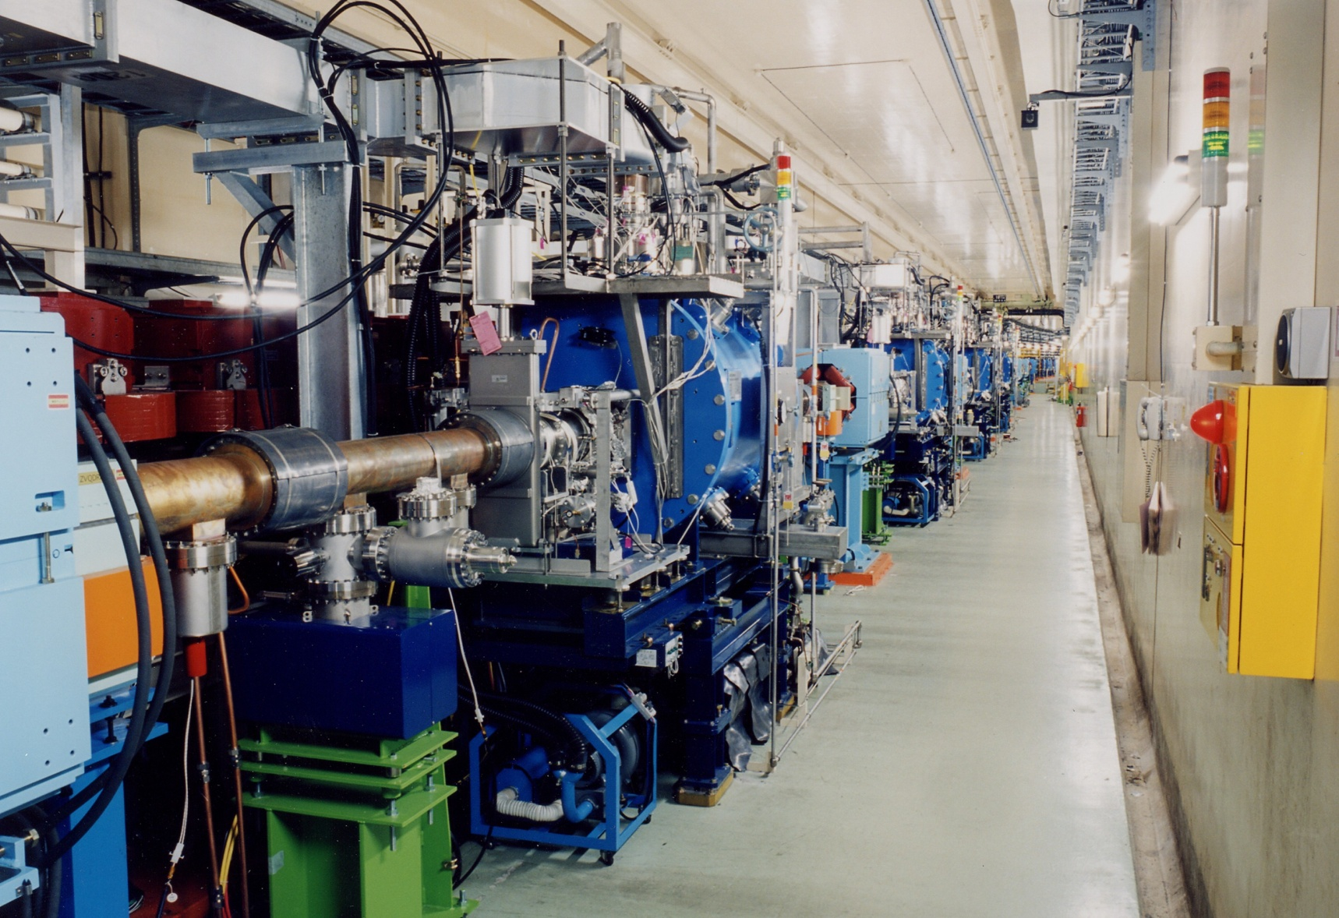
Cryomodules in the KEKB Tunnel
KEK Annual Report 1998 - http://www-lib.kek.jp/ar/ar.html
http://www-acc.kek.jp/kekb/pictures/KEKB_photo/ring1.jpg
Courtesy of N. Toge, KEK

Slide 11
DESY HERA 500 MHz Cryomodules
Electron-proton collider
16 SC cavities commissioned in electron storage ring in 1991-1992
Augmented 84 NC 500 MHz cavities to increase beam energy
Bulk niobium, RRR 300, 4-cell, 500 MHz elliptical cavities
Eacc = 5 MV/m, Qo = 2e9 at 4.2 K, continuous wave
Two klystrons, combined, drive all 16 cavities (vector sum RF control)
HERA experiment concluded in 2007
The initiation of the TESLA Test Facility coincided approximately with the successful commissioning of the HERA SC cavities
Courtesy of W-D Moeller, DESY

Slide 12
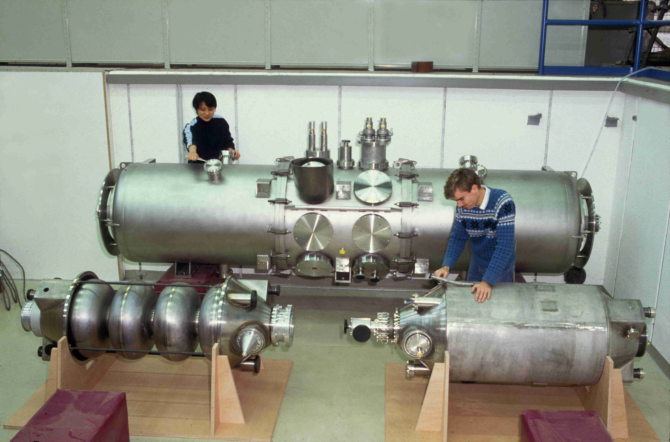
HERA Cavities and Cryomodule
Courtesy of W-D Moeller, DESY

Slide 13
LEP Superconducting Cavities
The LEP electron-positron collider at CERN was upgraded with SC cavities in the period 1992-1999
Beam energy increased from ~46 GeV to ~100 GeV
Final configuration: 288 four-cell cavities
272 niobium sputtered onto copper cavities
16 bulk niobium cavities
48 copper cavities (originally 128)
352 MHz, 4.5 K, continuous wave
8 cavities per 1.3 MW klystron
LEP cryomodules were removed in 2000-2001 to make way for the LHC

Slide 14
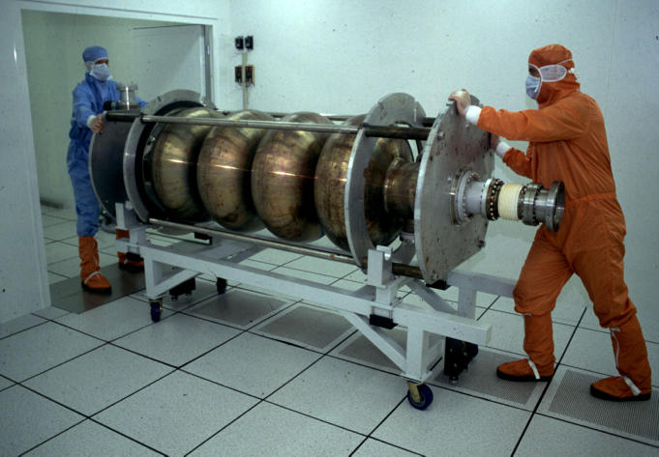
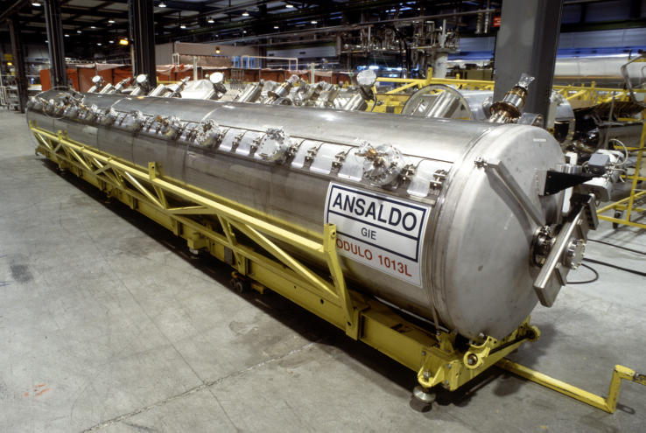
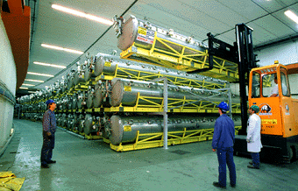
LEP 352 MHz Cavity and Cryomodule
4 cavities / cryomodule
Courtesy of CERN
72 modules going into storage

Slide 15
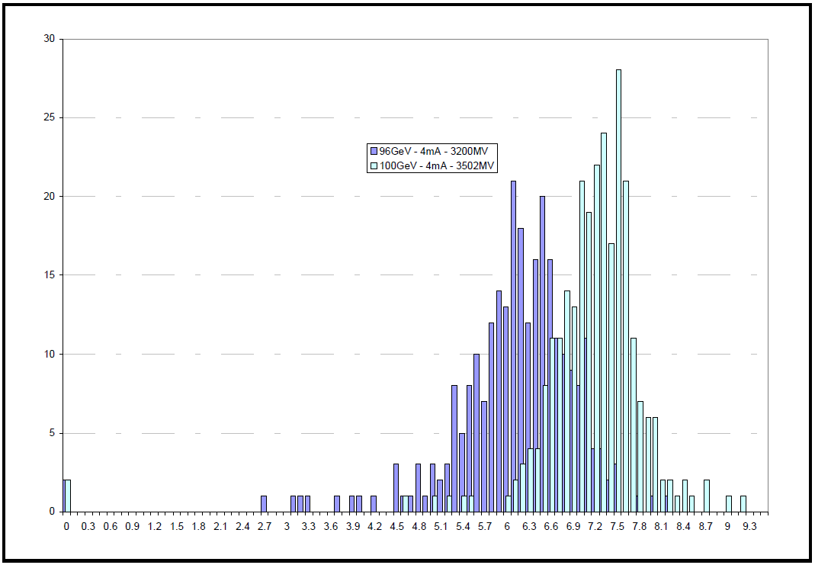
Achieved Gradients in LEP Cu/Nb Cavities in 1999
Highest performance achieved at end of run
Operated cavities near their limits
Increased limits via RF conditioning
< Eacc > ~ 7.2 MV/m
Qo ~ 3e9 at operating gradient
P. Brown et al., “Performance of the LEP200 Superconducting RF System,” SRF1999.

Slide 16
LHC Superconducting Cavities
400 MHz, single-cell, niobium sputtered onto copper cavities, 4.5 K, continuous wave
Four cavities per cryomodule
Sixteen cavities total
2 MV / cavity (5.3 MV/m), Qo > 1e9
One klystron per cavity

Slide 17
LHC SC Cavity
P. Maesen, “LHC Superconducting Cavities,” CWRF2008

Slide 18
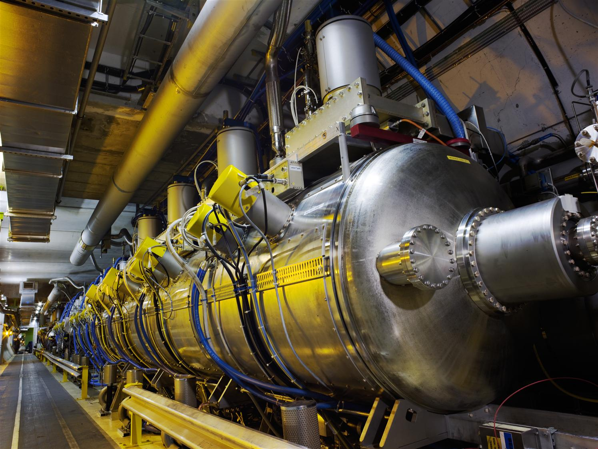
LHC Cryomodule
Courtesy of CERN

Slide 19
CESR – Cornell Electron Storage Ring
Electron-positron collider completed in 1979
Upgraded with four SC cavities in the period 1997 – 1999 (replaced NC cavities)
500 MHz, single-cell, one cavity per cryomodule
Eacc = 6 MV/m, Qo > 1e9 at 4.2 K, continuous wave
Heavy beam loading and HOM loading ( IB ~ 0.8 A max)
Cavity and Cryomodule design was industrialized with Accel (now RI) and sold to several light sources world wide
AES is presently fabricating two of these systems
Courtesy of Cornell University

Slide 20
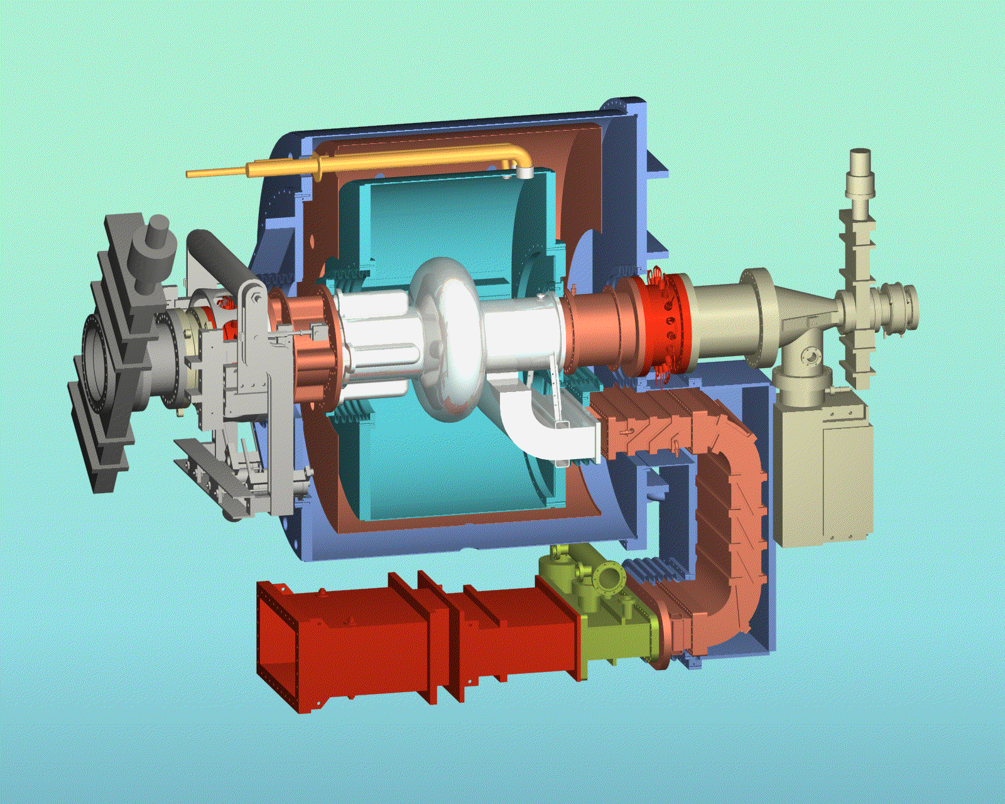
CESR-B 500 MHz Cryomodule
Courtesy of Cornell University

Slide 21
Future HEP Applications of SRF Technology
International Linear Collider
Approximately 17,000 cavities over 31 km
Project X
3 GeV continuous-wave H- linac followed by 8 GeV pulsed H- linac
Large Hadron Collider upgrades
Crab cavities for interaction region
Muon Collider / Neutrino Factory
Project X driver plus downstream acceleration of muon beam

Slide 22
International Linear Collider Layout

Slide 23
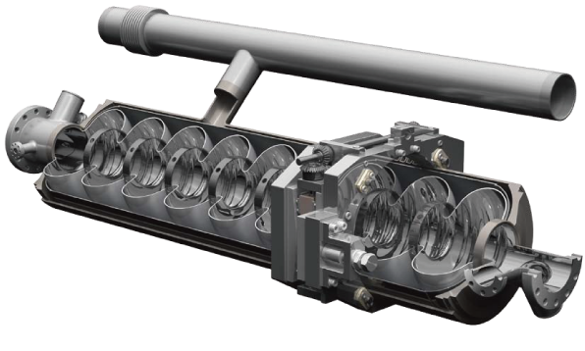
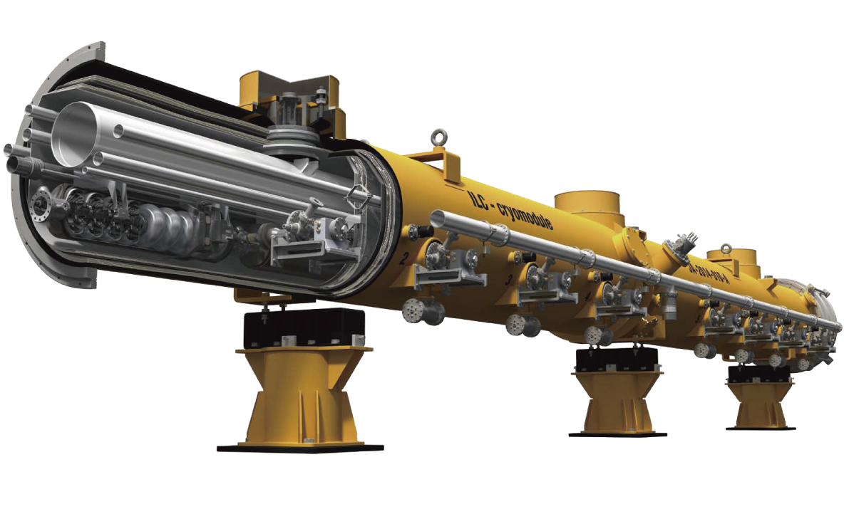
ILC Cavities and Cryomodules
Each cryomodule contains (8 cavities + 1 magnet) or (9 cavities)
Total ~2000 cryomodules, ~17000 cavities.

Slide 24
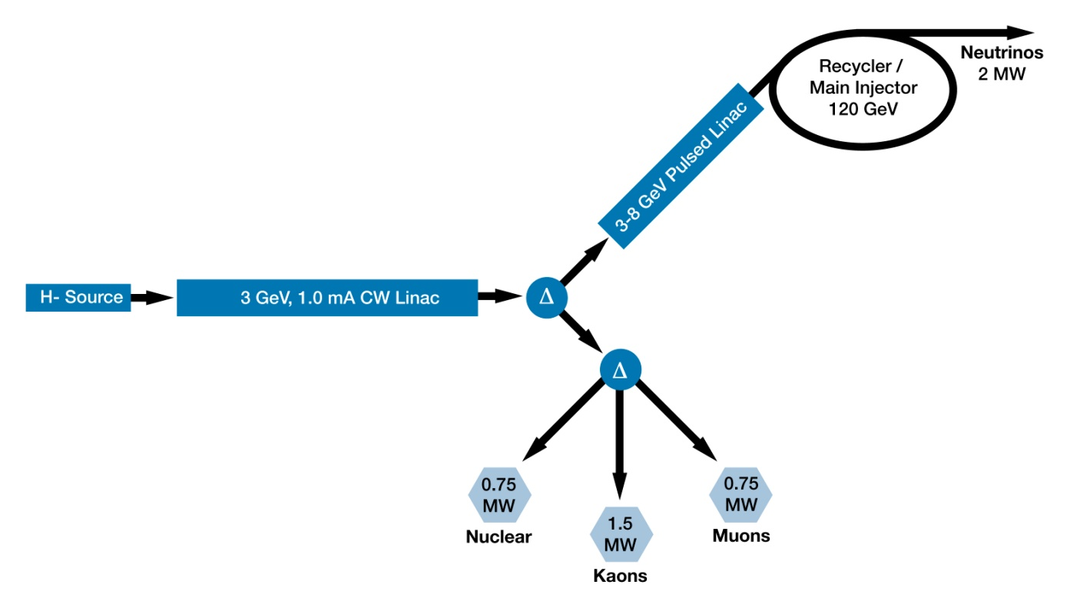
Project X Reference Design

Slide 25
PX SRF Linac Technology Map
ILC
β=0.11
β=0.22
β=0.4
β=0.61
β=0.9
β=1.0
CW
Pulsed
325 MHz
2.5-160 MeV
650 MHz
0.16-3 GeV
1.3 GHz
3-8 GeV
Section | Freq | Energy (MeV) | Cav/mag/CM | Type
SSR0 (β_{G}=0.11) | 325 | 2.5-10 | 18 /18/1 | SSR, solenoid
SSR1 (β_{G}=0.22) | 325 | 10-42 | 20/20/ 2 | SSR, solenoid
SSR2 (β_{G}=0.4) | 325 | 42-160 | 40/20/4 | SSR, solenoid
LB 650 (β_{G}=0.61) | 650 | 160-460 | 36 /24/6 | 5-cell elliptical, doublet
HB 650 (β_{G}=0.9) | 650 | 460-3000 | 160/40/20 | 5-cell elliptical, doublet
ILC 1.3 (β_{G}=1.0) | 1300 | 3000-8000 | 224 /28 /28 | 9-cell elliptical, quad
Courtesy of Bob Kephart, Fermilab

Slide 26
Courtesy of S. Geer, Fermilab

Slide 27
Summary
HEP has been a driver for the development of SRF technology for many years
Starting at Stanford in the early 60’s
Successful implementation at HERA, CESR, TRISTAN, KEKB, LEP, and LHC
HEP has continued this role in recent years with the ILC R&D program and Project X
HEP plans for future accelerators require SRF technology
ILC, Project X, LHC upgrades, and Muon collider / Neutrino factory
Substantial overlap with non-HEP applications is driving collaborations world wide
Spallation neutron sources, nuclear physics, light sources, and Accelerator Driven Systems

Slide 28
Acknowledgements
Thanks to all of the colleagues in the SRF community for 50 years of effort to develop and utilize SRF technology
Thanks for the many publications, from which I have obtained the information for this presentation
Special thanks to Wolf-Dietrich Moeller, Todd Smith, and Nobu Toge

