Slide 1


SRF Niobium thin films:
Substrates, nucleation & growth
Anne-Marie VALENTE-FELICIANO

Slide 2
OUTLINE
Approach/Motivation
Substrates
Nb nucleation
Nb crystal growth
Concluding Remarks

Slide 3
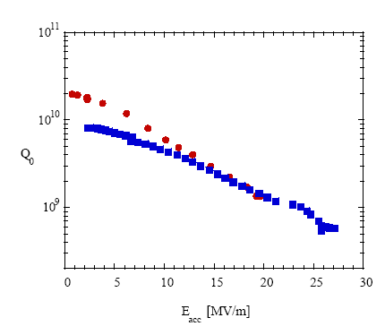
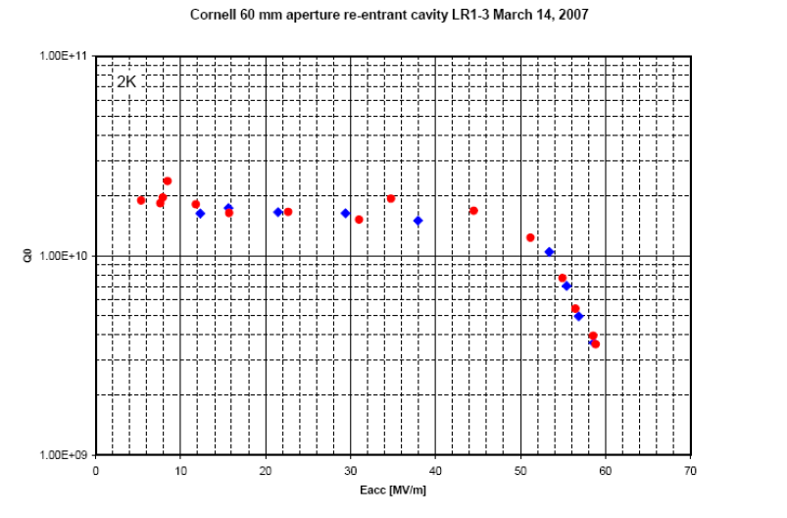
Thin Films: niobium –state of the art
1.5 GHz Nb/Cu cavities, sputtered w/ Kr
at 1.7 K (Q₀=295/R_{s})
Nb
Nb/Cu
CERN 2000
major system simplifications.
highest level of quality assurance and reliable performance.
Use of substrates with higher thermal conductivity
Bulk-like Performance Nb film

Slide 4
Substrate, nucleation and crystal growth : Why do we care?
The thickness of interest for SRF applications corresponds to the RF penetration depth, i.e. the very top 40 nm of the Nb film.
However the final surface is dictated from its origin, i.e. the substrate, the interface, and deposition technique (ion energy, substrate temperature…)
                Heterogeneous nucleation.
                Nucleation driven by nucleation centers such as defect, impurities on the substrate surface or the orientation of the underlying substrate in the case of hetero-epitaxy.

Slide 5
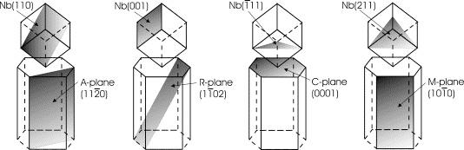
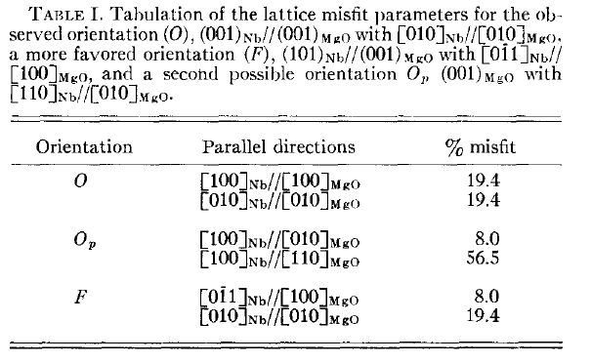
Substrate nature & substrate/film interface
Two common structures:
1. Hetero-epitaxy (film growth driven by orientation of underlying crystalline substrate)
2. Fiber structure (film grows on amorphous surface)
Hetero-epitaxial growth:
The growth of a crystal of a certain material on the crystal face of another material. The thin-film will be a single crystal if the substrate happens to be a single crystal.
      Nb[110] || Al2O3 [11-20], Nb[110] or Nb [111] || Al2O3 [0001]
      Nb[110] || Cu [100], Nb[100] || Cu [110], Nb[110] || Cu [111]
      Nb[110] || MgO [100], Nb[111] || MgO [110]
Lattice mismatch and difference in thermal expansion rate induce strain and stress during film growth. Al₂O₃:~1.9% (11-20)-12%(0001)
                MgO:10.8%
A. R. Wildes et al., Thin Solid Films, 401 7 (2001)

Slide 6
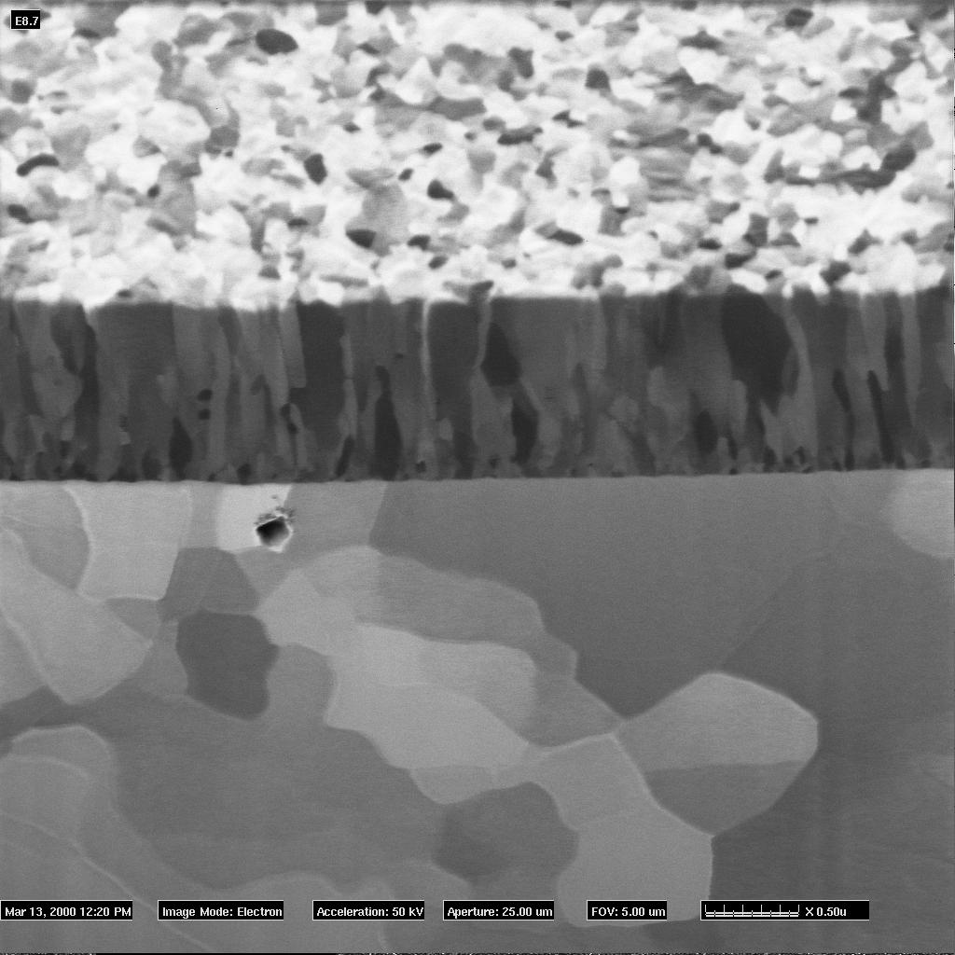
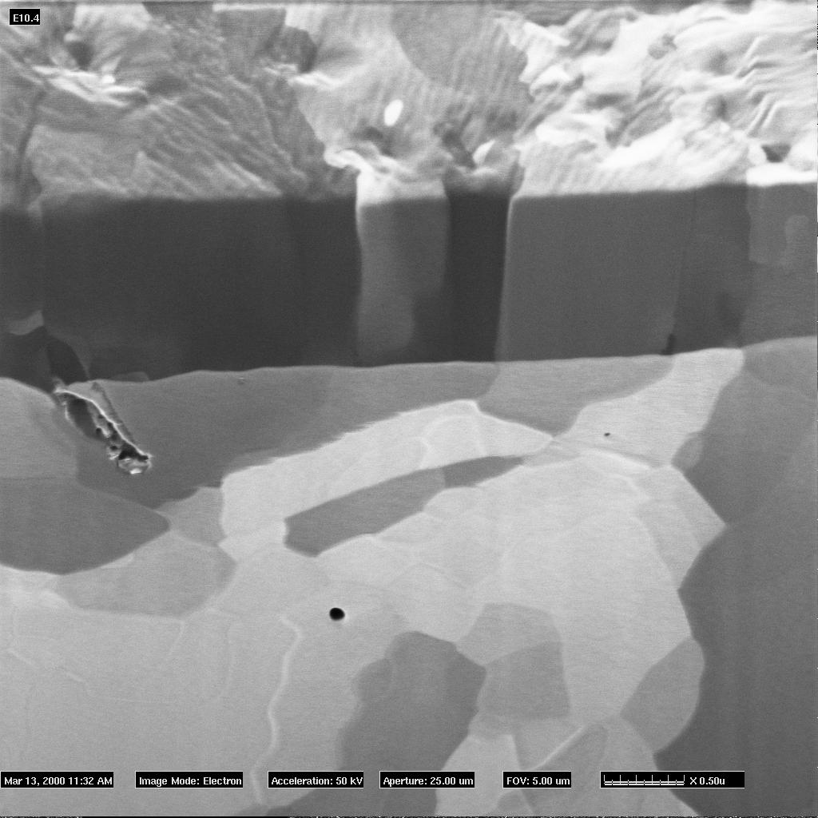

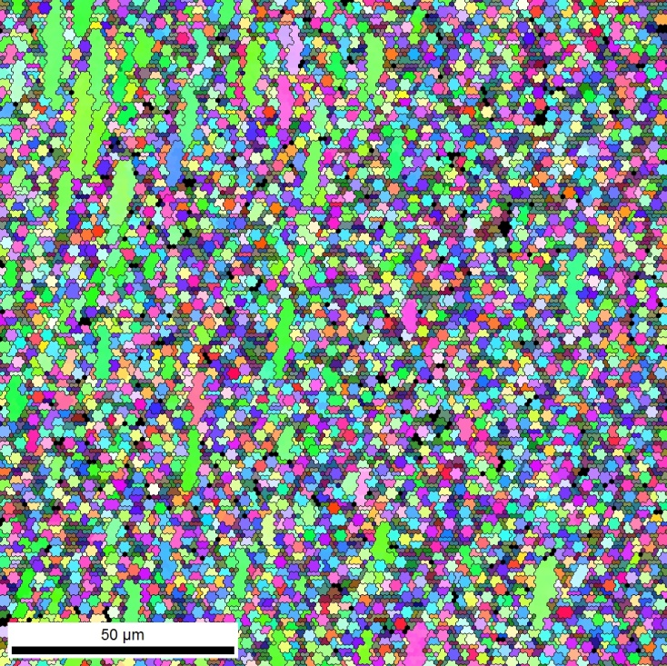
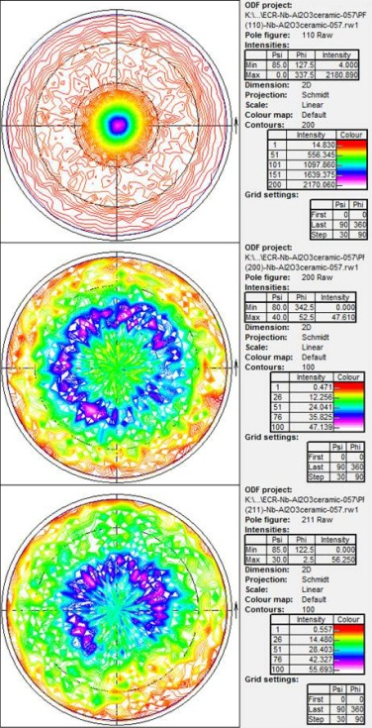

Crystalline vs. Amorphous Substrate
Standard films
Oxide-free films
The presence of an oxide on the surface, common with metallic substrates , inhibits epitaxy. The film then grows along the close-packed plane direction where the system energy is minimum ([110] for Nb).
CERN magnetron sputtered 1.5GHZ Nb/Cu films (coated with Ar)
Columnar grains, size ~ 100 nm
In plan diffraction pattern: powder diagram
(110) fiber texture ⊥ substrate plane
Equi-axed grains, size ~ 1-5μm
In plan diffraction pattern: zone axis [110]
Heteroepitaxy
Nb (110) //Cu(010) , Nb (110) //Cu(111),Nb (100) //Cu(110)
0.5 µm
0.5 µm
Crystalline Al₂O₃ (11-20)
Courtesy of CERN/P. Jacob,FEI
“Amorphous” Al₂O₃ ceramic
RRR= 247
RRR=89
ECR Nb films
Coated simultaneously

Slide 7
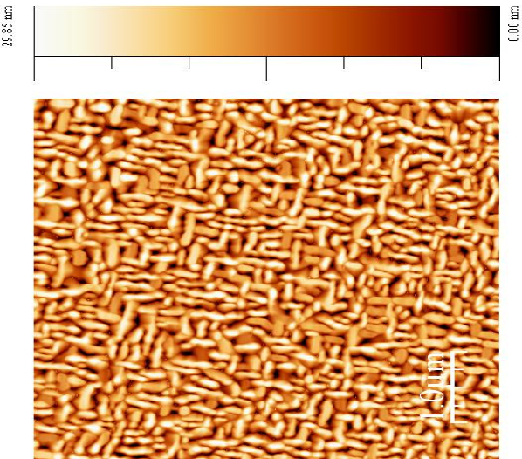
Growth domains due to substrate
Growth domains due to 2 possible equivalent
orthogonal orientations
are possible for the (011) Nb film on the MgO (100)
Morphology of Nb grown on MgO (100)
A. Lukaszew et al., College William & Mary
30 nm Nb/MgO
600 nm Nb / MgO
RMS Roughness = 6.5nm
RMS Roughness = 6.6nm
Magnetron sputtering 600nm , 600°C, 7h, RRR~47
ECR 620nm , 360°C, 30’, RRR~50
Similar growth variations for Al2O3, Cu…(different angles)

Slide 8
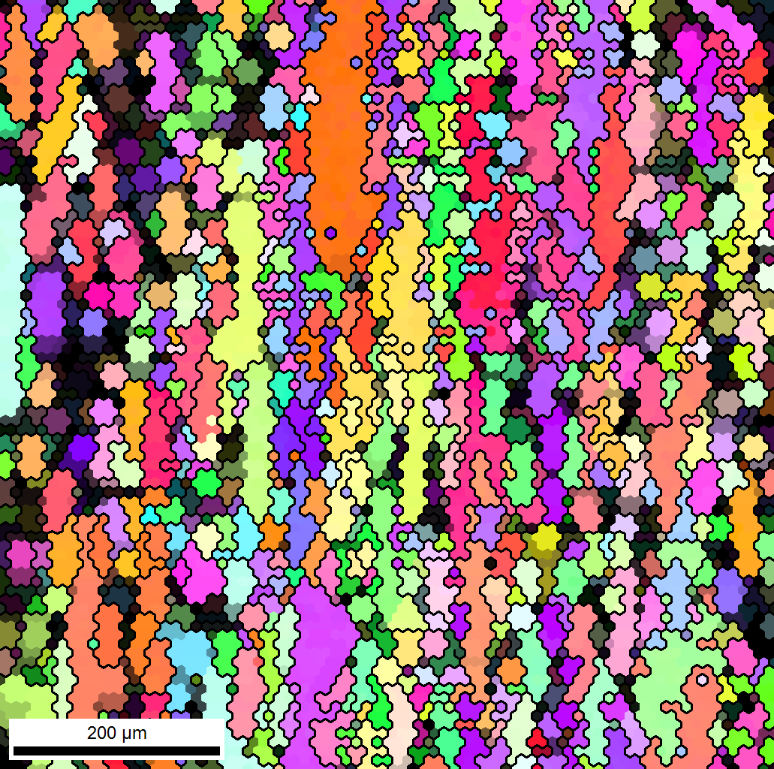
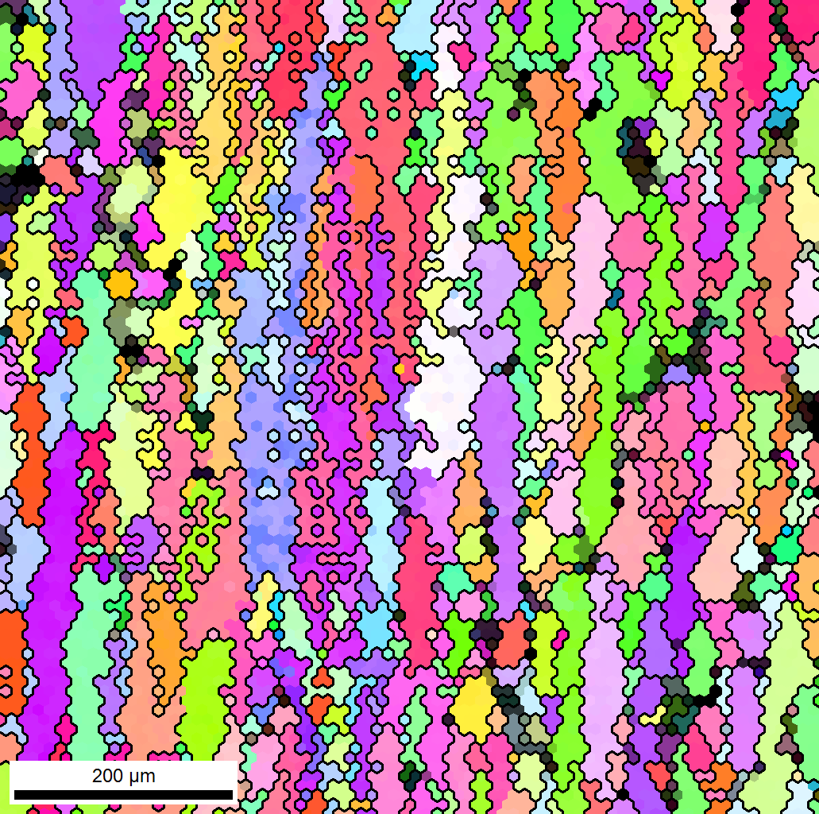
Substrate quality
Crystallinity or crystal quality
Nb/Cu, fine grain – effect of temperature pre-treatment
750μm x 750μm, 10μm 100x
THPO079 -Surface Preparation of Metallic Substrates for Quality SRF Thin Films
Joshua K. Spradlin, Olga Trofimova, Anne-Marie Valente-Feliciano (JLAB, Newport News, Virginia)
-120V, bake@360°C
CI =0.09
Oxide dissolution in the bulk
-120V, bake@700°C
CI =0.29
Oxide dissolution in the bulk
Annealing of substrate defects

Slide 9
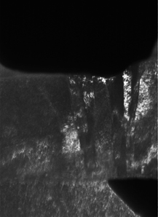
Substrate roughness and defects
Whatever the inherent nature of the film, the roughness of the substrate will dictate the minimum roughness of the film (the final roughness depends as well on the coating technique and other refinements).
Any defect (scratch, pin-hole) is duplicated and enhanced in the film as it grows.
Ion beam coated Pt
Section cut by FIB
E-beam evaporated Pt
Nb
Nb
Cu
Cu
Substrate cleanliness
Impurity on the substrate surface will drift into the film (blemishes on the film surface even if one cannot see them before sample coating).
ECR films grown on MgO side by side: RRR from 348 to 156 – SIMS data revealed on H signal 2 orders higher for the lower RRR.
Impurities also act as nucleation centers and can alter the nucleation and subsequent crystal growth of the film.
Can be improved by heating or using low energy ion beam to desorbed the impurities from the substrate surface

Slide 10
Substrate
The substrate has a significant impact in the resulting performance of Nb films.
The interface between substrate and film can be tailored to promote the desired film growth and properties.
Oxides on metallic substrate can be removed to promote hetero-epitaxy: substrate heating, surface etching with Ar ions…
The interface can also be amorphitized to grow independently of the substrate (anodization or modified otherwise).
A seed layer can be coated at the interface to favor the growth of a particular structure, minimize the density of grain boundaries…
THPO062: Epitaxial Niobium Thin Films for Accelerator Cavities
William Roach, Douglas Barry Beringer, Cesar Clavero, Rosa A. Lukaszew (The
College of William and Mary, Williamsburg), Charles E. Reece (JLAB, Newport
News, Virginia)

Slide 11




Film Nucleation & Growth
Thin film growth from the gas phase=non-equilibrium process phenomenon governed by a competition between kinetics & thermodynamics.
Production of ionic, molecular or atomic species in the gas phase.
Transport of species to the substrate
Condensation of species onto substrate directly or by chemical/electrochemical reaction.
Steps in Film Formation
1. Thermal accommodation
2. Binding
3. Surface diffusion
4. Nucleation
5. Island growth
6. Coalescence
7. Subsequent growth
Critical free energy (ΔG*) and critical radius (r*)
$∆G$=$\frac{4}{3}πr^{3}∆G_{V}$+4 $π$ $r^{2}γ$
$$\frac{d∆G}{dr}\text{=}0=4πr^{2}∆G_{V}+8πrγ$$
$∆G^{∗}$=$\frac{16πγ^{3}}{3{\left(∆G_{V}\right)}^{2}}$
$r^{∗}$= -$\frac{2γ}{∆G_{V}}$
Effective energy barrier for nucleation

Slide 12
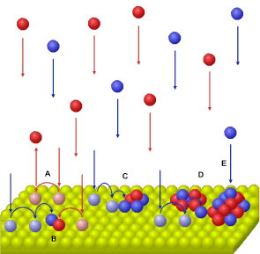
Competing Processes in Nucleation
Condensation from the vapor involves incident atoms becoming bonded adatoms which diffuse over the film surface until trapped at low energy lattice sites.
The atoms are continuously depositing on the surface. Depending on their energy and the position at which they hit the surface:
Re-evaporation from the surface
Adsorption (adatom)
sticking coefficient
=
mass deposited / mass impinging
Covalent/ionic bond with a surface atom-chemisorption.
Van der Waal’s bond with a surface atom -physisorption
Migration on the surface & interaction with each other or with the substrate atoms.
  Surface diffusion
  Bulk diffusion
  Desorption
  Shadowing
quantified by the characteristic diffusion & sublimation activation energies
from the line of sight impingement of arriving atoms
The dominance of one or more of these interactions is manifested by different structural morphologies.

Slide 13



Thin Film Growth Modes
3-D or island growth mode, also known as Volmer–Weber (VW) mode
  The adatoms have a strong affinity with each other and build 3-D islands that grow in all directions, including the direction normal to the surface. The growing islands eventually coalesce and form a contiguous and later continuous film.
2-D or layer-by-layer growth, also known as Frank–van der Merwe (FVDM) mode
  The condensing particles have a strong affinity for the substrate atoms: they bond to the substrate rather than to each other.
a mixed mode that starts with 2-D growth that switches into island mode after one or more monolayers; this mode is also known as the Stranski–Krastanov (SK) mode.
The film nucleation depends first and foremost on the nature of the material deposited (metal... )
Niobium as most metals grows often in the island mode, but of course it depends on the growth conditions.

Slide 14
Film Coalescence
Coalescence: 3 common mechanisms
1. Oswald ripening: atoms leave small islands more readily than large islands.
More convex curvature, higher activity, more atoms escape
2. Sintering: reduction of surface energy
3. Cluster migration:
Small clusters (<100Å across) move randomly
Some absorbed by larger clusters (increasing radius in height)
Similar studies for Nb growth on Cu are presently conducted by Prof. A Lukaszew's team (C. Clavero)
"Surface Science for Future Electronic Materials and Accelerator Applications“, AVS, Nashville , Oct. 30 -Nov 4, 2011
Topography STM maps of V islands deposited on Cr(001) substrates at 525 K with coverages from 0.12 to 1.65 AL. Layer-by-layer growth is observed. (PRB 82, 085445, 2010)
Once template has been formed, homo-epitaxy.

Slide 15
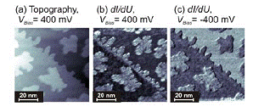
STM/STS studies-Proximity effects
STM images of V sub-monolayer on Cr. (a) Topography, (b) chemical contrast dI/dU map and (c) spin resolved dI/dU map corresponding to 0.24 AL V coverage.
C. Clavero, M. Bode, G. Bihlmayer, S. Bluegel and R. A. Lukaszew,
“Island assisted interface alloying and magnetic polarization at
submonolayer V/Cr interfaces”. Phys. Rev. B 82, 085445 (2010).
(a) Differential conductance curves measured on the substrate at different positions on one of the islands for 0.09 AL coverage.
(b, c) are topographic images.
(d) DOS simulations for a single V AL on Cr(001) and for a single AL of equi-atomic CrV alloy on Cr(001).
(PRB 82, 085445, 2010)

Slide 16
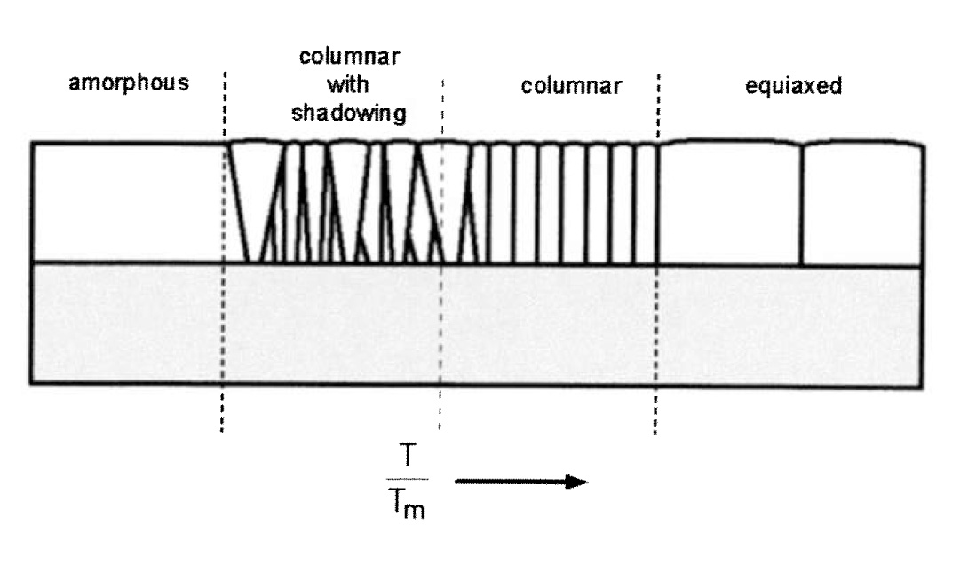
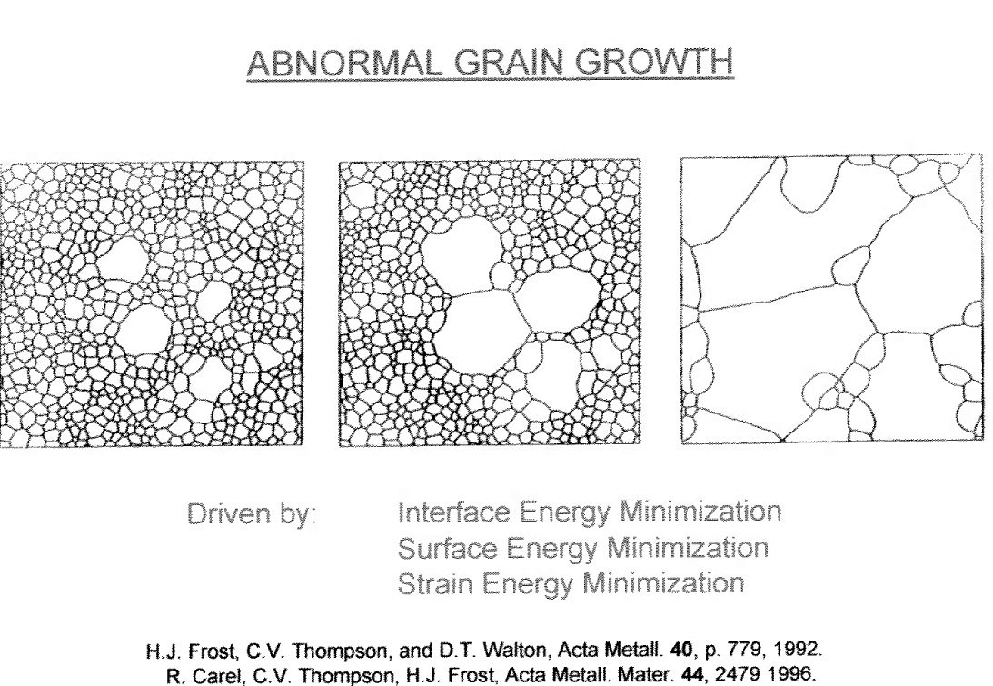
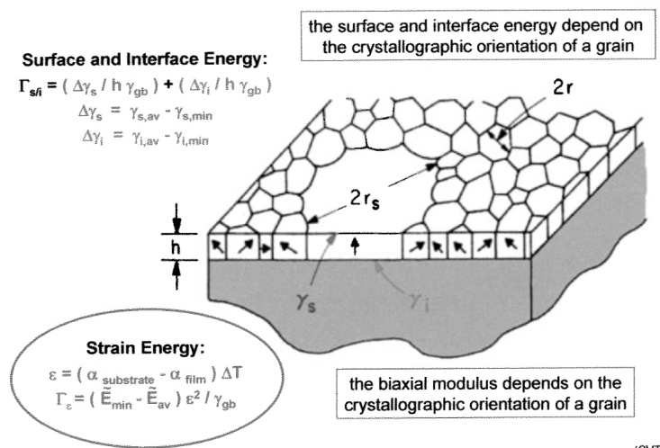
Subsequent Film Growth
The grain size of a polycrystalline film is affected by:
  • Substrate temperature during deposition (high for large grains)
  • Adatom diffusivity (high)
  • Annealing temperatures (high)
  • Deposition flux (low)
  • Impurity content (low)
  • Film thickness (high)
  Energy of the deposited atom (high)
  • Energy of bombarding ions/atoms (high)
  T_{m} of Material (low)
  • The materials class (metals)

Slide 17



Early stages of Nb growth on Al₂O₃
Using Reflection high energy electron diffraction (RHEED), a hexagonal Nb surface structure was observed for the first 3 atomic layers followed by a strained bcc Nb(110) structure and the lattice parameter relaxes after 3 nm.
RHEED images for the hexagonal phase at the third atomic layer. Patterns repeat every 60°.
0 deg 30 deg 60 deg

Slide 18
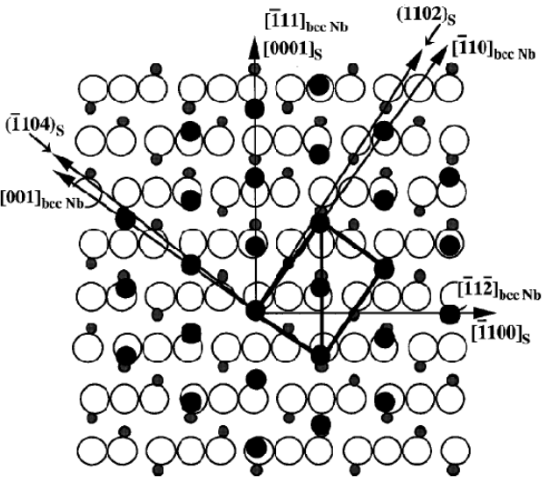
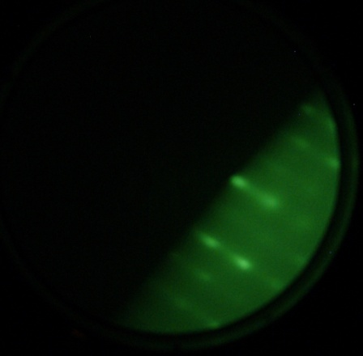
A. Lukaszew et al. , College of William & Mary
Subsequent Nb growth on
a-plane sapphire :
biaxial anisotropy in the surface
features.
.
Susceptibility AC measurements
50 nm
THPO047: Growth Mode and Strain Effects in the Superconducting Properties of Nb Thin Films on Sapphire
Cesar Clavero, Douglas Barry Beringer, Rosa A. Lukaszew, William Roach, Jonathan Skuza (The College of William and Mary, Williamsburg, VA), Charles E. Reece (JLAB, Newport News, VA)
χ(ω)= χ’(ω)+i χ’’(ω)

Slide 19
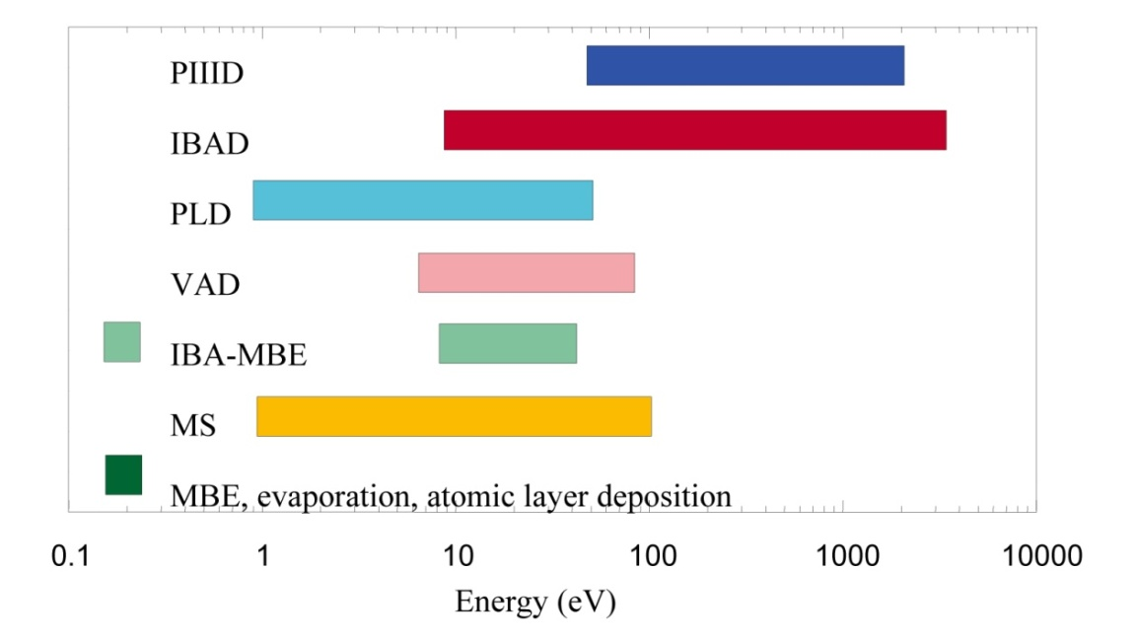
Deposition Techniques
Control over the deposition process is exercised by only
3 first-order vapor parameters & 1 first-order substrate parameter.
Vapor parameters Absolute arrival rates of film atoms
Partial pressures of background gases in the chamber Energies of the deposition fluxes.
Substrate parameter Substrate temperature T.
Without energetic atoms, only the substrate temperature influences the processes of physi- and chemisorption, thermal desorption, nucleation, nuclei dissociation, surface diffusion, and formation of specific nucleation sites.
Typical energy ranges for different PVD processes.
PIIID = plasma immersion ion implantation and deposition
IBAD = ion beam assisted deposition
PLD = pulsed laser deposition
VAD = vacuum arc deposition
IBA-MBE = ion beam assisted molecular beam epitaxy
MS = magnetron sputtering
MBE = molecular beam epitaxy.
However practical substrates for SRF cavities (Al, Cu) may not allow heating to high temperature!

Slide 20
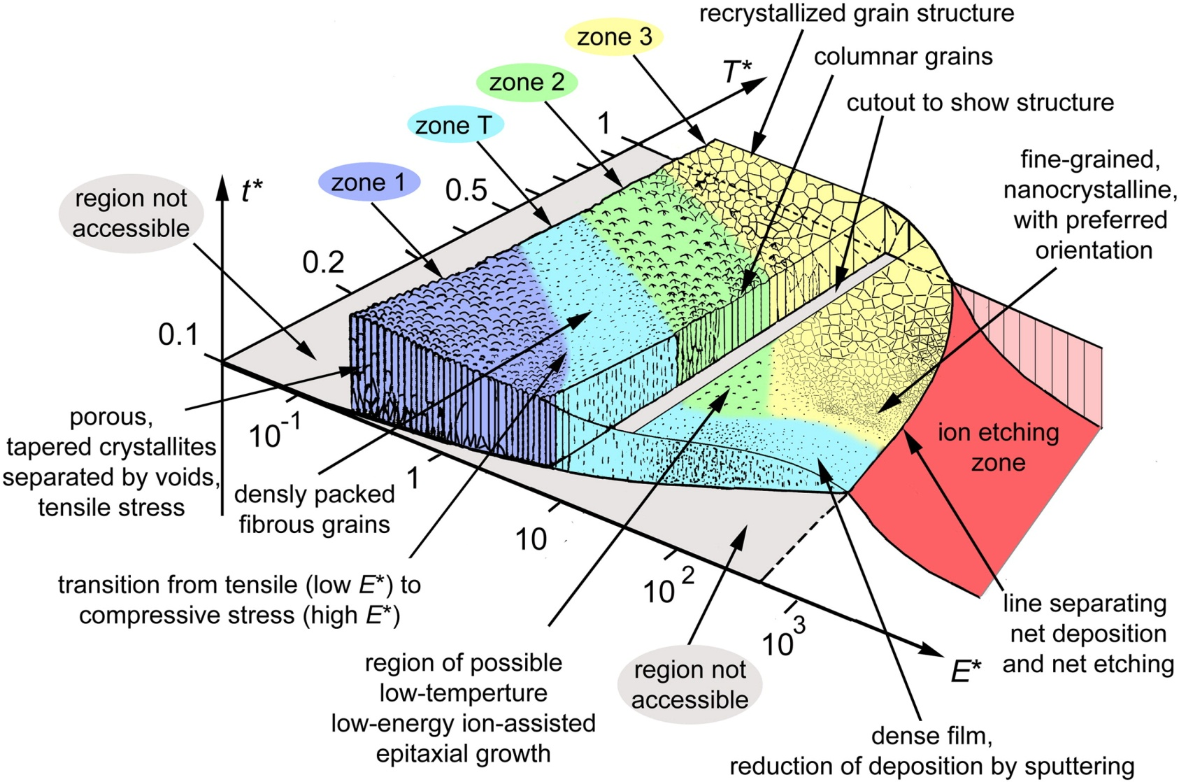
Deposition Techniques
Generalized Structure Zone Diagram
A. Anders, Thin Solid Films 518(2010) 4087
ENERGETIC CONDENSATION: HiPIMS, CED (Vacuum Arc Dep.), ECR…
Deposition process where a significant fraction of the condensing (film-forming) species have hyper-thermal & low energies (10 eV and greater).
Energetic condensation is characterized by a number of surface and sub-surface processes that are activated or enabled by the energy of the particles arriving at the surface such as desorption of adsorbed molecules, enhanced mobility of surface atoms, and the stopping of arriving ions under the surface.

Slide 21
Effect of ion energy and substrate temperature
Energetic particle bombardment (kinetic & potential energy) promotes competing processes of defect generation and annihilation.
                Promotion of surface diffusion of atoms
                Surface displacement (epitaxial growth)
                Bulk displacement cascades :defects followed by re-nucleation
                Post-ballistic thermal spike → atomic scale heating , annihilation of defects followed by re-nucleation (transient liquid, large amplitude thermal vibrations facilitating diffusion, migration of interstitials inside grains & adatoms on the surface).
                E_{pot}/E_{kin} per incident particle as well as the absolute value of the kinetic energy will shift the balance and affect the formation of preferred orientation and intrinsic stress (Minimization of volume free energy and surface free energy density).
                Sub-implantation - insertion of atoms under the surface yet still very little annealing .
                Sputtering yield is increased & net deposition rate is reduced (re-sputtering).
                Film growth ceases as the average yield ~1 (400-1400eV)
                Surface etching as energy further increased is further increased
At higher temperature (higher homologous temperature or temperature increase due to the process itself) the grains are enlarged because the increase of adatom mobility dominates over the increased ion-bombardment-induced defects and re-nucleation rates.
All energy forms brought by particles to the surface will ultimately contribute to broad, non-local heating of the film and shift the working point of process conditions to higher homologous temperature.
Regions of dominance for various ion-bombardment processes as a function of ion/atom ratio & ion energy.
J.M.E Harper et al., Ion Bombardment Modification of Surfaces: Fundamentals and Applications, eds. O. Auciello and R. Kelley, Elsevier, Amsterdam, 1984

Slide 22
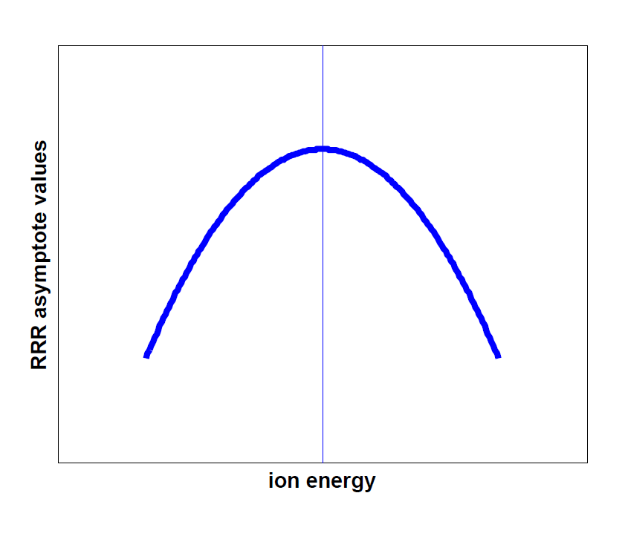
Effects of energetic condensation
The additional energy provided by fast particles arriving at a surface can induce the following changes to the film growth process:
  residual gases are desorbed from the substrate surface
  chemical bonds may be broken and defects created thus affecting nucleation processes and film adhesion
  film morphology changes
  microstructure is altered
  stress in the film alters
As a result of these fundamental changes, energetic condensation allows the possibility of controlling the following film properties:
  the density of the film may be modified to produce improved optical and corrosion-resistant coatings
  the film composition can be changed to produce a range of hard coatings and low friction surfaces
  crystal orientation may be controlled to give the possibility of low-temperature epitaxy.

Slide 23
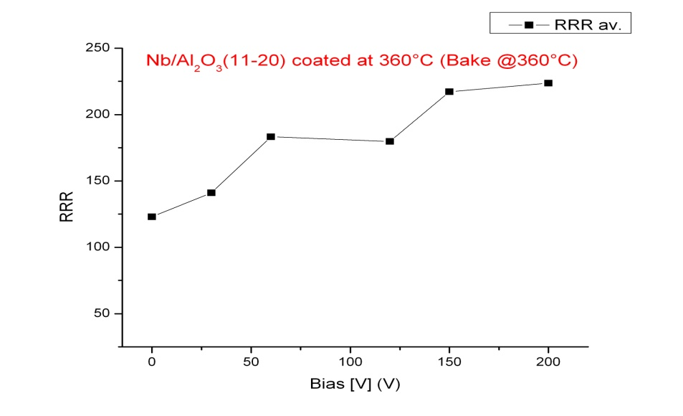
Effect of Ion energy, baking & coating temperatures
Nb grown on a-plane sapphire (ECR)
Nb grown on a-plane sapphire (Bias -120V)
RRR vs. .Bake & Coating Temp.
Bake Temp. | Coating Temp. | Bias [V] | Al₂o₃ (11-20)
360°C | 360°C | -120 | 179.8
360°C | 500°C | -120 | 189
700°C | 360°C | -120 | 348
500°C | 360°C | -120 | 348
500°C | 500°C | -120 | 488
Nb grown on a-plane sapphire
RRR vs. Bias
Nb (110) on (11-20) Al₂O₃
30’ coating, pressure during coating ~2.5e-8Torr

Slide 24
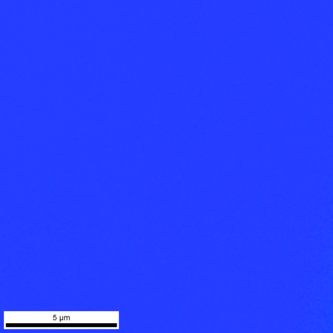
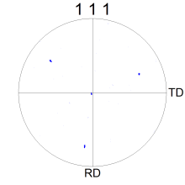
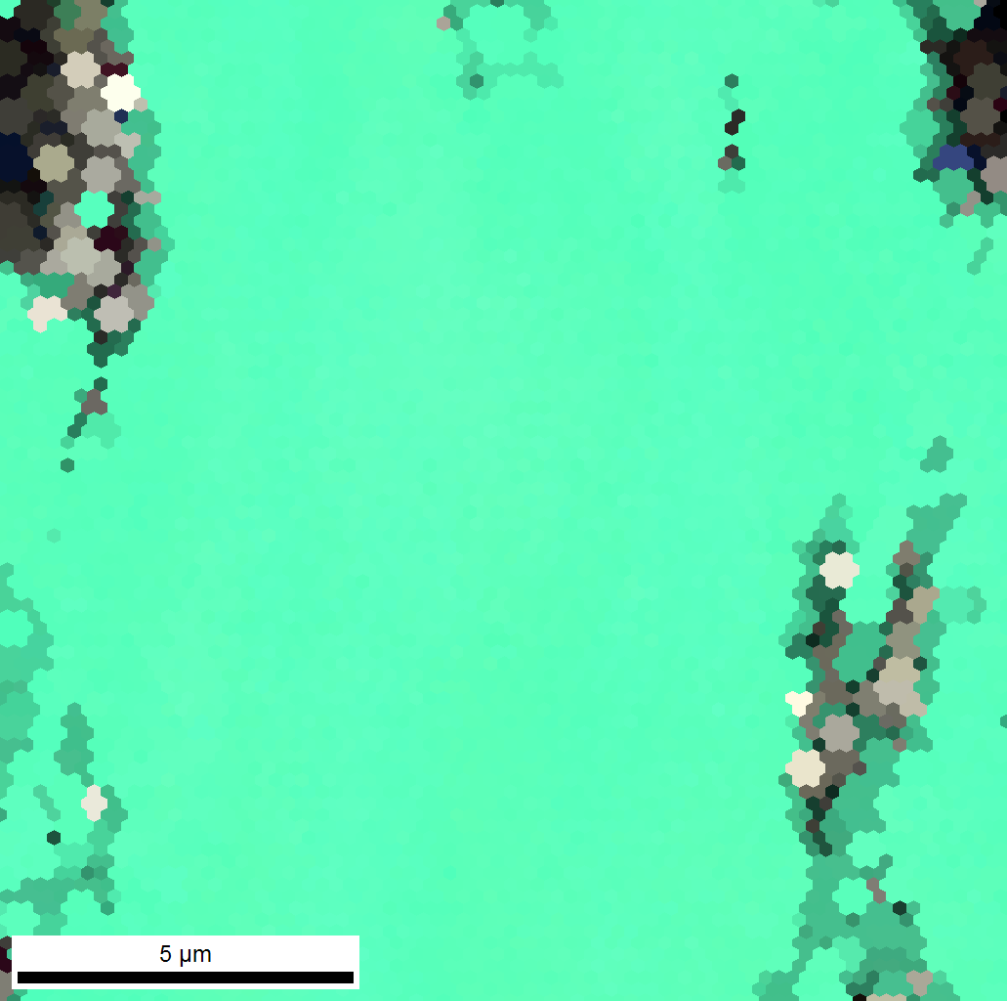
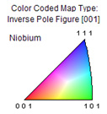
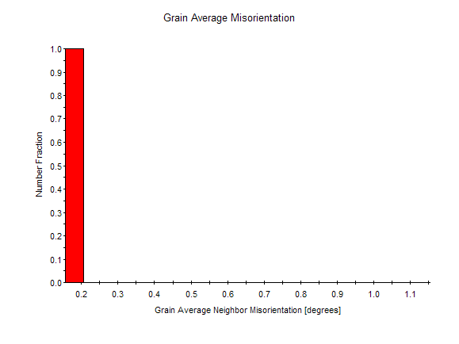
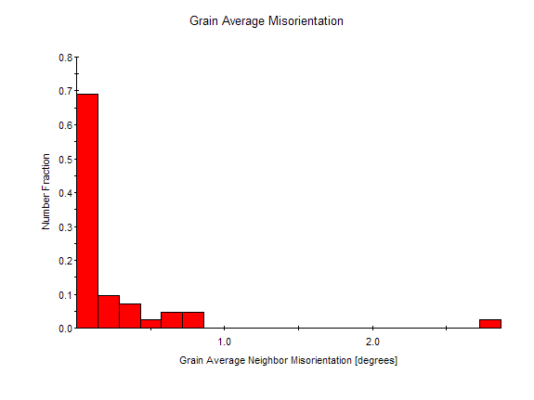
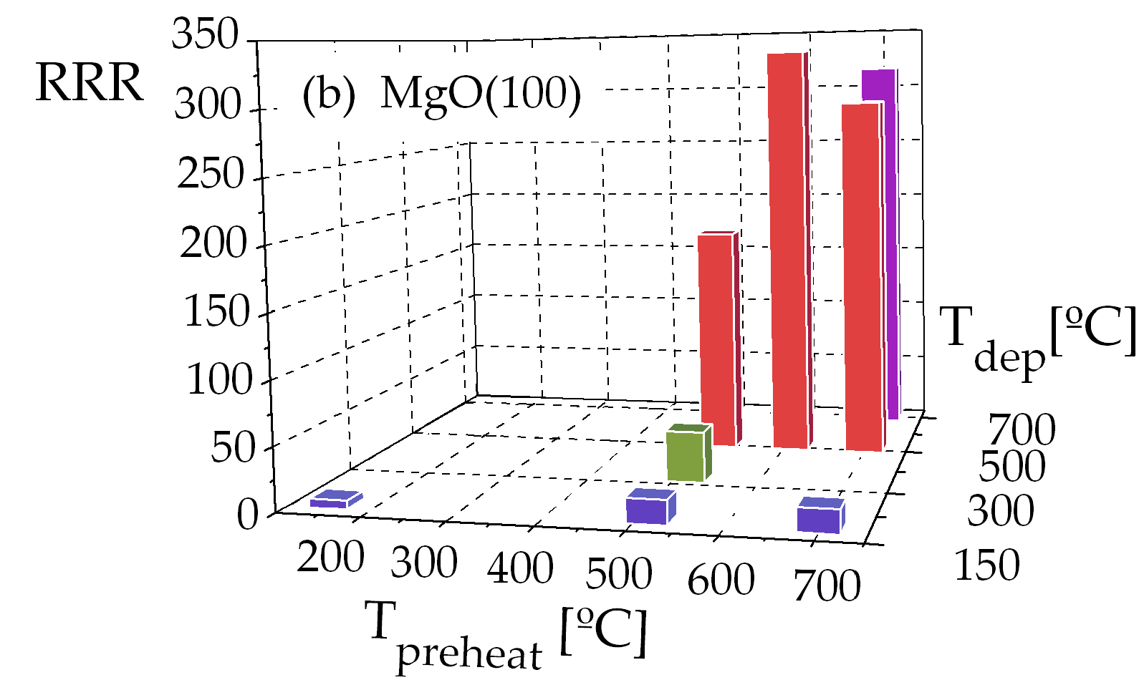
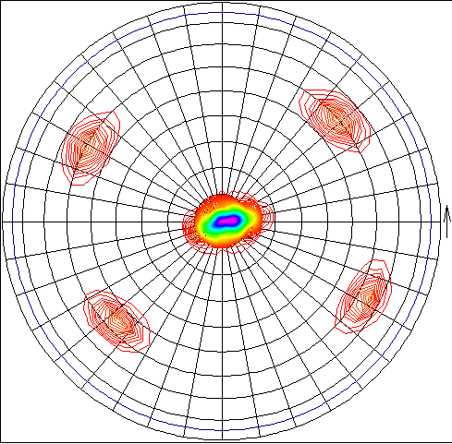
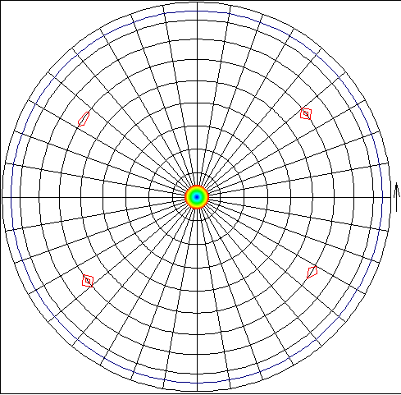
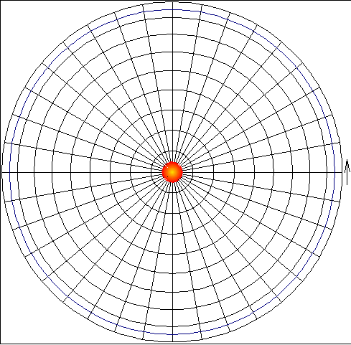
Film Nucleation
0V
-150V
Influence on ion energy on ECR film on Al2O3 (0001):switch from [111] to [110] above -90V bias (>154eV)
THPO064 Structural Properties of Niobium Thin Films Deposited on Metallic Substrates by ECR Plasma Energetic Condensation
AASC, Anne-Marie Valente-Feliciano, Larry Phillips, Charles E. Reece, Xin Zhao (JLAB, Newport News, Virginia), Kang Seo (NSU, Newport News), Diefeng Gu (ODU, Norfolk, Virginia)
CI =0.82
0.320°
CI =0.24
MBE Nb films on (0001) sapphire grow along (111) at 900°C, but (110) at 1100°C.
T. Wagner et al., J. Mat. Res. Vol. 11, nº5, pp. 1255-1264 (1996), Mat. Res. Symp. Proc, Vol. 440, pp.151-156, (1997)
5000x, 15 μm x 15μm, 0.1 μm step
Influence on temperature on CED films on MgO (100):
switch from (110) to (200) @700°C
Polycrystalline
Monocrystal with 2 variants
Monocrystal (100)
THPO044 Structural Characterization of Nb Films Deposited by ECR Plasma Energetic Condensation on Crystalline Insulators
Xin Zhao, Anne-Marie Valente-Feliciano, Larry Phillips, Charles E. Reece, Joshua K. Spradlin, (JLAB, Newport News, Virginia), Kang Seo (NSU, Newport News), Diefeng Gu (ODU, Norfolk, Virginia)
110 & 200
110
200
AASC
RRR=7, 150°C
RRR=181, 500°C
RRR=316, 700°C

Slide 25
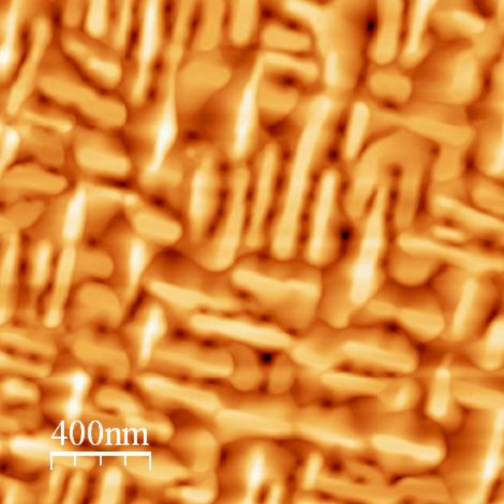
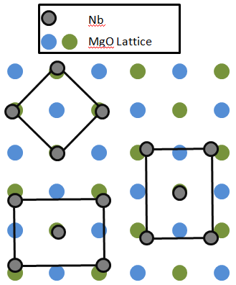
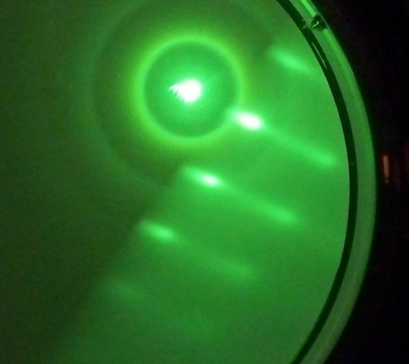
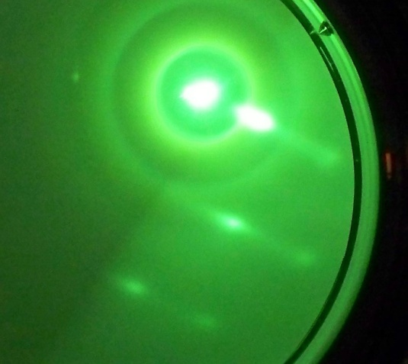
Nb on MgO(001)
14.29nm
slow deposition rate leads to rough surface with perpendicular (011) domains
Faster deposition rate leads to smoother surface with regular features indicative of single crystal (001) film!
RRR = 46.5
RMS = 6.51 nm
RRR = 165
RMS = 4.06 nm
RHEED images for Nb(110) on MgO
RHEED beam along MgO [100]
RHEED beam along MgO [110]
Two orthogonal patterns indicative of biaxial anisotropy of the surface features
Same substrate but different growth rate lead to very different growth

Slide 26
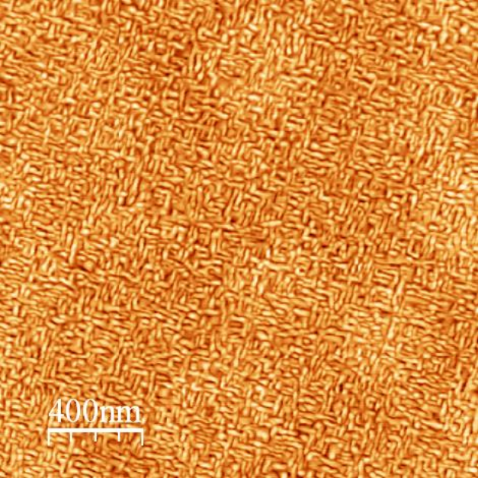
Scaling of surface features
50 nm
600 nm
THPO065 Anomalous Morphological Scaling in Epitaxial Nb Thin Films on MgO(001) Douglas Barry Beringer, Cesar Clavero, Rosa A. Lukaszew, William Roach(The College of William and Mary, Williamsburg), Charles E. Reece (JLAB, Newport News, Virginia)
Same scale in both images!
The surface features coarsen in the
thicker film, but retain their overall symmetry
RRR = 46.5
RMS = 6.51 nm

Slide 27
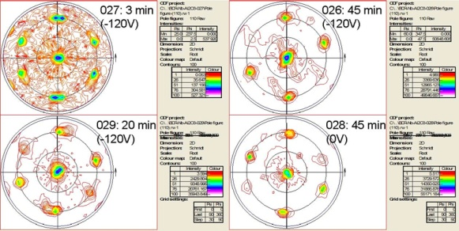
Evolution of Crystal Growth for Nb/Al₂O₃
4μm
XRD pole figures show the presence of growth domains (rotation the poles of 70°)
As the film grows one growth variant prevails.

Slide 28
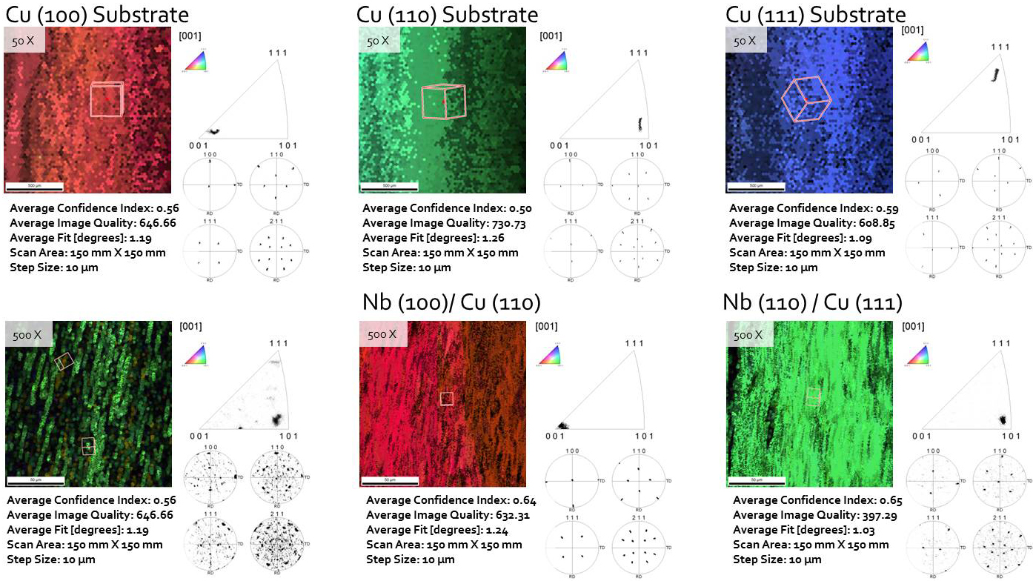
Nb on Cu single crystals
RRR=88
RRR=76
RRR=242
THPO064 Structural Properties of Niobium Thin Films Deposited on Metallic Substrates by ECR Plasma Energetic Condensation
Joshua K. Spradlin, Anne-Marie Valente-Feliciano, Larry Phillips, Charles E. Reece, Xin Zhao (JLAB, Newport News, Virginia), Kang Seo (NSU, Newport News), Diefeng Gu (ODU, Norfolk, Virginia)
In the same run, Nb/fine grain Cu RRR=82
Nb/large grain Cu RRR=169

Slide 29
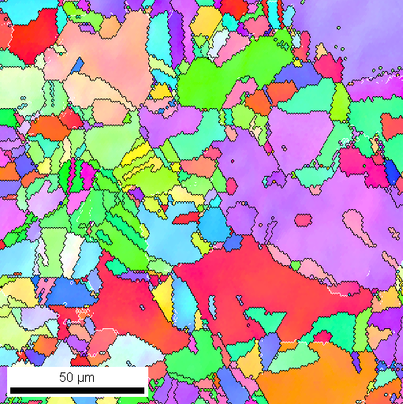
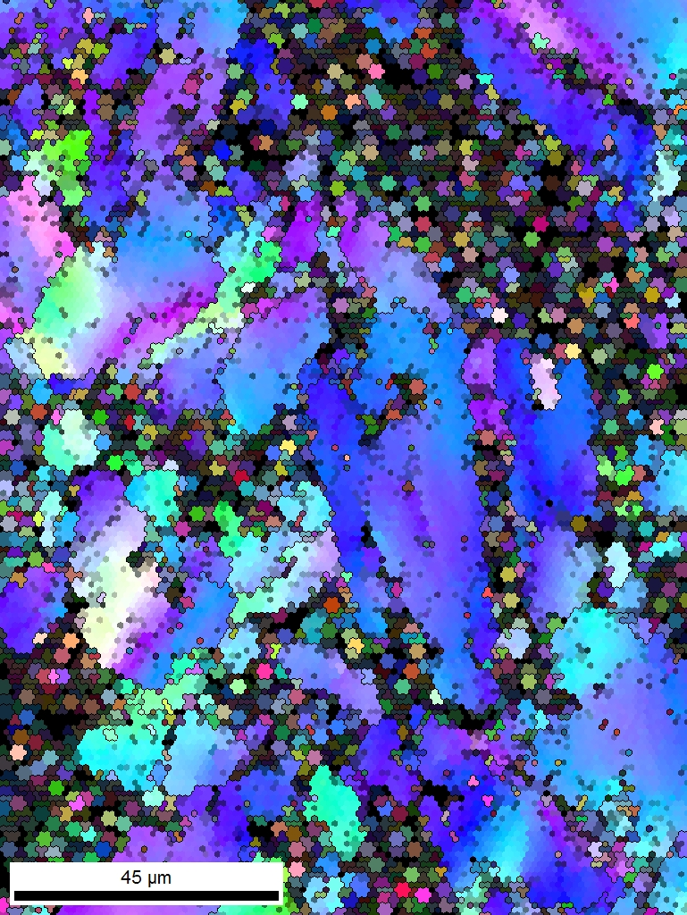
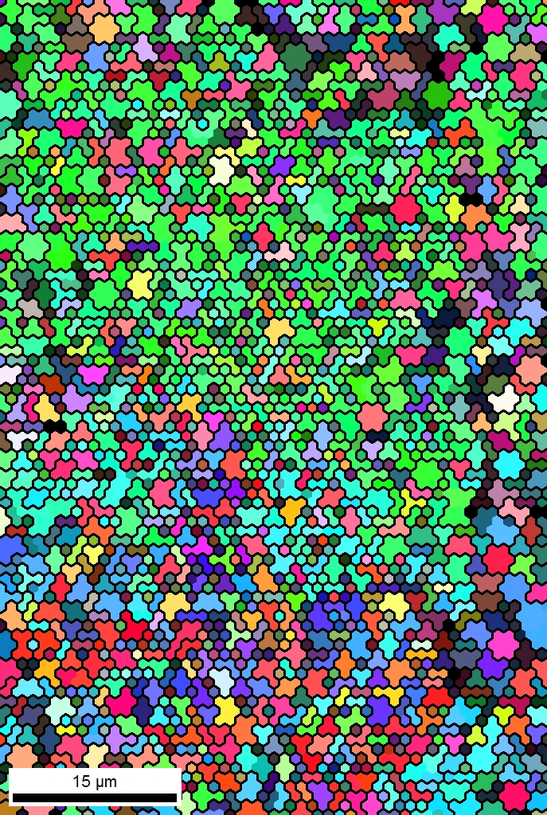
Effect of Bias Voltage for Nb on Cu
150 x 150 μm, 1 μm resolution, CI Avg. 0.71
Typical Cu substrate
Bias 0V , 4μm
Bias -120V, 2μm
Ab-normal growth
vith bias
vs.
columnar growth
without bias
120 x 150 μm, 1 μm resolution,
CI Avg. 0.23
50 x 75 μm, 1 μm resolution,
CI Avg. 0.16

Slide 30
Concluding Remarks
Substrate preparation (cleanliness, annealing of defects…) is critical.
The structure and morphology of the film are highly dependent on the substrate nature.
Nucleation & Growth modes :
The Nb film structure can be tuned from columnar growth, ab-normal to equi-axial growth by varying the incident ion energy with the substrate temperature for temperatures lower than if using thermal process only.
Enable use of adequate substrates for cavities (Cu, Al…)
Growth of preferred orientation as function of energy, temperature and growth rate (and substrate):
Nb/ Al2O3 (0001) from (111) to (110)
Nb/MgO (100) from (110) to (100)

Slide 31
Towards Bulk-like Engineered Nb Films
3 sequential phases for film growth
  Film nucleation on the substrate (Nb, Al₂O₃, Cu; single crystal & polycrystalline)
  Growth of an appropriate template for subsequent deposition of the final RF surface
  Deposition of the final surface optimized for minimum defect density.

Slide 32
Some RRR values measured recently:
MgO (100) 585 CED
MgO(110) 424 ECR
MgO(111) 176 ECR
Al2O2 (11-20) 488 ECR
Al2O3(0001) 247 ECR
Cu fine grains 82 ARCO, ECR
Cu large grains 289 ECR
Cu(111) 242 ECR
Al2O3 ceramic 89 ECR
AlN ceramic 72 ECR
Fused silica 34 ECR
Borosilicate 30 CED

Slide 33
SRF Thin Films Collaboration
Jlab: C.Reece, A-M Valente-Feliciano, J. Spradlin, L. Phillips, X. Zhao, B. Xiao, A. Wu
W&M: A. Lukaszew, D. Beringer, W. Roach, C. Clavero , R. Outlaw, O. Trofimova
NSU: K. Seo
ODU: H. Baumgart, D. Gu
Black Labs LLC: R. Crooks
NCSU: F. Stevie, D. Batchelor
AASC:M. Krishnan, E. Valderrama
Under DOE HEP Grant ARRA & U.S. DOE Contract No. DE-AC05-06OR23177
Special Thank You
Considerable improvement has been already accomplished thanks to the contributions from the different past & present research teams involved (AASC Inc., ANL, CERN, College William& Mary, INFN-LNL, INFN Roma II, JLAB, LANL, LBNL, SLAC, Temple Uni …)

Slide 34
Backup slides

Slide 35
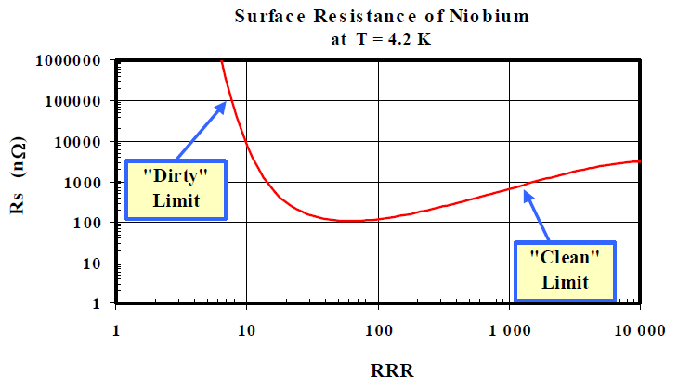
Optimum RRR
Image: CERN Accelerator School

Slide 36
Effect of ion energy on film growth
A. Anders / Thin Solid Films 518 (2010) 4087–4090
Kinetic energy of arriving positive ions - an initial component from the plasma, E₀ - a change due to acceleration in the sheath, E_{kin}=E₀+QeV_{sheath} where Q =ion charge state number, e =elementary charge, and V_{sheath} is the voltage drop between plasma and substrate surface.
Promotion of surface diffusion of atoms.
Between the surface displacement energy and bulk displacement energy: epitaxial growth is promoted because no defects are created in the film bulk .
Atomic displacement cascades if E_{kin} > E_{bulk} _{displacement}, (12–40 eV)
Very short (∼100 fs) ballistic phase with displacement cascades followed by a thermal spike phase (∼1 ps) (mobility of atoms in the spike volume very high) ~ transient liquid
large amplitude thermal vibrations still facilitate diffusion (migration of interstitials inside grains & adatoms on the surface).
The driving force is the gradient of the chemical potential, leading to minimization of volume free energy and surface free energy density with contributions of interface and elastic strain energies and often resulting in a film where grains have a preferred orientation.
As E_{kin} increase, e.g. by biasing, the sputtering yield is increased and the net deposition rate is reduced.
Film growth ceases as the average yield approaches unity, for most elements between 400 eV and 1400 eV
Surface etching as E_{kin} is further increased.
Non penetrating particles
Incident ion energy
Penetrating particles
L. Hultman, J.E. Sundgren, in: R.F. Bunshah (Ed.), Handbook of Hard Coatings, Noyes, Park Ridge, NY, 2001, p. 108.
D.K. Brice, J.Y. Tsao, S.T. Picraux, Nucl. Instrum. Methods Phys. Res. B 44 (1989) 68.
G. Carter, Phys. Rev. B 62 (2000) 8376.
M.M.M. Bilek, D.R. McKenzie, Surf. Coat. Technol. 200 (2006) 4345.
D.R. McKenzie, M.M.M. Bilek, Thin Solid Films 382 (2001) 280
W. Eckstein, Computer Simulation of Ion-Solid Interactions, Springer-Verlag, Berlin,1991.
D.K. Brice, J.Y. Tsao, S.T. Picraux, Nucl. Instrum. Methods Phys. Res. B 44 (1989) 68.

Slide 37
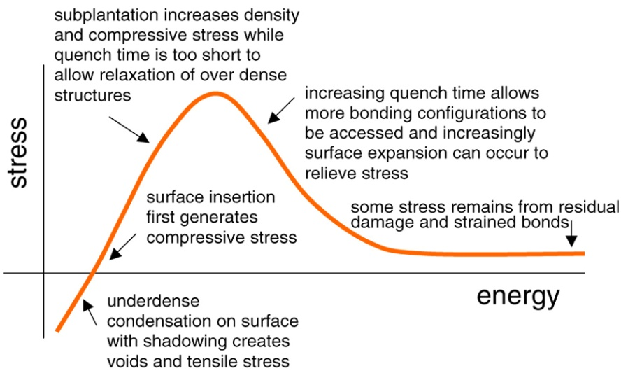
Effect of ion energy and substrate temperature
Energetic particle bombardment promotes competing processes of defect generation and annihilation.
  Kinetic energy → displacement and defects followed by re-nucleation
  Release of potential energy & post-ballistic thermal spike → atomic scale heating, annihilation of defects.
        - E_{pot}/E_{kin} per incident particle as well as the absolute value of the kinetic energy will shift the balance and affect the formation of preferred orientation and intrinsic stress .
        Maximum of intrinsic stress for E_{kin} ~100 eV; the actual value depends on the material and other factors. insertion of atoms under the surface yet still very little annealing .
At higher temperature (higher homologous temperature or temperature increase due to the process itself) the grains are enlarged because the increase of adatom mobility dominates over the increased ion-bombardment-induced defects and re-nucleation rates.
All energy forms brought by particles to the surface will ultimately contribute to broad, non-local heating of the film and shift the working point of process conditions to higher homologous temperature.
[M. M. Bilek, D. R. McKenzie “A comprehensive model of stress generation and relief processes in thin films deposited with energetic ions” Surf. And Coat. Techno. 200 (2006) 4345-4354]

Slide 38
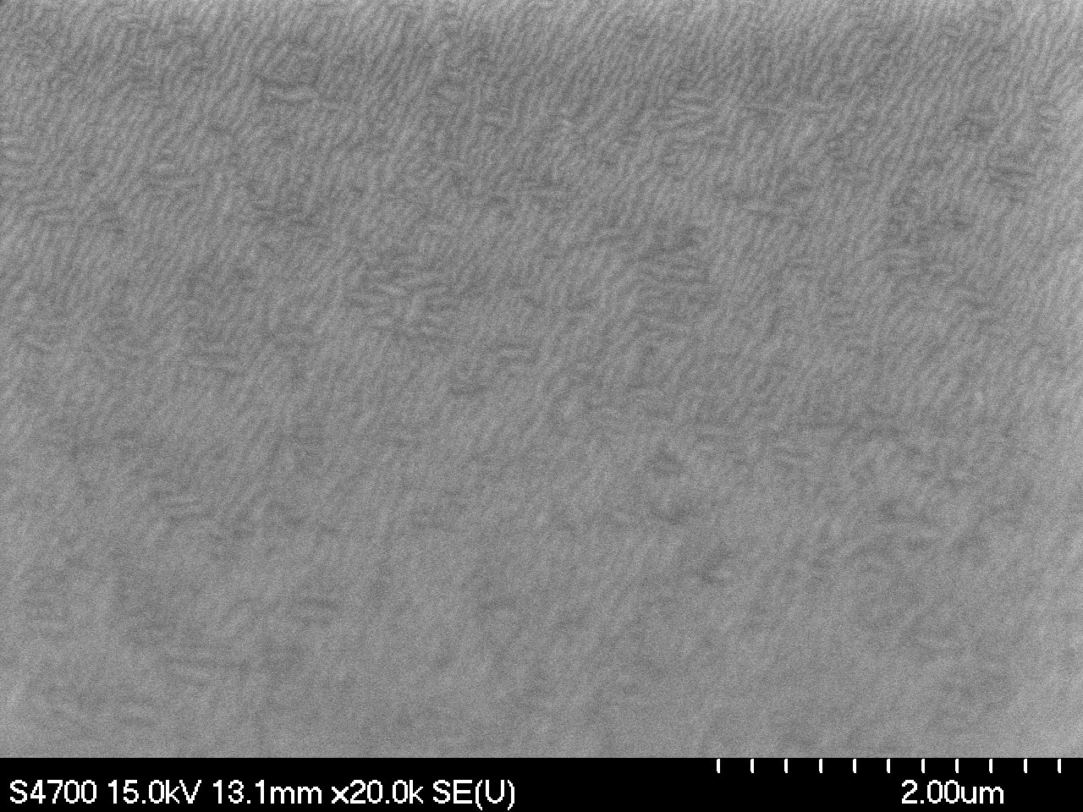
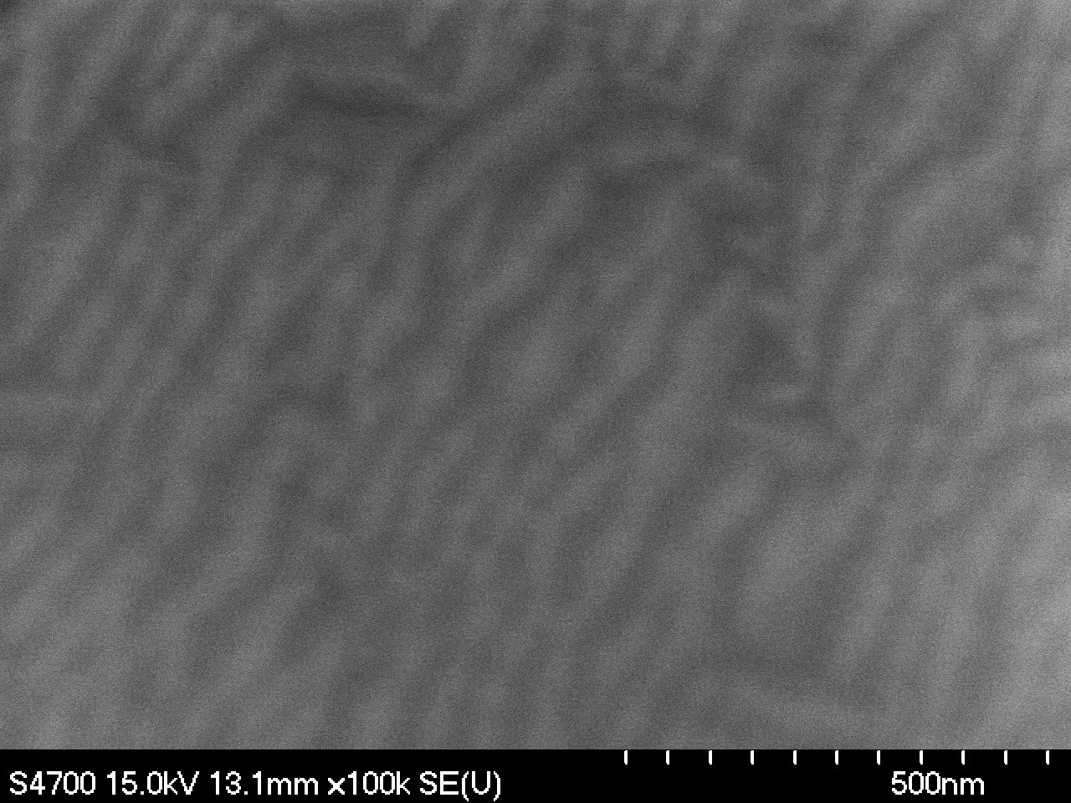
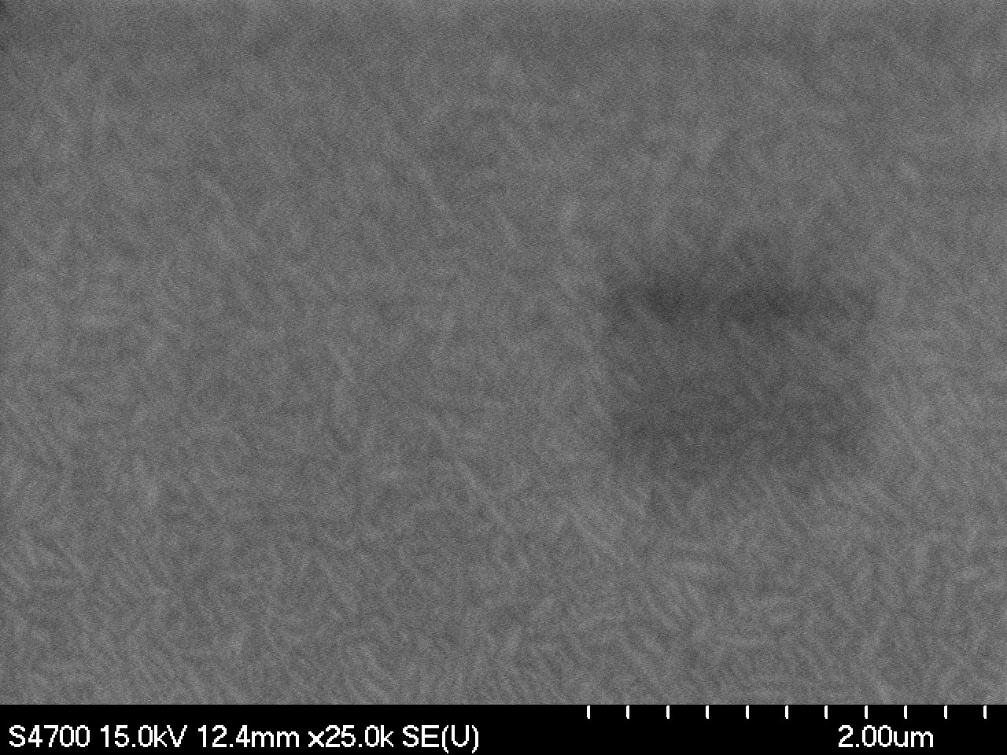
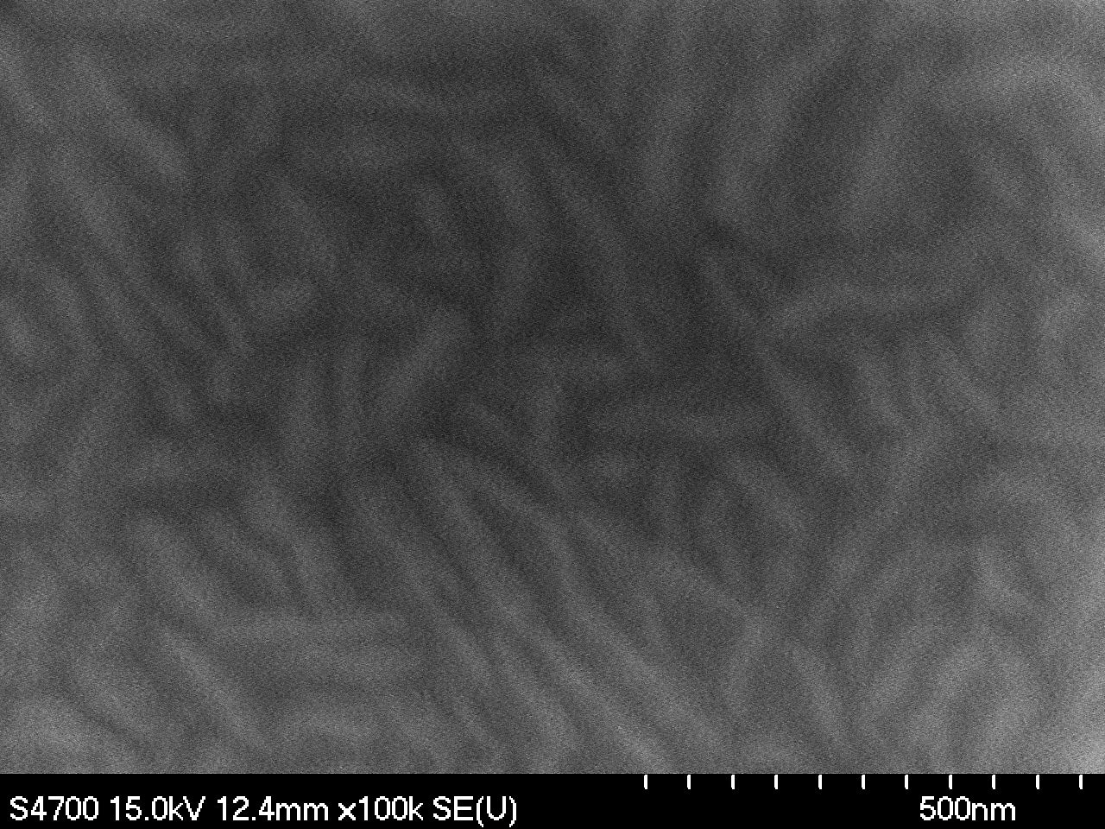
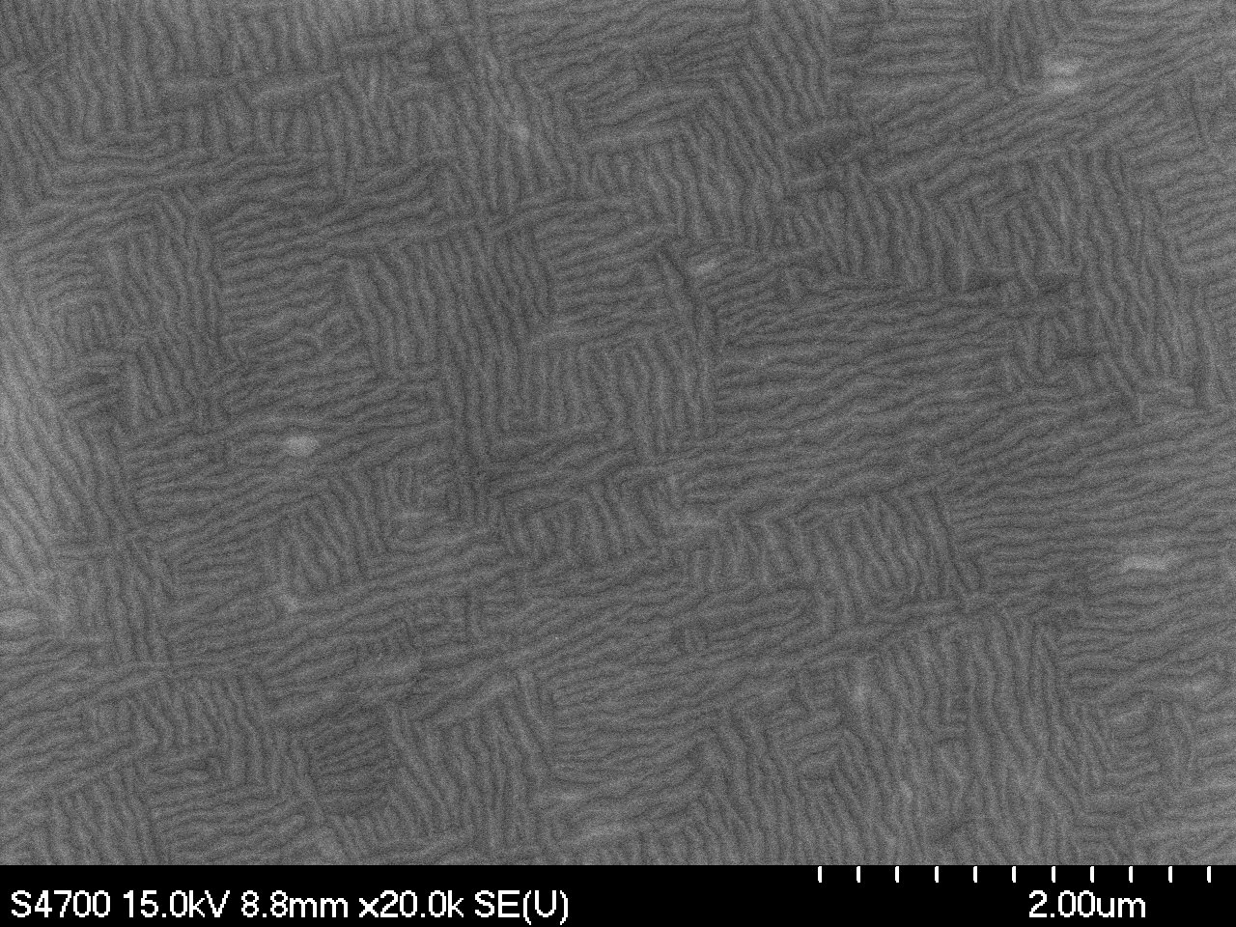



Nb/a-Al₂O₃ (11-20)
Nb/c-Al₂O₃ (0001)
Nb/MgO (100)
Nb/Cu

Slide 39






Nb/Al2O3 (11-20), magnetron sputtered @ 600°C
A. Lukaszew et al., College William & Mary
50nm
600 nm
RMS Roughness=4.84 nm
RRR = 96
After 50 nm
XRD pole figures about Nb(110)peak indicate (011) texturing along the 2 possible in-plane orientations in the thinner films while a strong preferred orientation was observed in the thicker film, consistent with the observed surface morphology.

Slide 40

R_{s} measurements for Nb/Cu

Slide 41





Strain Evolution & Structure
Lukaszew et al., College William & Mary
RHEED
•RHEED images were collected for epitaxial niobium for varying thicknesses and growth parameters.
•Image processing with MATLAB allows for a systematic way to abstract information related to surface crystallinity and morphology.
•A specific image can be used to calculate the lattice parameter corresponding to the top most layer of the sample using the following equation: a*= 2πW/λL
•Curve-fitting models are then applied to obtain quantitative information to extract the in-plane strain and lattice parameters

Slide 42



Cu thermal roughening
Heat Treatment@ 750 °C
In the range of the film thickness!!!
Z Range = 681.45 nm
RMS = 33.8 nm
Ra = 25.1 nm
Cu when heated to temperatures higher than 400°C due to roughening (P. Zeppenfeld et al., PRL 62,1, Jan 89)
            T_{roughening} Cu (111)~400°C
            T_{roughening} Cu (110), (100)>700°C

Slide 43

Nb/CuO – High Resolution TEM

Slide 44
RMS = 2.90 nm
RMS = 1.21 nm
RMS = 1.08 nm

