Slide 1
EBW Weld preparation and Weld Gap Detection
Hot Topic SRF 2011
By Ralf Edinger, PAVAC
July 28, 2011, Chicago

Slide 2
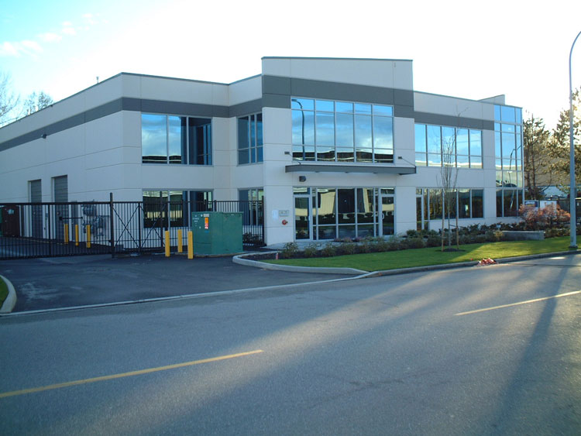
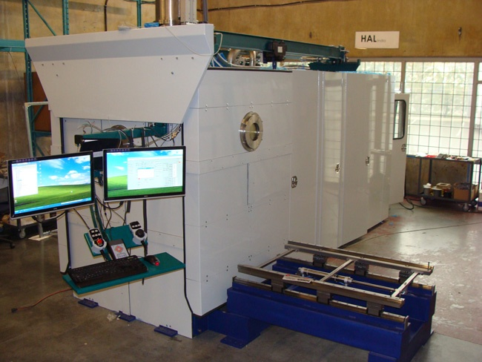
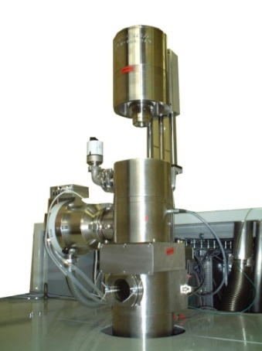
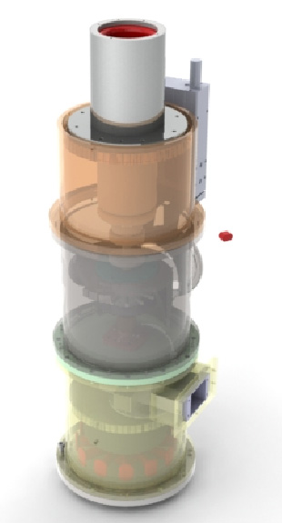
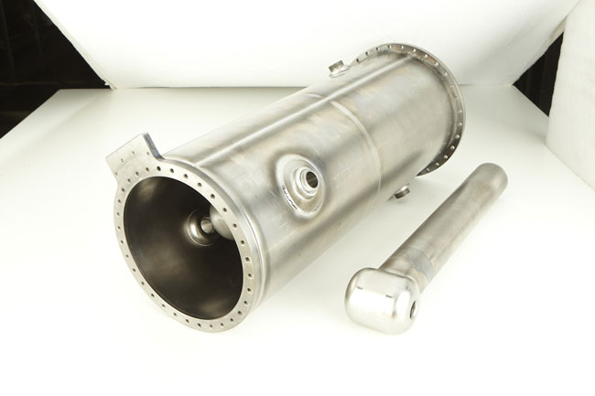
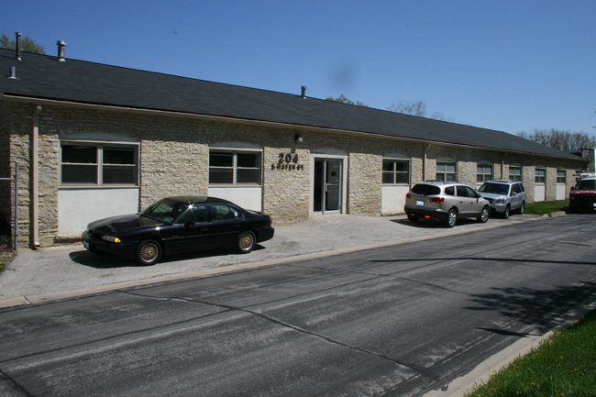
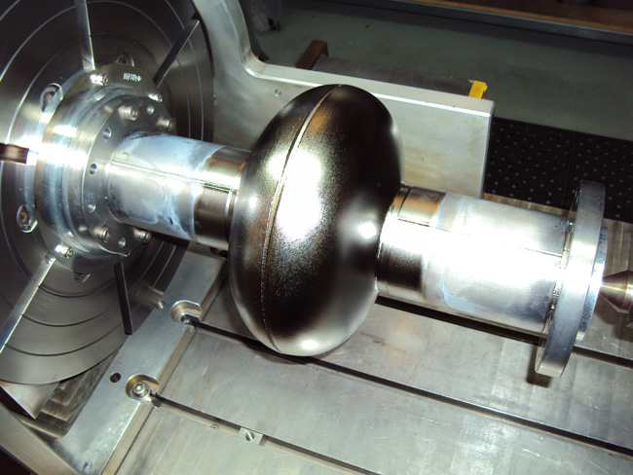
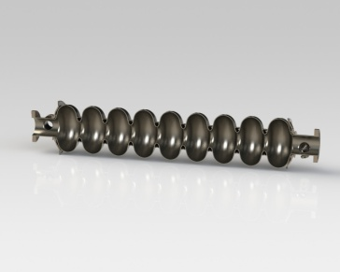
Introduction
PAVAC Industries Inc.
12371 Horseshoe Way, Unit 105
Richmond, BC
V7A 4X6, Canada
Phone 1 (604) 231 0014
Fax 1 (604) 326 9078
Electron Beam
SRF-Cavities
PAVAC produces Electron Beam Machines (EBW, EB-PVD...) and fabricates SRF cavities.
PAVAC Energy Corp.
204 S. Water Street
Batavia, IL,
60510, USA
Phone 1 (630) 326 9012
Fax 1 (630) 326 9078

Slide 3
EBW
Start at defining fabrication tolerances
Should allow test assembly before pre-weld etching, but minimizes the weld gap
Weld edge after pre-weld etch
Difficulty assembling etch parts
Geometric dimensioning and tolerance (GD&T)
Costs related to tolerances
0.02mm – 0.05mm – 0.1mm
Weld Gap detection
Positioning and contour accuracy during EBW

Slide 4
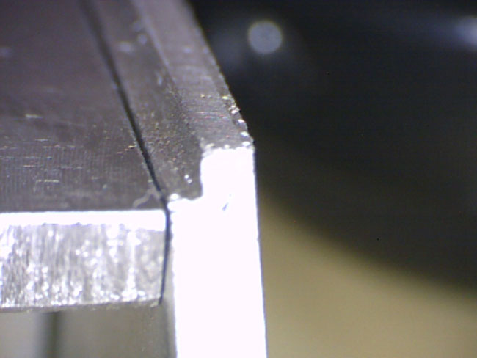
Conclusion to weld geometry
EBW requires to design a weld geometry which allows better melting of RRR Nb and NbTi. The proposed changes can be achieved with existing material selection.
Step in Beam tube min 0.8mm; can be achieved without changing the 3mm RRR Nb Sheet
3mm

Slide 5
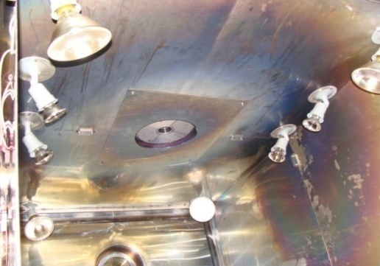
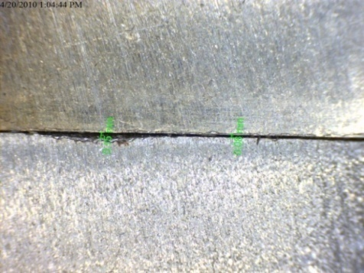
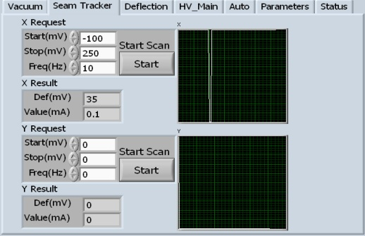
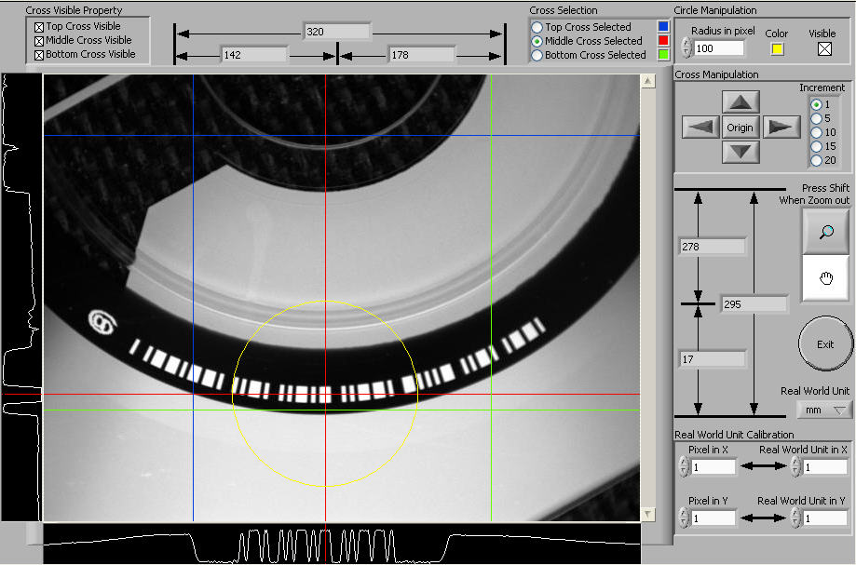
Weld Gap Detection
CCD Camera + Machine Vision
Machine Vision System takes real time CCD images and processes data and displays key information for user.
Reflective Electrons
Seam tracker (electron trap) mounted isolated in chamber
Software analysis the returned electrons and finds the gap.
Under Development
X-Ray Detection
X-Rays from electron beam show structural changes on X- ray chip below weld parts. X- ray image (array) transferred to Machine Vision software for processing.
e
X-Ray CCD

Slide 6
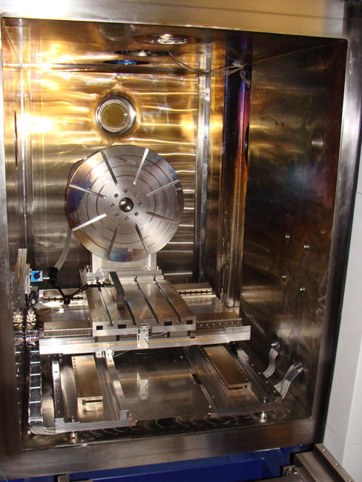
Accuracy and Repeatability
PAVAC uses AC linear motors combined with linear scales. Linear motors have no contact and, therefore, lubrication is not required.
Linear scales have a resolution of 0.001mm and allow a repeatability of less than 0.005mm.
The increased machine accuracy allows a better positioning of the beam for welding.
In order to form a consistent under bead in cavity areas, the beam requires a positioning accuracy of plus/ minus 0.025mm. Therefore the machine requires for control purposes a 10 times higher process resolution, which is 0.0025mm.
Linear Scales

Slide 7
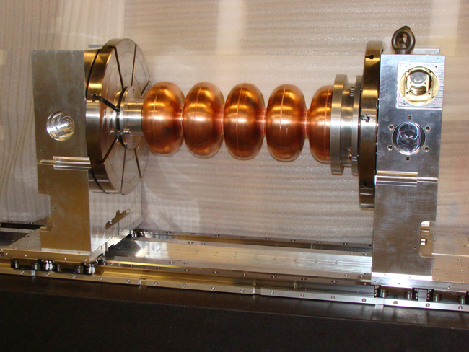
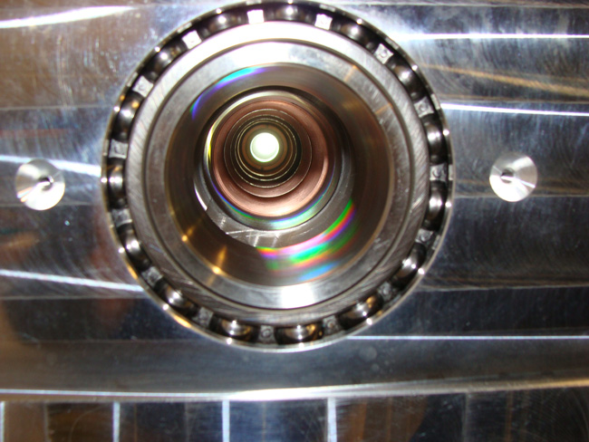
Vacuum Inside Cavity
Smart fixtures for better alignment and faster weld assembly
Vacuum pressure inside the cavity during weld procedures requires optimal tool design

Slide 8
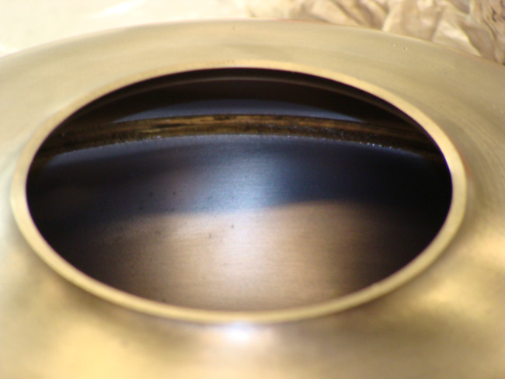
EBW & Fixture
BEAM - ARRANGEMENT
TYPE 1
TYPE 2
TYPE 3
EBW fixture to secure half cell close to equator during welding. Integrated dynamic weld preload (springs) for length compensation.
Effect: Colder surfaces (steeper Δ T) reduces adhesive bonding of weld deposition.

Slide 9
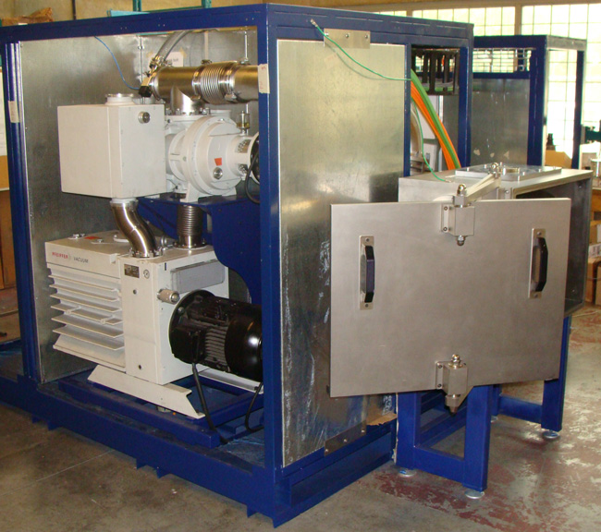
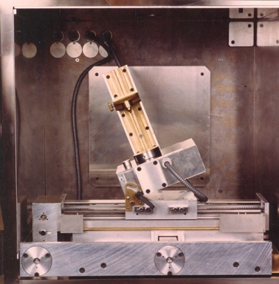
End Cell Fabrication
EBW-Medium Chamber for Aerospace Sensors
Design for end-cell production
Pump down to weld pressure 30 seconds
Single (simple) task tooling and process controls
Changing setup is easy
Operation entry user level

