Slide 1
EP Process Flow for 1.3 GHz Elliptical Shaped Cavities at the ANL/FNAL SCSPF
Cavity arrives at ANL
Cavity inspection, weight measurement, and ultrasonic thickness measurements
Ultrasonic cleaning (1% liquinox, 120°F, 60 min)
Mount cavity on EP tool and leak check system with water
Electropolishing
Ultrasonic cleaning (1% liquinox, 120°F, 60 min)
High pressure rinsing (2 passes)
1st assembly
High pressure rinsing (3 passes)
Final assembly
Leak check and RGA scan
Cavity leaves ANL for baking, testing, etc.

Slide 2
Evolution of ANL EP Parameters
Old ANL EP parameters
Constant voltage EP (18 V)
Acid return temperature 30-35°C
Acid recipe (85:10 vol ratio, old siemens recipe) and later standard 9:1 vol ratio (Feb 2010)
Changes made to EP parameters beginning March 2010 based on discussions with FNAL, KEK, J-Lab
Adjusted ANL EP parameters (April 2010)
Constant voltage EP (14.5 V)
Cavity surface temperature at equator of 30-35°C for bulk EP, 25-30°C for light EP
Standard 9:1 vol ratio electrolyte

Slide 3
Evolution of ANL EP Parameters
Decrease in Q_{o}
Adjusted EP parameters resulted in lower Q values (no longer polishing on plateau of I-V curve)

Slide 4
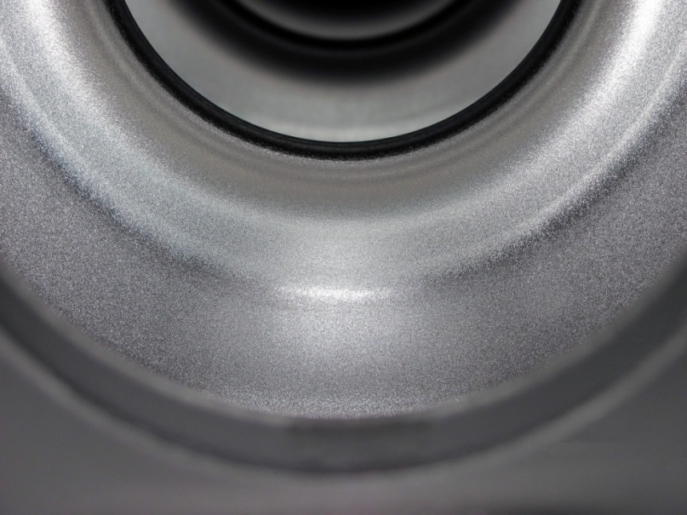
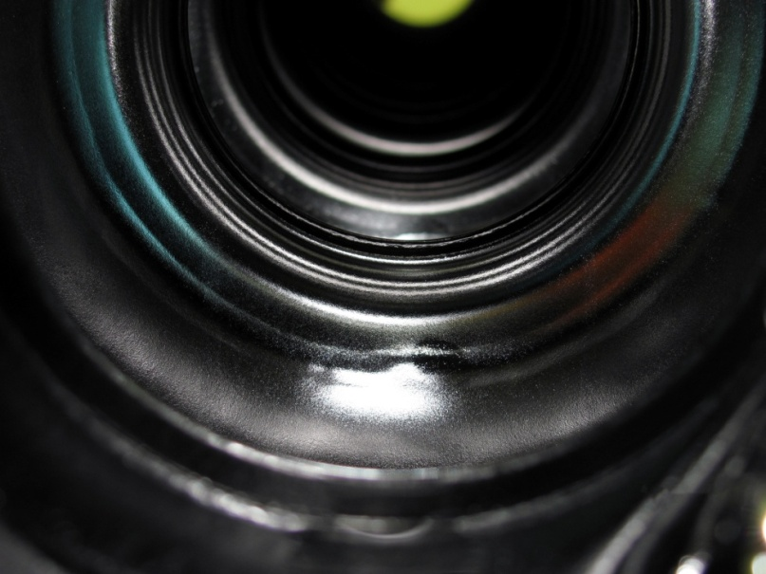
Typical EP Process Data Using Current Parameters
Cavity surface temperatures
(equator, iris, beam tubes)
Before bulk EP
Current
Voltage
Acid dump tank temperature
Acid return temperature
After bulk EP
Water chiller temperature (return)
Acid flow rate
EP monitoring data for the bulk (120 µm) EP of TE1CAT003
 | 1-cell TE1CAT003 |  | 9-cell TB9AES013
EP Type | Bulk EP | Light EP | Bulk EP | Light EP
Voltage | 18 V
Average Current Density | 48 mA/cm² | 35 mA/cm² | 37 mA/cm² | 27 mA/cm²
Nb Concentration of the acid | 2.5 g/L | 3.1 g/L | 1.9 g/L | 1.8 g/L
Cavity Equator Temperature | 30-35°C | 25-30°C | 30-35°C | 25-30°C
Acid Temperature (Return) | 24-26°C | 18-21°C | 26-29°C | 21-23°C
Current ANL EP Parameters
Constant voltage EP: 18 Volts
Slow acid flow
Cavity equator temperature
Bulk EP: 30-35°C
Light EP: 25-30°C

Slide 5
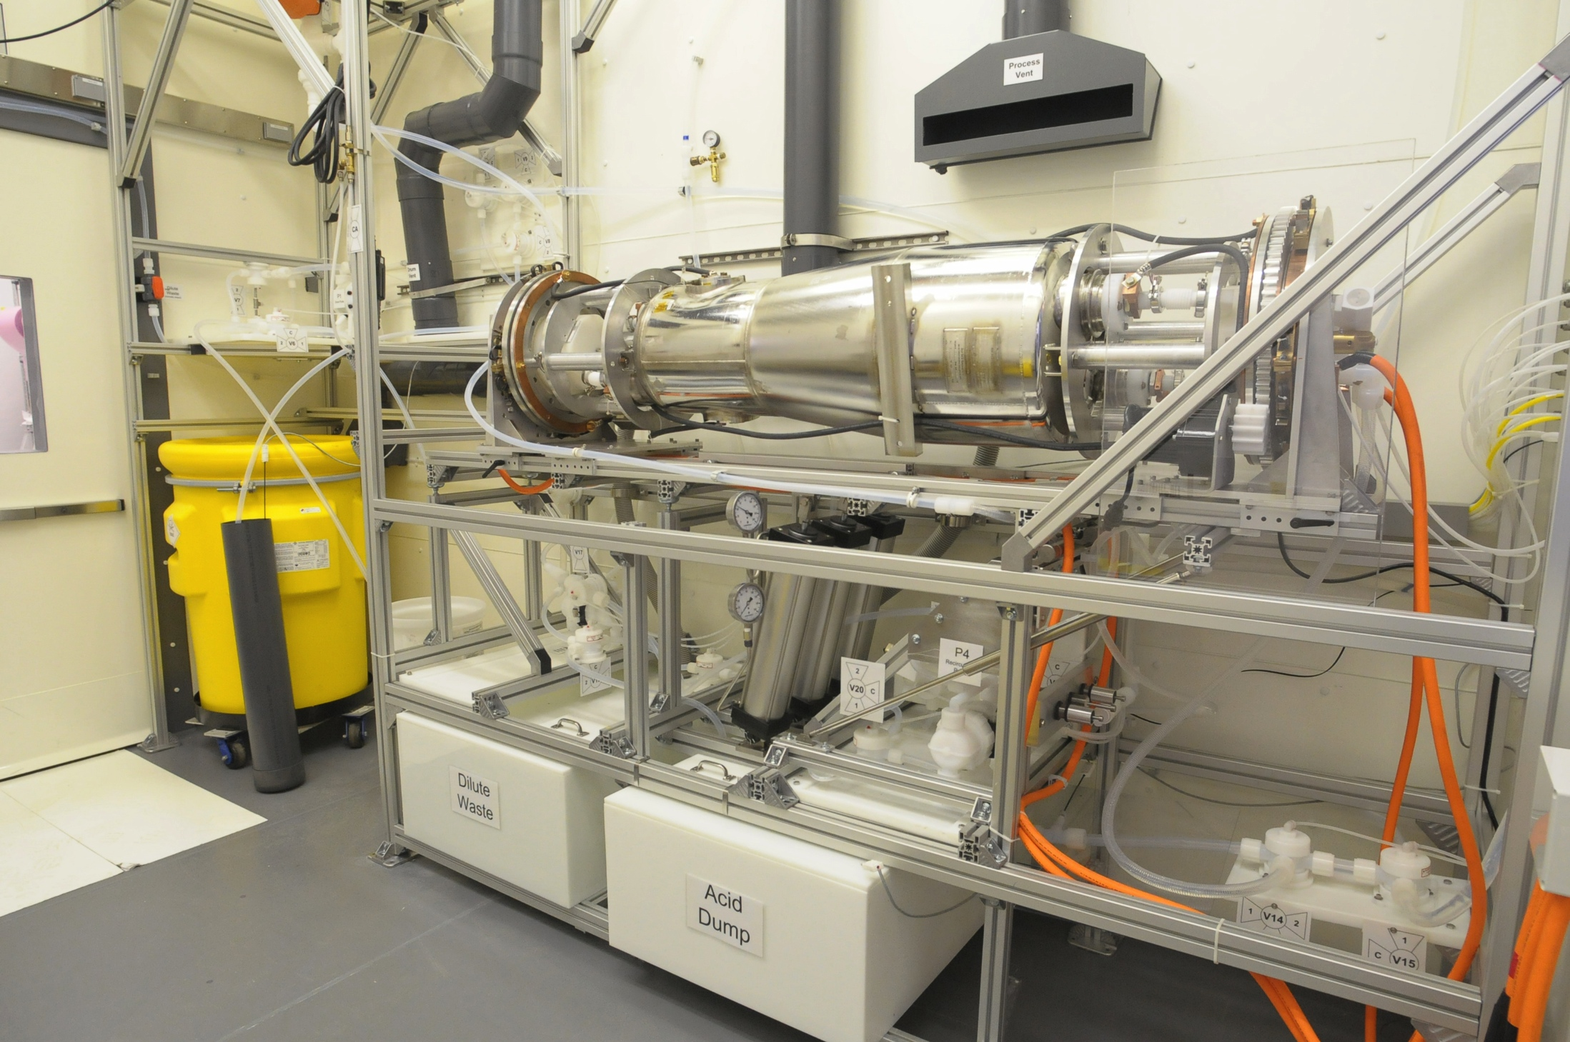
72 MHz QWR EP for ATLAS Intensity Upgrade
Cavity surface temperatures
Current
Voltage
Acid dump tank temperature
Acid return temperature
Water chiller temperature (return)
Benefits of external water cooling:
De-couples temperature control from the acid
Better control of the EP process
Very stable EP

Slide 6
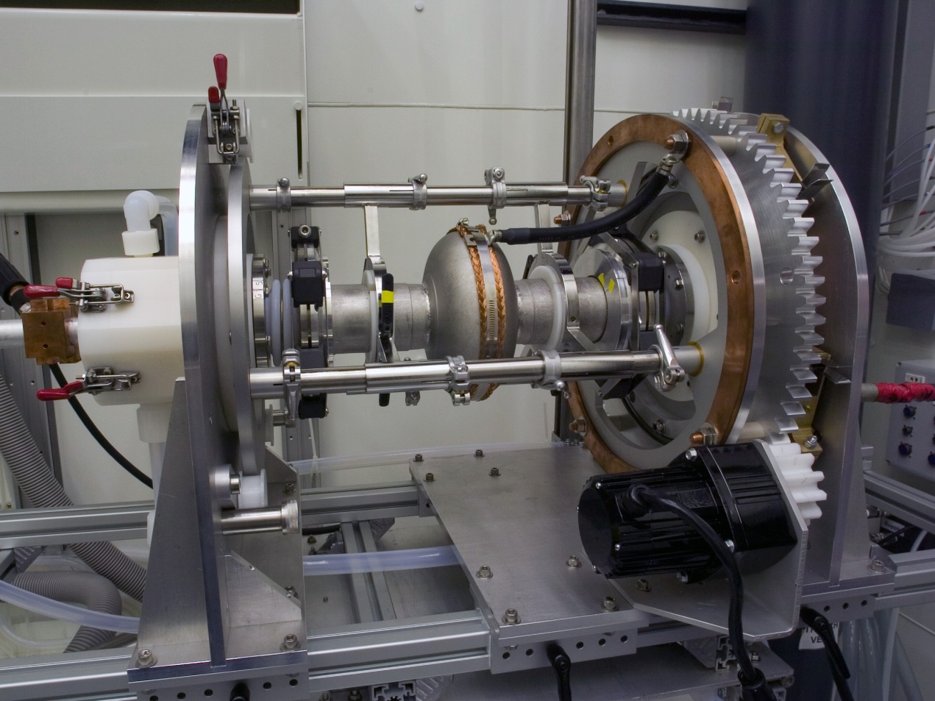
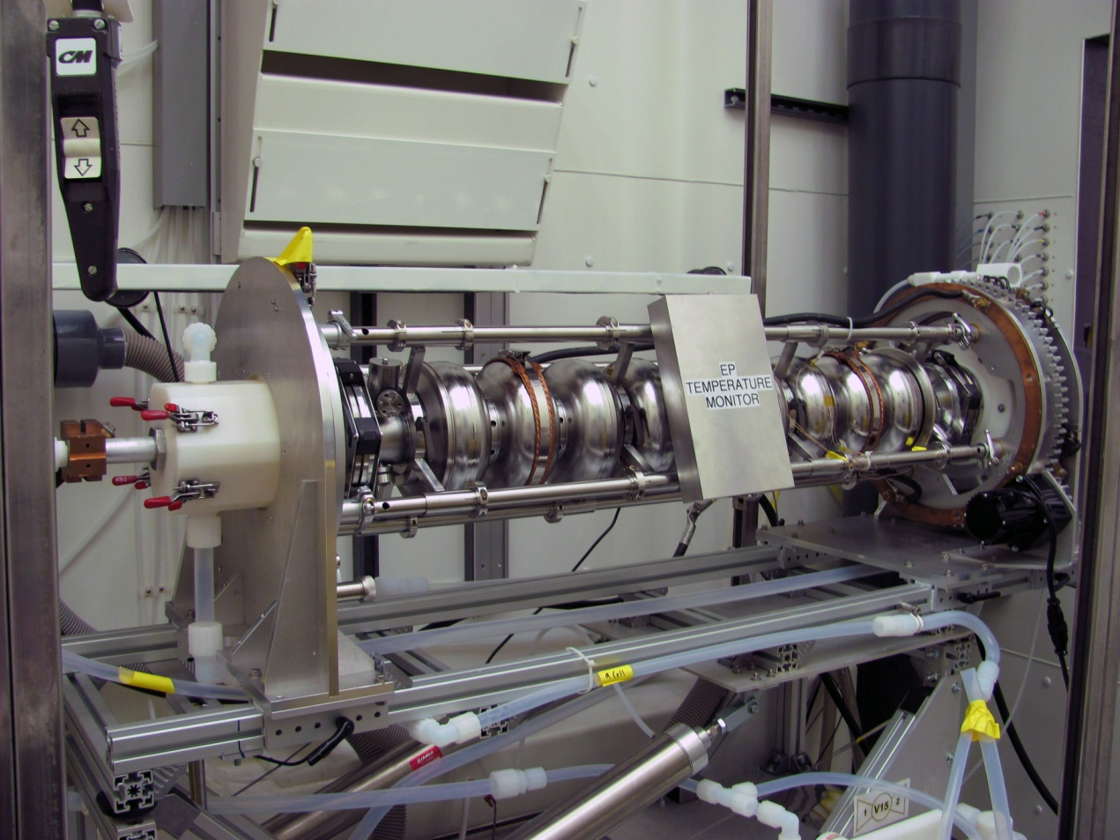
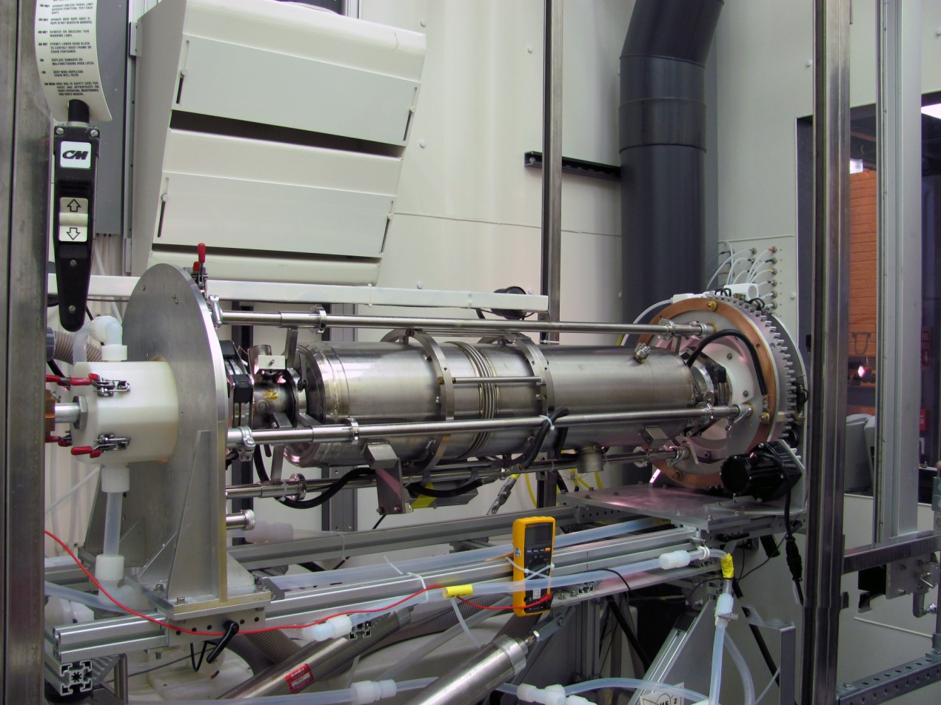
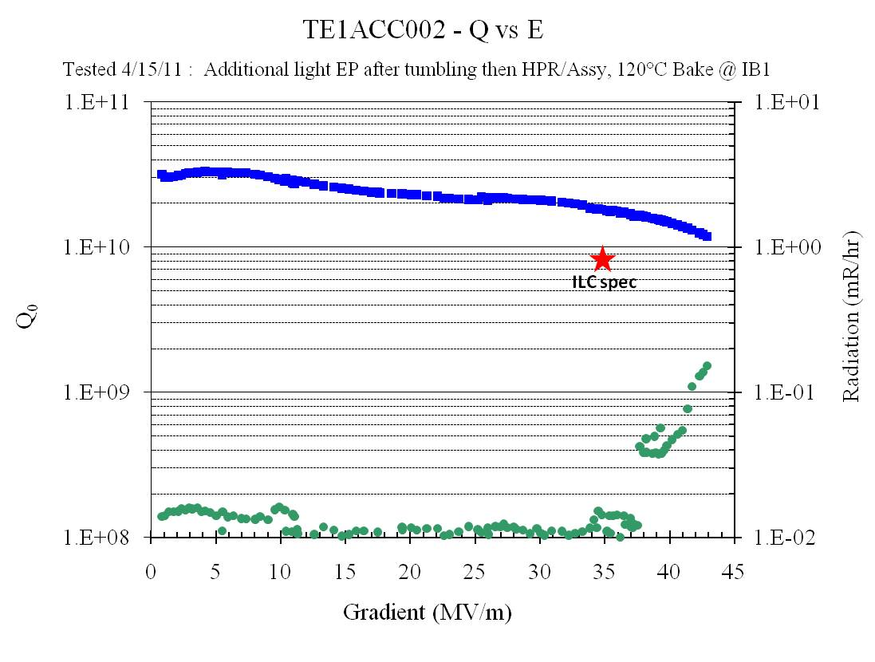
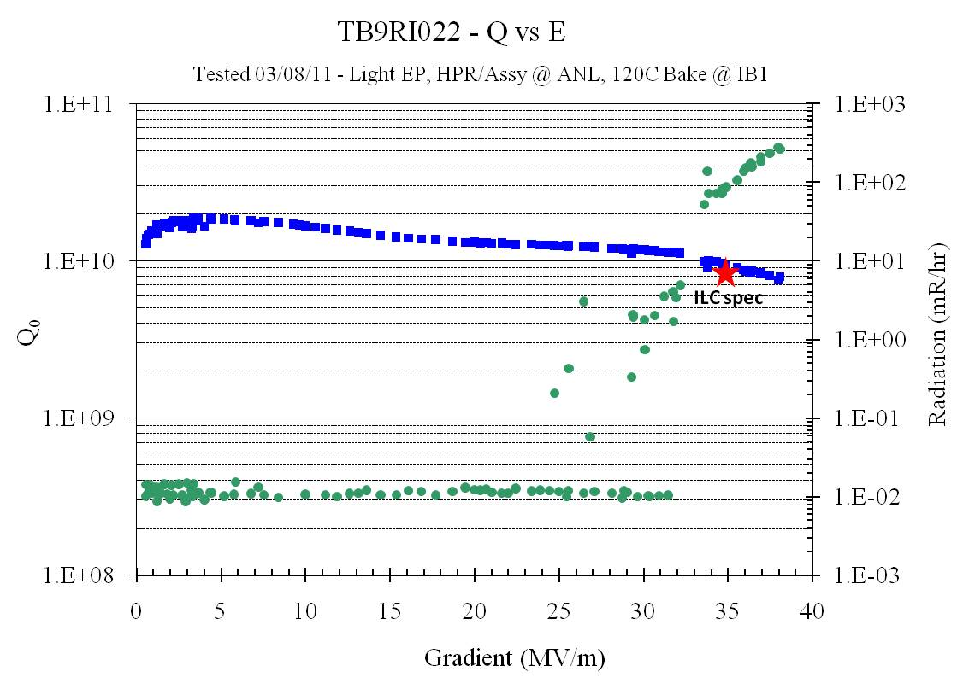
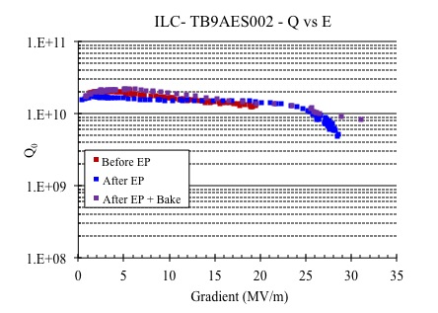
Recent Cavity Test Results
1.3 GHz Single Cell Cavity
1.3 GHz Bare 9-Cell Cavity
1.3 GHz Dressed 9-Cell Cavity
Best performing cavities:
Single cell: TE1ACC002 – tumbling + light EP (left)
9-cell: TB9RI022 – light EP (center)
Repair cavity: TB9AES002 (right)
Previous good performing bare cavity
Improved performance after dressed EP
Cavity performance recovered after baking

