Slide 1
Advances in SRF Development for ILC
Akira Yamamoto
ILC-GDE and KEK
Prepared for SRF2011, Chicago, July 25, 2011
With sincere acknowledgment for all
ILC-GDE SCRF collaborators and global SCRF industrial partners
Special thanks for M. Ross, N. Walker, and R. Geng

Slide 2

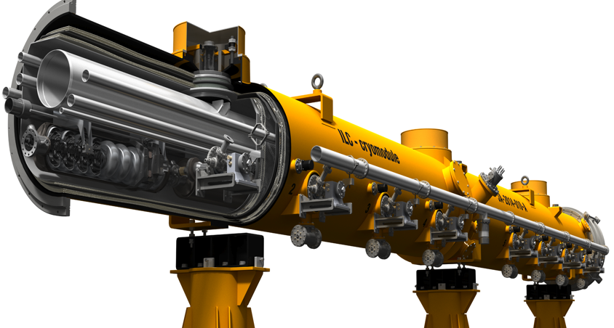
Design Update in SB2009
RDR → SB2009
Motivation: Cost containment
Single accelerator tunnel
Smaller damping ring
e+ target location at high-energy end,
SCRF: Gradient variation of 31.5 MV/m +/- 20 %,
HLRF: KCS and DRFS with RDR-RF unit as backup

Slide 3
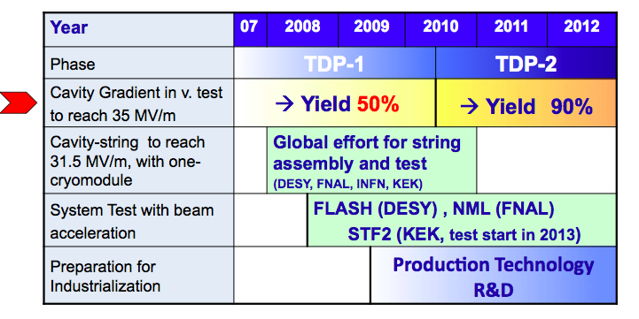
Global Plan for ILC Gradient R&D
New baseline gradient:
Vertical acceptance: 35 MV/m average, allowing ±20% spread (28-42 MV/m)
Operational: 31.5 MV/m average, allowing ±20% spread (25-38 MV/m)

Slide 4
Global Plan for ILC Gradient R&D
New baseline gradient:
Vertical acceptance: 35 MV/m average, allowing ±20% spread (28-42 MV/m)
Operational: 31.5 MV/m average, allowing ±20% spread (25-38 MV/m)

Slide 5
Global Yield of Cavities in 2008 tested at DESY and JLab
Originally reported by H. Padamsee
H. Padamsee, ILC-08 (Chicago)
Process Yield: ~ 23 % @ 35 MV/m, based on 48 Tests for19 cavities
Manufactured by ACCEL, AES, Zanon, KEK (Ichiro-type), and JLab
Reported by H. Padamsee at TTC-08 (IUAC), and ILC-08, (Chicago), based on the status in 2008。
50%
Definition for production yield, not established yet
5

Slide 6
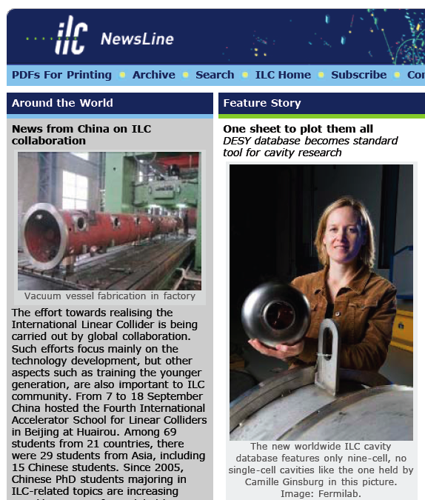
Creation of a Global Database for
Better Understanding of “Production Yield”
Global Data Base Team formed by:
  Camille Ginsburg (Fermilab), leader
  Rongli Geng (JLab)
  Zack Conway (Cornell University)
  Sebastian Aderhold (DESY)
  Yasuchika Yamamoto (KEK)
Activity
  July 2009:
  - Determine DESY-DB to be viable option,
  Sept., 2009: (ALCPG/GDE)
  - Dataset, web-based, support by FNAL/DESY,
  Dec., 2009: (SB2009) : 1st update
  March, 2010 (IW-ILC) : 2nd update
  June, 2010 (End TDP-1) : 3rd update
  March, 2011 (ILC-ALCPG): 4th update
  RI, Zanon, AES, MHI manufactured
  Cavity data included.
  (3 region’s data available)
Production yield allowing to:
- include the 2nd chemical process

Slide 7
Standard Procedure Established for ILC-SCRF Cavity evaluation, in guidance of TTC
 | Standard Fabrication/Process
Fabrication | Nb-sheet purchasing
 | Component Fabrication
 | Cavity assembly with EBW
Process | EP-1 (~150um)
 | Ultrasonic degreasing with detergent, or ethanol rinse
 | High-pressure pure-water rinsing
 | Hydrogen degassing at > 600 C
 | Field flatness tuning
 | EP-2 (~20um)
 | Ultrasonic degreasing or ethanol (or EP 5 um with fresh acid)
 | High-pressure pure-water rinsing
 | Antenna Assembly
 | Baking at 120 C
Cold Test (vertical test) | Performance Test with temperature and mode measurement
Key Process
Fabrication
Material
EBW
Shape
Process
Electro-Polishing
Ethanol Rinsing or
Ultra sonic. + Detergent Rins.
High Pr. Pure Water cleaning
allow twice

Slide 8
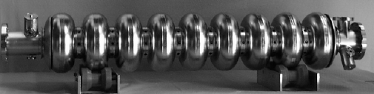
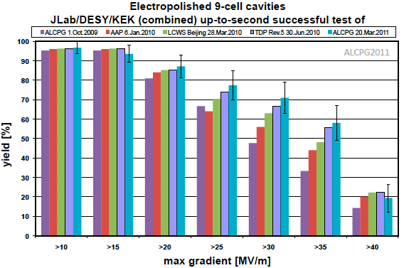
Global ILC Cavity Gradient Yield
Updated, March, 2011
Plot courtesy
Camille Ginsburg of FNAL
TDP-2 Goal
35 MV/m usable
TDP-1 Goal
Achieved
> 50 %

Slide 9
Global ILC Cavity Gradient Yield
Updated, March, 2011
Plot courtesy
Camille Ginsburg of FNAL
TDP-2 Goal
> 28 MV/m usable
Effectively
Achieved:
> 70 %

Slide 10
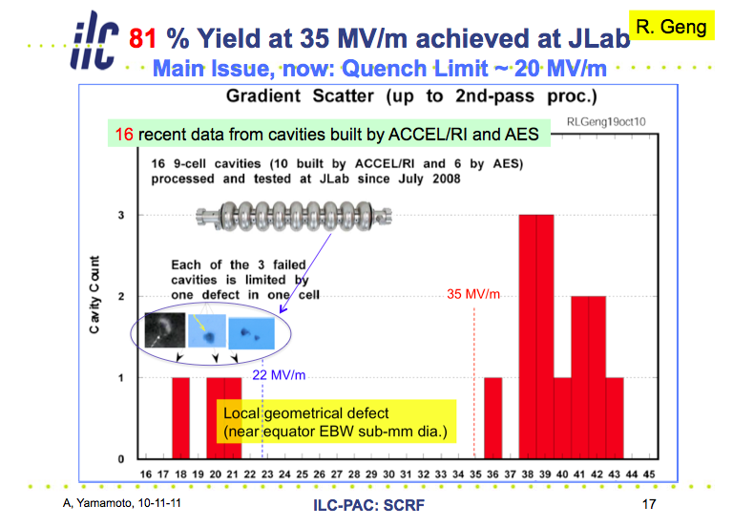



Impact of Mechanical Polishing progress in Nov, 2010 ~ May, 2011
88%
JLAB + FNAL
Average gradient 39 MV/m
94% yield at ≥31 MV/m
+ +
Average gradient 38.8 MV/m
✔
✔
AES5 After
Mechanical
Polishing
at Cornell
ACC15 after
Mechanical
Polishing
at FNAL
This cavity
AES6 is being
treated with
mechanical
polishing at
FNAL and will
be then EP
processed and
tested at JLAB
Courtesy: R. Geng

Slide 11
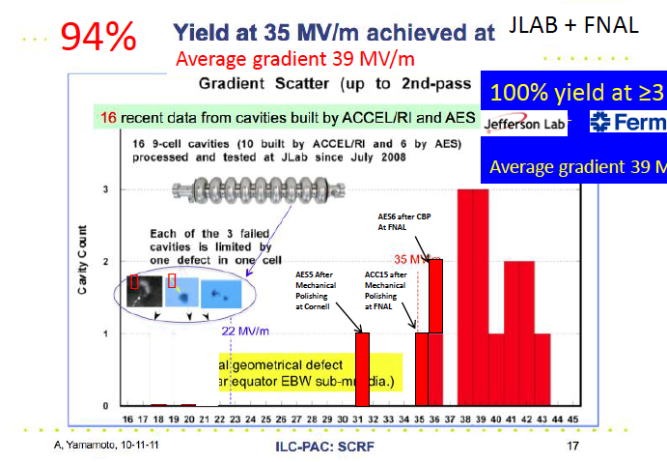
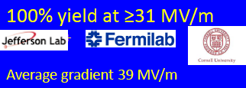
Impact of Mechanical Polishing as of July, 2011
88%
JLAB + FNAL
Average gradient 39 MV/m
94% yield at ≥31 MV/m
+ +
Average gradient 38.8 MV/m
✔
✔
AES5 After
Mechanical
Polishing
at Cornell
ACC15 after
Mechanical
Polishing
at FNAL
This cavity
AES6 is being
treated with
mechanical
polishing at
FNAL and will
be then EP
processed and
tested at JLAB
Courtesy: R. Geng

Slide 12
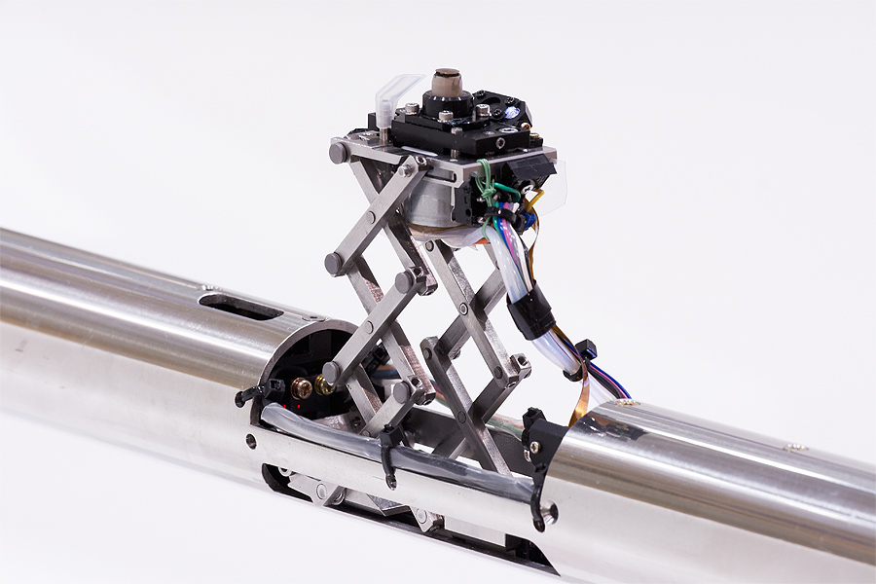
SCRF 9-Cell Cavity
Highlight: in 2010
Americas:
Niowave-Roark-FNAL: 1st cavity reached 28.8 MV/m.
Jlab set ~ 90% yield @ 35 MV/m (1 vendor, process at JLab
FNAL-KEK: Cavity repaired, G improved from 11 to 30 MV/m
Asia:
IHEP-KEK: 1st cavity (LL, large-grain, no-end) reached 20 MV/m,
PKU-JLab: Cavity (Tesla, fine-grain) reached 28 MV/m,
Hitachi-KEK: 1st cavity (Tesla-like, no-end) reached 35 MV/m
MHI-KEK: Cavity (Tesla-like w/ end-HOM) reached 37 MV/m,
MHI-KEK-S1-Global: cavity (Tesla-like) reached > 35 (40) MV/m
Europe:
E-XFEL / HG-FP7: 600 cavity production order placed (2 vendors)

Slide 13
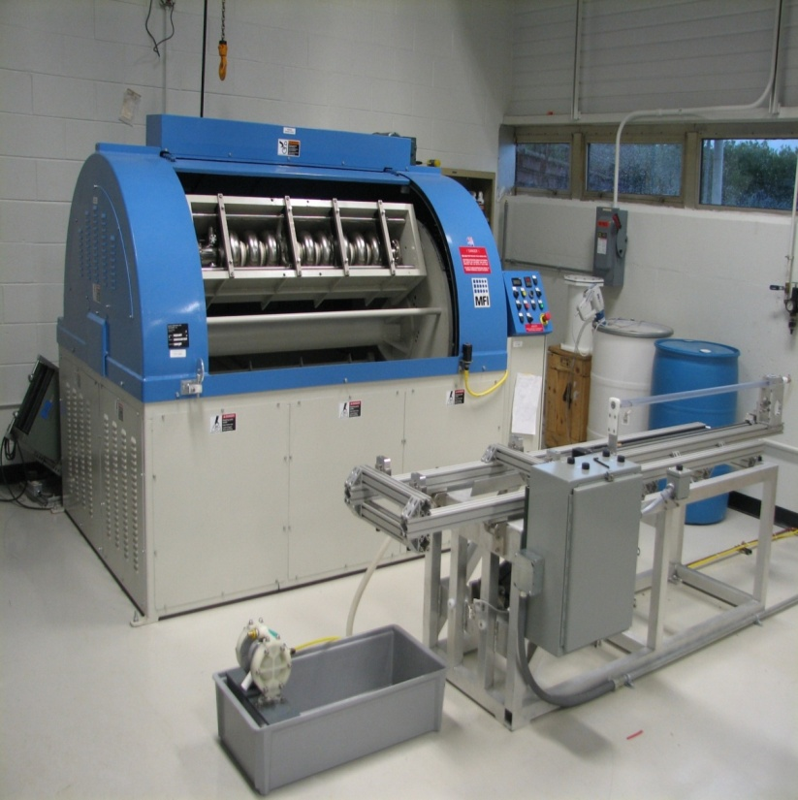
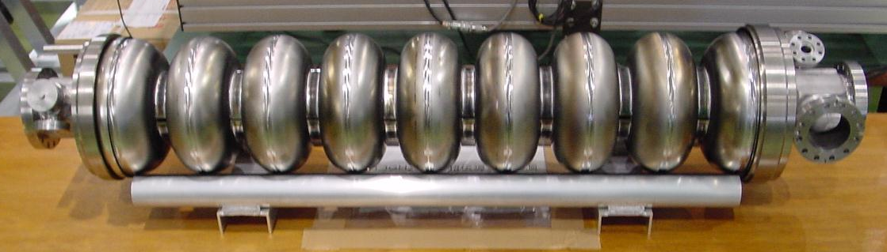
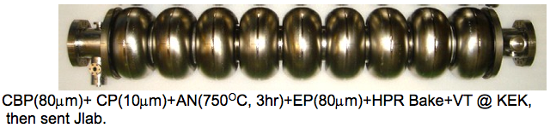
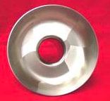
SRF Cavity and Gradient Highlights 2010~ 2011
R. Geng
Americas
  FNAL mechanical polishing improved 9-cell cavity ACC15 gradient from 19 MV/m to 35 MV/m
  JLAB started processing and testing DESY seamless 9-cell cavity built from DESY 3-cell seamless units
  6 of AES 3rd production & 4 Niowave-Roark 1st production received by FNAL
Asia
  KEK MHI-12 reached 40.7 MV/m gradient at Q0 6.2E9
  KEK-JLAB: ACD shape cavity ICHIRO7 reached 40 MV/m gradient at Q0 8E9
Europe
  DESY large-grain 9-cell cavity AC155 reached 45 MV/m at Q0 > 1E10, and more reached in the next, …

Slide 14
Global Plan for SCRF R&D
Year | 07 | 2008 |  | 2009 |  | 2010 |  | 2011 | 2012
Phase | TDP-1 |  |  |  |  |  | TDP-2
Cavity Gradient in v. test to reach 35 MV/m | → Yield 50% |  |  |  |  |  | → Yield 90%
Cavity-string to reach 31.5 MV/m, with one-cryomodule |  | Global effort for string assembly and test (DESY, FNAL, INFN, KEK)
System Test with beam acceleration |  |  | FLASH (DESY) , NML (FNAL) STF2 (KEK, test start in 2013)
Preparation for Industrialization |  |  |  |  | Production Technology R&D
Communication with industry: | 2009: 1st step: Visit Vender (2009) 2010: 2nd step: Organize Workshop (2010) 2011: 3rd step: Send specification & receive response
We are here

Slide 15
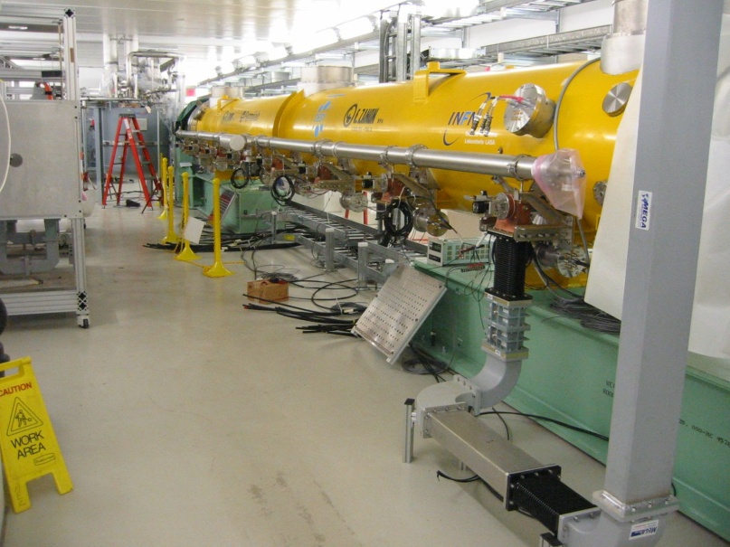
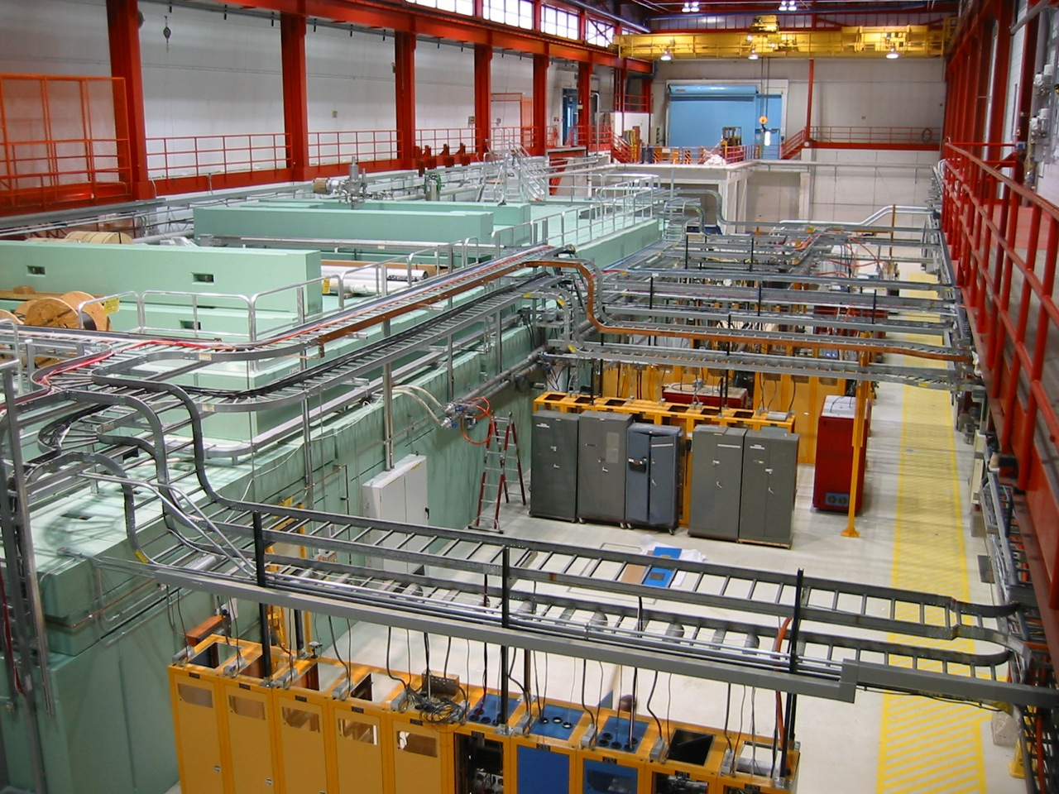
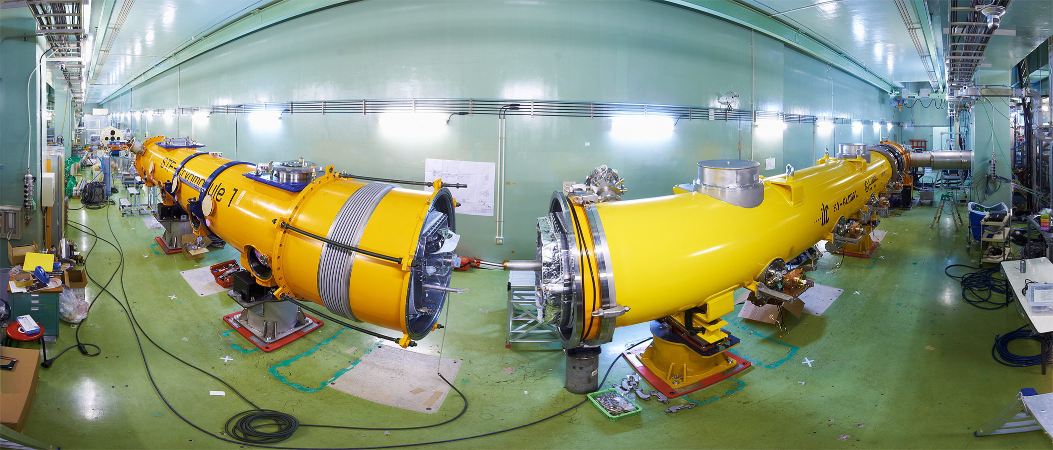
Integrated Systems Tests
2009 ~
Full systems integration testing
FLASH (DESY)
NML (FNAL)
STF (KEK)
TDP focus
Under construction
Up to 6 cryomodules
Operation: end 2012
“Quantum Beam” experiment 2011
1 CM with beam 2013
7 CM → 1.2 GeV beam
photon user facility
(2 CM 2015)
(3 CM)
“9mA experiment”
achieved ~1800 bunches at 9mA in 09.2009
ΔE/E_{RMS} ~0.5% (@ 0.8 GeV)
~0.1% within pulse

Slide 16
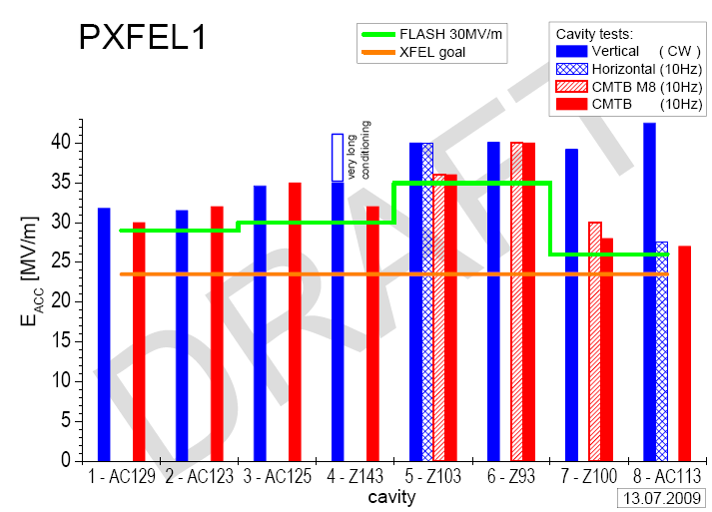
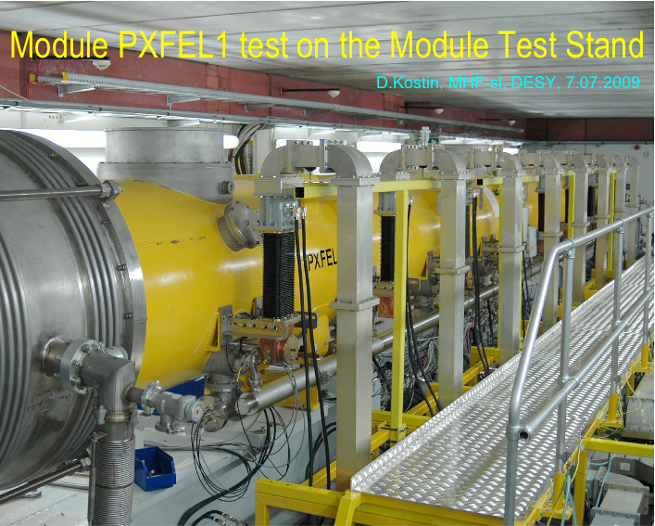
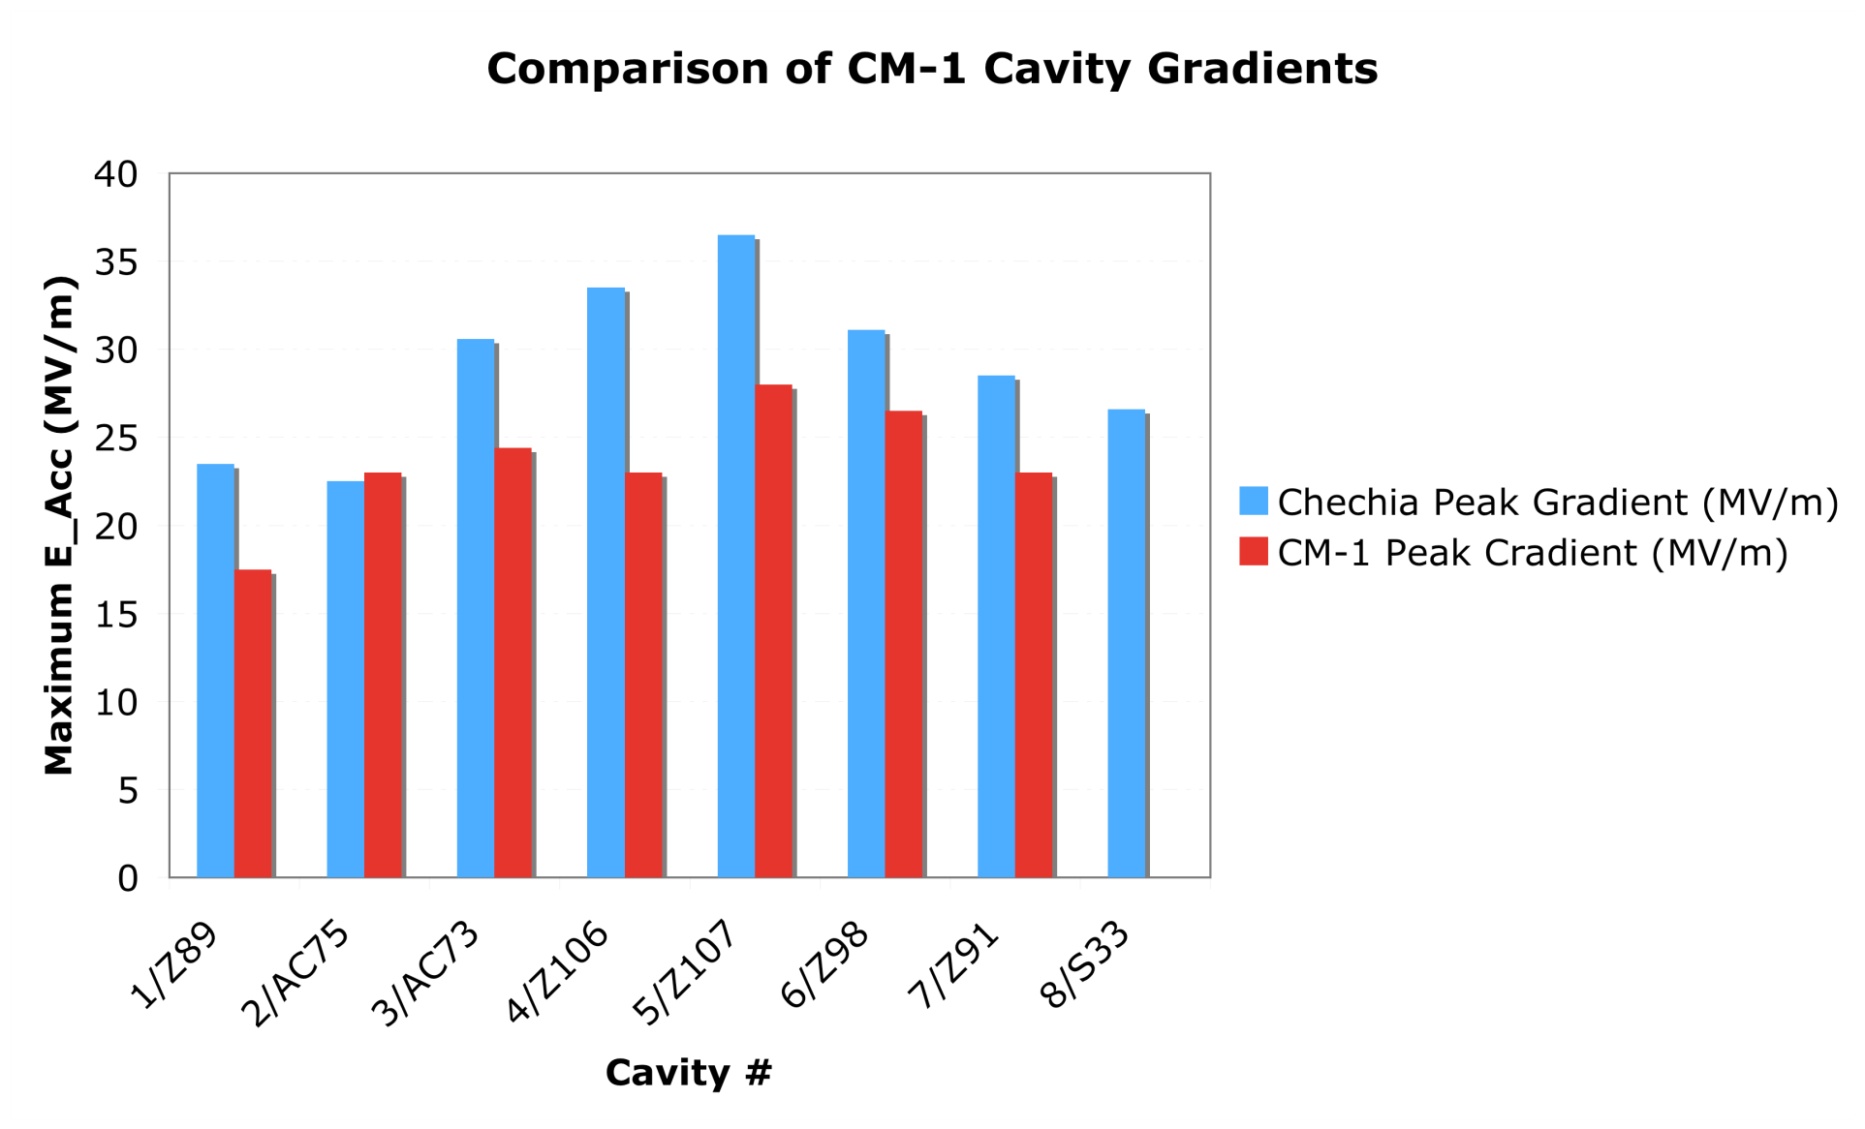
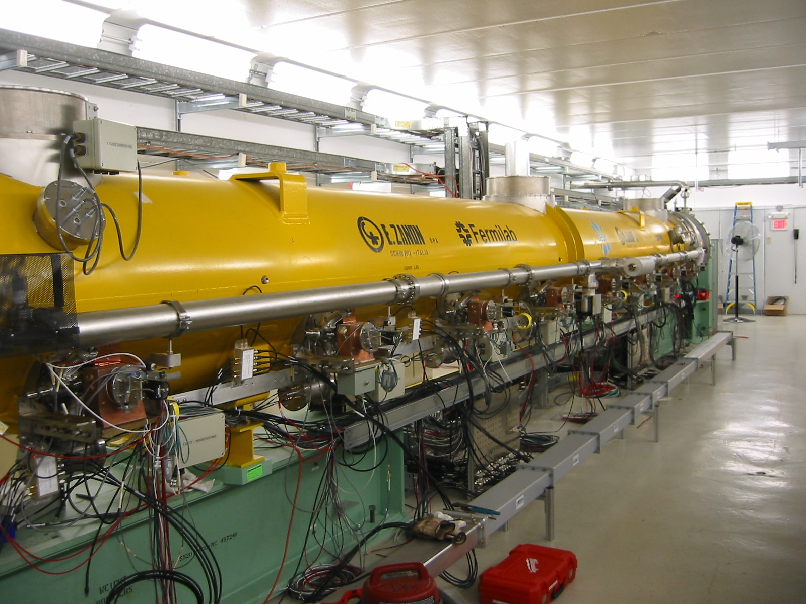
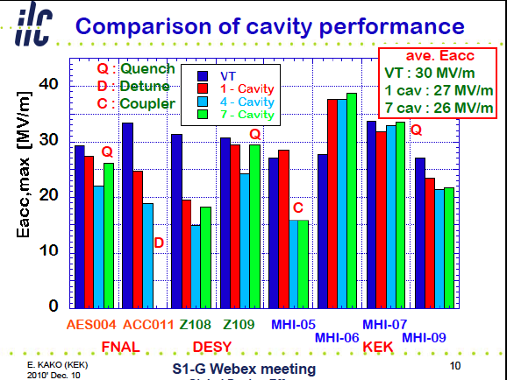
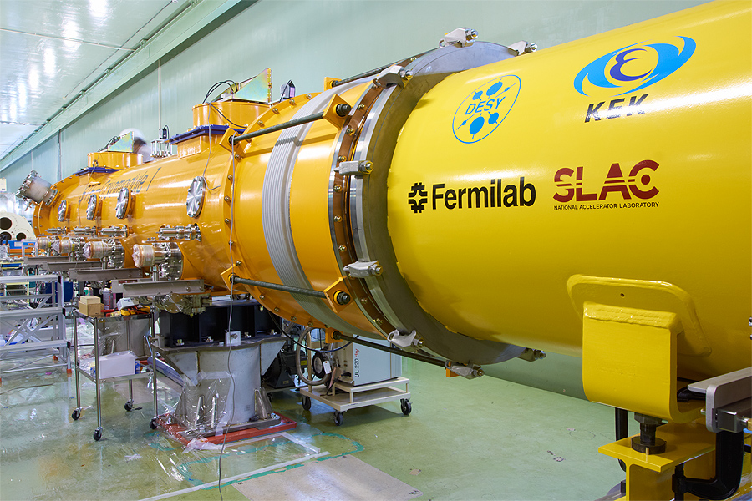
Cryomodule Development & Test
FLASH (DESY)
  <32 MV/m> in CM operation, PXFEL-1
  < 30 MV/m> in FLASH operation
NML-CM1 (Fermi)
  In progress
STF: S1-Global (KEK)
  Global effort
    DESY/INFN/FNAL/SLAC/KEK
  <26 MV/m> in CM operation

Slide 17
M. Ross

Slide 18
M. Ross

Slide 19
Cryomodule-1 Testing at Fermilab
Preliminary
7 of 8 cavities powered,
2 with high heat; no FE?
1 tuner motor failure
Calibrations under study

Slide 20
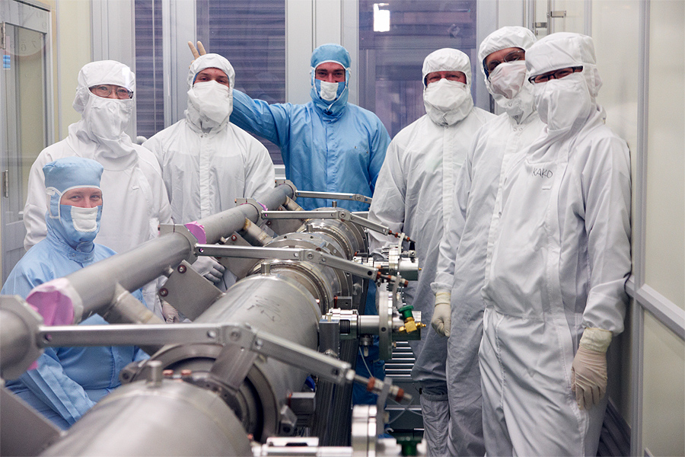
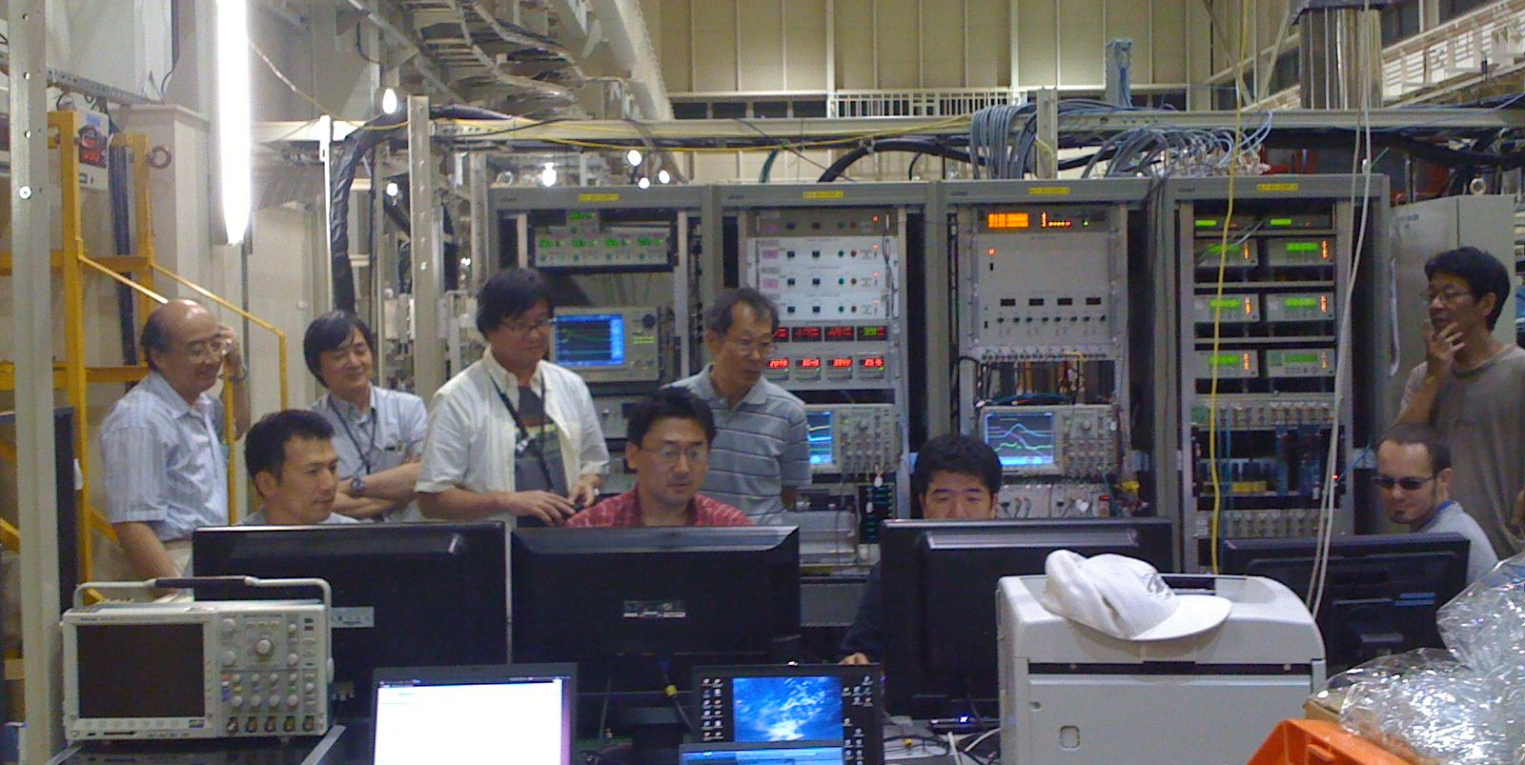
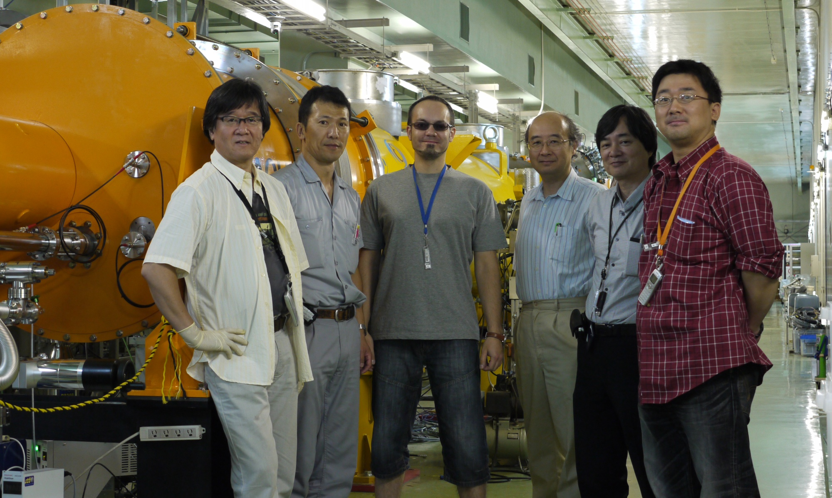
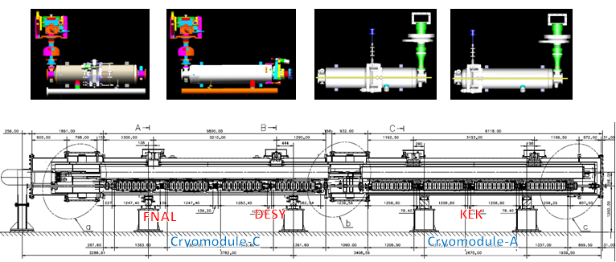
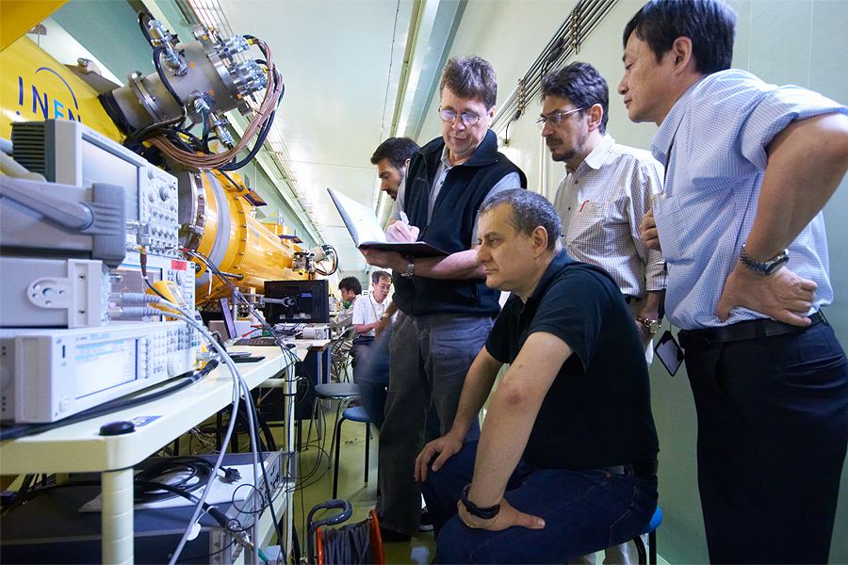
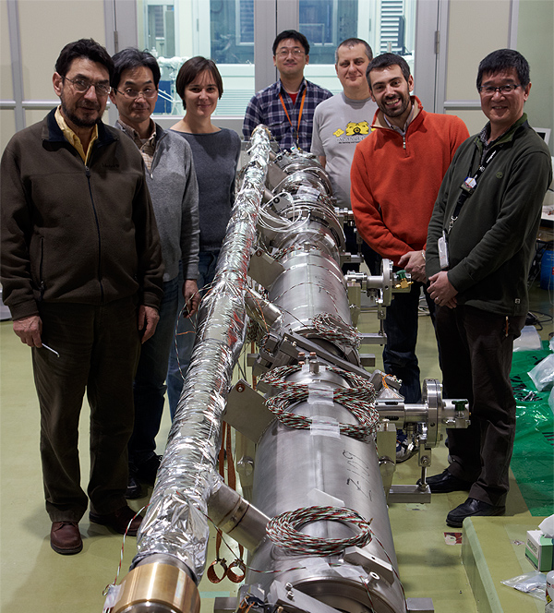
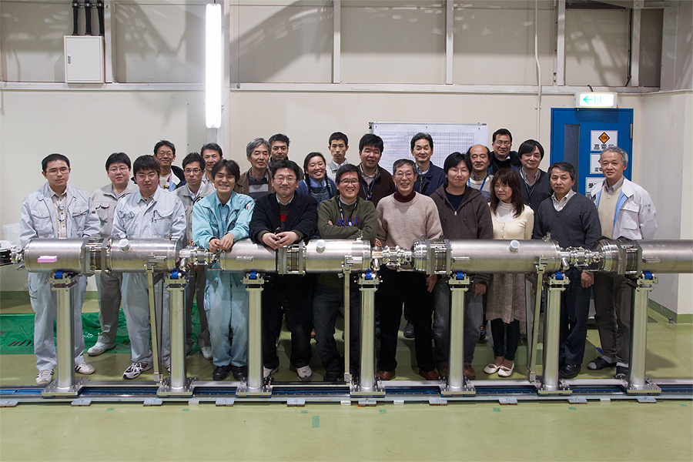
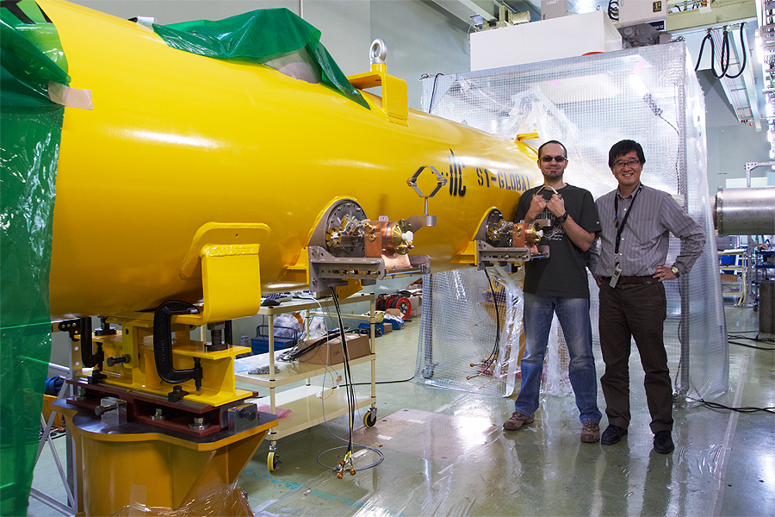
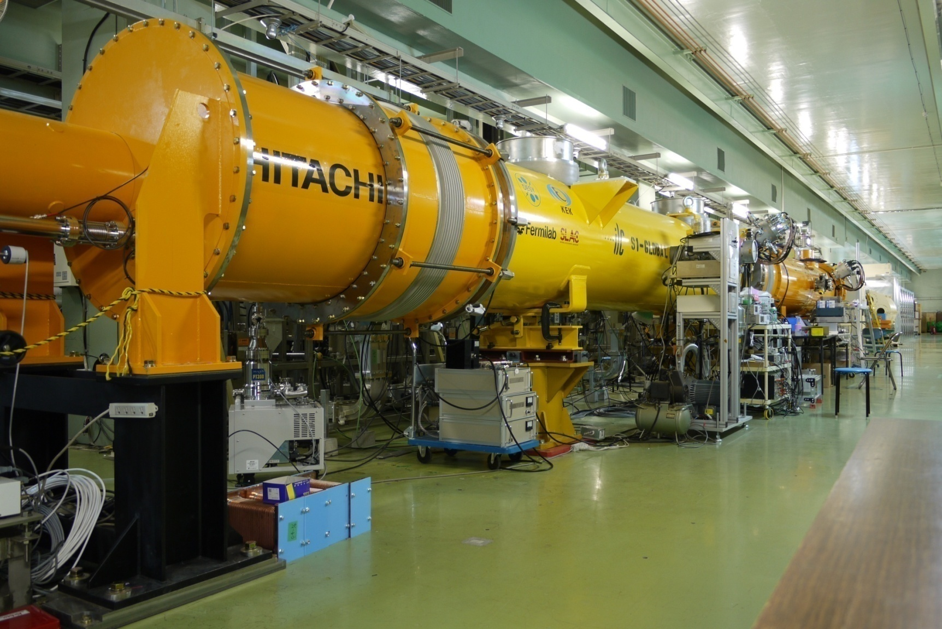
S1-Global Assembly/Test with Global Effort
DESY, FNAL, Jan., 2010
DESY, Sept. 2010
FNAL & INFN, July, 2010
INFN
and
FNAL
Feb.
2010
March, 2010
DESY, May, 2010
June, 2010 ~

Slide 21
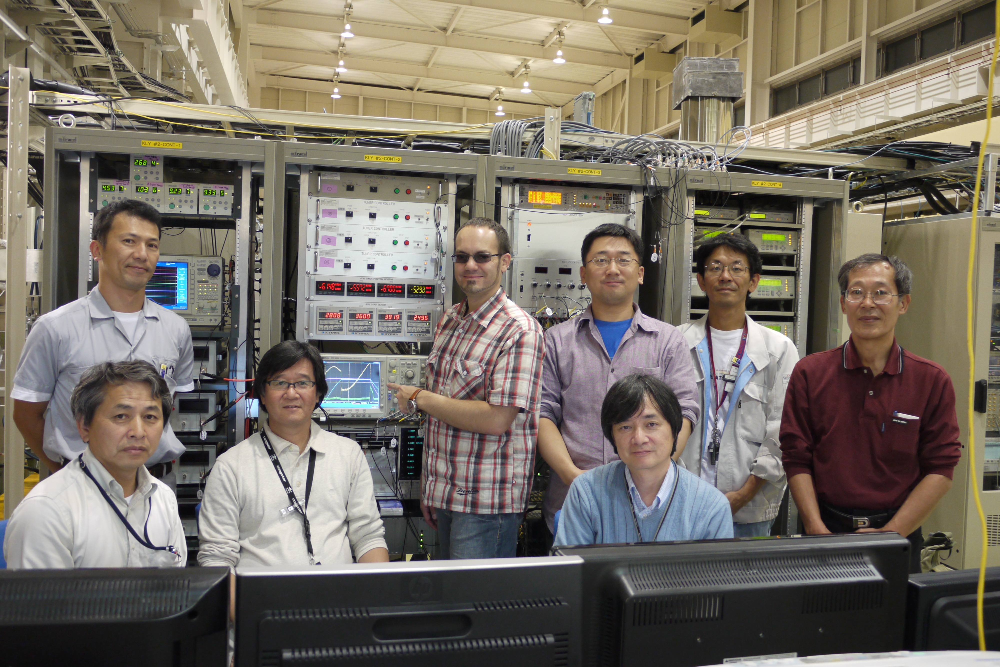
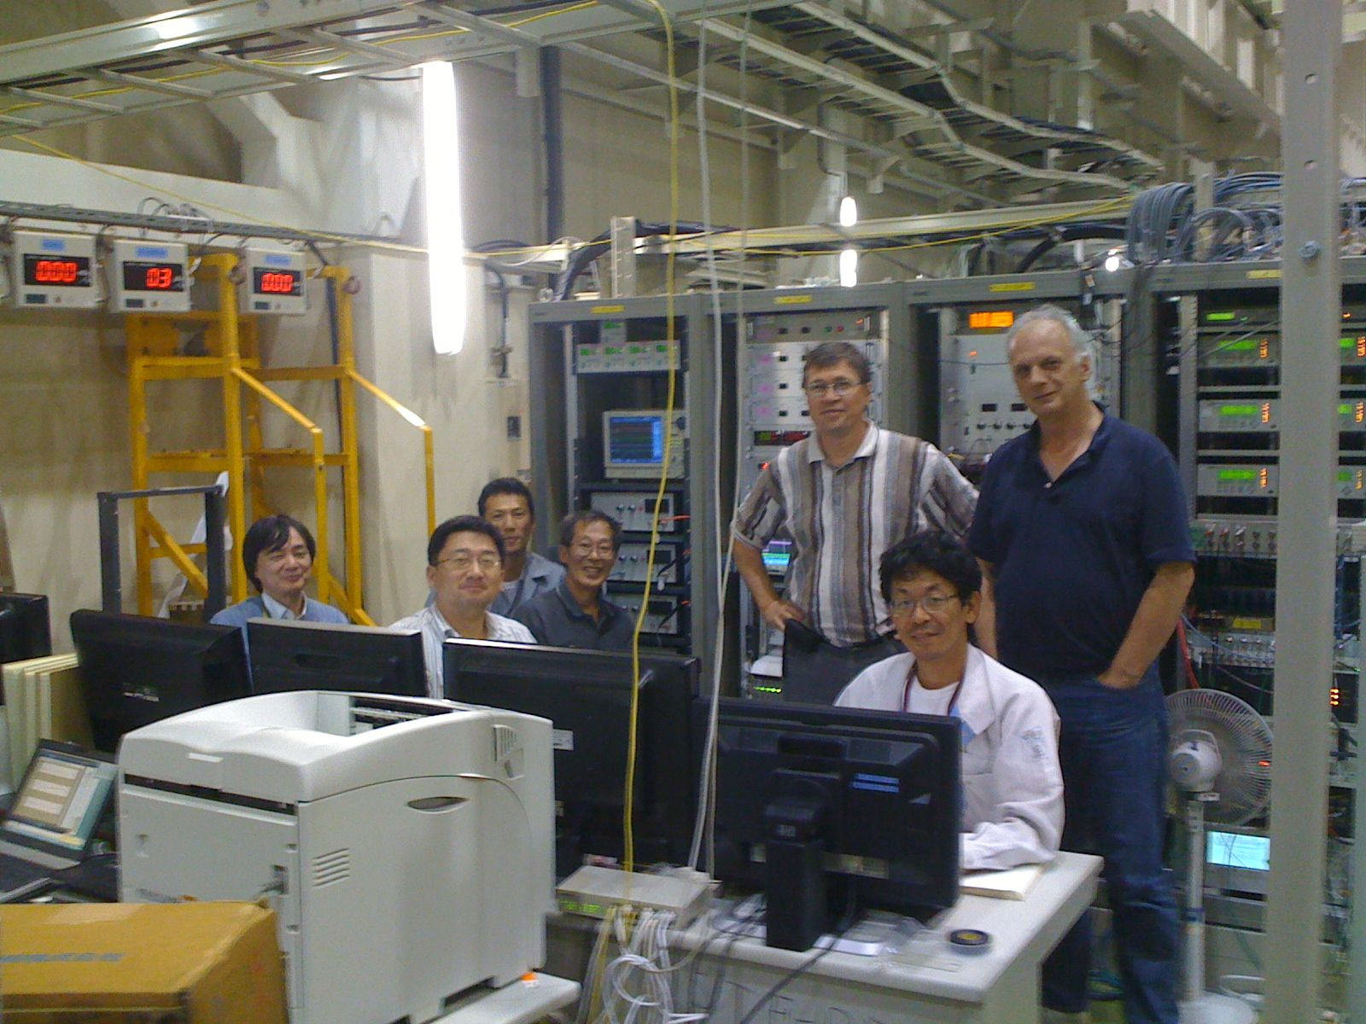
S1-Global High Power Test
at STF/KEK, Sep., 2010 ~
With
Yuriy Pischalnikov
Warren Schappert
(FNAL) Oct. 2010
With
Denis Kostin
(DESY) Sept. 2010
Notes:
777
888
21
777
21
888

Slide 22
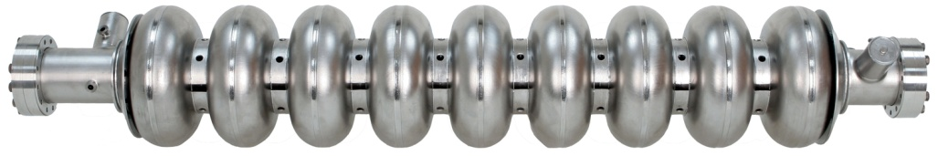
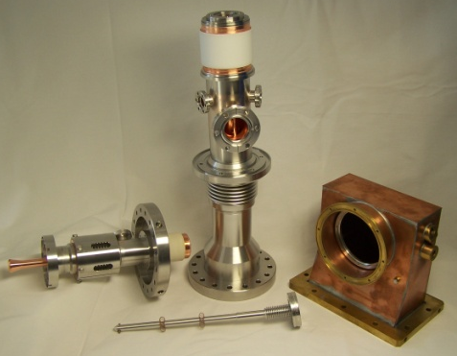
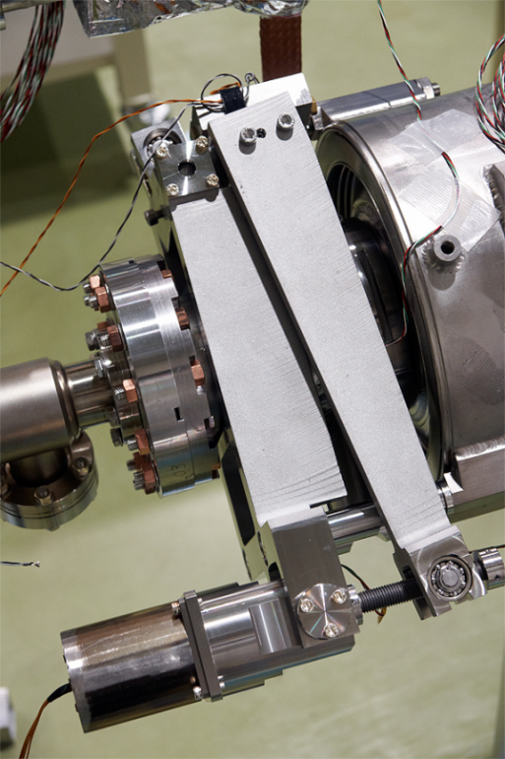
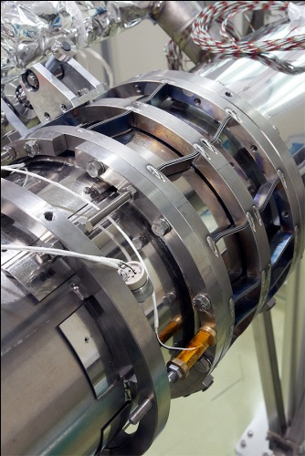
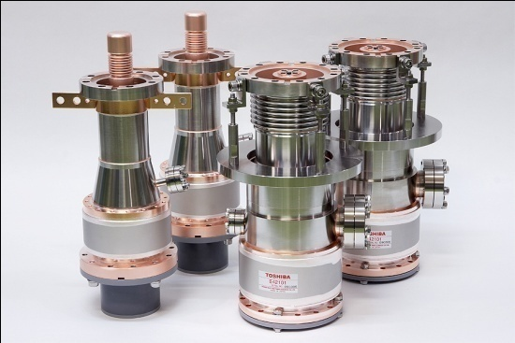
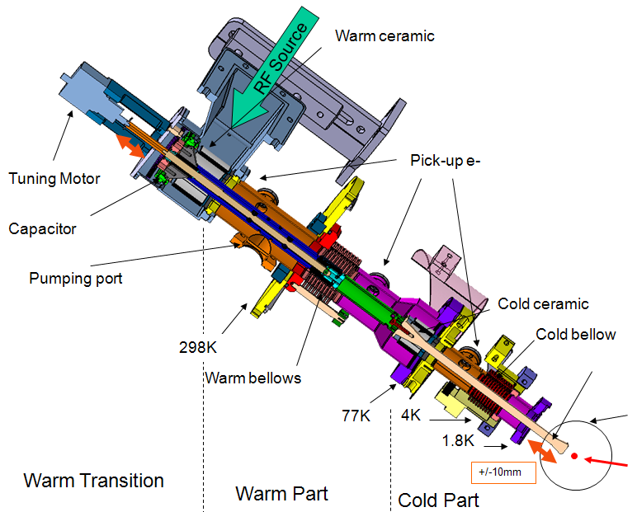
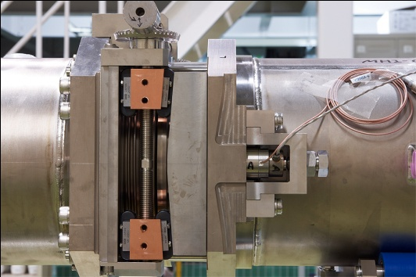
S1-Global: Demonstrations/evaluation of Various Couplers and Tuners
Every coupler and tuner demonstrated, as expected, and be applicable for ILC cavities
Finding various subjects to be further investigated and settled

Slide 23
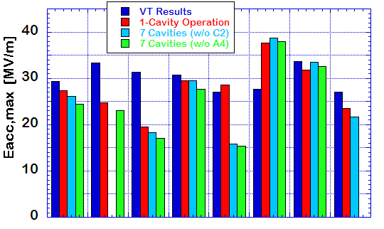
Comparison of cavity performance
ave. Eacc,max
VT : 30 MV/m
1 cav : 27 MV/m
7 cav : 26 MV/m
C
D
D
AES004
ACC011
D : Detune
C : Coupler
Z108
Z109
MHI-05
MHI-07
MHI-06
MHI-09
FNAL
DESY
KEK
Performance reduction in two cavities and one coupler
Tuner mechanics trouble in two cavities

Slide 24
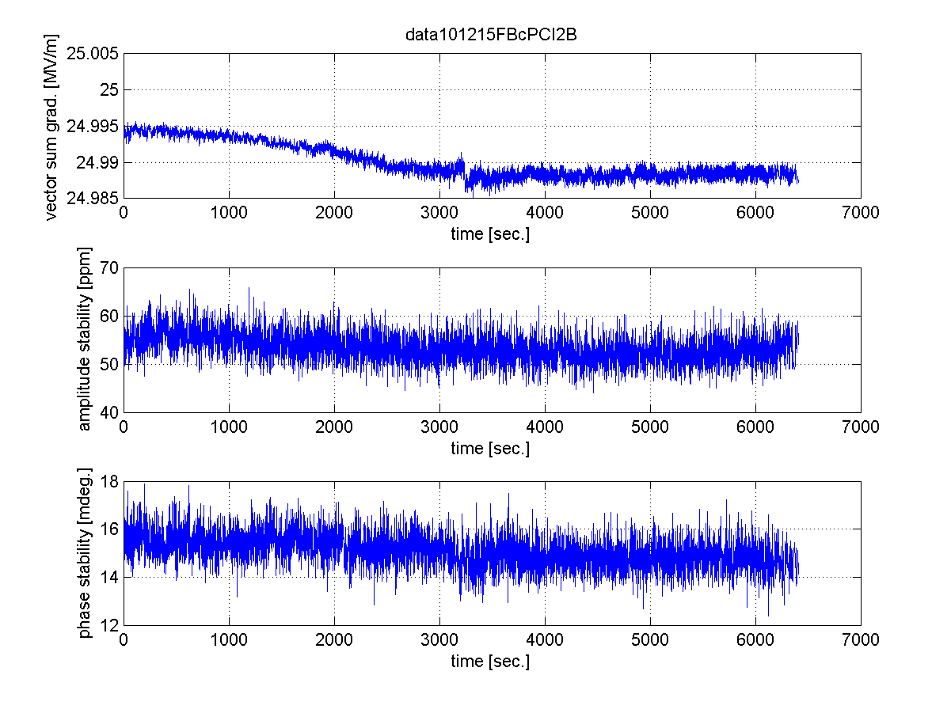
7-cavity operation by digital LLRF
LLRF stability study with 7 cavities operation at 25MV/m
Field Waveform of each cavity
Stability in 6300 sec.
vector-sum gradient
amplitude stability in pulse flat-top
phase stability in pulse flat-top
- Vector-sum stability: 24.995MV/m ~ 24.988MV/m (~0.03%)
- Amplitude stability in pulse flat-top: < 60ppm=0.006%rms
- Phase stability in pulse flat-top: < 0.0017 degree.rms

Slide 25
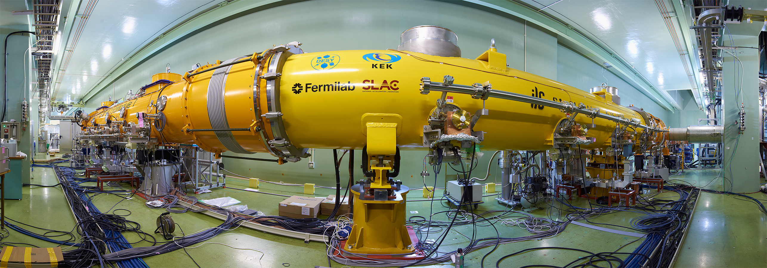
Many Thanks for
Global Collaboration for S1-Global
M. Akemoto, S. Fukuda, K. Hara, H. Hayano, N. Higashi, E. Kako,
H. Katagiri, Y. Kojima, Y. Kondo, T. Matsumoto, S. Michizono, T. Miura,
H. Nakai, H. Nakajima, K. Nakanishi, S. Noguchi, N. Ohuchi, T. Saeki,
M. Satoh, T. Shishido, T. Shidara, T. Takenaka, A. Terashima,
N. Toge, K. Tsuchiya, K. Watanabe, S. Yamaguchi,
A. Yamamoto, Y. Yamamoto, K. Yokoya,
KEK (Japan)
A. Bosotti, C. Pagani, R. Paparella, P. Pierini,
INFN (Italy)
K. Jensch, D. Kostin, L. Lilje, A. Matheisen, W.-D. Moeller,
M. Schmoekel, P. Schilling, N. Walker, H. Weise,
DESY (Germany)
T. Arkan, S. Barbanotti, M. Battistoni, H. Carter,
M. Champion, A. Hocker, R. Kephart, J. Kerby, D. Mitchell,
Y. Pischalnikov, T.J. Peterson, M. Ross, W. Schappert,
B. Smith
FNAL (USA)
C. Adolphsen, C. Nantista, SLAC (USA)

Slide 26
Global Plan for SCRF R&D
Year | 07 | 2008 |  | 2009 |  | 2010 |  | 2011 | 2012
Phase | TDP-1 |  |  |  |  |  | TDP-2
Cavity Gradient in v. test to reach 35 MV/m | → Yield 50% |  |  |  |  |  | → Yield 90%
Cavity-string to reach 31.5 MV/m, with one-cryomodule |  | Global effort for string assembly and test (DESY, FNAL, INFN, KEK)
System Test with beam acceleration |  |  | FLASH (DESY) , NML (FNAL) STF2 (KEK, test start in 2013)
Preparation for Industrialization |  |  |  |  | Production Technology R&D
Communication with industry: | 2009: 1st step: Visit Vender (2009) 2010: 2nd step: Organize Workshop (2010) 2011: 3rd step: Send specification & receive response
We are here

Slide 27
SCRF-ML Technology Required
RDR Parameters | Value
C.M. Energy | 500 GeV
Peak luminosity | 2x10³⁴ cm⁻²s⁻¹
Beam Rep. rate | 5 Hz
Pulse time duration | 1 ms
Average beam current | 9 mA (in pulse)
Av. field gradient | 31.5 MV/m
# 9-cell cavity | 14,560
# cryomodule | 1,680
# RF units | 560
RDR → SB2009

Slide 28
SCRF Procurement/Manufacturing Model
ILC Host-Lab
Technical Coordination
for Lab-Consortium
Regional Hub-Lab:
A
Regional Hub-Lab:
E, & …
World-wide
Industry responsible to
‘Build-to-Print’ manufacturing
Regional Hub-Lab:
B
Regional Hub-Lab:
D
Regional Hub-Lab:
C: responsible to
Hosting System Test and Gradient Performance
Regional hub-laboratories responsible to regional procurements to be open for any world-wide industry participation
: Technical
coordination link
: Procurement link

Slide 29
Communication with Industry in 2011
Visit factories, and Request for information
  Based on currently available manufacturing technology and available information with worldwide industry
    Assume the EXFEL ‘build-to-print’ specifications as a common reference, and
    Allow ‘plug-compatible’ alternate designs with the cost equivalent or more effective production and/or better performance
Requests for information to companies
  Cost comparisons: 20/50/100 % in 3 or 6 year production ?
  Factory-site location: company or laboratory ?
  Sharing responsibilities for the cost-effective production ?
  Deliverables with ‘build-to-print’ fabrication?
  Consortium to be considered or not

Slide 30
Visiting Companies in Progress
(and further plan)
 | Date | Company | Place | Technical sbject
1 | 2/8 | Hitachi | Tokyo (JP) | Cavity/Cryomodule
2 | 2/8 | Toshiba | Yokohana (JP) | Cavity/Cryomodule, Magnet
3 | 2/9 | MHI | Kobe (JP) | Cavity / (Cryomodule)
4 | 2/9 | Tokyo-Denkai | Tokyo (JP) | Material (Nb)
5 | 2/18 | OTIC | NingXia (CN) | Material (Nb, NbTi, Ti)
6 | 3/3 | (Zanon) mtg at INFN | Verona (IT) | Cavity/(Cryomodule)
7 | 3/4 | RI | Koeln (DE) | Cavity (Cryomodule)
8 | 3/14, (4/8) | AES | Medford, NY (US) | Cavity (Cryomodule)
9 | 3/15, (4/7) | Niowave | Lansing, MI (US) | Cavity/ (Cryomodule)
10 | 4/6 | PAVAC | Vancouver (CA) | Cavity, EBW-machine
11 | 4/25 | ATI Wah-Chang | Albany, OR (US) | Material (Nb, Nb-Ti, Ti)
12 | 4/27 | Plansee | Ruette (AS) | Material (Nb, Nb-Ti, Ti)
13 | 5/24 | SDMS | Sr. Romans (FR) | Cavity, Vessel, joint
14 | 7/6 | Heraeus | Hanau (DE) | Material (Nb, Nb-Ti, Ti)
15 | 9/14 | Zanon | Verona (IT) | Cryomodule
16 | 11/16 | SST | Munchen (DE) | EBW-machine

Slide 31
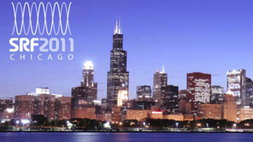
The 2nd workshop on SCRF Technology and Industrialization for the ILC
as a satellite meeting of SRF 2011
Date: July 24, 2011
Place: Chicago
Agenda:
  Introduction
  Reports from SCRF cavity/cryomodule industry
  Reports from SC material vendor
  Comments from Potential Regional Hub-laboratory
  Discussions on the ILC SCRF industrialization model
Note:
  Open for everybody,
  Many Industrial participations acknowledged

Slide 32
Workshop Objectives
Exchange information:
  efforts on cost-effective SCRF cavity/cryomodule production and quality control
Discuss on:
  optimum industrialization models for ILC including the scale, time, and site,
  sharing responsibilities between industry and laboratories, and/or industry and industry,
  how to manage industrial constraint/regulation and to coordination it in global scale
Provide:
  advices for the ILC TDR and cost-estimate.

Slide 33
Cavity R&D for ILC 1 TeV-Upgrade (continued)
R. Geng
ILC SRF cavity R&D beyond 2012
  Importance
    Maintain “global” nature for coherence
    Project oriented, targeted R&D, benchmarked progress
    Resource sharing, cross-region experience exchange
  ILC: driver for high gradient SRF cavity technology
    Pursuit of ultimate gradient continues to motivate innovation
    Gradient success continues to benefit SRF based accelerators
year | # of >35 MV/m 9-cell cavities | # of labs capable of 35 MV/m processing | # of Industrial manufacturers capable of 35 MV/m fabrication
2006 | 10 | 1 DESY | 2 ACCEL, ZANON
2011 | 41 | 4 DESY, JLAB, FNAL, KEK and others joining soon | 4 RI, ZANON, AES, MHI, and others joining soon

Slide 34
Cavity R&D to be extended for possible ILC 1 TeV Upgrade
M. Ross
High gradient
  Shape: LL/ICHIRO, RE, LSF – on going
  Processing: Mechanical polishing – on going
  Material
    Large grain – on going
    Nb/Cu laminate – needs re-start
    Multi-layer and material beyond Nb – to be encouraged
High Q0
  Large grain – on going
  ALD over coating – R&D started
Suppress field emission
  CO2 snow cleaning – on going
  HOM can cleaning – R&D started

Slide 35
Summary
Please refer
further ILC related papers
presented in SRF2011
SRF 1.3 GHz cavity R&D progressed
  9-cell cavity Gradient R&D:
    Maximum gradient reaching > 45 MV/m (w/ large-grain)
    Production-yield progressed in ILC Global data-base:
      ~ 20 % at 35 MV/m in 2008 to ~ 60 % at 35 MV/m in 2011
  Cavity-string performance in Cryomodule
    FLASH/PXFEL-1: reached <32 MV/m>
    NML: in progress
    S1-Global: reached <26 MV/m> with 7 cavity-string
  Superconducting accelerator system test
    FLASH: progressing in acceleration for 9 mA demonstration
Industrialization study in progress
  in close communication with industry
Further high-gradient R&D after TDR being prepared,
  for possible 1-TeV upgrade

Slide 36
backup

Slide 37
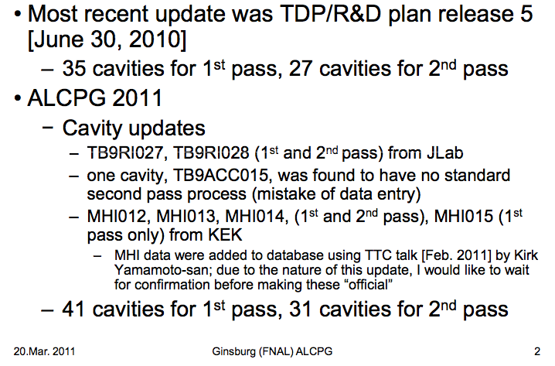
Four Cavity Manufacturer Data
Now Included for Global Yield Analysis

Slide 38
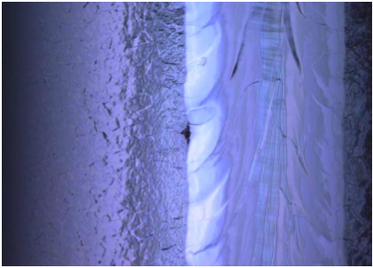
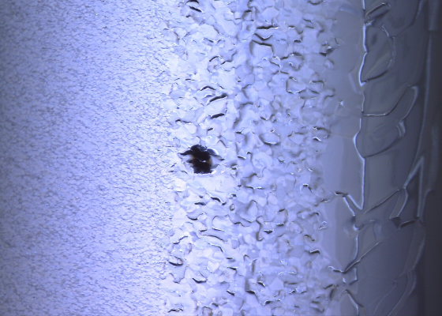
Local grinding of quench location
200um x 600um, depth 115um
600um x 600um, hight ~50? um
MHI08 2-cell equator, t=172 degree
AES003 4-cell equator, t=306 degree
Pit; appeared after bulk EP,
limit to 16MV/m
Bump at heat affecting zone,
limit to 20MV/m
Local grinder tool
local grinding & EP
local grinding & EP
27MV/m
30MV/m
additional EP
additional HPR and bake
38MV/m
34MV/m

Slide 39
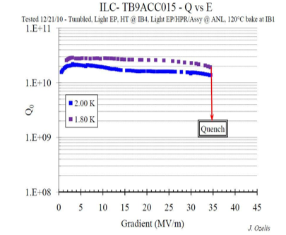
ACC15 Reached 35 MV/m after Mechanical Polishing at FNAL
More cavities
by FNAL mechanical
polishing
on the way…

Slide 40
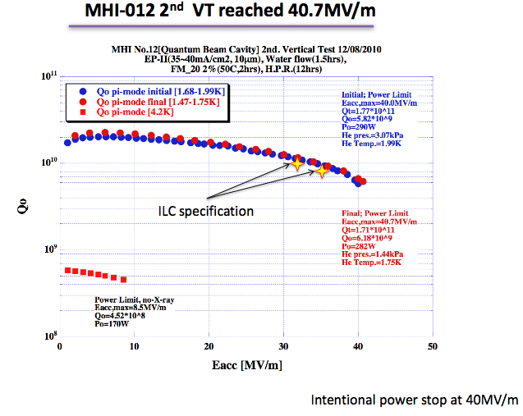

KEK MHI-12 Exceeded 40 MV/m
MHI-13 reached 36.5 MV/m at Q0 7.5E9 after first-pass processing

Slide 41
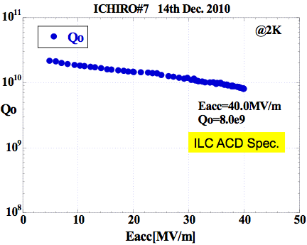

KEK ICHIRO7 Reached 40 MV/m
Photo courtesy
Kenji Saito & Fumio Furuta
of KEK
50 MV/m in perspective as
many ICHIRO
1-cell cavities achieved gradient of > 50 MV/m…

Slide 42

DESY Large-Grain Cavity AC155 Reached > 45 MV/m at Q0 > 1E10
Heavy BCP + EP + low temperature bake
7 more cavities
on the way…

Slide 43


Gradient Progress at TTF at DESY
~ 2008
ILC:
  <31.5> MV/m
TTF: ~ 2008：
  <~ 30> MV/m
  >> EXFEL

Slide 44
Simulation
(time: us from start of fill)

Slide 45
Achievements: SRF Linac – FLASH (DESY)
High beam power and long bunch-trains (Sept 2009)
Metric | ILC Goal | Achieved
Macro-pulse current | 9mA | 9mA
Bunches per pulse | 2400 x 3nC (3MHz) | 1800 x 3nC 2400 x 2nC
Cavities operating at high gradients, close to quench | 31.5MV/m +/-20% | 4 cavities > 30MV/m
Gradient operating margins (Feb 2011)
Metric | ILC Goal | Achieved
Cavity gradient flatness (all cavities in vector sum) | 2% ΔV/V (800μs, 9mA) | 2.5% ΔV/V (400μs, 4.5mA) “Methodology established”
Gradient operating margin | All cavities operating within 3% of quench limits | (Focus of early 2012 run)
Energy Stability | 0.1% at 250GeV | <0.15% p-p (0.4ms) <0.02% rms (5Hz)

Slide 46


New Cryomodule Test Facility
(ARRA funded )
New 500 W 1.8 K refrigerator
(under fabrication in industry)
will be located in CMTF bldg
New Electronics building above tunnel extension
New Cryomodule Test Facility
Compressor building

Slide 47
Production Process/Responsibility
Step hosted | Industry | Industry/Laboratory | Hub-laboratory | ILC Host-laboratory
Regional constraint | no | yes | yes | yes
Accelerator - Integration, Commissioning |  |  |  | Accelerator sys. Integ.
SCRF Cryomodule - Perofrmance Test |  |  | Cold, gradient test | As partly as hub-lab
Cryomodule/Cavity - Assembly |  | Coupler, tuner, cav-string/cryomoduleassmbly work |  | As partly as hub-lab
Cryomodule component - Manufacturing | V. vessel, cold-mass ...
9-cell Cavity - Performance Test |  |  | Cold, gradient test | As partly as hub-lab
9-cell Cavity - Manufacturing | 9-cell, end-group assembly, Chem-process, He-Jacketing
Sub-comp/material - Production/Procurement | Nb, Ti, specific comp. … |  | Procurement

Slide 48
Agenda (a.m.)
08:30 - 08:35 Welcome 05'
Speakers: Mark Champion (FNAL) , Camille Ginsburg (FNAL)
08:35 - 09:15 Introduction 40'
Speaker: Akira Yamamoto (KEK)
09:15 - 12:00 Cavity Industrial Partners
09:15 ILC SCRF Dressed Cavity, An Industrial Cost Estimate Update 25'
Speaker: J. Sredniawski (AES)
09:40 Niowave’s Industrialization Plan 25'
Speakers: T.L. Grimm, C.H. Boulware, A.A. Kolka, and J.L. Hollister (Niowave)
10:05-10:20 Coffee Break--> 15’
10:20 Utilization of Industrial Electron Beam Processing
in Order to Optimize Fabrication of SRF Cavities in Larger Quantities 25'
Speaker: R. Edinger (Pavac)
10:45 Preparing RI for the Mechanical Manufacturing and
Surface Preparation of 300 XFEL Cavities 25'
Speaker: M. Pekeler (RI)
11:10 Study of Industrialization and Factory Layout for SCRF Cavity Production 25'
Speaker: S. Ishii (MHI)
11:35 Study of Industrialization and Factory Layout for Cryomodule Assembly 25'
Speaker: T. Semba (Hitachi)
12:00 - 13:00 Lunch (working lunch served by GDE, Maxine)

Slide 49
Agenda (p.m.)
13:00 - 14:40 Material Industry Partners
13:00 Niobium from OTIC 20'
Speaker: H. Zhao (OTIC Ningxia)
13:20 Nb-sheet Production Status and Future Prospects 20'
Speaker: H. Umezawa (Tokyo Denkai)
13:40 Status and Future Prospect for Superconducting Material 20'
Speaker: T. Nelson (ATI/Wah Chang)
14:00 Progress and Capability of Nb Seamless Pipe 20’
Speaker: B. Spaniol (Heraeus)
14:20 Progress and Capability of Nb Sheet Production 20'
Speaker: R. Grill (Plansee)
14:40 - 14:50 Coffee Break
14:50 - 15:30 Laboratory
14:50 Industrialization Activities in the Americas 20'
Speaker: Bob Kephart (FNAL)
15:10 Industrialization Studies in the KEK Cavity Fabrication Facility (CFF) 20’ Speaker: Hitoshi Hayano (KEK)
15:30 - 16:00 Summary and Discussion 30'
Conveners: Mark Champion (FNAL) , Camille Ginsburg (FNAL)

Slide 50

Main Issues at Very High Gradient
“Knobs” for improved reproducibility in overcoming local quench at very high gradient of 40-50 MV/m
Material
Nb: > 2000 Oe (exp.)
2400 Oe (the.)
Nb₃Sn: > 4000 Oe (the.)
Achievable gradient
Cavity surface chemistry
Cavity wall
thermal conductance
Cavity surface smoothness
Cavity shape
Alternate cavity shape for reduced Hpk/Eacc ratio. In hand (LL, RE, LSF).
Uniform cavity processing for reduced local “bad” spots. In hand (EP).
Smooth surface for reduced local magnetic field enhancement. In hand(CBP & derivative + EP).
Improved wall thermal conductance for increased local heating tolerance.
  Cavity heat treatment optimization for “phonon peak engineering”
  Use Nb/Cu composite material (such as explosion bonded material)
(5) The game-changing knob is a Nb replacement material (such as Nb₃Sn or Mg₂B w/ multi-layer).

Slide 51


Global Plan for SCRF R&D
Year | 07 | 2008 |  | 2009 |  | 2010 |  | 2011 | 2012
Phase | TDP-1 |  |  |  |  |  | TDP-2
Cavity Gradient in v. test to reach 35 MV/m | → Yield 50% |  |  |  |  |  | → Yield 90%
Cavity-string to reach 31.5 MV/m, with one-cryomodule |  | Global effort for string assembly and test (DESY, FNAL, INFN, KEK)
System Test with beam acceleration |  |  | FLASH (DESY) , NML (FNAL) STF2 (KEK, test start in 2013)
Preparation for Industrialization |  |  |  |  | Production Technology R&D
Communication with industry: | 2009: 1st step: Visit Vendor (2009) 2010: 2nd step: Organize Workshop (2010) 2011: 3rd step: Send specification & receive response

