Slide 1
An X-band Testing System for Novel Superconducting RF Materials
Jiquan Guo, Sami Tantawi,
Charles Yoneda, David Martin
SLAC National Accelerator Laboratory
July 26, 2011
SRF 2011

Slide 2
Outline
Motivation
SLAC X-band testing system
Overview
RF design
SLAC testing results
Bulk Niobium
Thinfilm
Summary

Slide 3
Motivation
Testbed for novel SRF materials
Surface Resistance:
RF Magnetic Field limits: beyond 200mT
New superconductors: See Gurevich and Tajima’s Talks
Large energy gap materials (MgB₂, Nb₃Sn, etc) with lower surface resistance, higher T_{c}, higher H_{c}, but lower H_{c1} due to shorter ξ.
Multi-layer S-I-S thinfilm to enhance H_{c1}
Conventional materials:
Nb: different finishing, processing, thinfilm…
NC materials: Cu plated on SS, etc
H_{Nb}
Multilayer superconductor-insulator thinfilm proposed by A. Gurevich

Slide 4
SLAC X-band Testing System overview
f~11.424GHz, compact size and short fill-time
Can easily achieve >400mT with SLAC’s 50MW klystron
Characterize surface impedance by measuring the Qs of a cavity at different H-field level
Capable of low power(NWA) and high power(Klystron) measurements
Interchangeable flat cavity bottom, fits 2-3” diameter samples. Samples can be attached to the cavity with a holder
Cavity design maximizes H-field and has zero E-field on the sample surface
Short pulse (1.6-2µs) at low rep-rate(~1Hz) to reduce pulsed heating, heat load and thermal feedback
A closed-loop Helium refrigerator capable to cool down to 3K

Slide 5
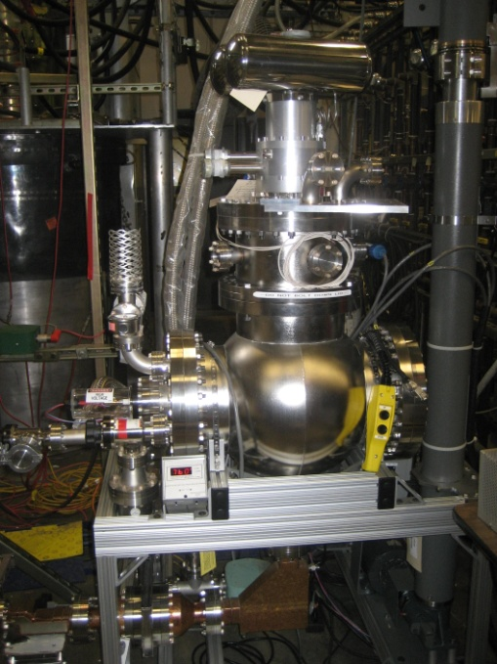
System overview
Measurement ports:
Forward Power: 2 or 5
Reflected power: 4 or 3
Waveform measured by either a Peak Power Meter or a scope with mixers
Low power NWA measurement:
6, 7, or 3
Klystron
1
Cryostat
55dB
2
Cavity
3
10dB
Cryostat
4
5
7
6
45dB
45dB
Mode converter
Bend
Waveguide to Klystron/NWA
Load
System Diagram

Slide 6
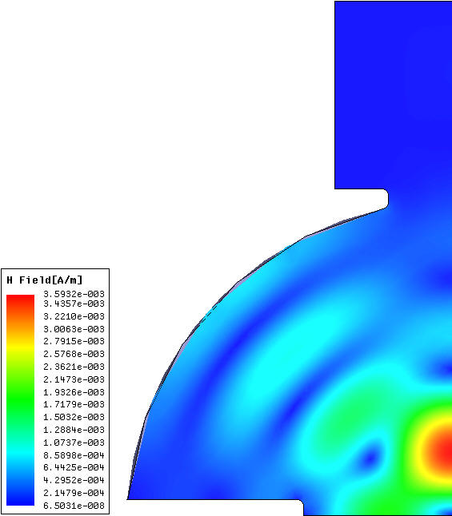
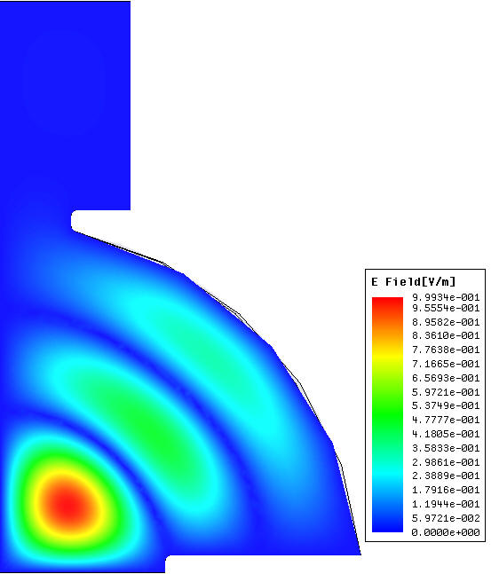
Cavity Design
High-Q hemispheric cavity under a TE₀₁₃ like mode
Zero E-field on all surfaces
Maximize H-field on the samples
H_{peak} on sample is ~2.5 times of peak on dome
Maximize loss on the sample, 36% of cavity total
No azimuthal H, no radial E or current on bottom plate (no searious RF leak at the gaps)
Step height at bottom will affect Q_{e} and geometric factors, which will result in lower accuracy. A quarter wavelength mushroom cavity can mitigate the problem.
Surface H-field(relative)
(m)
E
H
Sample
R=0.95”

Slide 7
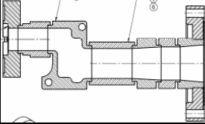
Coupling and the mode converter
High power RF is delivered through WR90 in TE₁₀ mode from Klystron
TE₀₁ mode in circular waveguide is launched through a compact rectangular to circular waveguide mode converter
RF coupled with circular TE₀₁ mode through iris
Same field symmetry in the waveguide and cavity
Sensitive to iris radius
Rect
TE₂₀
Rect
(WR90)
TE₁₀
Circ
TE₀₁
Rectangular TE₁₀ to Circular TE₀₁ mode converter

Slide 8
Cu vs. Nb cavities
Cu cavity body:
no temperature transition (great for testing higher T_{c} material)
R_{s} independent of H-field (great for high power testing)
Higher R_{s}
resulting lower Q₀ and Q_{e}
shorter cavity fill-time, positive for reducing pulsed heating
Lower accuracy for sample R_{s} characterization, ~0.1-0.2mΩ,
Nb cavity body
More precise R_{s} characterization(good for low power testing)
Larger Q_{e}
Nb sputtered cavity will be prepared by S. Calatroni
Bulk Nb cavity also under design
Version of cavity: | Cu | Nb (smaller iris)
Design Fres@4K (GHz) | 11.424 | 11.424
Q_{ext} @4K (design value) | ~350,000 | ~10,000,000
Q₀ @ 4K (reference sample) | ~224,000(measured) | Est. 3 - 35×10⁶
Q₀ @ 300K (reference sample) | ~50,000(measured) | Est. 16,500
Q0 @4K (0 resistivity sample) | ~348,000
Filltime(4K with SC sample) | ~4μs | ~1ms

Slide 9
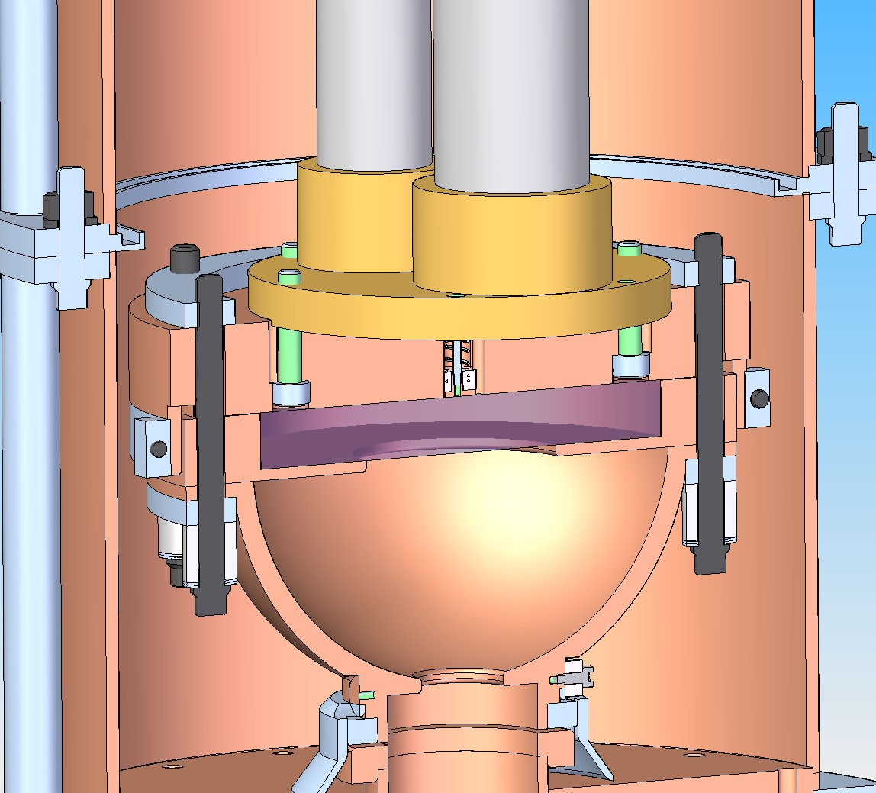
Cavity Assembly

Slide 10
Cavity Assembly

Slide 11
High power test flow chart
Cavity heater power supply
Amp and phase
Scope
T read/
control
Temperature Monitor
Computer
Power trace
PPM
I/Q control
Amp Contr/Freq FB
LO
REF
RF
FWD
RF
I
Cavity
LO
AFG
TWT
Klystron
Q
Load
Load

Slide 12
Measurement Results: Bulk Cu
This reference Cu sample is used to estimate the surface impedance of the cavity body. It uses similar material as the body, and the same annealing process.

Slide 13
Measurement Results: FNAL Nb S15-1
FNAL bulk large grain Nb sample
Before baking, the sample showed signs of Hydrogen poisoning. 5 rounds of tests were made in 5 consecutive days, before the baking, with magnetic shielding. On each day the sample is cooled down to 3K, then warmed up to 120-130K on the next morning. Result shows that Q0 drops on every day.
Cleaning/800̊C bake removes Hydrogen and improves Q.

Slide 14
Measurement Results: Bulk Nb, high power test
Power traces of the high power test

Slide 15
Measurement Results: S15-1, high power test
FNAL bulk large grain Nb sample
The residual resistivity is causing pulse heating and degrades the quenching field.
Before magnetic shielding and baking, the sample start to quench at ~65mT with temperature rises ~5K.
After shielding and baking, quenching starts at about 120mT.

Slide 16
S19, Bulk CMP Nb
Before baking, shielding helps to improve Q0. After baking, Q0 becomes quite good; removing the shielding does not make much difference.
The Max Q0 is about 333,000
We also tested with external H-field after baking, the results are very close.
High power test after baking
1st time 170mT was achieved

Slide 17
Measurement results: 300nm MgB₂ on Sapphire
300nm MgB2 thin film on Sapphire substrate,

Slide 18
S19-3: 100nm MgB₂/20nm Al₂O₃/Nb

Slide 19
Summary
Schemes of new SRF material structures have been proposed to enhance quenching field and RF loss.
An X-band system at SLAC is demonstrated, which can precisely measure a possible quenching field of more than 400mT.
Nb test results are very sensitive to the sample conditions. We have observed 170mT quenching field with only 1 sample.
100nm MgB₂/20nm Al₂O₃/Nb showed some improvement in H_{c1} over MgB₂ films; substrate and film quality still needs to be improved.
R_{s} measurement needs to be improved with Nb cavity, and possibly 1/4λ mushroom cavity
More samples from the SRF community are welcome.

Slide 20
Acknowledgements
We need to thank our colleagues in the SLAC Klystron department for all the support on the tests.
We also need to thank our collaborators providing the cavity preparation, samples, and advices on our work: S. Calatroni, L. Cooley, A. Romanenko, W. Singer, T. Tajima, A. Valente, B. Xiao, and many more.

