Slide 1
Energetic Condensation Growth of Nb films for SRF Accelerators *
Mahadevan Krishnan, AASC
E. Valderrama, C. James
Alameda Applied Sciences Corporation (AASC), San Leandro, California 94577
X. Zhao, J. Spradlin, A-M Valente Feliciano, L. Phillips, C. Reece
Thomas Jefferson National Accelerator Facility (Jefferson Lab), Newport News, Virginia 23606
K. Seo
Norfolk State University (NSU), Norfolk, Virginia 23504
Z.H. Sung and P. Lee,
Applied Superconductivity Center, Florida State University (FSU), Tallahassee, Florida 32310
F. A. Stevie, P. Maheshwari,
Analytical Instrumentation Facility, North Carolina State University, Raleigh, NC 27695
presented at
SRF-2011, Tuesday July 26, 2011
This research is supported at AASC by DOE via Grant DE-FG02-08ER85162 and Grant DE-SC0004994
The JLab effort was provided by Jefferson Science Associates, LLC under U.S. DOE Contract No. DE-AC05-06OR23177, including supplemental funding provided by the American Recovery and Reinvestment Act

Slide 2
Outline
Motivation for thin films in SRF cavities
History of thin film development
Energetic Condensation
Morphology of thin films produced by energetic condensation
Thin films on Cu
Future Plans

Slide 3
Motivation
More than 10000 particle accelerators worldwide; most use normal cavities
Facility for Rare Isotope Beams (FRIB), ILC and other large facilities:
NSAC report states that as a result of technical advances, a world-class rare isotope facility can be built at ≈ half the cost of the originally planned Rare Isotope Accelerator (RIA), employing a superconducting linac
SRF at 2K is good, but operating at ~10K would further reduce SRF costs as the cryogenic cooling moves towards off the shelf cryo-coolers
Replacing bulk Nb with Nb coated Cu cavities would also reduce costs
The ultimate payoff would be from Cu or cast Al SRF cavities coated with higher temperature superconductors (NbN, Mo₃Re, Nb₃Sn, MgB₂, oxypnictides)
SRF uses less power than normal
SRF with cheaper cavity materials (Cu) would be better
SRF with cheaper cavity materials and high-T_{c} thinfilms would be better still
AASC’s thin film superconductor development is aimed at these goals

Slide 4
Two examples of early SRF thin film development
LEP at CERN tested Cu cavities Magnetron sputter coated with ~1.5µm Nb thin films (1984-)
C. Benvenuti, N. Circelli, M. Hauer, Appl. Phys. Lett. 45, 1984. 583; C. Benvenuti, Part. Accel. 40 1992. 43; C. Benvenuti, S. Calatroni, G. Orlandi in: 20th International conference on Low Temperature Physics, Eugene 1993, to be published in Physica B; C. Benvenuti, S. Calatroni, I.E. Campisi, P. Darriulat , M.A. Peck,R. Russo, A.-M. Valente, Physica C316, 1999, 153–188, (Elsevier): Study of the surface resistance of superconducting niobium films at 1.5 GHz
RRR=11.5 on oxide coated Cu, 29 on oxide-free Cu coated at 150º C
G.Amolds, Doktorarbeit, University of Wuppertal, WUB 79-14 (1979)
Wuppertal studied 8, 3 and 1GHz Nb cells vapor deposition coated with Nb₃Sn

Slide 5
Limitations of Magnetron sputtering and Vapor Deposition
LEP2 at CERN tested Cu cavities Magnetron sputter coated with ~1.5µm Nb thin films (1984-)

Slide 6
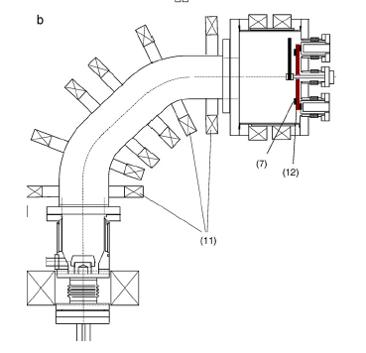
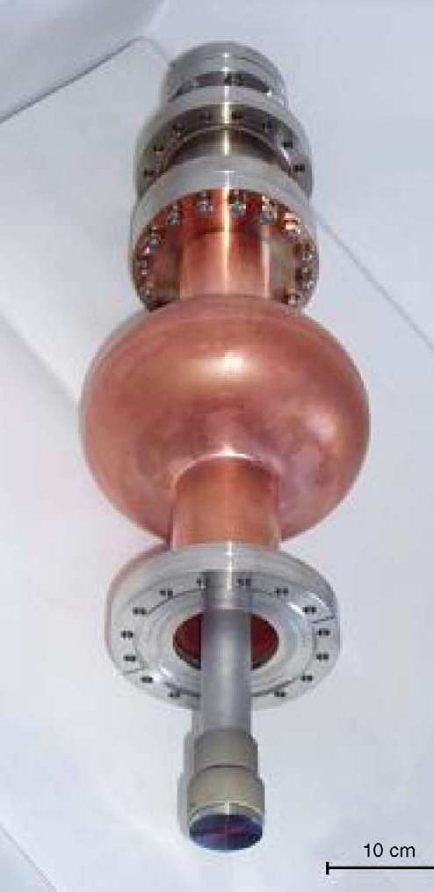
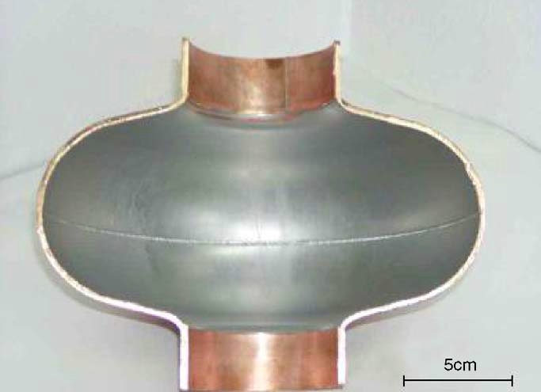
Prior UHV Arc Nb thin films: Tor Vergata, Rome/IPJ, Poland
R. Russo, A. Cianchi, Y.H. Akhmadeev, L. Catani, J. Langner, J. Lorkiewicz, R. Polini, B. Ruggiero, M.J. Sadowski, S. Tazzari, N.N. Koval, Surface & Coatings Technology 201 (2006) 3987–3992
Base pressure of 1–2×10⁻¹⁰ mbar in the system is reached after one night bake at 150 °C, but pressure increased to 10⁻⁷ mbar during run
Laser trigger to minimize impurities in Nb film
Magnetic sector filter to reduce macro-particles in film
Lattice parameter (from XRD spectra) showed much lower stress than observed in niobium deposited by magnetron sputtering
Surface roughness was ~few nm on sapphire and on Cu, was comparable to that of the Cu substrate itself
RRR of 20-50 was measured on ~1µm Nb films deposited on Quartz at room temperature (higher than typical sputtering values)
RRR up to 80 was reported with substrate heated to 200ºC
Dominant impurity was H atoms outgassed from Nb cathode (needed careful bakeout of cathode to minimize this problem
J. Langner, R. Mirowski, M.J. Sadowski, P. Strzyzewski, J. Witkowski, S. Tazzari, L. Catani, A. Cianchi, J. Lorkiewicz, R. Russo, Vacuum 80 (2006) 1288–1293
RRR up to 80 was reported with substrate heated to 200ºC

Slide 7
Outline
Motivation for thin films in SRF cavities
History of thin film development for SRF cavities
Energetic Condensation ( a very brief primer)
Morphology of thin films produced by energetic condensation
Thin films on Cu
Future Plans

Slide 8
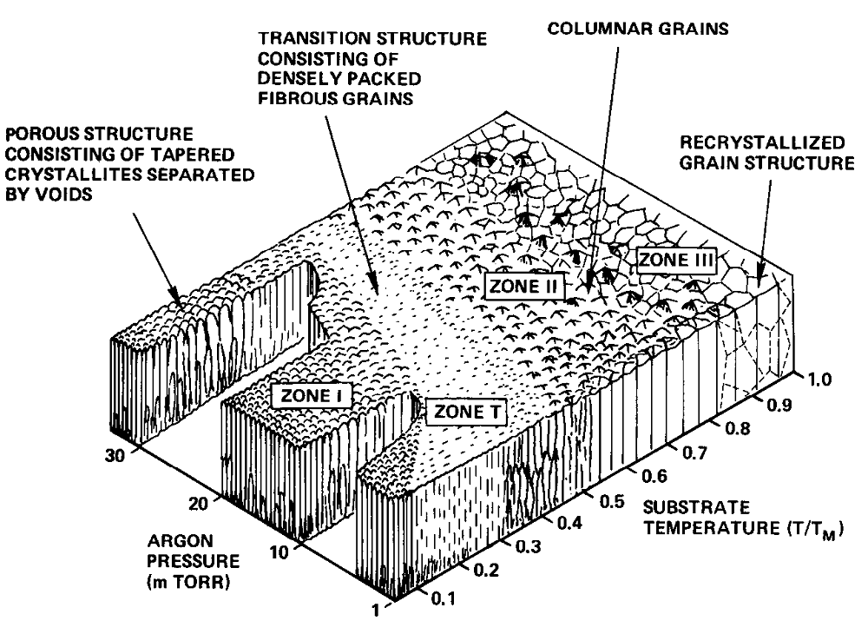
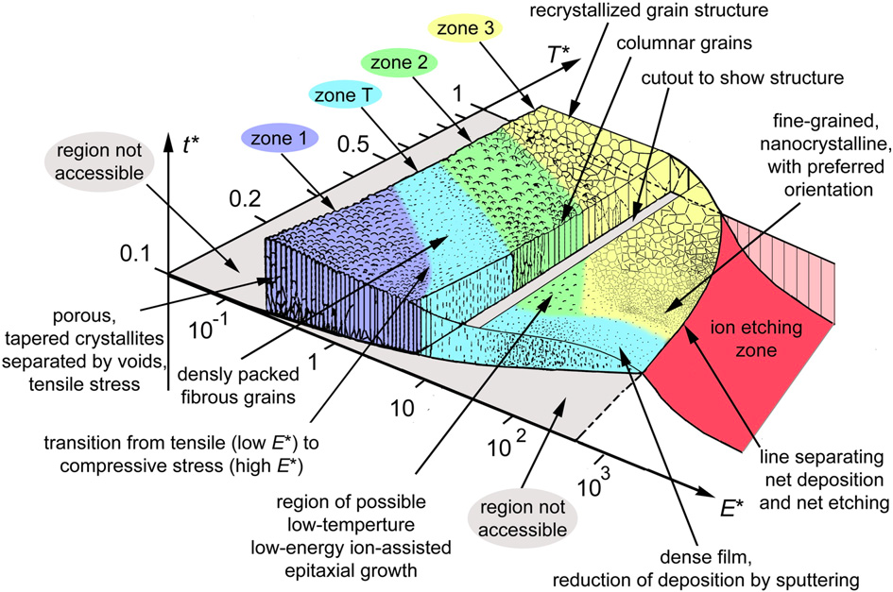
Energetic Condensation
J.A. Thornton, "Influence of substrate temperature and deposition rate on the structure of thick sputtered Cu coatings”, J. Vac. Sci. Technol. Vol. 12, 4 Jul/Aug 1975
Andre Anders, A structure zone diagram including plasma-based deposition and ion etching, Thin Solid Films 518 (2010) 4087–4090
In Energetic Condensation, the ions deposit energy in a sub-surface layer (≈3 atomic layers deep for ~100eV Nb ions), shaking up the lattice, causing adatom mobility and promoting epitaxial crystal growth
Energetic Condensation when combined with substrate heating promotes lower-defect crystal growth

Slide 9
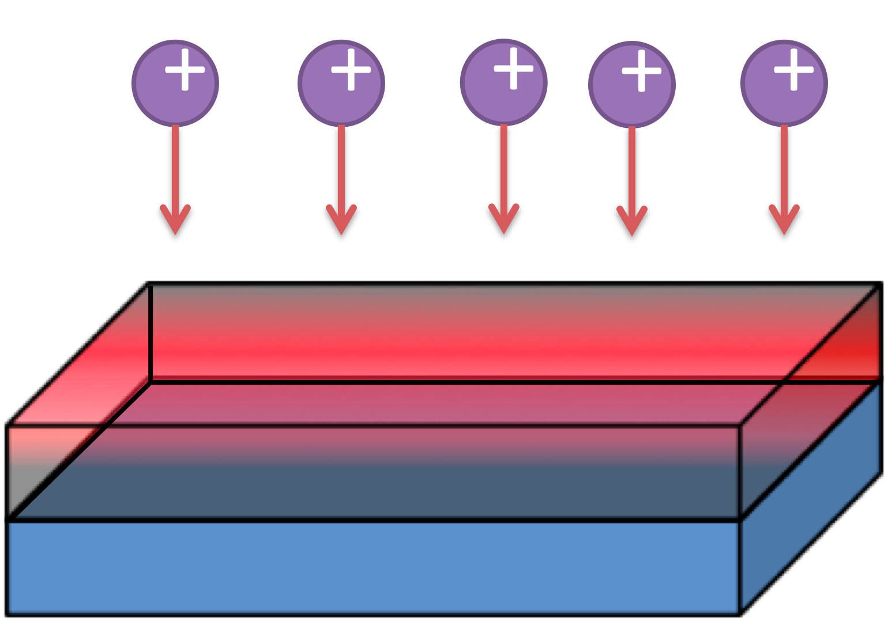
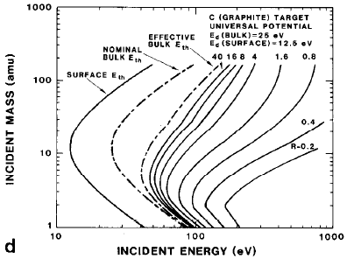
Subplantation Models
Y. Lifshitz, S. R. Kasi, J.Rabalais, W. Eckstein, Phy. Rev. B Vol. 41, #15, 15 May 1990-II: Subplantation model for film growth from hyperthermal species
D.K. Brice, J.Y. Tsao and S.T. Picraux: PARTITIONING OF ION-INDUCED SURFACE AND BULK DISPLACEMENTS
W. D. Wilson, Radiat. Eff. 78, 11 (1983)
Thermal-Vacuum Stability of the Surface Oxide Complex on Cu
M. Bagge-Hansen, R.A. Outlaw, K. Seo, C. Reese, J. Spradlin, Anne Marie Valente-Feliciano and D.M. Manos, Journal of Vacuum Science and Technology (2011), in press
50-120eV energy spread in Nb ions from cathodic arc
* A. BENDAVID, P. J. MARTIN, R. P. NETTERFIELD, G. J. SLOGGETT, T. J. KINDER, C., ANDRIKIDIS, JOURNAL OF MATERIALS SCIENCE LETTERS 12 (1993) 322-323

Slide 10
Challenges for thin film SRF: path to success
Cu and/or Al cavity substrates might be of two different forms
Polycrystalline
Amorphous
How do we grow low-defect Nb films on such substrates?
Study adhesion, thickness, smoothness, RRR, stability
Understand these issues at the coupon level
Proceed to RF cavity level and measure Q at high fields
Install multi-cell Nb coated Cu modules in SRF accelerator and validate the thin film solution
Spur acceptance of thin film Nb by accelerator community
Continue R&D towards higher T_{c} films and Al cavities

Slide 11
Coaxial Energetic Deposition (CED) Coater at AASC
Coaxial Energetic Deposition (CEDTM)
CED coater uses “welding torch” technology
Arc source is scalable to high throughputs for large scale cavity coatings
Present version deposits ≈1 monolayer/pulse in ≈1ms
Russo’s and Langner’s emphasis on UHV and clean walls is important
Notes:
11
11

Slide 12
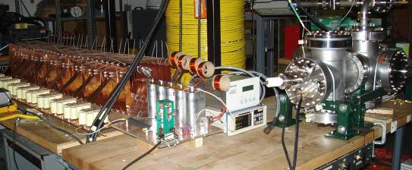
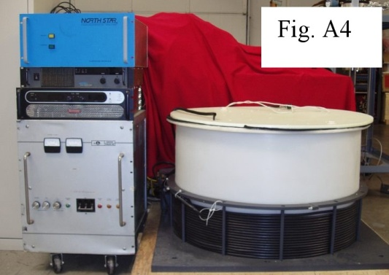
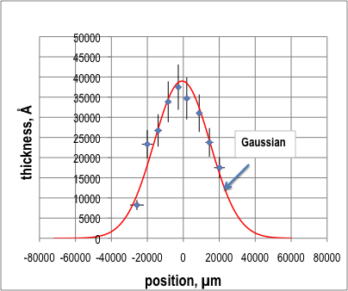
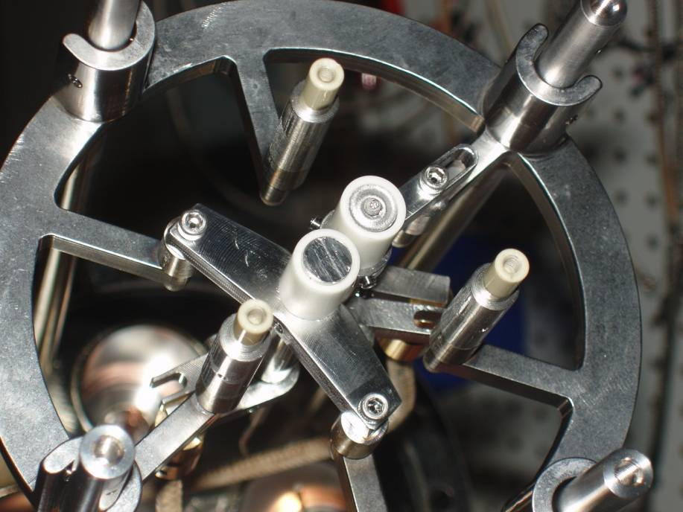
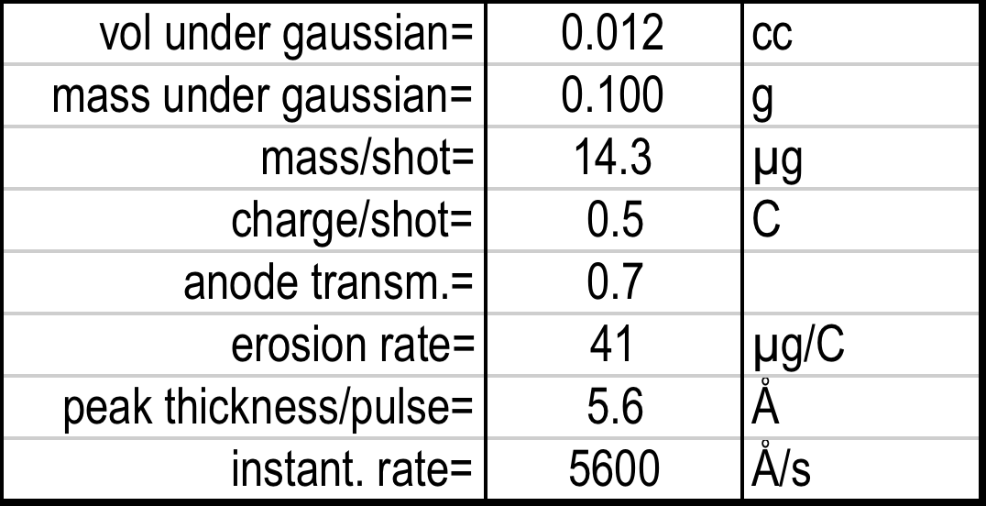
CAD: Pulsed Biased deposition; Dual Targets
* A. BENDAVID, P. J. MARTIN, R. P. NETTERFIELD, G. J. SLOGGETT, T. J. KINDER, C., ANDRIKIDIS, JOURNAL OF MATERIALS SCIENCE LETTERS 12 (1993) 322-323
Cathodic Arc Deposition (CAD)
Pulsed Bias capability
Dual Target source for Nb₃Sn, Mo₃Re, MgB₂ etc.
Please visit Poster THPO077 on Thursday: Mo-Re Films for SRF Applications”, Dr. Enrique Valderrama

Slide 13
Collaborative progress made by AASC and JLab
AASC’s UHV Arc coater (CED/CAD) and JLab’s ECR source are both Energetic Condensation Coaters
The CED/CAD plasma generates Nb²⁺ and Nb³⁺ ions with 40-120eV energy spread
The ECR plasma also produces ~100eV ions by biasing the substrate, with Nb¹⁺ ions
AASC and JLab collaborate on thin film development for SRF. Over the past year, we have achieved record RRR values in Nb films
RRR=585 in Nb on MgO using CED
RRR=488 in Nb on a-sapphire using ECR
RRR=289 in Nb on LG Cu using ECR
We are learning more about the epitaxial growth modes on different substrates, building a knowledge base from which to proceed to Cu cavity coatings in the near future
Please see A-M Valente Feliciano’ s talk later in this session!

Slide 14
Outline
Motivation for thin films in SRF cavities
History of thin film development
Energetic Condensation
Morphology of thin films produced by energetic condensation
Thin films on Cu
Future Plans

Slide 15
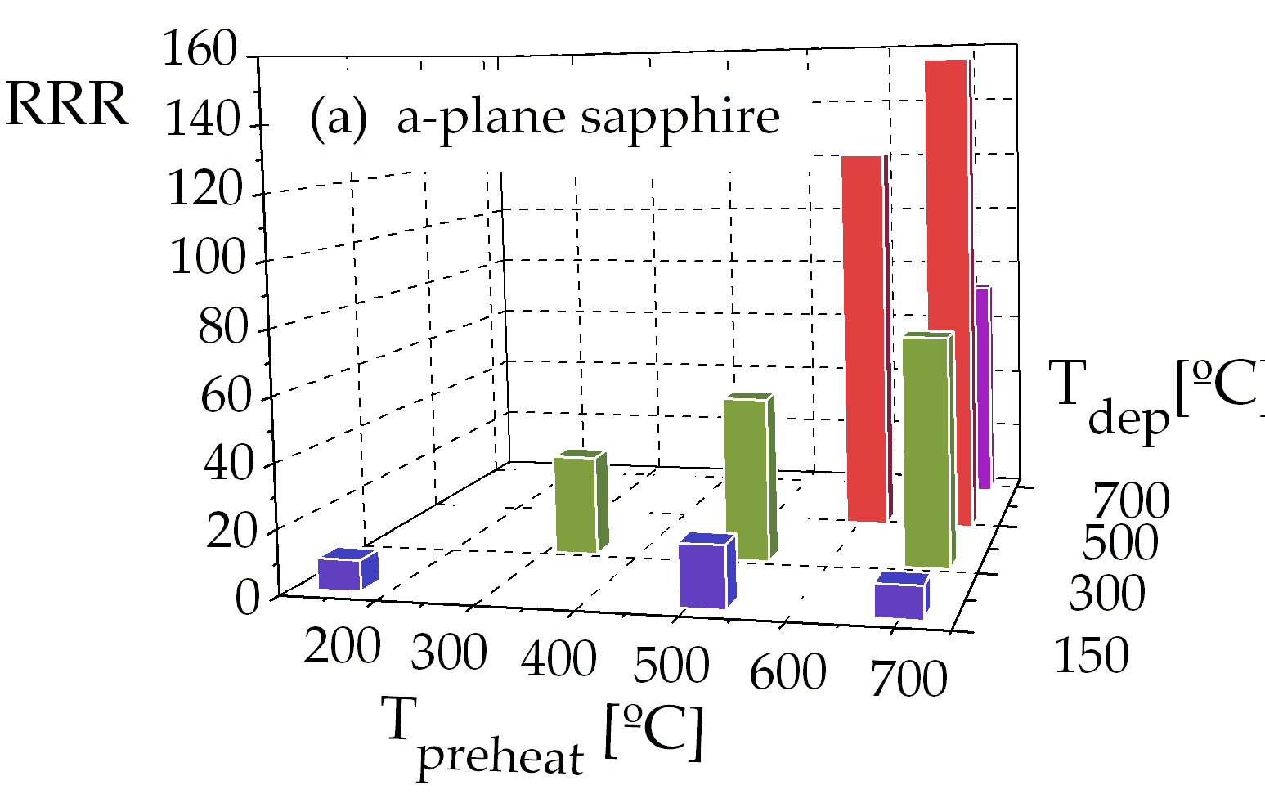
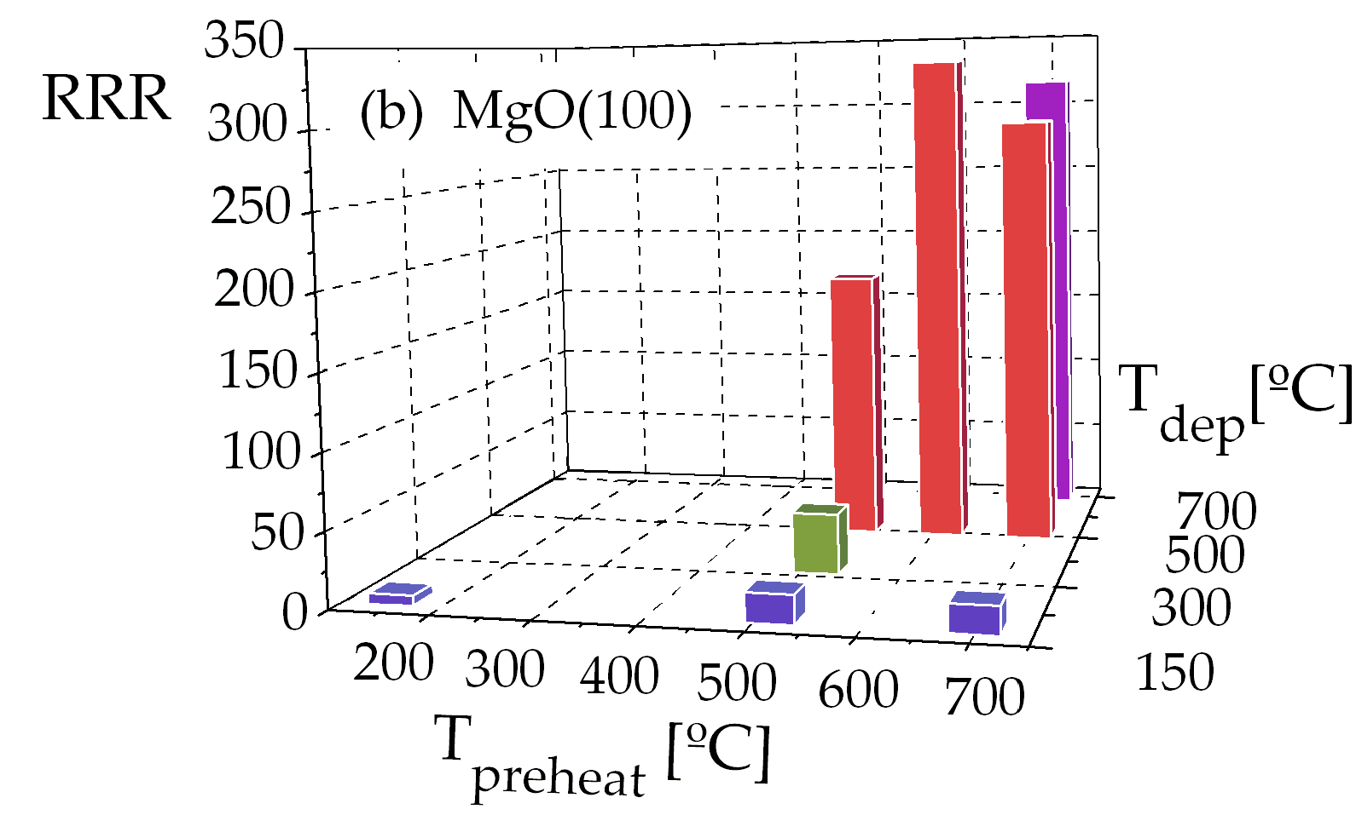
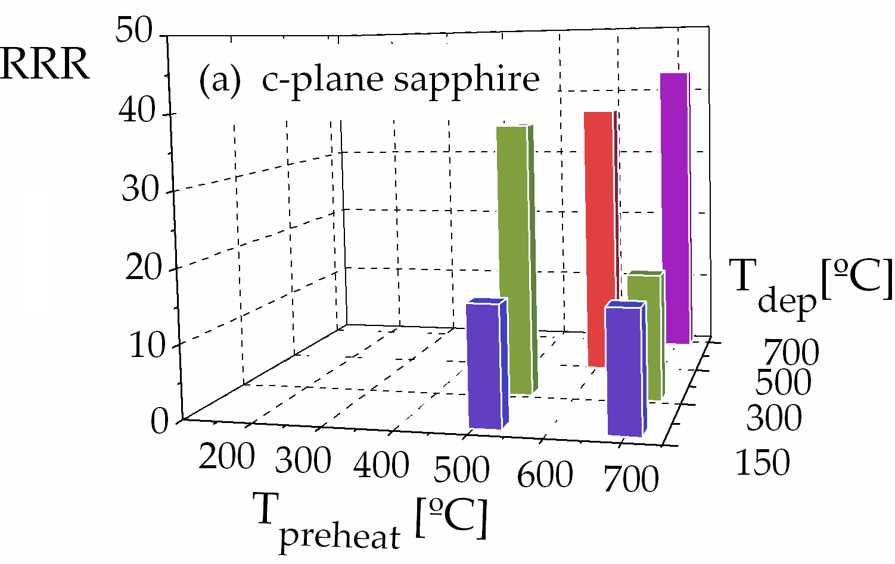
RRR of Nb thin films on sapphire and MgO substrates
Nb thin films grown on sapphire and MgO crystals have demonstrated higher levels of RRR than were reported by the pioneers, and XRD spectra reveal crucial features
RRR-585 (±1% error) measured on 5µm film on MgO
RRR-330 measured on a-sapphire
M. Krishnan, E. Valderrama, B. Bures, K. Wilson-Elliott, X. Zhao, L. Phillips, Anne-Marie Valente-Feliciano, Joshua Spradlin, C. Reece, K. Seo, submitted to Superconducting Science and Technology

Slide 16
Nb on MgO: Local RRR vs. averaged <RRR>
<RRR> vs. film thickness
Ad hoc model fit to <RRR> data
G. Orlandi, C. Benvenuti, S. Calatroni, F. Scalambrin, Expected dependence of Nb-coated RF cavity performance on the characteristics of niobium, Proc. Of 6th workshop on RF Superconductivity, CEBAF, (1993)

Slide 17
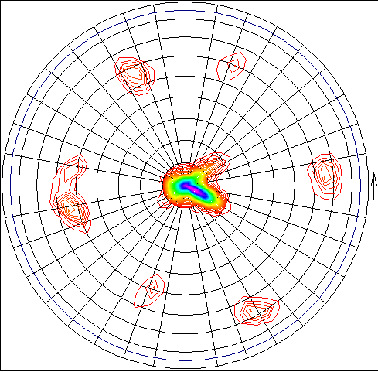
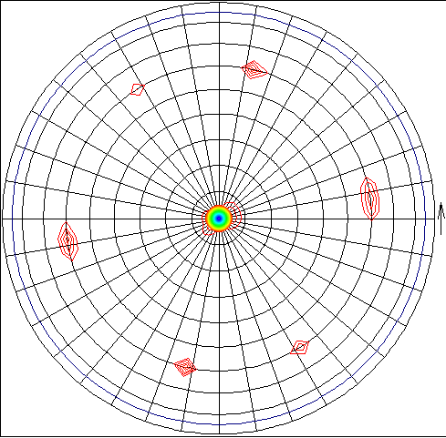
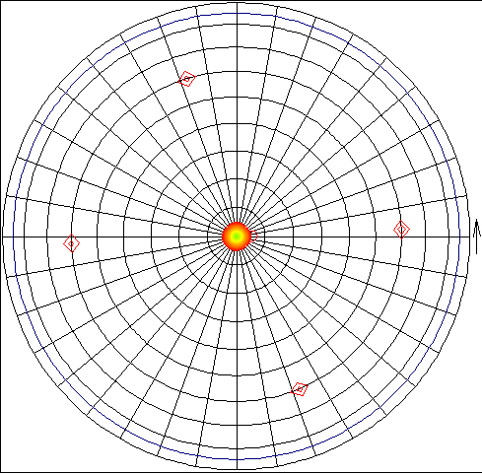
RRR of Nb thin films on a-sapphire substrates
XRD Pole Figures show that higher RRR correlates with higher crystalline order
Polycrystalline
Polycrystalline with twins
Monocrystal
RRR=10, 150/150
RRR=31, 300/300
RRR=155, 700/500
"Twin symmetry texture of energetically condensed niobium thin films on sapphire substrate (a-plane Al2O3)”, X. Zhao, L. Philips, C. E. Reece, Kang Seo, M. Krishnan, E. Valderrama, Journal of Applied Physics, Vol 115, Issue 2, 2011, [in-press],

Slide 18
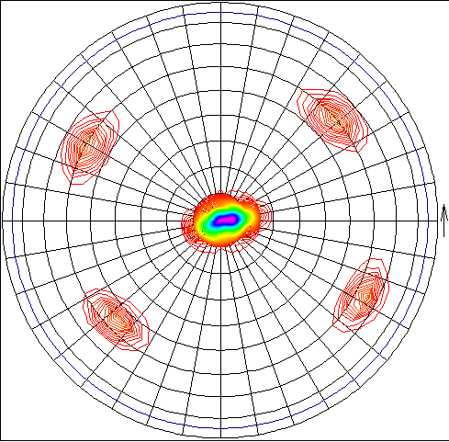
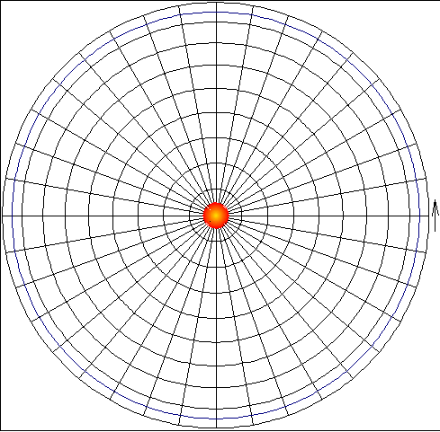
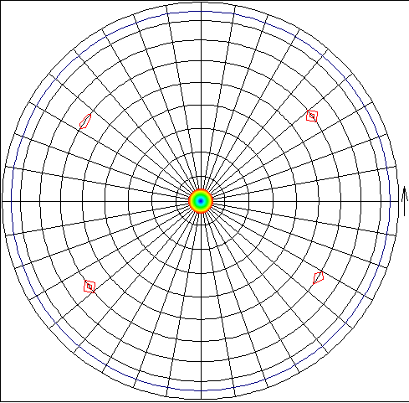
RRR of Nb thin films on MgO substrates
Pole Figures show change in crystal orientation from 110 to 200 at higher temperature
Polycrystalline
Monocrystal with two orientations
Monocrystal with 100 orientation
110
110 & 200
200
RRR=7, 150/150
RRR=181, 500/500
RRR=316, 700/700
Please visit poster THP0042 (given by Xin Zhao of JLab) for more details

Slide 19
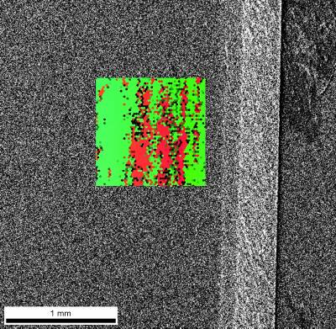
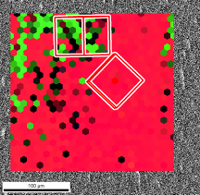
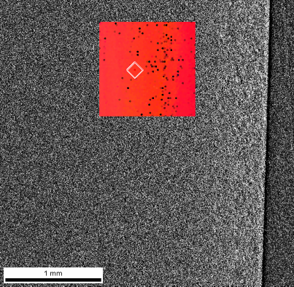
Nb on MgO: temp. driven transition in crystal orientation
EBSD data shows intermixed Nb (110) and Nb (100) for lower RRR samples
High RRR samples show pure Nb (100) for the entire surface
RRR = 196, 500/500
RRR = 333, 600/500
Nb (100)
100µm
Nb (110)
Nb (100)
1mm
1mm
EBSD shows 110 to 100 transition (Pole figure captures the 200 plane):

Slide 20
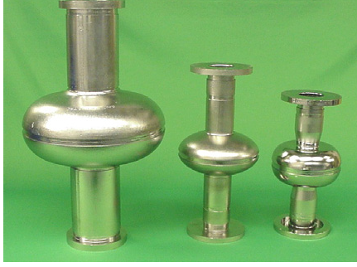
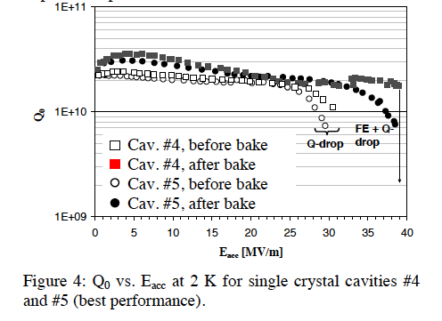
Observations about bulk single crystal Nb orientation
PERFORMANCE OF SINGLE CRYSTAL NIOBIUM CAVITIES, P. Kneisel, G. Ciovati, TJNAF, Newport News, VA 23606, U.S.A. W. Singer, X. Singer, D. Reschke, A. Brinkmann, Proceedings of EPAC08, Genoa, Italy MOPP136
PROGRESS ON LARGE GRAIN AND SINGLE GRAIN NIOBIUM – INGOTS AND SHEET AND REVIEW OF PROGRESS ON LARGE GRAIN AND SINGLE GRAIN NIOBIUM CAVITIES, P. Kneisel, Proceedings of SRF2007, Peking Univ., Beijing, China
Cavity #5 showed a different behavior than all other single crystal/large grain cavities after baking: the Q-drop did not disappear after 12 hours. The crystal orientation of the single crystals of this cavity was (110) with a tilt against the surface. For cavity #4 the crystal orientation was (100).
The surface of both cavities appeared quite different after BCP: whereas cavity #4 exhibited a very smooth, shiny surface, the surface of cavity #5 was “rough” (orange peel/fish scale appearance) and less shiny.
Obviously, there is a difference in the reaction of the BCP chemicals at different crystal orientations {D. Baars et al., ”Crystal orientation effects during fabrication of single or multi-crystal Nb SRF cavities”, SRF07, Beijing, Oct. 2007, TH102; http://www.pku.edu.cn/academic/srf2007/proceeding}
Could CED (Energetic Condensation) be used to grow (100) Nb films on existing Nb cavities to help improve performance?

Slide 21
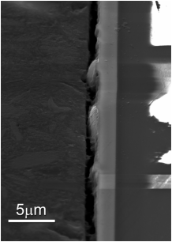
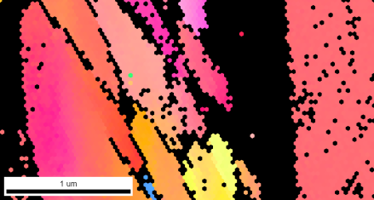
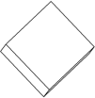
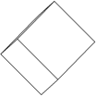
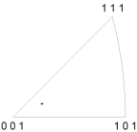
RRR–7: Cross sectional EBSD (OIM)
BSE image – Cross sectional view
Lower CI values between Nb matrix and MgO substrate indicate that there could be an amorphous or non-structured layer between them
Conductor – Mounting material
0.1μm Scan step size
35nm Scan step size
Nb
MgO
Nb thin film layer
MgO layer
MgO IPF map

Slide 22
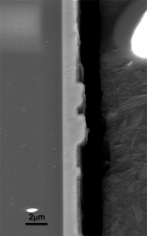
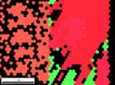
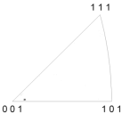
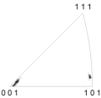
RRR–196: Cross sectional EBSD: shows mix of (110) and (100)
Conductor – Mounting material
Area A
Area B
Area C
Area D
Area E
MgO
Nb
Nb structures are mostly (001) & (101)
MgO

Slide 23
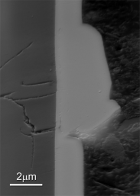
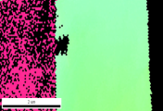
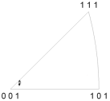
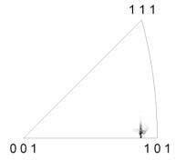
RRR–316: Cross sectional EBSD
Conductor – Mounting material
MgO
Nb
0.15μm scan step size
MgO
Nb

Slide 24
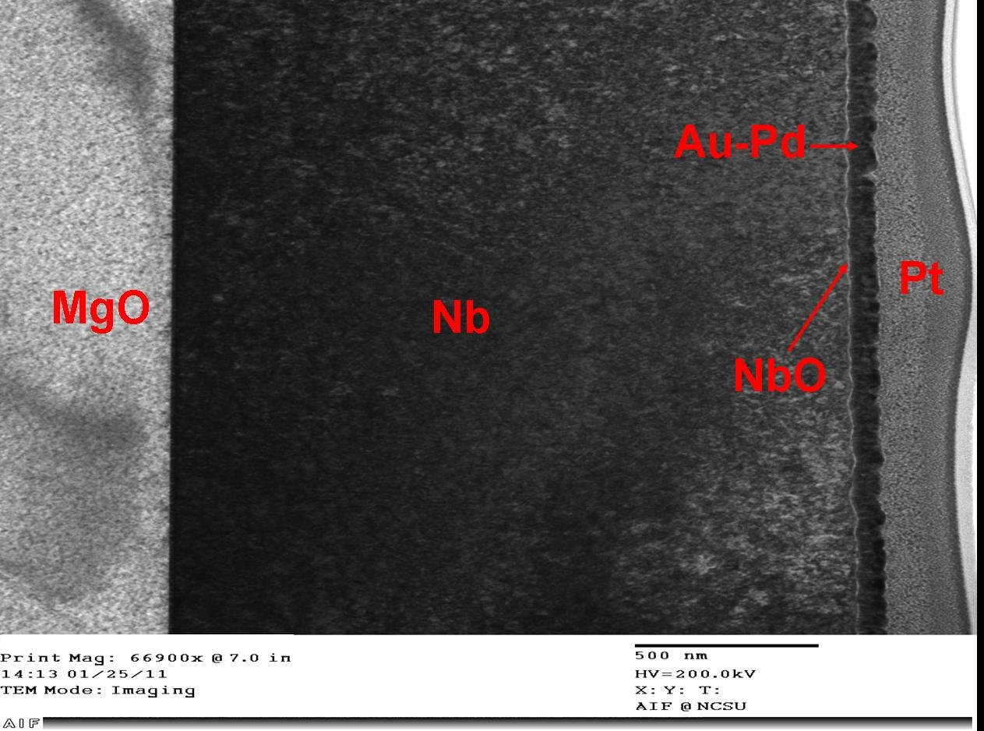
TEM/AFM of high RRR samples
R_{q} = 5.34 nm
R_{a} = 4.29 nm
Energetic Condensation (subplantation) physics drives an adhesive, non-porous, dense interface between substrate and Nb film
Nb surface is smooth (~5nm roughness)

Slide 25
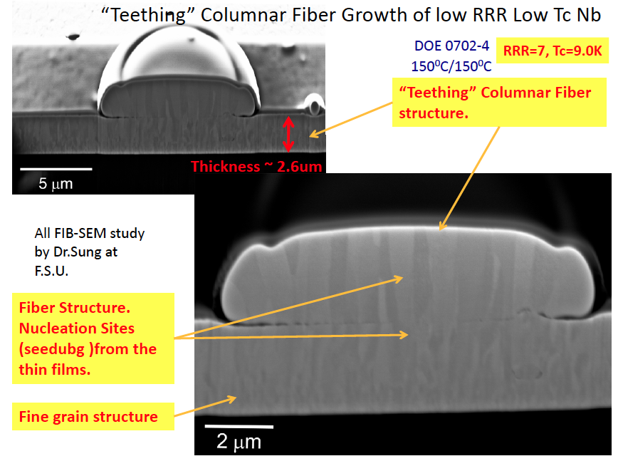
“Mold” effect of subplanted Nb films: low RRR film
The macroparticle acquires the same crystallite structure as does the underlying Nb thin film that preceded it . This is for a low RRR film.

Slide 26
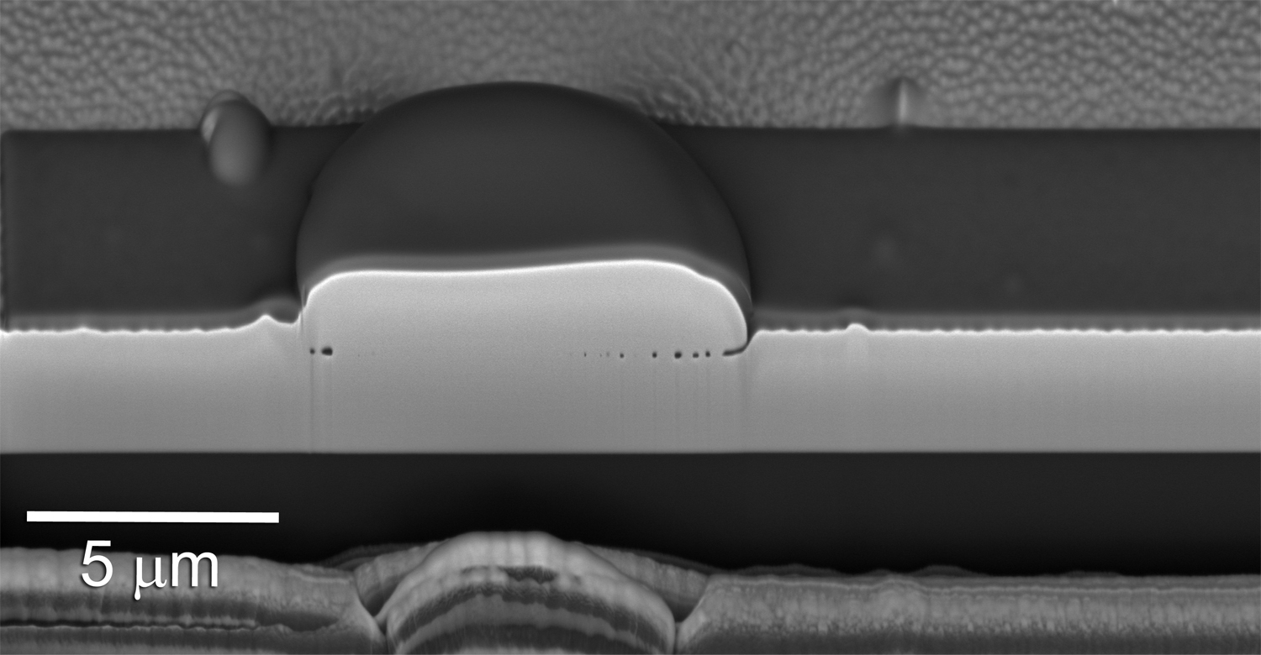
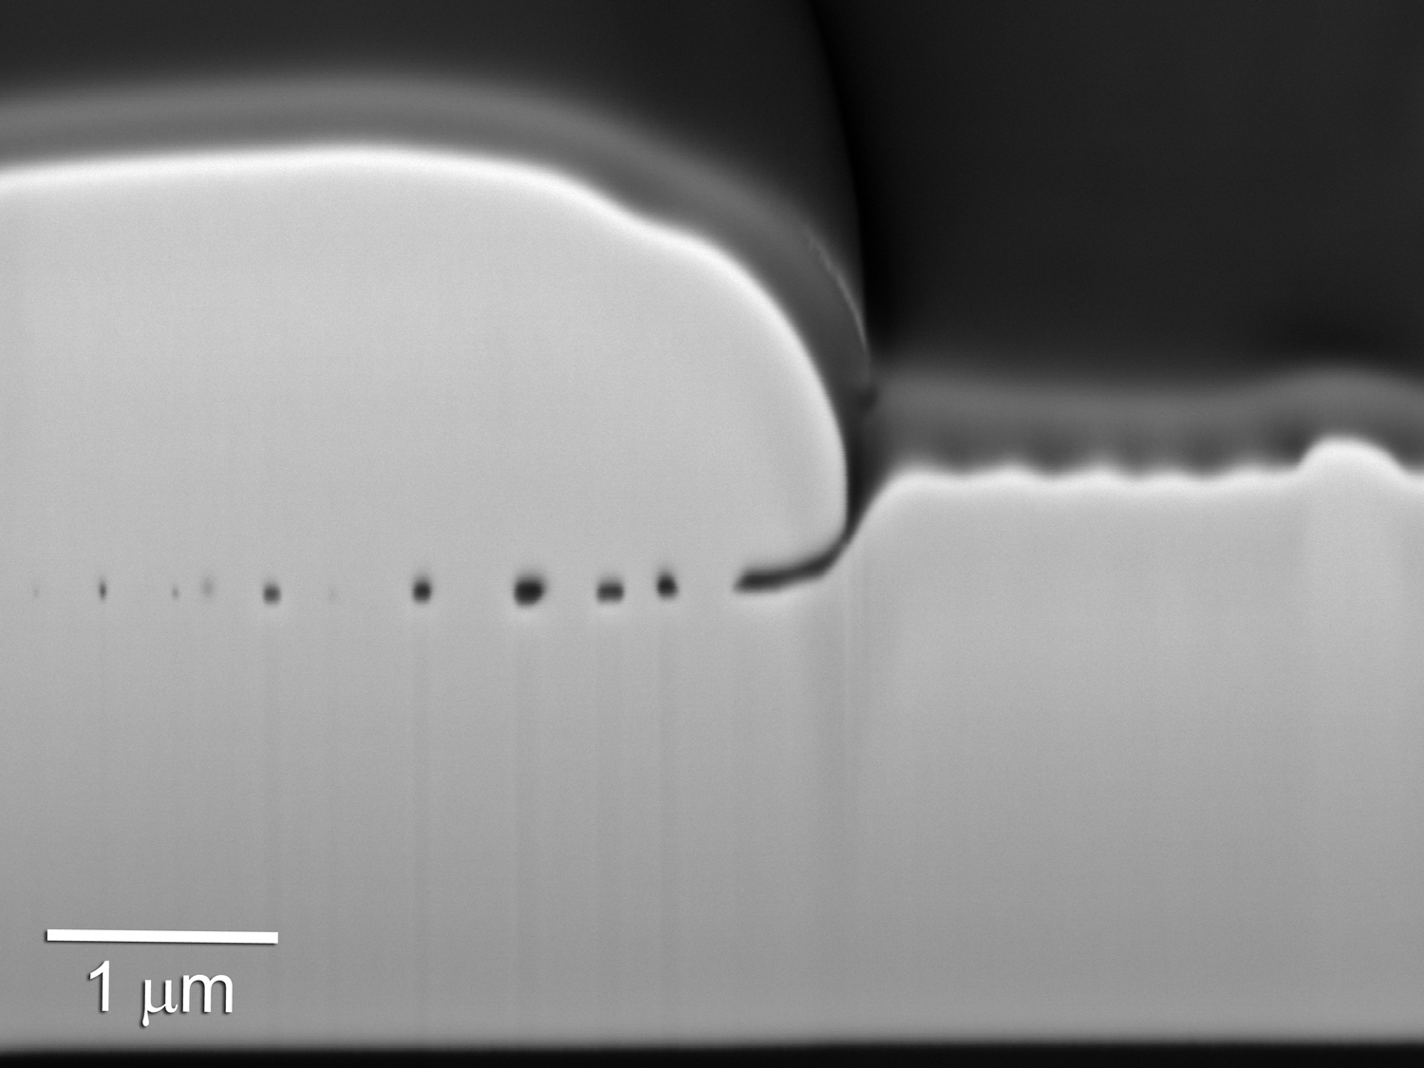
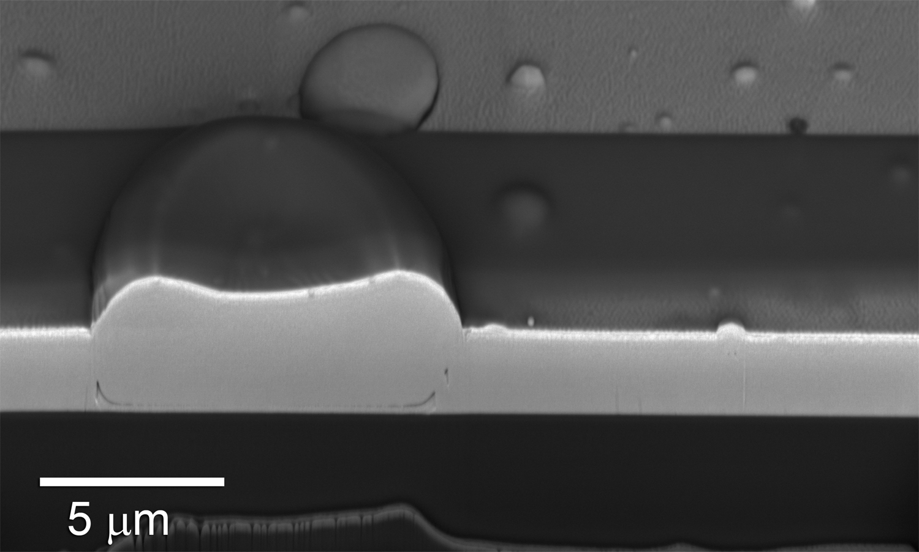
“Mold” effect of subplanted Nb films: high RRR film
This macro landed on 2.4µm Nb film
This macro landed near MgO surface
No Columnar structure; XRD shows (100) single crystal
Thickness ~ 2.43um
Thickness ~ 2.27um
Contrast due to FIB milling trace

Slide 27
Revisit Andre Anders’ SZD
Macro-particles appear to have the same crystal structure as subplantation grown films
Macroparticles arrive at surface with very low kinetic energy but T/T_{m} ~1
Macro-particles
Nb ions
Can we develop a “hybrid” growth concept in which Energetic Condensation plants the seed and then pure molten metal is poured on this seed, to develop a highly crystalline order via the “mold” effect?

Slide 28
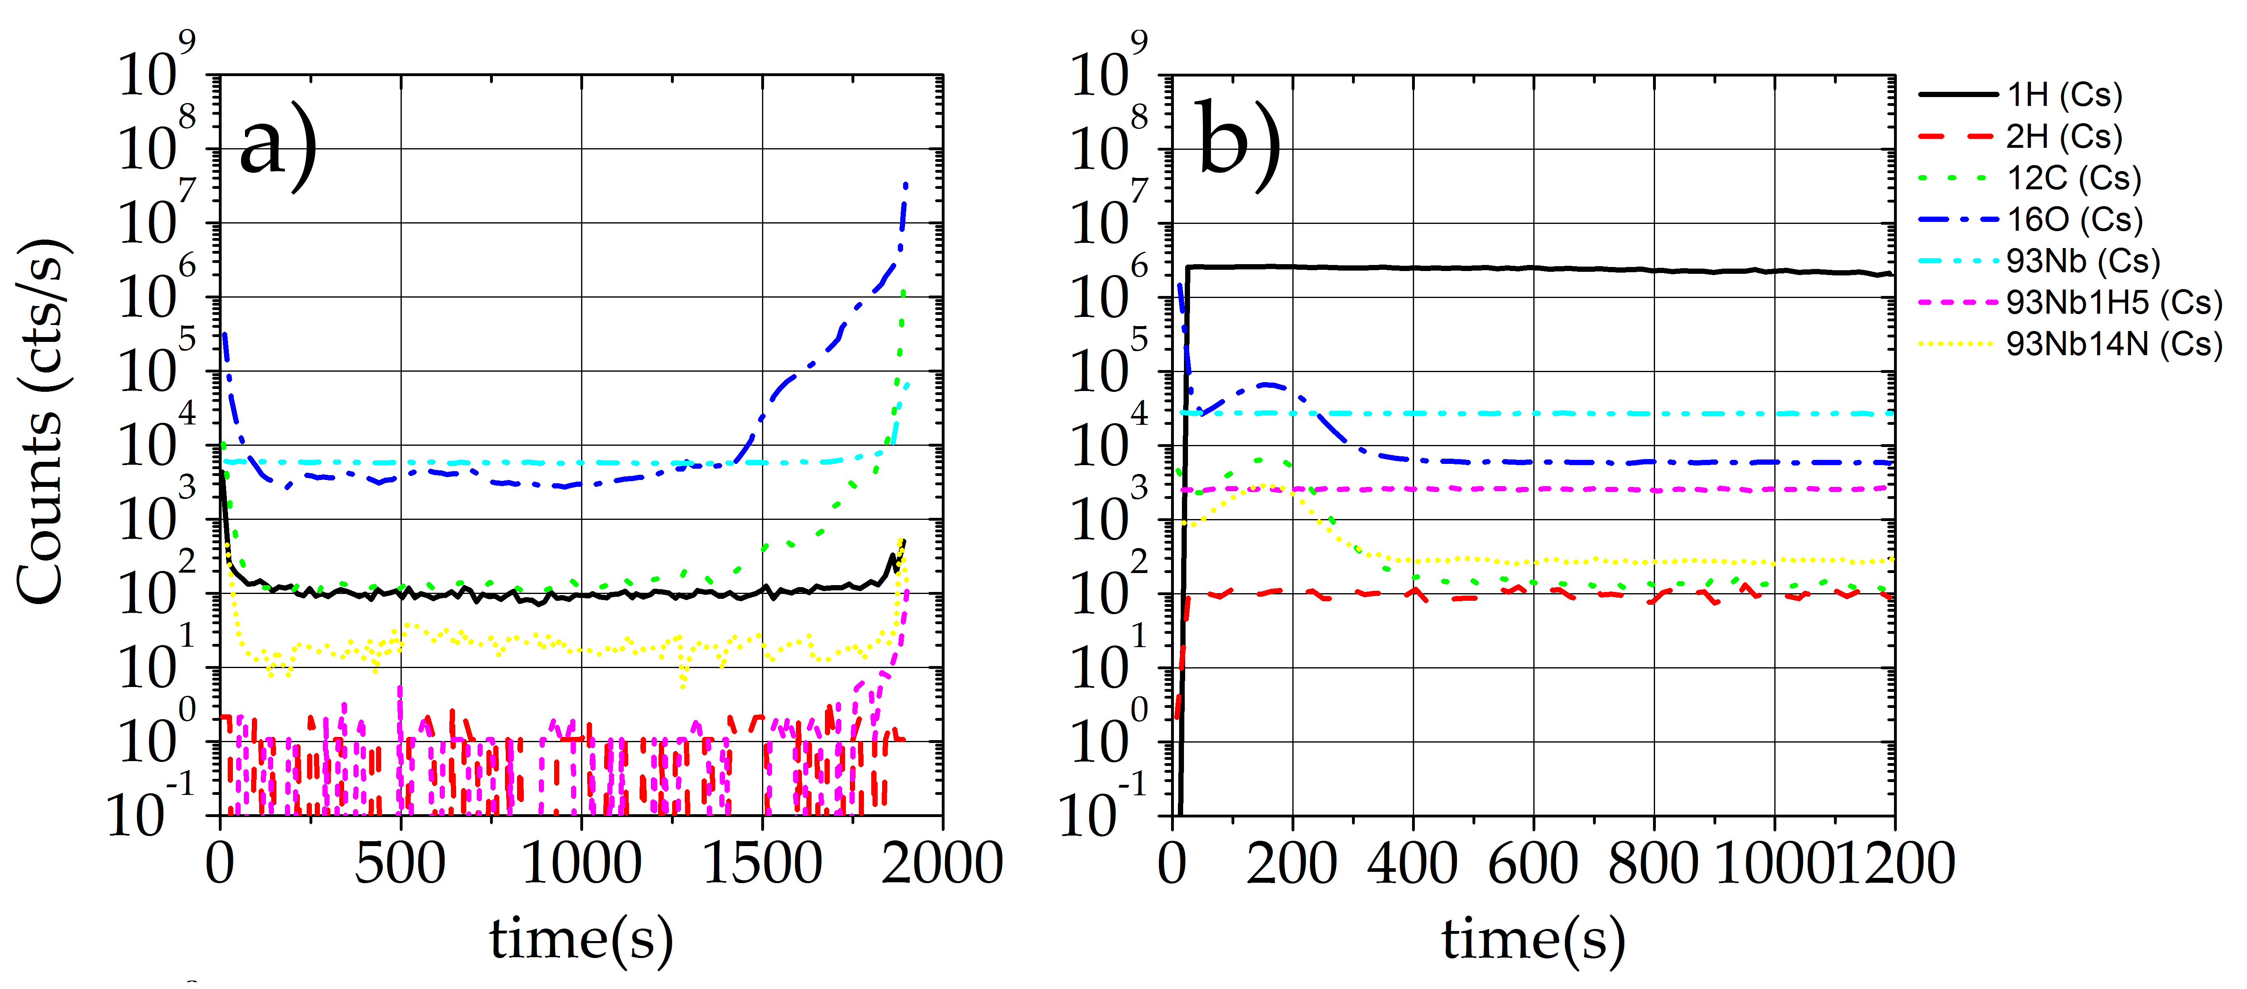
SIMS with Cs beam of high RRR Nb films:
Nb (100) on MgO: RRR=442
Bulk Nb sample: RRR~300
H count rate (normalized) in thin films is 7x10³ times lower than in bulk Nb!

Slide 29
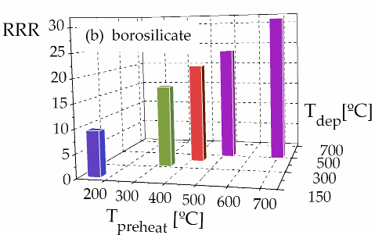
Nb thin films grown on Borosilicate: a proxy for Cu/Al
Nb thin films grown on amorphous borosilicate show a similar trend of higher RRR with higher substrate temperature
One option for Nb-on-Cu growth is to first “amorphize” the substrate by high energy “subplantation”, then attempt to drive Nb crystal growth
Aluminum substrates would also use this approach. Borosilicate is a proxy
Please visit THPO069 on Thursday: Nb Film Growth on Crystalline and Amorphous Substrates” Dr. Enrique Valderrama

Slide 30
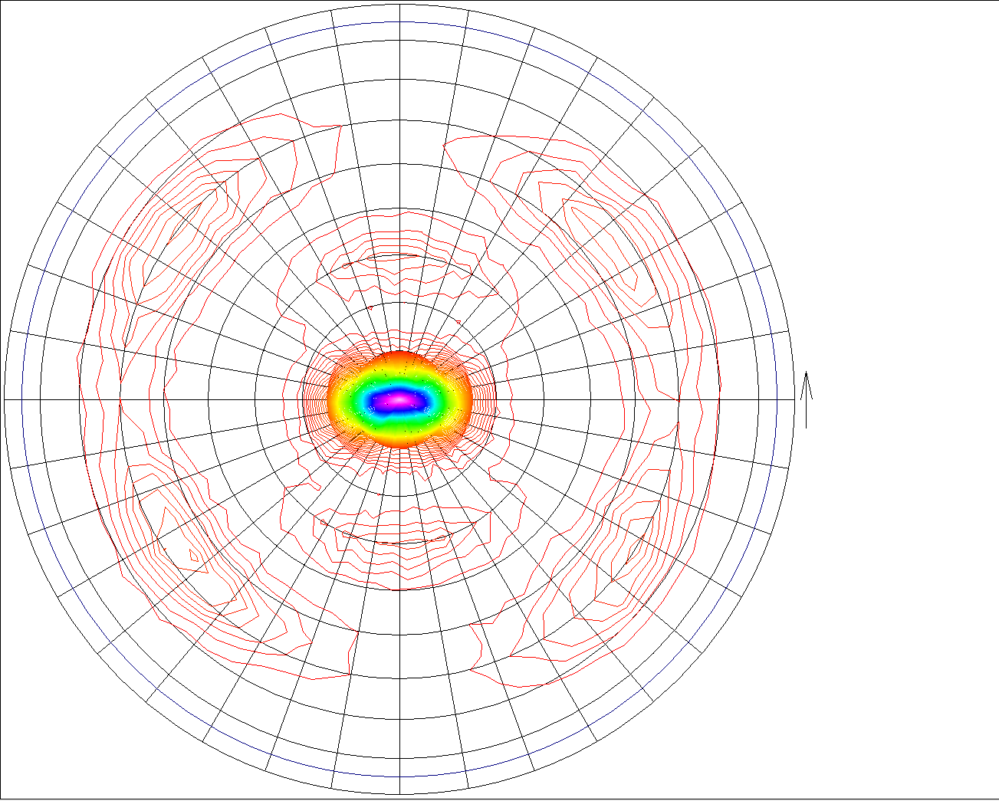
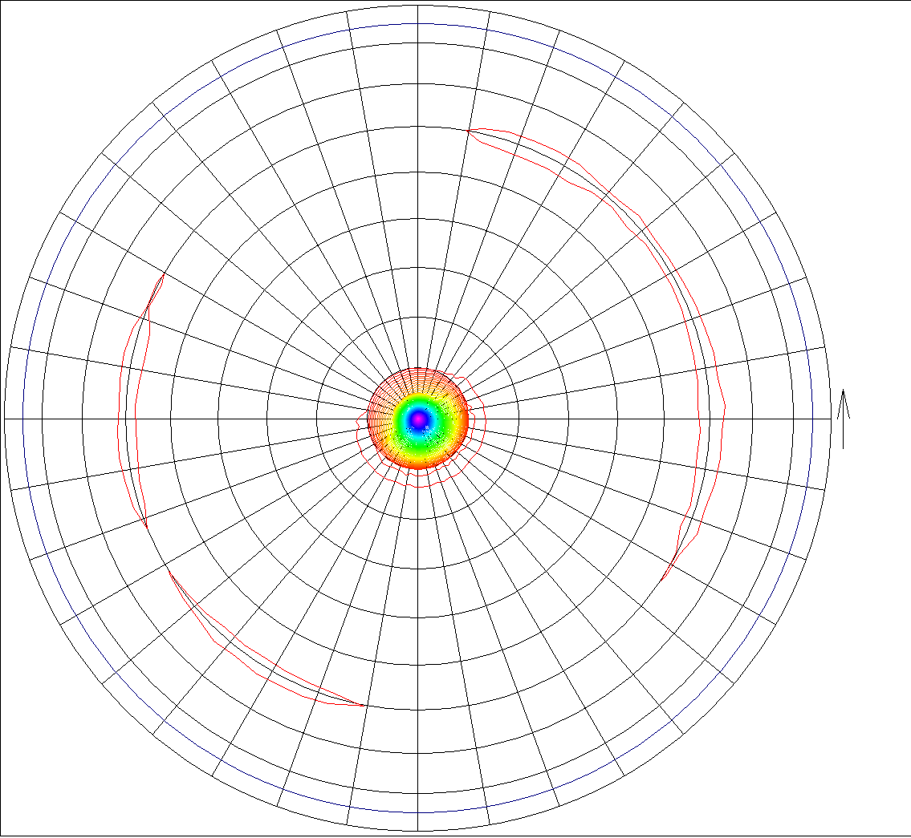
XRD Pole Figures for Nb thin films grown on Borosilicate
Subplantation physics of energetic condensation at work here
(110) Nb on Borosilicate at 150/150C
(110) Nb on Borosilicate at 400/400C
(211) plane
(110) plane
Phi (rotation)
[110]
[110]
Psi (tilt)
A strong [110] Nb fiber structure perpendicular to the substrate
At higher coating temperature, in-plane texture shows that [110] fiber texture is highly oriented to the substrate

Slide 31
~50µm grains of Nb measured in 0.4µm thick films on Cu
"Large crystal grain niobium thin films deposited by energetic condensation in vacuum arc”, X. Zhao, A.-M. Valente-Feliciano, C. Xu, R. L. P. Geng, L., C. E. Reece, K. Seo, R. Crooks, M. Krishnan, A. Gerhan, B. Bures, K. W. Elliott, and J. Wright, Journal of Vacuum Science & Technology A 27, 620-625 (2009).

Slide 32
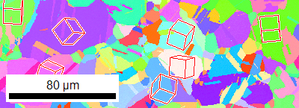
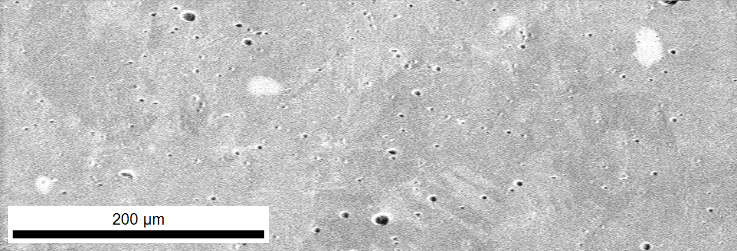
CEDTM Nb Film on polycrystalline Cu substrate: Hetero-epitaxy
Bare Cu
Working Distance: 15.000000
Number of points: 13094
Number of good points: 13093
150.00 microns x 74.48 microns
Step: 1.00 microns
Average Confidence Index: 0.42
Average Image Quality: 2633.56
Average Fit [degrees]: 1.35
Nb film
EBSD Image of Sample TF-AASC-CED-Nb-Cu-103,CEDTM, Cu substrate T=400C
Energetic Condensation demonstrated growth of very large Nb grains on Cu.
Please see Anne-Marie’s talk later for recent RRR and other data from an ECR source

Slide 33
Vielen Dank Fragen, bitte?

Slide 34
Nb on a-sapphire: Local RRR vs. averaged <RRR>
<RRR> vs. film thickness
Ad hoc model fit to <RRR> data
Thicker films must be analyzed before we can do a better model fit

Slide 35
SIC measurements at JLab
R_{s} vs. T: thin film Nb on Cu sample TF-AASC-CED-103; EP, annealed at 750 C, then EP again

Slide 36
RRR of Nb thin films on c-sapphire substrates
Pole Figures show better crystal structure at higher temperature
RRR=16, 700/150
RRR=43, 700/700

Slide 37
RRR of Nb thin films on c-sapphire substrates
Pole Figures show better crystal structure at higher temperature
RRR=43, 700/700
RRR=43, 700/700
Despite high crystalline order, RRR is only 43. High order is a necessary condition for high RRR, but film might have impurities that limit electron mean free path.

Slide 38
RRR–196: Cross sectional EBSD: shows mix of (110) and (100)

