Slide 1



Stoichiometric Nb₃Sn in First Samples Coated at Cornell
Sam Posen
Cornell University
Notes:
Thanks, honoured

Slide 2
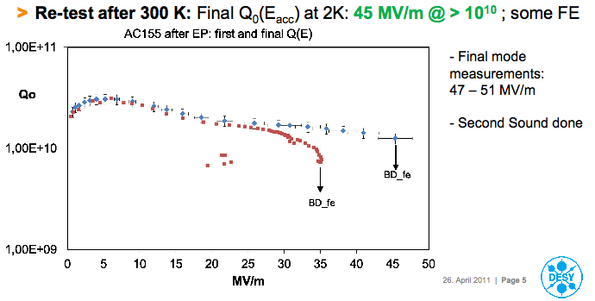
Motivation – High Gradients
Nb cavities are reaching fundamental limit
Alternative materials required to reach higher gradients
Nb₃Sn 100 MV/m?
From Akira Yamamoto’s talk “Advances in SRF Development for ILC” on Monday

Slide 3
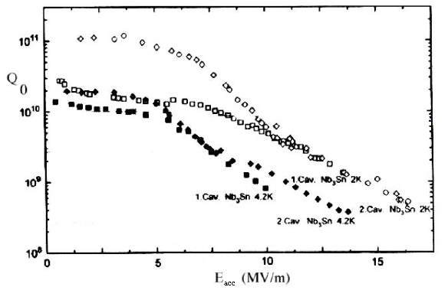
Motivation – Low Surface Resistance
Nb₃Sn has already shown great promise
Great potential of Nb₃Sn for moderate field, high Q machines. Modest cyrogenic costs!
  ~10¹⁰ at 4.2K! ~10¹¹ at 2K!
Cavities produced by University of Wuppertal

Slide 4
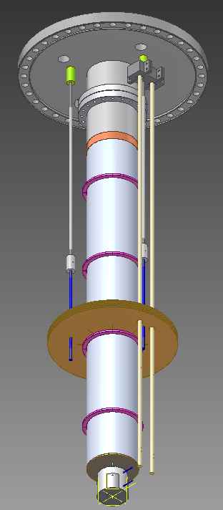
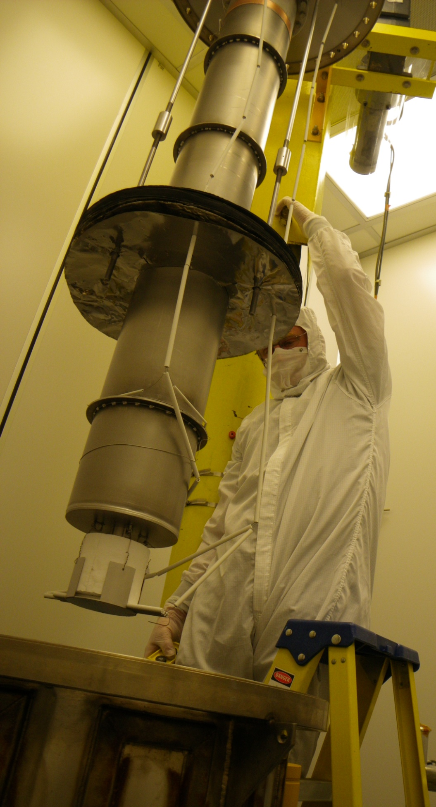
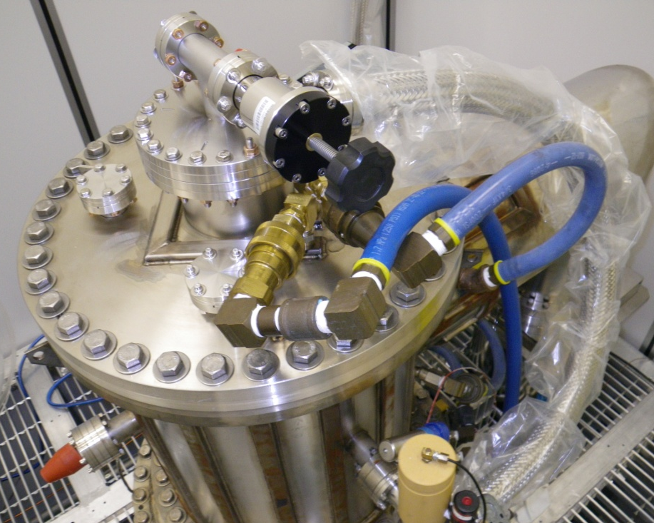
Nb₃Sn Furnace Insert
Copper transition weld from stainless to Nb
Coating chamber is inserted into UHV furnace. Separate vacuum system keeps cavity furnace free from tin contamination
Flange to UHV furnace
Nb heat Shields
Top of insert
UHV Furnace
Power for heater
Notes:
Small samples relative to furnace size may help keep temperature more uniform

Slide 5
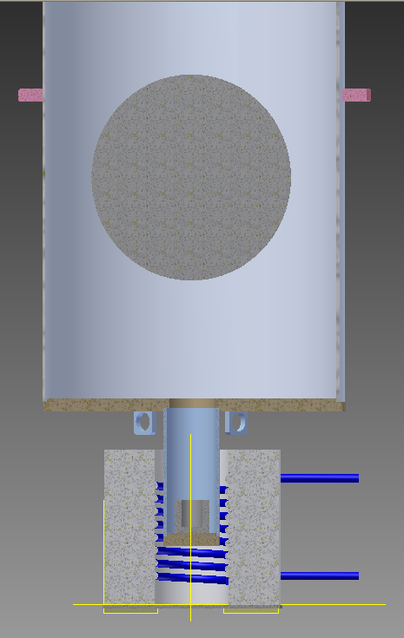
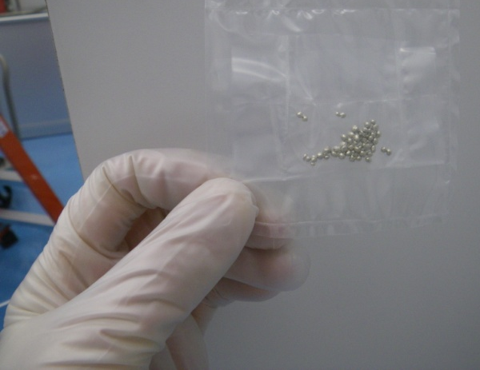
Nb₃Sn Fabrication at Cornell
Coating by Vapor Diffusion
Coating procedure follows work of Müller et al., University of Wuppertal in 80s and 90s
1100 C
Temperature monitoring by thermocouples inside furnace. Gradient <1 K across sample
Nb substrate to be coated
W crucible holding 99.999% Sn
1200 C
UHV Furnace
Heater

Slide 6
New Surface Preparation Techniques
Add to Wuppertal procedure new techniques that have increased Q and E values in Nb cavities

Slide 7
New Surface Preparation Techniques
Add to Wuppertal procedure new techniques that have increased Q and E values in Nb cavities
Nb, 1993

Slide 8
New Surface Preparation Techniques
Add to Wuppertal procedure new techniques that have increased Q and E values in Nb cavities
Nb, 1993
+ HPR, EP, 120 deg C bake, CBP, single crystal Nb
Nb, 2011

Slide 9
New Surface Preparation Techniques
Add to Wuppertal procedure new techniques that have increased Q and E values in Nb cavities
Nb₃Sn, 1995

Slide 10
New Surface Preparation Techniques
Add to Wuppertal procedure new techniques that have increased Q and E values in Nb cavities
???
Nb₃Sn, 1995
+ HPR, EP, 120 deg C bake, CBP, single crystal Nb
Nb₃Sn, 2012
Notes:
Improve substrate – maybe push off the onset of Q-drop – increase Hc1?

Slide 11
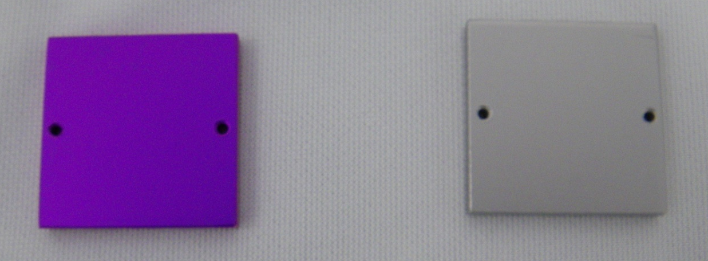
First Coated Samples
2 square samples were coated
Coatings were characterized in various ways
One of the samples was anodized in NH₄OH at 75V
Nb->blue Sn-> yellow Nb3Sn -> Pink/purple
Uniform coating! No excess tin on surface!
1”
Not anodized
Anodized

Slide 12

First Coated Samples
2 square samples were coated
Coatings were characterized in various ways
One of the samples was anodized in NH₄OH at 75V
Nb->blue Sn-> yellow Nb3Sn -> Pink/purple
Uniform coating! No excess tin on surface!
1”
Not anodized
Anodized

Slide 13
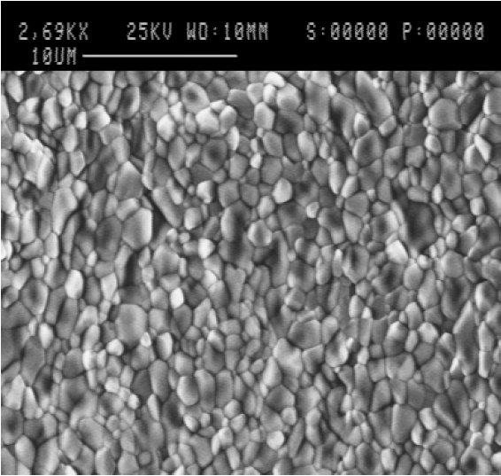
SEM Images
Wuppertal, 1996
Cornell, 2011

Slide 14
SEM Images
Wuppertal, 1996
Cornell, 2011

Slide 15
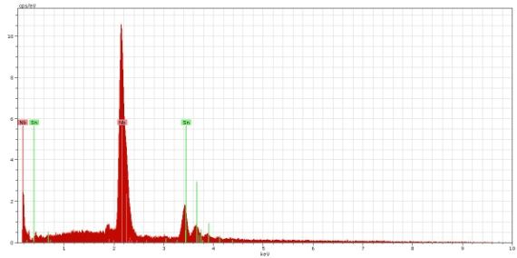
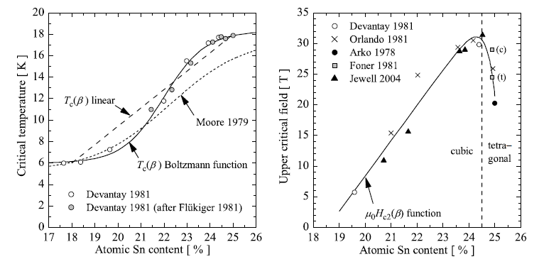
EDX Analysis
Uniform coating!
24.2±0.5 atomic % Sn!
T_{c} vs %Sn
H_{c2} vs %Sn

Slide 16
EDX Analysis
Uniform coating!
24.2±0.5 atomic % Sn!
Increased lattice strain above
24.5 atm%Sn
T_{c} vs %Sn
H_{c2} vs %Sn

Slide 17
EDX Analysis
Uniform coating!
24.2±0.5 atomic % Sn!
Increased lattice strain above
24.5 atm%Sn
T_{c} vs %Sn
H_{c2} vs %Sn

Slide 18
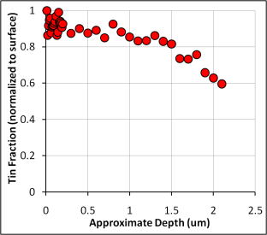
XPS Analysis

Slide 19
XPS Analysis

Slide 20
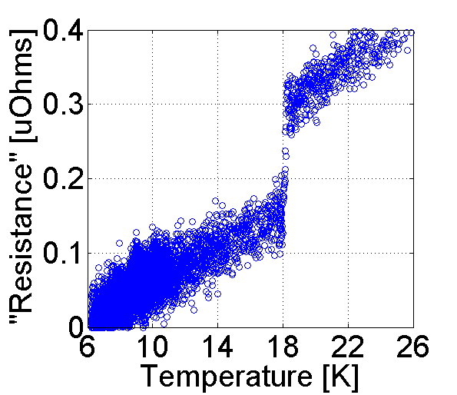
4-Wire Resistance Measurement
T_{c}
Notes:
2 checks

Slide 21
4-Wire Resistance Measurement
T_{c}
Notes:
2 checks

Slide 22
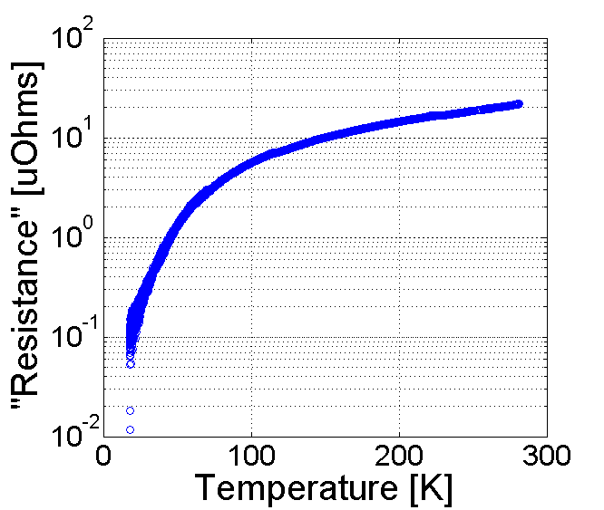
4-Wire Resistance Measurement
T_{c}
RRR
Notes:
2 checks

Slide 23
4-Wire Resistance Measurement
T_{c}
RRR
Notes:
2 checks

Slide 24
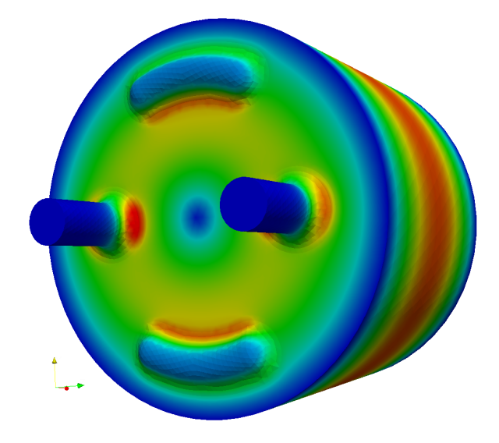
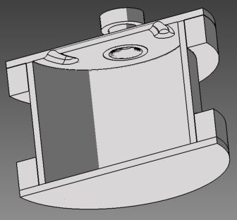
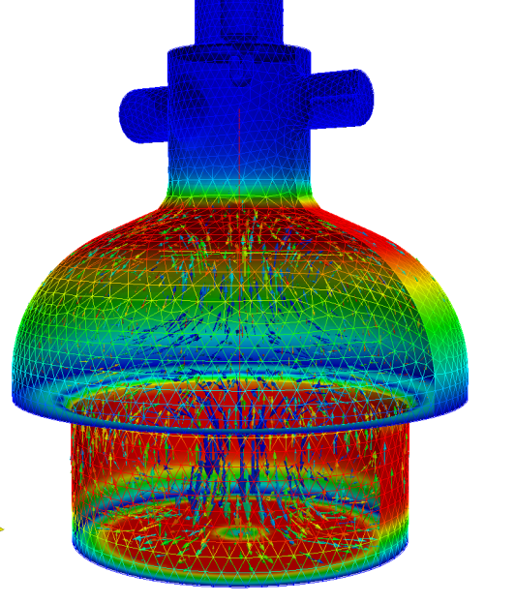
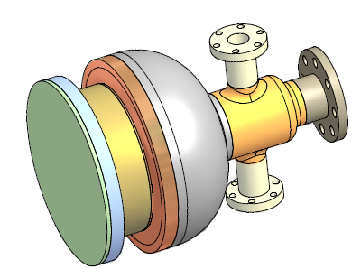
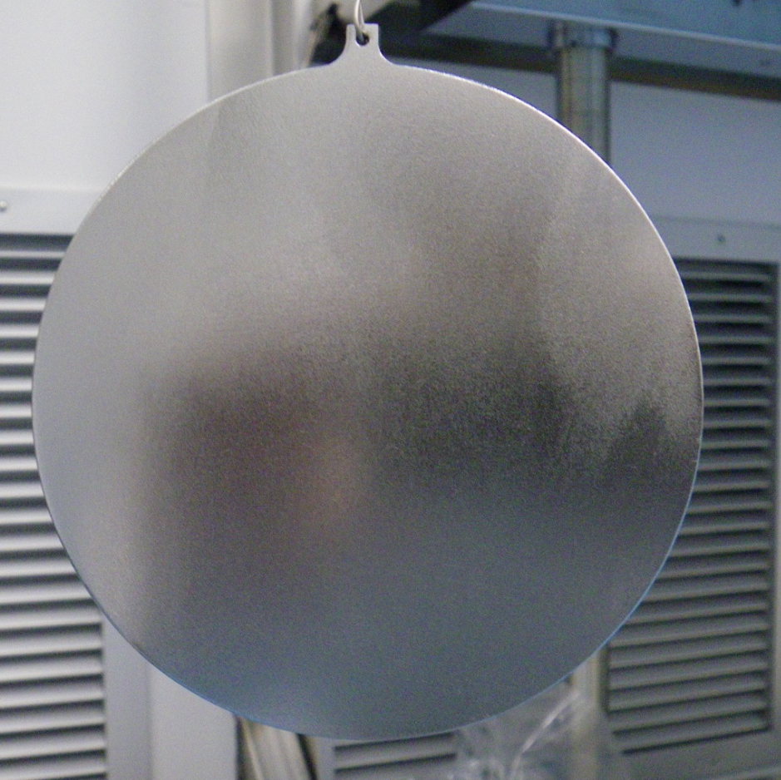
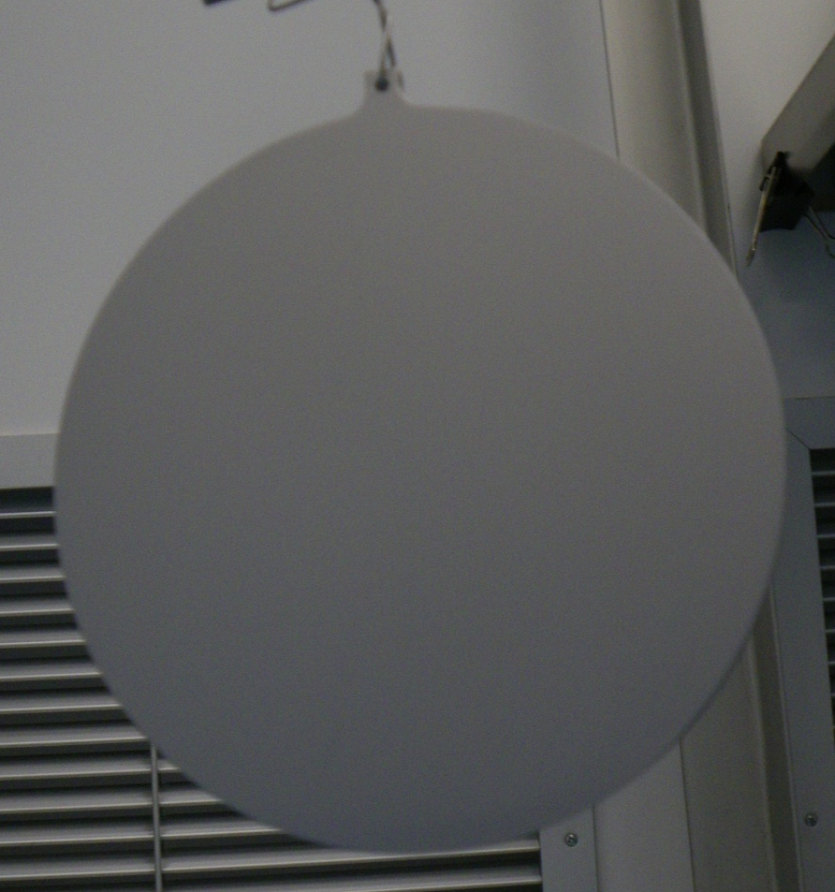
RF Tests of Samples
Already fabricated Nb₃Sn bottom plate for Pillbox TE cavity. Anodization, EDX, SEM show similar results. RF testing very soon!
Next step: Mushroom TE cavity. Designed to reach >200 mT on sample!
See Yi Xie’s poster THPO050
Before coating
With Nb₃Sn coating
Notes:
4”

Slide 25
Future Plans
Next few months
  RF tests of samples in TE cavities
2012
  Coat single cell 1.3 GHz cavity
  RF tests with full cavity T-map
Beyond
  At any locations with poor performance, cut cavity and perform surface analysis
  Use RF performance as feedback to guide improvement of coating process

Slide 26
Acknowledgements and References
Special thanks to my advisor Matthias Liepe for his guidance and insight and to Hasan Padamsee for his knowledge and advice
A. Yamamoto’s “Advances in SRF Development for ILC,” this conference.
G. Müller et al. “Nb₃Sn layers on high purity Nb cavities with very high quality factors and accelerating gradients,” EPAC 1996, Barcelona, Spain, pp. 208-2087, 1996.
H. Padamsee, J. Knobloch, and T. Hays, RF Superconductivity for Accelerators, Wiley & Sons, New York, ISBN 0-471-15432-6, 1998.
A. Godeke, “A review of the properties of Nb₃Sn and their variation with A15 composition, morphology and strain state,” Supercond. Sci. Technol., 19, R68–R80, 2006.
A. Godeke, “Nb₃Sn for Radio Frequency Cavities,” LBNL-62140, 2006.

