Slide 1
DUNE Flux – Correlation Studies
Deepika Jena
6 Nov 2020

Slide 2
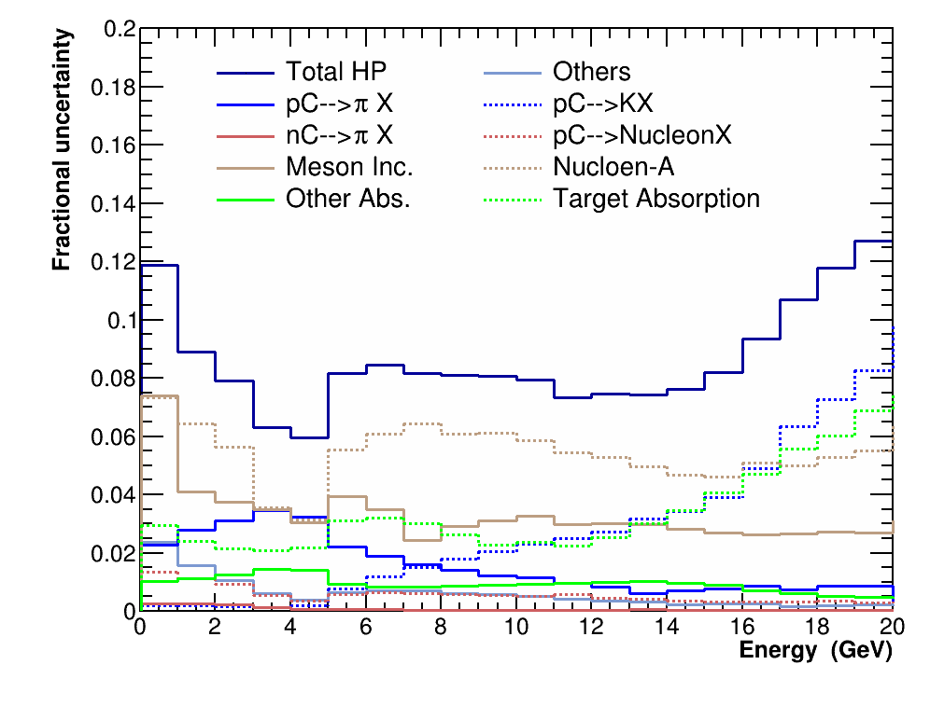
Fractional Uncertainty
Interactions covered by external data
pC -> 𝜋 X
pC -> K X
pC-> Nucleon X
There was no information from the external data related to bin to bin correlations. Thus bin-to-bin correlations are assumed to be 100 % .

Slide 3
How it is done in PPFX ? – Previous SLIDE
The correlation and other data are kept in a plain database file in following ways :
The parameter file contains the input data from results of studies to make interpolations and correlations between bins.
For uncorrelated data, the central value and its uncertainty are provided as single values or a list of values.
Correlated data requires a list of central values per bin, a list of statistical errors and a covariance matrix of the systematic errors.
However, for these interactions : pC -> 𝜋 X , pC -> K X, pC-> Nucleon X the elements of cov matrix becomes very large. Due to the many values it becomes impossible to process.
So in order to introduce correlations a trick is made where 100% correlation is to use the same random shift value per universe for all bins of a dataset.

Slide 4
NA61 phase space
Split this into finer bins.
Map the NA61 phase space onto the neutrino energy phase space.

Slide 5
Splitting up the phase space
This is the binning scheme taken into account for thin target pc->pi interactions, and respective plots for fractional uncertainties and correlations matrices are made.
Bin 1 : 0.02 < xf <= 0.2 and 0.025 < Pt <= 0.15 GeV/c
Bin 2 : 0.02 < xf <= 0.2 and 0.15 < Pt <= 0.3 GeV/c
Bin 3 : 0.02 < xf <= 0.2 and 0.3 < Pt <= 0.6 GeV/c
Bin 4 : 0.2 < xf <= 0.35 and 0.02 < Pt <= 0.2 GeV/c
Bin 5 : 0.35 < xf <= 0.5 and 0.02 < Pt <= 0.2 GeV/c
Bin 6: Everything else
Focusing region
c
high energy tail

Slide 6
Fractional Uncertainties

Slide 7
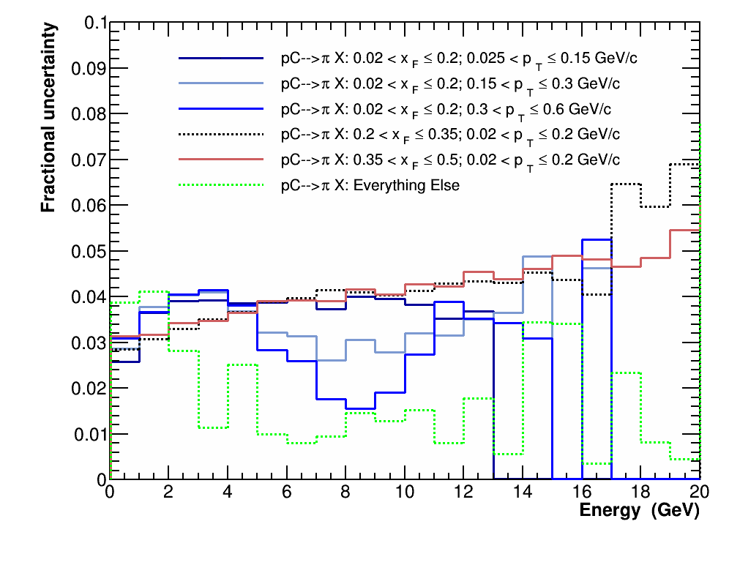
Default Case – (numu) near detector :

Slide 8
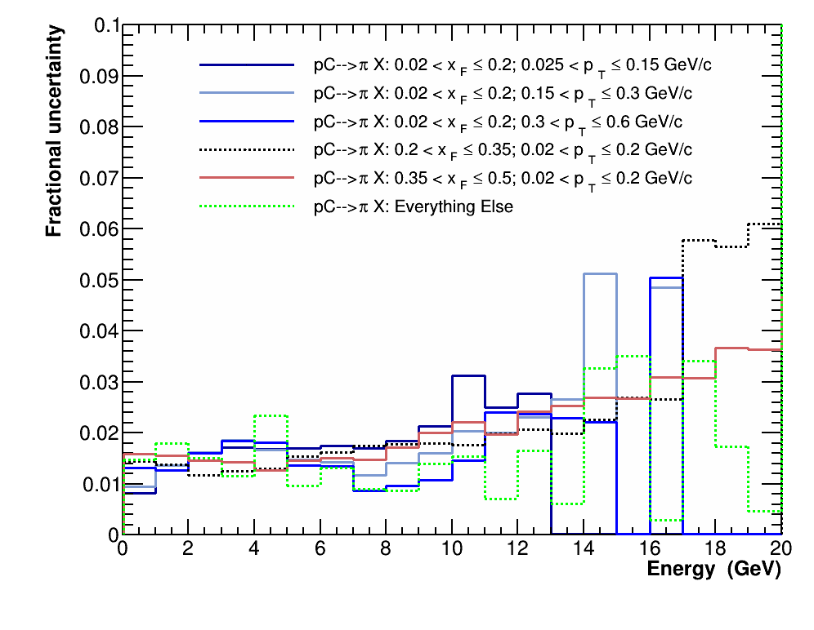
Uncorrelated Case – (numu) near detector :

Slide 9
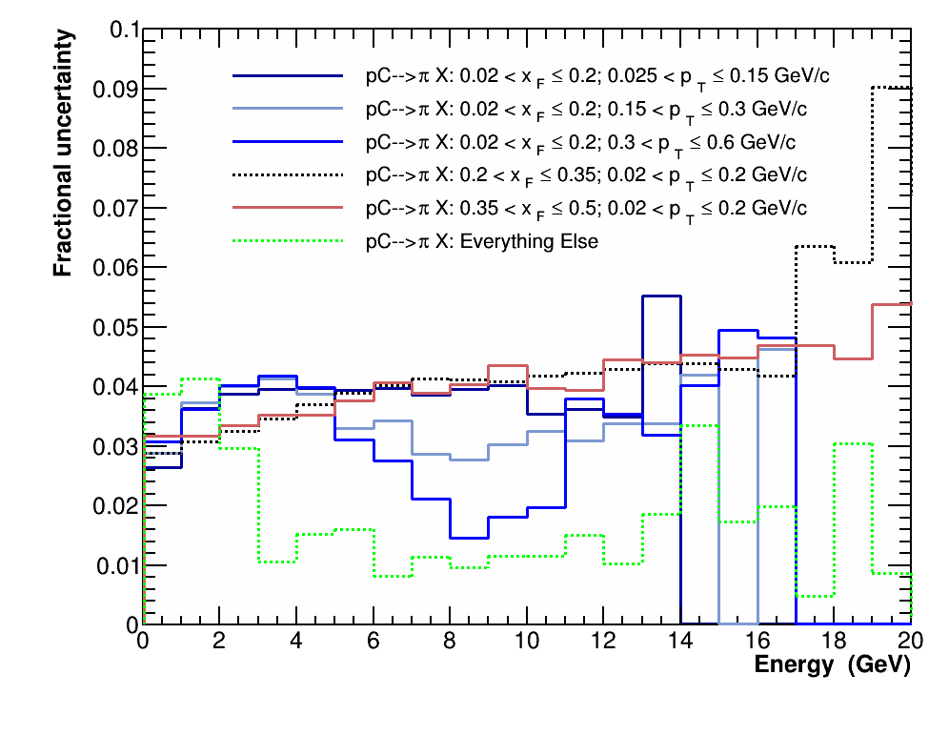
Default Case – (numu) Far detector :

Slide 10
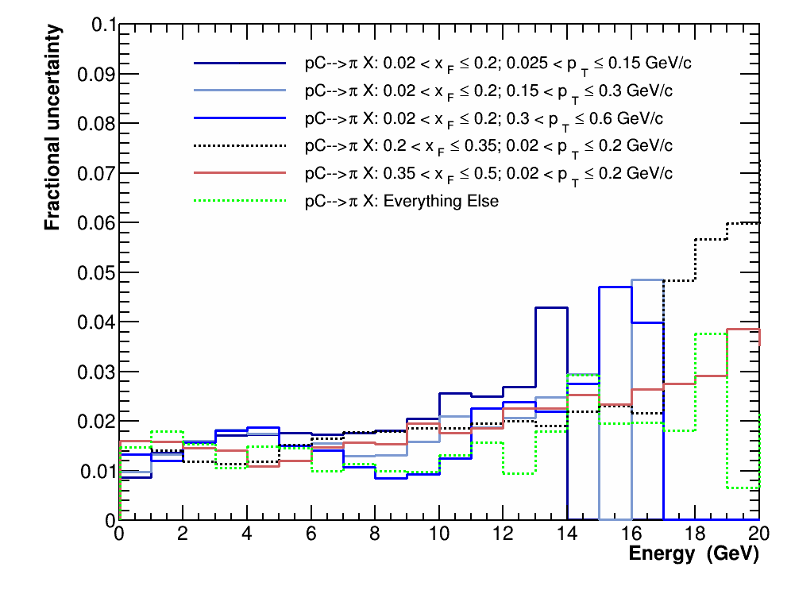
Uncorrelated Case – (numu) Far detector :

Slide 11
Covariances

Slide 12
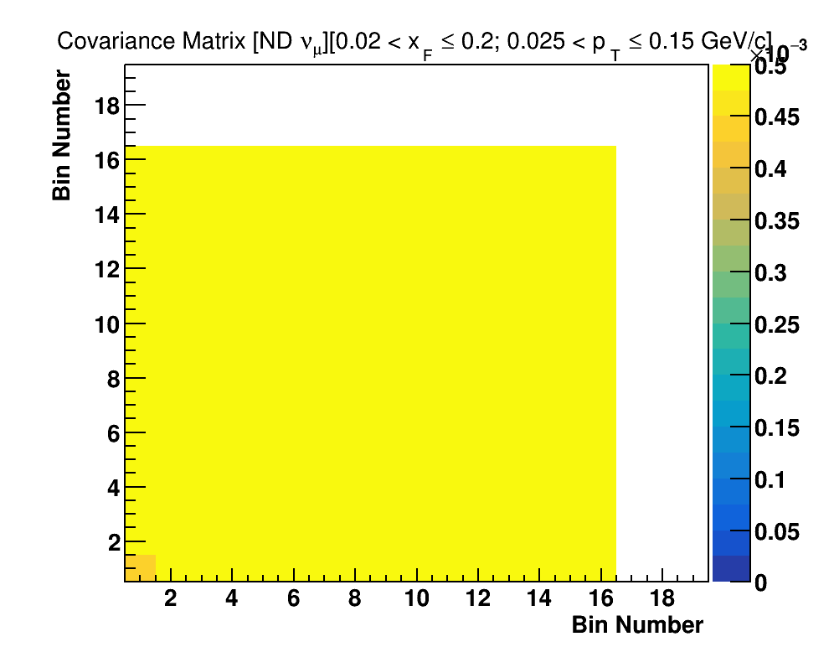
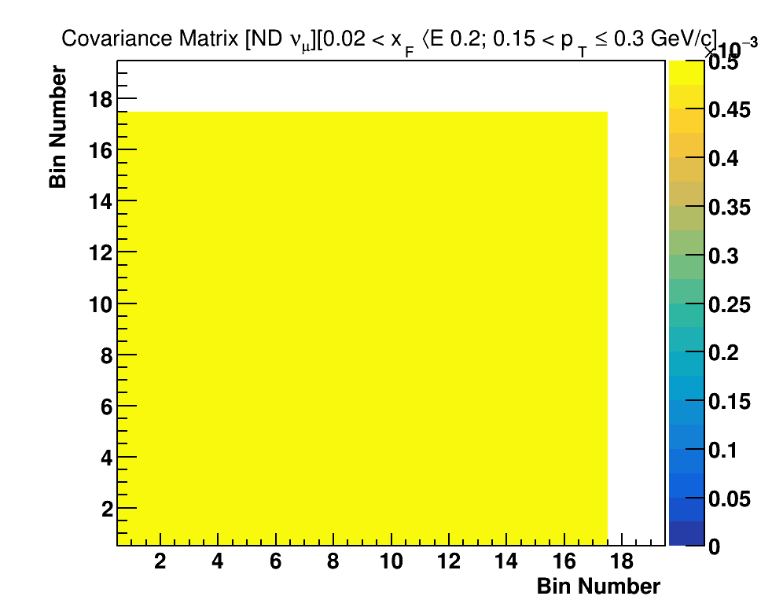
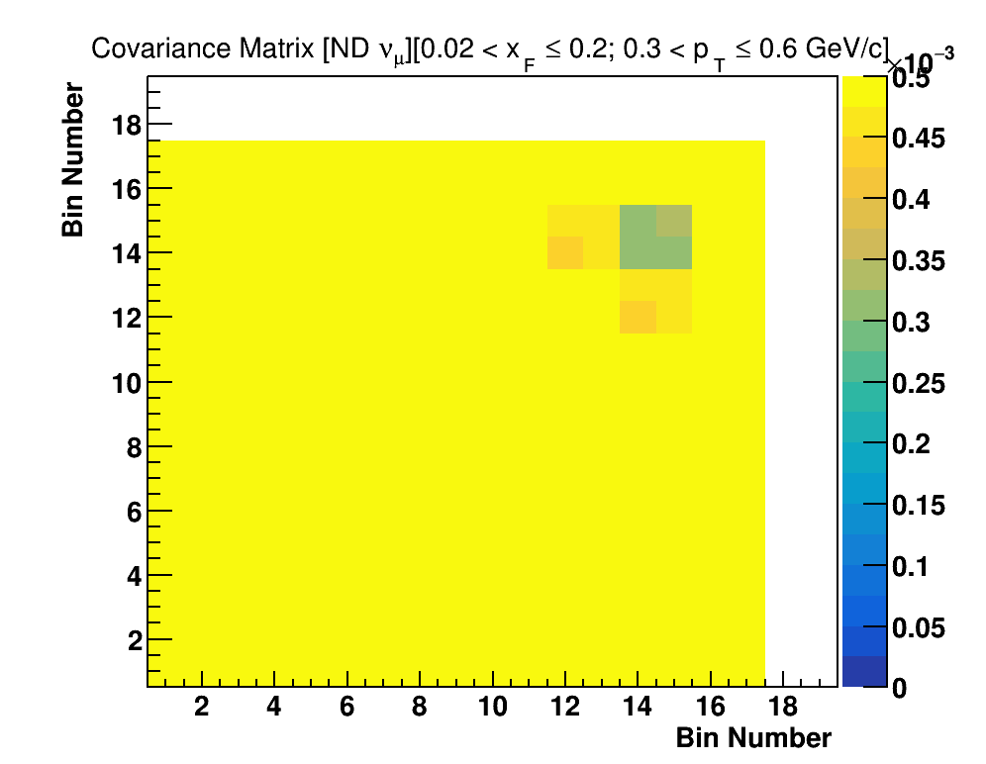
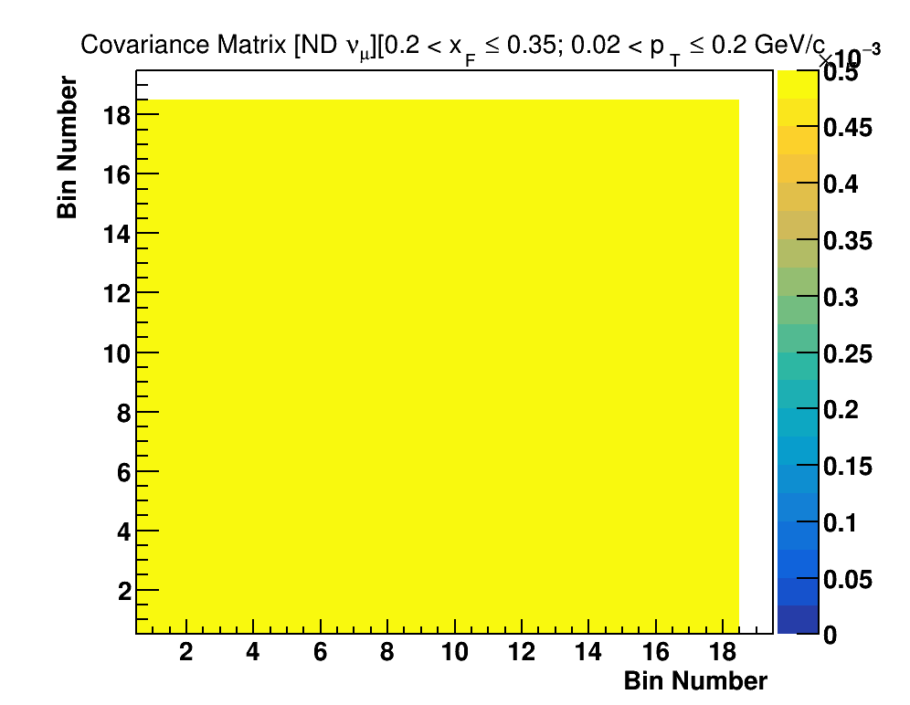
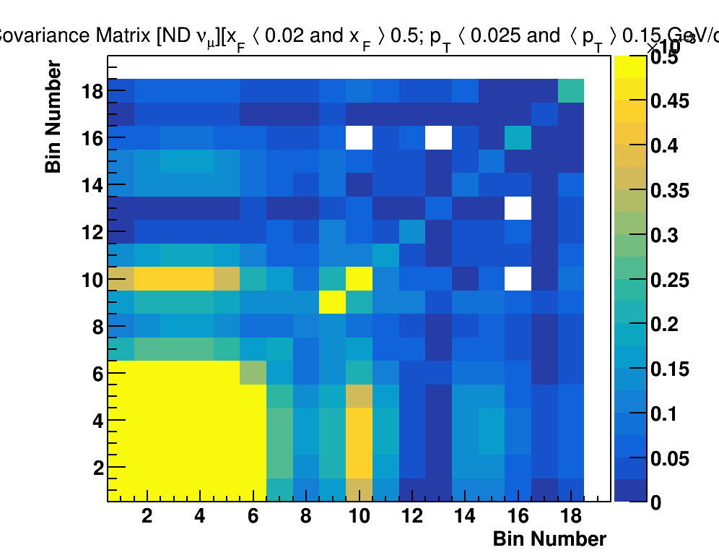
Default Case – (numu) near detector :

Slide 13
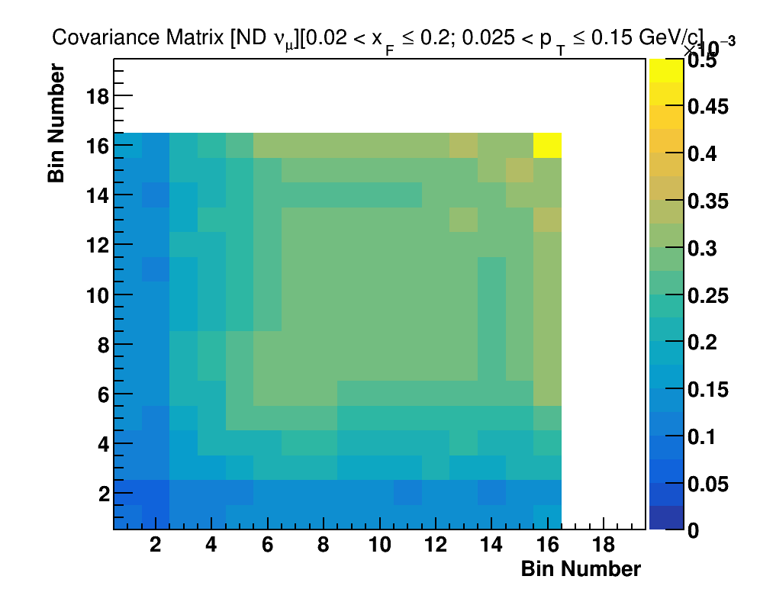
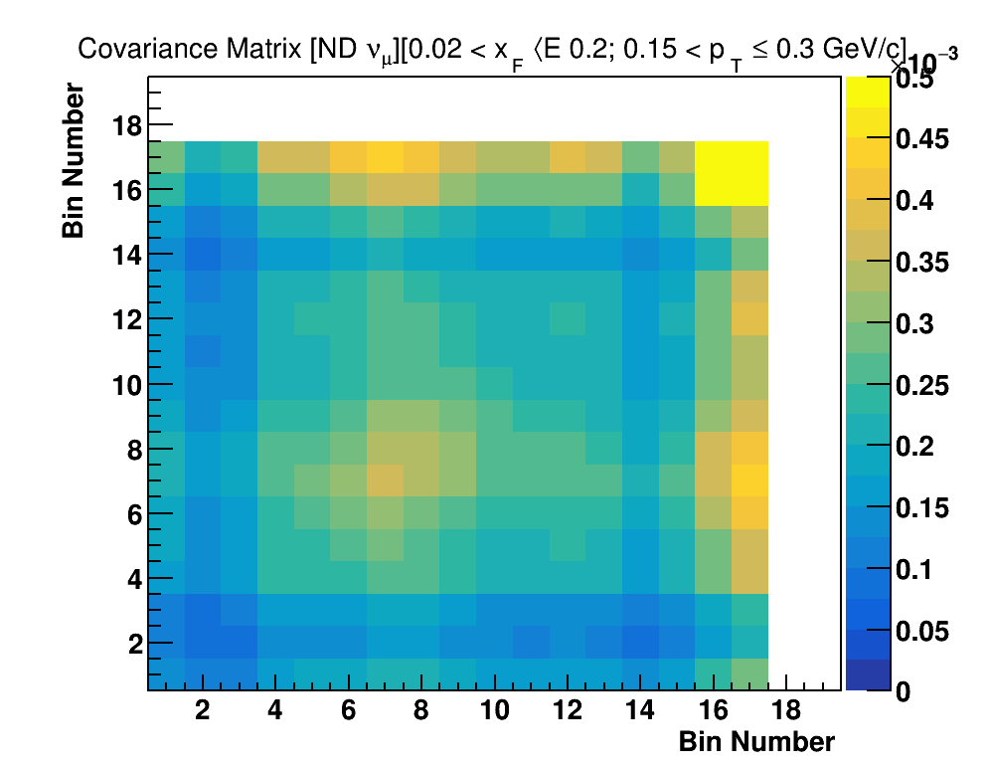
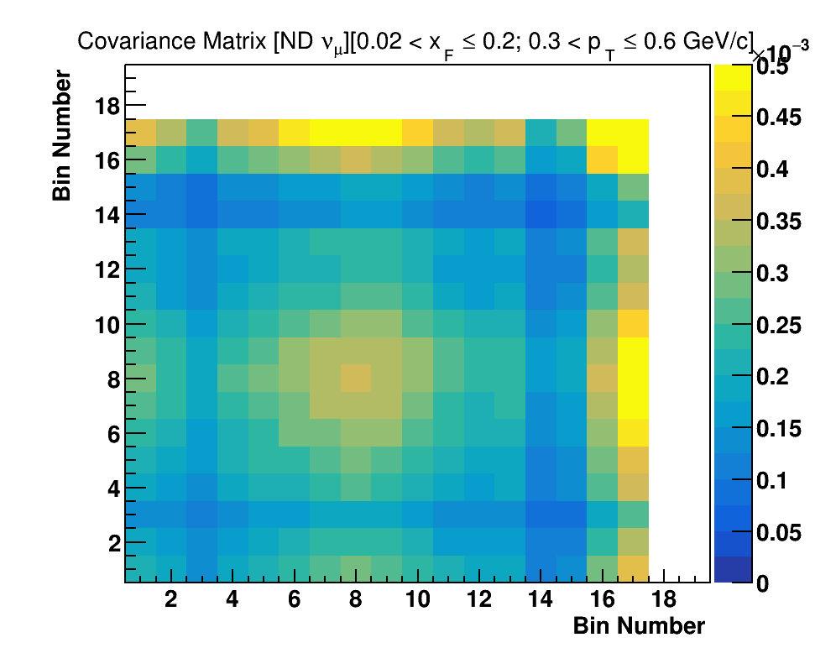
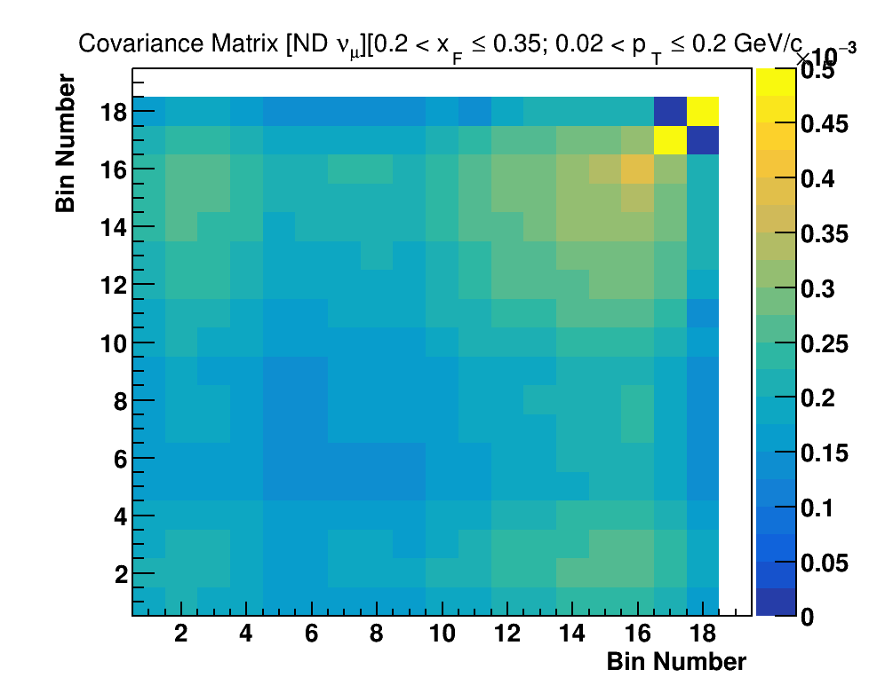
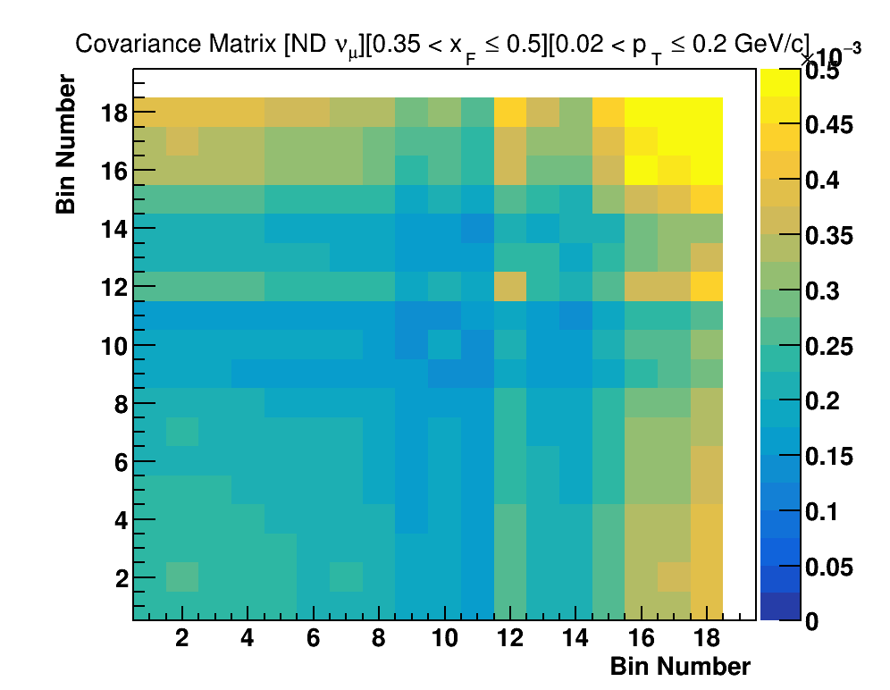
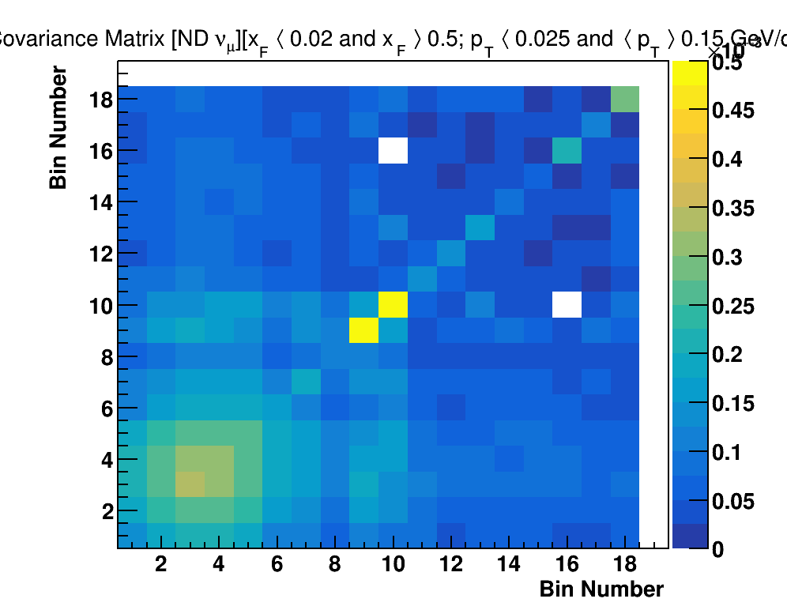
Uncorrelated Case – (numu) near detector :

Slide 14
Default – Bin 1

Slide 15
Uncorrelated – Bin 1

Slide 16
Default – Bin 2

Slide 17
Uncorrelated – Bin 2

Slide 18
Default – Bin 3

Slide 19
Uncorrelated – Bin 3

Slide 20
Default – Bin 4

Slide 21
Uncorrelated – Bin 4

Slide 22
Default – Bin 5

Slide 23
Uncorrelated – Bin 5

Slide 24
Default – Bin 6

Slide 25
Uncorrelated – Bin 6

Slide 26
Correlations
Each small block corresponds to bins of energy with bin boundaries [0,0.5,1,1.5,2,2.5,3,3.5,4,4.5,5,5.5,6,7,8,12,16,20,40,100] GeV for all sign and all flavor of neutrinos.

Slide 27
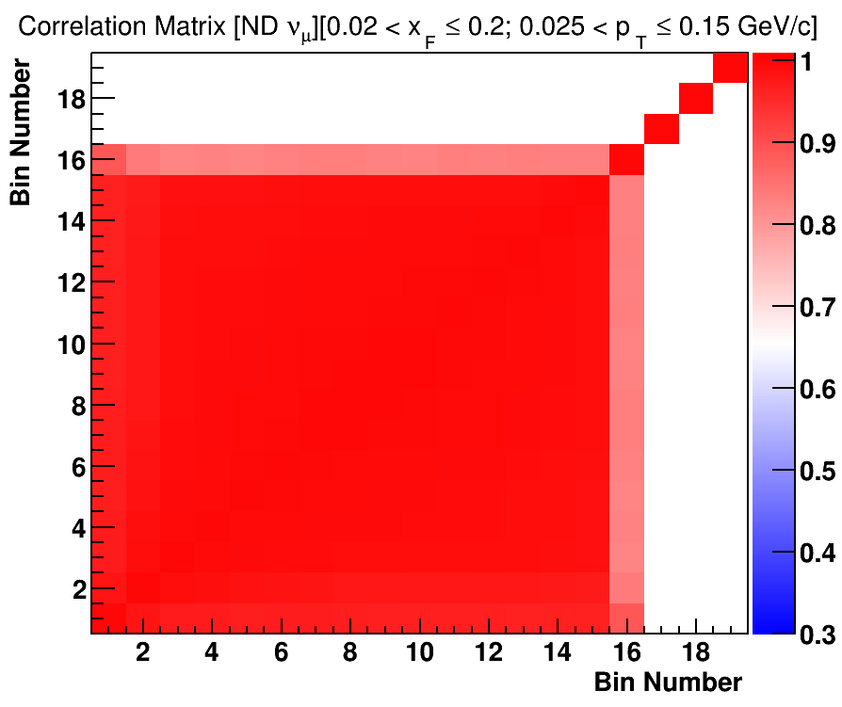
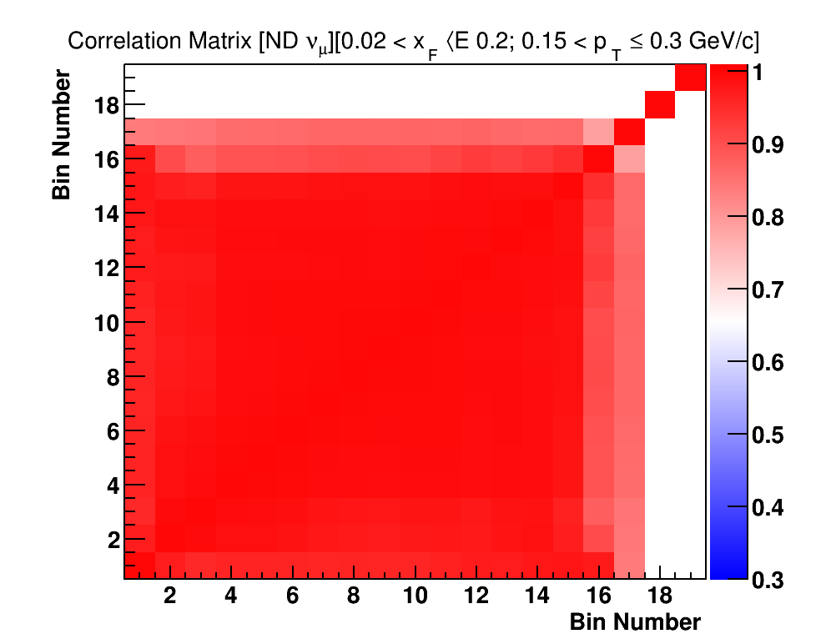
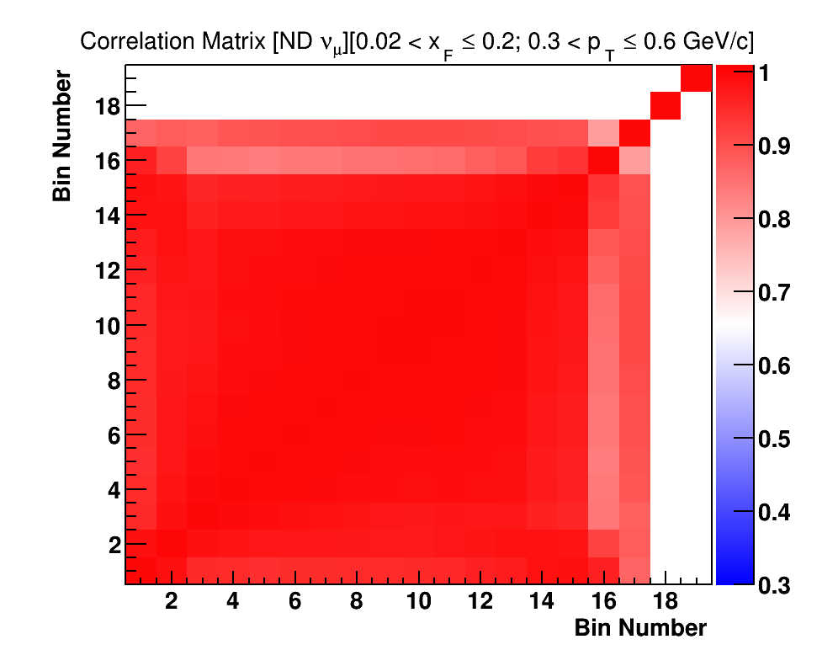
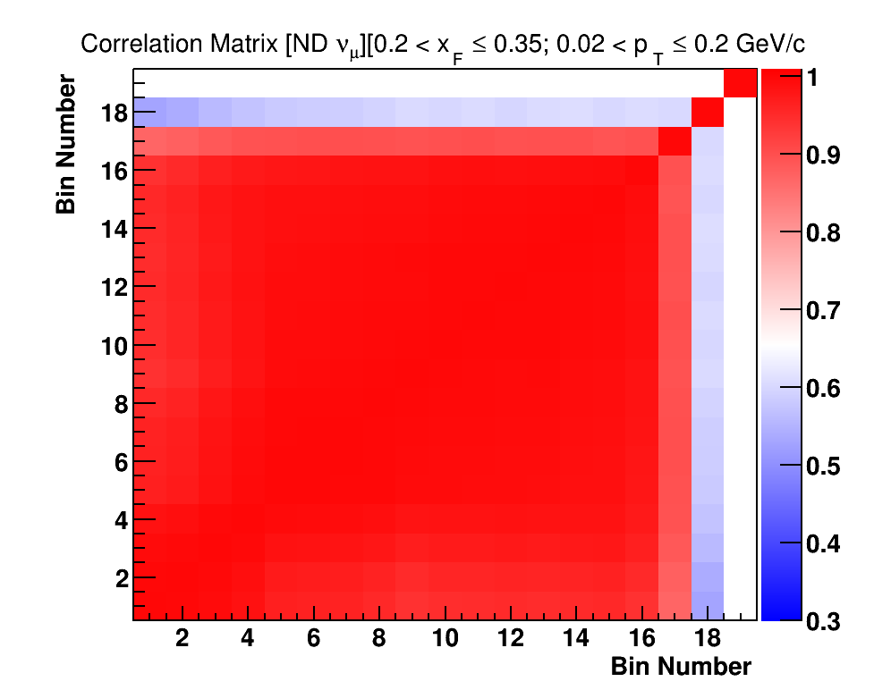
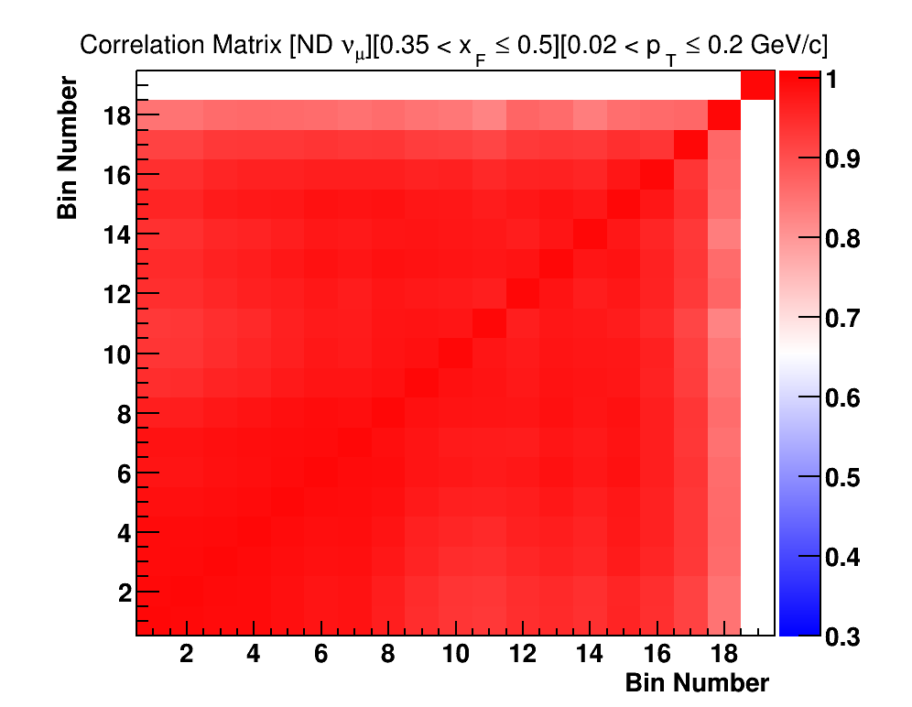
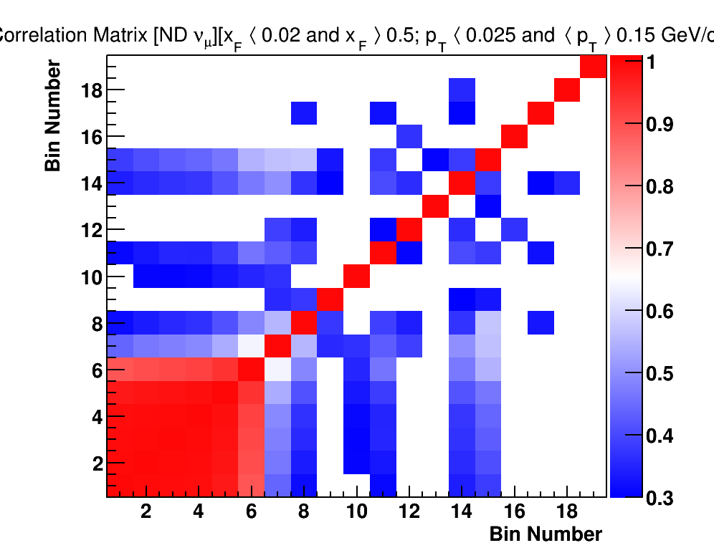
Default Case – (numu) near detector :

Slide 28
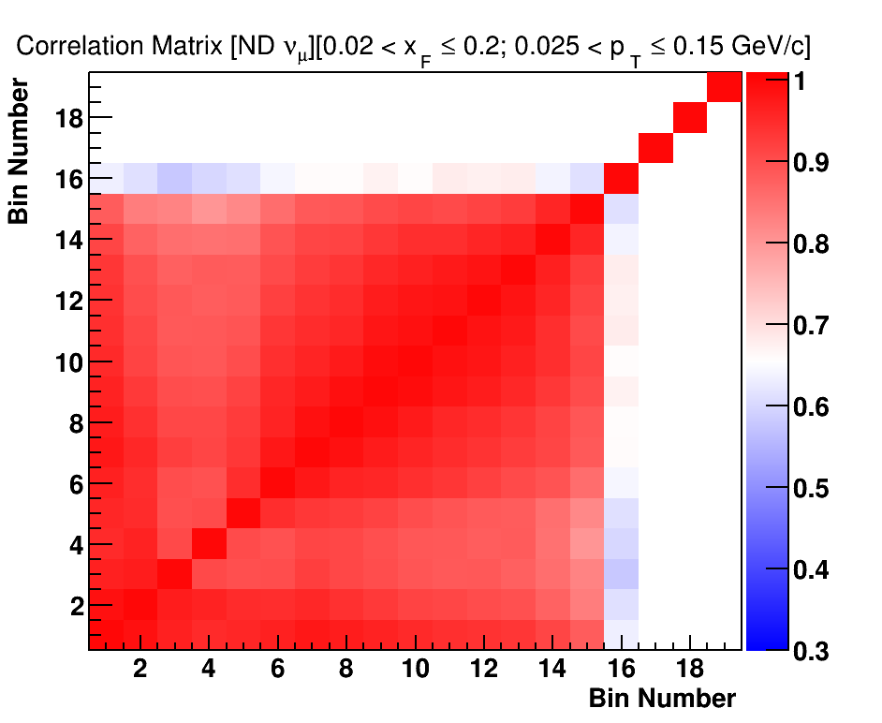
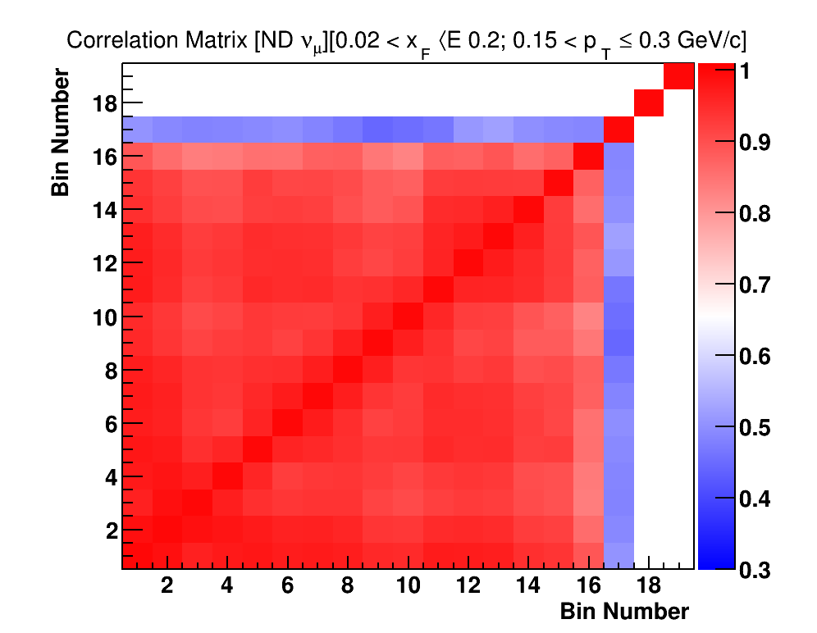
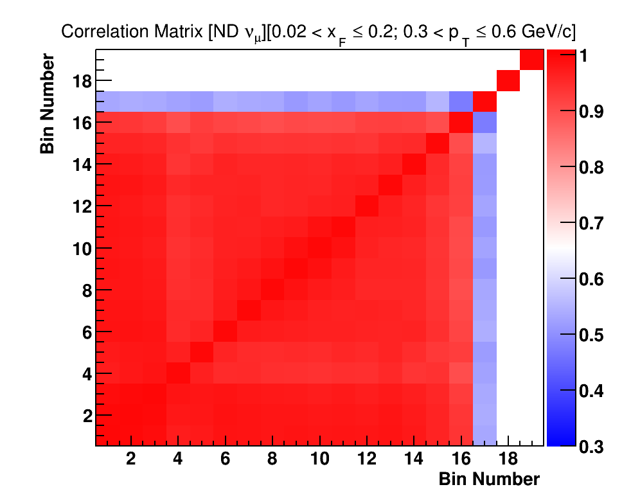
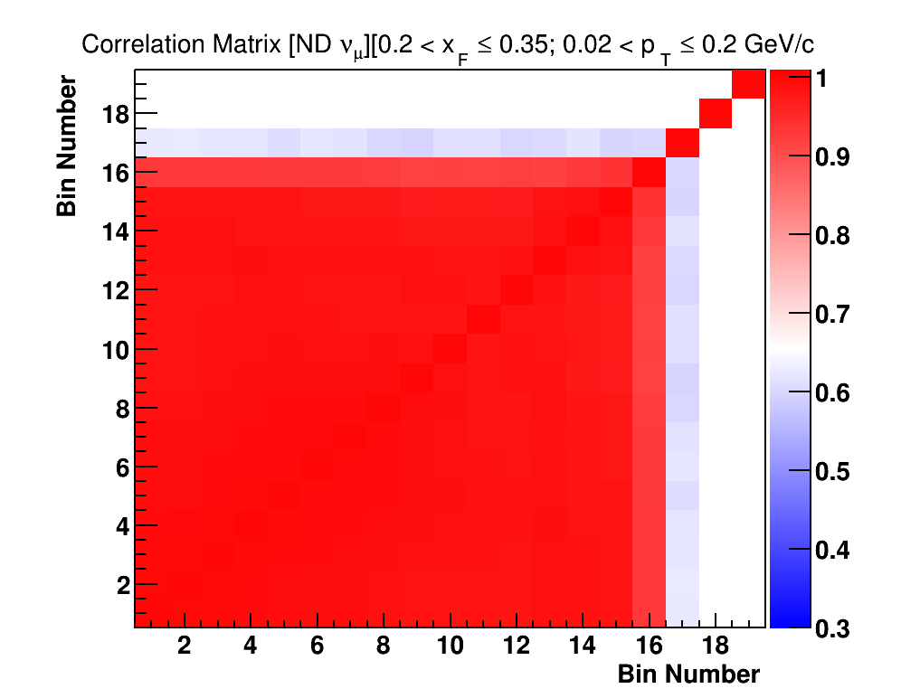
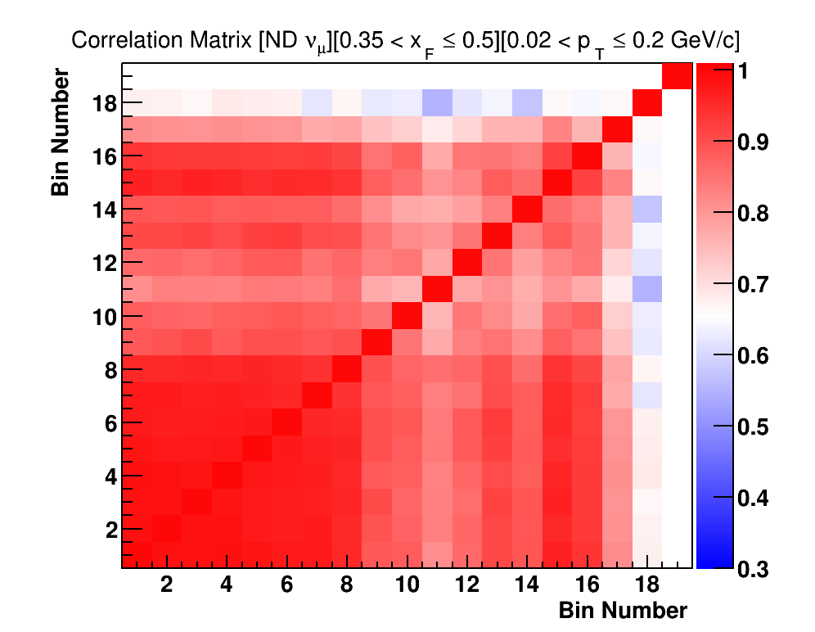
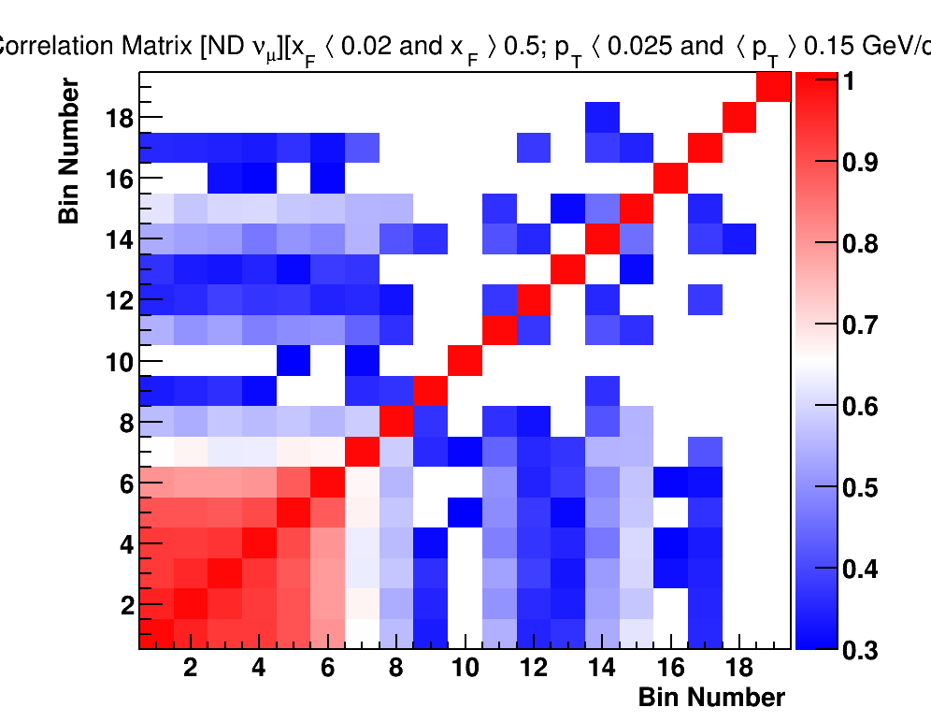
Uncorrelated Case – (numu) near detector :

Slide 29
Default – Bin 1

Slide 30
Uncorrelated – Bin 1

Slide 31
Default – Bin 2

Slide 32
Uncorrelated – Bin 2

Slide 33
Default – Bin 3

Slide 34
Uncorrelated – Bin 3

Slide 35
Default – Bin 4

Slide 36
Uncorrelated – Bin 4

Slide 37
Default – Bin 5

Slide 38
Uncorrelated – Bin 5

Slide 39
Default – Bin 6

Slide 40
Uncorrelated – Bin 6

Slide 41
FAR Detector Results, antinu results I have them with me. Will update my talk later.

Slide 42
Correlations

Slide 43
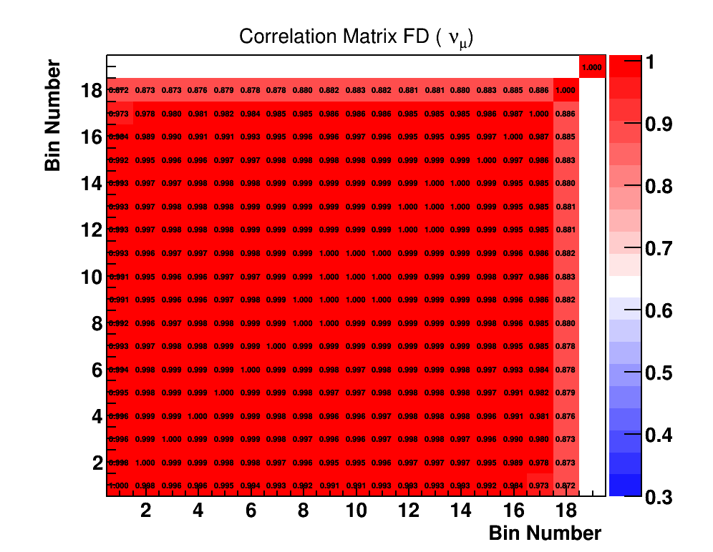
Correlation for numu far detector pc->Pi - Default

Slide 44
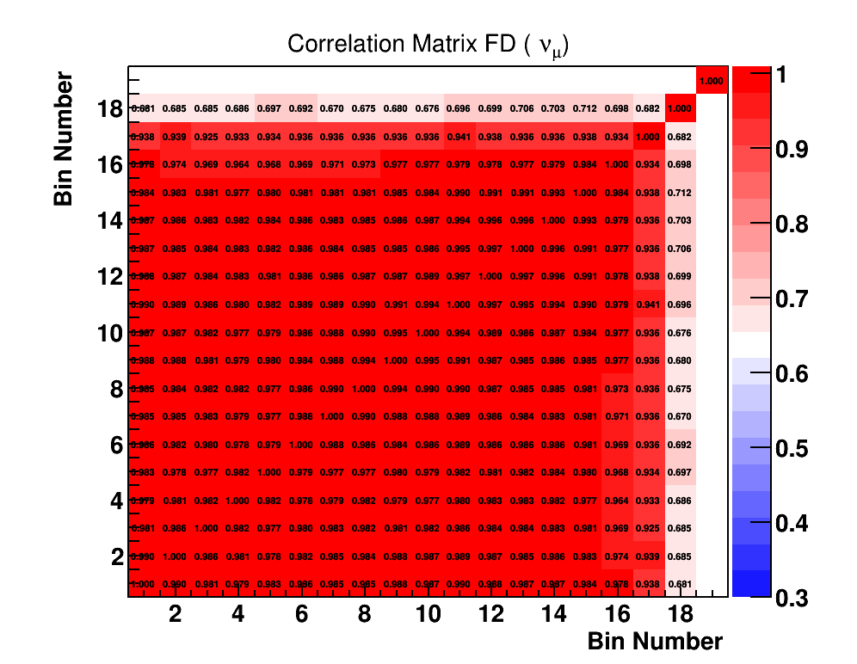
Correlation for numu far detector pc->Pi – No Corr
Correlations decreases, more significantly in the higher bin regions.

