Slide 1
It’s all about mass
Young-Kee Kim
The University of Chicago
December 5, 2020
Oxford University
Notes:
This talk is about our journey in searching for the most fundamental unit of matter. To find that, we had to peel matter like we peel an onion layer by layer discovering what’s at its core. My rese

Slide 2
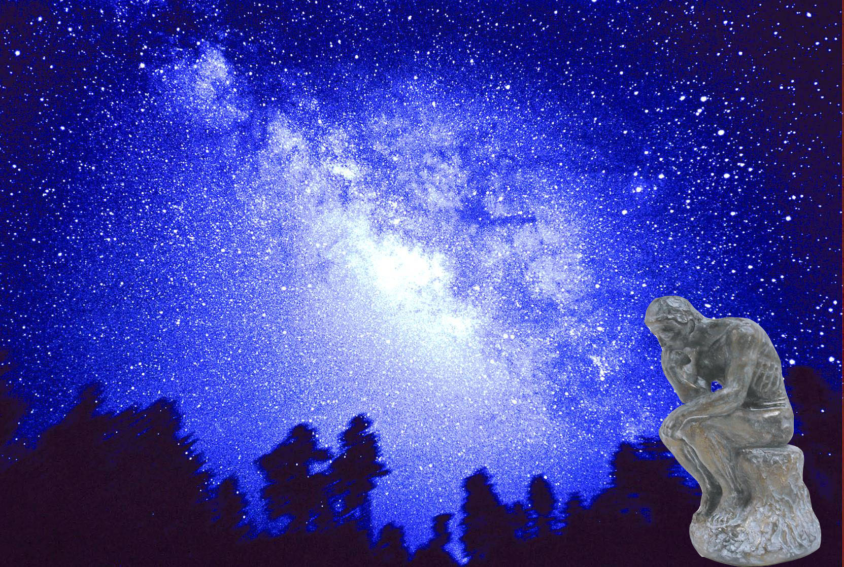
Particle Physics:
What is the universe made of ?
What holds it together ?
Where did we come from ?

Slide 3
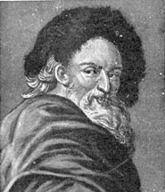
Atom
Indivisible
Democritus (Greek philosopher 460 BC – 370 BC)
The universe is composed of the atoms and the void
Notes:
Around 2,500 years Greek philosopher was thinking about cutting stuff up and came up with the idea that there must be a point where you could no longer cut something any smaller. He named the atom after the Greek word atomos, which means 'that which can't be split.
The universe is composed of two elements: the atoms and the void in which they exist and move.
Space was infinite in extent, and the atoms were infinite in number.

Slide 4
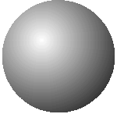
Atom (400 BC)
Indivisible
Atoms were “then” building blocks of the world
The conception of the atom has been modified in several essential respects, but the philosophy remains the foundation of modern science.
Notes:
All matter consists of atoms:
Solids are made of small, pointy atoms.
Liquids are made of large, round atoms.
Oils are made of very fine, small atoms that can easily slip past each other.
The atomic model helped scientists further look into the science of the atom and its generic makeup.
The conception of the atom has been modified in several essential respects in modern times, but his philosophy remains the foundation of modern science.

Slide 5
We are made of atoms
Are atoms building blocks of the world?
To answer this,
we have to peel an atom
like we peel an anion layer by layer discovering what’s at its core.
Notes:
This talk is about our journey in searching for the most fundamental unit of matter. To find that, we had to peel matter like we peel an onion layer by layer discovering what’s at its core.
Your journey is not taking you anywhere but inward.

Slide 6
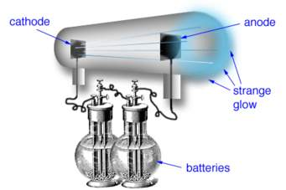
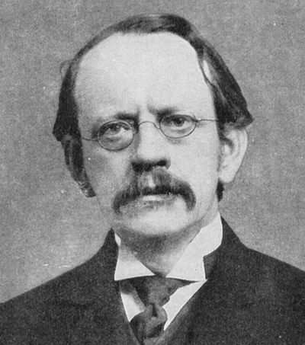
Discovery of the electron
Atoms have tiny, negatively charged particles (electrons) inside them.
The atom can be split into even smaller parts.
1897
metal
metal
J.J. Thomson (1856 – 1940)
Nobel Prize (1906)
Notes:
His discovery was the first step towards a detailed model of the atom.

Slide 7
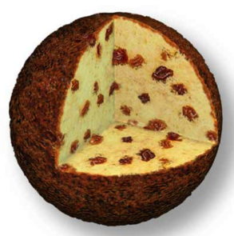
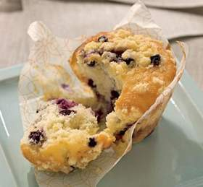
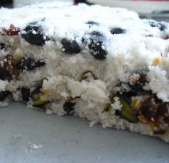
Atom (~1900)
negatively charged
electrons
positively charged matter
plum pudding model
blueberry muffin model
bean rice cake model
Notes:
With the discovery of electrons by J.J. Thomson in 1897, scientists thought of atoms as a sphere of positive charge throughout which the electrons were distributed, a bit like plums in a Christmas pudding.

Slide 8
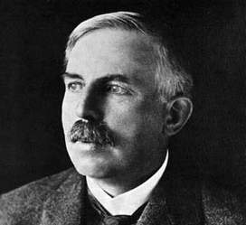
Peeling an atom
Ernest Rutherford
(1871 – 1937)
Nobel Prize (1908)
Particle beam
Observed
(1909)
small heavy core
“It was almost as incredible as if you fired a 15-inch shell at a piece of tissue paper and it came back and hit you.”
Notes:
With the discovery of electrons by J.J. Thomson in 1897, scientists thought of atoms as a sphere of positive charge throughout which the electrons were distributed, a bit like plums in a Christmas pudding.

Slide 9
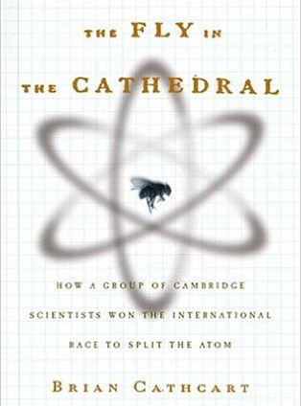
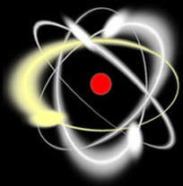
Atom (1909)
electron orbits
nucleus
nucleus = small nut
size = 0.0001 x atom, mass = atom mass
mass (e) < 0.001 mass (nucleus)
“the fly in the cathedral”
Building blocks (1909): atoms nuclei and electrons
Notes:
The Fly in the Cathedral is a 2004 book by Brian Cathcart, telling the story of how physicists around the world, but particularly in the University of Cambridge's Cavendish Laboratory, split the atom in the 1930s.
The title refers to the size of the atomic nucleus in relation to the size of the whole atom. Although this analogy was made in the very early 20th century, many years before accurate figures were known, it turns out to be an appropriate illustration of the size difference, to within a couple of orders of magnitude.

Slide 10
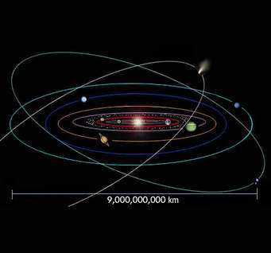
Atom (1909)
mostly empty space
electron orbits
nucleus
nucleus = small nut
size = 0.0001 x atom, mass = atom mass
mass (e) < 0.001 mass (nucleus)
our solar system
Inner Space Outer Space

Slide 11
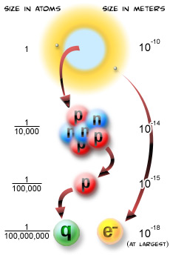
Peeling a nucleus
nucleus
Nucleus
.
.
.
.
.
.
Nucleus
U
s

Slide 12
Peeling a nucleus
nucleus
Nucleus
Us
Discovery of the neutron
(1932)
Nucleus
U
s
Building blocks (1932): protons, neutrons, and electrons

Slide 13
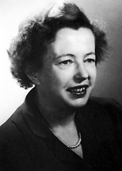
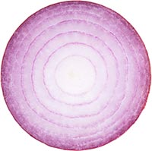
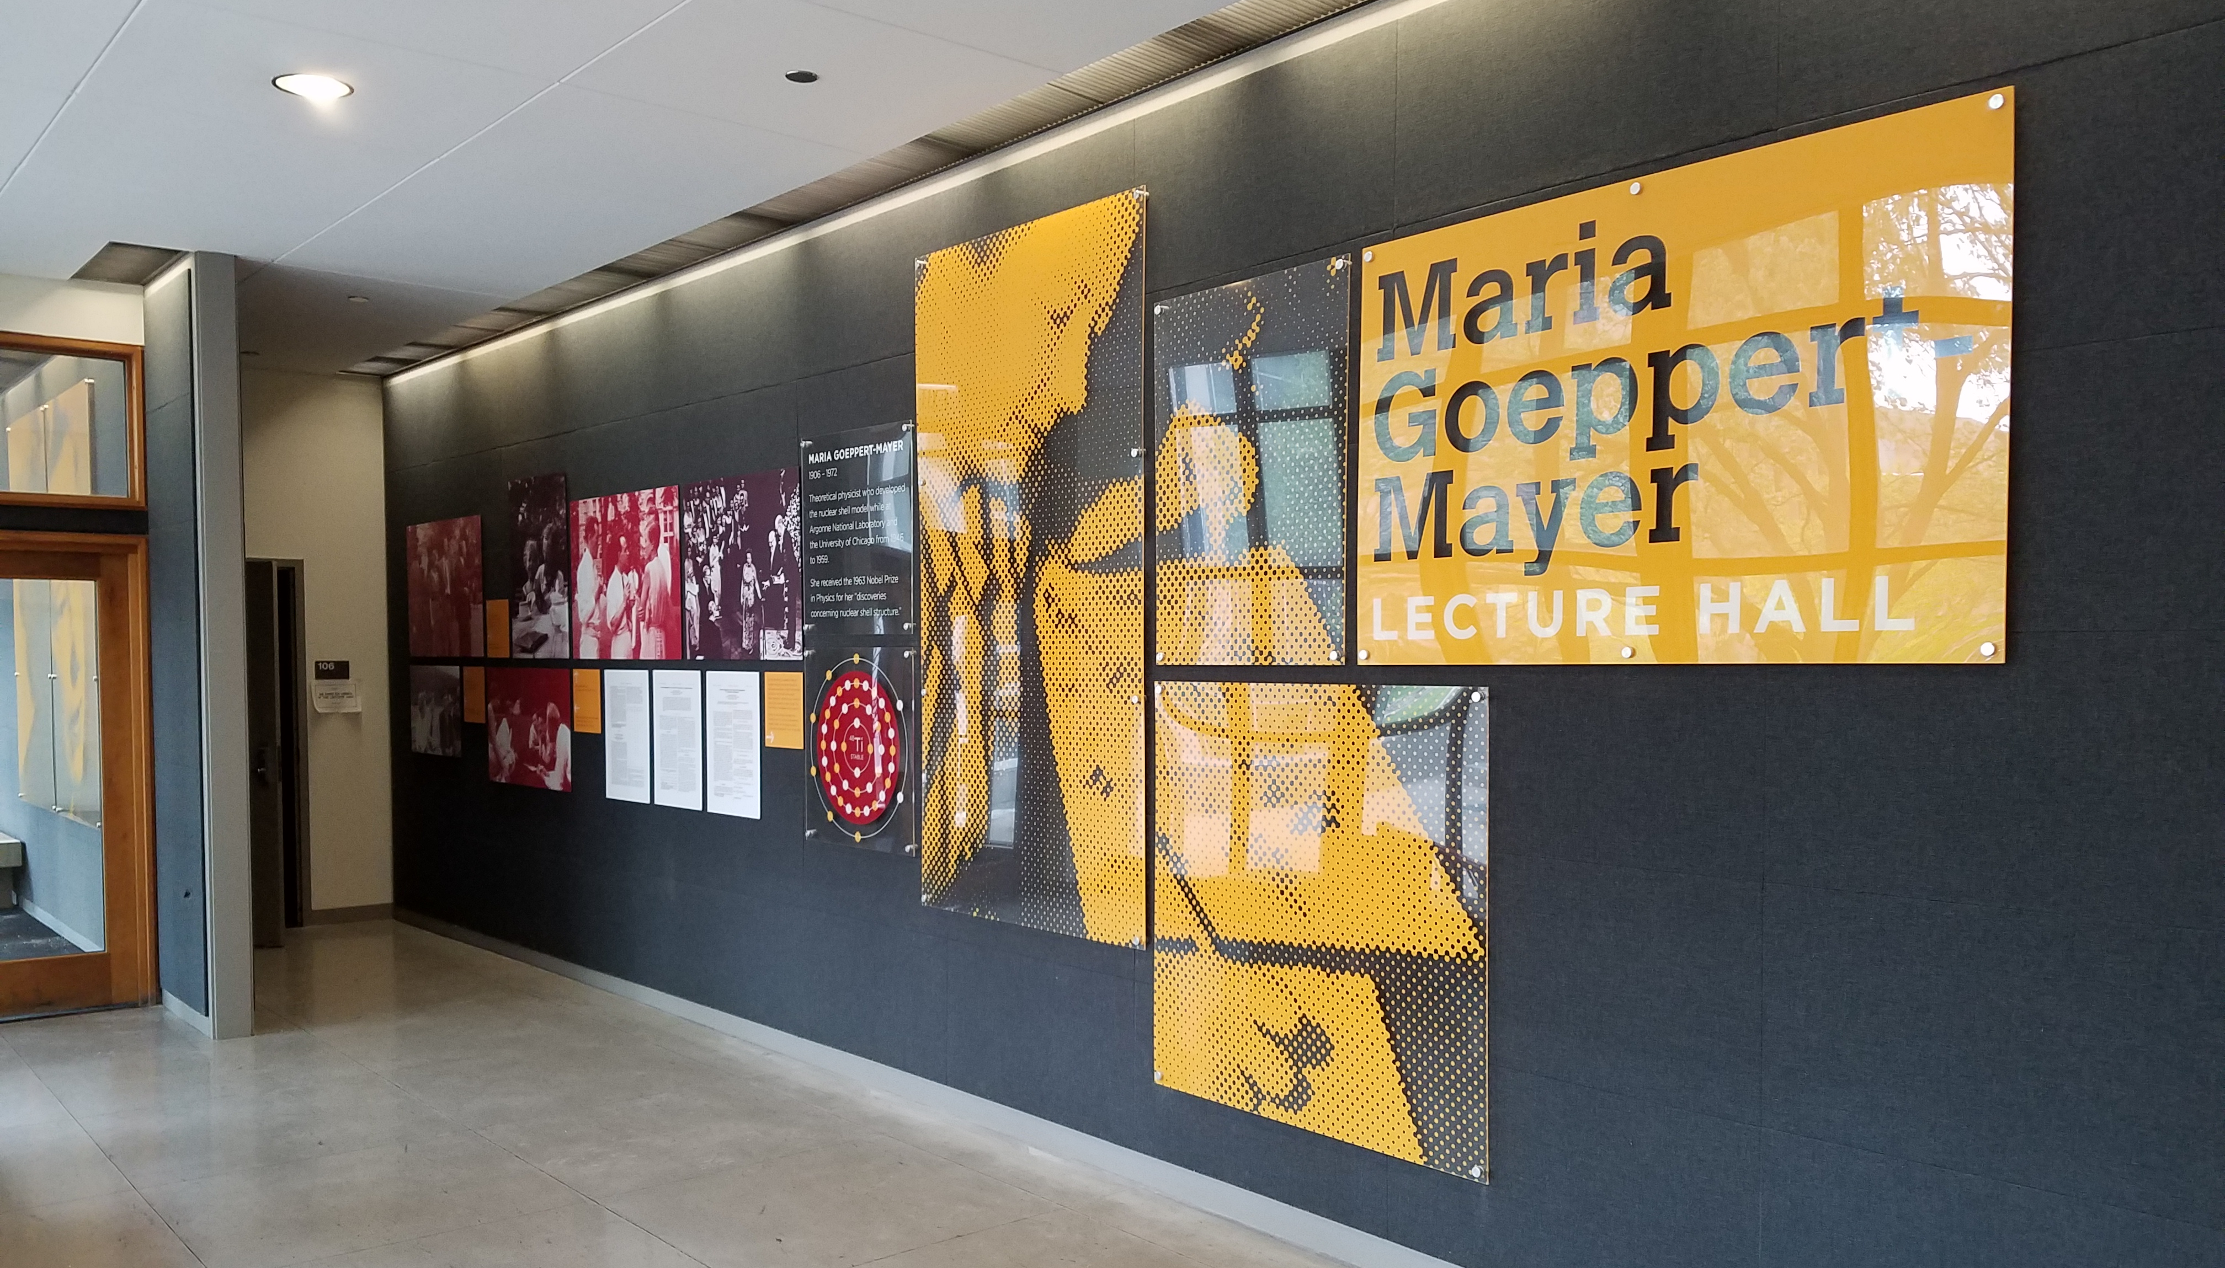
Peeling a nucleus
Maria Goeppert-Mayer
(1906 – 1972)
Nobel prize (1963)
“The Onion Madonna”
“Protons and neutrons spin along orbits like several shells,
much like an onion with many shells”
Maria Goeppert-Mayer
U.Chicago physics faculty (1946-1959)
U.Chicago Physics
Notes:
The last piece in the puzzle was the discovery that protons and neutrons are spinning along orbits inside the atomic nucleus - in the same manner that earth spins around its own axis while moving in an orbit around the sun. The orbits in the atomic nuclei are like several shells, much like an onion with many shells but nothing in the center, Maria explained.
The first orbit, or shell, in an isotope should for the best stability have 2 particles, the second orbit 8 particles, the third orbit 20, the fifth 28, the sixth 50 and so on. The "magic numbers" would represent the points at which the various shells would be complete.
Maria's idea to liken the atomic nuclei with an onion made Wolfgang Pauli, also awarded a Nobel Prize in Physics, give her the nickname “The Onion Madonna”.
the nuclear shell model is a model of the atomic nucleus which uses the Pauli exclusion principle to describe the structure of the nucleus in terms of energy levels. The first shell model was proposed in 1932. The model was developed in 1949 following independent work by several physicists, most notably Eugene Paul Wigner, Maria Goeppert Mayer and J. Hans D. Jensen, who shared the 1963 for their contributions.

Slide 14
Peeling a proton and a neutron
Seeing inside a proton and a neutron
Nucleus
10⁻¹⁵ m
us
Nucleus
U
s
Notes:
While an atom is tiny, the nucleus is ten thousand times smaller than the atom and the quarks and electrons are at least ten thousand times smaller than that. We don't know exactly how small quarks and electrons are; they are definitely smaller than 10⁻¹⁸ meters, and they might literally be points, but we do not know.
It is also possible that quarks and electrons are not fundamental after all, and will turn out to be made up of other, more fundamental particles. (Oh, will this madness ever end?)

Slide 15
Sun
light source
light ray
light ray
eyes,
cameras

Slide 16
Seeing the “small” invisible by an electron microscope
electron
sources
electron source
electron beam
electron beam
electron
detector
specimen
electron beam
Breast Cancer Cell
electron-beam
electron
detectors

Slide 17
Peeling a proton and a neutron
high energy
particles sources
high energy
particle beam
Nucleus
λ = h / p
10⁻¹⁵ m
us
Nucleus
U
s
particle detectors
proton (p)
neutron (n)
Notes:
1 GeV electron wave length = ~10 fm
While an atom is tiny, the nucleus is ten thousand times smaller than the atom and the quarks and electrons are at least ten thousand times smaller than that. We don't know exactly how small quarks and electrons are; they are definitely smaller than 10⁻¹⁸ meters, and they might literally be points, but we do not know.
It is also possible that quarks and electrons are not fundamental after all, and will turn out to be made up of other, more fundamental particles. (Oh, will this madness ever end?)
Scattering is a tool used for many decades. Inteferometer…

Slide 18
Today’s building blocks
10⁻¹⁸ m
1 nano nano meter
up quarks, down quarks, electrons
Notes:
While an atom is tiny, the nucleus is ten thousand times smaller than the atom and the quarks and electrons are at least ten thousand times smaller than that. We don't know exactly how small quarks and electrons are; they are definitely smaller than 10⁻¹⁸ meters, and they might literally be points, but we do not know.
It is also possible that quarks and electrons are not fundamental after all, and will turn out to be made up of other, more fundamental particles. (Oh, will this madness ever end?)

Slide 19
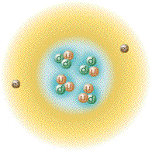
Building blocks
atom nucleus proton, neutron up, down quarks
electron electron electron
electromagnetic forces
weak forces & strong forces
nucleus
n
n
p
p
~400 BC ~ 1910 ~1930 Today

Slide 20
Tools
λ = h / p
Low energy particle High energy particle
Today
nano nano
meter

Slide 21
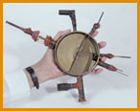
High energy beam by particle accelerators
Particle Accelerators
1930
Ernest Lawrence (1901-1958)

Slide 22
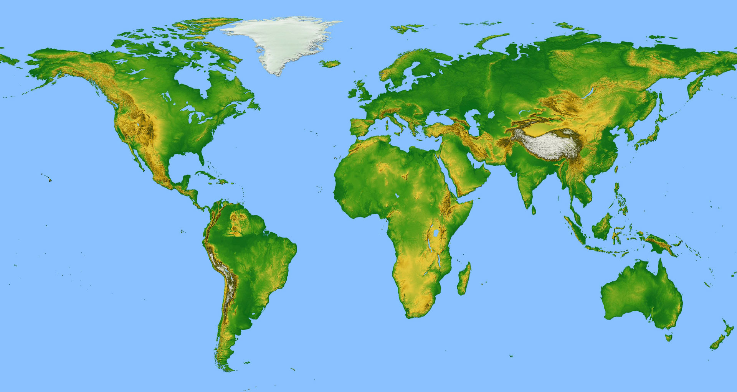
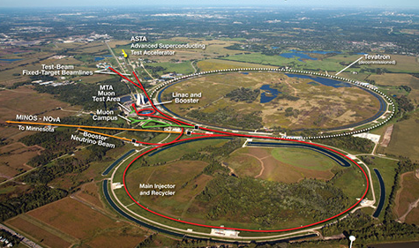
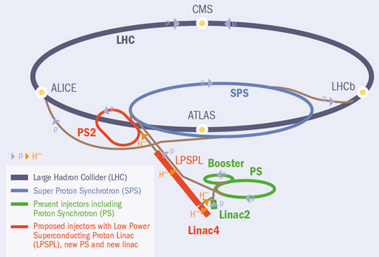
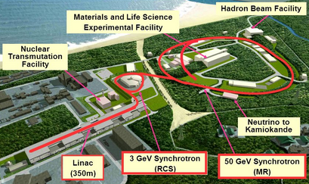
Today’s Accelerators for Particle Physics Research
CERN
High energy directly
Fermilab
KEK
Fermilab and KEK
Extremely high intensity beams
High energy indirectly
ΔE x Δt ~ h

Slide 23
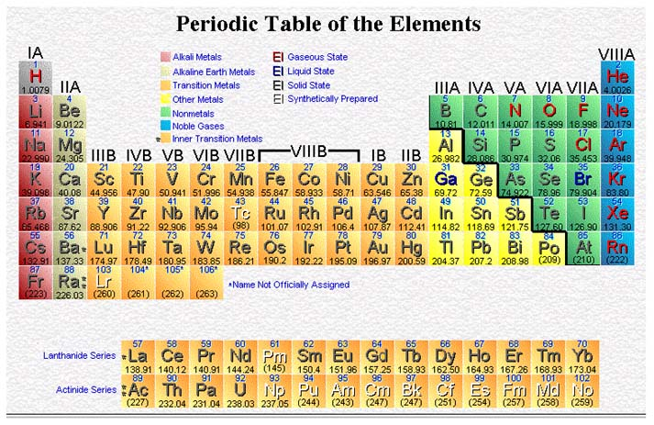
Accomplishment
of the 19th Century
Periodic Table of Elements
Accomplishment
of the 20th Century
Table of Elementary Particles
Standard Model

Slide 24
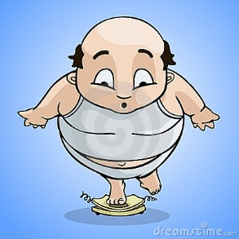
Origin of the Mass of Matter?
Can we blame up quarks, down quarks and electrons for our mass?

Slide 25
Origin of the Mass of Matter?
~
~
~
M_{atom} = M_{nucleus} + M_{electrons}
= M_{protons} + M_{neutrons} + M_{electrons}
= M_{up-quarks} + M_{down quarks} + M_{electrons}
valence
quarks
up, down quarks contribute ~1% proton, neutron mass
~99% of proton, neutron mass contained in interaction energies of “sea” quarks/anti-quarks + gluons: E = Mc² → M = E/c²
Mass of building blocks (up/down quarks, electrons) ~ 1% x atom mass

Slide 26
Origin of the Mass of Matter?
Though very very tiny,
we cannot exist without masses of up and down quarks and electrons.
If electron mass = 0, atoms cannot be formed
If up, down quark mass = 0,
proton mass > neutron mass; protons decay into neutrons; no protons
What is the origin of masses of up, down quarks and electrons?

Slide 27
Big Surprises with High Energy Accelerators

Slide 28
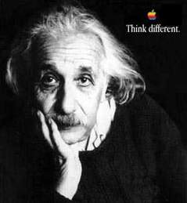
anti particle
E
particle
E = Mc²
Notes:
Has Mass an Origin?
The concept of mass is one of the first things we discuss in my freshman mechanics class. Classical mechanics is, literally, unthinkable without it. Newton’s second law of motion says that the acceleration of a body is given by dividing the force acting upon it by its mass. So a body without mass wouldn’t know how to move, because you’d be dividing by zero. Also, in Newton’s law of gravity, the mass of an object governs the strength of the force it exerts. One cannot build up an object that gravitates, out of material that does not, so you can’t get rid of mass without getting rid of gravity. Finally, the most basic feature of mass in classical mechanics is that it is conserved. For example, when you bring together two bodies, the total mass is just the sum of the individual masses. This assumption is so deeply ingrained that it was not even explicitly formulated as a law. (Though I teach it as Newton’s Zeroth Law.) Altogether, in the Newtonian framework it is difficult to imagine what would constitute an “origin of mass,’’ or even what this phrase could possibly mean. In that framework mass just is what it is — a primary concept.
Later developments in physics make the concept of mass seem less irreducible. Einstein’s famous equation E=mc2 of special relativity theory, written in that way, betrays the prejudice that we should express energy in terms of mass. But we can write the same equation in the alternative form m=E/c . When expressed
in this form, it suggests the possibility of explaining mass in terms of energy. Einstein was aware of this possibility from the beginning. Indeed, his original 1905 paper is entitled, “Does the Inertia of a Body Depend on Its Energy Content?” and it derives m=E/c2, not E=mc2. Einstein was thinking about fundamental physics, not bombs.

Slide 29
Exotic particles last seen in the earliest moments of the universe
anti particle
M
particle
E = Mc²

Slide 30
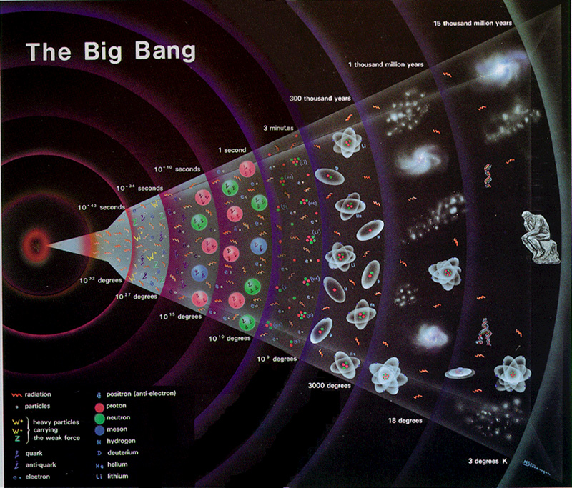
History of the Universe
W, Z
Top quark
peeling backward in time
(higher energy)
M
peeling inward
(higher energy)
Intimate connection: Standard Model
Matter particles
6 leptons / 6 anti-leptons
6 quarks / 6 anti-quarks
Forces between them
3 forces (γ, W, Z, g) + gravitational force
Notes:
Peeling backward in time

Slide 31
Exotic particles last seen in the earliest moments of the universe
anti particle
M
particle
E = Mc²

Slide 32
Discovering elementary particles
Top quark
hydrogen atom mass
Z
gluons
W
b
.
τ
ν_{τ}
.
c
c
ν_{μ}
Spin ½ Fermions
Spin 1 Bosons
Particles are messengers:
Building a theory / understanding laws of nature

Slide 33
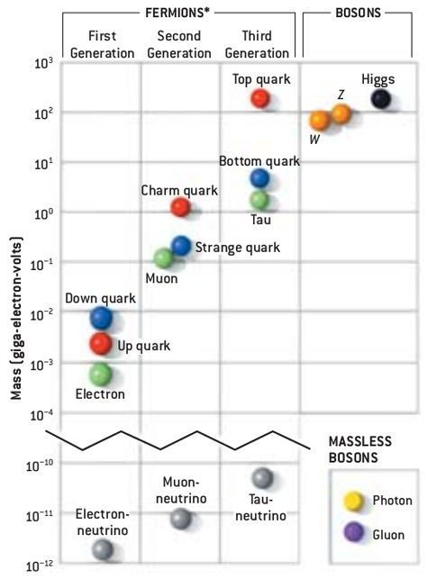
1. How did elementary particles get mass?
Higgs
Mass values:
6 orders of magnitude diff.
between top quark and electron
Mass values:
6 orders of magnitude diff.
between electron and neutrinos
2. What is the origin of mass values?

Slide 34
Visible Universe: Higgs Particles
Nothing in the universe
Something in the universe
Higgs field
no mass
mass
electron
top quark
x
x
top
x
x
x
x
x
x
Spontaneous Symmetry Breaking (Higgs Mechanism) ~10⁻¹⁰ s after the Big Bang
The Higgs field is non-zero even in empty space
Notes:
the weak symmetry is spontaneously broken
weak interactions respect the symmetry but the state of the minimum energy, the vacuum, does not.
According to quantum field theory (QFT) the vacuum is not simply ’nothing’
but a complex dynamic state full of fields, one for each elementary particle.
According to this picture the Universe might have gone through a phase transition very early after the Big Bang from a high temperature phase
with the symmetric vacuum (zero average Higgs field) to a low temperature phase6 when it fell into one of the minima, which became our current vacuum.

Slide 35
Discovering elementary particles
Top quark
hydrogen atom mass
Higgs boson
Z
gluons
W
b
.
τ
ν_{τ}
.
c
c
ν_{μ}
Spin 0 Boson
Spin ½ Fermions
Spin 1 Bosons
Particles are messengers:
Building a theory / understanding laws of nature

Slide 36
Accomplishment
of the 19th Century
Periodic Table of Elements
Accomplishment
of the 20th Century
Table of Elementary Particles
Standard Model
Completion of Standard Model !

Slide 37
Stop peeling?
No, because
despite considerable successes,
this theory has within it the seeds of its own demise

Slide 38
……………. and the mysteries
WHY ?
WHAT ?
mass
6 quarks
3 families
forces
anti-matter
neutrinos
dark matter
dark energy

Slide 39
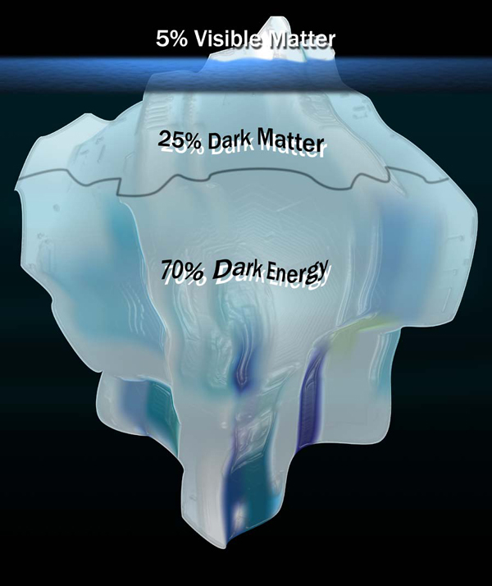
……………. and the mysteries
Visible Universe
Invisible Universe
(Dark Universe)

Slide 40
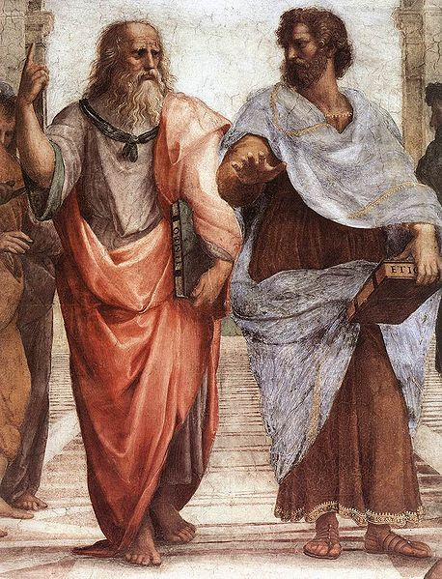
“The more you know, the more you know you don't know.”
Aristotle (Greek philosopher and scientist, 384 – 322 BC)
Peeling continues
to search for a more complete and elegant theory

Slide 41
……………. and the mysteries
WHY ?
WHAT ?
mass
6 quarks
3 families
forces
anti-matter
neutrinos
dark matter
dark energy
mass
mass
Discovery of Physics that explains the origin of “mass”
→ Potential Phyiscs for other questions

Slide 42
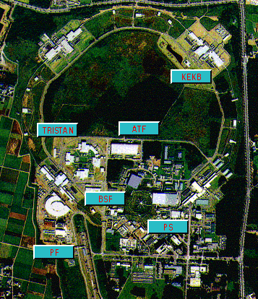
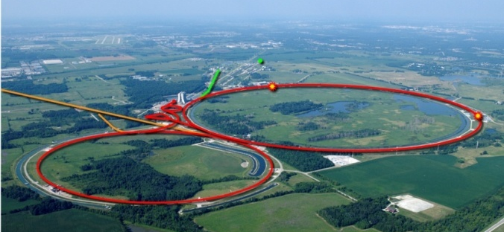
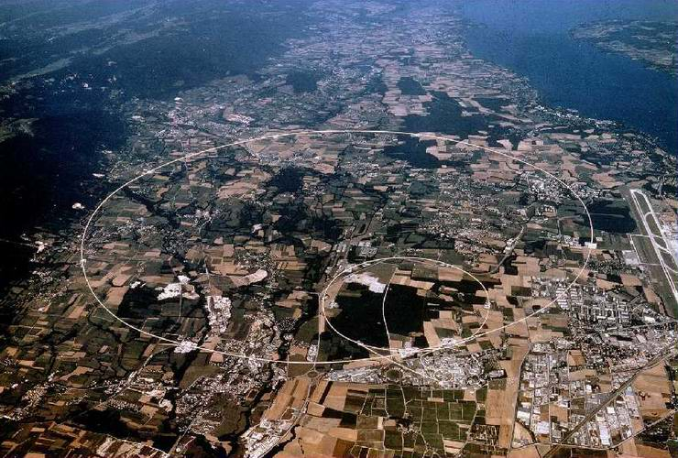
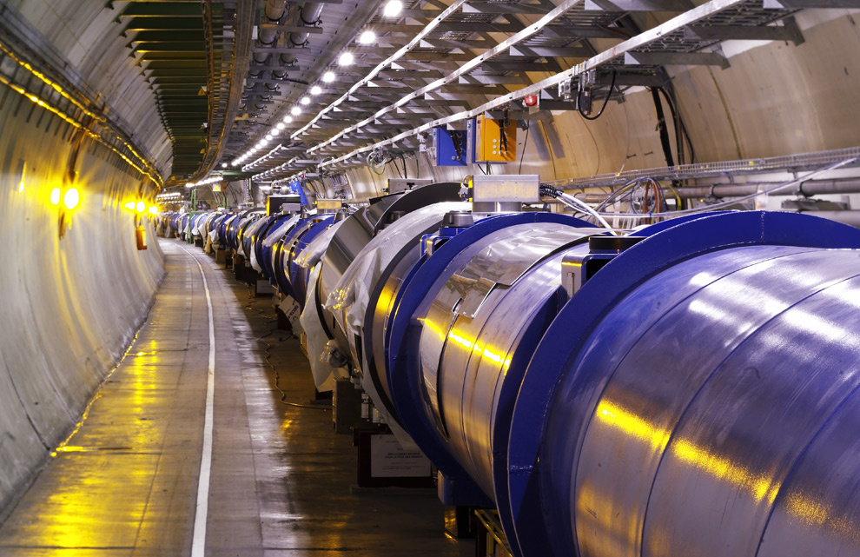
TRISTAN e⁺e⁻ (Japan)
60 GeV, 3 km
_
Tevatron pp (U.S.)
2 TeV, 6 km
LHC pp
13 TeV, 27 km
My journey (higher energy accelerators)

Slide 43
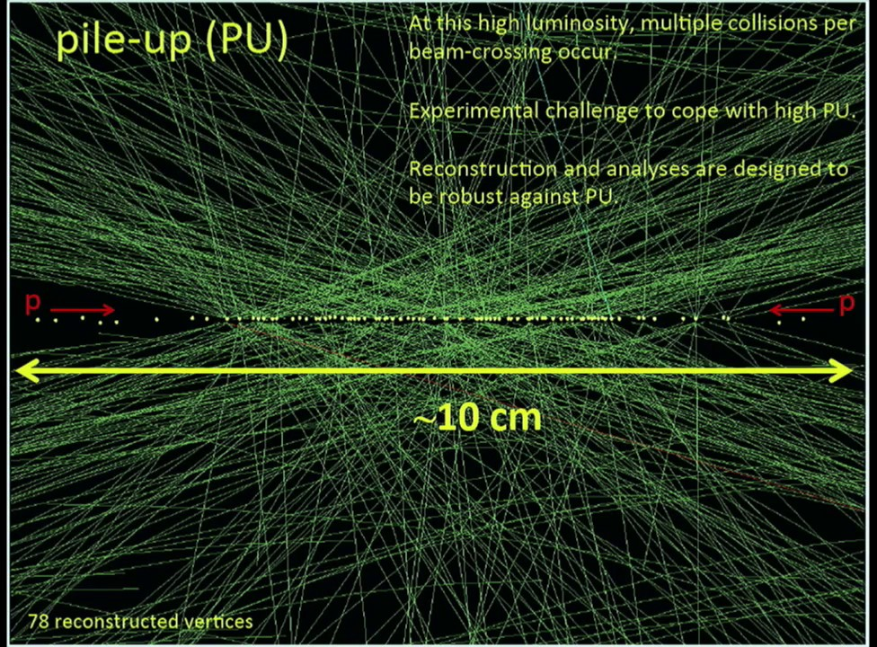
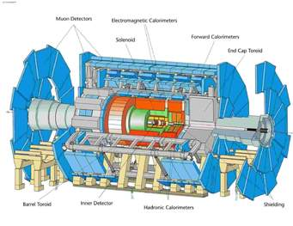
High Energy Colliders and Collider Experiments
Large Hadron Collider (LHC)
1 W, Z / 1 million collisions
1 Top / 100 millions collisions
1 Higgs / 1 billion collision
~10¹¹
protons
E
~10¹¹
protons
ATLAS Collider Experiment
M
Notes:
Currently, colliders work with around ∼10¹¹ particles per colliding bunch. Recently LHC has increased this number to 1013. I would like to know if there are, in principle, physical limits that can forbid higher number of particles per bunch. For example, are very high values such as ∼10¹⁹ conceivable?
Many challenges
Real time decision on which collision events to store (triggers)
Interactions of other pairs of proton-proton (pile-up) → reconstruction
Huge physics backgrounds
Sophisticated analysis algorithms (e.g. machine leaning methods)

Slide 44
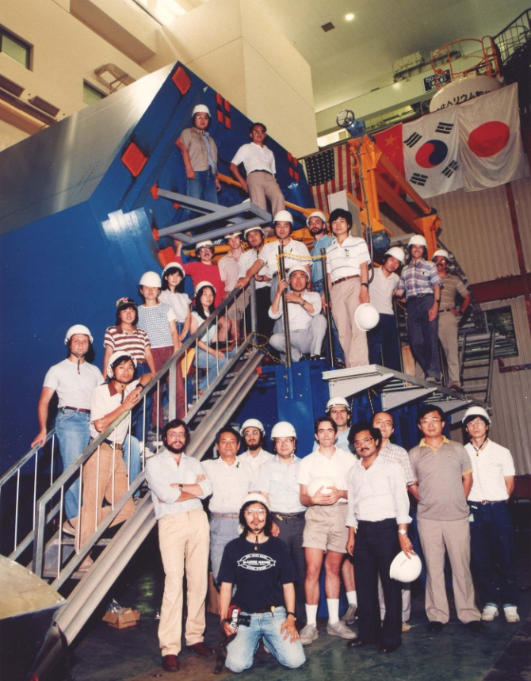
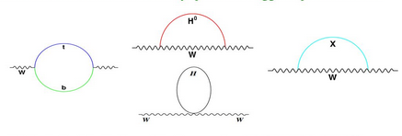
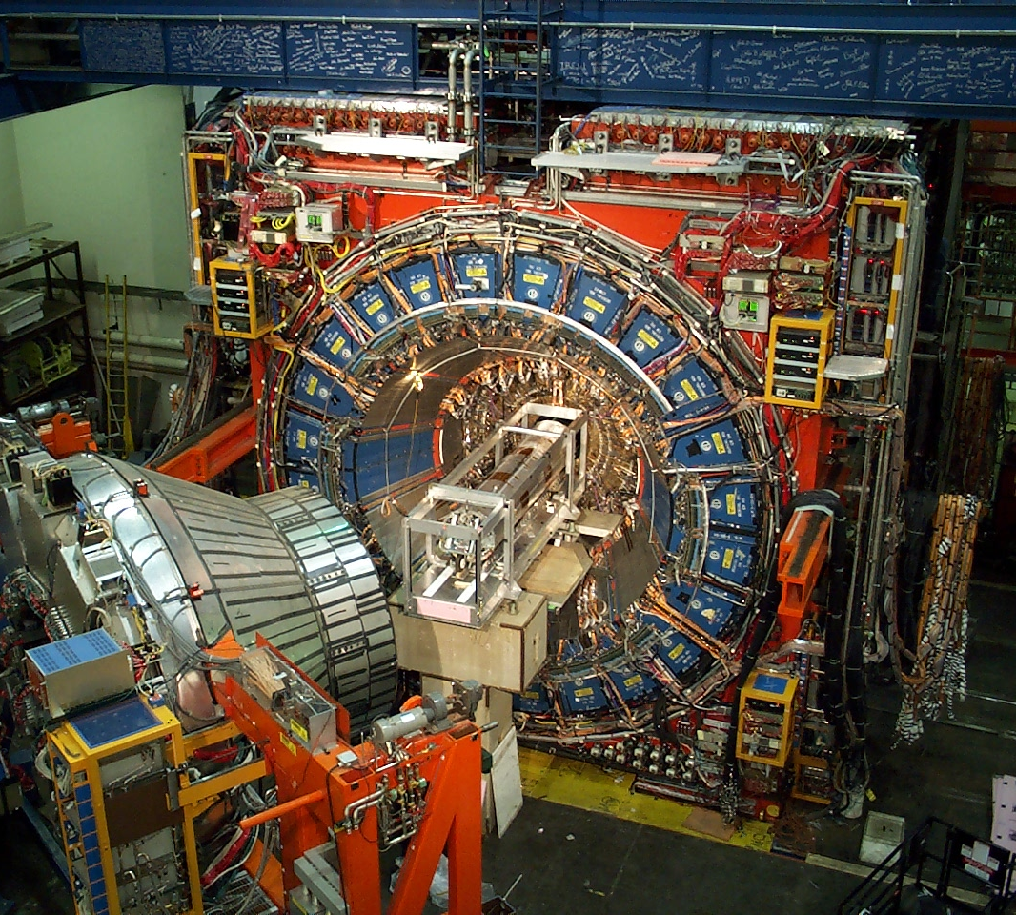
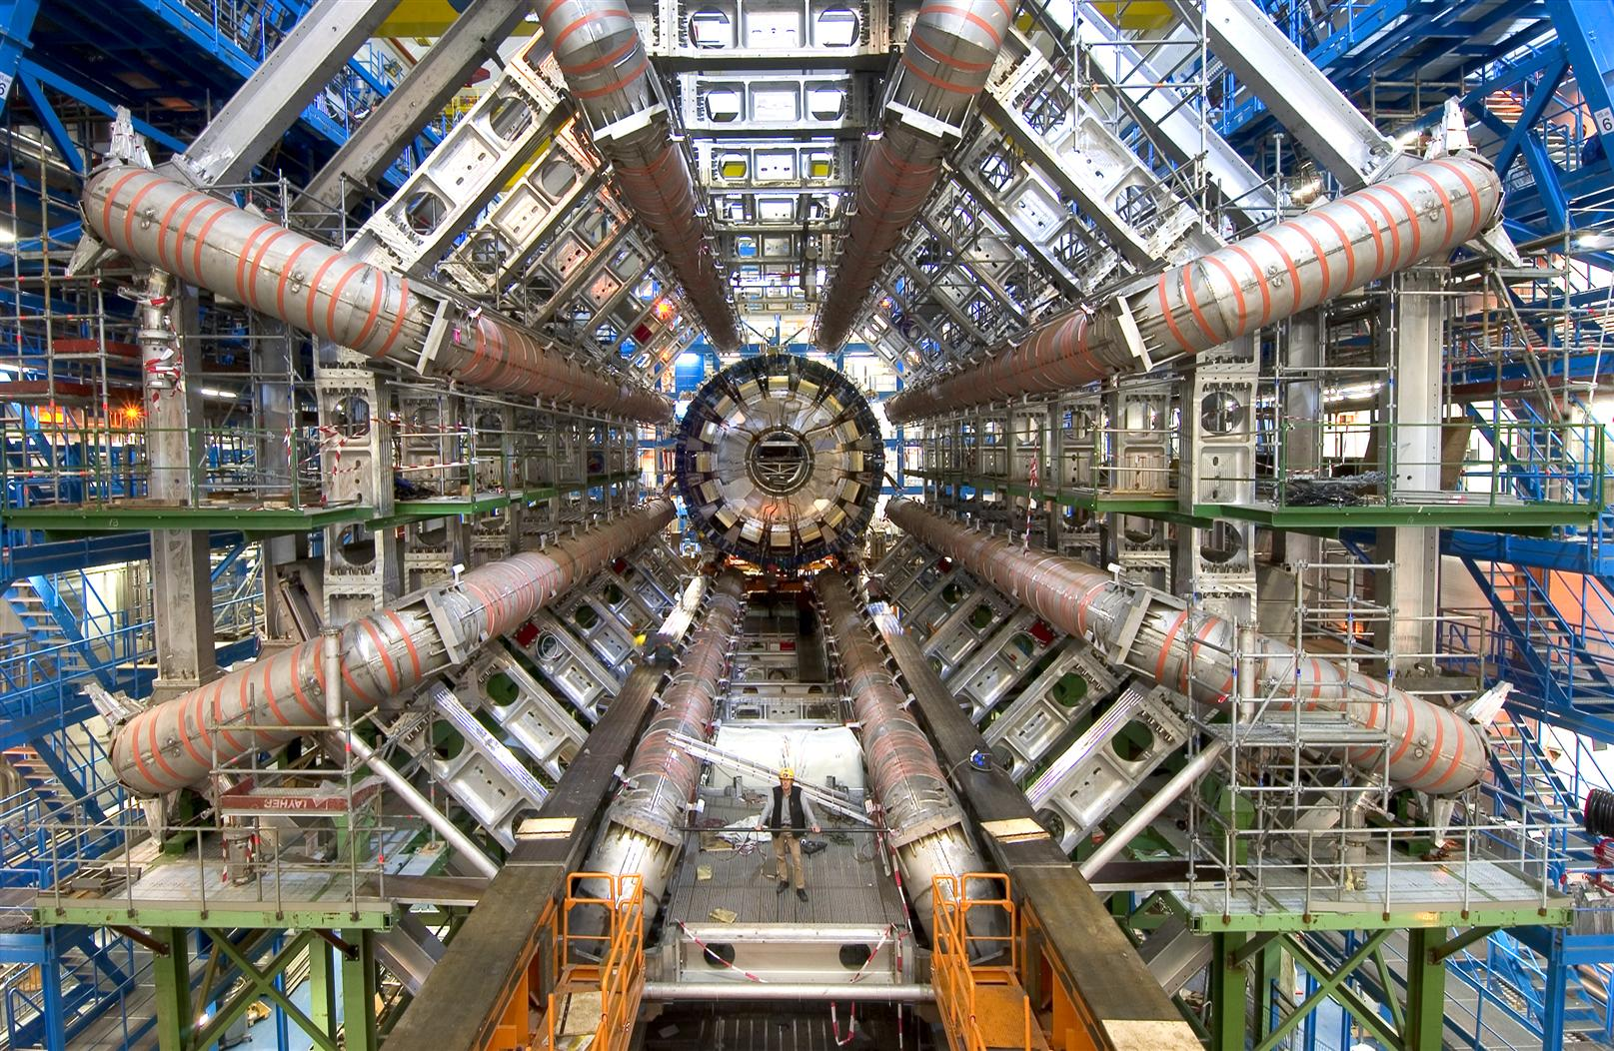
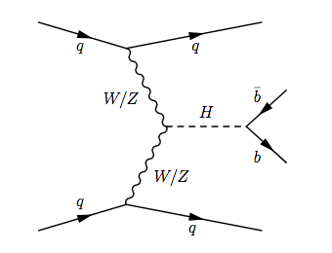
AMY Experiment: 60 physicists from 4 countries
CDF Experiment: 300 → 700 physicists from 20 countries
Standard Model
ATLAS Experiment:
~3,000 physicists from 40 countries
My journey (more powerful detectors)
quantum fluctuations
W mass [GeV/c²]
bottom
quark
Dark
Matter
Higgs
Higgs
Top quark mass [GeV/c²]
anti-bottom
quark
Dark
Matter

Slide 45
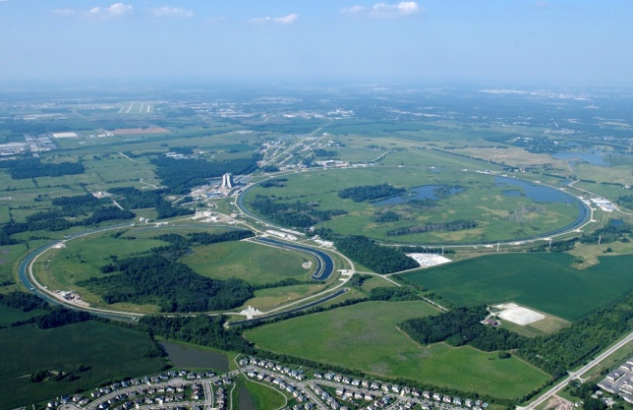
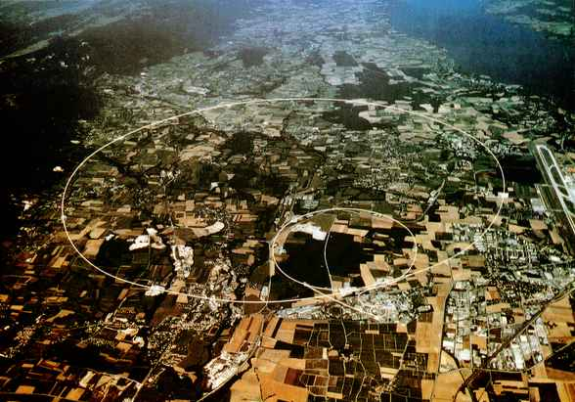
My journey
KEK
Fermilab
CERN
TRISTAN
e⁺e⁻: 60 GeV
Tevatron
pp: 2 TeV
_
LHC
pp: 7,8 TeV → 13 TeV
Lepton collider
Hadron collider
(decision)

Slide 46
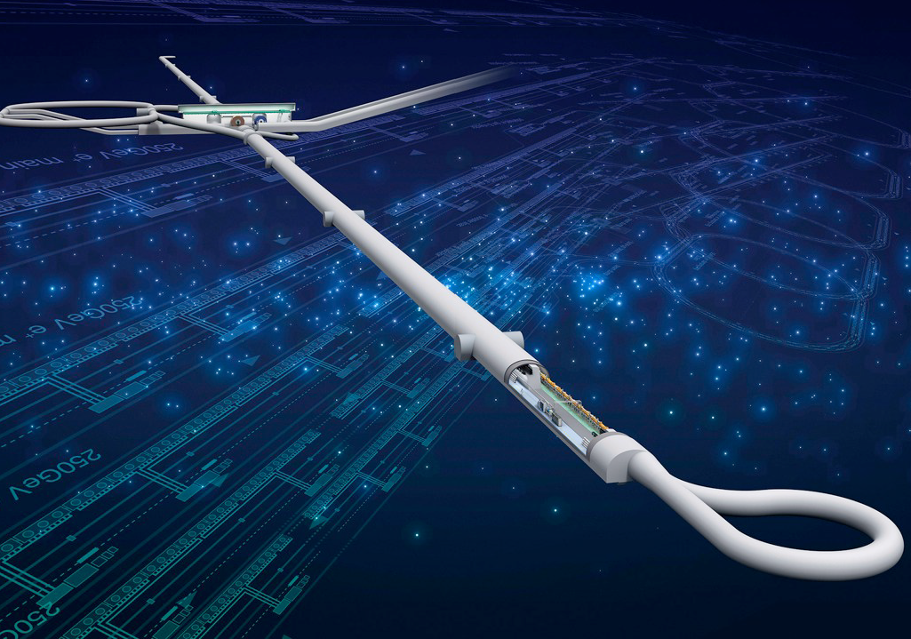
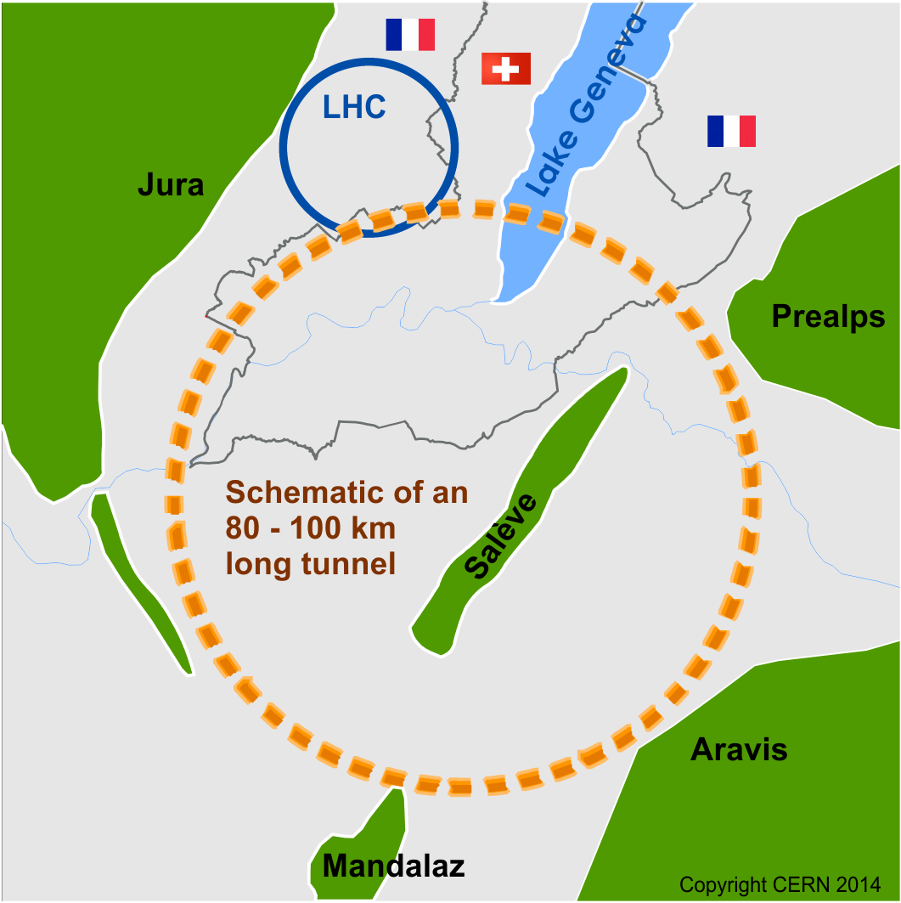
Possible Future Colliders
Muon collider
~10 TeV
Super pp Collider (SppC) E_{cm} ~100 TeV
2045
Compact Linear Collider (CLIC) e⁺e⁻ E_{cm} < 3 TeV
2040
Circular Electron Positron Collider (CEPC) E_{cm} < 250 GeV
2035
2030
Future Circular Collider (FCC)
e⁺e⁻ E_{cm} < 350 GeV pp E_{cm} ~100 TeV AA E_{cm} ~40TeV
LHC
2025
International Linear Collider (ILC)
e⁺e⁻ E_{cm} < 1 TeV

Slide 47
History of the Universe
Searching for an elegant and complete theory
peeling backward in time
(higher energy)
peeling inward
(higher energy)
Elegant Theory
Unified Theory
Incorporate leptons and quarks into a single family
Understand all forces as a single underlying force
Notes:
Peeling backward in time

Slide 48
By using our increased understanding,
we continue to peel away at the more hidden layers of truth
with the hope of discovering a more elegant and complete theory.

Slide 49
But as is the case with the onion,
we must wonder whether there will ever emerge an ultimate layer where the peeling must stop.

