Slide 1
LArTPC CFD Simulation – Fluid Sloshing
Part 1 – Empty Tank (No Modules)
Erik Voirin
10/08/2020

Slide 2

Sloshing Simulation: Case 1: No Modules in Cryostat
Cryostat with LAr initially at rest.
Length of cryostat = 8.99m; Liquid Depth = 4.316m:
Constant Horizontal Accelerations Applied to Cryostat
We run several accelerations and form simplified general equations for any acceleration for:
  Wave Height, Frequency, and Damping
  Pressure Differential on Internal Surfaces (Between Left and Right walls in this empty case)
Ran test simulation two ways, achieving the same results. (Also a Mesh Sensitivity Study was Performed)
  Use Domain Motion to actually simulate transient displacement of the vessel.
  Add Force Source Term by including horizonal acceleration in gravity vector.
    This is allegedly only an approximation of the true physics, and must be tested on a case by case basis.
      In our case there was no difference between the two methods.

Slide 3
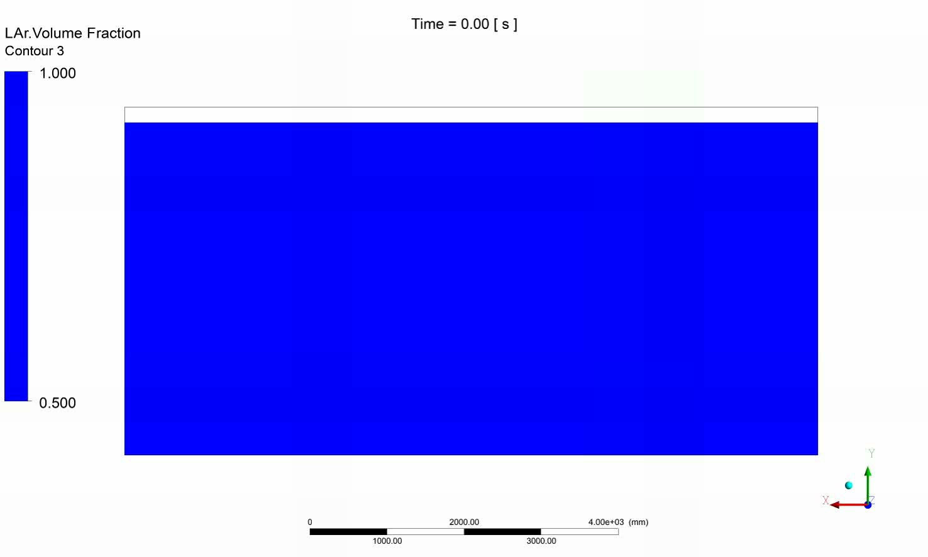
Animation of Simulation using Acceleration: 100 x 0.25 cm/s²

Slide 4
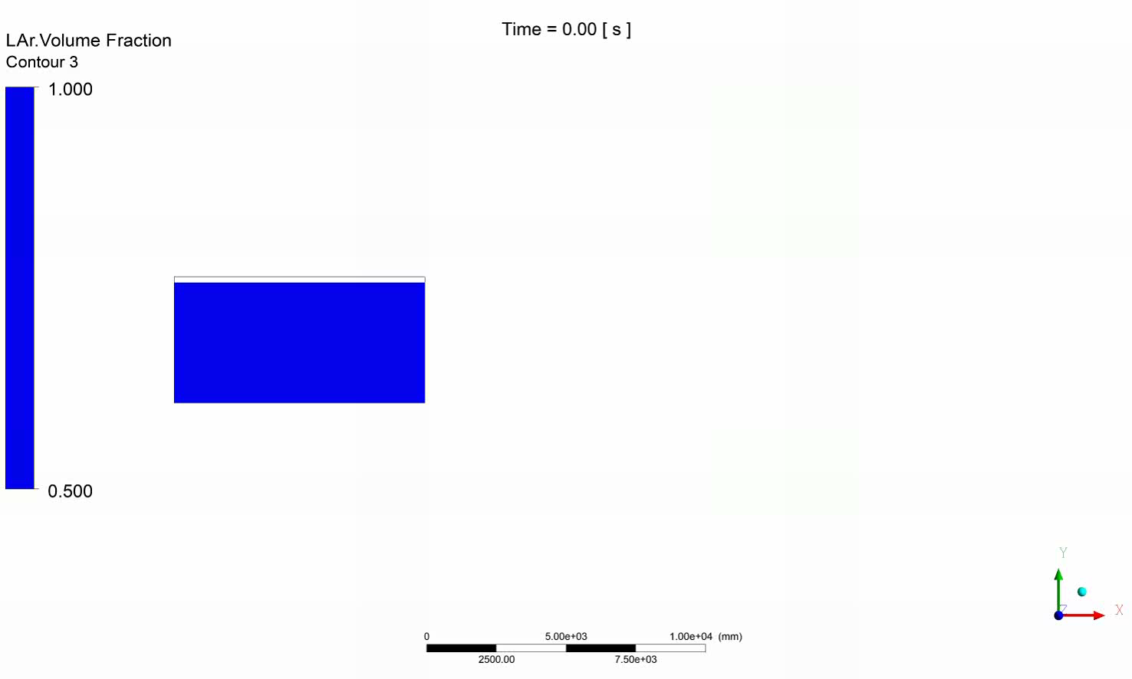
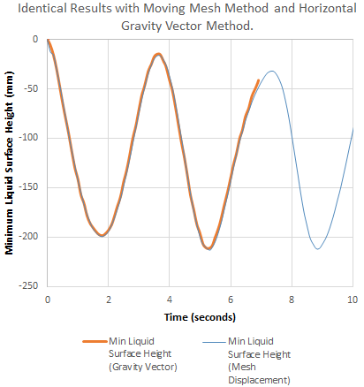
Animation of Simulation using Domain Motion: 100 x 0.25 cm/s²

Slide 5

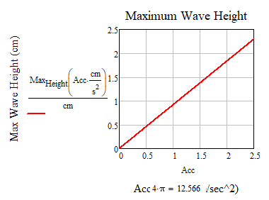
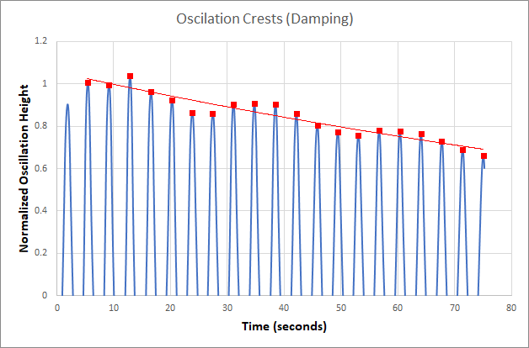
Period and Damping Max Wave Height
Time Period of Sloshing:
3.66 seconds (Independent of Acceleration)
Damping: ~9.3e-4
(Full equation shown in next slide)
Notice small secondary oscillation in crests
Height = 0.92 cm per cm/s^2 acceleration

Slide 6
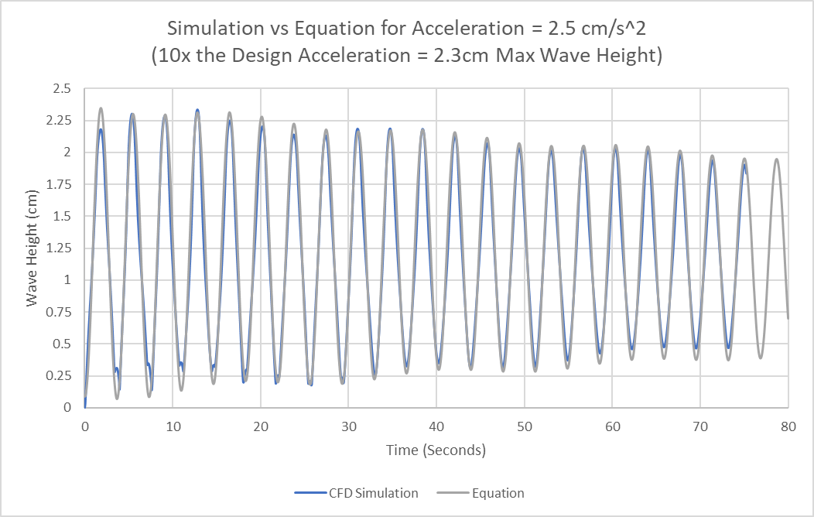
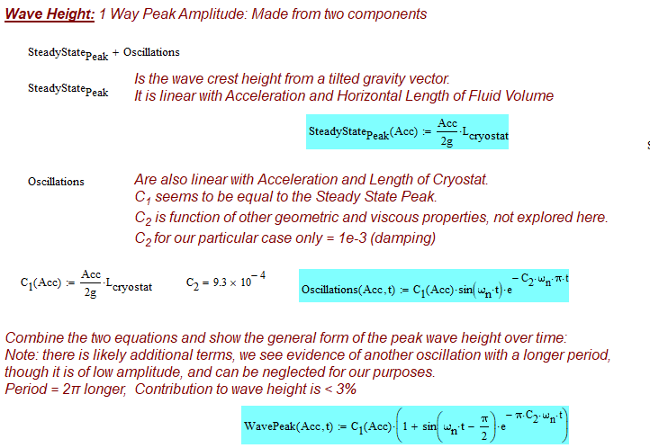
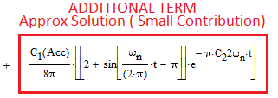
Wave Height: Linear with Acceleration and Characteristic Length

Slide 7
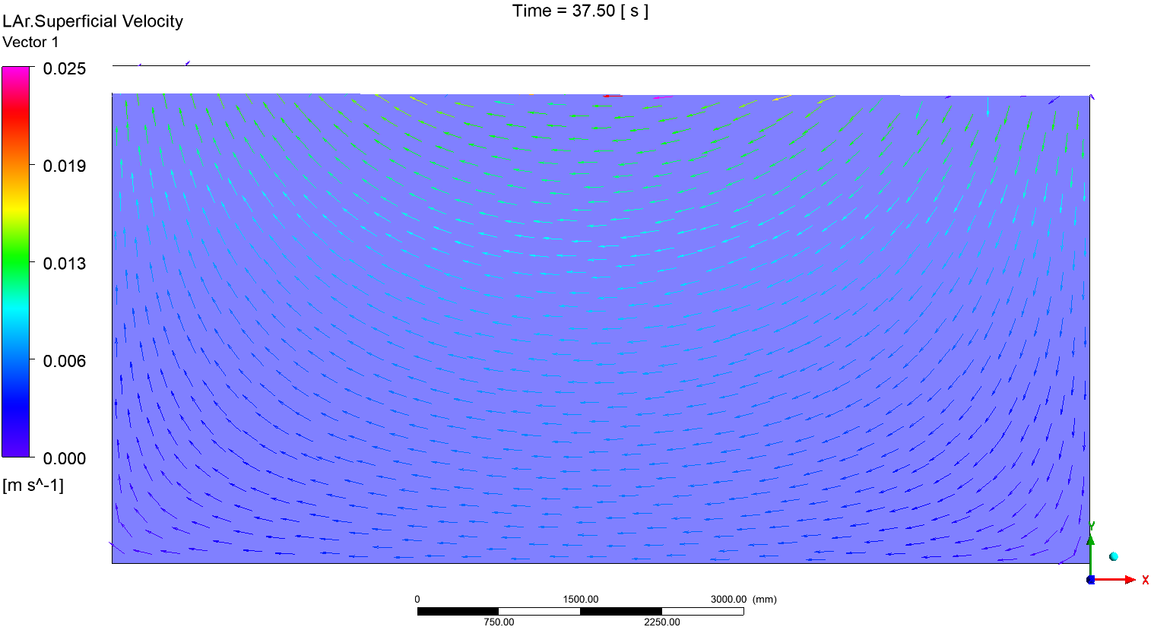
Back and Forth Rocking Fluid Motion: Velocity Linear with Acceleration:
Higher Velocity near liquid surface = Higher Delta P near Surface
Results @ 10 x 0.25 cm/s². Time is in between Crest and Trough of Max Wave Height

Slide 8
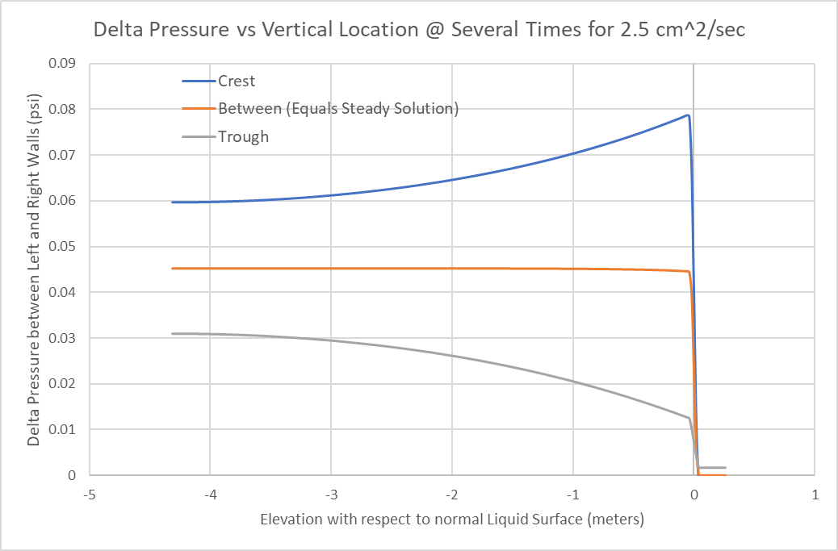
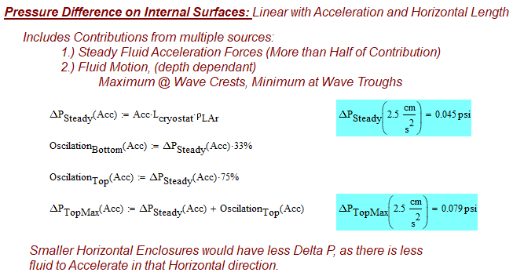
Delta Pressure on Internal Surfaces:
Location Dependent, Higher Near liquid Surface as Shown by previous slide
Also Linear with Acceleration and Characteristic Length
Difference Between left and right walls of cryostat

Slide 9
Conclusion and Other Considerations
  Total Force on an internal object would consist of:
    Delta Pressure described in this document
    Force to accelerate that object, minus the buoyant force in that direction.
      (DensityObject – DensityLAr) * ObjectVolume * Horizontal Acceleration
      (Found to be negligible compared to fluid forces)
  Short simulation done acceleration of 0.25 cm/s^2, and results agree well with previously formed equations:
    Delta P has Excellent agreement along full depth
    Frequency is identical
    Wave height is slightly higher than expected: 3mm vs 2.35mm predicted (about 30% higher)
      May be real, or may be do to slight numerical disturbance at beginning of simulation

Slide 10
Conclusion and Other Considerations
Wave Height and Delta Pressure:
  These could theoretically double if accelerated, then decelerated at the perfect wrong time
    Meaning in phase with the sloshing frequency
    Damping will reduce this effect to 1.5x if accelerated for a time period of >7.5 minutes, then went straight from accelerating to decelerating.
    Down to ~1.0x if cryostat accelerated, then held at constant velocity for a time period of >7.5 minutes minutes before decelerating.
  Accelerations for Maximum Wave = Ullage Height * 10% = 3.96 cm
    Acceleration for this wave height in an empty tank = 4.3 cm/s^2

Slide 11
LArTPC CFD Simulation – Fluid Sloshing
Part 2 – (With Module Cross Sections)
Erik Voirin
10/13/2020

Slide 12
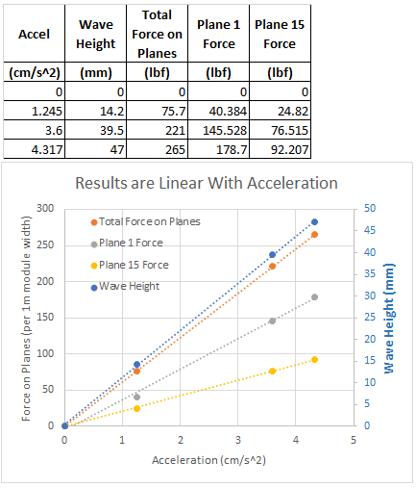
Results for Module Forces and Wave Height are very close to linear.
3 Accelerations Run:
  Ullage Height * 10% = 3.96 cm
    Acceleration for the wave height equal to 10% Ullage height for a module filled Tank = 3.6 cm/s^2.
    Wave is slightly higher in module filled tank vs empty tank at the same acceleration
      (less than 20% difference)
Note: geometry was slightly different in 1.245 cm/s^2 case (CPA planes extended too high, above liquid surface) The CPA planes were corrected for the 3.6 and 4.317 cm/s^2 cases.
3.6 cm/s^2 Acceleration is the case of interest as it is where wave height is 10% of the ullage height.

Slide 13
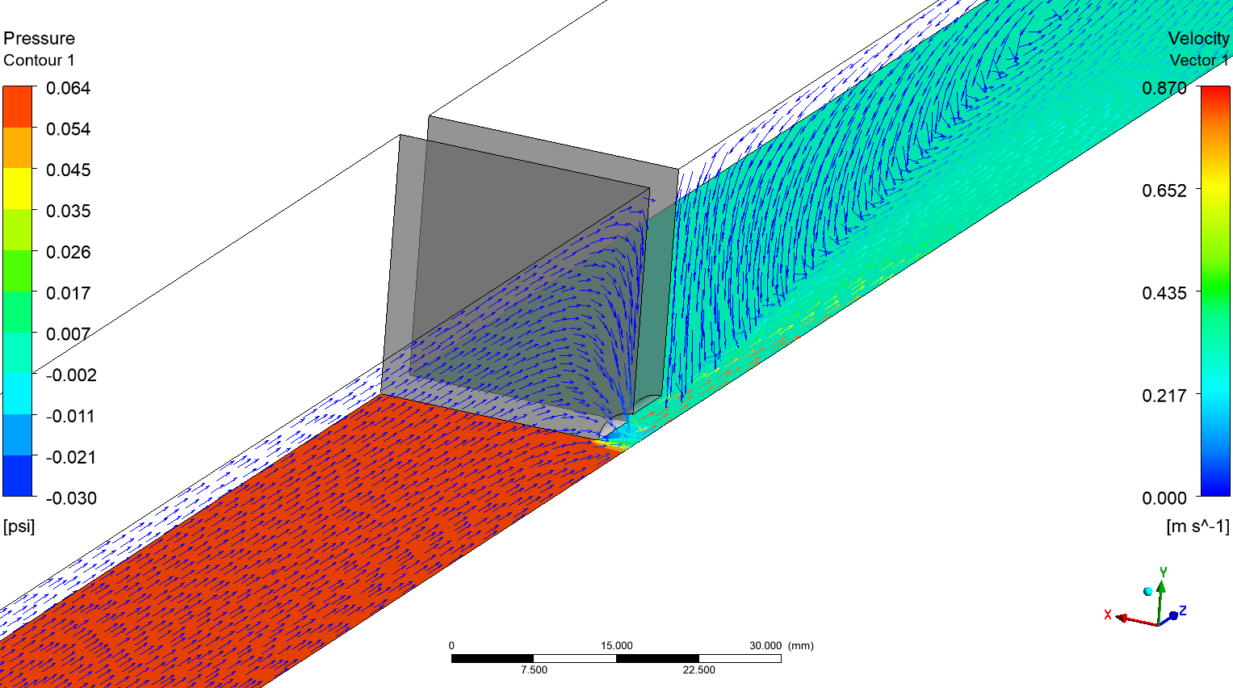
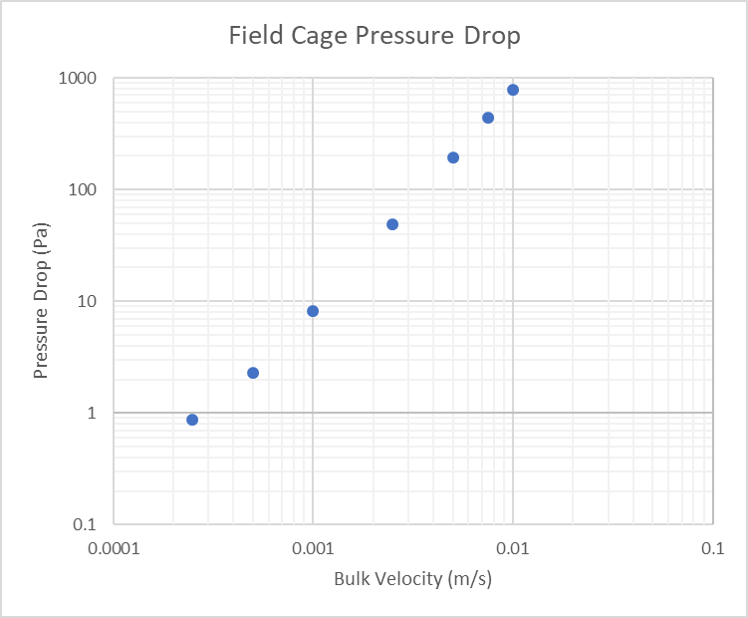
Field Cage Plane Pre-modeled, then represented as porous media with momentum loss source term to simulate flow resistance characteristics.

Slide 14
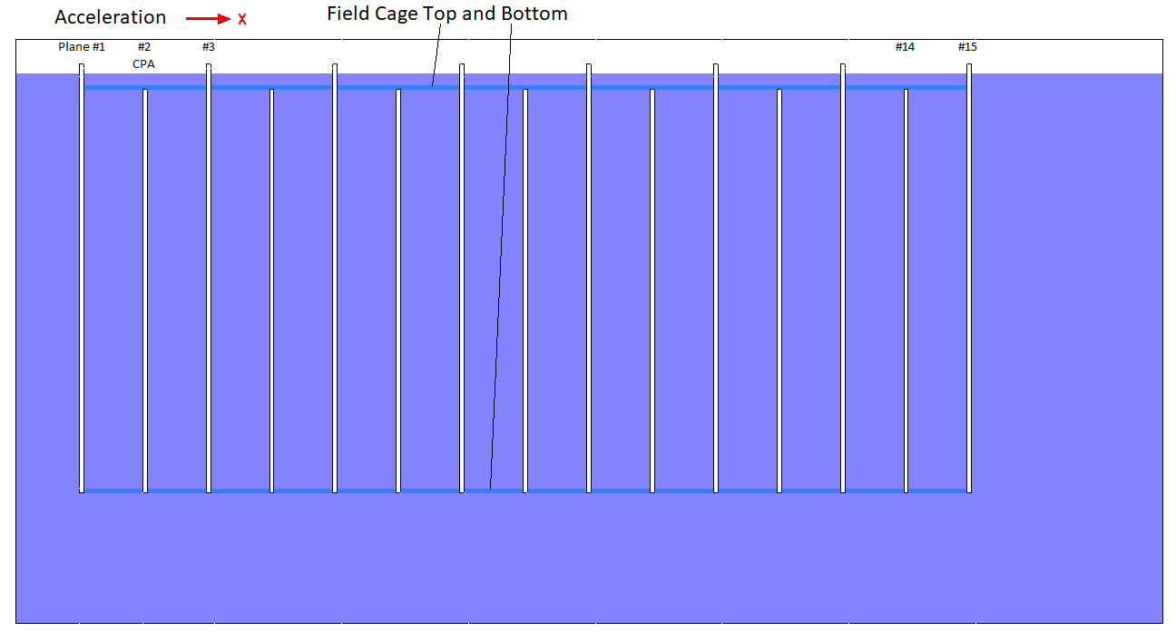
2D Model with APA and CPA Planes + Field Cages inserted into model

Slide 15
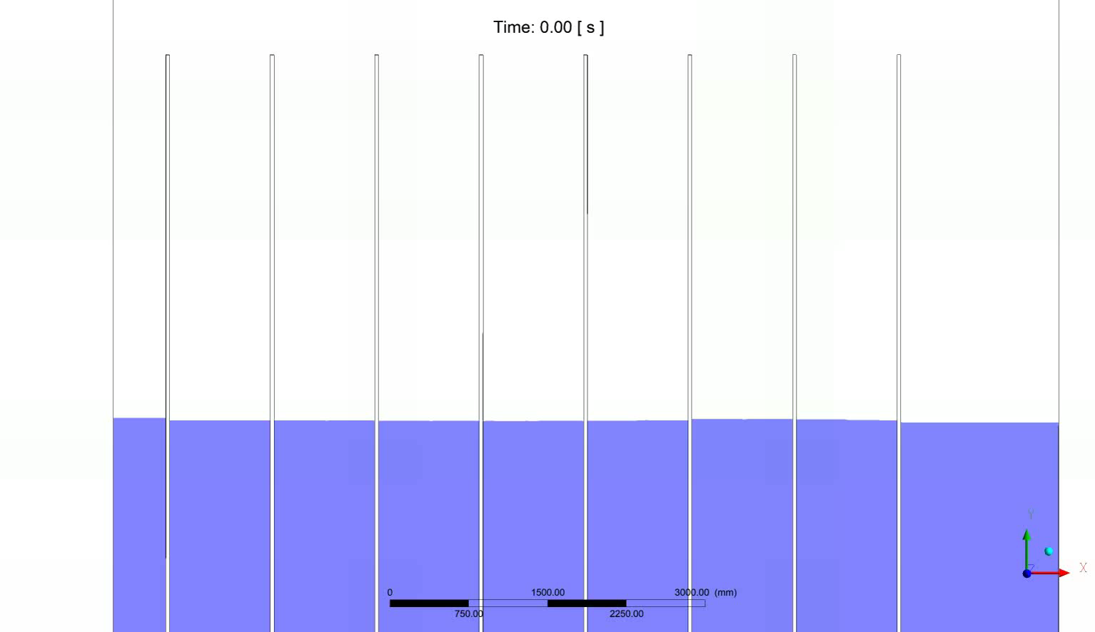
Animation of liquid level: Vertical direction Scaled x50 (3.6 cm/s^2)
Max @ 2.6 sec: 39.5mm wave height, which is slightly higher then empty tank case.
We see much more damping in this configuration than the empty tank.

Slide 16
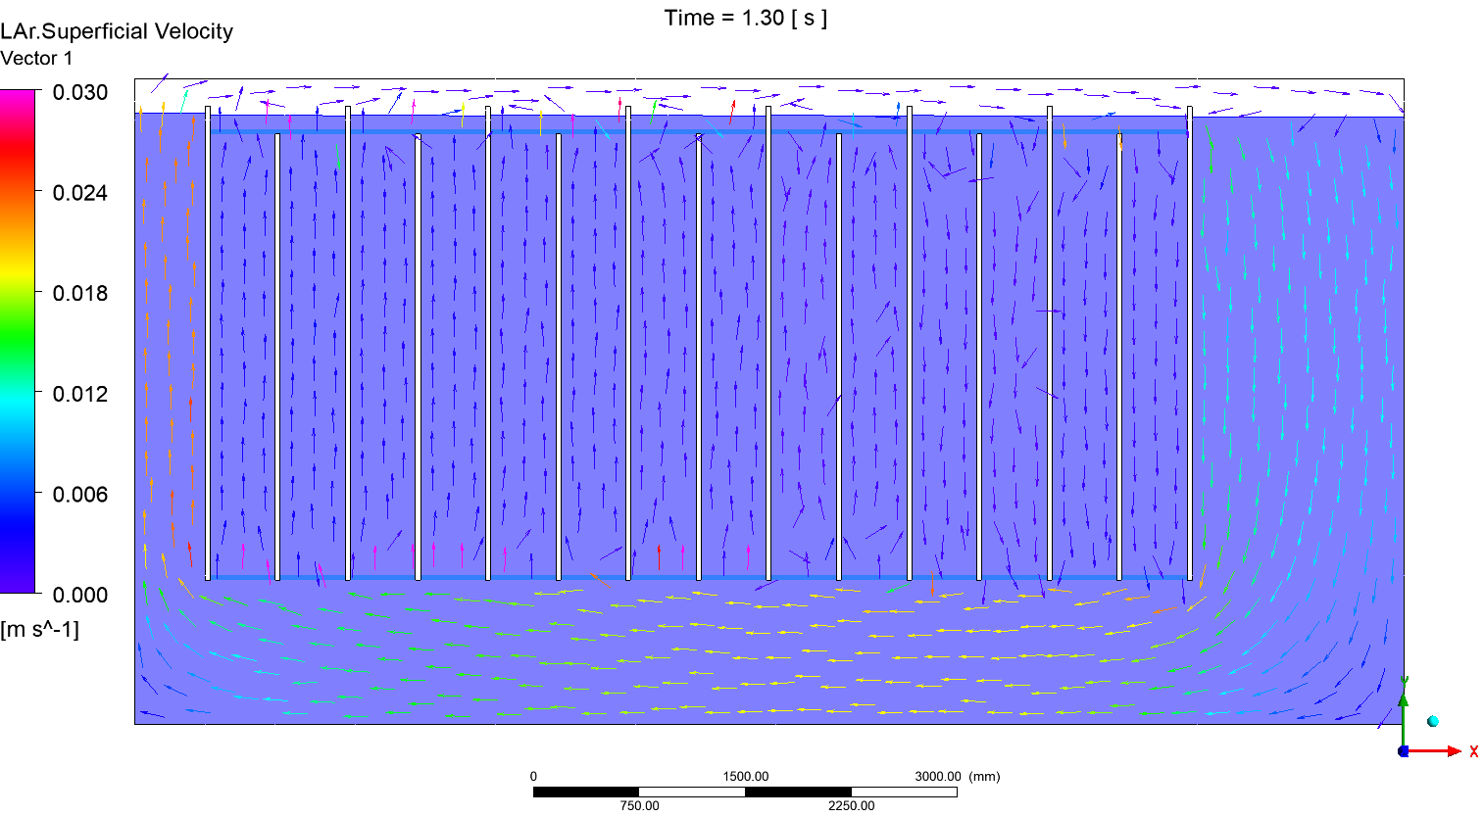
Velocity is max @ 1.3 sec (half the time of max wave height) (3.6 cm/s^2)

Slide 17
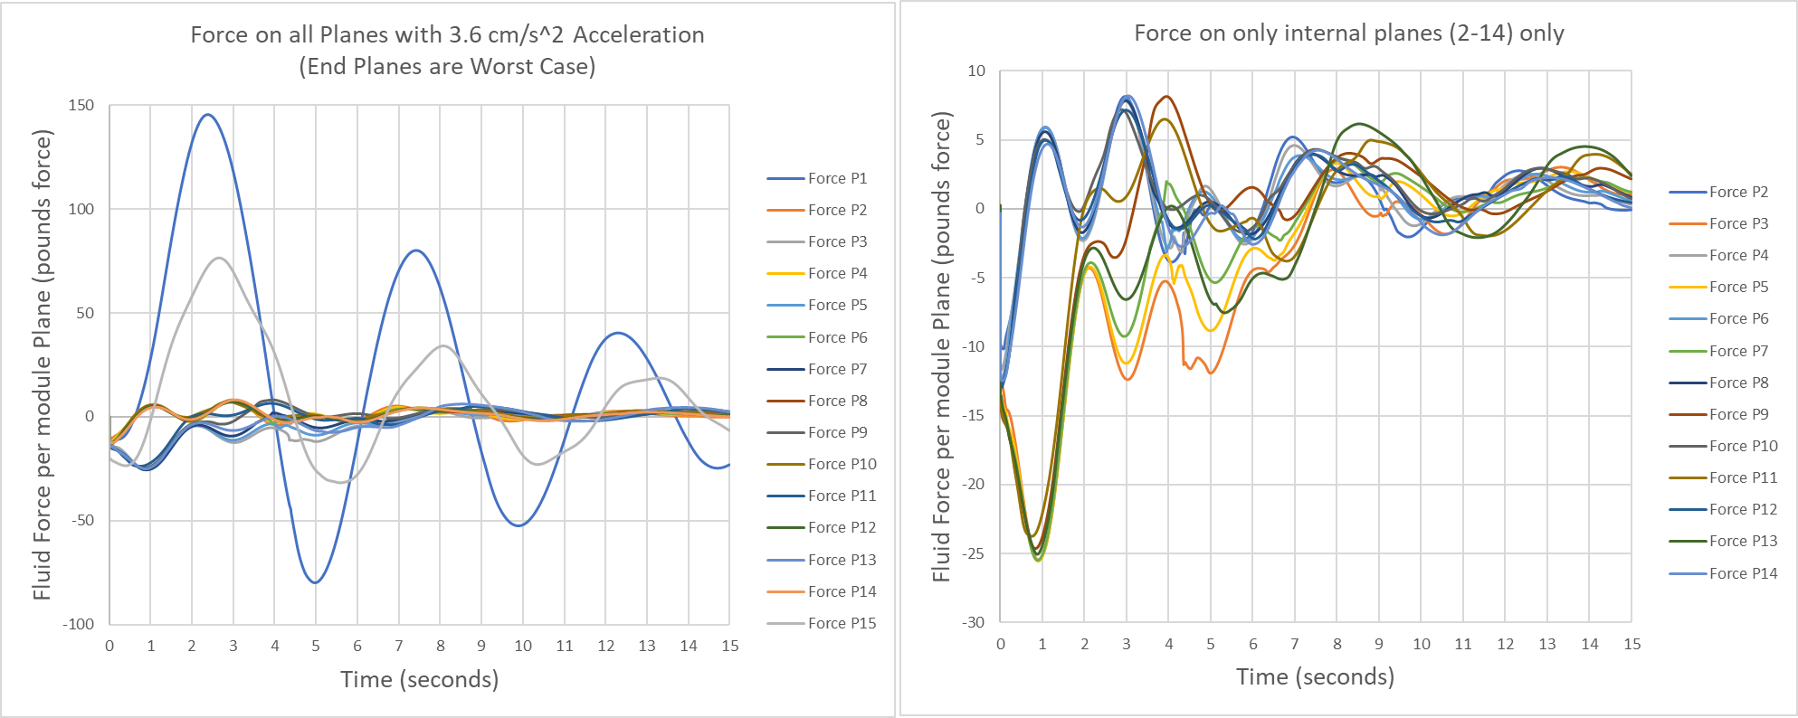
Forces on Planes: End Planes See Largest DeltaP as the outer liquid levels change much more than the liquid levels in each module due to the field cage planes restricting flow in and out of the module volume.
Very High Damping means resonance is not a concern.
= 0.0292 psi DP on Plane 1

Slide 18
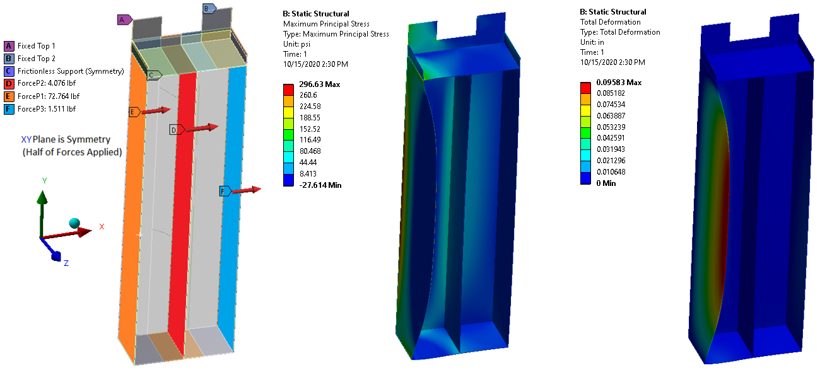
Simplified FEA Model: Basic Dimensions of Module used
Everything is 0.635 cm thick G10. Only half of module modeled due to symmetry
Max +X forces on Plane 1, 2, and 3 applied, Module Fixed At Top of Extensions

Slide 19
Conclusion and Other Considerations
  Accelerations for Wave = Ullage Height * 10% = 3.95 cm
    ~3.6 cm/s^2 maximum for module filled cryostat.
    Wave height linear with acceleration in both empty case, and module filed case.
  At this 3.6 cm/s^2 acceleration, the max force on Plane 1 is 145.5 lbf.
    Stresses and Deformation are low in simple FEA model
    Forces are linear in empty case as well as module filed case.
      Module stresses and deformations would therefore be linear as well.
      Force to accelerate module itself is negligible compared to the fluid force from acceleration
  High Damping of fluid sloshing with modules
    Resonance is not a concern.
    Other vibrational forces not of concern for resonance, and will only make very small ripples on surface
  Water vs LAr: Fluid forces are linear with fluid density (72% forces with water vs LAr)

Slide 20
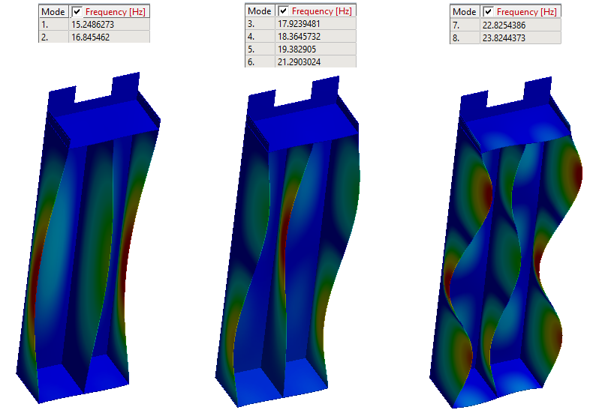
Modal Analysis Shows 15.2Hz is the lowest natural frequency for these simplified 0.635 cm G10 Sheets. LAr will greatly damp any resonances below the liquid level.

Slide 21
LArTPC CFD Simulation – Fluid Sloshing
Part 3 – (1/2 Scale Model = 7.08ft LAr depth)
3.6 cm/s^2 Acceleration
Field Cage flow resistance is identical to full model (not scaled)
Erik Voirin
10/20/2020

Slide 22

Velocity and main frequency of sloshing scale to ScaleSize^0.5.
Not perfect, but a close approximation with this limited study.
(3.6 cm/s^2)

Slide 23
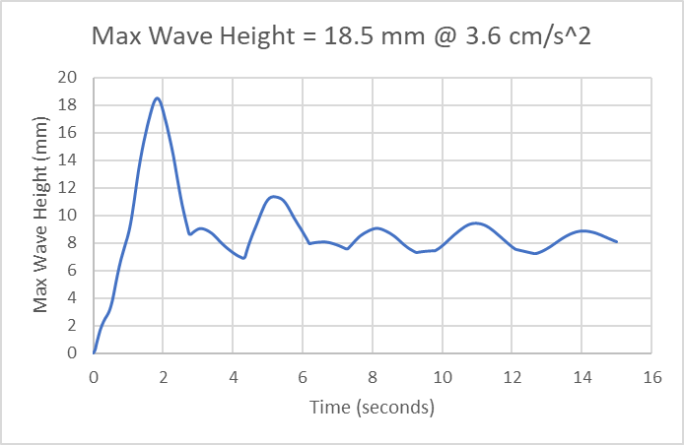
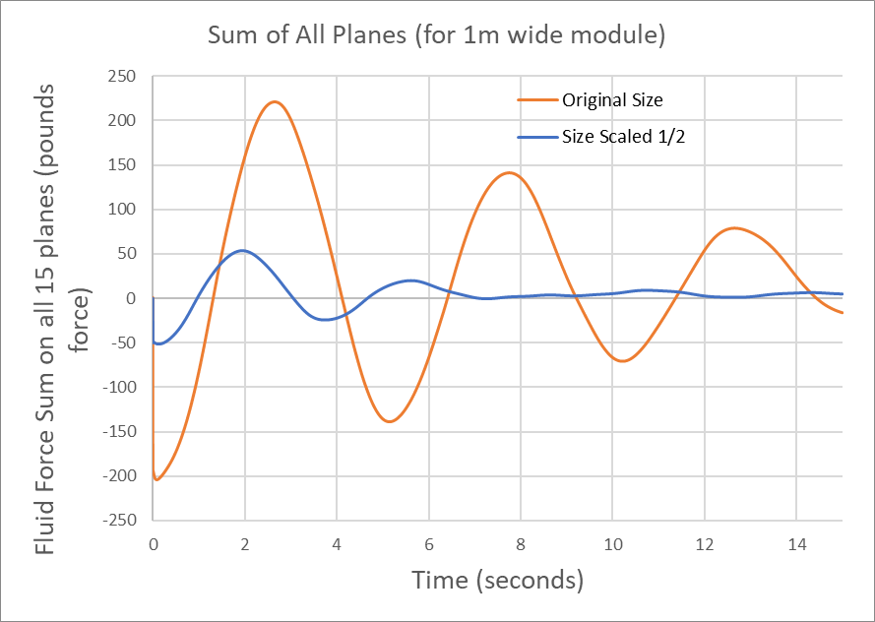
Wave Height scales linear with Size.
This matches our previous correlation of being linear with L_{c} (Length of cryostat)
~39.5mm with full scale
~18.5 mm with ½ scale
(about half, but with more damping)
Delta Pressure on planes scales linearly with Size This matches our previous correlation of being linear with L_{c} (Length of cryostat)
Forces on 1m wide planes are average of about ¼ that of original model. (half the DP x half the plane depth, 2D model) Not perfect, as there are several changing frequencies of sloshing and damping

Slide 24



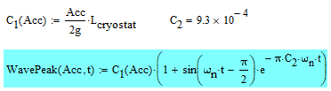
Empty Tank Scale Model: Wave parameters scale just like model with modules inside
Max Wave height occurs on wall opposite of movement direction
L_{c} = Length of cryostat in movement direction = L_{cryostat}
Wave Height and Internal DeltaP are linear with Acceleration and Lc
  Delta P also Linear with fluid Density
Wave Period Proportional to L_{c}^0.5
Max Wave Height Equation (height of wave on wall opposite of movement direction

Slide 25
Backup Slides / Additional info

Slide 26
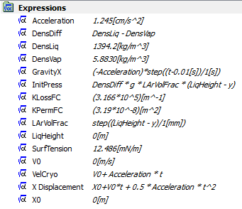
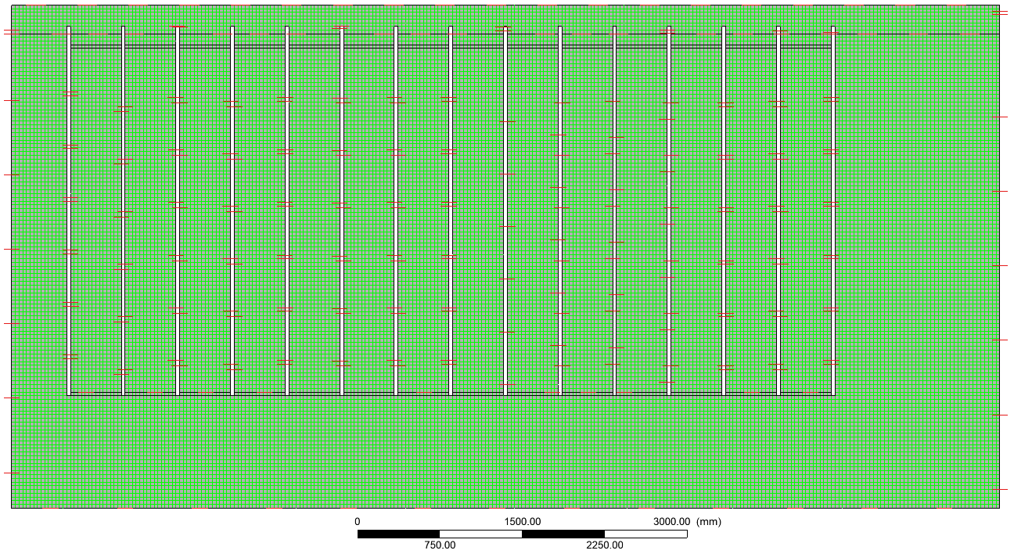
Additional Slides / Model Information.
Expressions Used in Fluid Setup Numerical Mesh; 3.5 cm structured Hex Grid
Time Steps: Adaptive time steps based on numerical convergence
4 iteration minimum per time step, 10 Max. Step Limits: 0.5 ms to 5 ms.
CFD Solver: ANSYS CFX v19.2

Slide 27
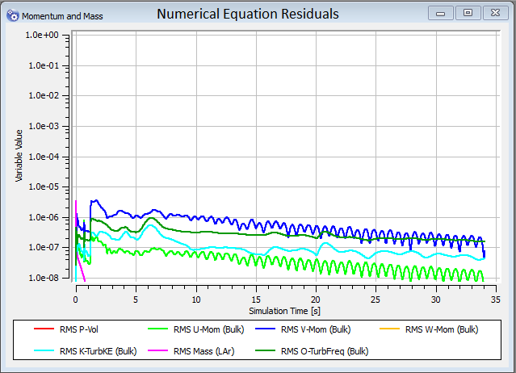
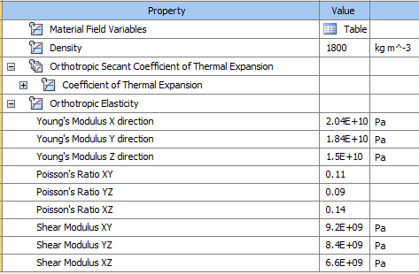
Excellent numerical convergence throughout simulation
G10 Properties in FEA
  Z is out of plane direction

