Slide 1
Some ¹³⁶Xe considerations for 0νββ at kTonne scale
Eric Church

Slide 2
Two topics
Xenon collection at the kTon scale
Where I only want to add some color to the situation …
Solar ν Background
In principle, the irreducible background to 0νββ
Short exercise to show this bkgd is likely removable in an HPGXeTPC, ala NEXT

Slide 3
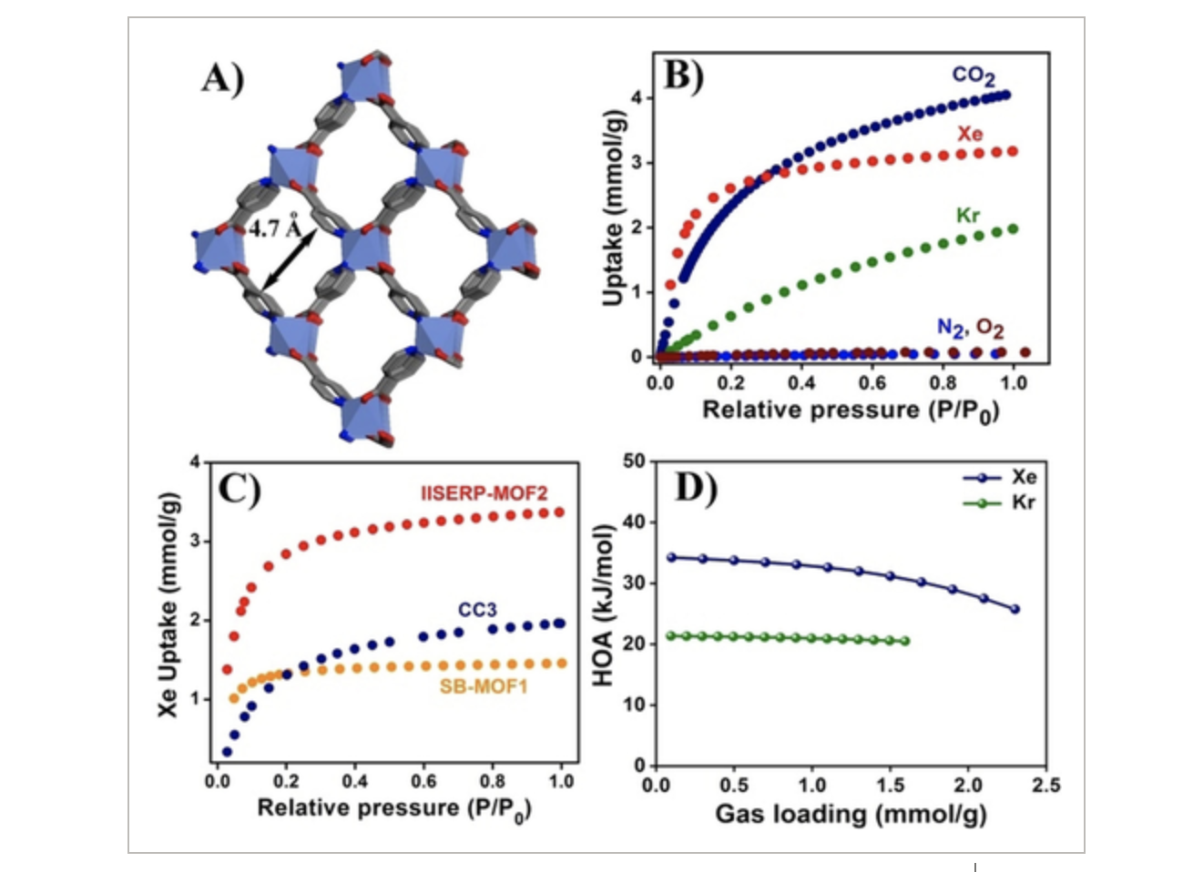
PNNL has world experts in MOFs
This MOF business looks hard.
10 yr/$100million of R&D has yielded a material which, if you have 100s of megatons of it, can get you a ktonne Xe from air. 1E9 Joules required to then get it out of the MOF. Assuming no losses.
Bonus is that you also get 50x more CO2 and probably at least ppm levels of O2 and N2. These must be removed for TPC to properly function.
Compare to charcoal.

Slide 4
Traditional method on the other hand ..
Buying it on the market is ~$5k/L
=> ~1.2 E9 USD for 1 ktonne
This is … a lot of money.
Also presumes current Oxygen production plants can parasitically create this much xenon, as is done now at much smaller scales.
PNNL uses cc’s of xenon in International Monitoring Stations to support the Comprehensive Test Ban Treaty.
Can market demand for Krypton (automobile headlights!), Xenon (anesthesia!) create ”single” purpose plants that drive this price down?
Dunno

Slide 5
PNNL would be happy to host a workshop
Where we can think through large scale xenon collection
There is obviously an interested physics community
There’s a whole LOI/WhitePaper group now meeting monthly to discuss this
Belgians (SCK-CEN company), Germans, others we could bring to Washington who have an interest in this.
If there’s interest in such a workshop, let’s do it post-vaccine
Have said nothing yet about isotopic separation
Which I’m told is its own minefield
Please express interest to eric.church@pnnl.gov or richard.saldanha@pnnl.gov

Slide 6
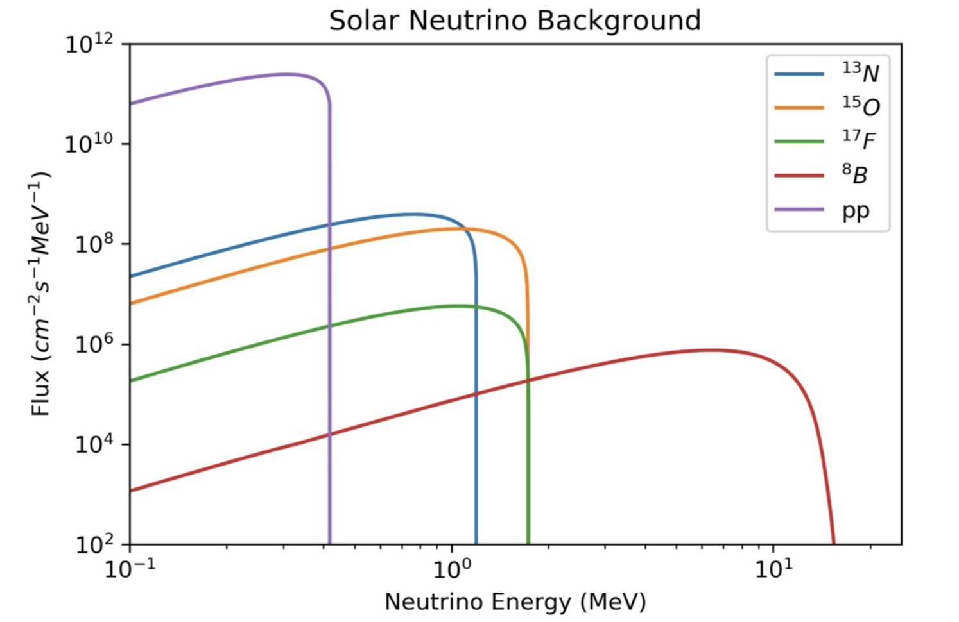
Solar neutrino background at Q_{ββ}=2.48 MeV
⁸B is the culprit.
hep is negligible
pp, CNO and everything else gives more events but quite below endpoint
b.o.e. calculation (Giunti and Kim xsection) gives 0.2 evts/keV/kT/yr
An ambitious 1% resolution suggests a 25 keV ROI
=> 5 evts/yr/kT in the ROI

Slide 7
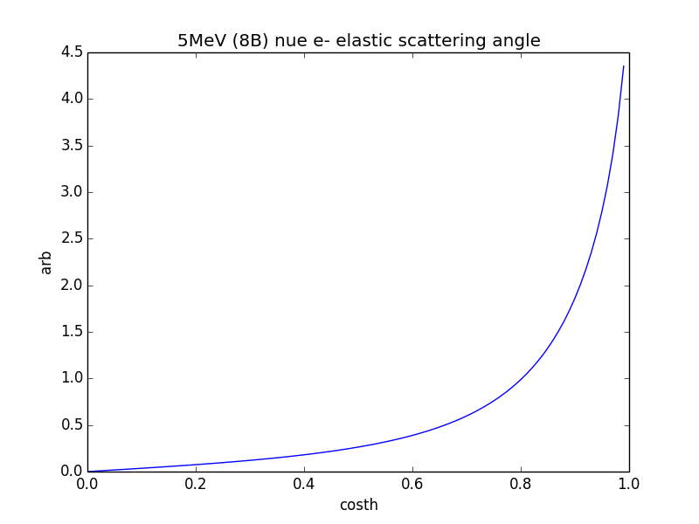
Solar nu bkgd removal in an HPGXe
The nue-e elastic x-section yields a mostly flat e⁻ Energy spectrum out to 10 MeV.
Slight hump at E=0.
In a 10-bar HPGXe detector this means ~80% of e⁻ tracks are at least, say, 10 cm long and give a direction.
The true e- scattering angle wrt Sun direction is quite peaked. The reco’d version is of course to be shown, but should be mostly faithful.
One imagines a very efficient cut using this direction and requiring single-track topology (one Bragg peak, not two) can cut these 5 evts to close to 0.
Of course, it goes w.o. saying that, in general, single e bkgd events are largely removable from topology in NEXT-like detectors.

Slide 8
Solar nuCC in Xenon, by the way
The solar CC xs seems to be as much as 12x in fact bigger than the elastic scattering xs (1E-44 cm^2) at the endpoint, producing a 2 MeV KE e- and then a gamma. Should be rejectable for a few reasons in an HPGXe TPC.
https://arxiv.org/pdf/2009.00535.pdf

