Slide 1
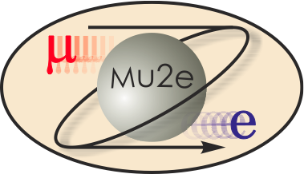
-II
Mu2e-II Workshop (vi) - Introduction
Frank Porter
December 9, 2020
DocDB-36285
This meeting will be recorded

Slide 2
Mu2e-II workshops
Workshop dates | Links to recordings
Thursday, June 18 https://mu2e-docdb.fnal.gov/cgi-bin/sso/DisplayMeeting?conferenceid=9755 | AM: https://caltech.box.com/s/b67edbgtxofaujuooorafm4kfq9owhjd PM: https://caltech.box.com/s/vnsm9nh7qroznt3n6q5n3sn4ut1bswo5
Wednesday, July 29 https://indico.fnal.gov/event/44541/ | https://caltech.box.com/s/k45jik5i7uztq2letmaxb93fq3arl0kf
Wednesday, August 26 https://indico.fnal.gov/event/44997/ | https://caltech.box.com/s/ws8hkzmjo96xlnile8q27yphb87nlpjp
Wednesday, September 23 https://indico.fnal.gov/event/45632/ | https://caltech.zoom.us/rec/play/_xbOzK448M0VhhDArf9UE8AjiOKdshh4et0tYOOhtViPn3qveG95CkQUOHQ0_SzeJ8pxVzw5M0PoIvjD.I-zdhaNXvu3i5Sll?autoplay=true&startTime=1600873315000
Wednesday, October 28 https://indico.fnal.gov/event/45937/ | https://caltech.zoom.us/rec/share/zCGxa2uJwAKwONXm7pyiqrrLPJvIxTaNHkY2cxHRDjtmb_mWOYqraV8D9ynUMATk.JNeSkLhSj4-Hfcof
Wednesday, December 9 https://indico.fnal.gov/event/46433/
Wednesday, January 27

Slide 3
Working Groups
Mu2e-II working groups | Convenors
Theory mu2eii-theory@fnal.gov | Julian Heeck Lorenzo Calibbi
Accelerator (including PS, production target, extinction) mu2e-ii-accelerator@fnal.gov | Karie Badgley David Neuffer Eric Prebys
Radiation mitigation (includes radiation simulation) mu2eii-radiation@fnal.gov | Vitaly Pronskikh Michael MacKenzie Stefan Mueller
Tracker mu2eii-tracker@fnal.gov | Daniel Ambrose Giovanni Tassielli
Calorimeter (and STM?) mu2eii-calorimeter@listserv.fnal.gov | Ivano Sarra Luca Morescalchi David Hitlin
CRV mu2eii-crv@listserv.fnal.gov | Yuri Oksuzian Craig Dukes
Sensitivity estimate (includes simulation, stopping target) mu2e-ii-sensitivity@listserv.fnal.gov | Lisa Goodenough Sophie Middleton Yuri Oksuzian
Trigger and DAQ mu2eii-tdaq@listserv.fnal.gov | Giani Pezzullo Antonio Gioiosa

Slide 4
Accelerator
Karie Badgley, Convenor, FNAL
David Neuffer, Convenor, FNAL
Eric Prebys, Convenor, UCD
Mary Anne Cummings, Muons, Inc.
Keegan Harrig, UCD
Andrei Gaponenko, FNAL
Vadim Kashikhin, FNAL
Kevin Lynch, CUNY
James Popp, CUNY
Diktys Stratakis, FNAL

Slide 5
Radiation simulation and mitigation
Michael MacKenzie, Convenor, Northwestern
Vitaly Pronskikh, Convenor, FNAL
Stefan Mueller, Convenor, HZDR
James Popp, CUNY
David Pushka, FNAL
Anna Ferrari, Reuven Rachamin, HZDR
Vadim Kashikhin, FNAL
Yuri Oksuzian – CRV
Sophie Middleton – Sensitivity
Giani Pezzullo - TDAQ

Slide 6
Theory
Julian Heeck, Convenor, Uva
Lorenzo Calibbi, Convenor, Nankai U
Robert Szafron, CERN
Yuichi Uesaka, Kyushu Sangyo University

Slide 7
Tracker
Daniel Ambrose, Convenor, UMinn
Giovanni Tassielli, Convenor, INFN Lecce
David Brown, LBNL
Brendan Casey, FNAL
Manolis Kargiantoulakis, FNAL
Mete Yucel, FNAL
Tracker meetings every two weeks on Tuesdays 11AM CT
Next meeting Jan 5, 2021

Slide 8
Calorimeter
David Hitlin, Convenor, Caltech
Luca Morescalchi, Convenor, INFN Pisa
Ivano Sarra, Convenor, LNF
Leo Borrell, Bertrand Echenard, Dexu Lin, Sophie Middleton, James Oyang, Frank Porter, Liyuan Zhang, Renyuan Zhu, Caltech
Eleonara Diociaiuti, Raffaella Donghia, Simona Giovannella, Fabio Happacher, Stefano Miscetti, LNF
Stefano Di Falco, Simone Donati, Antonio Gioiosa, Elena Pedreschi, Franco Spinella, INFN Pisa
Next calorimeter meeting Jan 12, 2021, 1000 CT

Slide 9
Cosmic Ray Veto
Craig Dukes, Convenor, Uva
Yuri Oksuzian, Convenor, ANL
Karen Byrum, Simon Corrodi, Peter Winter, Lei Xia, ANL
Raymond Culbertson, Gary Drake, Anna Pla-Dalmau, Greg Rakness, FNAL
Akram Artikov, Yuri Davydov, JINR, Dubna
Timothy Bolton, Glenn Horton-Smith, Yurii Maravin, Kres Neely, KSU
Gerald Blazey, Kurt Francis, Sergey Uzunyan, Vishnu Zutshi, NIU
Merrill Jenkins, U South Alabama
Steven Boi, Ralf Ehrlich, Stephen Goadhouse, Craig Group, UVa
CRV workshop: Friday, December 11 (10-12 CT) (contact: Yuri Oksuzian)

Slide 10
Trigger/DAQ
Gianantonio Pezzullo, Convenor, Yale
Antonio Gioiosa, Convenor, INFN Pisa
Richard Bonventre, LBNL
Rebecca Chislett, UCL, Tracker
Raffaella Donghia, LNF
Bertrand Echenard, Caltech
Ryan Rivera, FNAL
Franco Spinella, INFN Pisa – Calorimeter
Craig Dukes, UVa - CRV

Slide 11
Sensitivity estimates
Lisa Goodenough, Convenor, FNAL
Sophie Middleton, Convenor, Caltech
Yuri Oksuzian, Convenor, ANL
Rebecca Chislett, UCL
Michael Hedges, Purdue
Cole Kampa, Northwestern
Manolis Kargiantoulakis, FNAL
Michael MacKenzie, Northwestern

Slide 12
Production solenoid
Karie Badgley has agreed to co-convene accelerator working group
Vadim Kashikhin has joined the accelerator and the radiation working groups
Vadim Kashikhin will make a presentation at this workshop on the production solenoid

Slide 13
Contributed Paper
Next (and final) product is Contributed Paper, deadline July 31, 2021
Schedule subject to change according to ongoing community discussion
Desirable to have something ready as input to Rare Frontier meeting in early June 2021
Contributed papers are required to be on the arXiv
Planning to produce a decent draft by May 1, 2021
Will prepare an outline and framework on Overleaf (read link):
https://www.overleaf.com/read/mrbgttkmfgvq
Ask me if you would like edit link
https://snowmass21.org/submissions/start

Slide 14
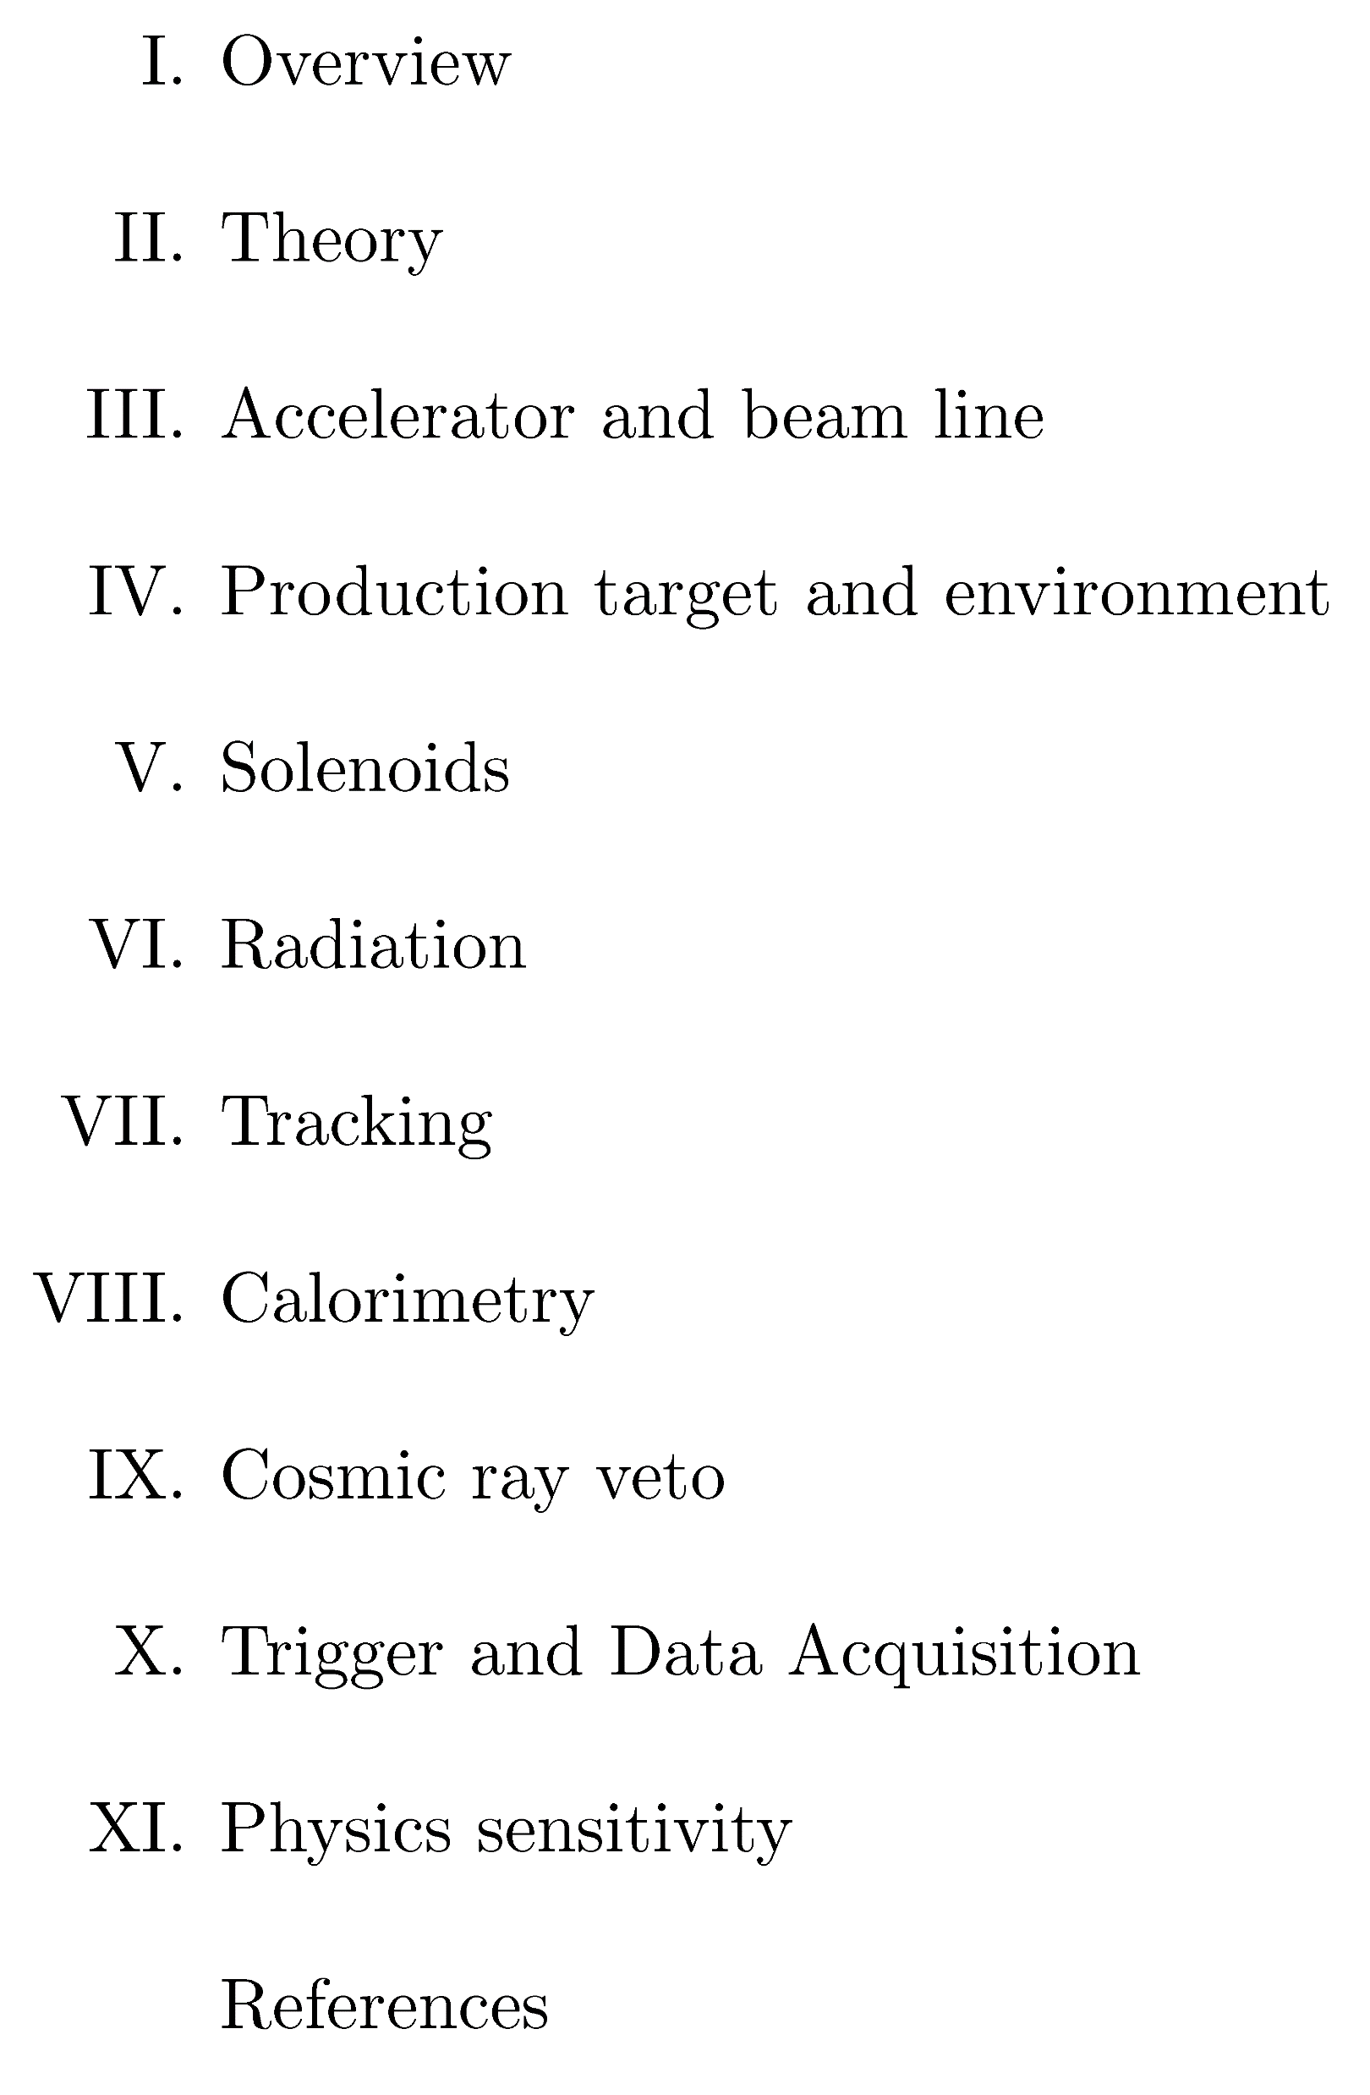
Contributed Paper – Proposed Top Level Outline

Slide 15
Future Mu2e-II/Snowmass21 Events of interest
Thursday, December 10, 2020 (9AM-1PMCT): CLFV – CLFV with high intensity muon factory
CRV workshop: Friday, December 11 (10-12 CT) (contact: Yuri Oksuzian)
Tuesday, December 15, 2020 (1-3PM CT) Beam Physics with a Booster Accumulator Ring
January TBD, 2021 (10-12 CT): AF2/AF5/AF7/RP/NP target workshop (contact: Eric Prebys) https://indico.fnal.gov/event/46752/
Wednesday, January 27, 2021 (10AM-2PM CT): Mu2e-II workshop
Early June 2021 at Cincinatti: Rare/precision frontier meeting
2021 Snowmass Summer Study (July 11 - 20, 2021 at UW Seattle)

Slide 16
Mu2e-II Communication
Public wiki page: https://mu2eiiwiki.fnal.gov
Please email Lisa if you wish to have write access
Private Wiki
Has been created:
https://mu2eii-internal-wiki.fnal.gov/wiki/Main_Page
SSO log-on
Need to contact Lisa or Frank to request access
Help request to find out how to manage this
Want to add a Mu2e-II calendar with links
Mu2e-II mailing list: mu2eii@listserv.fnal.gov
Mu2e-II Slack channel invite link:
https://join.slack.com/t/caltech-tka1525/shared_invite/zt-glsr3405-OondWg0KCpBoUJwIr2uyJw

Slide 17
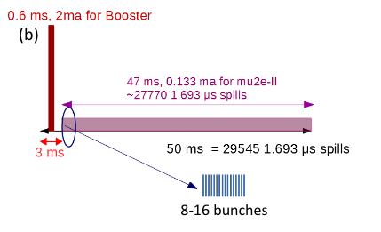
Proposed Mu2e-II beam nomenclature
Follow accelerator group usage
Beam delivery is different than Mu2e
Quantity | Name
Beam in one PIP-II RF bucket (162.5 MHz) | Bunch
PIP-II pulse (20 Hz/0.55 ms) | Pulse (but see below)*
Mu2e-II repetition (e.g., 1693 ns) | Spill (also pulse, but see above)**
Set of bunches in one spill (e.g., 8) | Burst (also pulse, but see above)**
*One PIP-II pulse is about 27770 Mu2e-II spills; suggest saying “PIP-II pulse”
to avoid confusion.
**”Pulse” may be used when distinction is not important
Eric Prebys https://indico.fnal.gov/event/44997/
David Neuffer, DocDB 33896

Slide 18
December 9 Mu2e-II workshop agenda
When (CT) | Who | What
10:00-10:20 | Frank Porter | Introduction
10:20-11:00 | Vadim Kashikhin | Production solenoid
11:00-11:15 | Sophie Middleton | Sensitivity
11:15-11:45 | Julian Heeck | Theory
11:45-12:00 | Giani/Antonio | TDAQ
11:55-12:30 | All | Break
12:30-12:40 | Ivano Sarra | Calorimeter
12:40-13:05 | Daniel Ambrose | Tracker (report from Dec 8 workshop)
13:05-13:10 | Yuri Oksuzian | CRV
13:10-13:25 | David Neuffer | Accelerator
13:25-14:00 | Vitaly (20 min)/Michael/Stefan | Radiation & targets (20 min Vitaly + update)
14:00 | All | End
Indico timetable at: https://indico.fnal.gov/event/46433/

Slide 19
Next Mu2e-II workshop: Wednesday, January 27, 2021

Slide 20
Additional Material

Slide 21
Mu2e-II Snowmass21 Committee
Name | Institution | Email
Dan Ambrose | U Minn | ambrose0028@gmail.com
Rebecca Chislett | UC London | rebecca.chislett@ucl.ac.uk
Lisa Goodenough | FNAL | goodenou@fnal.gov
Julian Heeck | U Virginia | julian.heeck@gmail.com
David Neuffer | FNAL | neuffer@fnal.gov
Yuri Oksuzian | ANL | yoksuzian@anl.gov
Frank Porter (chair) | Caltech | fcp@caltech.edu
Giovanni Tassielli | INFN-Lecce | giovani.tassielli@le.infn.it
Robert Bernstein (ex officio) | FNAL | rhbob@fnal.gov
Jim Miller (ex officio) | Boston U | miller@bu.edu

Slide 22
Calendar
Wiki already has a calendar of Mu2e-II workshops:
https://mu2eiiwiki.fnal.gov/wiki/Calendar_of_Workshops
Also, Rare frontier has a calendar:
https://snowmass21.org/rare/start#calendar_of_meetings
Proposing to provide an editable Mu2e-II calendar on the private Wiki page
Working group meetings and workshops
Ad hoc working meetings
Convenor meetings
Committee meetings
Related Snowmass21 events
Include links to Zoom, agendas

