Slide 1
Production Solenoid for Mu2e-II
(2020 update)
Vadim Kashikhin
Mu2e-II Workshop
December 9, 2020

Slide 2
Role of the Production Solenoid
The Mu2e magnet system consists of three large superconducting solenoids. Production Solenoid (PS) is the first magnet in the chain, which collects and focuses pions and muons generated in interactions of an 8-GeV proton beam with a tilted high-Z target and directs them towards Transport Solenoid (TS).
PS performs the following functions in the mu2e:
Maximizes muon yield by efficiently focusing secondary pions and subsequent secondary muons towards the Transport Solenoid (TS) system, in the momentum range to be stopped in the stopping target;
Provides a clear bore for beam line elements such as the primary production target and secondary particle Heat and Radiation Shield (HRS);
Allows the primary proton beam to be steered into primary target; allows outgoing proton beam to exit without striking PS magnet shield.

Slide 3
Possible scenarios for transitioning to Mu2e-II
By the time of the Mu2e-II experiment, the Production Solenoid of the Mu2e-I may already consume a substantial fraction of its absorbed dose budget (i.e. 7 MGy) and become activated.
Even though only one coil will see the peak radiation level, it may be difficult or impossible to perform the following tasks:
  Remove or replace the HRS;
  Transport the magnet to the vendor;
  Disassemble the vacuum vessel and replace the coil(s).
Two most realistic scenarios:
  Use the PS “as is” at the Mu2e-II radiation load with or without the HRS upgrade and with some upgrade of the cryo-system;
  Rebuild the PS entirely (or substantially):
    Depending on the activation level, it may be possible to recycle the vacuum vessel, the thermo-shield and the cold mass supports, but the cold mass will likely have to be replaced.
    Since the new cable and coils will have to be fabricated, it makes sense to design them for the maximum expected radiation load.

Slide 4
Overview of the Mu2e-I Production Solenoid Design

Slide 5
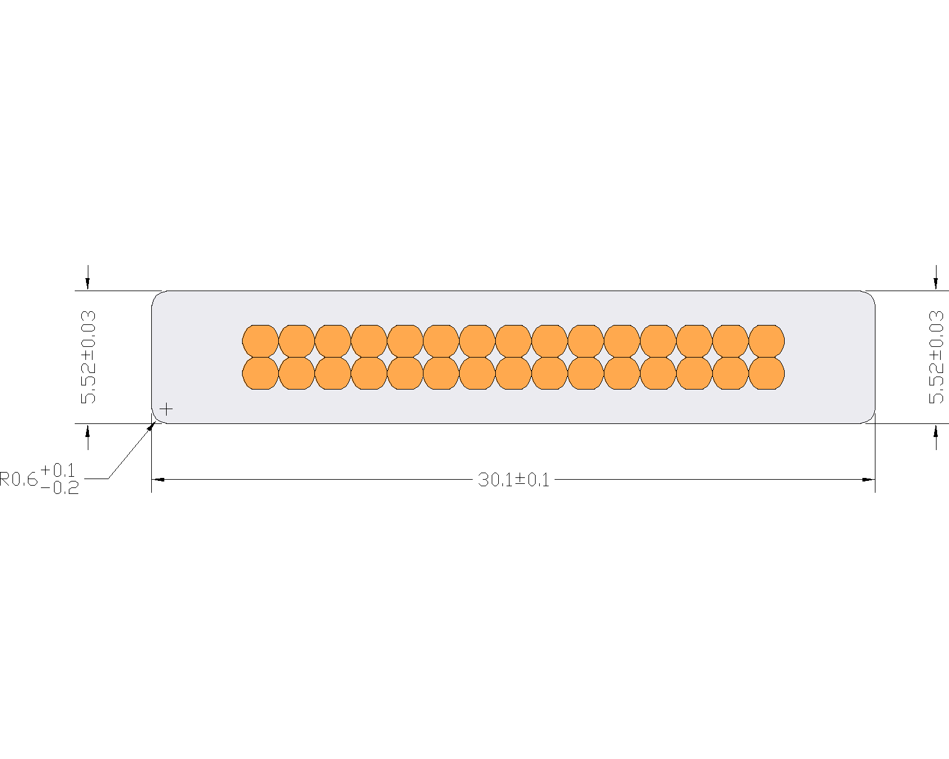
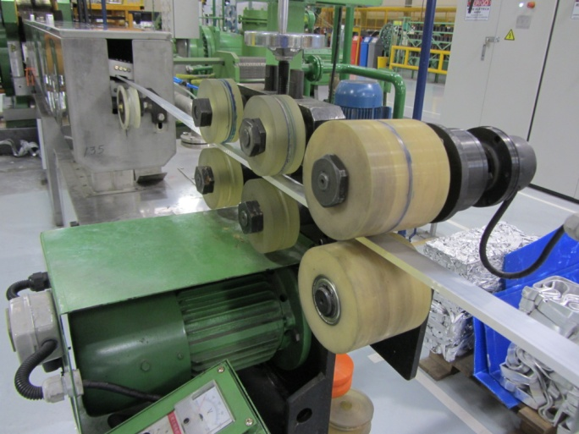
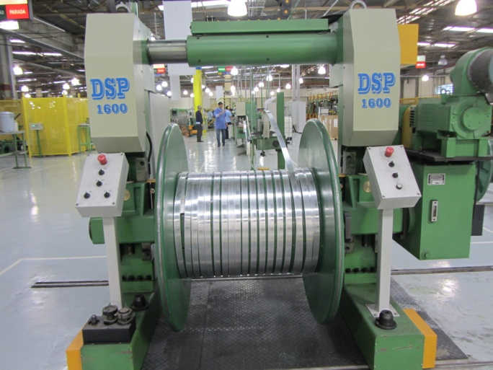
Cable
7 main cable unit lengths and 3 spares, sufficient to replace any coil

Slide 6
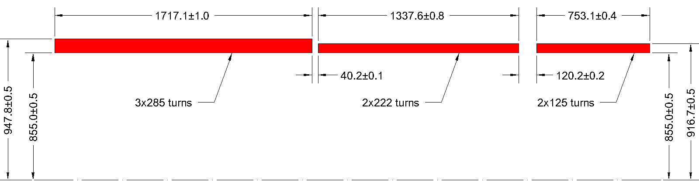
Coils and insulation
Coil envelope: exact number of turns and dimensions are important;
Insulation:
  Must contain 2 layers of polyimide in the cable and ground insulation per the design requirement.
  Must not contain any voids (i.e. be impregnated with epoxy).

Slide 7
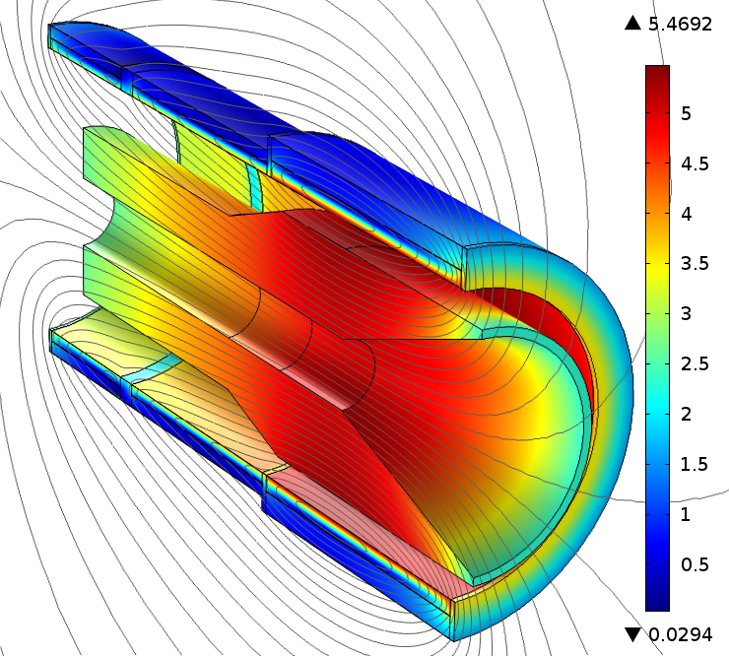
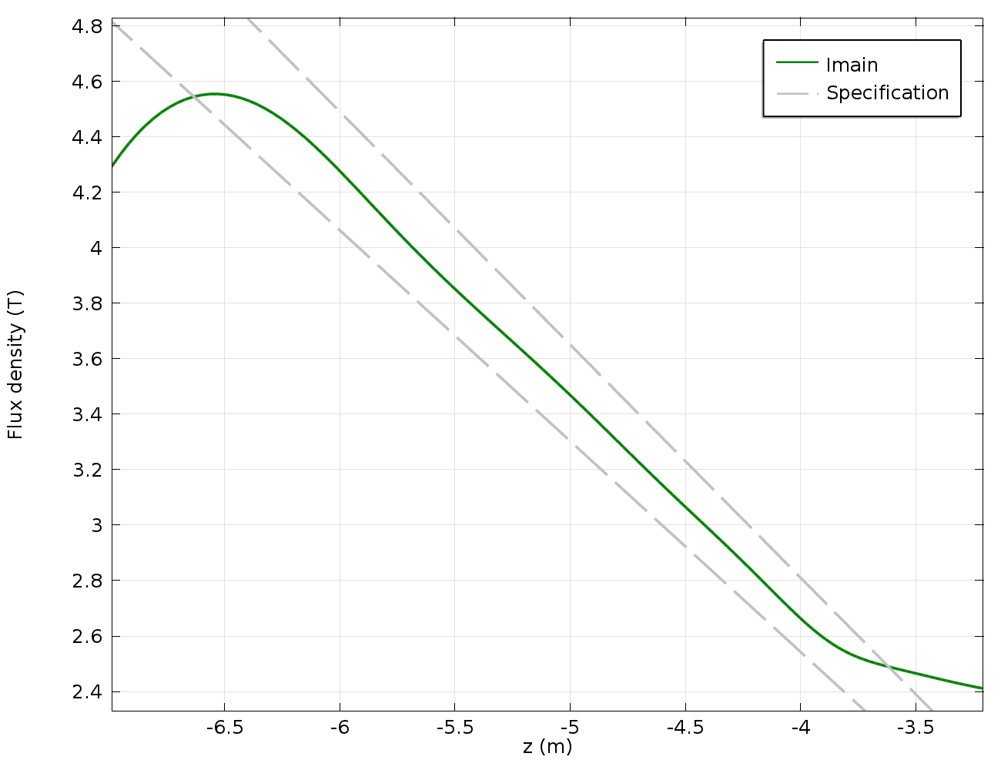
Magnetic field
The magnetic field profile is within the specification;
Radiation shield (shown) made of high-resistivity bronze (magnetic permeability of ≤1.04) has a minor impact on the field quality.

Slide 8
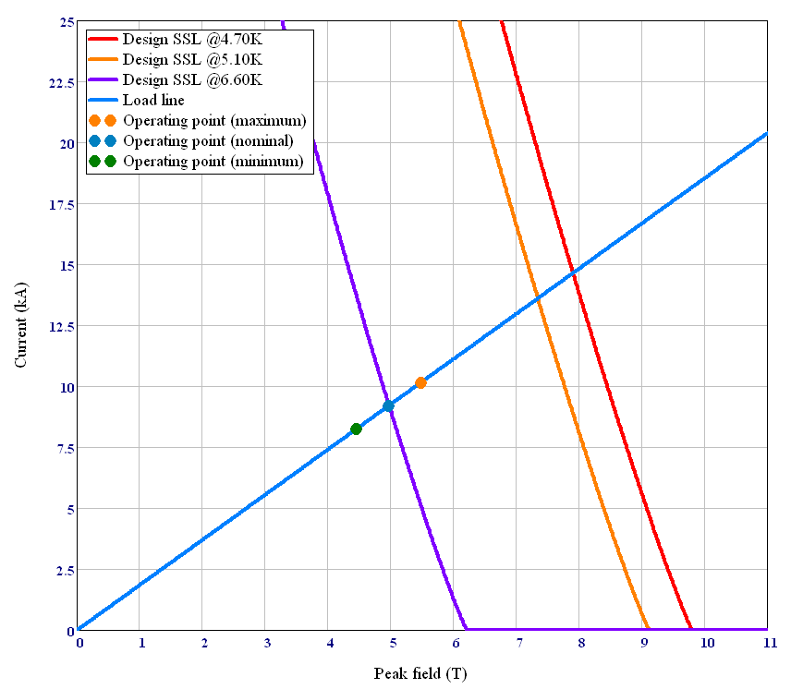
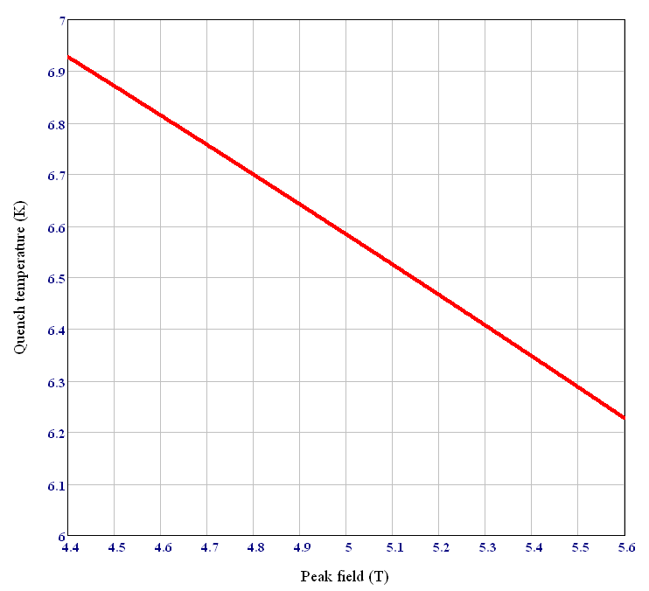
Operating margins
Maximum current
Nominal current
The 1.50 K thermal margin must be maintained during the nominal operation per the magnet requirements;
It defines the maximum allowed coil temperature of 5.10 K (at the nominal current).

Slide 9
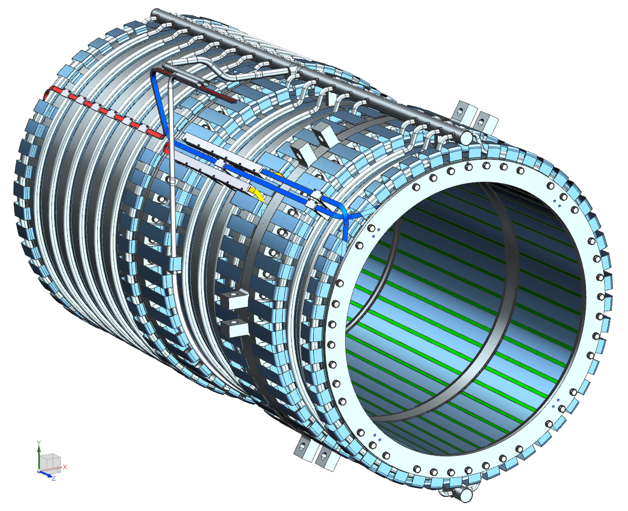
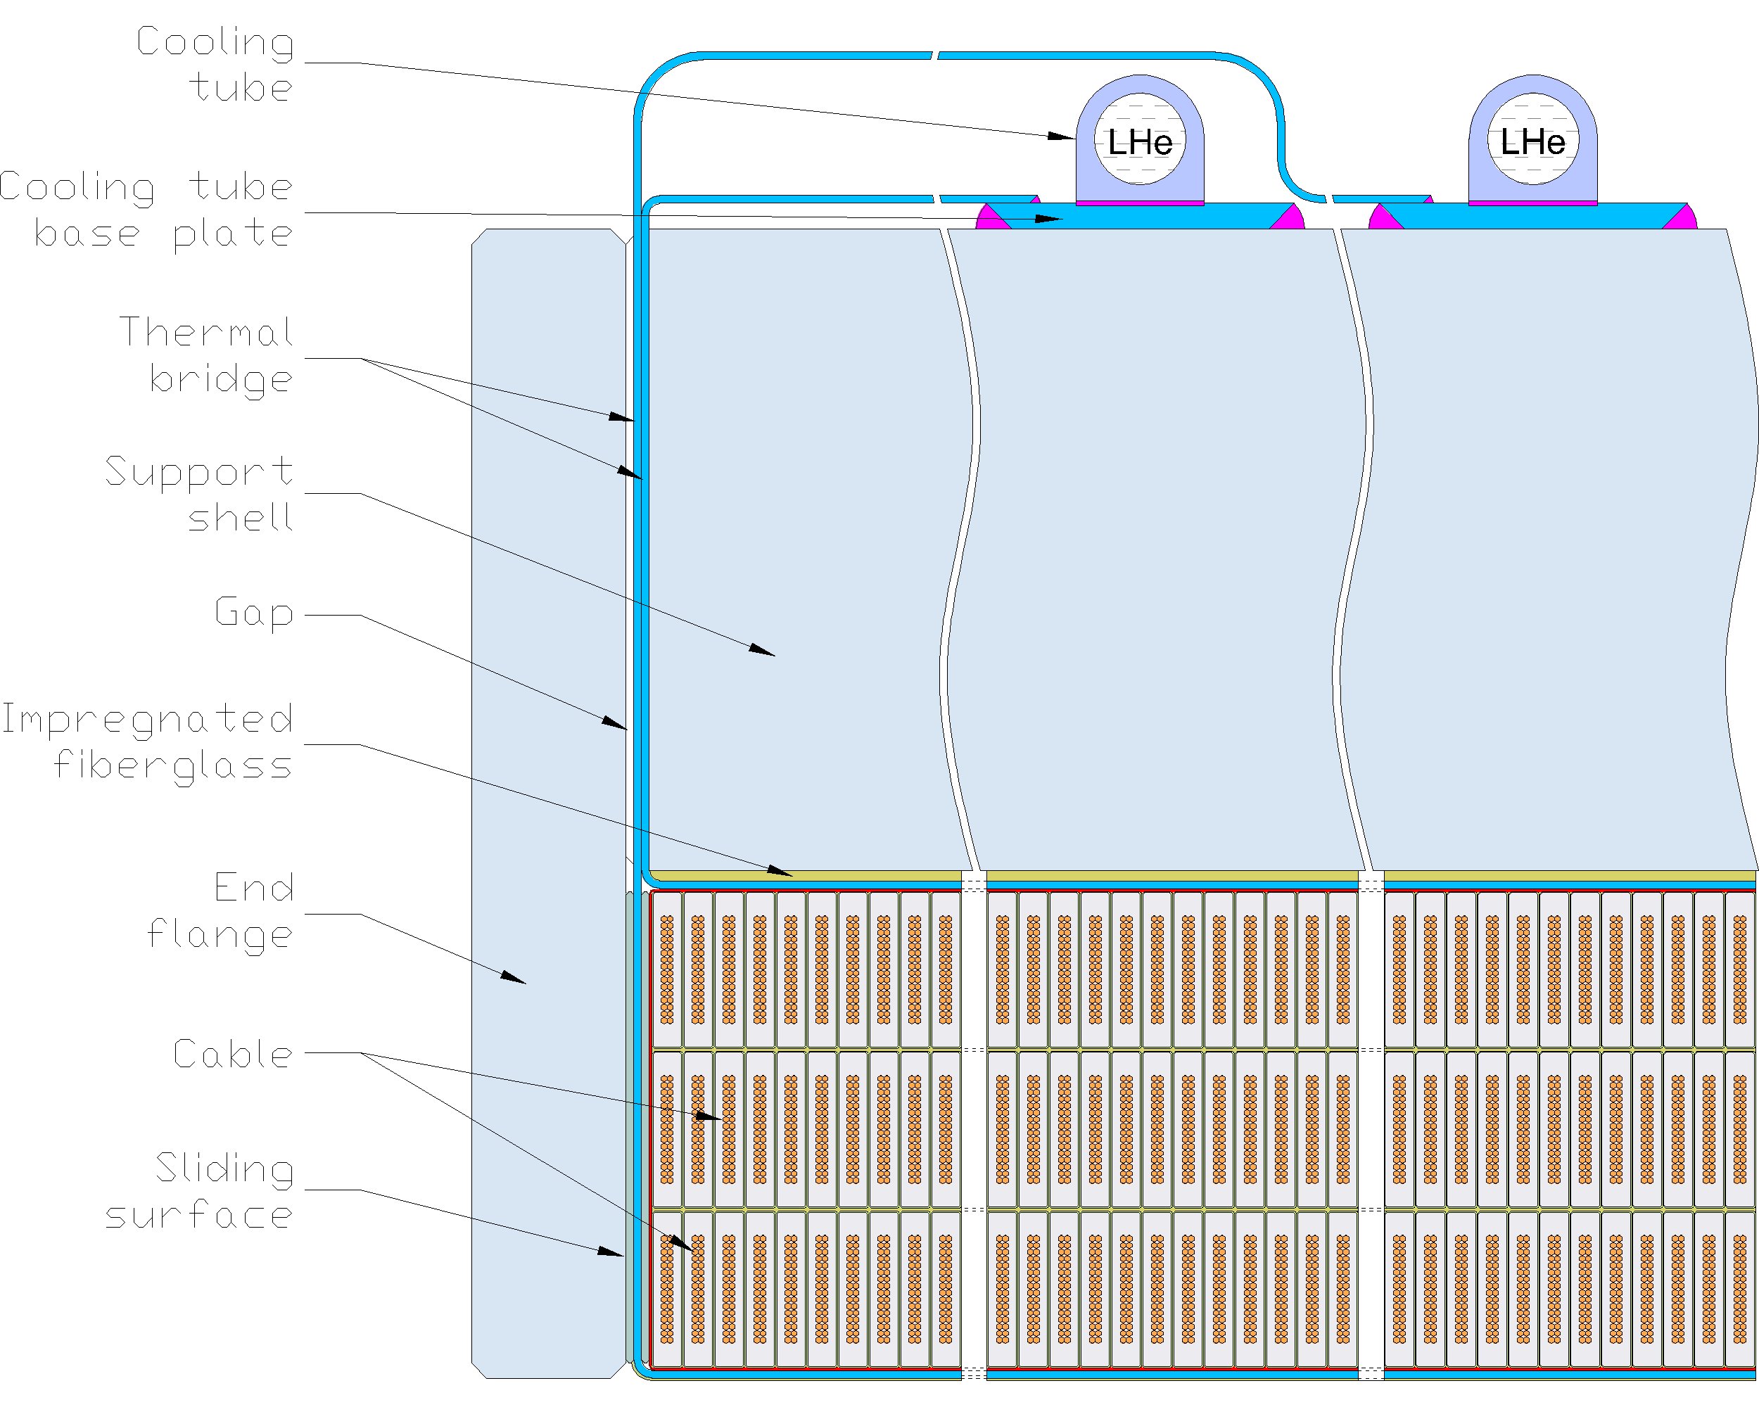
“Conventional” cooling technology with advanced features
The radiation heat escapes from the coil in the radial direction.
Because of that, the number of layers (i.e. the number of thermal barriers in the radial direction) should be minimized.
Cable with a large aspect ratio that has to be wound in the “hard” way... which is literally hard to wind.
This design concept has already been pushed to the limit of what can be achieved using conventional technology. The Mu2e-II would likely require other technical solutions.

Slide 10
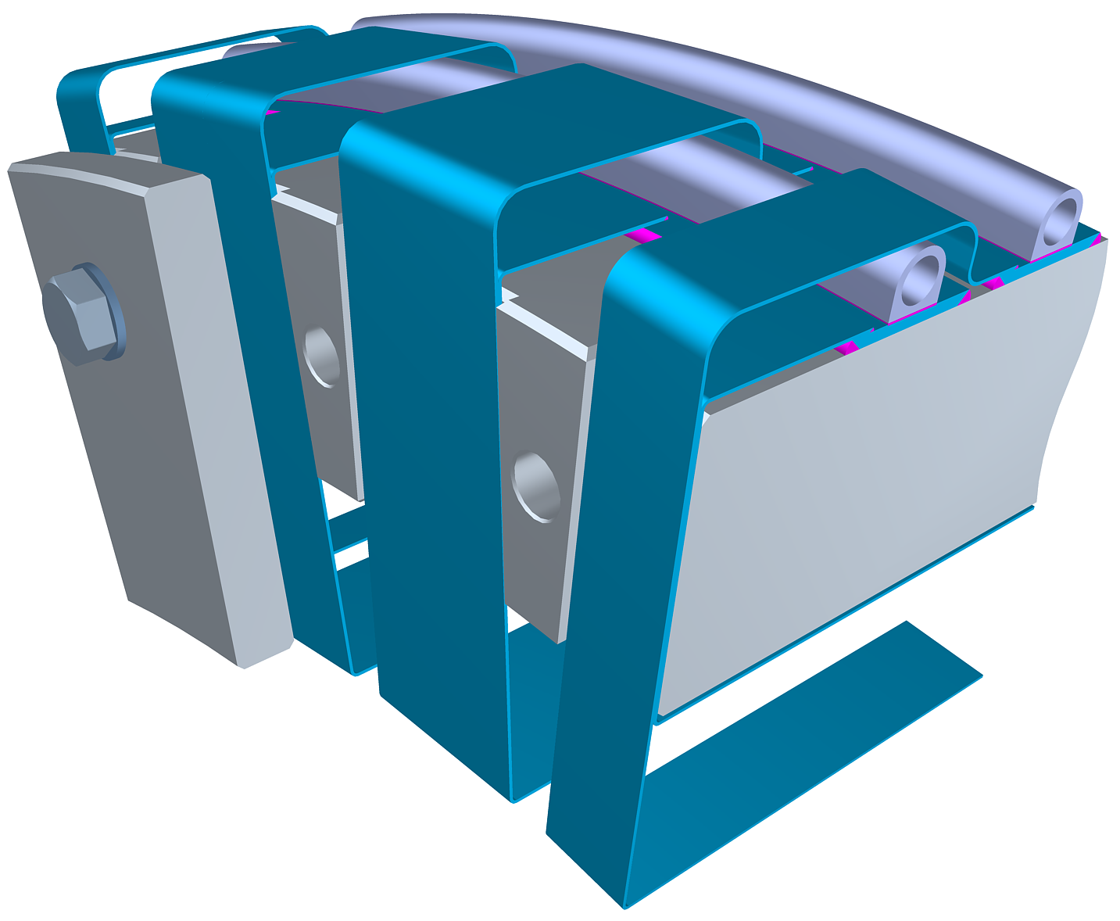
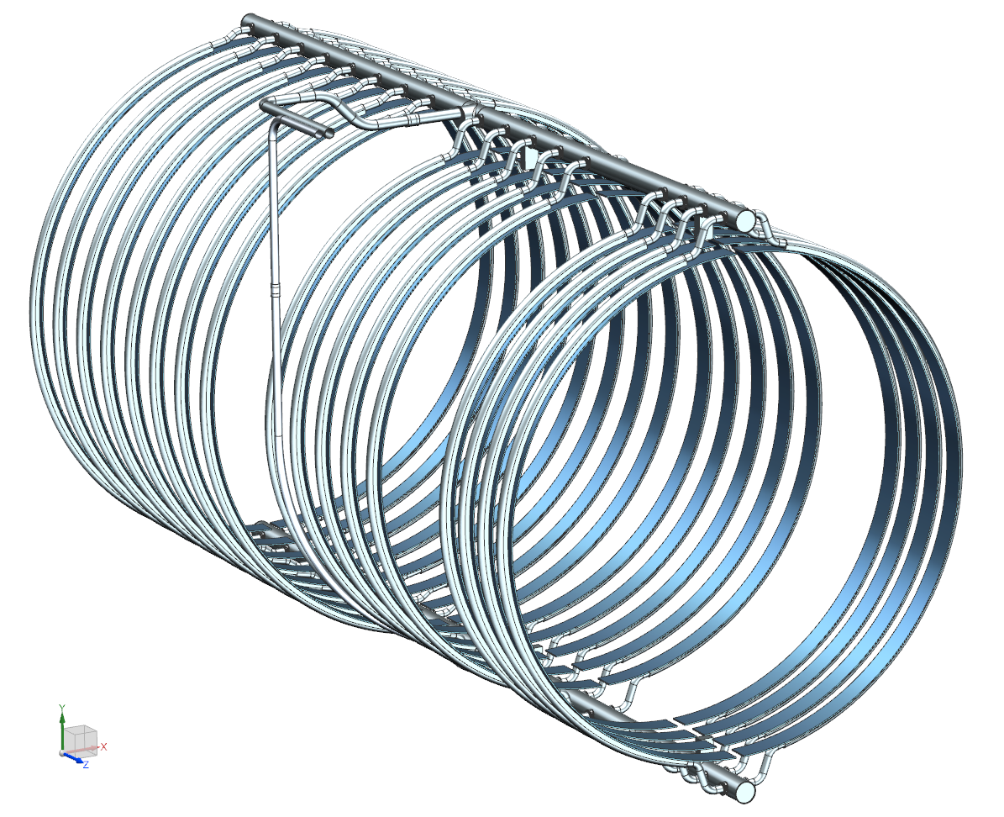
Thermosiphon system
2-phase He return
LHe supply
Return manifold
Thermal bridges (TB) are the main elements of the heat extraction:
  TB connection to the cooling system is an important design detail;
The cooling tubes are EB-welded to the plates of 5N Al;
TBs are TIG welded to the 5N plates;
This design minimizes the ΔT between TB and LHe.
Transition tubes
Supply manifold

Slide 11
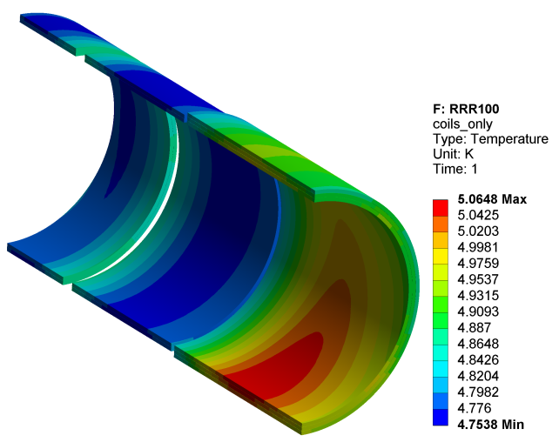
Thermal analysis at T₀=4.7 K: static+dynamic heat load
Operating cycle
The peak ΔT in the coil due to the static heat load is 100 mK;
When the beam is turned on, the peak temperature goes up by 200 mK;
As the magnet gets irradiated and the RRR of Al drops to its minimally allowed value of 100, the temperature goes up by another 50 mK;
After that, the magnet is thermo-cycled to the room temperature to recover the RRR.

Slide 12
Is it possible to use Mu2e-I PS for Mu2e-II?
If the thermal conductivities are constant, the temperature raise in the coil is proportional to the power density of the heat source times the insulation thickness.
  For the Mu2e-I, the ΔT in the coil is 0.25 K. If the power density goes up by a factor of 10, the ΔT becomes 2.5 K.
  The cable critical temperature is 6.6 K at the nominal operating current. The magnet quench temperature will be 6.6 K – 2.5 K = 4.1 K.
  The magnet operating temperature shall be 4.1 K – 1.5 K = 2.6 K - pretty close to the lambda point (2.17 K) – may be difficult to stabilize at that temperature.
  Also, the thermal conductivity of the insulation goes down by about a factor of 2 in the 5.1 K - 2.6 K range. Requires further reduction of the cooling temperature. The magnetic field may also have to be reduced to gain an additional thermal margin.
Using of the superfluid helium cooling at <1.9 K seems to be the only viable option to preserve the operating margin of 1.5 K if the HRS is not replaced.
  The thermal margin may be traded for a higher operating temperature, up to 3.5 K. The risk is that the magnet may become unstable and quench.
Replacing the bronze HRS with tungsten will give a factor of ~2.5 reduction in the power density and dose (TBC with the radiation group).
  May not be a viable option considering challenges with tungsten for Mu2e-I.
  The magnet would still have to be sub-cooled and/or the operating margin reduced.
In either case, the (remaining) insulation lifetime will be substantially reduced.

Slide 13
Other technical solutions

Slide 14
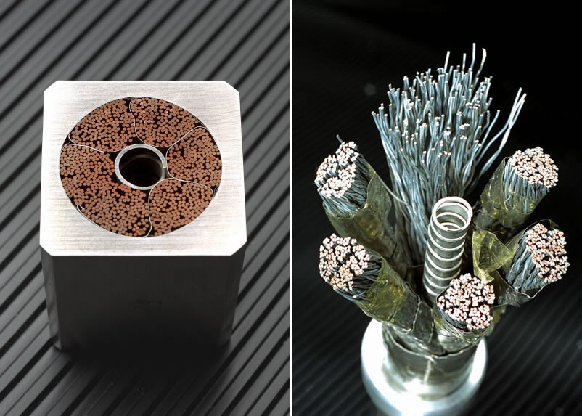
Cable-In-Conduit Conductor (CICC)
Pros:
  Direct cooling of superconductor by liquid helium – can tolerate large power dissipations;
  Cable and magnet technology is relatively well developed and understood by the fusion community.
Cons:
  Using of high-density materials (Cu for the stabilizer and SS for the conduit). Would triple the heat dissipations and the load on the cryo-system comparing with the Al-stabilized conductors;
  May have to use Nb₃Sn (expensive and difficult to work with) instead of NbTi to cope with the higher thermal load;
  Electrical conductivity of Cu permanently degrades under irradiation, while the electrical conductivity of Al completely recovers during a thermo-cycle;
  Still uses organic insulation, which limits the radiation dose;
  Very few capable cable and magnet vendors.
ITER Central Solenoid cable

Slide 15
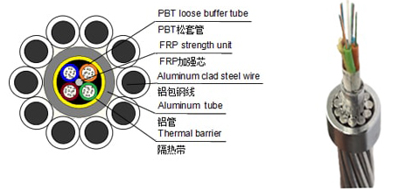
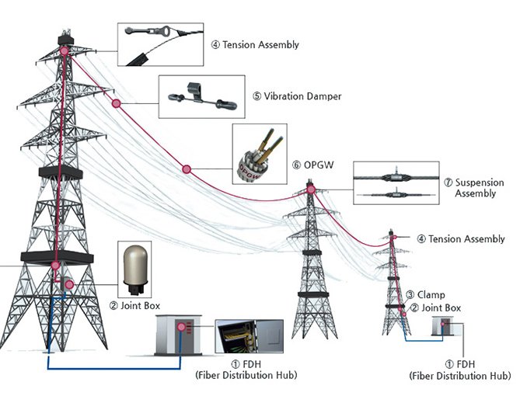
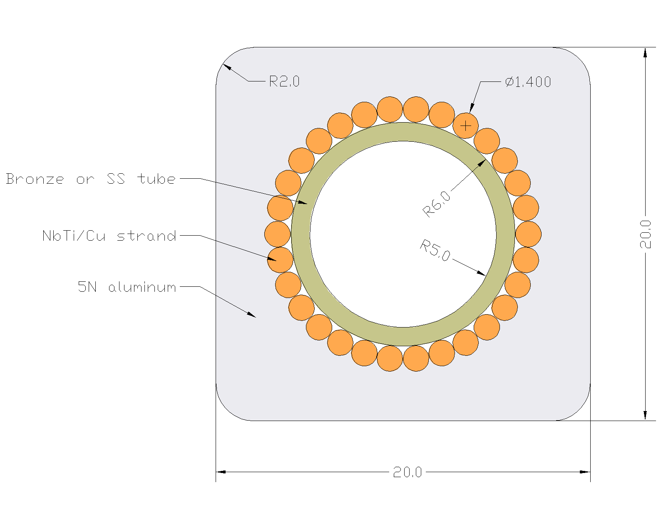
Internally-cooled aluminum stabilized cable
Al-stabilized cable
CICC OPGW
LHe forced flow
Pros:
  Nearly direct cooling of superconductor by LHe.
  Low-density materials.
  No permanent degradation under irradiation.
Cons:
  No one has ever made such a cable (but the Mu2e-I cable vendor was optimistic and willing to try).

Slide 16
Resistive coil at around room temperature
A water-cooled copper coil can take space (and potentially replace) the HRS, thereby taking advantage of the otherwise unused (for magnetic purposes) volume.
Pros:
  No need for cryogenics, simple coil design, fabrication and operation;
  No upper limit on radiation power or dose;
  Minimum R&D is needed, mostly for inorganic insulations;
  More potential vendors;
  One of the lowest-cost options to build.
Cons:
  Needs a lot of electrical power – around 5 MW (~1/3 of the FNAL Main Injector power) to create the same field distribution as the Mu2e-I PS magnet;
  Needs electrical substation and a high-voltage feed;
  Needs water cooling infrastructure - a cooling tower or a pond.

Slide 17
Cryo-cooled resistive coil
A resistive copper or aluminum coil cooled by LN₂ can take space (and potentially replace) the HRS, thereby taking advantage of the otherwise unused (for magnetic purposes) volume.
Pros:
  The room-temperature resistivities of copper and aluminum drop by factors of 6-10 at 77 K. The resistive power dissipations would drop by the same amounts, bringing it to under 1 MW.
  Almost no upper limit on radiation power or dose;
  Moderate R&D is needed, mostly for inorganic insulation and aluminum/copper electrical properties under irradiation at LN₂ temperature;
Cons:
  Needs a lot of LN₂ – around 20,000 liters/hour when the magnet is on;
  Still needs a respectable electrical power and water cooling solutions.

Slide 18
HTS coil
Possible candidate materials: REBCO, Bi-2212
  Pros:
    May tolerate higher hear dissipations in the coils due to much higher critical temperatures than LTS;
    May allow to operate at higher temperatures (e.g. in 30-50 K) range. Operation at LN₂ temperature would be a pretty big stretch for a 5 T magnet.
    REBCO comes as a tape with a very high anisotropy of J_{c} vs. B. Can take advantage of the (order of magnitude) higher J_{c} in when B is parallel to the tape (applies to ~90% of the solenoid coil). Can use “no-insulation” technology to avoid degradation of insulation (the impact of radiation on superconductor and stabilizer would still apply).
  Cons:
    EXTREMELY expensive, difficult to work with, unobtainable in sufficiently large quantities even for R&D purposes, has many unresolved issues (e.g. quench detection and protection);
    Needs a very extensive R&D to determine if HTS option is feasible at all.

Slide 19
Summary
The Mu2e-I Production solenoid design has already been pushed to the limit of the conventional detector magnet technology.
  The only possibility of re-using this magnet at a higher radiation load is to lower the operating temperature;
  Using of the Mu2e-I PS magnet “as is” at the Mu2e-II radiation load with or without the HRS upgrades is the lowest cost option. However, it comes with a high risk that the magnet may fail before Mu2e-II physics goals are achieved.
Any other option would require R&D and prototyping before a technical feasibility can be assessed.
Different alternative technical solutions are possible for Mu2e-II Production Solenoid, ranging in complexity, cost and risk.
  Resistive water-cooled or cryo-cooled magnets are the lowest capital cost options and require the least amount of R&D. The caveat is a high operating cost.
  Internally cooled cable-in-conduit and aluminum stabilized cables offer robust solutions and seems to have the optimum balance between capital and operating expenses.
  The HTS magnet options are the most expensive and least understood and would require substantial R&D investments.

Slide 20
Additional information

Slide 21
General requirements for Mu2e-I PS
Magnetic:
  Nominal peak field on the axis 4.6 T;
  Maximum peak field on axis 5.0 T;
  Axial gradient -1 T/m;
  Gradient uniformity ±5 %.
Electrical:
  Operating margins: ≥ 30 % in I_{c}, ≥ 1.5 K in T_{c};
  Operating current 9÷10 kA;
  Peak quench temperature ≤ 130 K;
  Voltage across terminals ≤ 600 V.
Structural:
  Withstand forces at all conditions while part of the system or stand-alone;
  Cryostated magnet weight ≤ 60 tons;
  Compliance with applicable structural codes.
Cryogenic:
  Cooling agent: LHe at 4.7 K;
  Total heat flow to LHe ≤ 100 W;
  Cryostat ID 1.5 m;
  Conduction cooling.
Radiation:
  Absorbed dose ≤ 7 MGy total;
  Minimum RRR of Al stabilizer in the operating cycle ≥ 100.

Slide 22
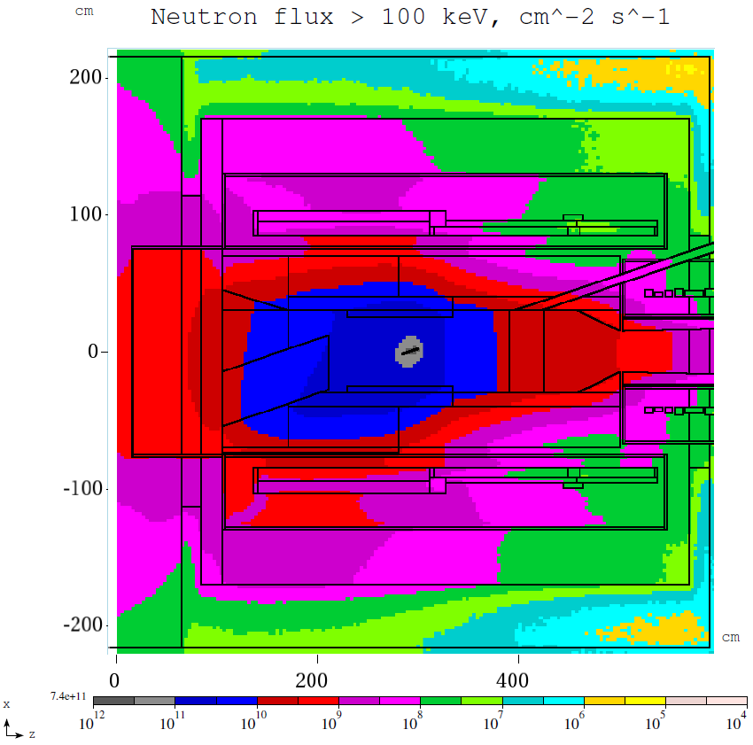
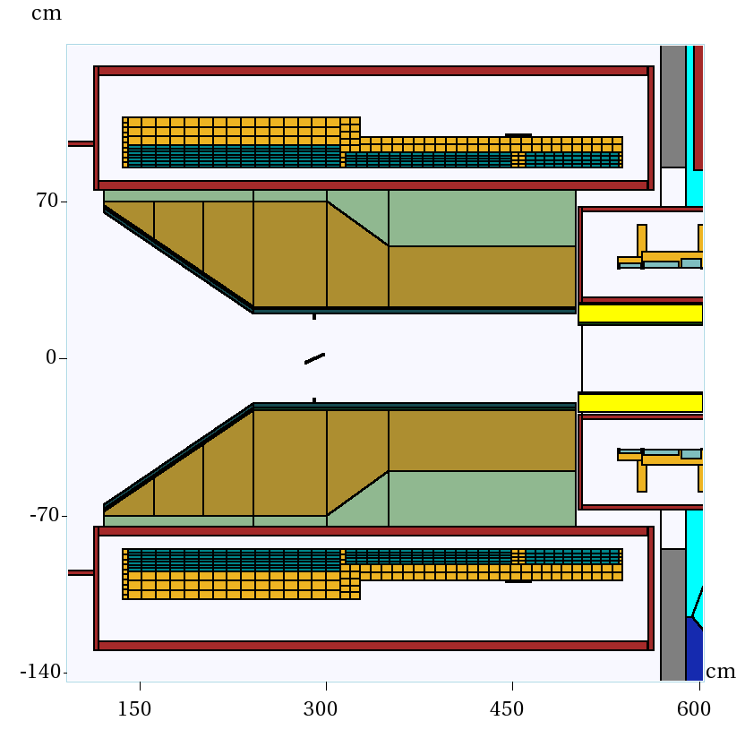
Radiation environment of Mu2e-I PS
It is expected that RRR will degrade after one year of operation as follows:
  Al RRR 500 → 100;
  Cu RRR 100 → 50;
Once the critical degradation is detected, the magnet will be thermo-cycled to recover the resistivity.

Slide 23
Impact of radiation on the magnet performance

Slide 24
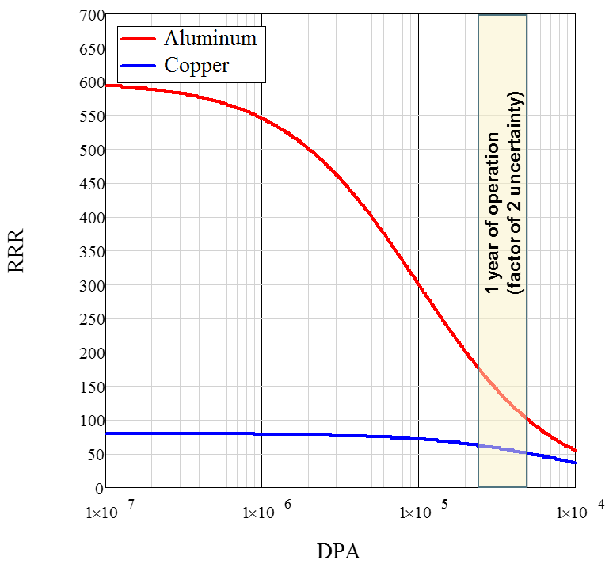
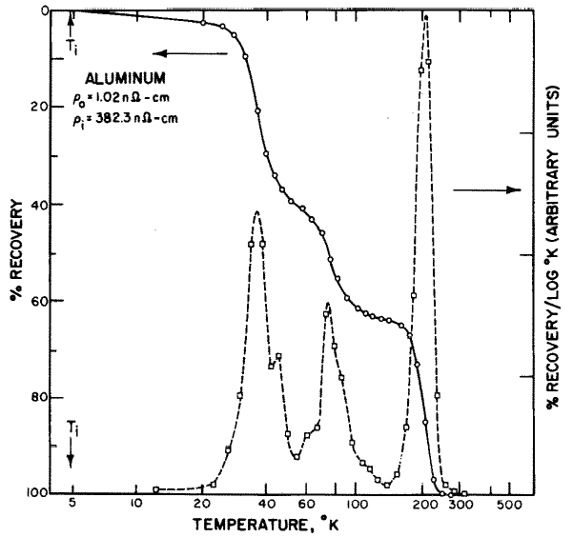
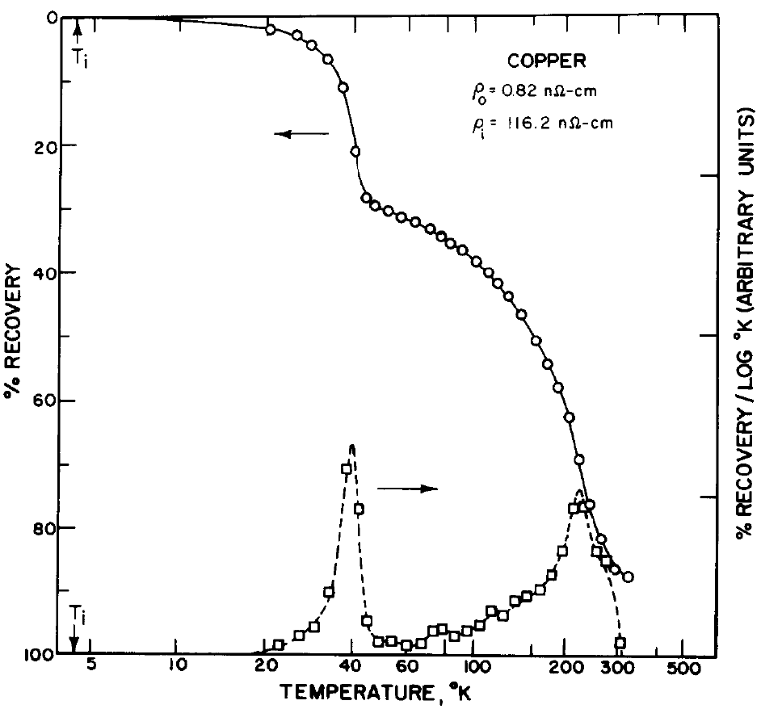
Radiation effects
Thermal:
  Heat deposition in the coil reduces the thermal margin.
  The heat should be extracted from the coil to the cryogenic system.
Electrical:
  Degradation of the stabilizer properties (RRR).
Structural/electrical:
  Degradation of the organic insulating materials (epoxy).
  Limit for conventional epoxies - 10 MGy.
100% recovery
85% recovery

Slide 25
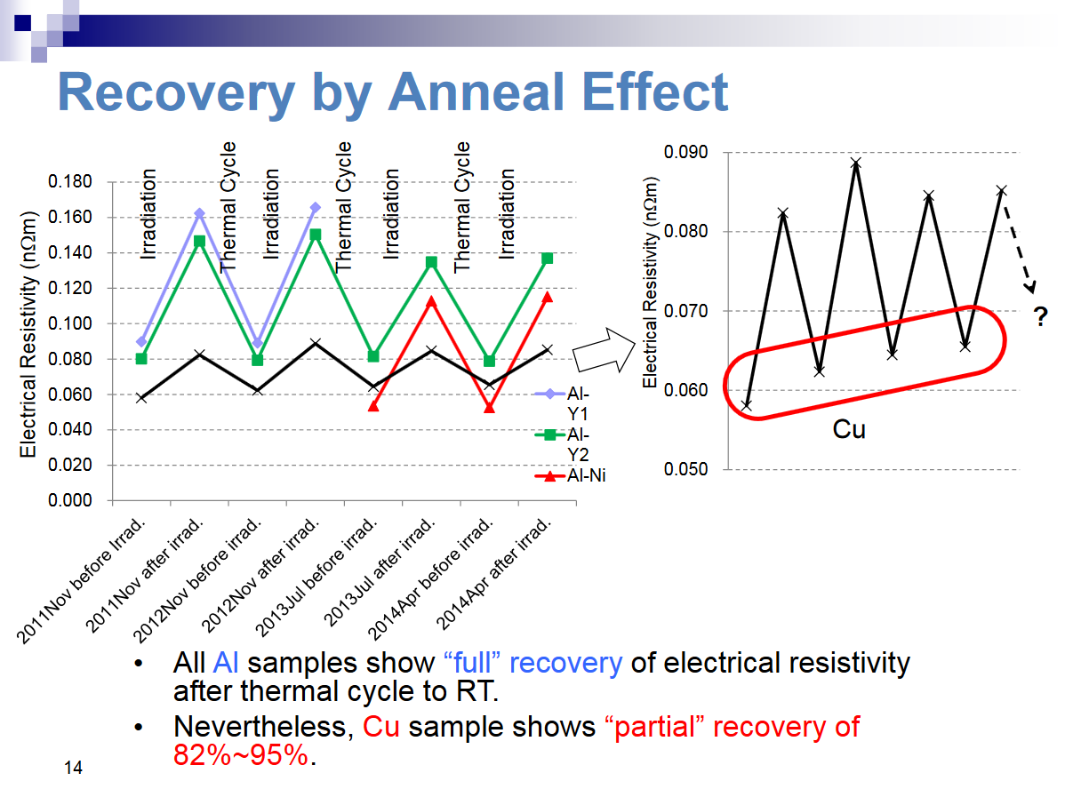
Irradiation experiments at Kyoto University
Presented by M. Yoshida at RESMM’14

Slide 26
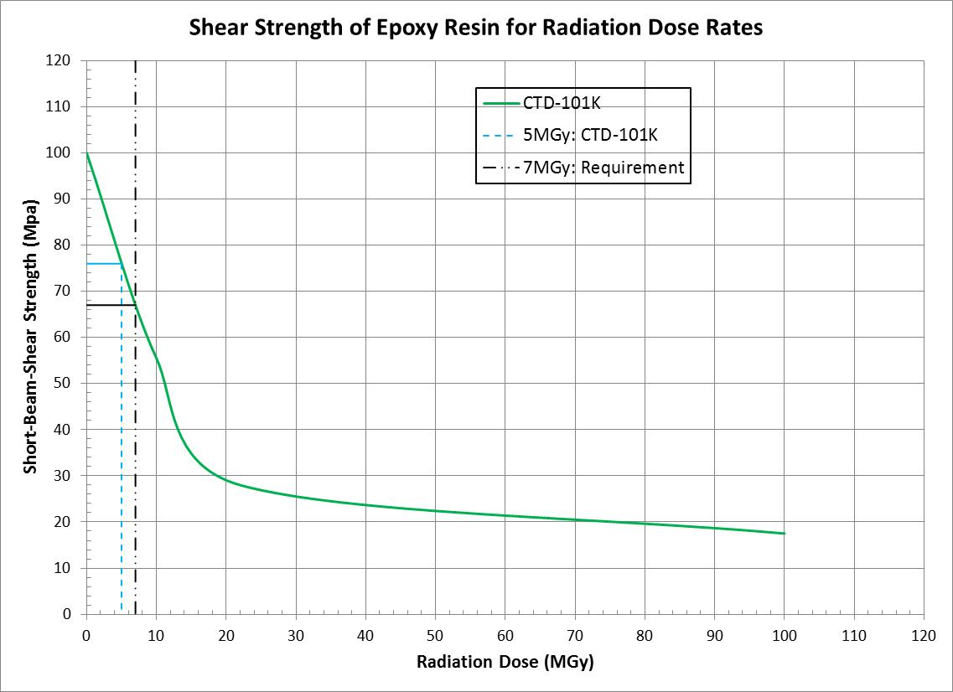
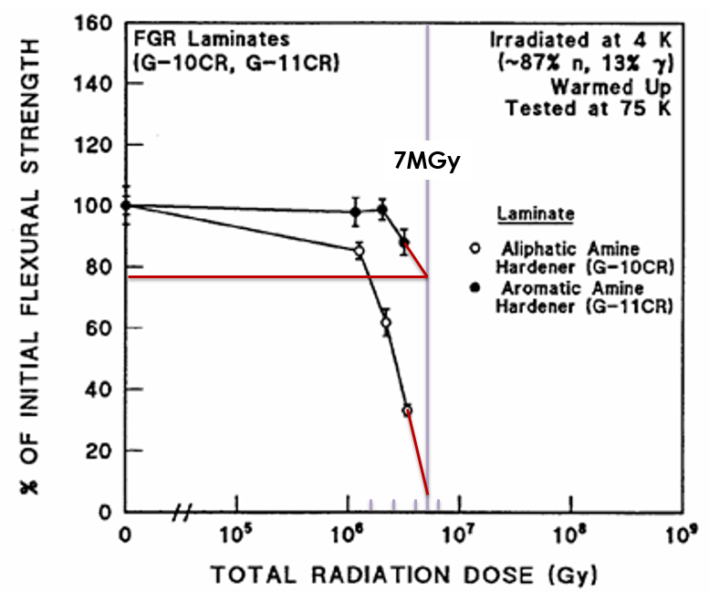
Radiation damage to insulating materials
Similar to the Mu2e resin
Data from
Dick Reed

Slide 27
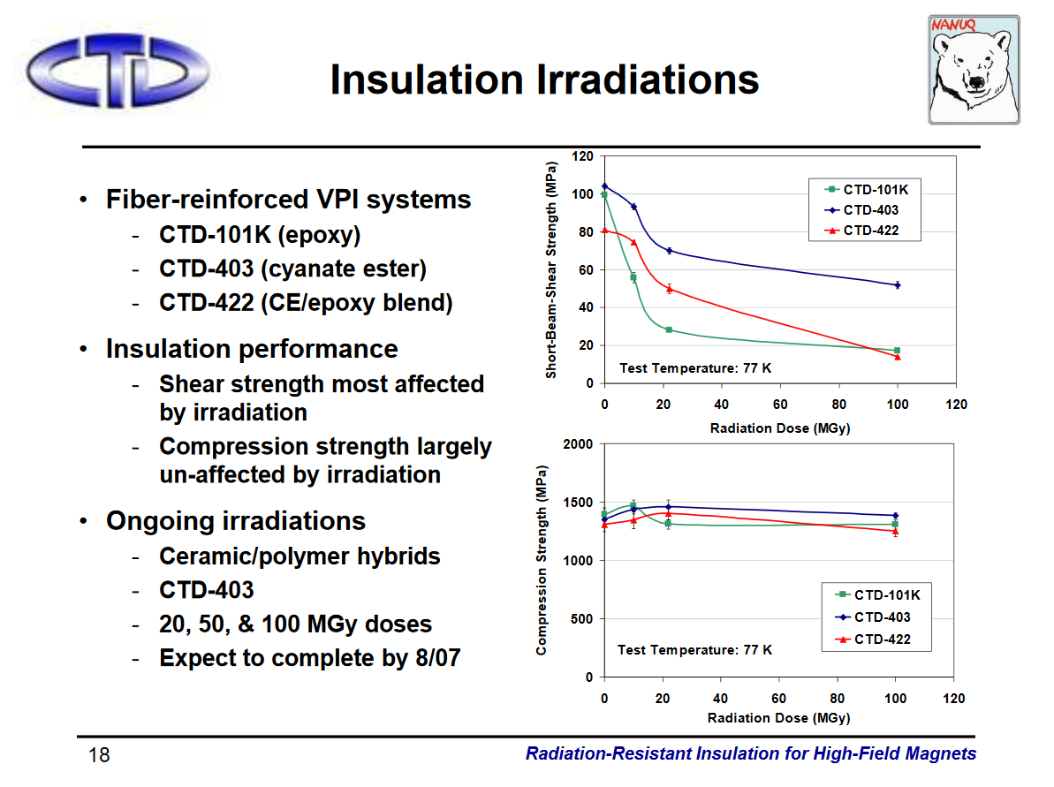
Advanced resin systems

