Slide 1
Welcome to the Fall 2020 Collaboration meeting
Gianpaolo Carosi
Nov 16th, 2020

Slide 2
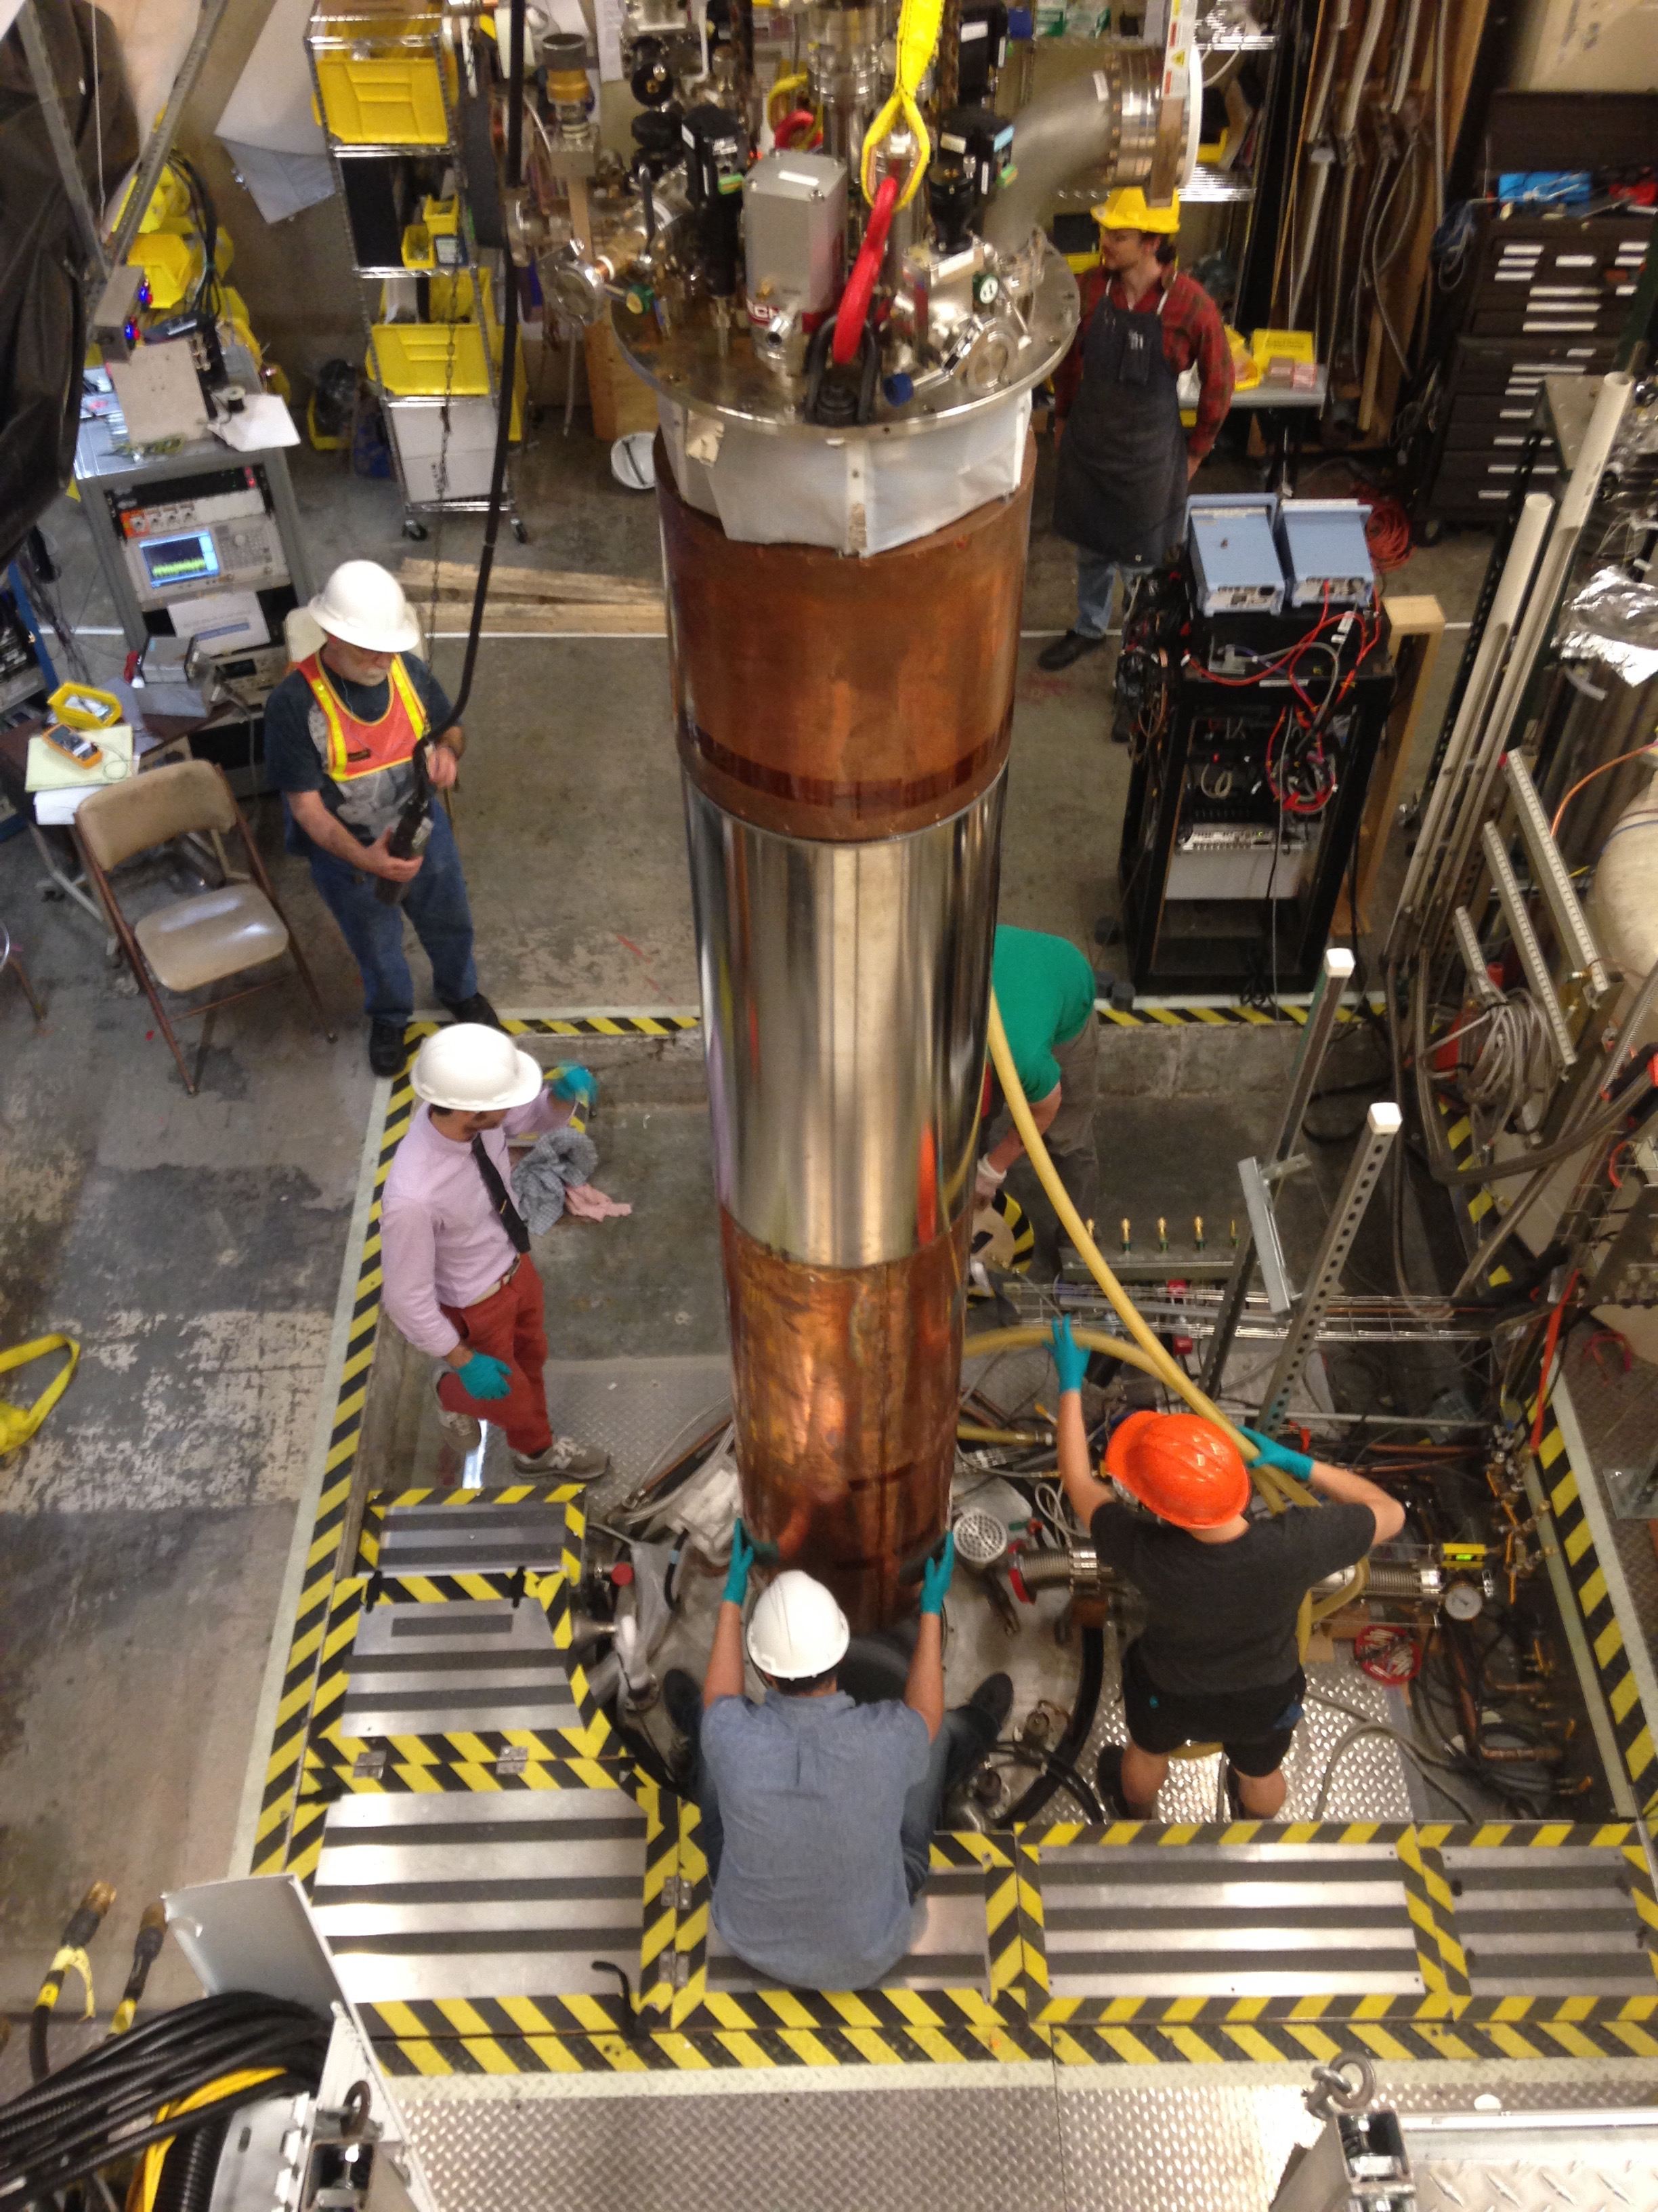
Outline of the collaboration meeting (Nov 16-19)
Brief introductions & meeting logistics (indico site)
Brief introductions of the various groups & members
(special thanks to UW Staff: Madeline, Ida & Gary)
4 days split into morning (8-11:30 am / 2:30-6 pm PST)
ADMX Gen 2: Days 1-2
Current operations and analysis
Testing & planning for rest of Gen 2 operations
ADMX 2-4 GHz and beyond: Day 3
Planning for multicavity system
ADMX Collaboration Business: Day 4
Primary Goal of Meeting:
Review current progress & plan for increasing search rate.
Long term planning for covering entire frequency range (10 GHz and beyond)
Side goal: Practice run for upcoming “Axions beyond Gen2” Workshop in Jan

Slide 3
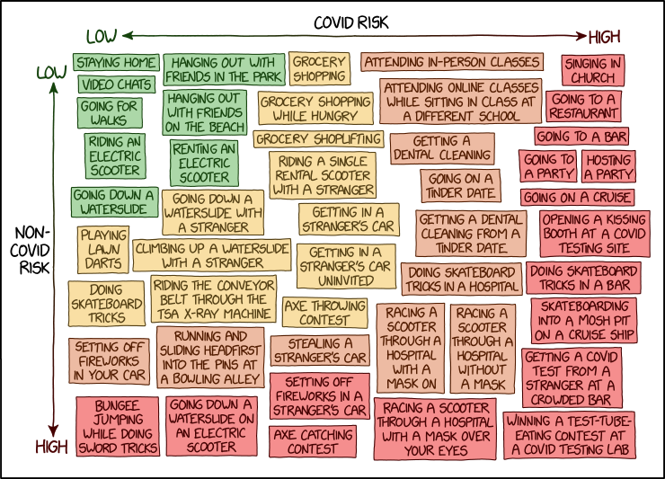
Reminder of why we are having a virtual meeting
Covid-19 has had a huge impact
Side benefits
Save $$$ / Time on Travel
Less chance of getting stuck in random airports from terrible weather
Can take meeting wearing PJ bottoms
Obvious detriment
Collaboration dinner >> Collaboration virtual happy hour

Slide 4
It’s been far to long since the last collaboration meeting
Last meeting was at PNNL in July 2019!
Successful Dark Matter New Initiative Proposal Sept 2019.
ADMX 2-4 GHz design!
Multi-cavity array, superconducting cavities, new magnet, new JPA’s (squeezing)
2 years for funding for engineering & design studies ($15M full project)
ADMX DOE 2019 Operations Review: Oct 4 @ FNAL
Successful review. Led to revised Exp Ops Plan (May 2020)
Began Full Operations of ADMX Run 1C (800 – 1020 MHz)
Feb 2020 (after fixing broken cryogenic cable)
Covid-19 lockdowns (March 2020)!!
Operations slowed but one of the few experiments to be operating!

Slide 5
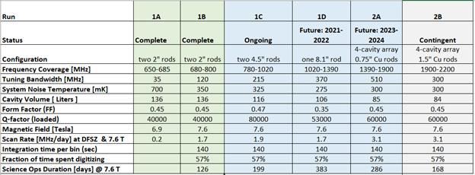
Run 1C has been operating while construction & testing of 1D & 2A/B
We are here!

Slide 6
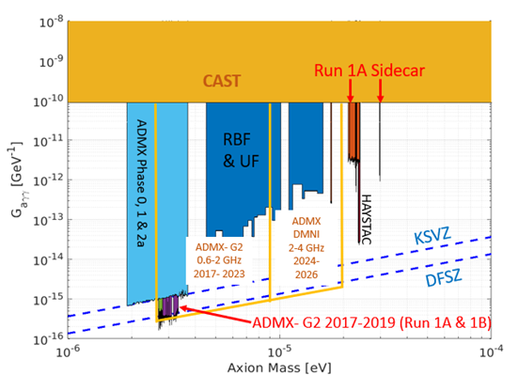
Data taking has been slowed by Covid-19 limiting site access
However we have made a search at DFSZ sensitivity between 1020 – 960 MHz
(80 MHz).
Have 160 MHz to go (need to increase speed)!
Looking to recover SNRI improvements of JPA after upcoming warm up (hopefully no pull-out).

Slide 7
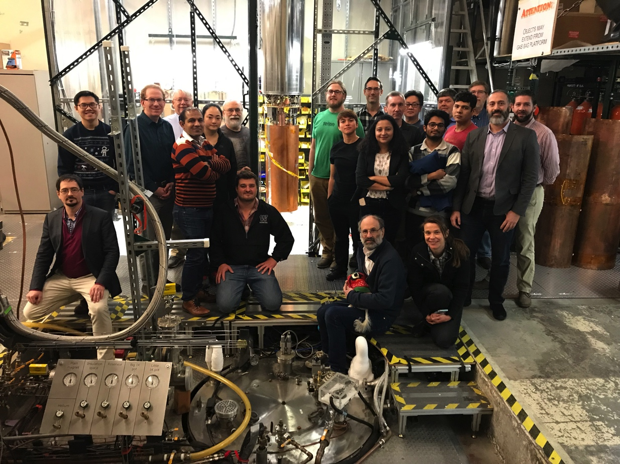
ADMX is a strong collaboration and is growing!
Run 1C is continuing to take high quality data (but need to speed up)
We are funded to lay the groundwork for the next phase of ADMX (2-4 GHz).
We continue to maintain DOE support during challenging fiscal times (research and project). Continue to expand collaboration.
Still the only Gen2 project with published results!

Slide 8
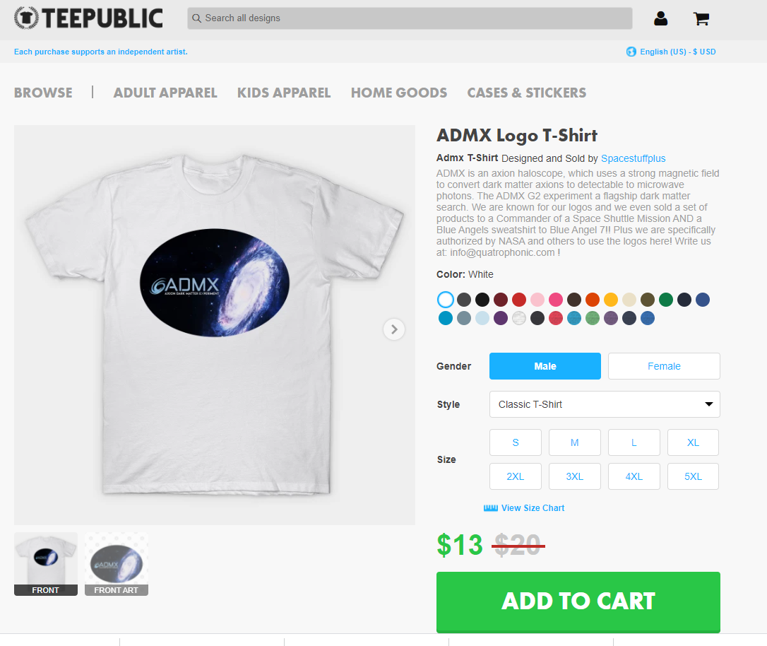
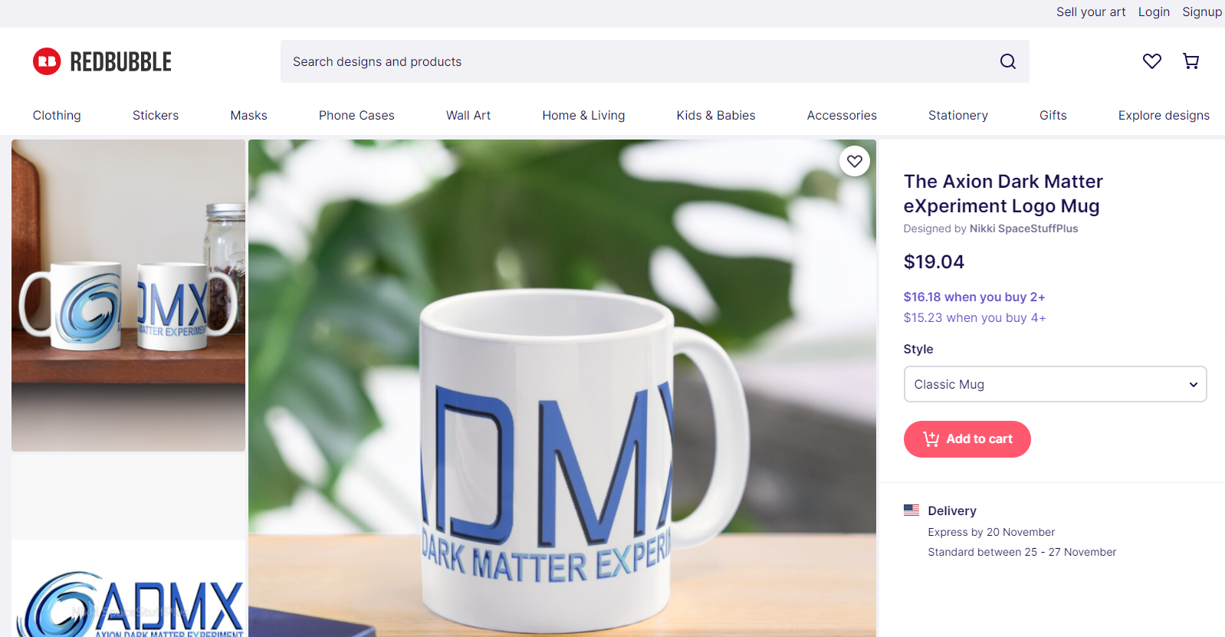
ADMX may want to consider getting a cut of the Merch!
If funding gets tight!

