Slide 1
ADMX Cold Electronics Overview
Nov 16th, 2020
Collaboration Meeting
Gianpaolo Carosi

Slide 2
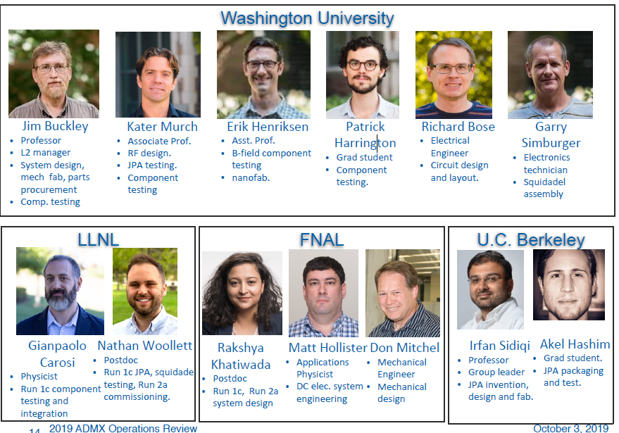

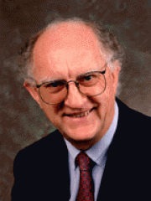
Cold Electronics Group
Additional members
Jonah Hoffman (WUSTL grad student)
Prof. John Clarke (UC Berkeley) Microstrip SQUID Amp (run 1A)

Slide 3
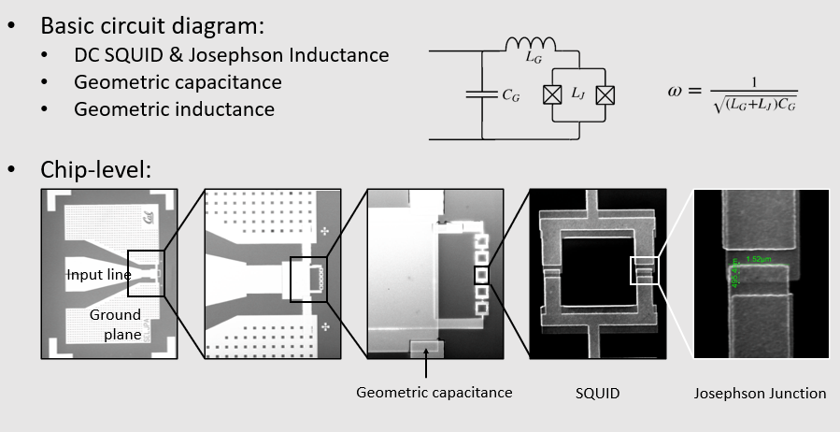
JPA Circuit (slide from Akel Hashim)

Slide 4
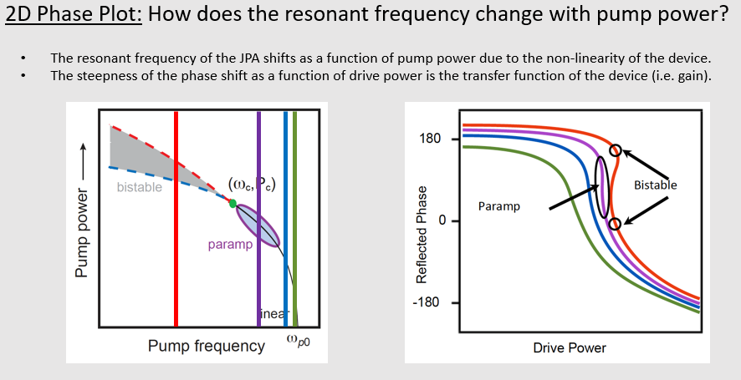
JPA Phase as function of VNA power (slide from Akel Hashim)

Slide 5
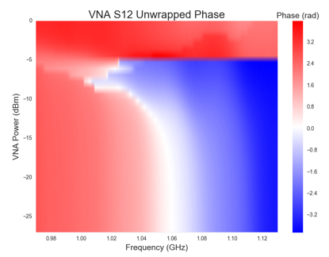
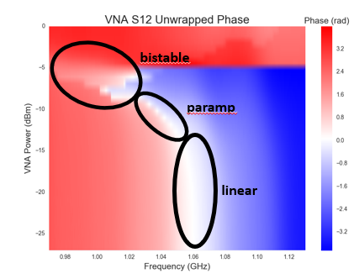
JPA Phase as function of VNA power (slide from Akel Hashim)

Slide 6
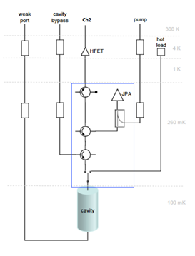
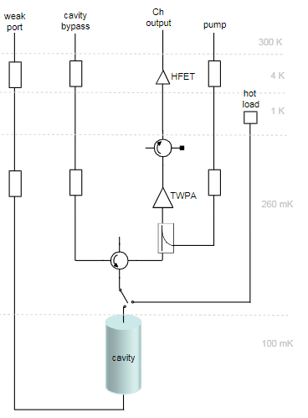
JPA and TWPA Layout
Main Cavity (JPA)
Sidecar Cavity (TWPA)
JPA from UC Berkeley
TWPA from Lincoln Lab
SQUIDADEL components in the blue box region (single temperature stage)

Slide 7
JPA System for run 1C
Currently have 1 untested backup at LLNL (looking to test in fridge next few weeks)
Several more chips that we can get

Slide 8
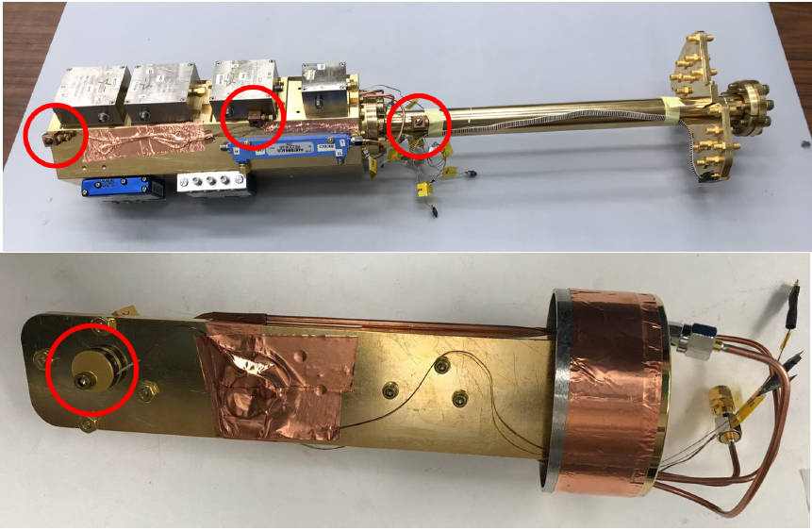
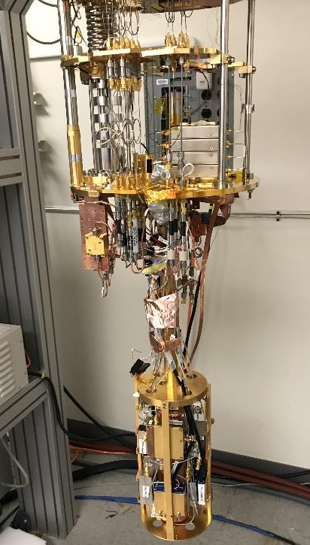
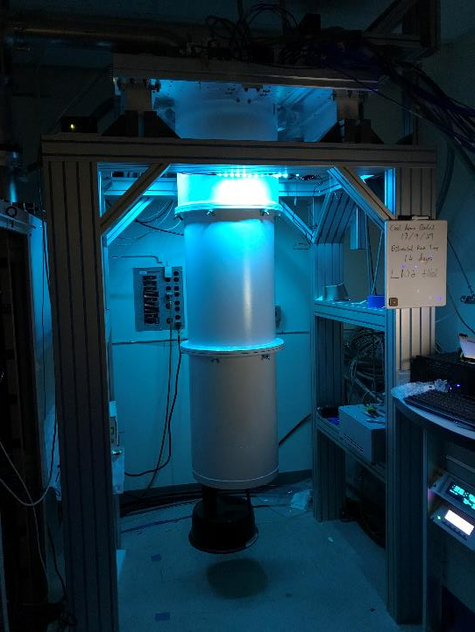
1 calibrated sensor (SQUID_JPA_Temp) and several RuOx from WUSTL

Slide 9
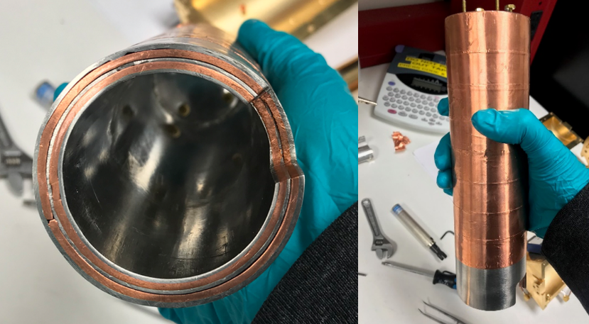
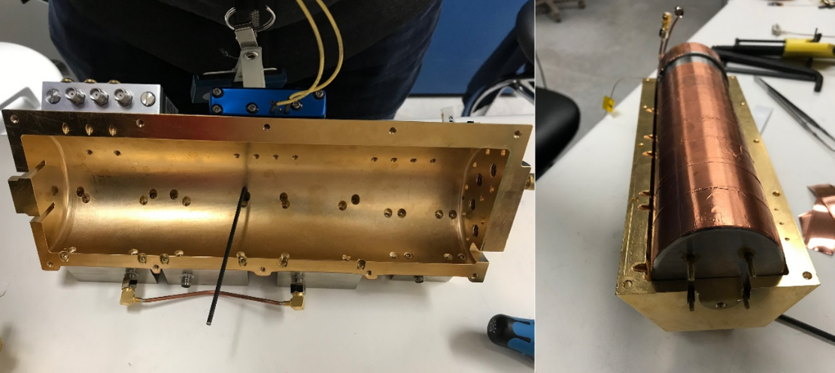
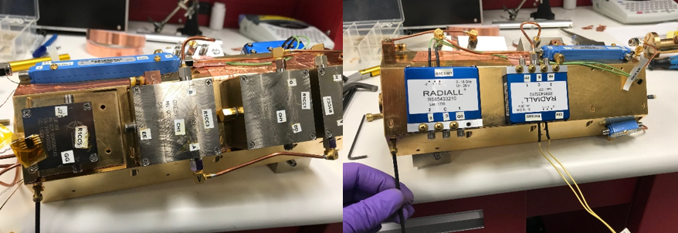
Nested design with magnetic components on outside
3 layers of A4K magnetic shield
Clamshell design (FNAL)
Switches and circulators on outside

Slide 10
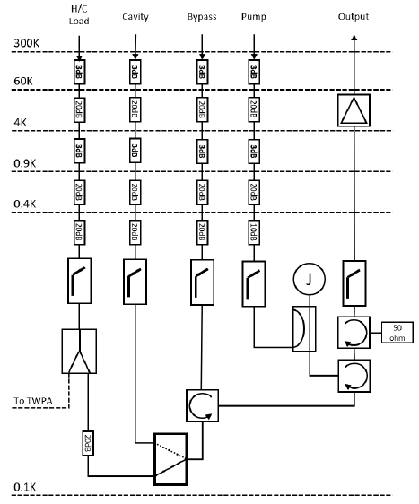
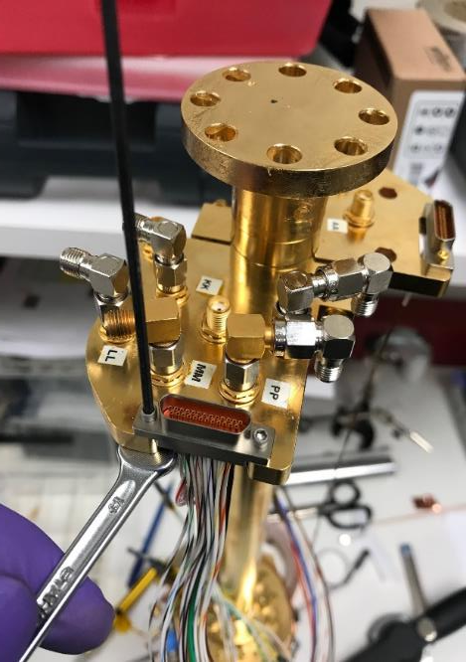
Initially tested at LLNL (future SQUIDADEL tests at WUSTL)
DC wiring goes to two 24-pin micro-D female connectors
  Temp sensors (ordinary wire)
  Flux Bias & switches (NbTi superconducting)

Slide 11
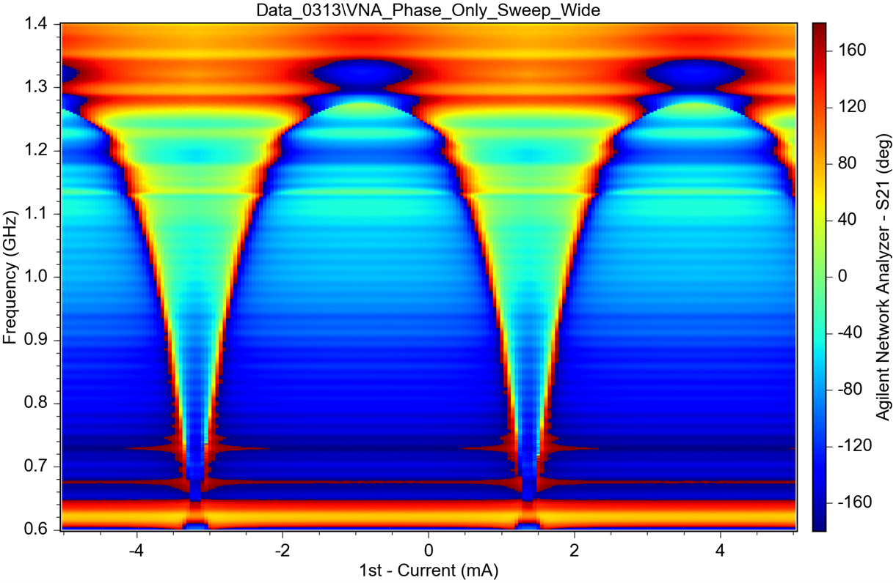
Initial test is low power VNA sweep (<-130 dB on chip) tuning flux bias
Monitor unwrapped phase and confirm that the phase changes as a function of current (flux bias)

Slide 12
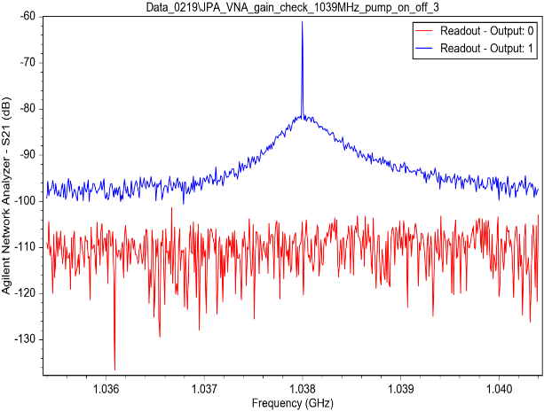
Find pump power & frequency and optimize gain & SNRI
Turn up VNA until you achieve sharp response (this tells you the approx. pump power)
Set pump tone power & frequency to region close to sharp transition. Optimize SNRI (adjust power & freq while keeping flux current constant).
More details to follow in noise and SNRI discussions (and SQUIDADEL testing report from LLNL)

Slide 13
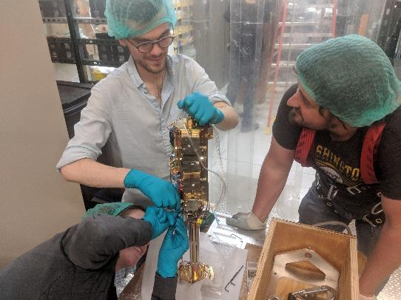
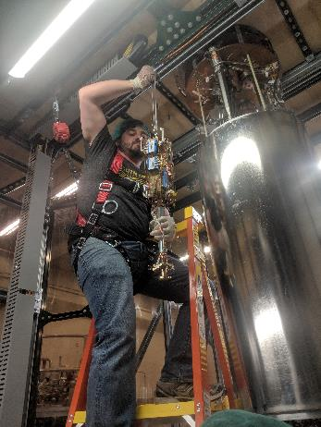
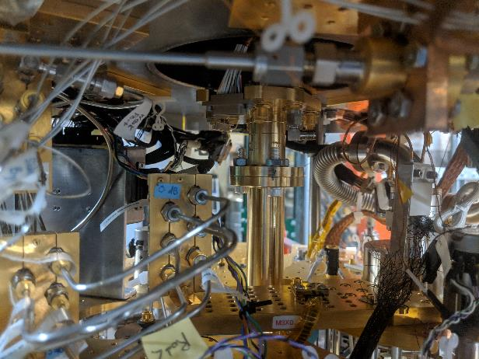
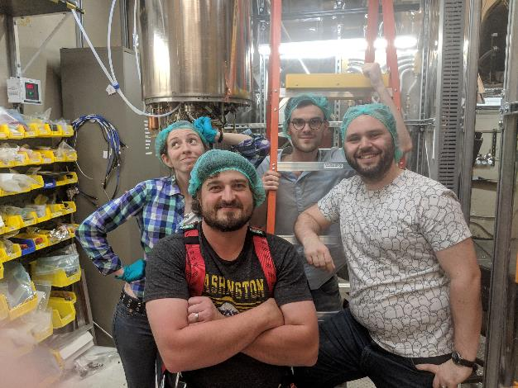
Installed in ADMX Insert
System installed Winter of 2019
JPA operational
TWPA unfortunately damaged (we have 2 spares though)
More details on operations in next talks.

