Slide 1
High Res Multi-Resolution Search
L. Duffy for ADMX High Res group
11/16/2020
11
High resolution search for fine structure axion signals
Strategy is that cold flows may produce high power in a single or few narrow frequency bins
Signal width of fine structure is proportional to the velocity dispersion:
$$\frac{δf}{f}=\frac{vδv}{c^{2}}$$
But what is the velocity dispersion? The caustic ring model makes predictions for flow velocities, but not the velocity dispersions:
“The ring widths depend in a complicated way on the velocity distribution of the infalling dark matter at last turnaround and are not predicted by the model. They also need not be constant along the ring.”
– P. Sikivie, PLB, 2003.
Maxwellian: Isothermal galactic halo
Fine structure: Cold flows of dark matter axions

Slide 2
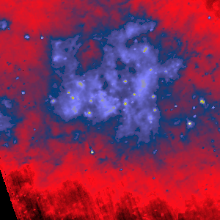
Flow Velocity Dispersion
Flow velocity dispersion can be estimated from observation. For caustic rings:
With (Sikivie, PLB, 2003):
R = 180 kpc (ring location from galactic center)
$δa$ < 20 pc (extent of caustic ring)
$v≃$ 480 km/s
$δv$ = 53 m/s -> $δf\sim$0.3 Hz @ 1 GHz
Flows also possible from tidal stripping of satellite galaxies.
Run 1b high res search at resolution 10 mHz (see Ram’s talk).
Extension to multiple wider resolutions (1b discussing with Chelsea, Alex 1c future) allows different possible velocity dispersions, and maximize future discovery potential!
$$δa≃\frac{Rδv}{v}$$
$$δa$$
IRAS 25 μm image, discussed at http://www.phys.ufl.edu/~sikivie

